Slide 1
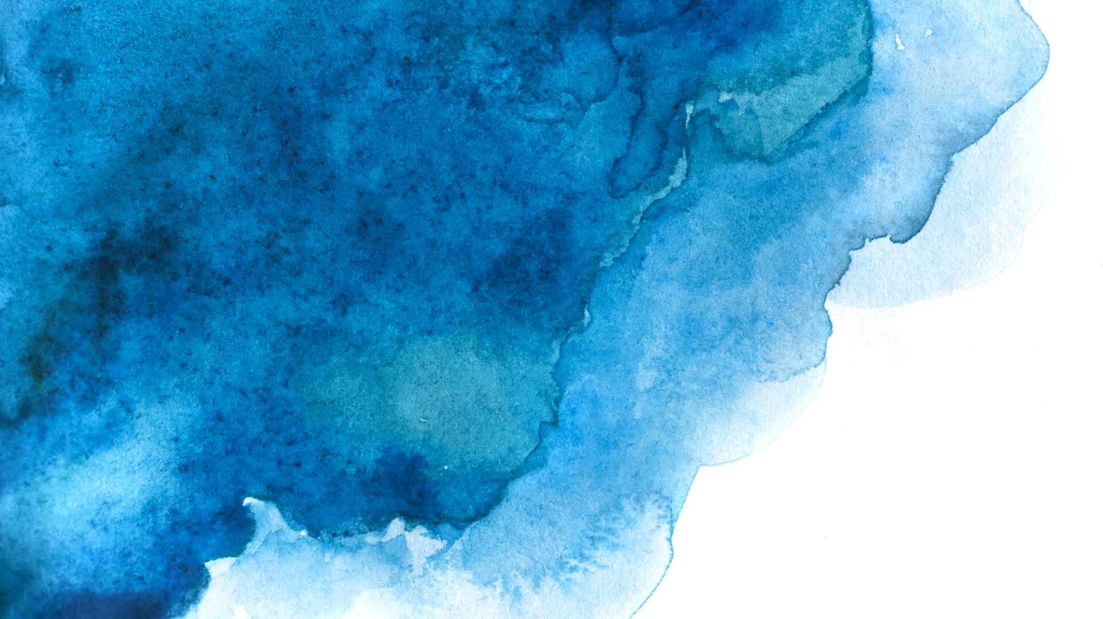

Langchain complete tutorial for beginners
Build email assistant Using Langchain Agent & OpenAI
TUTORIAL : 8

Slide 2
How to setup google api credentials
https://developers.google.com/gmail/api/quickstart/python#authorize_credentials_for_a_desktop_application

Slide 3
Build email assistant

