Slide 1
Windows Phone Performance and Memory consumption FOR MANGO/TANGO
By Jevgeni Tsaikin

Slide 2
Why is it important?
Users
Smooth user experience
Responsiveness
Preventing crashes
Marketplace Technical Certification Requirements
Performance and Resource Management (section 5.2)
Launch Time and Application Responsiveness
startup within 5 secs
responsive within 20 secs
Memory Consumption
an application must not exceed 90 MB of RAM usage, except on 256MB devices

Slide 3
AGENDA
Threading Model
Tools
Images
Panorama
Showing and Hiding objects
Speeding up startup
Speeding up navigation
Lists
Other

Slide 4
Threading model
Direct Manipulation Thread
ListBox
ScrollViewer.ManipulationMode
Composition Thread
Storyboard-driven animations (including ScaleTransform, TranslateTransform, RotateTransform, PlaneProjection)
NB! Scale transforms must be less than 50 percent of the original size
Clip, Opacity
Back-buffer
UI Thread
Parse and create objects from XAML.
Draw all visuals the first time they are drawn.
Process per-frame callbacks and execute other user code
Bindings
OS interop
Background Threads
loading, parsing, fetching data
networking
BackgroundWorker

Slide 5
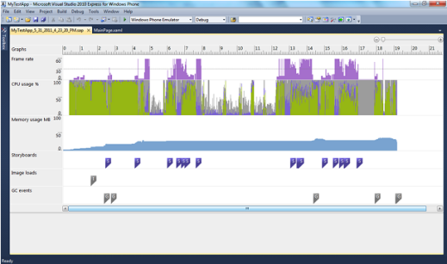
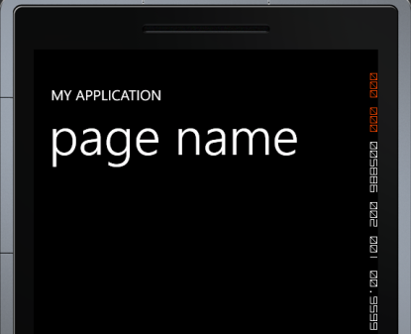
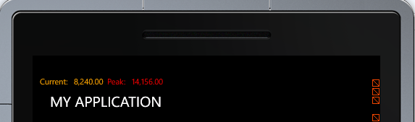
TOOLS
Windows Phone Performance Analysis
Frame Rate Counters
Settings.EnableRedrawRegions Property
Custom MemoryProfiler

Slide 6
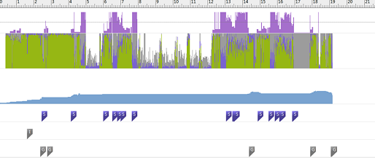
Windows Phone Performance Analysis
What issues can we easily identify?
Inconsistent application frame rate
High CPU usage
High memory usage
Insufficient garbage collection
Check the tutorial bellow
Memory Profiling for Application Performance
User Interface (UI) thread | Green | Indicates screen updates and touch inputs. You should try to keep the UI thread to less than 50% of CPU usage.
Application Threads | Purple | Indicates application activity that is not UI. This could be composition thread or background threads.
System Threads | Grey | Indicates activity that is not for the application. A large system thread percentage indicates that the system is busy with other background tasks and is affecting application performance.
Idle Threads | White | Indicates available CPU percentage. The higher the idle thread percentage, the more responsive the application should be.

Slide 7
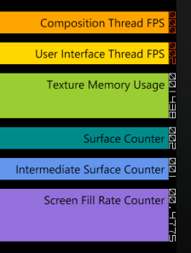
Frame Rate Counters
Composition (Render) Thread Frame Rate (FPS) | The rate at which the screen is updated.
User Interface Thread Frame Rate (FPS) | The rate at which the UI thread is running.
Texture Memory Usage | The video memory and system memory copies of textures being used in the application.
Surface Counter | The number of explicit surfaces being passed to the GPU for processing.
Intermediate Surface Counter | The number of implicit surfaces generated as a result of cached surfaces.
Screen Fill Rate Counter | The number of pixels being painted per frame in terms of screens. A value of 1 represents 480 x 800 pixels.

Slide 8
Recommended Frame and Fill Rates
Counter | Red Value Threshold* | Recommended Value | Upper Threshold
Composition Thread Frame Rate | 30 Frames/Second | 45 Frames/Second | 60 Frames/Second
UI Thread Frame Rate | 15 Frames/Second | 30 Frames/Second | 60 Frames/Second
Screen Fill Rate | >3 | <= 2.5 | 3.0

Slide 9
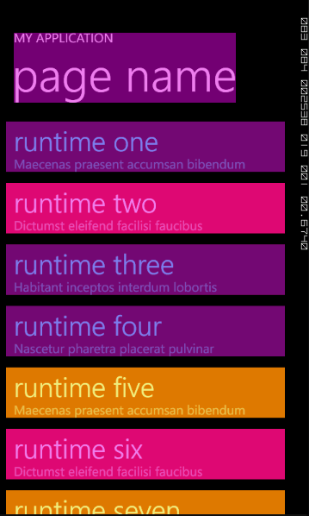
Settings.EnableRedrawRegions
Showing the areas that are being redrawn each frame.

Slide 10

CUSTOM MEMORY PROFILER
Console Output
Popup
Usage
MemoryProfiler.Start();
MemoryProfiler.Start(bool isConsoleLoggingEnabled, bool isPopupLoggingEnabled)
MemoryProfiler.Start(bool isConsoleLoggingEnabled, bool isPopupLoggingEnabled, TimeSpan interval)
MemoryProfiler.Stop();

Slide 11

Images
Supported types: JPG and PNG
JPG decoder is much faster than the PNG decoder
JPG does not support transparency
Store static visuals as images instead of XAML
Limit the image size to 2000 x 2000 pixels because larger images will be sampled at a lower resolution
Avoid scaling
To move image decoding to background threads instead of blocking the UI thread use:

Slide 12
Resources
Build Action set to Content and not Resource for Media
Content > XAP
Resource > DLL
…Media processing on Windows Phone is optimized to use files and network streams, but not in-memory streams
…When a media file is compiled as a resource, the content is copied to a file on Windows Phone before playback, which decreases performance

Slide 13
Panorama
Ensure panoramic applications perform smoothly by limiting the number of sections used to a maximum of four sections
Background images for Panorama should be between 480 x 800 pixels and 1024 x 800 pixels (width x height) to ensure good performance, minimal load time, and no scaling
Use either a single-color background or an image that spans the entire Panorama control
Background bitmap as a Resource

Slide 14
Showing and Hiding objects
When Visibility == Collapsed then Silverlight does not hold any visual data for the element in visual memory
When changing Collapsed to Visible the element is redrawn completely
Opacity + Bitmap Caching can improve performance
Bitmap caching allows visual elements to be stored as bitmaps after the first render pass
Using Opacity without Bitmap Caching could decrease the performance
While using Opacity the element will remain in memory
Evaluate the performance of each technique on a case-by-case basis

Slide 15
Speeding up startup
Minimize the size of application assemblies
set Build Action of images and media files to Content
smaller size of images (JPG instead of PNG)
Break the application into smaller assemblies
move localized resources to satellite assemblies if possible
move pages and controls which are rarely used to different assemblies
Minimize the logic in Application_Launching and Application_Activated methods

Slide 16
Speeding up navigation
Minimize code in:
Page/Control constructors
OnNavigatedTo
OnNavigatedFrom (previous page)
Remove unnecessary XAML
Defer loading activities until the first frame is rendered
Disable page transitions

Slide 17
Lists
Avoid using a user or custom control inside the data template
Avoid using nested StackPanel and Grid controls
Avoid using complex data templates containing images if possible
Avoid using ValueConverters
Implement Virtualization or Paging
Avoid Element name binding in a ListBox control
TextBlocks with opacity = 0 in a ListBox cause performance problems

Slide 18
Other
Using explicit Home Button can result in circular navigation loops which can fill the back stack with redundant page instances
…or use NavigationService.RemoveBackEntry
Deregister event handlers to static objects in PhoneApplicationPage.OnRemovedFromJournal
…called after OnNavigatedFrom
Keep as much activity off of the UI thread as possible

Slide 19
Links
Performance Considerations in Applications for Windows Phone
Nokia Wiki: Windows Phone Performance and Optimisation
Performance Techniques for Windows Phone
Optimizing Apps for Lower Cost Devices
Silverlight for Windows Phone Performance team blog

