Slide 1

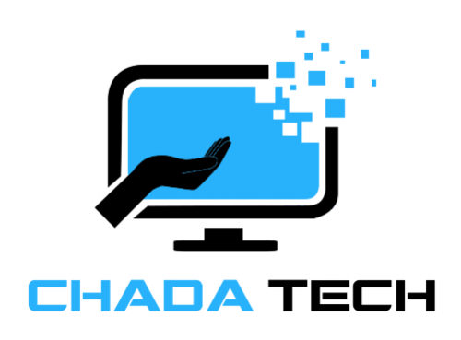
AGILE DEVELOPMENT

Slide 2

Explaining agile Roles
Product Owner
Maxes the value of the product and the Development team.
Scrum Master
Brings guidance to Scrum meetings.
Servant-Leader to the Product Owner.
Facilitates and manages Scrum events.
Development Team
Consists of developers and testers
Self-organized
Cross-functional

Slide 3
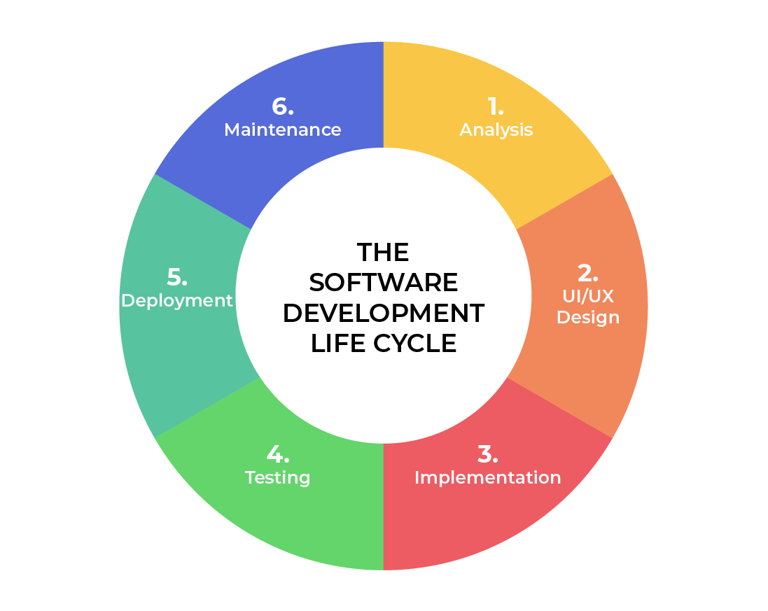
SOFTWARE DEVELOPMENT LIFECYCLE
Analysis
Collaborate and works with the stakeholders.
Helps gather requirements.
Design
Defines detailed processes for functionality.
Defines technology, time frames, limitations, and budget.
Implementation
Development starts.
Functionality is broken up into smaller increments.
Testing
Occurs along with development.
Process for identifying and mitigating reported problems and bugs as well as issuing tracking.
Deployment
Testing and development finishes and the product is released to market.
Maintenance
Post deployment production.
Developers must be ready to implement NEW features and bug fixes as they are found by the public.
Notes:
Analysis – This is the basic and first building block of the software development lifecycle. This is where the leads collaborate with various stakeholders to collect requirements of the project.
Design – In this phase, the functionality is defined in detail. The technologies used and project resources, limitations, time frames and budgets are also discussed.
Development – In this phase, development officially begins. The programming language used is dependent, and sometimes crucial, on the project. This is the longest phase in the SDLC because each functionality is broken into smaller sections to allow for value-based code development.
Testing – In conjunction with development, testing is also a common activity. Happens at all phases but specifically reserved for defects and issue tracking with existing code base and builds.
Deployment – In this stage, testing is complete, and the product is ready to be deployed to market. UAT (User Acceptance Testing) may be performed in a limited environment before releasing to market.
Maintenance – In this stage, the product has been deployed into market. Developers must be ready and able to address any new features and bug fixes that users request and experience in production.

Slide 4
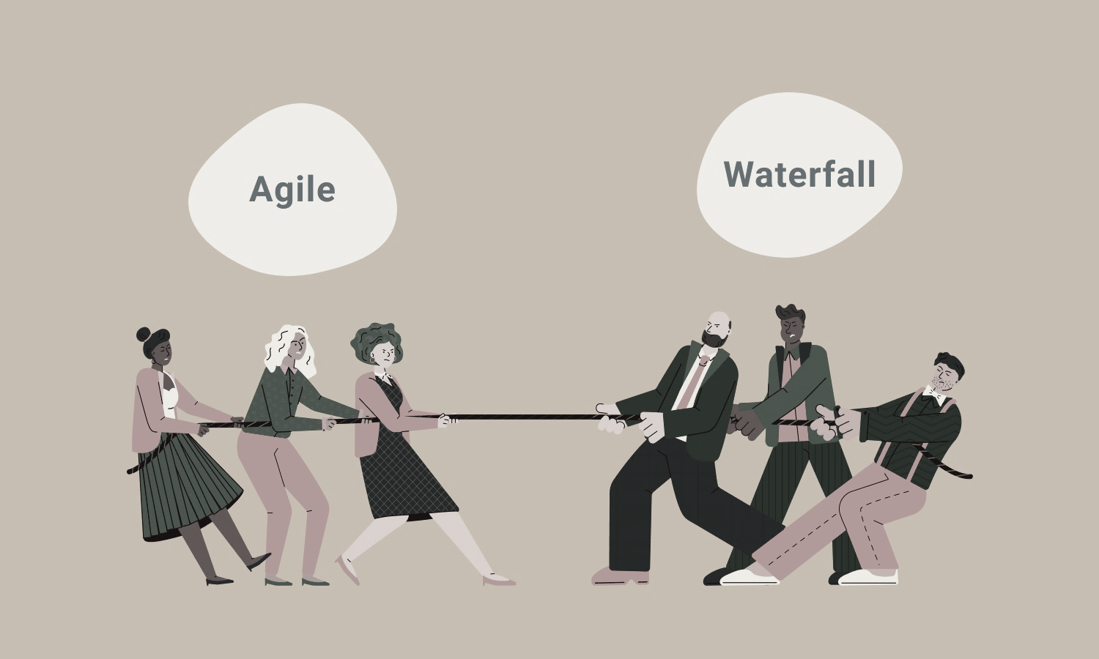
vs
No need to define or set all requirements.
Major requirements can be defined but functionality can evolve over time, causing requirements to change.
No time to market constraint.
All requirements must be defined and set.
Contract Negotiation.
Sequential/Linear stages.
Best for simple, unchanging projects with a clear goal.
Notes:
The SNHU Travel project would have been difficult to accomplish using a waterfall approach. Given the amount of uncertainty any changes would have had a negative impact on the project. Even with the high level of uncertainty with agile, any issues discovered would require a change order to the agreement which can be costly.

Slide 5
References
Charles G. Cobb. (2015). The Project Manager’s Guide
to Mastering Agile : Principles and Practices for an Adaptive Approach. Wiley. Software Development Life Cycle (SDLC). (2021, May 19). Retrieved June 2023, from
linkedin.com: https://www.linkedin.com/pulse/software-development-life-
cycle-sdlc-tutorial-richard-harris/

