Slide 1
Diffusion models for image generation
Aditya kumar
Azeem Motiwala
Jay Chaudhary

Slide 2
Methods FOR DIFFERENT TASKS
Method of learning to generate new images Forward/reverse diffusion
Way to compress images Autoencoder
Way to add in good inductive images U-net + ‘attention

Slide 3
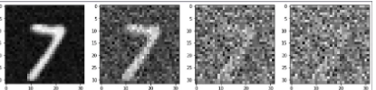
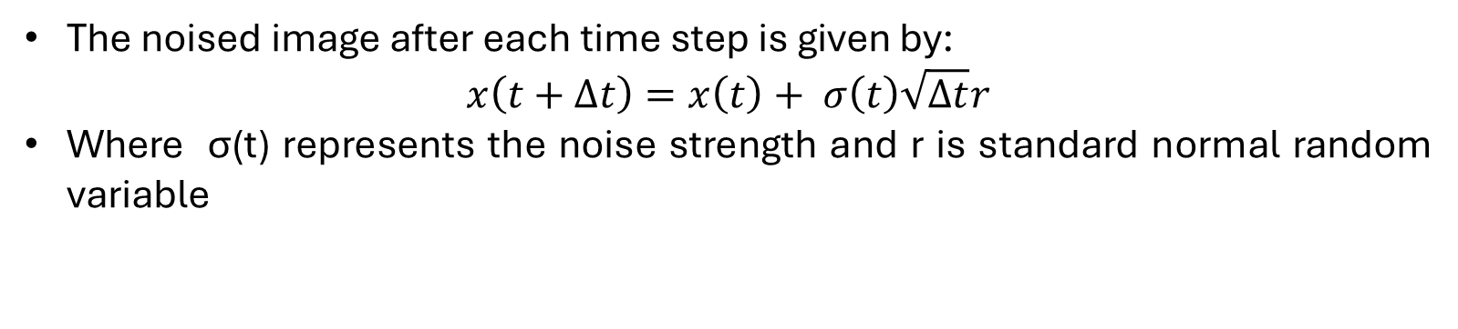
Noising PROCESS
The noised image after each time step is given by:
$$x\left(t+∆t\right)=x\left(t\right)+ σ\left(t\right)\sqrt{∆t}r$$
Where σ(t) represents the noise strength and r is standard normal random variable

Slide 4

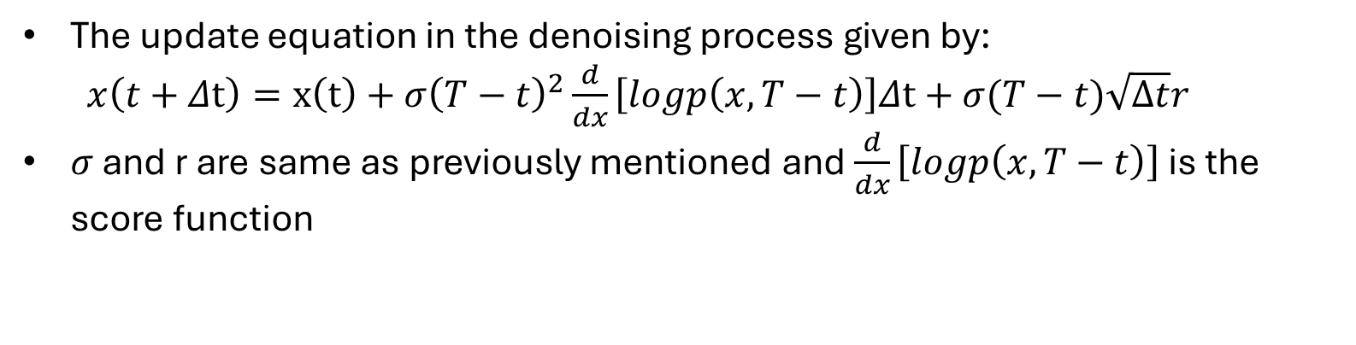
Denoising Process
The update equation in the denoising process given by:
$x\left(t+Δt\right)=x\left(t\right)+σ{\left(T−t\right)}^{2}\frac{d}{dx}\left[logp\left(x,T−t\right)\right]Δt+σ(T−t)\sqrt{∆t}r$
$σ$ and r are same as previously mentioned and $\frac{d}{dx}\left[logp\left(x,T−t\right)\right]$ is the score function

Slide 5
Objectives & Methods
As explained in earlier slides we change not only noise level during noising stage but also carefully tweak the variance of noise . This suggested idea aims to give a more flexible and rich structure.
We step further into conditional Diffusion models based on textual prompt. This one basically implemented using cross-attention between image and text.
We also explored stable diffusion, type of diffusion that simplifies images into hidden area called latent zone.

Slide 6
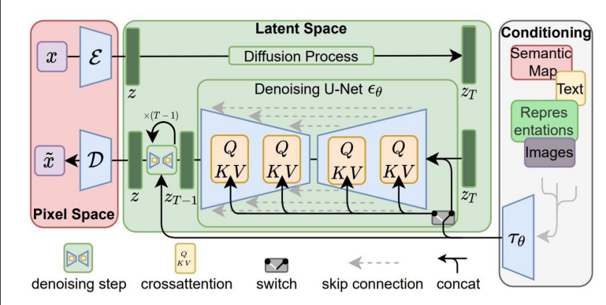
Model architecture

Slide 7
RELATED WORK
The above one is the architecture we used. It comprises of basic input noising block which adds noise based on equation in slide 3.
Model uses Gaussian Fourier Projection block, the primary objective to embed time related info into network’s representations.
Used sampler to sample or generate random noise.
We performed training on 3 datasets:
1.MNIST 2.Fashion MNIST 3.CIFAR10

Slide 8
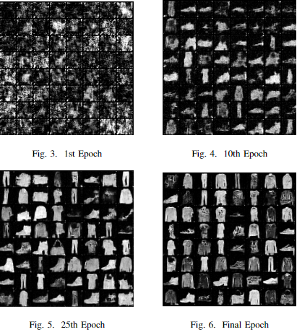
UNCONDITIONAL DDPM
We set number of time steps as 500 and used Adam as optimizer and learning rate scheduler(cosine annealing upto 50 epochs and multistep after that)
Here the generated images for model trained on fashion MNIST

Slide 9
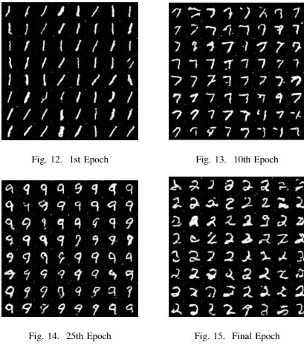
CONDITIONAL DDPM
the settings used for this version are similar to the previous model, except now we've included attention within the convolutional layers.
The images shown belong to different categories in the MNIST dataset, each representing a different handwritten numerical digit.

Slide 10
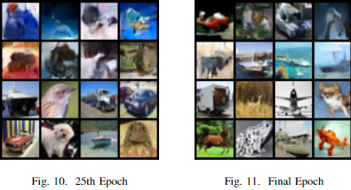
Results on cifar10
Lower eight are ground truth and above ones are generated

Slide 11
STABLE DIFFUSION
For stable diffusion we compress the input images using autoencoder which was initially trained on degradation and restoration task and then perform noising and denoising on compressed images.
Now instead of dealing with whole detailed images, we used it’s simpler forms
This helps our network to train fast as compared to usual one.

Slide 12
Challenges faced
While developing the UNet model, we faced challenges related to shape inconsistencies between layers and embeddings during the addition operation. We resolved this issue through rigorous debugging and careful examination of the code.
During the training process, there are instances where the loss tends to plateau or saturate. To address this, we experimented with various learning rates and optimizers to achieve better training convergence.

