Slide 1
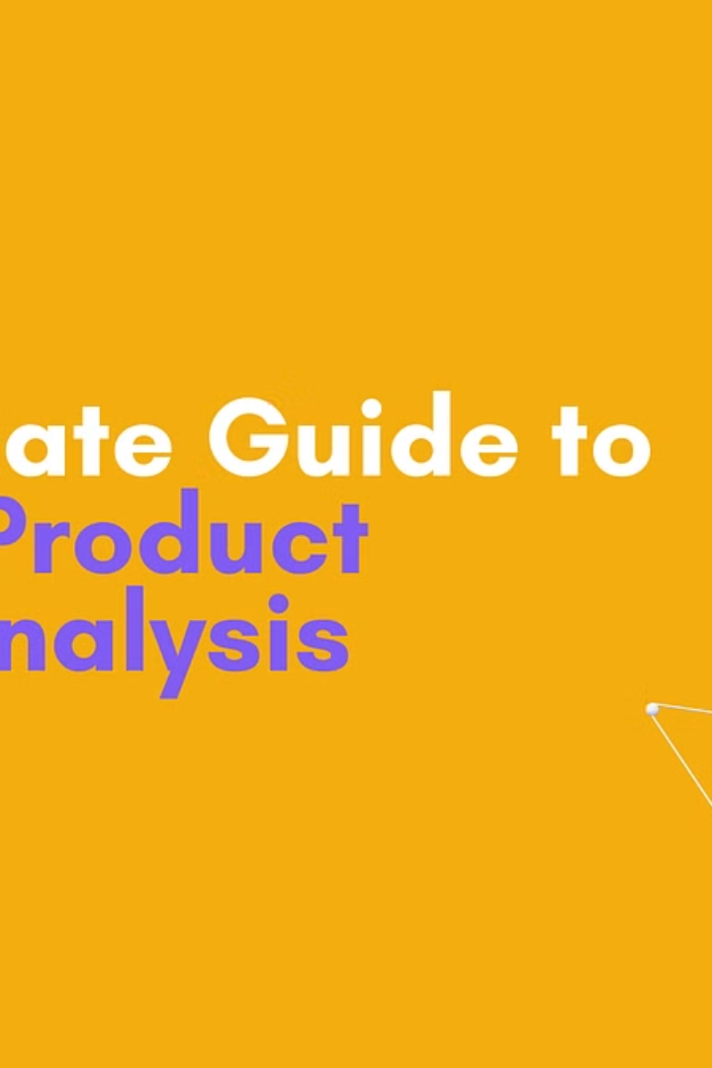

NLP Project : Sentiment Analysis on Amazon Reviews
Presented By :
Zeel Parekh (1196109)
Jay Gondalia (1196220)

Slide 2
Agenda
Objective
Dataset and Preprocessing
Visualization
Feature Extraction
Model Selection and Training
Model Evaluation
Conclusion

Slide 3
a
NLP Project : Sentiment Analysis on Amazon Reviews
Sentiment Analysis is crucial for mitigating financial and reputational risks associated with misleading comments, thereby safeguarding customer loyalty. To address these critical issue, this project focuses on leveraging sentiment analysis techniques applied to Amazon product reviews sourced from Kaggle.
By employing a variety of machine learning models and SpaCy's neural network, the goal is to get actionable insights that empower e-commerce platforms and sellers to optimize sales strategies, while facilitating hassle-free purchasing journeys for customers.

Slide 4
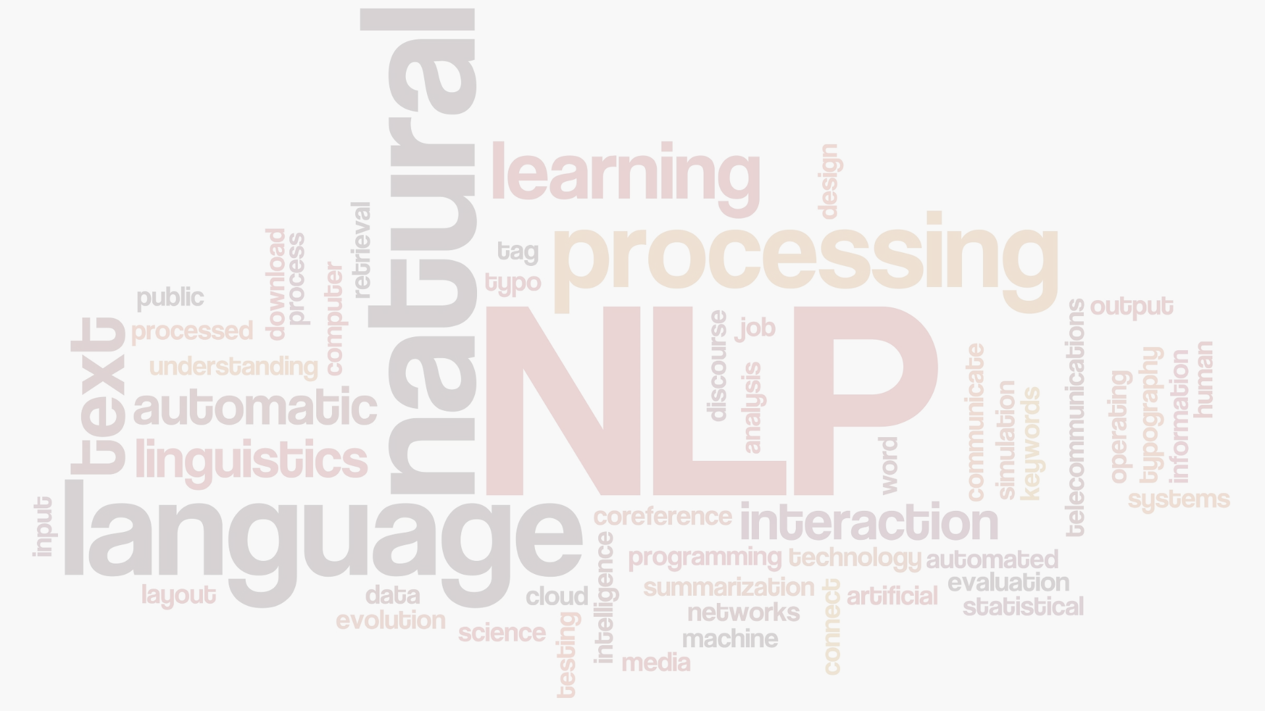
Dataset and Preprocessing
1
Dataset
2
Data Preprocessing
The dataset comprised Amazon product reviews, consisting of a 'reviewText' feature and a calculated 'sentiment_label' feature indicating positive or negative sentiment. After removing missing values, the dataset contained 2100 records.
Several preprocessing steps were applied using SpaCy and NLTK, including text normalization, removal of punctuation and numerical characters, elimination of stop words, and lemmatization to reduce words to their base form.
Dataset : https://www.kaggle.com/datasets/tarkkaanko/amazon

Slide 5
Dataset and Preprocessing
Import Libraries : Import Necessary Libraries
Data Loading : Load data from the CSV file (Amazon Reviews)
Tokenization : Tokenize the text into individual words or tokens.
Lemmatization : Reduce words to their base or root form to normalize the vocabulary.
Lowercasing : Convert all text to lowercase to ensure consistency.
Remove Punctuation : Eliminate punctuation marks from the text.
Remove Stop words : Exclude common words that do not carry significant meaning.
Clean Text : Combine the above steps to create a clean version of the text data.

Slide 6
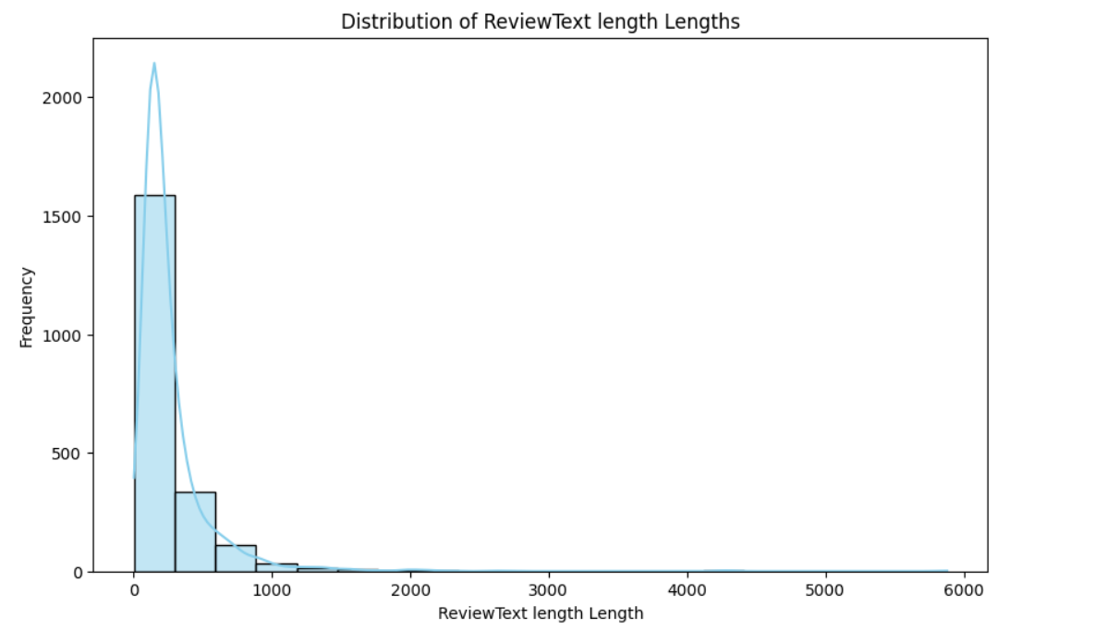
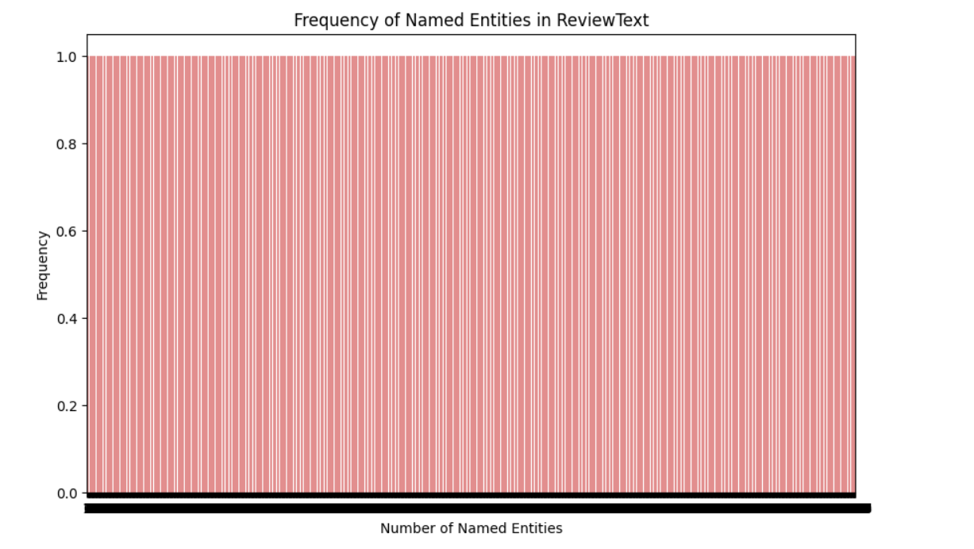
Visualization
Visualizations were performed to gain insights, including a histogram illustrating the distribution of reviewText lengths and a bar plot depicting the frequency of named entities.
This visualization represents the lengths of the review Texts in a dataset. The x-axis typically represents the length of the review Texts, while the y-axis represents the frequency or count of reviewTexts falling within each length range.
Named entities refer to specific, named objects or entities within the text, such as people's names, locations, organizations, dates, etc.

Slide 7
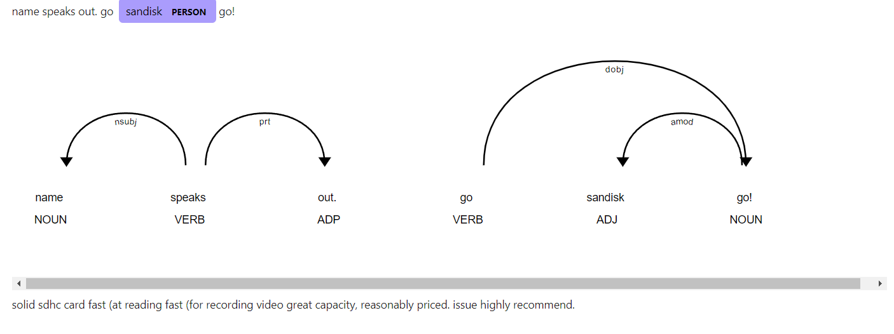
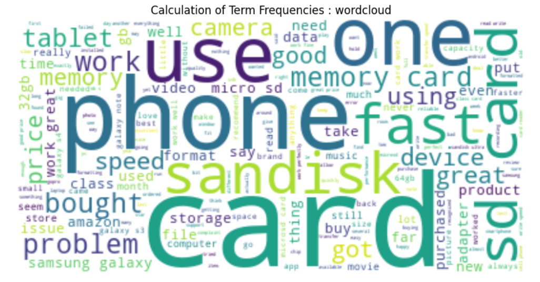
Feature Extraction

Slide 8



Model Selection and Training
Model Selection
Logistic Regression, Random Forest, and SVM models were trained using Count Vectorization technique. The best-performing model was selected based on cross-validation accuracy.
SpaCy Neural Network Model
SpaCy's built-in text categorization model was trained using the dataset, and hyperparameter tuning was conducted to improve model performance.

Slide 9
Model Evaluation
Algorithm
Accuracy
Parameters
Logistic Regression
78.9%
Count Vectorization
Random Forest
77.0%
Count Vectorization
SVM
78.3%
Linear Kernel, C=10
SpaCy NN Model
83.9%
4 epochs, batch size 10
The accuracy of each model was evaluated using cross-validation, and the best hyperparameters for each model were identified. The SpaCy neural network model achieved the highest accuracy of 83.9%.

Slide 10
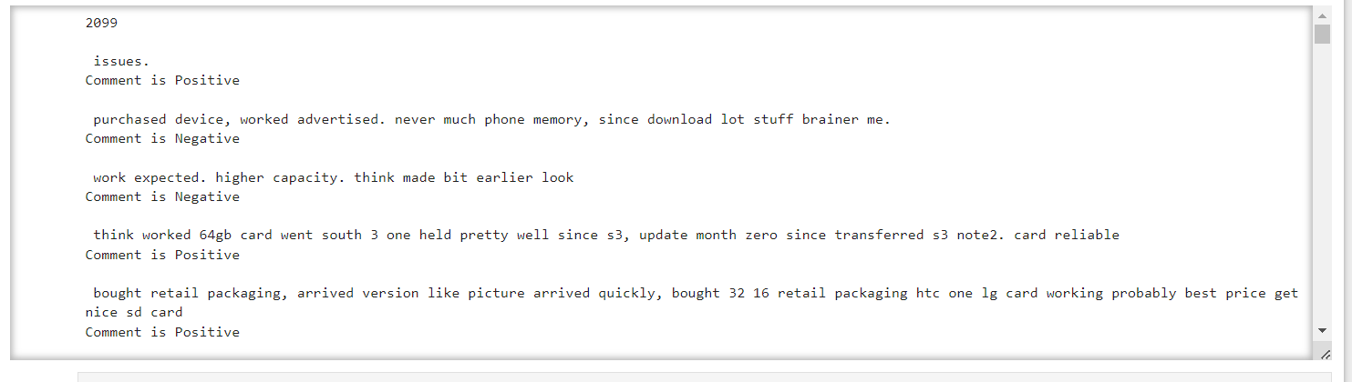
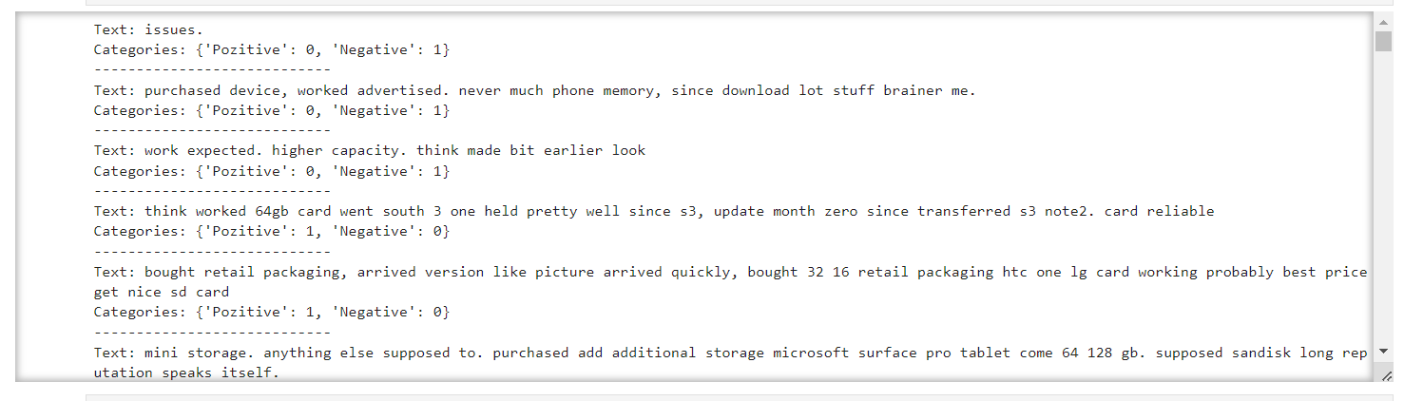
Model Evaluation
Random Forest Model :
Spacy Model :

Slide 11



Conclusion
Effective Techniques
Insights into Customer Sentiments
High Accuracy
This project demonstrates the effectiveness of different techniques in sentiment analysis, including machine learning models and SpaCy's built-in neural network model.
The project provides valuable insights into customer sentiments towards Amazon products, which can be leveraged for product development and marketing strategies.
The best-performing model achieved an accuracy of 83.9%, showcasing the potential of these techniques for sentiment analysis tasks.

Slide 12


