Slide 1
PRESENTATION ON JAVA
BY – JAY GULVI

Slide 2
INTRODUCTION TO JAVA
Java was developed by James Goslings from sun microsystem in the year 1991.
Java is open source software , Now currently java is owned by Oracle
PLATFORM INDEPENDENT :
If a software is built on one platform and it can run on any platform is termed as platform independent .
Example – Java
1 byte = 8 bits
Data types :
INTEGER FLOATING
Byte - 1 byte Float – 4 byte
Short - 2 byte Double – 8 byte
Int - 4 byte
Long - 8 byte
Character =====→ Char (2 byte)

Slide 3
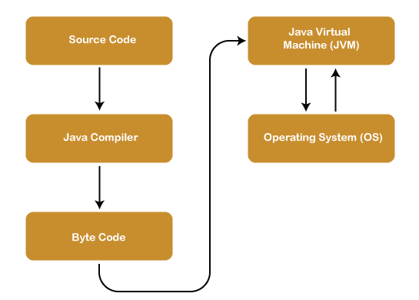
Java Architecture
Architecture of Java --------------------------
Step-1: Source code - whatever program we write it is called as source code.
Step-2: Compilation - The process of converting our program into system understandable form (byte code) is purpose of compiling a program .
Step-3: Execution – JVM - java virtual machine is responsible for execution of every java program.
- execution will happen in line by line manner.

Slide 4
JDK-JAVA DEVELOPMENT KIT – IF WE WANT TO DEVELOP AND EXECUTE JAVA PROGRAM IN OUR SYSYTEM WE HAVE TO INSATLL JDK(JRE,JVM,SUPPORTING TOOLS AND SUPPORTING CLASSES).
Components of JDK ---------------------------
JRE - java runtime environment - JVM - java virtual machine
JRE: JAVA RUNTIME ENVIRONMENT - IT IS USED FOR EXECUTING JAVA PROGRAM OR RUNNING JAVA APP
JVM: JAVA VIRTUAL MACHINE - IT IS RESPONSIBLE TO EXECUTE EVERY JAVA PROGRAM.

Slide 5
Byte Code
Byte Code can be defined as an intermediate code generated by the compiler after the compilation of source code(JAVA Program). This intermediate code makes Java a platform-independent language.
Stack
Java Collection framework provides a Stack class that models and implements a Stack data structure. The class is based on the basic principle of last-in-first-out. In addition to the basic push and pop operations, the class provides three more functions of empty, search, and peek.

