Slide 1
Travel agent
CAPSTONE PROJECT
Presented By:
Student name : Jay Gupta
College Name & Department : Greater Noida Institute of Technology, Computer Science & Engineering

Slide 2
OUTLINE
Problem Statement
Technology used
Wow factor
End users
Result
Conclusion
Git-hub Link
Future scope
IBM Certifications

Slide 3
Problem Statement
Planning travel is often time-consuming, fragmented, and inefficient. Travelers need to research destinations, compare transportation and accommodation, and build itineraries—often from scratch. Proposed Solution: An AI-powered Travel Planner Agent that simplifies trip planning by understanding user preferences, budget, and constraints. It provides real-time destination suggestions, custom itineraries, transport & stay options, integrated maps, local guides, booking management, and dynamic travel updates. This transforms planning into a smooth and enjoyable experience

Slide 4
Technology used
IBM cloud lite services
Natural Language Processing (NLP)
Retrieval Augmented Generation (RAG)
IBM Granite model

Slide 5
IBM cloud services used
IBM Cloud Watsonx AI Studio – for building the AI agent
IBM Cloud Watsonx AI runtime – for deploying the model
IBM Cloud Agent Lab – for testing and managing the agent pipeline
IBM Granite foundation model – to power natural interactions

Slide 6
Wow factors
Real-time destination & itinerary planning Dynamic schedule adjustment based on flight/train delays Personalized recommendations based on budget and interests Integrated with maps, weather, and booking platforms Alerts for weather changes, travel disruptions Multilingual travel assistant Offline support for saved trips & guidance

Slide 7
End users
Tourists and travelers Travel agencies and tour operators Backpackers and solo adventurers Corporate/business travelers Students planning educational trips

Slide 8
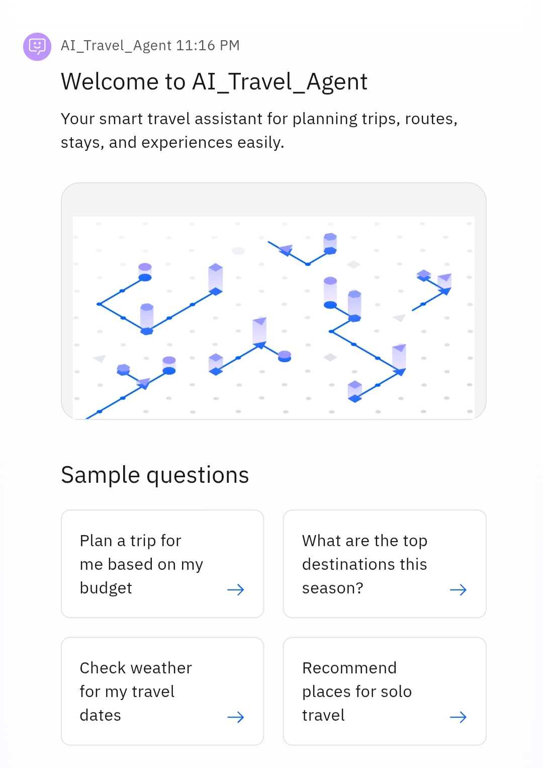
Results
Deployed AI Agent via IBM Cloud Users receive a custom itinerary based on input

Slide 9
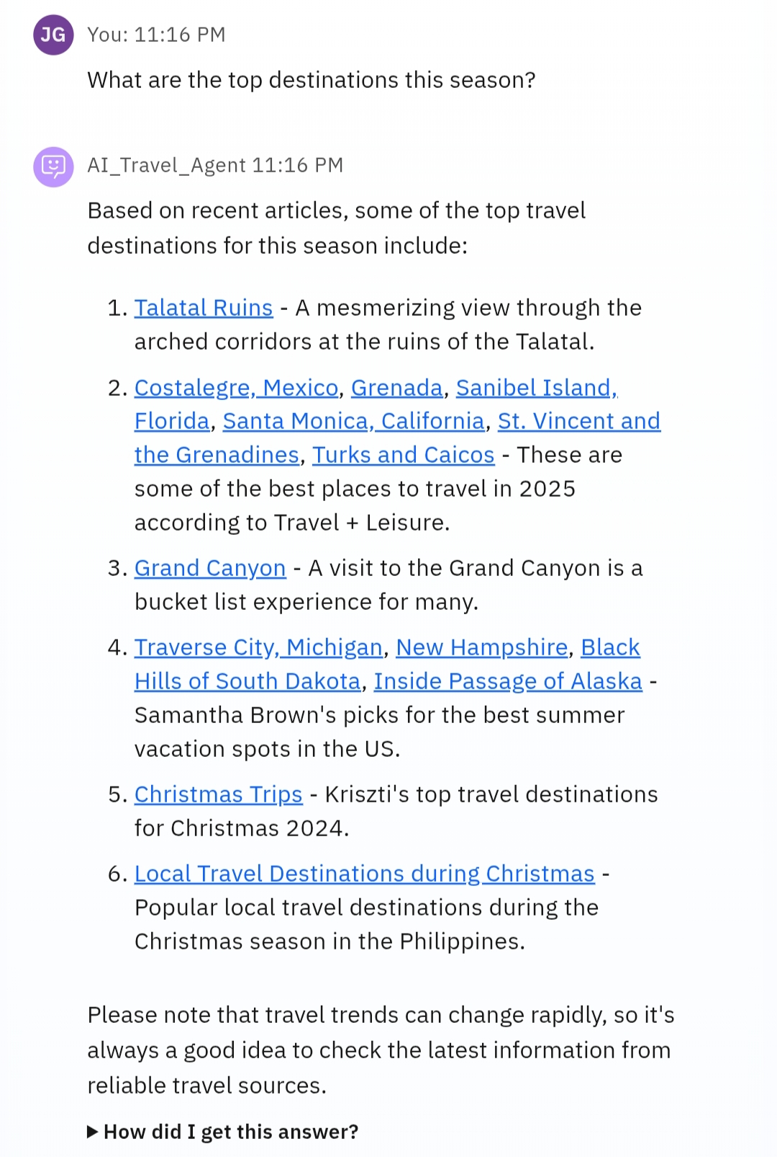
Results
Live demo enables trip planning in under 2 minutes

Slide 10
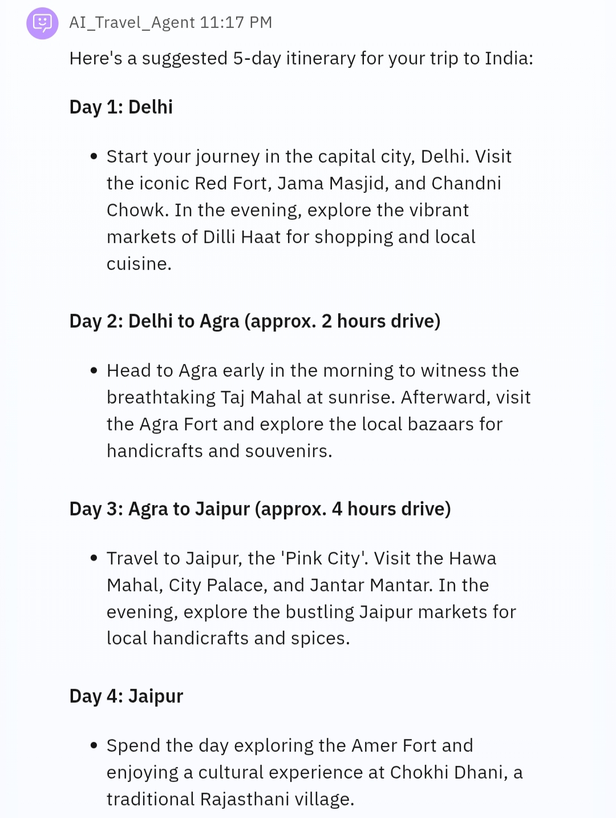
Results
Prototype supports personalized suggestions for hotels, flights, attractions

Slide 11
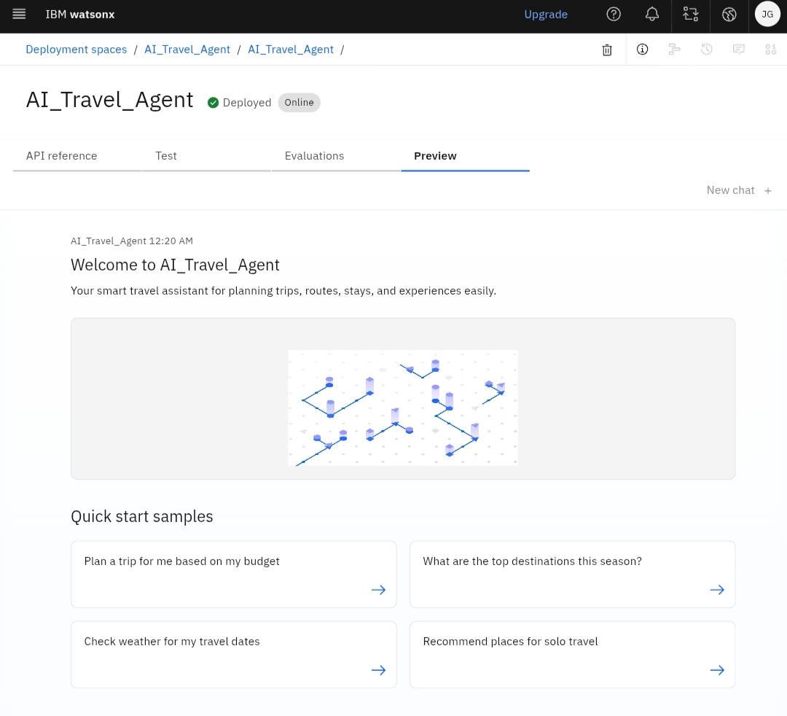
Results
Deployed AI Agent

Slide 12
Conclusion
The Travel Planner Agent automates and personalizes the trip planning experience, reducing stress and improving travel efficiency.
It brings together real-time data, intelligent suggestions, and user-focused customization, making it a valuable assistant for modern travelers.
Future integrations can include ticket booking, visa support, and AR-based local guides

Slide 13
Future scope
Integration with booking APIs (MakeMyTrip, Booking.com) Voice-activated itinerary assistant Expense tracker for travel budget management Smart recommendations based on past trips Cross-platform mobile app version Local language support with real-time translation Emergency contact & alert system integration

Slide 14
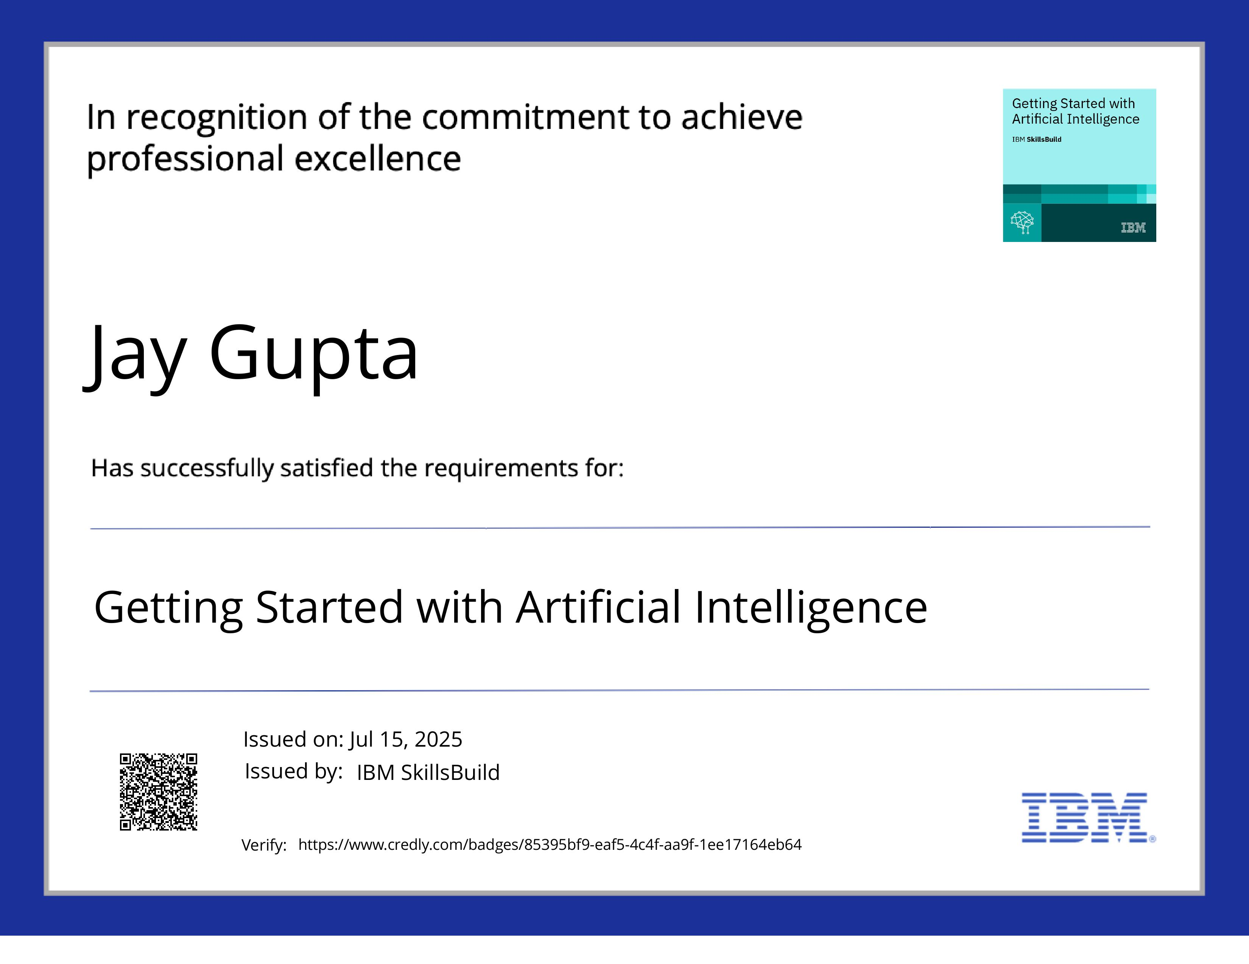
IBM Certifications

Slide 15
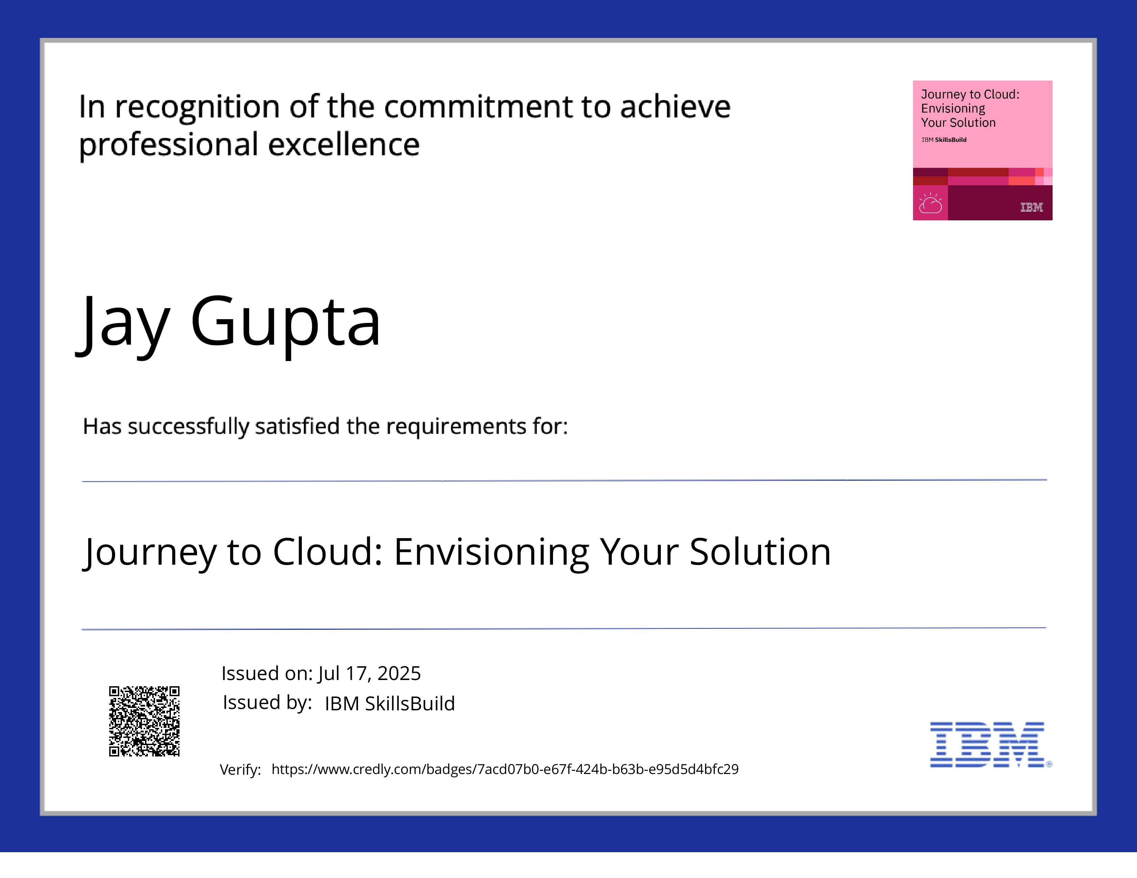
IBM CertificationS

Slide 16
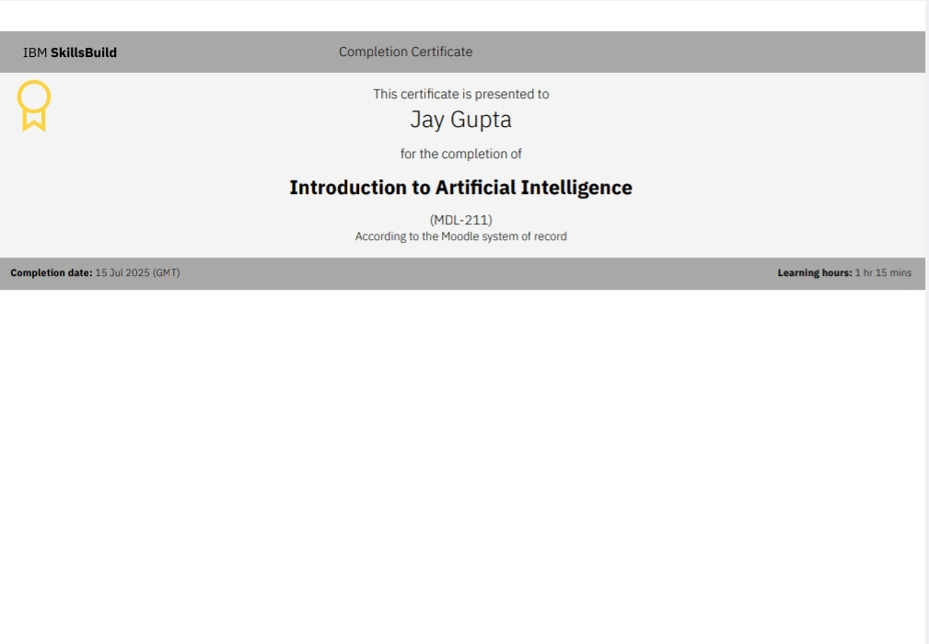

Slide 17
GitHub Link
https://github.com/JayGupta11/AI_Travel_Agent

Slide 18
THANK YOU

