Slide 1
Vehicle Insurance
Feature engineering, data modeling and optimization

Slide 2
Introduction
Our client is an Insurance company that has provided Health Insurance to its customers now they need your help in building a model to predict whether the policyholders (customers) from past year will also be interested in Vehicle Insurance provided by the company.
87.4% of the dataset contains policy holders that are not interested in vehicle insurance, while 12.26% of the dataset contains policy holders that are interested in vehicle insurance.
“This dataset is severely imbalanced and as such using accuracy as a metric for model validation would be not be wise decision.”

Slide 3
Alternative model validation(metrics)
Since accuracy score is not a good metric for imbalanced data set, we considered the following metrics
1. Precision
2. Recall
3. F1 score
4. Mathews Correlation Coefficient

Slide 4
Sampling Techniques
To overcome the imbalanced nature of the dataset, some sampling techniques were done. These techniques include
1. Random Over Sampling
2. Random Under Sampling
3. Synthetic Minority Over Sampling Technique(SMOTE)

Slide 5
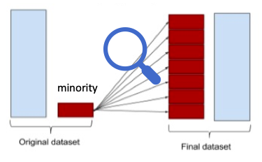
Random Over Sampling
This sampling technique involves randomly duplicating examples of the minority class and adding them to the training set.
Examples from the training dataset are selected randomly with replacement i.e examples from the minority class can be chosen and added to the new “more balanced” training dataset multiple times; they are selected from the original training dataset, added to the new training set and then returned or “replaced” in the original dataset, allowing them to be selected again

Slide 6
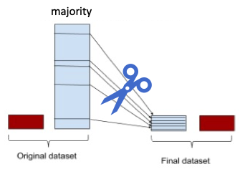
Random Under Sampling
This sampling technique involves randomly removing examples of the majority class
Examples from the training dataset are selected randomly i.e examples from the majority class can be chosen and removed from the new “more balanced” training dataset;

Slide 7
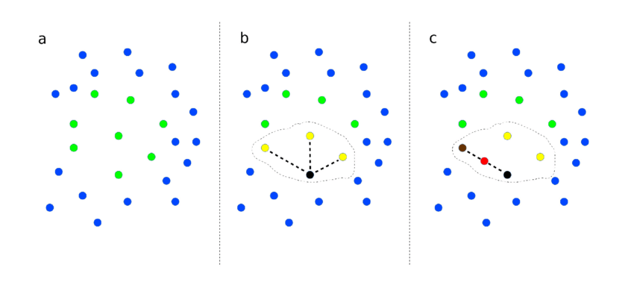
SMOTE
This technique works like K Nearest Neighbors,
“Specifically, a random example from the minority class is first chosen, Then k of the nearest neighbors is found for that example are found. A randomly selected neighbor is chosen and a synthetic example is created at a randomly selected point between the two examples in feature space”

Slide 8
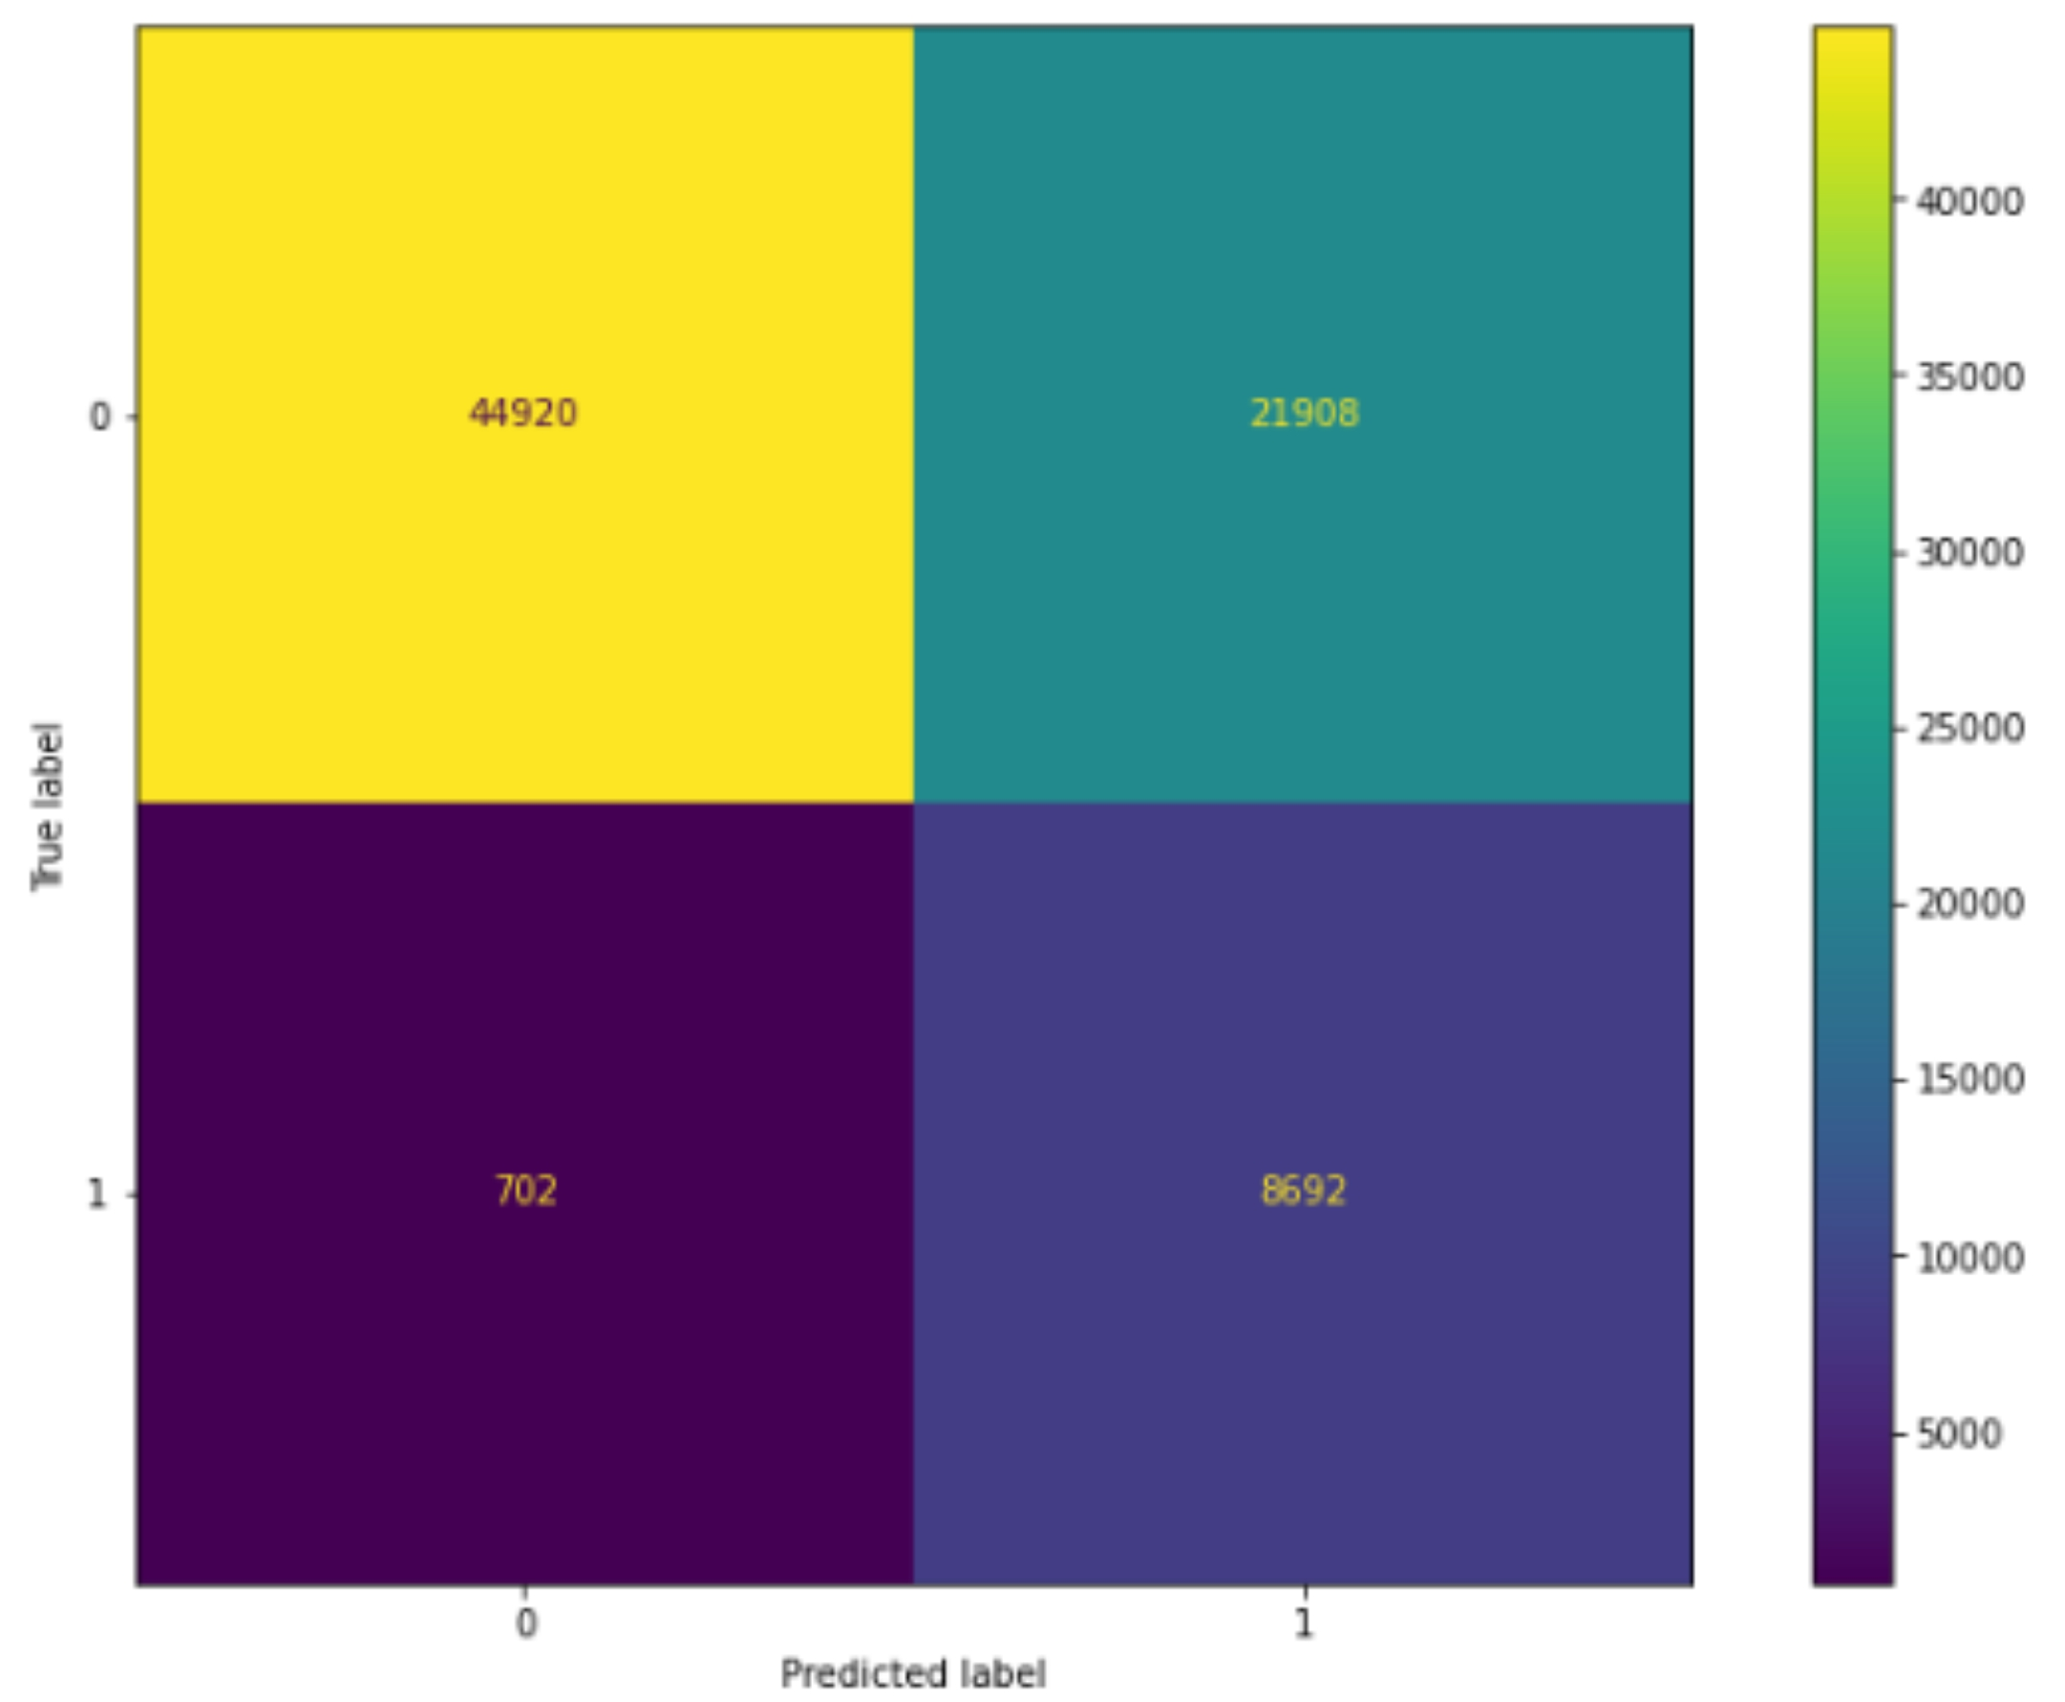
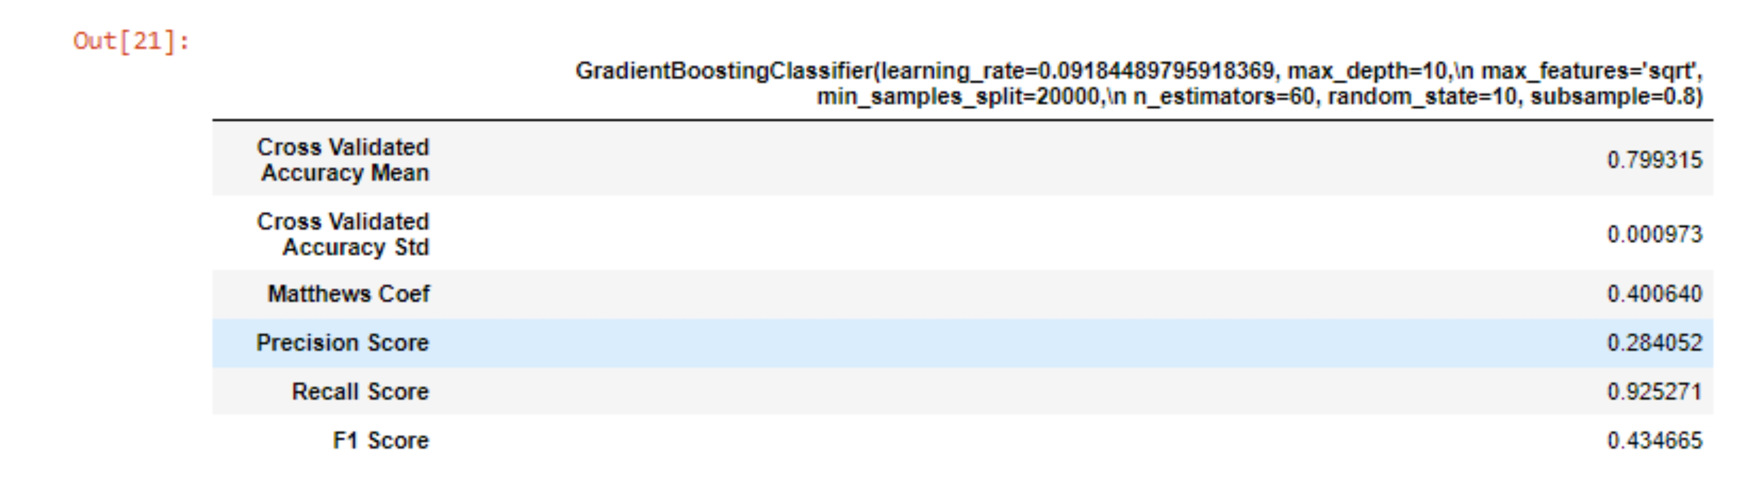
Model Performance

Slide 9
Model Performance

Slide 10
Conclusion and Future Works
This project uses machine learning techniques and algorithm to predict if a policy holder would be interested in vehicle insurance.
In business context
1. If advertising vehicle insurance to health insurance policy holder would be very expensive, then we optimize the model for precision, because we want to be very sure that they would be interested
2. If advertising vehicle insurance to health insurance policy holder would not be very expensive, then we optimize the model for recall, because we want to advertise to everyone that would be interested.
A future work would include
1. Using deep learning to improve the model performance
2. Creating an application programming interface for web developers

Slide 11


