Slide 1
Project

Slide 2
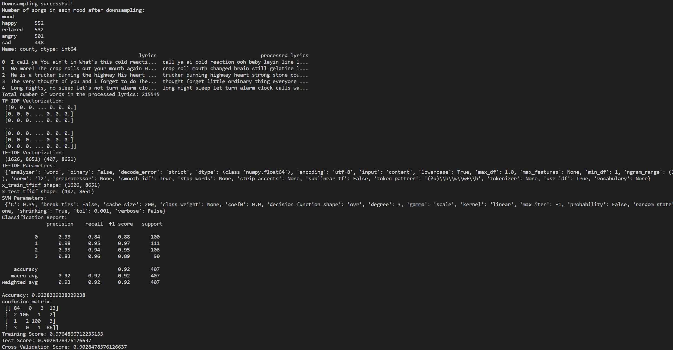
TF-IDF SVM

Slide 3
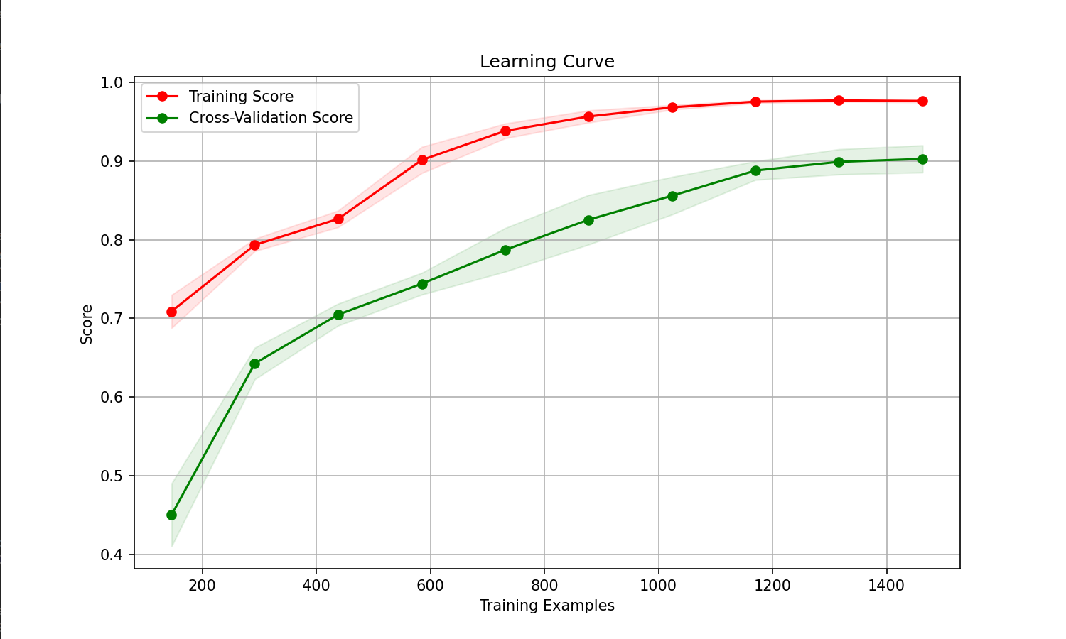
TF-IDF SVM

Slide 4
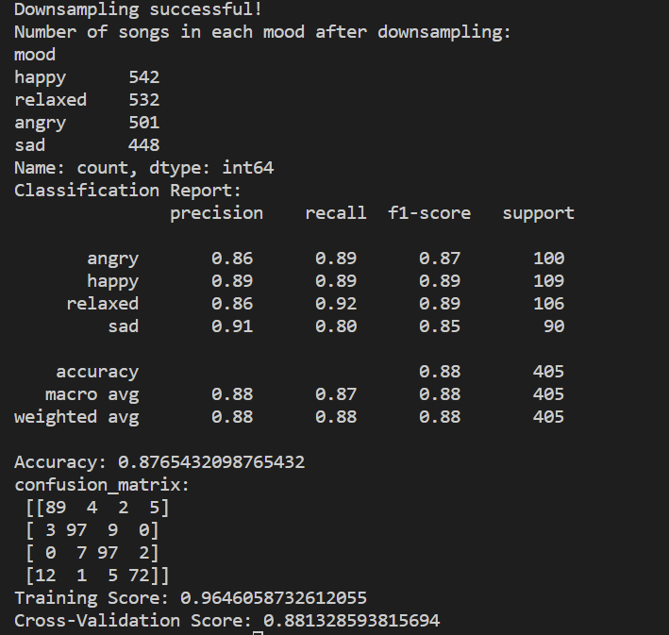
TF IDF LOG

Slide 5
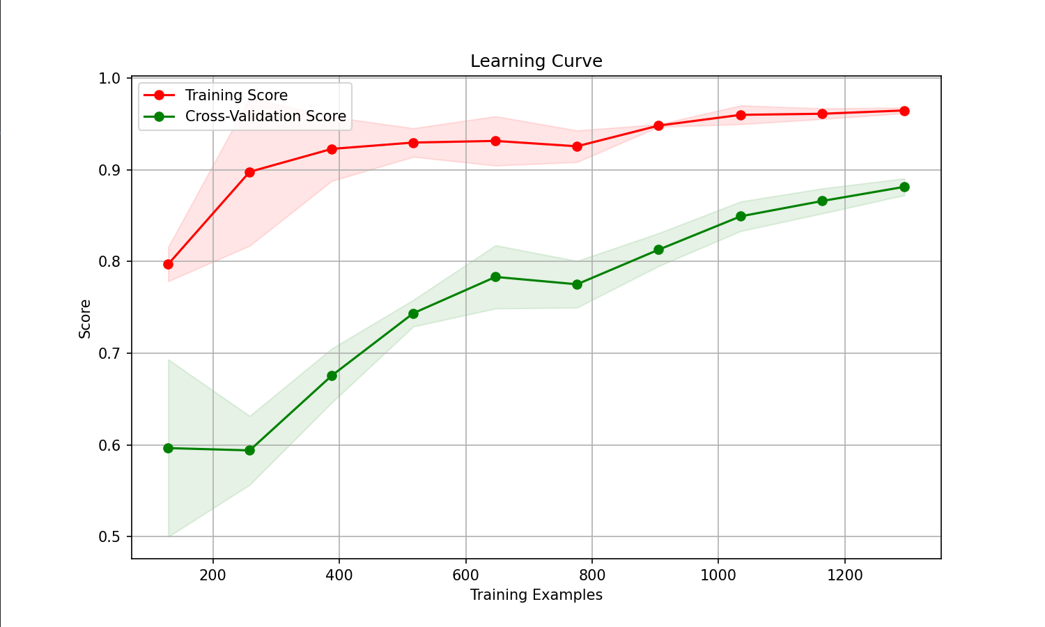
TFIDF- Log

Slide 6
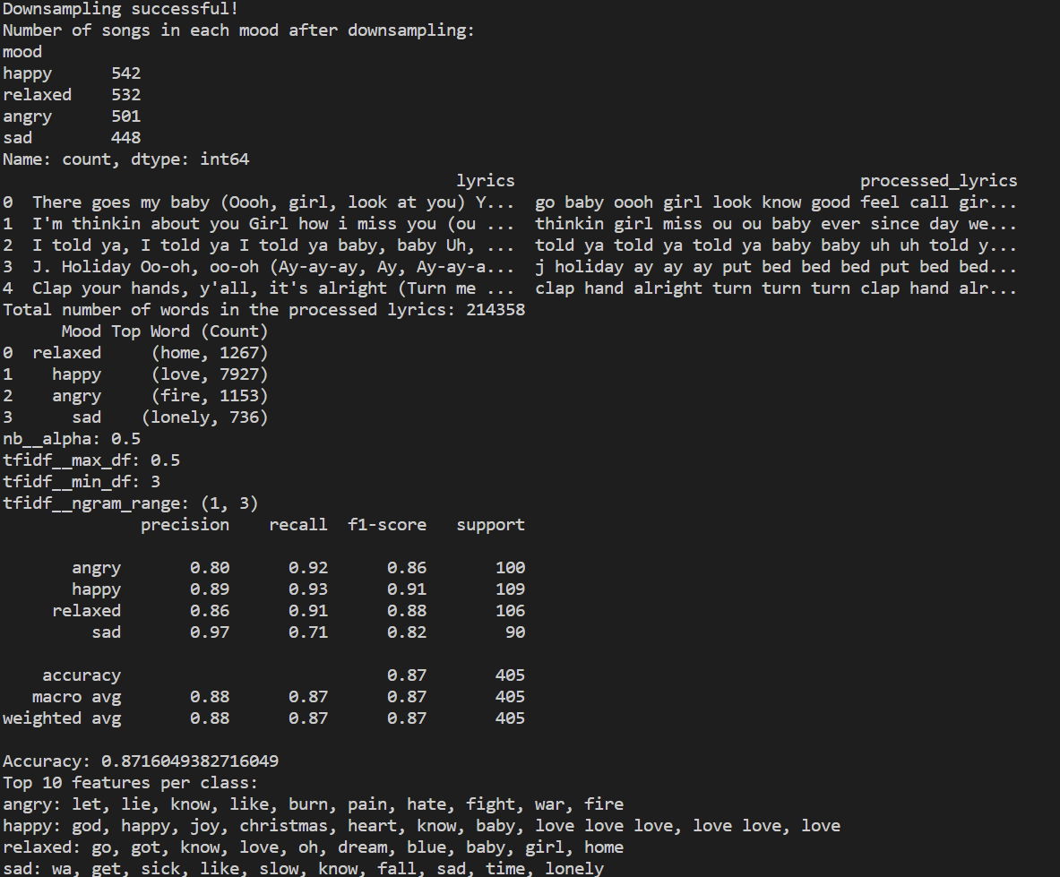
NB- TF-IDF

Slide 7
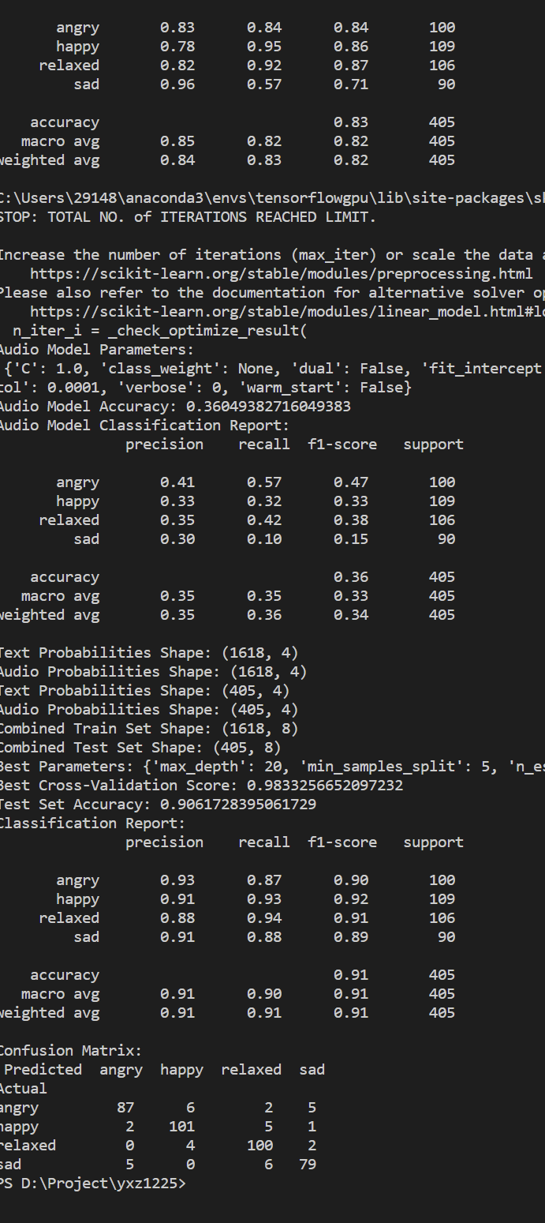
NB – LOG –RandomFR

Slide 8
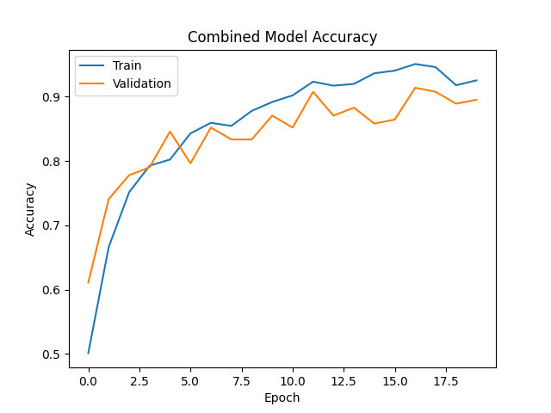
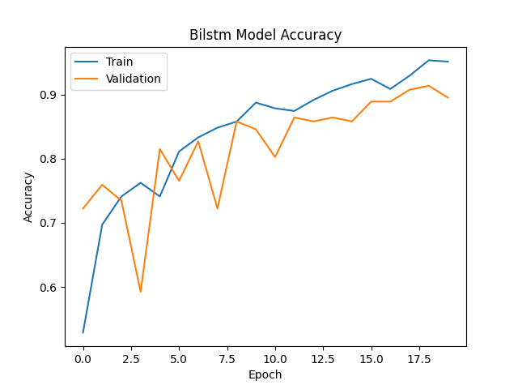
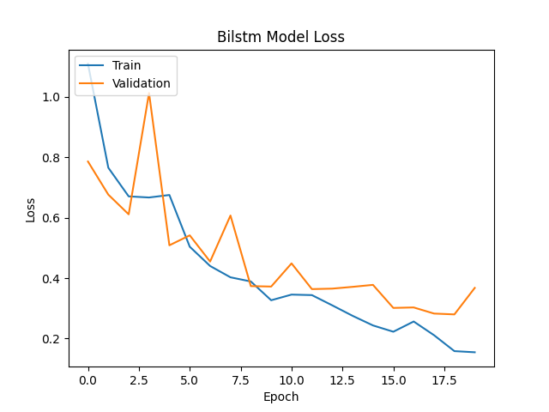
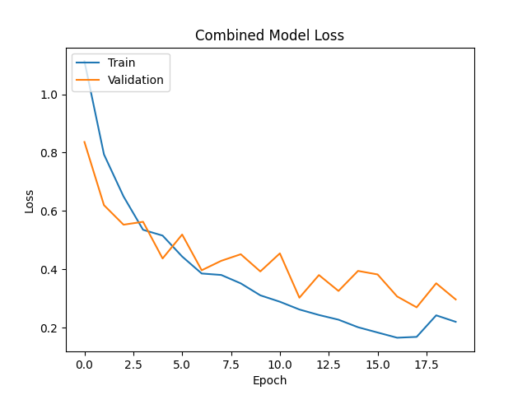
Bilstm-Glove

Slide 9
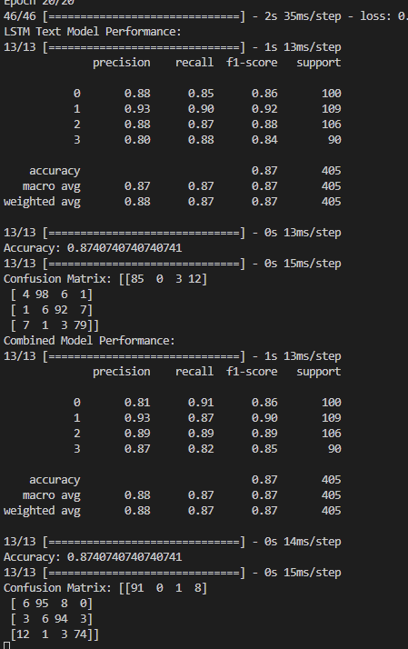
Bilstm-Glove

Slide 10
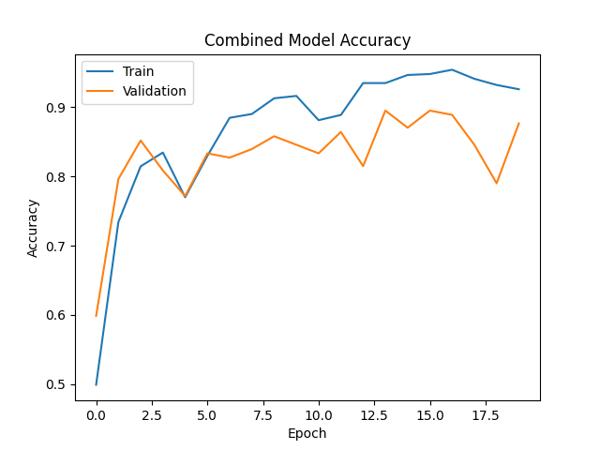
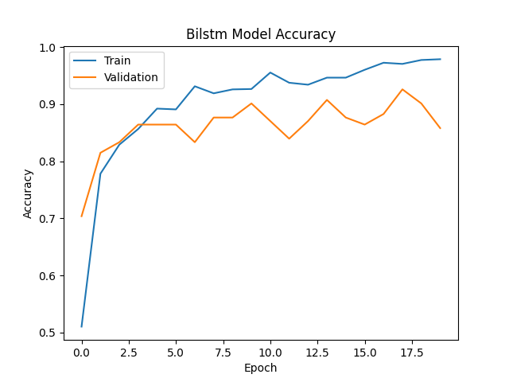
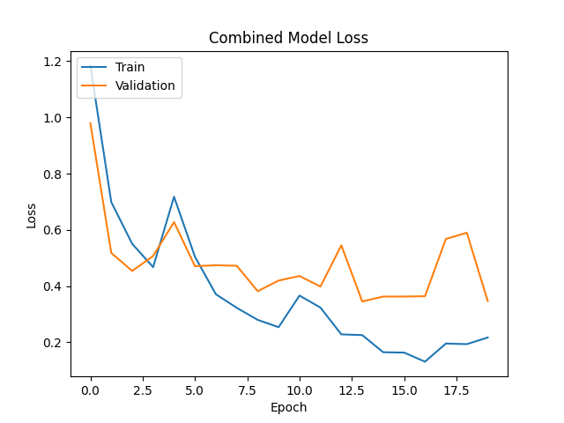
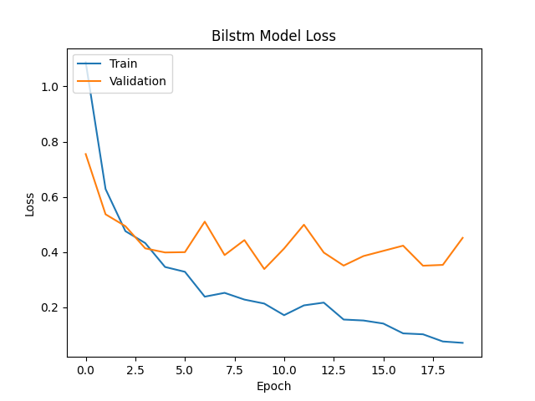
Bi-LSTM with wor2vec

Slide 11
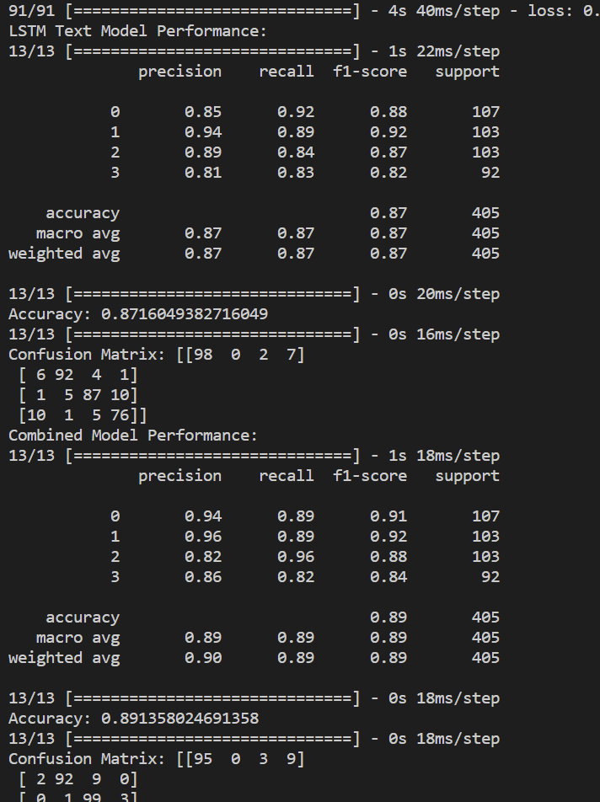
Bi-LSTM with wor2vec

Slide 12
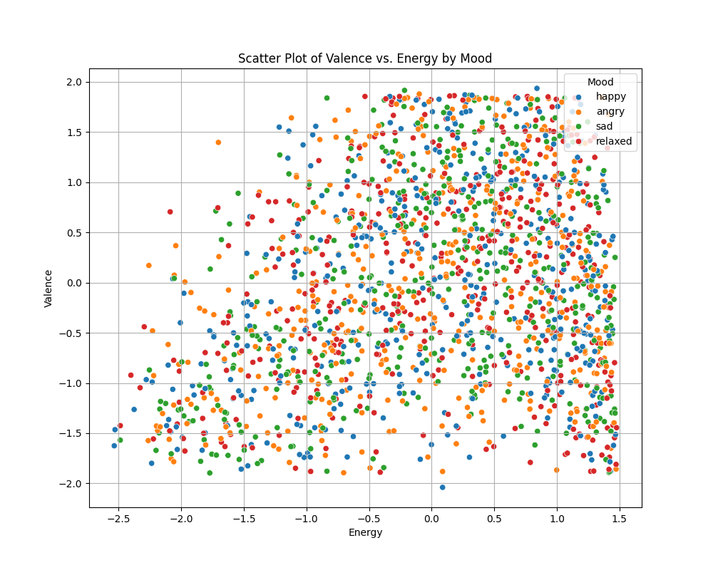
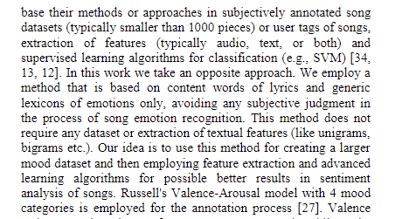


Audio feature Heatmap(moodyrcis 2595)

Slide 13
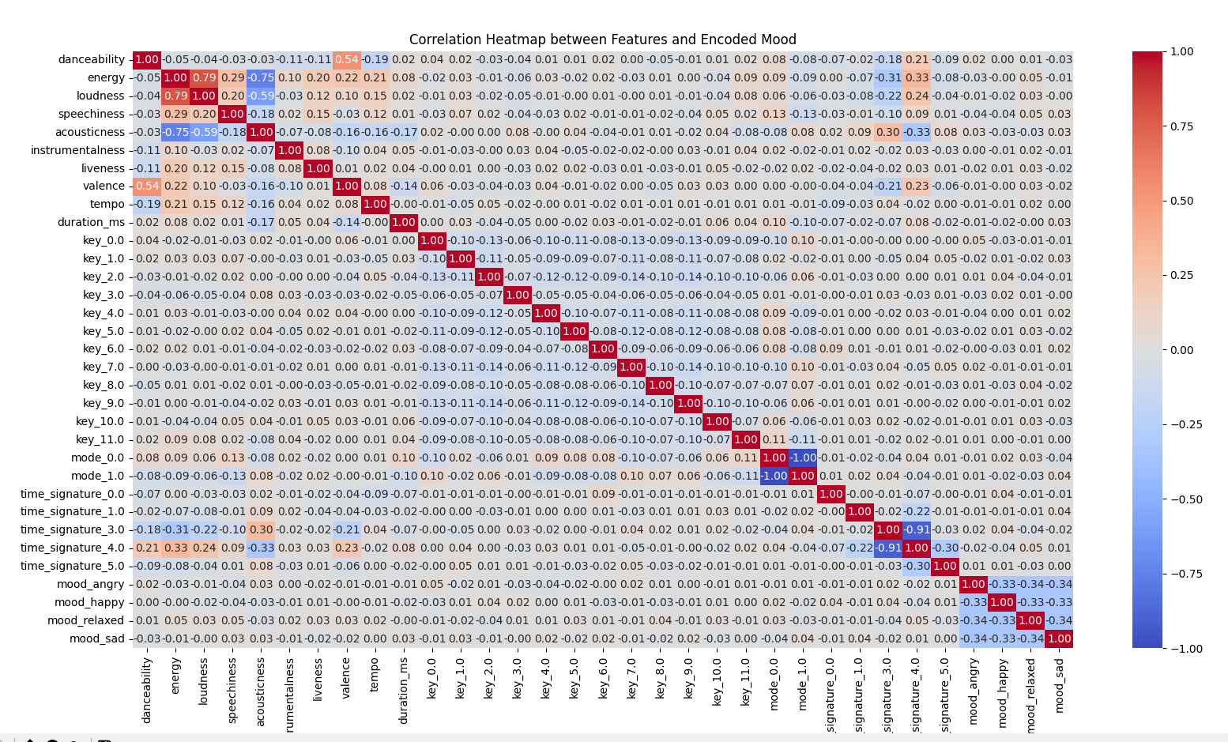
Audio feature Heatmap(moodyrcis 2595)

Slide 14

Audio feature Heatmap(moodyrcis4Q lsfm)

Slide 15
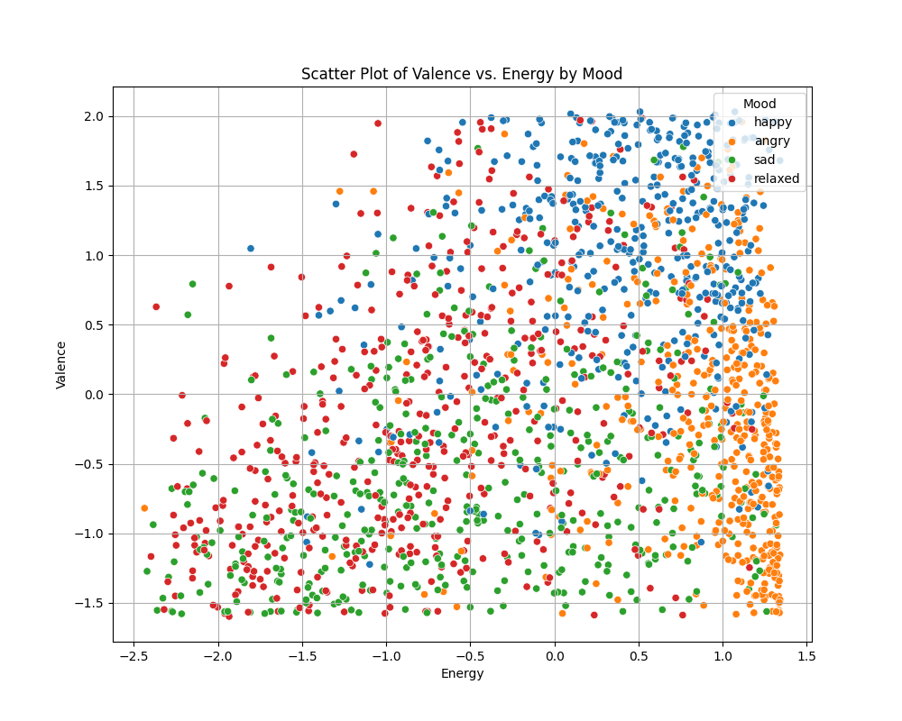
Audio feature Heatmap(moodyrcis4Q lsfm)

Slide 16
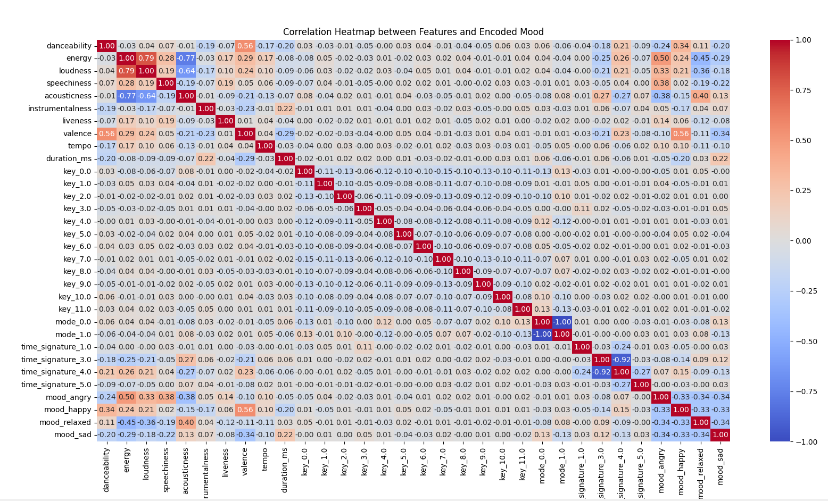
Audio feature Heatmap(moodyrcis lsfm)

Slide 17
