Slide 1
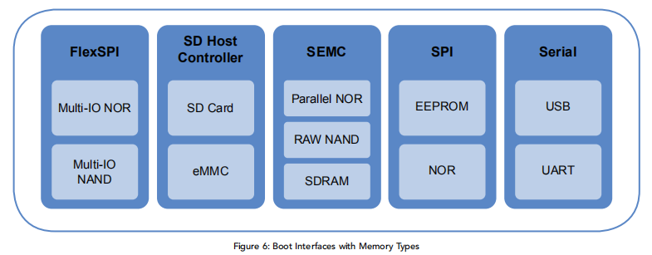
BootROM Features
The main features of the ROM include:
Support for booting from various boot devices
Serial downloader support (USB HID and UART)
Device Configuration Data (DCD) and plugin
Digital signature and encryption based High-Assurance Boot (HAB)
Wake-up from the low-power modes
Encrypted XIP on Serial NOR via FlexSPI interface powered by BEE and DCP controller

Slide 2
Primary Boot
1st stage
Recovery Boot
2nd stage
Manufacture Boot
3rd stage
FlexSPI
1/2/4/8bit
Serial
NOR
Serial
NAND
uSDHC
1/4/8bit
LPSPI
1bit
uSDHC
1bit
SD
Card
eMMC
Serial
NOR
EEPROM
SD
Card
eMMC
SEMC
8/16bit
Parallel
NOR
Raw
NAND

