Slide 1
CSE328
Portal Raycaster
Jay Gress - 115469091

Slide 2
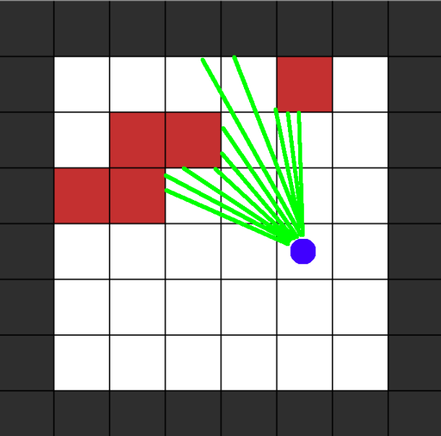
What is Raycasting?
Simulate a 3d perspective from a 2D map
One ray cast per screen column
Step through map until wall is found
Wall distance -> slice height = depth illusion

Slide 3
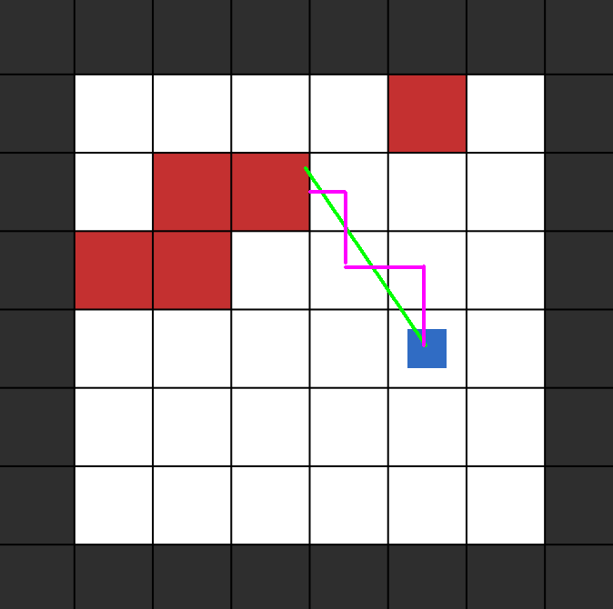
DDA Algorithm
Digital Differential Analyzer
Steps a ray through a tile grid one cell boundary at a time (either in the X or Y direction, whichever is closer)
This stepping continues until the boundary of a non-zero tile is hit.

Slide 4
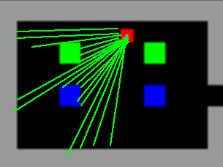
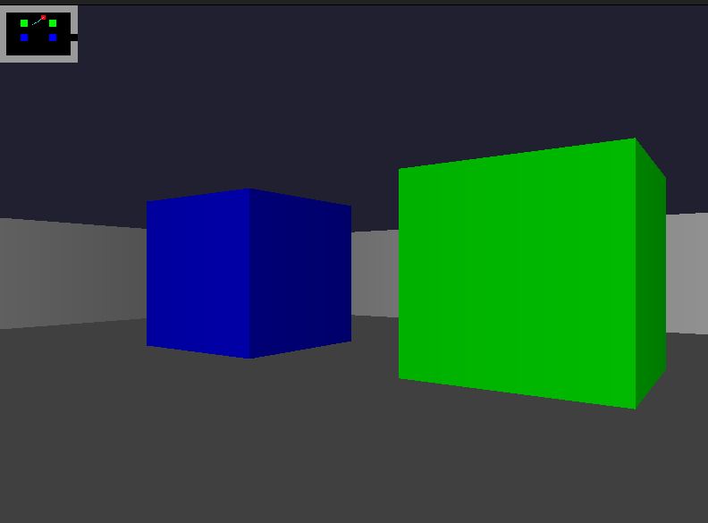
Raycasting in my implementation

Slide 5
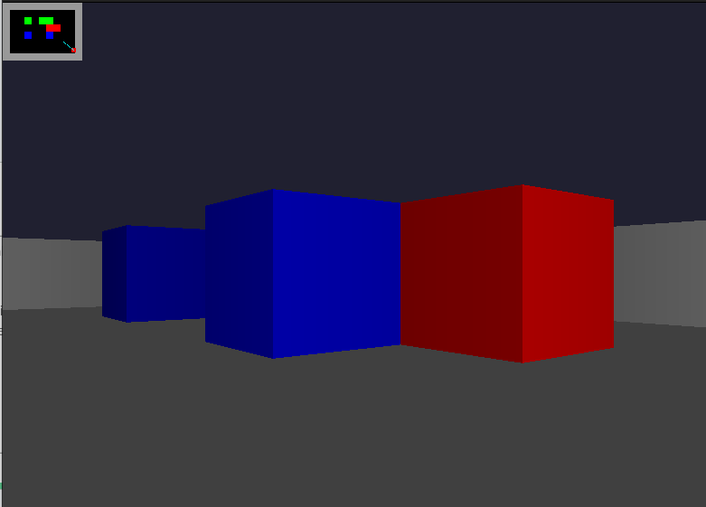
Wall Rendering
Slice height: SCREEN_HEIGHT / wall distance.
Slice color: Taken from tile ID
Slice brightness: Fades based on distance. Additionally, Y-facing walls are slightly darkened.

Slide 6
Cell/Portal Model
Cell A
Cells: Discrete rooms, with 11x8 tile grid Portals: Line segments placed within a cell
Portals store: - Center position & facing angle - Destination cell pointer - Partner portal pointer & midpoint - Rotation angle Based on the Cell and Portal Graph (CPG) model. [1]
Cell B

Slide 7
Portal Ray Traversal
Intersect
Before each DDA step, test ray against all portals in current cell
Remap
If hit, remap position to partner portal midpoint.
Rotate
Rotate ray direction by precomputed rotation rangle
Continue
Resume DDA in destination cell (accumulating distance data)

Slide 8
Portal Rotation/Linking
Rotation angle = B.facingAngle - A.facingAngle + π
Tangent alignment check: - Rotate A’s tangent by rotation angle - If dot product with B’s tangent < 0, flip endpoints This prevents mirrored offset mapping.

Slide 9
Same-Room Portals
Both portals can point to the same cell.
Non-adjacent portals work identically to adjacent portals. - Direct cell pointer, not physical neighbor - Raycaster traverses whatever cell is pointed to Special case: Return-teleport flicker After crossing, the player could immediately re-trigger the partner portal. Fixed by storing previous cell and suppressing crossings

Slide 10
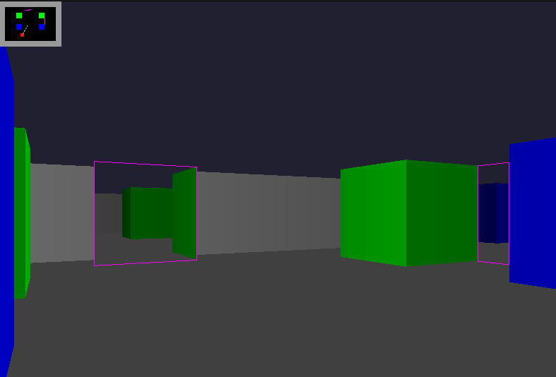
Runtime Portal Editing
Controls: Tab - Cycle selected portal Arrows - Translate portal ,/. - Rotate portal F - Toggle debug overlap After any edit: Rotation angle is recomputed for both linked portals. The endpoint tangent check is re-run. The exit anchor midpoint is updated.

Slide 12
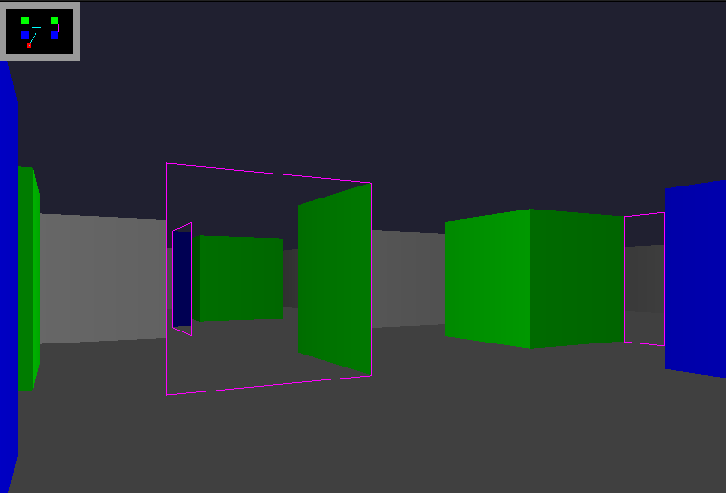

Slide 13
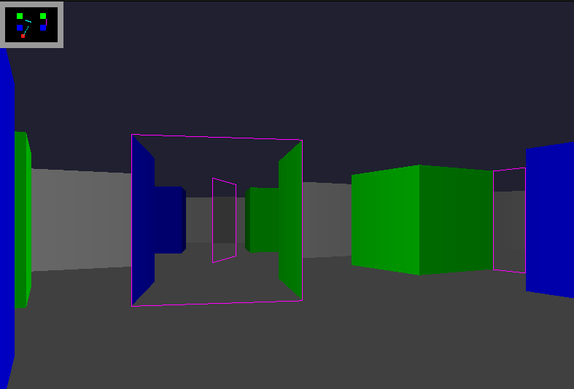

Slide 14
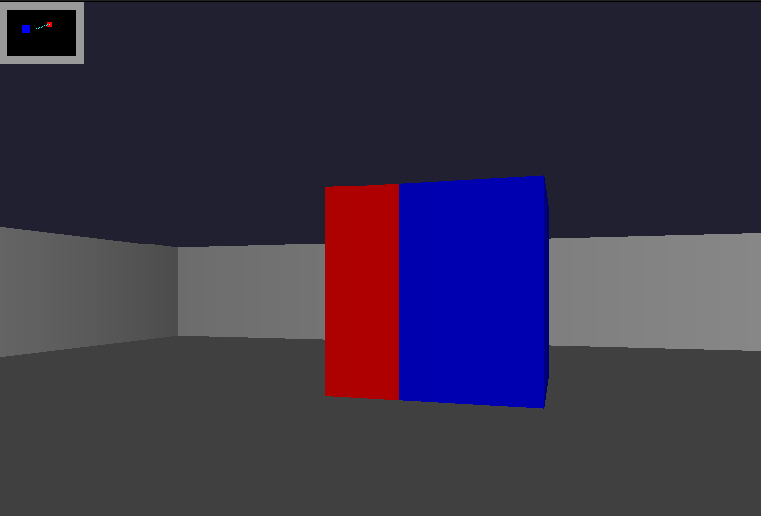

Slide 15


Slide 16
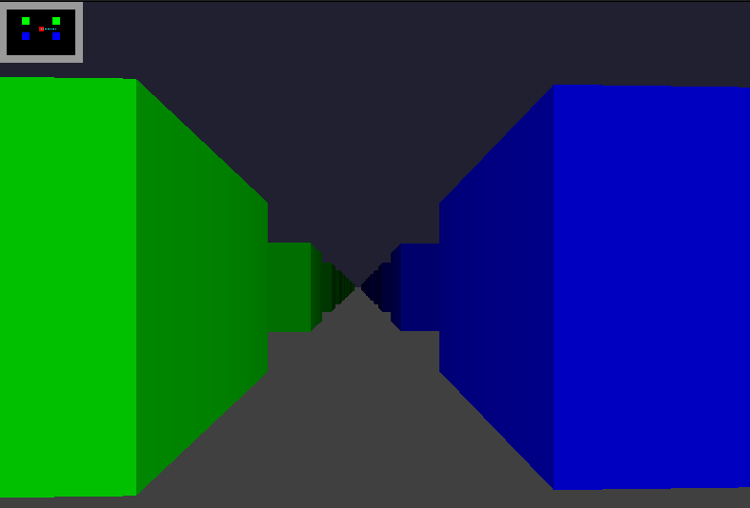

Slide 17
