Slide 1
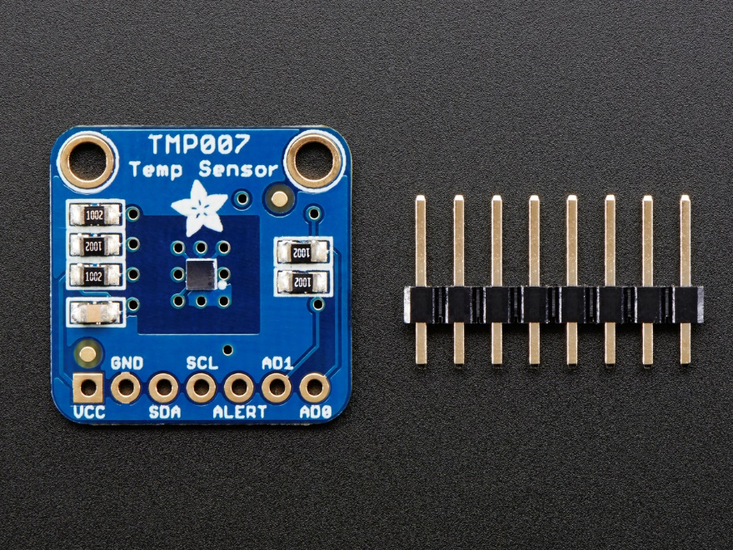
Tmp007 Sensor

Slide 2
Introduction
Purpose of my sensor is to detect the temperature by absorbing IR waves emitted. The embedded sensor generates micro voltage which is a key for calculating temperature. This sensor is useful to calculate average temperature of surroundings. Later in capstone project, this sensor will be useful for our “Fruit Ripening Project”.

Slide 3
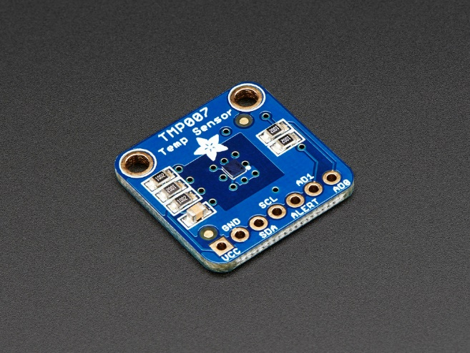
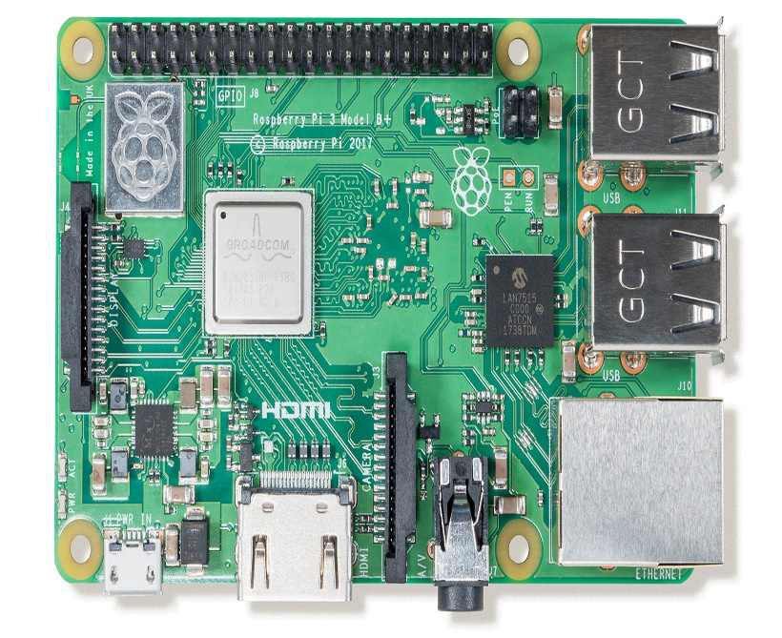
Budget
1st Sensor : $36.14
2nd Sensor (Damaged 1st Sensor) : $42.57
Rpi 3b+ : $89.95
Total: $168.66

Slide 4
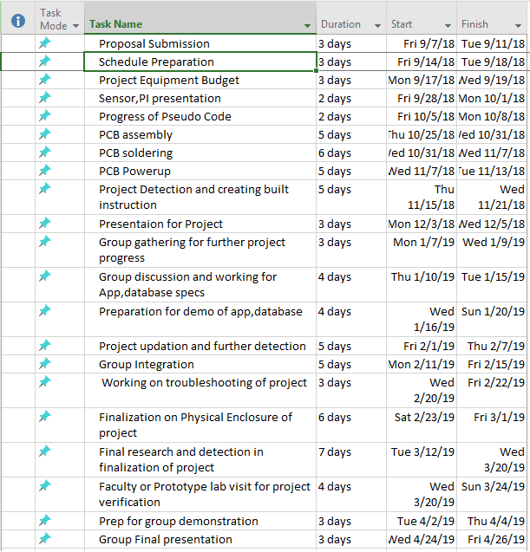
Project Plan

Slide 5
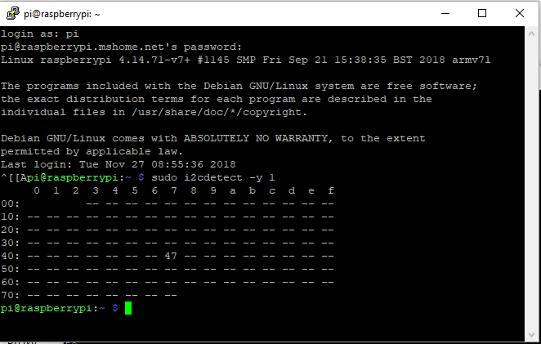
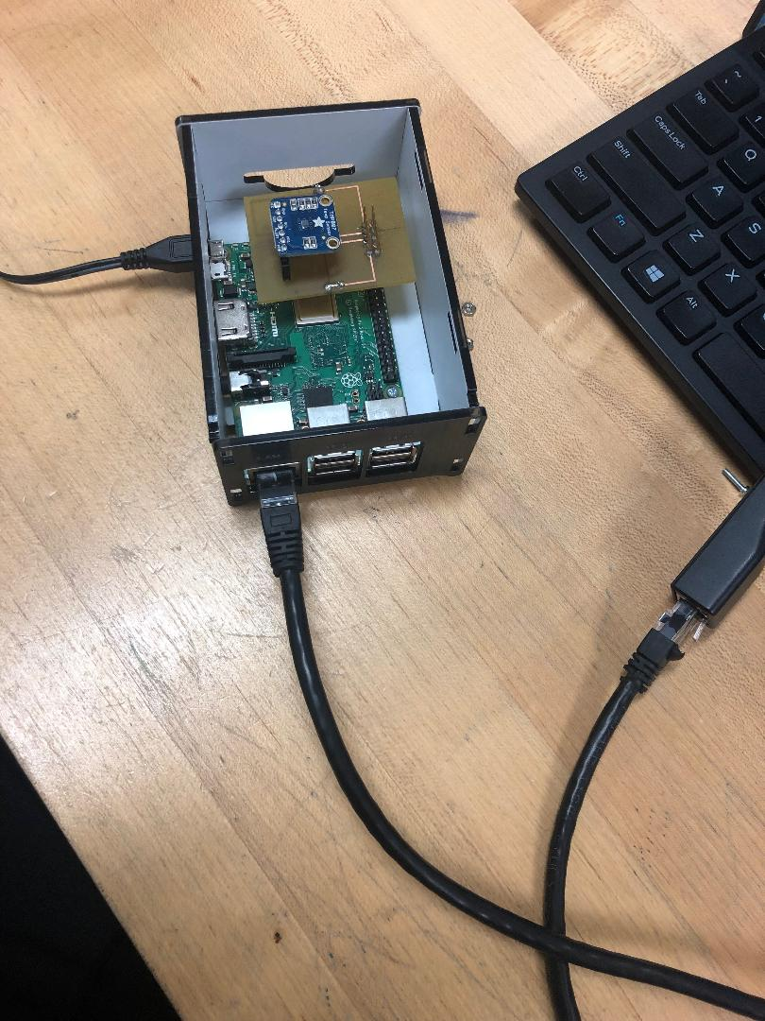
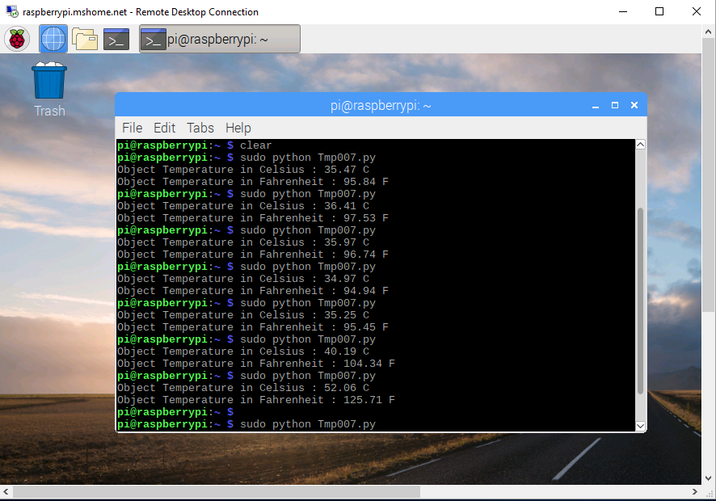
Pictures of Progress!
Address Enclosed Hardware Readings

Slide 6
Course Knowledge
Digital Fundamentals (TECH 103)
Micro Assembly (CENG 209)
Embedded System (CENG 252)
Technical Workplace Writing Skills (WRIT 220)
Introduction to Software Engineering (CENG 216)

