Slide 1
Airflow Controller

Slide 2
A Fan Automation Solution for the Differently Abled
By:-
20BCE0681 Bidwan Rath
20BCE0920 Jay Jajoo
20BCE2641 Aniket Sharma
Under the Guidance of : Dr. Swarnlatha P

Slide 3
Introduction with Requirements
Scope:
The fan used in today’s world is very old fashioned and not that advance. Most human feels the inconvenient about changing the fan speed level, turning it on/off manually when he wants to change. It is very hard for specially-abled people to operate an ordinary fan also. Our proposed project will be helpful in eradicating the following problems –
• Old aged people can easily operate it without much to remember how to use it.
• Specially-abled peoples face a lot of issues to use a fan
Abstract:
Microcontrollers are being developed with the intention of automating various aspects of human existence in order to better the lot of the poor and disadvantaged. Product applications of gesture and motion detection algorithms, such as the 'Gesture-based Fan. Using camera sensors for motion detection, we can determine whether or not there is a human presence in a space. The fan's speed and on/off switch can be controlled by gestures of the hand. There are some human emotions that are better conveyed through physical gestures than through words. The global community is searching for a cutting-edge, low-priced option.

Slide 4
Introduction with Requirements
Objective:
Our project fulfils the objective of creating an affordable Smart Fan which does not need any remote control, rather it works on the principles of Hand Gesture Recognition and Motion Detection. Following are some of the objectives –
• To recognize fingers in the environment.
• Detecting special gestures for turning on/off.
• Detecting the presence of person in the room whether the person is present or not.
• Counting the fingers so that the speed of the fan can be changed.

Slide 5
Introduction with Requirements
Requirement Specification:
A possible set of requirement specifications for the proposed system is,
Hardware Requirement
Arduino Board
Connection wires
5V Fan
2G RAM
Software Requirement
Python environment
Port Manager
VS CODE
Arduino IDE

Slide 6
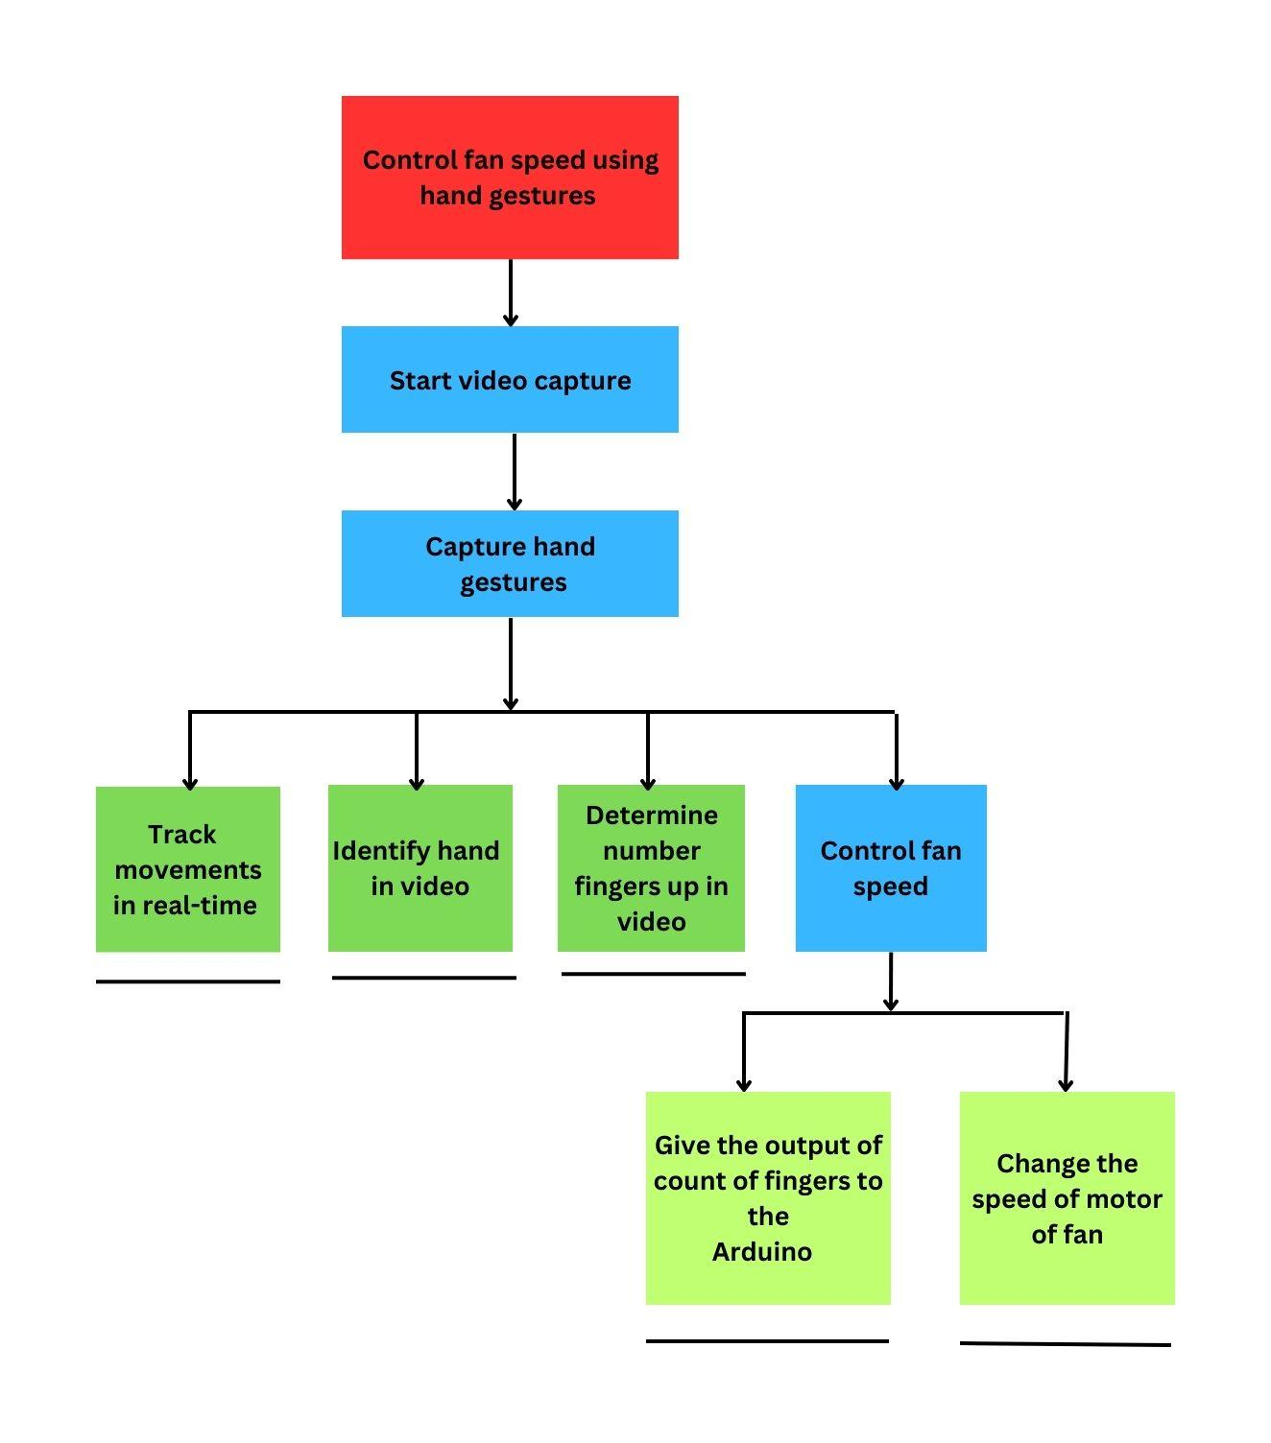
Design Specifications
HTA:

Slide 7
Design Specifications
Interaction Design:
The possible terms for the proposed system is,
Inclusive interaction design for fan automation solution for disabled
User-centered design for fan automation control for differently abled
Accessibility fan control interface design for disabled
Stakeholder Identification:
Classification of the stakeholders for the "Fan speed controller using hand gestures" project into primary, secondary, and tertiary categories:
Primary stakeholders:
End users, Developers
These stakeholders are directly involved in the development and use of the system, and their needs and requirements should be given the highest priority.

Slide 8
Design Specifications
Stakeholder Identification:
Secondary stakeholders:
Project managers, Quality assurance team, Investors, Suppliers, Regulators, Service providers, Marketing team
These stakeholders are indirectly involved in the development and use of the system, and their needs and requirements should also be taken into account. They may have an impact on the success or failure of the project and should be considered when making decisions.
Tertiary stakeholders:
Competitors, Partners, Other members of the community
These stakeholders are not directly involved in the development and use of the system, but they may be impacted by the project in some way. Their needs and requirements should also be considered, but to a lesser extent than primary and secondary stakeholders

Slide 9
Design Specifications
Storyboarding:
Panel 1: A person with limited mobility is sitting in a room, trying to adjust the fan speed using a traditional fan controller that is difficult for them to use.
Panel 2: The person sees a laptop with a camera and comes up with an idea to use hand gestures to control the fan, which would be easier for them to do.
Panel 3: The person starts researching and experimenting with different computer vision libraries and gesture recognition algorithms that are tailored to their unique needs.
Panel 4: The person settles on using the Mediapipe and OpenCV libraries to detect hand gestures in real-time, and modifies the gesture recognition algorithm to suit their specific hand movements.
Panel 5: The person connects an Arduino board to the laptop and writes a code to control the fan speed based on the detected hand gesture.
Panel 6: The person tests the system and successfully controls the fan speed using hand gestures, feeling empowered by the ability to control their environment independently.

Slide 10
Design Specifications
Storyboarding:
Panel 7: The person decides to share the system with others who have limited mobility or other disabilities that make traditional fan controllers difficult to use.
Panel 8: The system gains popularity among the differently abled community, and the person receives positive feedback from users who find it easy and intuitive to use.
Panel 9: The person continues to improve the system, adding features such as customizable gestures and voice control to make it even more accessible and convenient for users.
Panel 10: The project inspires others to develop similar assistive technologies that leverage the power of computer vision and gesture recognition to empower the differently abled community.

Slide 11
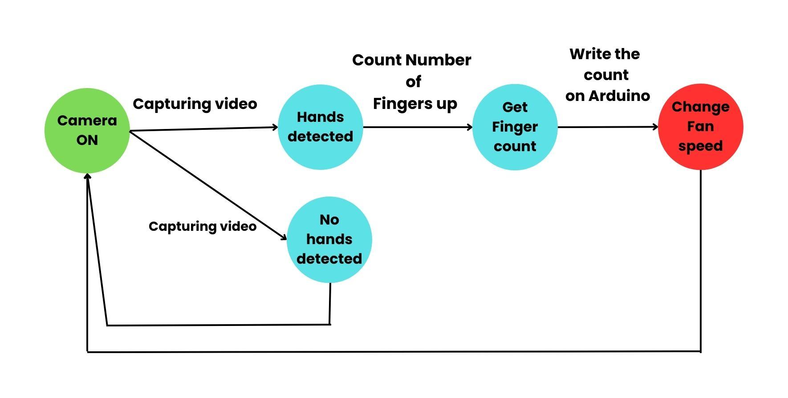
Design Specifications
State Transition Network:

Slide 12
Apply of Guidelines/Principles
Schneiderman's Heuristic Evaluation:
Visibility of system status: The system always keep the user informed about what is going on, through appropriate feedback within a reasonable amount of time. In the given project, the user receive feedback on the fan speed being controlled based on their hand gestures.
Match between system and the real world: The system speak the user's language, with words, phrases, and concepts familiar to the user. In this project, the hand gestures required to control the fan is intuitive and easy for users to understand.
User control and freedom: The system allow users to easily undo and redo actions and provide clear exit points for each step of the interaction. In this project, the users are able to easily adjust the fan speed according to their preferences.
Consistency and standards: The system follows established conventions and standards to provide a consistent user experience. In this project, the hand gestures used to control the fan is consistent with commonly used hand gestures.
Error prevention: The system id designed to prevent errors from occurring in the first place, through careful design and error prevention techniques. In this project, its able to detect and correct errors, such as misinterpreting the user's hand gestures.

Slide 13
Apply of Guidelines/Principles
Norman’s Heuristic Evaluation:
Visibility: The system make all necessary functions visible, without distracting the user with irrelevant information. In this project, the user are be able to clearly see the fan speed being controlled based on their hand gestures.
Feedback: The system provide feedback to the user in a timely and appropriate manner. In this project, the system is able to provide immediate feedback to the user about the fan speed being controlled.
Constraints: The system constrain the user's actions to prevent them from making errors. In this project, the system prevent the user from accidentally changing the fan speed to an unintended level.
Mapping: The system have a clear mapping between the user's actions and the system's response. In this project, the hand gestures used to control the fan should have a clear and consistent mapping to the fan speed.
Consistency: The system have a consistent and predictable interface. In this project, the hand gestures used to control the fan should be consistent with commonly used hand gestures.

Slide 14
Apply of Guidelines/Principles
Nielsen’s Heuristic Evaluation:
Visibility of system status: The system always keep the user informed about what is going on, through appropriate feedback within a reasonable amount of time. In this project, the user should receive feedback on the fan speed being controlled based on their hand gestures.
User control and freedom: The system allow users to easily undo and redo actions and provide clear exit points for each step of the interaction. In this project, the user are able to easily adjust the fan speed according to their preferences.
Consistency and standards: The system follow established conventions and standards to provide a consistent user experience. In this project, the hand gestures used to control the fan should be consistent with commonly used hand gestures.
Error prevention: The system is designed to prevent errors from occurring in the first place, through careful design and error prevention techniques. In this project, the system is able to detect and correct errors, such as misinterpreting the user's hand gestures.
Recognition rather than recall: The system minimize the user's memory load by making objects, actions, and options visible. In this project, the hand gestures used to control the fan is intuitive and easy for users to remember.

Slide 15
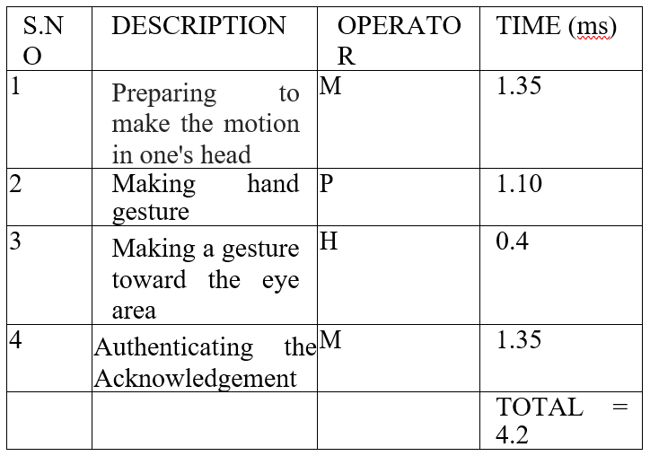
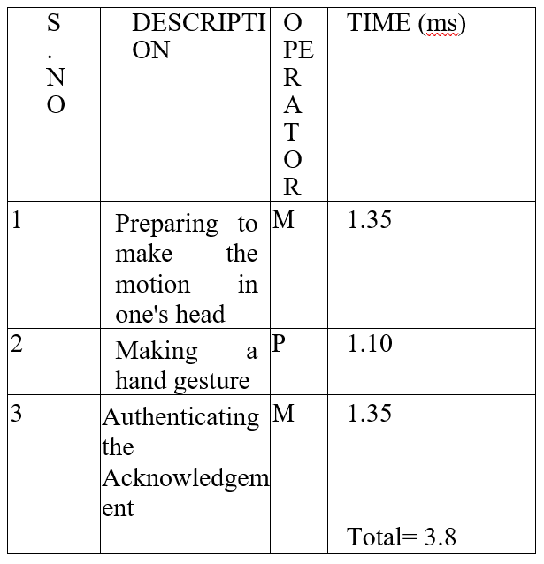
Apply of Guidelines/Principles
KLM: Outside the visual area Inside the visual area

Slide 16
GOMS:
Method for goal: Preparing to make the motion in one's head
Step 1. You pick the move..
Step 2. Come back when you're done.
Method for goal: Making hand gesture
Step 1. Direct the gesture at the eyes.
Step 2. Come back when you're done.
Method for goal: Making a gesture toward the eyes
Step 1. Put your gestured hand camera see it.
Step 2. Come back when you're done.
Method for goal: Authenticating the Acknowledgement
Step 1. Verify the Recognition.
Step 2. Come back when you're done.

Slide 17
Apply of Guidelines/Principles
GOMS:
Method for goal: Preparing to make the motion in one's head
Step 1. You pick the move..
Step 2. Come back when you're done.
Method for goal: Making hand gesture
Step 1. Direct the gesture at the eyes.
Step 2. Come back when you're done.
Method for goal: Making a gesture toward the eyes
Step 1. Put your gestured hand camera see it.
Step 2. Come back when you're done.
Method for goal: Authenticating the Acknowledgement
Step 1. Verify the Recognition.
Step 2. Come back when you're done.
Method for goal: Making a gesture toward the eyes
Step 1 Direct the gesture toward the eyes.
Step 2. Come back when you're done.
Method for goal: Preparing to make the motion in one's head
Step 1. Pick the hand signal.
Step 2. Come back when you're done.
Method for goal:Making a hand gesture
Step 1. Aim the gesture right at their camera.
Step 2. Come back when you're done.
Method for goal: Authenticating the Acknowledgement
Step 1. Authenticating the Acknowledgement
Step 2. Come back when you're done..

Slide 18
Communication, Collaboration and Groupware
For the "Fan speed controller using hand gestures for differently abled" project, we needed to communicate and collaborate effectively among ourselves as the project team, as well as with the users and caregivers. We used various groupware tools to support these activities and facilitate effective collaboration.
To manage our tasks, assign responsibilities, and track progress, we used project management tools such as Asana, Trello, or Jira. We also used communication tools such as Slack or Microsoft Teams to communicate with each other and with the users and caregivers.
To collaborate on designing, developing, and testing the system, we used design collaboration tools such as Figma or Adobe XD to create and iterate on the user interface design. We also used version control tools such as Git to manage code changes and collaborate on development. To test the system with users and caregivers, we used remote collaboration tools such as Zoom or Google Meet to conduct user testing sessions.
Since the system needed to be accessible to users with different abilities, we collaborated with accessibility experts and users with disabilities to ensure that the system is fully accessible and meets their needs. We used accessibility testing tools such as Axe or WebAIM to identify and fix accessibility issues.
Overall, communication and collaboration were critical for the success of the "Fan speed controller using hand gestures for differently abled" project, and the groupware tools we used were essential in facilitating effective collaboration among stakeholders.

Slide 19
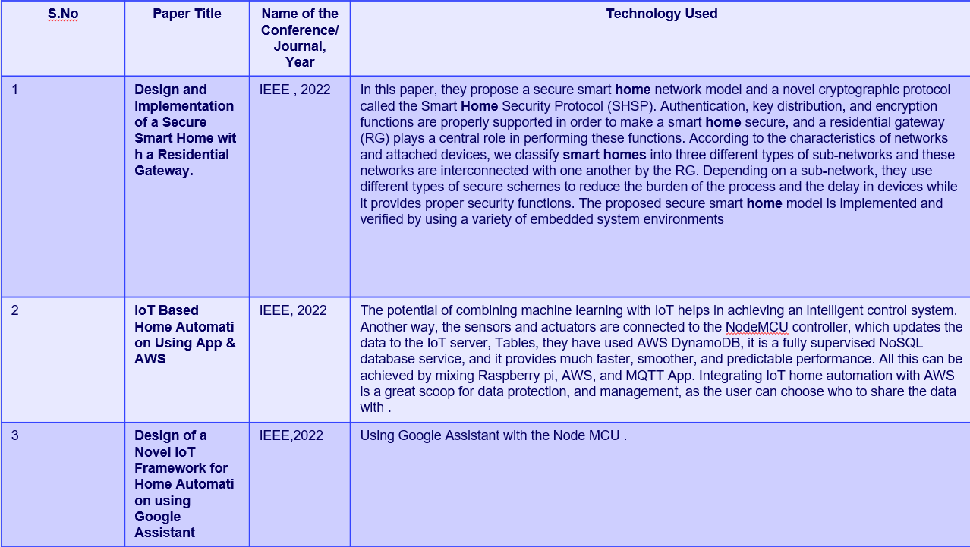
Implementation
Survey

Slide 20
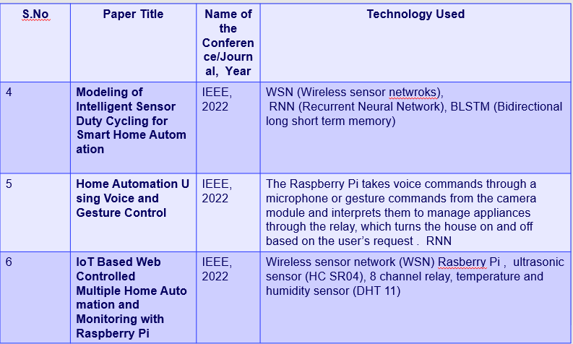
Implementation - Survey

Slide 21
Implementation
Inference from Survey
⬡A. Design and Implementation of a Secure Smart Home with a Residential Gateway For Secure Smart Home, the response time can be improved.
⬡B. Design of a Novel IoT Framework for Home Automation using Google Assistant , An inadequate network connection may be the reason something does not work. Those who are unable to pay the monthly Wi-Fi expenses cannot purchase these items.
⬡C. Modeling of Intelligent Sensor Duty Cycling for Smart Home Automation This does not work with datasets made up of ADLs of more than two residents, such as those from smart cities and buildings.
⬡D. IoT Based Home Automation Using App & AWS Automated Home can be problematic as it might produce false positives.
⬡E. Automized Gesture Controlled Switch The usage is limited to Switch ON and Switch OFF Functionalities. Limited Range (7) of commands.
⬡F. Smart Home Automation for Differently Abled Person using Controller and IoT This device will not be of much use for people who have a difficulty in speaking or certain speech related disorders.
⬡G. Intelligent Home Automation System for Disabled People The range of PIR sensor is 5 meters. The device will not function if the user is further apart from the sensor. And, the camera fails to capture image if the surroundings are dimly lit.
⬡H. Hand Gesture Based Home Automation System for Physically Challenged Humans This system is not feasible when the user has a disability where they cannot move their hand.
⬡I. Smart Home Automation System for Elderly and Handicapped People Using Mobile Phone This project is based on a mobile application and thus if someone doesn’t own a mobile or if they are not familiar with mobile applications, they cannot use it.
J. Home Automation System for People with Visual and Motor Disabilities in Colombia This system is based on a smartphone which makes it difficult to use for people unfamiliar with phone applications and for those who cannot purchase a smartphone.

Slide 22
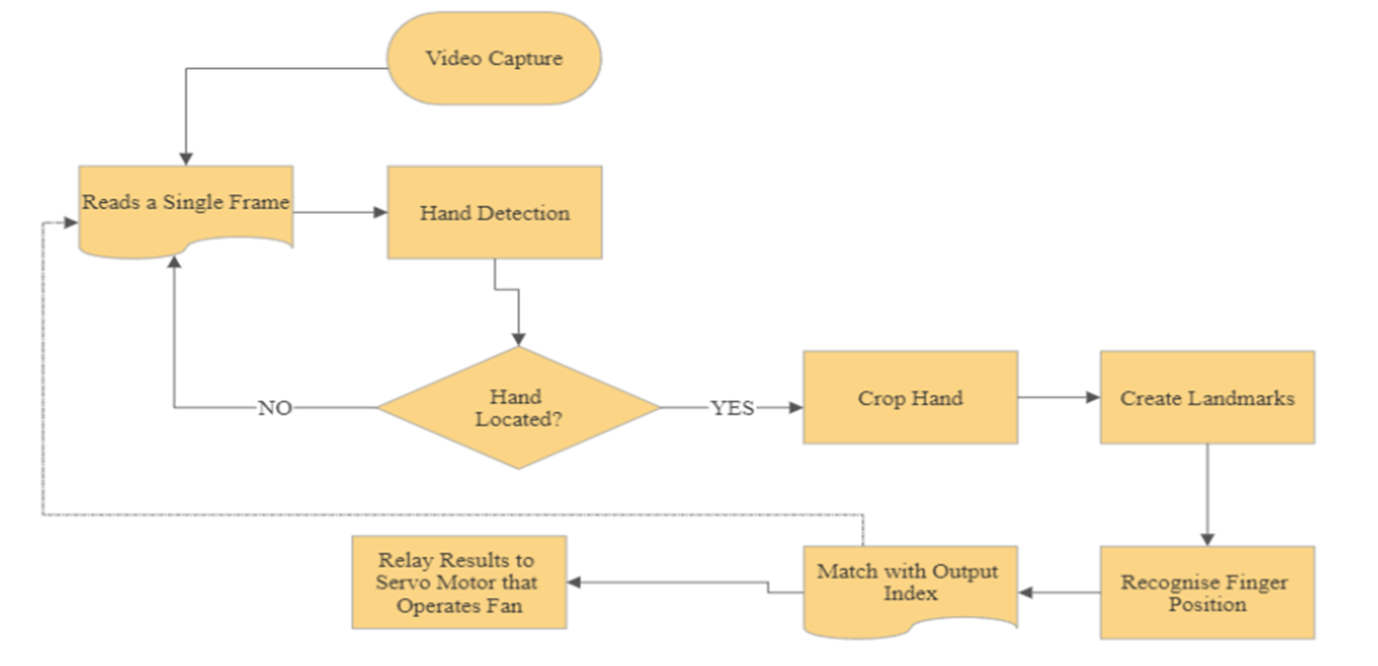
FlowChart Diagram of the System:

Slide 23
Working
Our approach prioritizes both products and equity. The preceding figure 1 depicts the process flow of our project. Those with limited mobility or who are elderly will have difficulty operating the equipment. However, our suggested paradigm shift will eliminate the need to deal with this issue in the future. Normally, turning on a fan requires either locating the remote or getting out of bed to flip the switch. This method of switching cannot be taken anywhere. But remotes can be carried about easily. The overuse of remote controls is a problem that has to be addressed. As a result, we propose a novel method of operating the fans via hand gestures, in which the user indicates his intention to do so by pointing his hands towards the camera and making various finger patterns that may be recognized by computer vision. The model's recognition capabilities are constrained to reduce the possibility of misinterpretation and guarantee that the fan's speed will not be adjusted in response to an inaccurately captured finger pattern. The model automatically creates a response whenever a pattern is recognized. The Arduino runs the code that controls the fan motor.

Slide 24
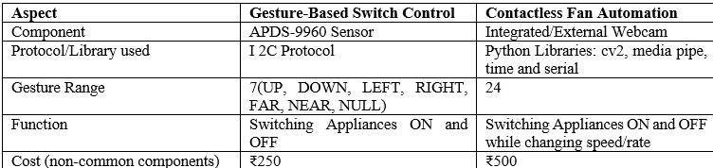
Implementation
Comparison
As presented by the comparative analysis in Table , the contactless fan is superior due to wider range of gestures recognized. Due to the same and added functionality of ‘rate-control’ it has a wider range of application in fan-operation and ultimately, home-automation

Slide 25
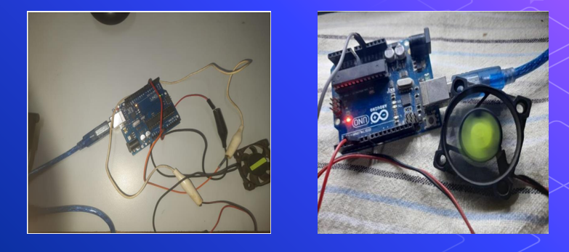
Implementation
Demo

Slide 26
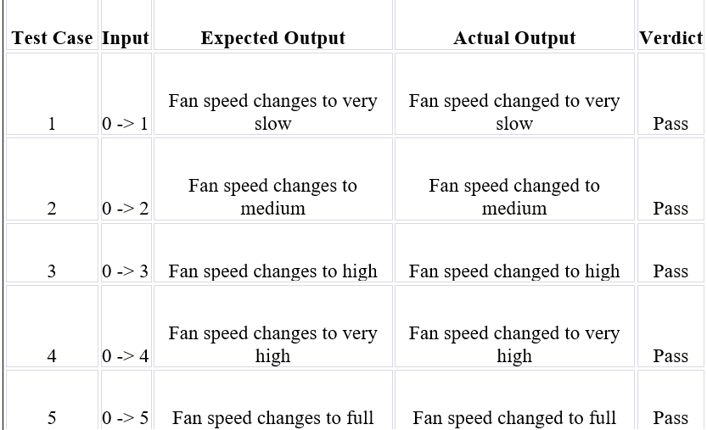
TESTING
Usability Testing

Slide 27
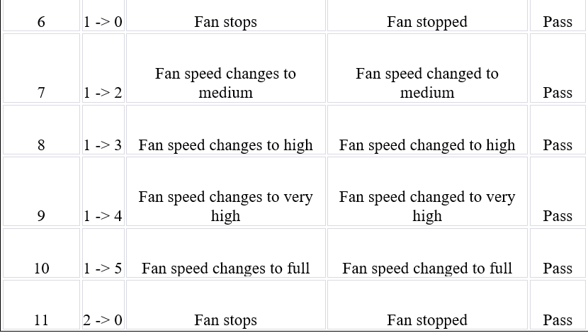
TESTING
Usability Testing

Slide 28
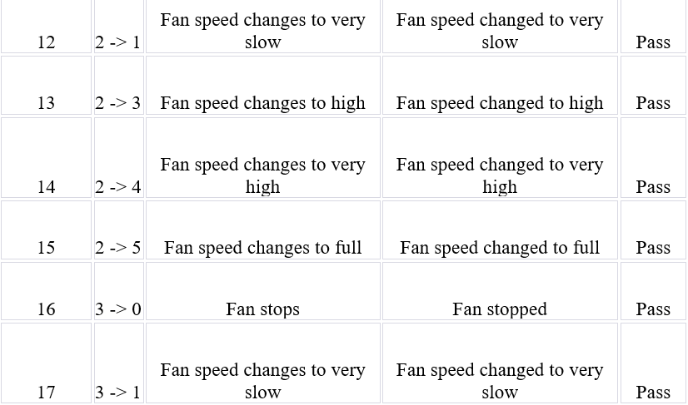
TESTING
Usability Testing

Slide 29
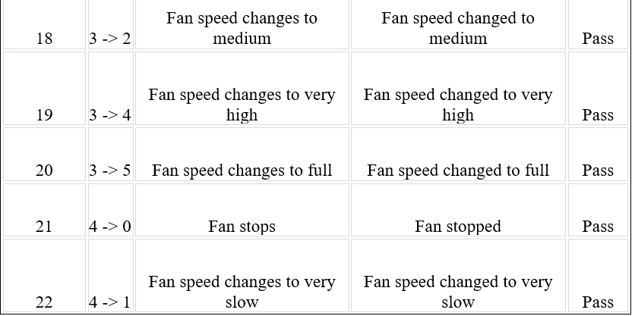
TESTING
Usability Testing

Slide 30
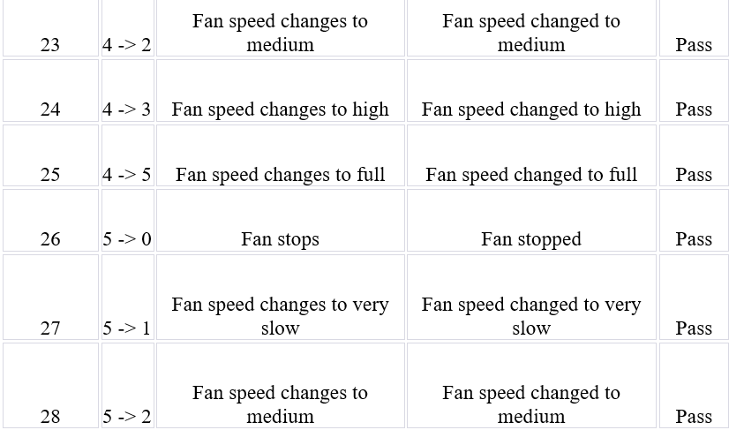
TESTING
Usability Testing

Slide 31
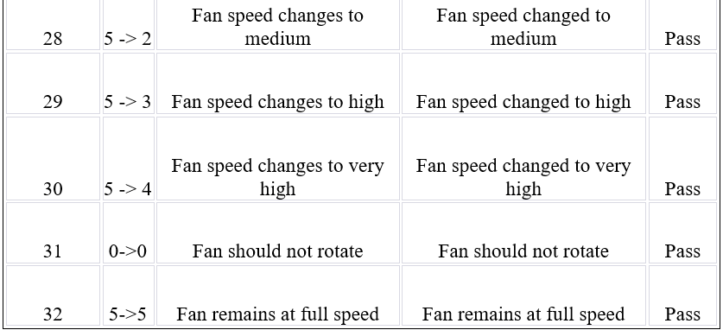
TESTING
Usability Testing

Slide 32
TESTING
Usability Testing
Based on the test cases performed, it can be concluded that the project is functioning as expected. All the expected outputs matched with the actual outputs for all the test cases performed. It is safe to say that the system is reliable and efficient in controlling the fan speed through hand gestures

Slide 33
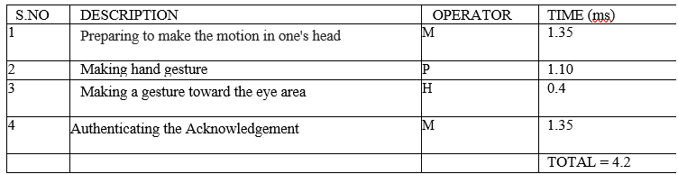
RESULTS AND DISCUSSION
A. MAKE A MOVE BEYOND FIELD OF VIEW
1) MODEL HUMAN PROCESSOR
Total Time = Tp + Tc +Tm=100+(5+1)70+70=590ms
2) KEYBOARD LEVEL MODEL:

Slide 34
RESULTS AND DISCUSSION
3) GOMS ANALYSIS -
Method for goal: Preparing to make the motion in one's head
Step 1. You pick the move..
Step 2. Come back when you're done.
Method for goal: Making hand gesture
Step 1. Direct the gesture at the eyes.
Step 2. Come back when you're done.
Method for goal: Making a gesture toward the eyes
Step 1. Put your gestured hand camera see it.
Step 2. Come back when you're done.
Method for goal: Authenticating the Acknowledgement
Step 1. Verify the Recognition.
Step 2. Come back when you're done.

Slide 35
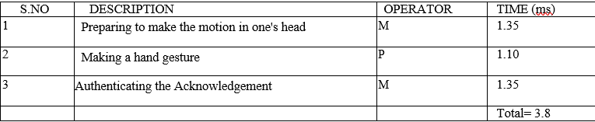
RESULTS AND DISCUSSION
B. MAKE A MOVE IN SIGHTLINE
1) MODEL HUMAN PROCESSOR
Total Time = Tp + Tc + Tm=100+(5)70+70=520ms
2) KEYBOARD LEVEL MODEL:

Slide 36
RESULTS AND DISCUSSION
3) GOMS ANALYSIS-
i. Method for goal: Making a gesture toward the eyes
Step 1 Direct the gesture toward the eyes.
Step 2. Come back when you're done.
ii. Method for goal: Preparing to make the motion in one's head
Step 1. Pick the hand signal.
Step 2. Come back when you're done.
iii. Method for goal:
Making a hand gesture
Step 1. Aim the gesture right at their camera.
Step 2. Come back when you're done.
iv. Method for goal: Authenticating the Acknowledgement
Step 1. Authenticating the Acknowledgement
Step 2. Come back when you're done..

Slide 37
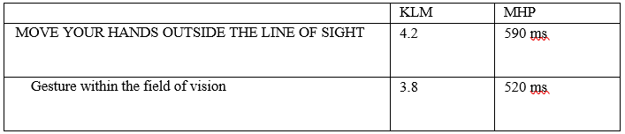
RESULTS AND DISCUSSION
COMPARISON

Slide 38
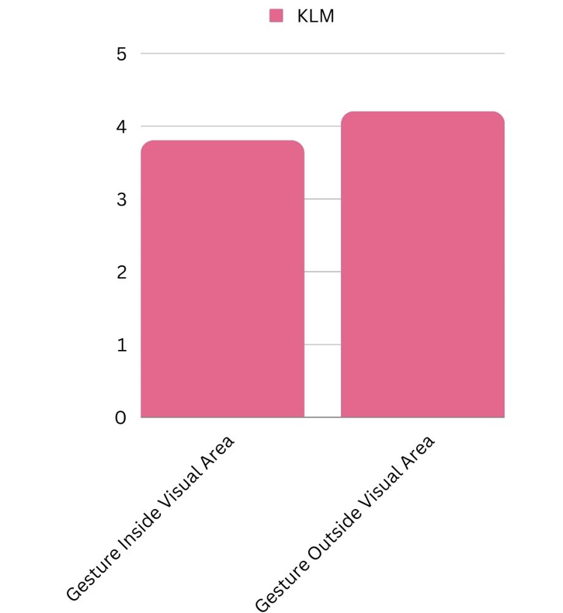
RESULTS AND DISCUSSION
GRAPH GENERATION

Slide 39
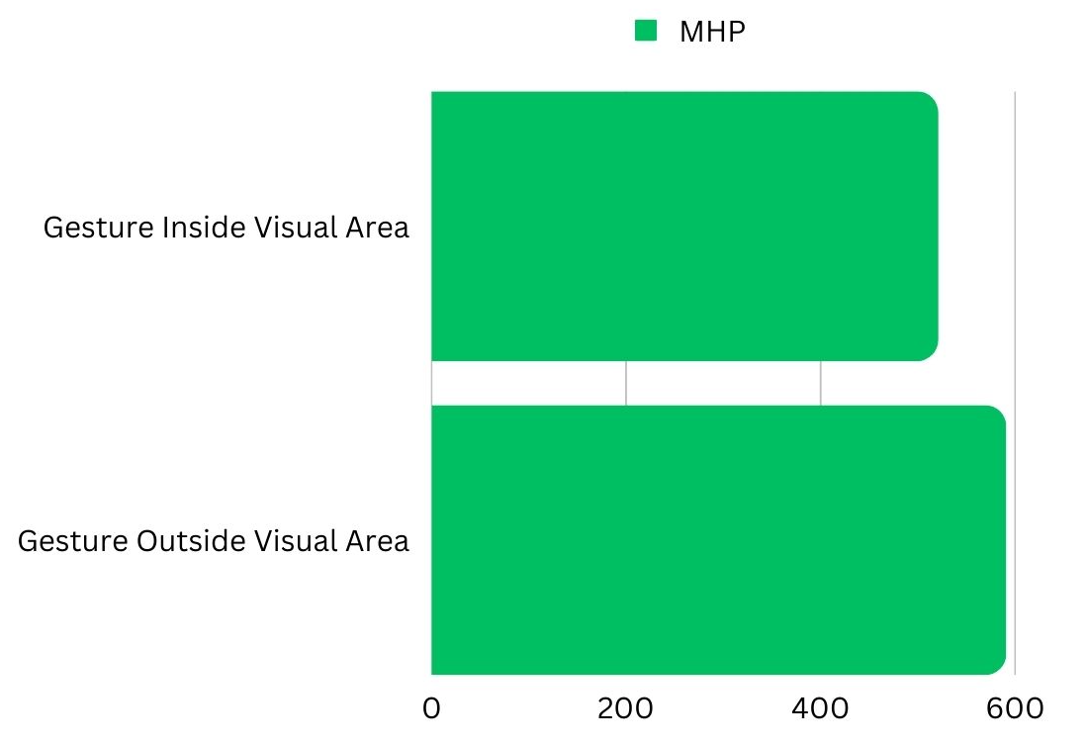
RESULTS AND DISCUSSION
GRAPH GENERATION

Slide 40
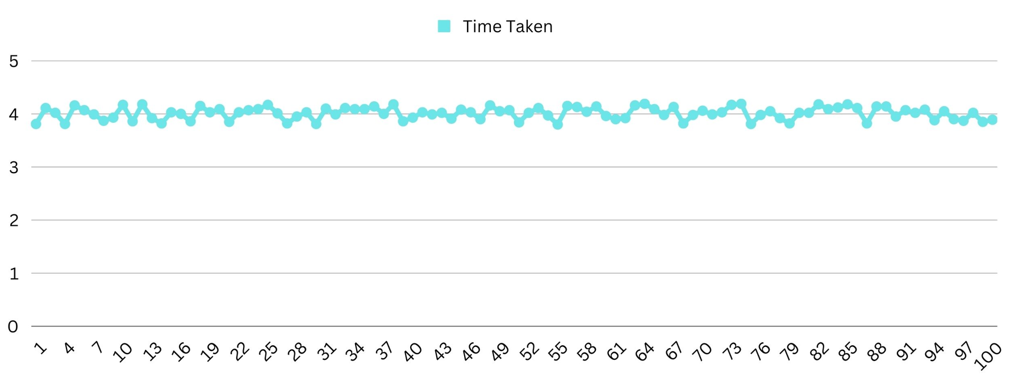
RESULTS AND DISCUSSION
GRAPH GENERATION

Slide 41
CONCLUSION
The 'Gesture-Based Fan' recognizes hand gestures to function without a remote and adapt to its user's preferences. The camera detects the user's hand movements and uses image recognition to translate that into commands for the fan. This idea project designed a automated fan based on the Arduino platform, which can be operated by human motion and would thus be usable by people of varying ages and abilities.
Without having to appear on camera, we can control the fan with a custom-made app on our mobile devices. This kind of technology might be used to improve a wide variety of household products, including lights, fans, and even smart-gas hob regulators.

Slide 42
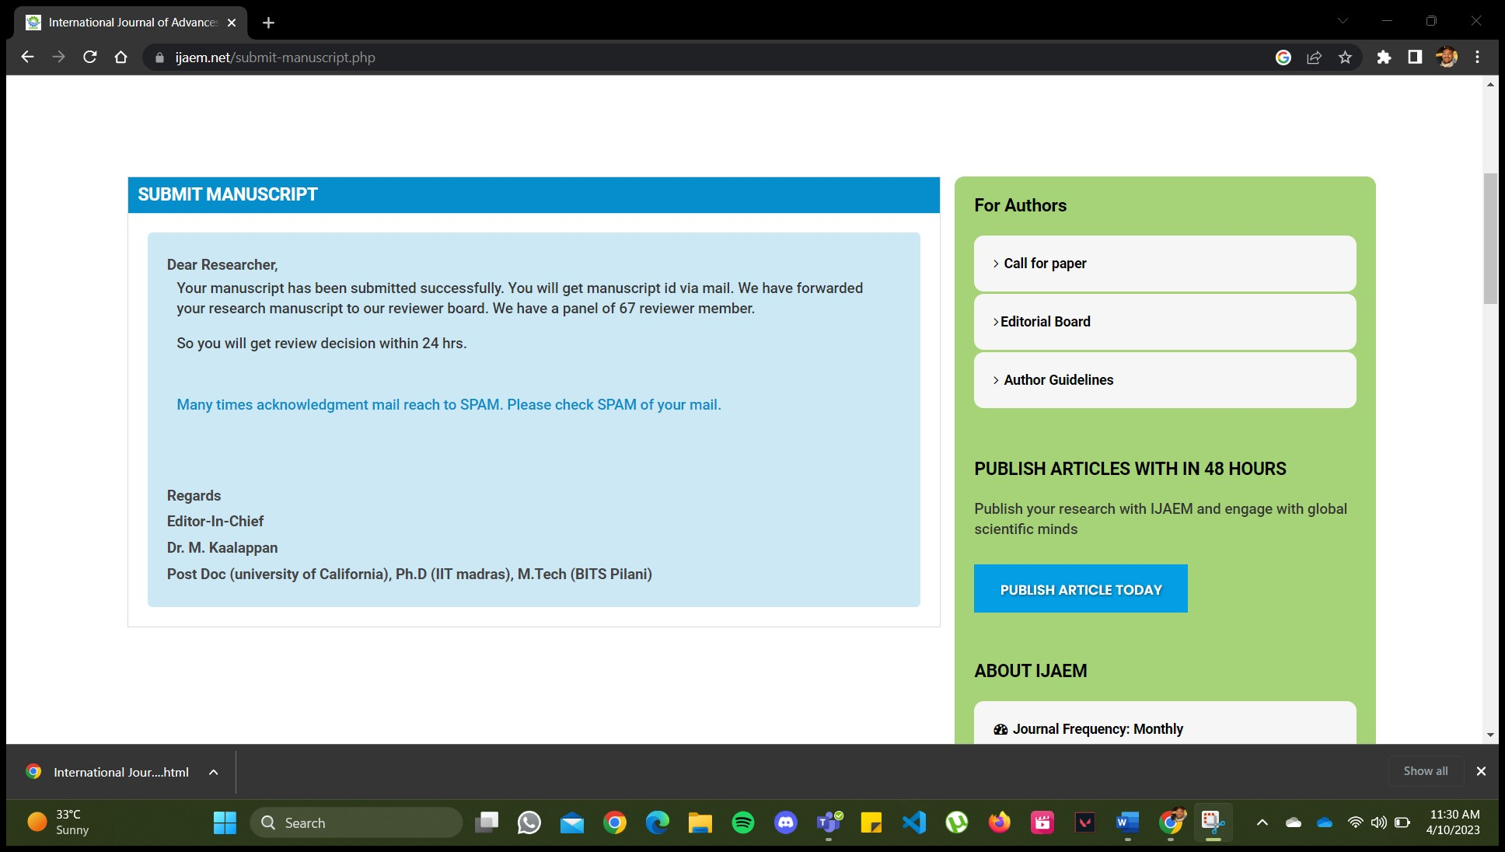
PAPER STATUS
Paper Submitted: (Mail sent to Course Faculty )

Slide 43


