Slide 1


Pothole Detection System
Vivekananda Education Society’s Institute of Technology, Computer Department
The Newcomers
Prem Chhabria
Prasad Govekar
Jay Jhaveri
06 March 2020

Slide 2
Abstract.
Potholes are the most common form of distress while driving, leading to numerous accidents every year( 10 deaths/ day)
We are proposing a YOLO(deep learning) based project to cheaply and efficiently report these potholes directly to the concerned authorities with the required information.
People will be able to install this software on their car dashcams, mobile phones and pc hassle free.
06 March 2020

Slide 3
Proposed Architecture/Diagram
Image Conversion
BGR img -> Gray scale.
Gray scale -> Binary Image //explain
Open CV
Extract the potholes using YOLO, then by “grab cut”.
Find the centroid and Area of the cut.
Using basic 2D to 3D conversion of matplot we try to predict the visible depth
Matplot 3D
Find moments -> From Centroid -> Find Area.
06 March 2020
Notes:
Open cv . countourArea()
Open cv moments()

Slide 4
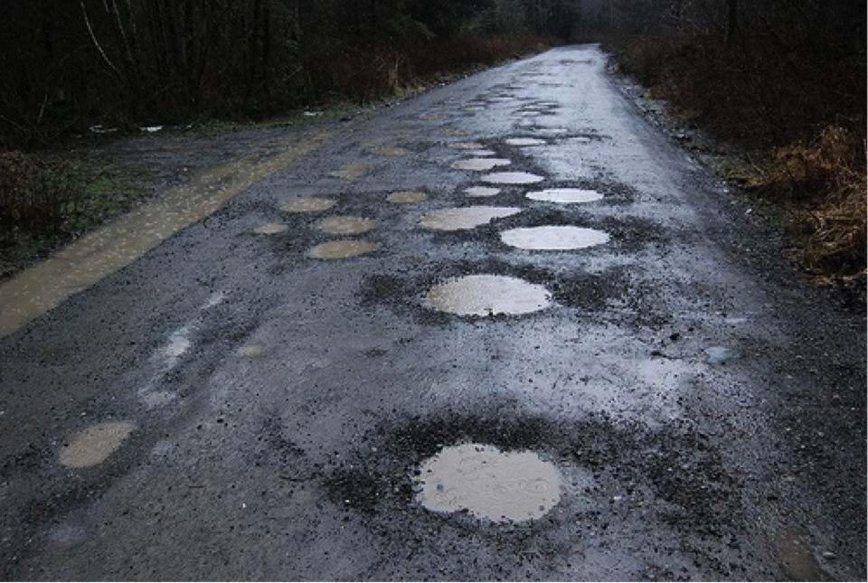
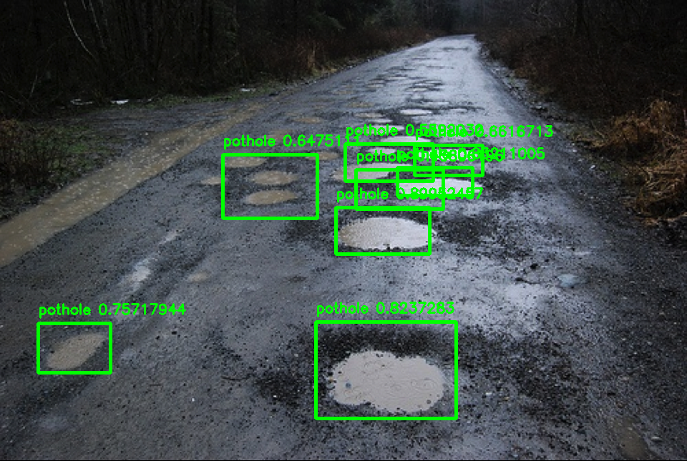
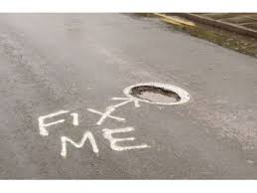
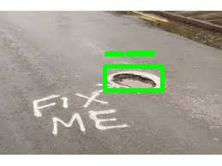
Some Examples

Slide 5
Technology Stack
Python (3.7)
Tensorflow-gpu 1.14
Yolo – v2
Google colab
Opencv-python – 4.0
06 March 2020

Slide 6
Conclusion
This, if implemented correctly and efficiently will lead to pothole ERADICTION from India.
It will in turn also decrease lethal traffic accidents by 2.5%(directly due to potholes) and by 17%( Indirectly due to potholes).

Slide 7
Thank You :)

