Slide 1
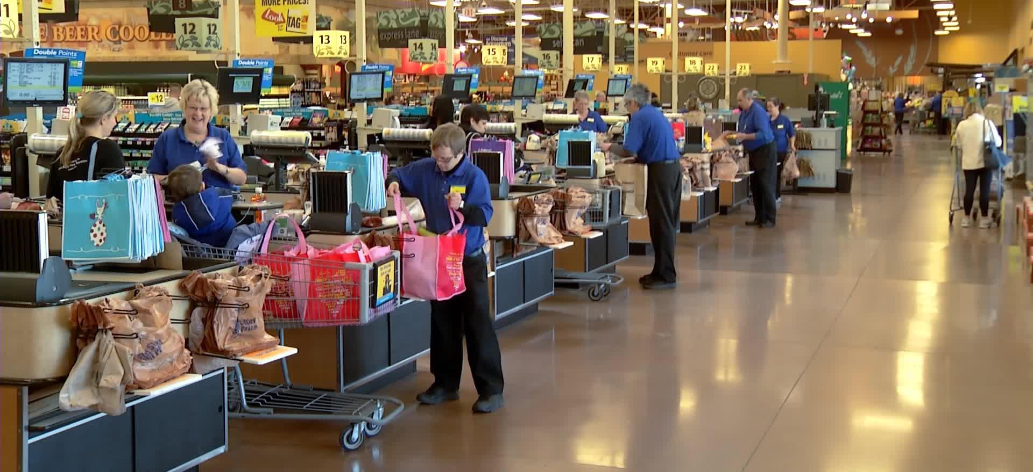
Previously @ the supermarket

Slide 2
Group 7
Sherwin Lau
Lee Joo Chuen
Chow Wong Chong
Ong Jing Jie
Evelyn Ng
Notes:
https://upload.wikimedia.org/wikipedia/commons/thumb/b/b7/MasterCard_Logo.svg/2000px-MasterCard_Logo.svg.png
https://gavi.nl/media/wysiwyg/visa-logo-high-resolution.jpg

Slide 3
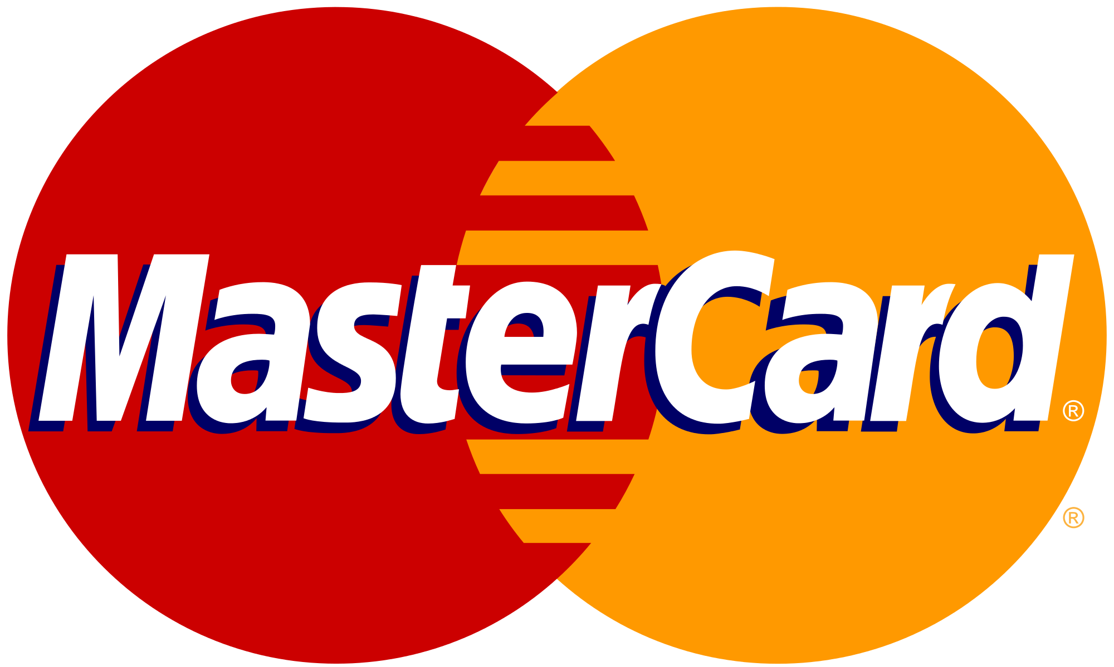
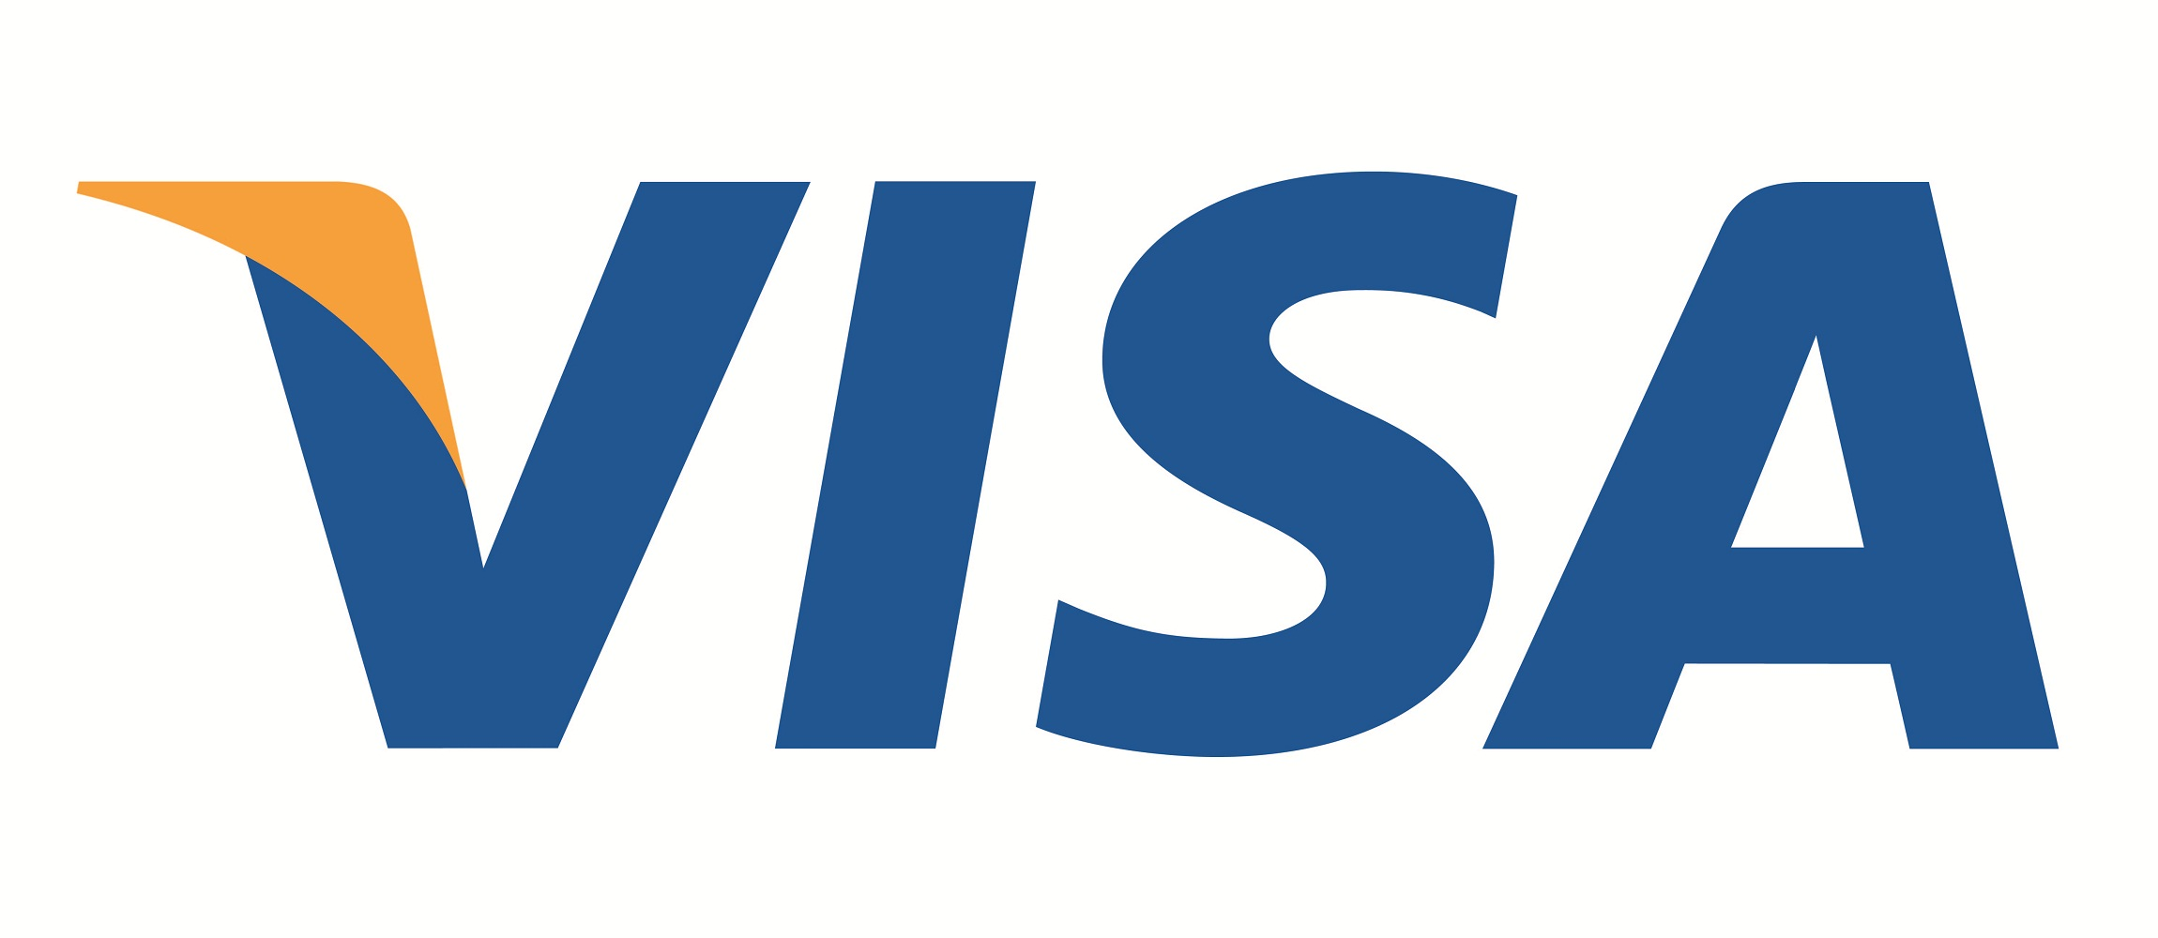
vs.
Ratio Analysis
Notes:
https://upload.wikimedia.org/wikipedia/commons/thumb/b/b7/MasterCard_Logo.svg/2000px-MasterCard_Logo.svg.png
https://gavi.nl/media/wysiwyg/visa-logo-high-resolution.jpg

Slide 4
Mastercard vs. Visa
Both payment systems, not credit cards in themselves
No significant differences
Only underlying difference between credit cards are the perks, choosing the right card network comes down to what the customer values most.

Slide 5
Mastercard vs. Visa
No. of countries | 210 | 200
Founding year | 1966 | 1970
Market capitalization | 97 billion | 168 billion
Enterprise value | 93 billion | 164 billion
Stock Price (200-Day Moving Average) | 93.13 | 74.33
Tiers of benefits | 3 | 2

Slide 6
What causes the difference between the stock prices of the two companies?

Slide 7
Return on Equity

Slide 8
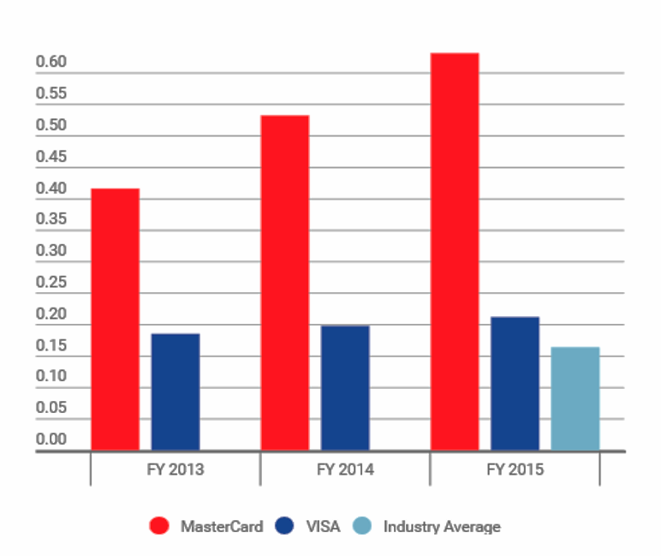
Return on Equity
Measure of how much profits a company generates with the money shareholders have invested
Net income
Return on Equity =
Stockholder’s Equity
Mastercard’s ratio is higher because they are generating more profits with shareholders money and have lower shareholders equity.
Mastercard repurchased $3.5 and $3.75 billion worth of shares in 2014 and 2015 respectively.
Notes:
First point to be revealed later in the slides

Slide 9
Earnings-per-share (EPS)

Slide 10
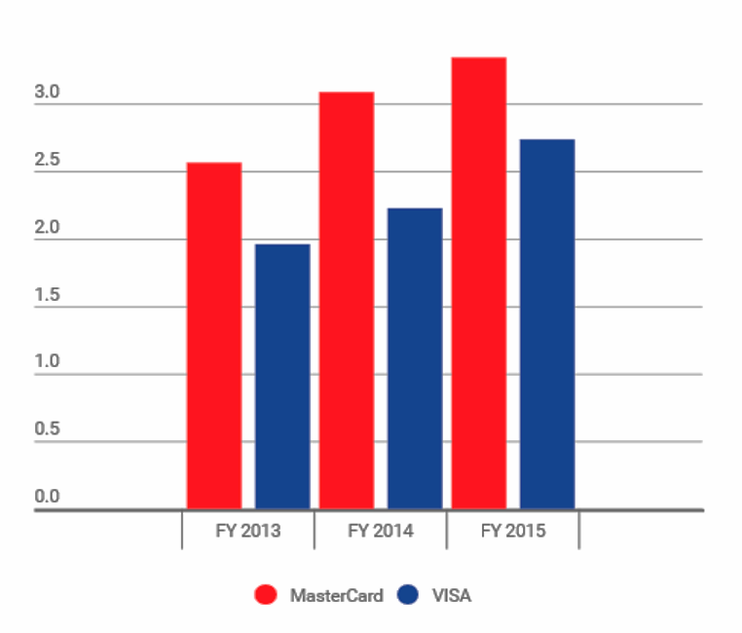
Earnings-per-share (EPS)
Portion of a company’s profits allocated to each outstanding share of common stock
Net income - prefered dividends
EPS =
Outstanding shares
Mastercard’s ratio is higher because they generate more profits for each outstanding share of common stock.
Mastercard has lesser outstanding shares at 1.11bn compared to Visa at 2.18bn
Increasing trends for both companies because they are growing well.

Slide 11
Trailing P/E

Slide 12
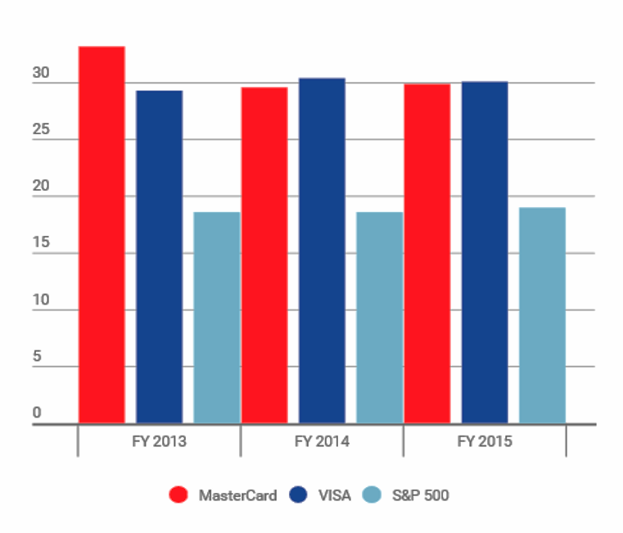
Trailing P/E
Current stock price
Indicator of the true value of the company
Trailing P/E =
Earnings per share (last 12 months)
Stock prices for both companies are priced similarly for their respective Earnings Per Share.
Both companies have higher than average ratios and are expected to perform strongly in the future

Slide 13
Dividend Payout

Slide 14
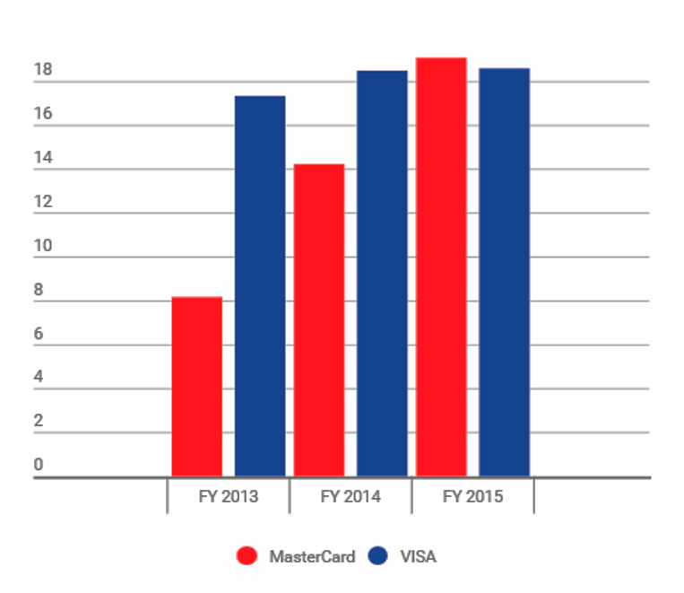
Dividend Payout
Dividends
Earnings paid to shareholders in dividends
Dividend payout =
Net income
Mastercard has an increasing dividend payout
Visa has a stable dividend payout
Mastercard increased dividend in 2014 to show that they are committed to investors
Notes:
Perhaps can say higher dividend payout, thats why higher demand and higher prices

Slide 15
Dividend Yield

Slide 16
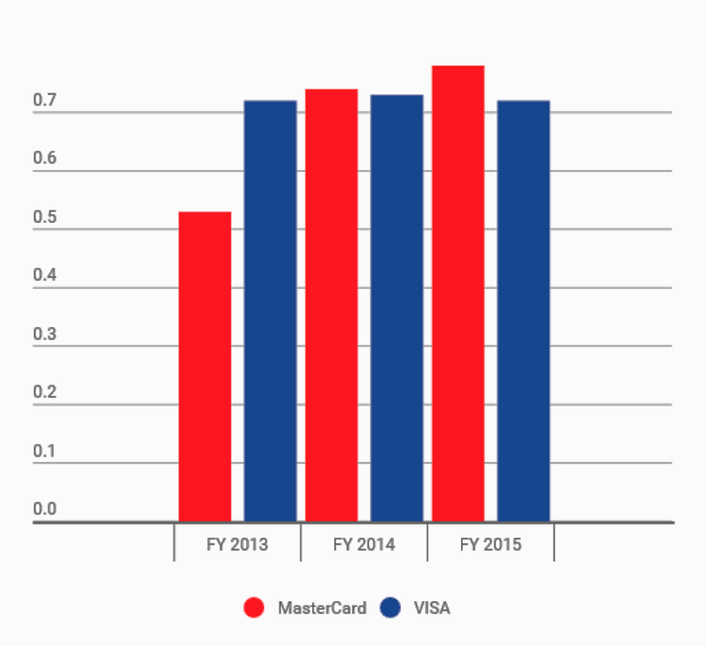
Dividend Yield
Indicated how much a company pays out in dividends each year relative to its share price
Dividend per share
Dividend Yield =
Price per share
Measure of how much cash flow you are getting for each dollar invested in an equity position
Mastercard’s dividend yield has been steadily increasing
Despite Mastercard having a higher stock price, it pays out more dividend than Visa

Slide 17
What causes the difference between the stock prices of the two companies?
Increase in Dividend Payout, Dividend yield and high EPS and ROE, leading to higher demand for MasterCard’s stocks and pushes stock prices up
Buyback program causes a decrease in supply of stocks hence increasing the demand of stocks and its price.

Slide 18
Deeper look at Company’s performance
Return On Equity = Profit Margin x Asset Turnover x Financial Leverage

Slide 19
Profit Margin

Slide 20
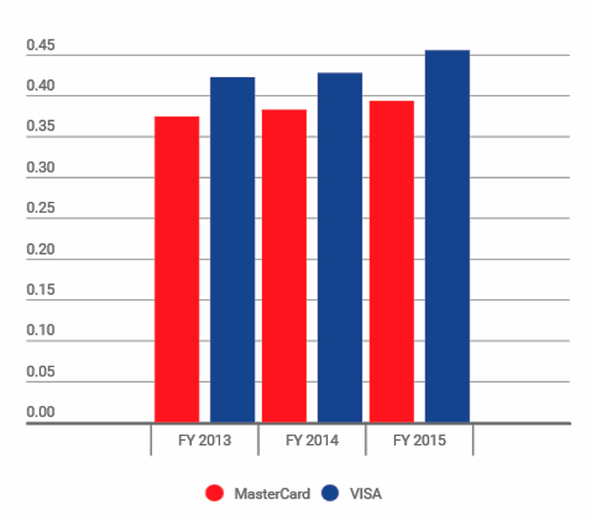
Profit Margin
Measure how much a dollar of sales a company actually keeps in earnings
Net income
Profit Margin =
sales
Ratio are close due to similarity of company
Earn by taking a portion of the transaction
Visa’s profit margin is higher due to better operating margin

Slide 21
Operating Margin

Slide 22
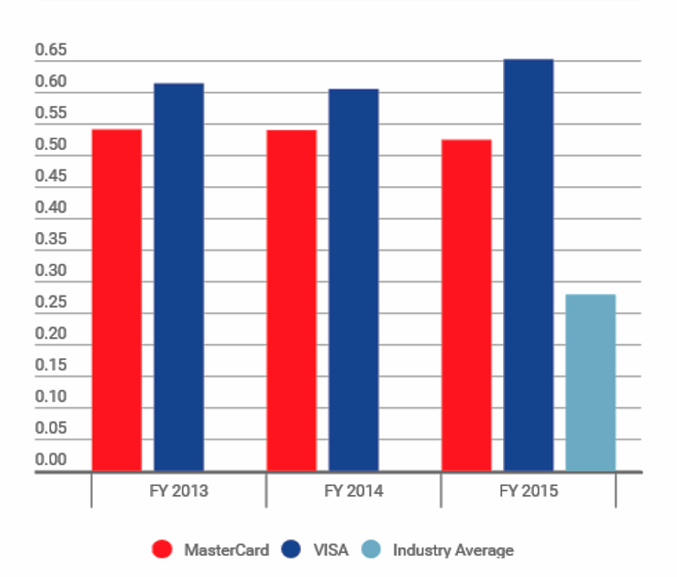
Operating Margin
Operating income
Measure efficiency of a company’s pricing strategies and operations
Operating Margin =
Net sales
Higher operating income means Visa is more efficient in their operation
MasterCard has much higher Selling General and Administrative cost
Leads to higher profit margin due to lower operating expenses
Notes:
so basically, MasterCard has much higher Selling General and Administrative cost (about twice of that of VISA’s), their operating expense is higher, and hence operating income is lower. Lower sales from MasterCard mitigate the effects of the much lower operating income

Slide 23
Asset Turnover

Slide 24
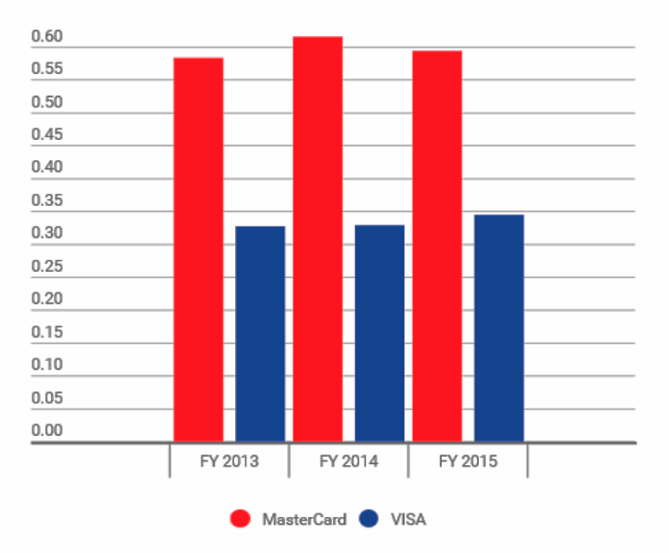
Asset Turnover
Net sales
Asset turnover =
Total assets
Indicator of the efficiency with which a company is deploying its assets in generating revenue
Generally, Visa’s total assets are more than twice of Mastercard’s
Visa’s high total assets is attributed to its high goodwill and intangible assets
Visa focuses more on its branding as it builds up its relationships with its clients and its brand name

Slide 25
Return on Assets

Slide 26
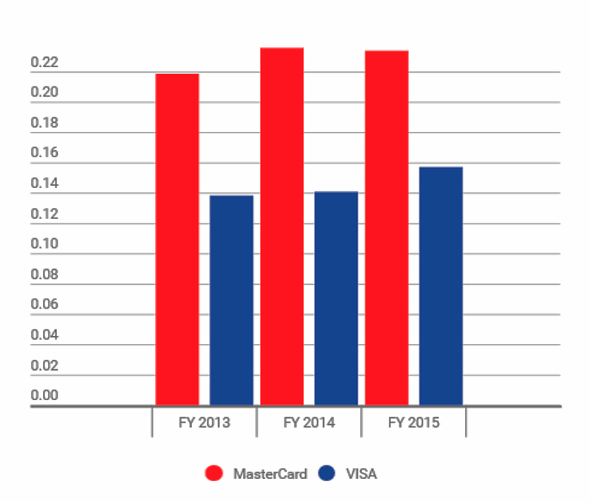
Return on Assets
Net income
Return on Assets =
Indicator of how profitable a company is relative to its total assets
Total assets
Product of Profit Margin and Asset Turnover, thus same effect due to Visa’s high total assets
Slight increase in Visa’s ROA due to lower operating expense

Slide 27
Financial Leverage

Slide 28
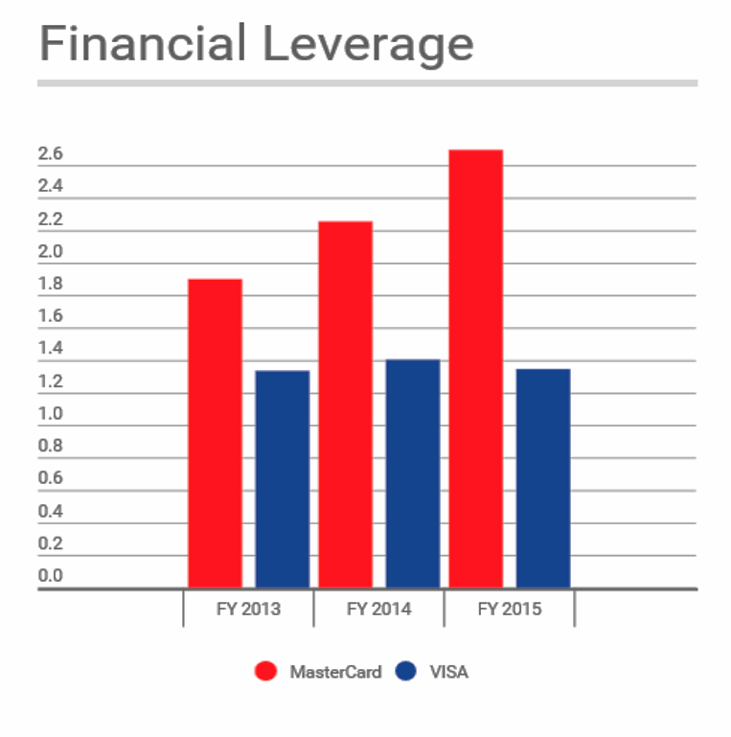
Financial Leverage
Total assets
Financial Leverage =
Stockholder’s Equity
Measure of debt financing a company uses
Also commonly called “equity multiplier”
Most of Mastercard’s assets are funded by creditors rather than investors
Visa is more conservative, less dependent on debt financing

Slide 29
Debt Ratio

Slide 30
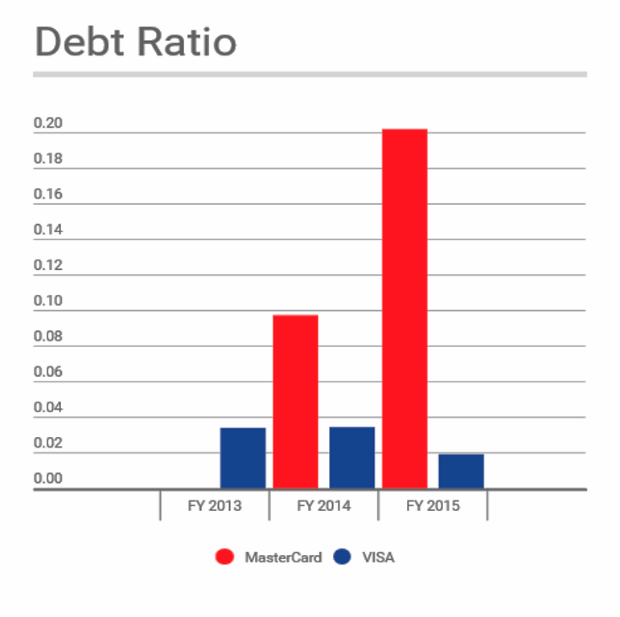
Debt Ratio
Total liabilities
Debt Ratio =
Total assets
Proportion of a company’s assets financed by debt
Mastercard’s business approach is riskier
A great leap from 2014 to 2015 and this may be due to buying of new technologies
Visa reduces its reliance on debt

Slide 31
Current Ratio

Slide 32
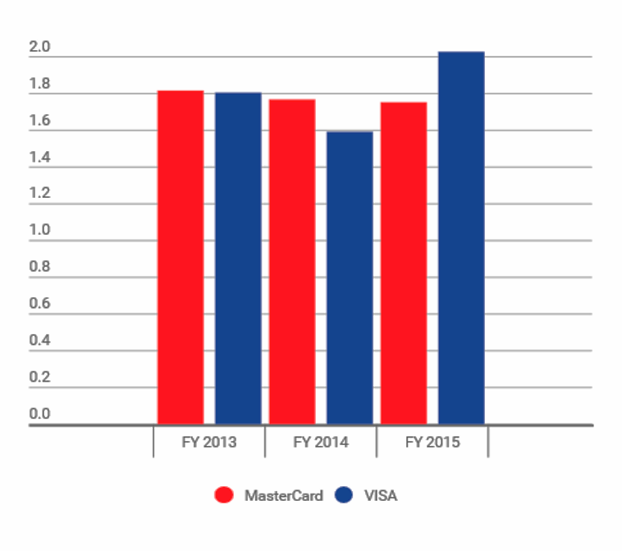
Current Ratio
Current Assets
Current Ratio =
Measures a company’s ability to pay her short- and long- term obligations
Current Liabilities
Most recently, VISA’s current ratio increased significantly which may suggest healthier financials
Slightly decreasing trend of MasterCard’s current ratio could potentially be attributed to lower current assets resulting from active acquisitions:
Provus (2013),
Applied Predictive Technologies (2014)

Slide 33
Quick Ratio

Slide 34
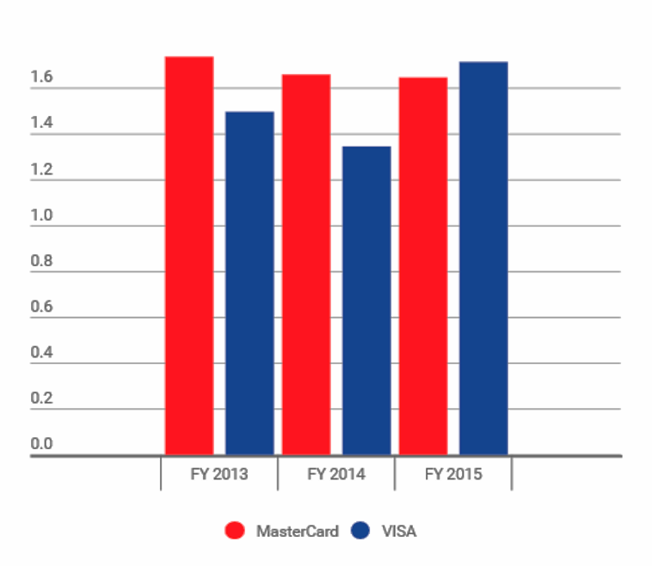
Quick Ratio
Indicator of whether a firm has sufficient short-term assets to cover its immediate liabilities
(cash + accounts receivable + short term investments)
Quick Ratio =
Current Liabilities
MasterCard’s quick ratio is fairly stable, and higher than VISA’s which may suggests greater ability to cover her immediate liabilities

Slide 35
Hypothetical Question:
What if debtors do not pay up?

Slide 36
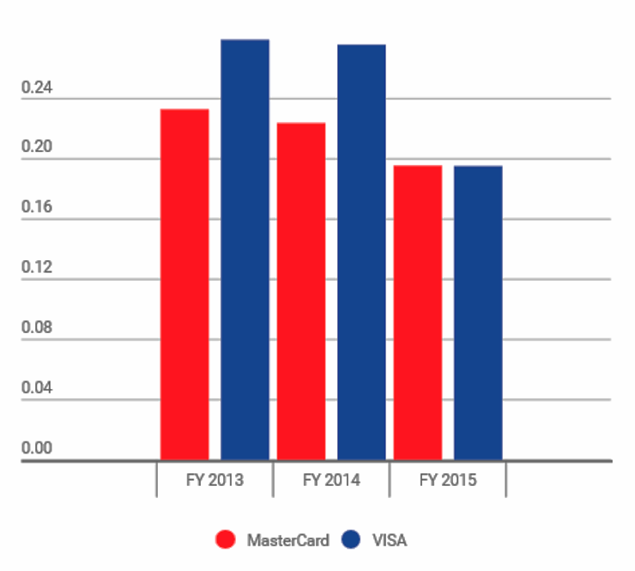
Proportion of Accounts Receivables in Current Assets
VISA is at greater risk of running into liquidity problems should her debtors not pay up

Slide 37
Industry Prospects

Slide 38
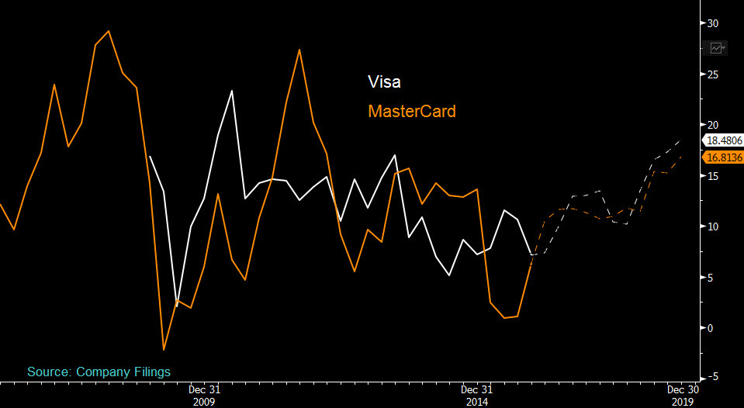
Sales Growth
Source:
Bloomberg Terminal
Projected that 2016 sales growth for Visa and MasterCard to accelerate to double-digit levels

Slide 39
So which company is performing better?

Slide 40
More efficient use of her assets
Operating more efficiently
Risk taking
Low debt

Slide 41
Back @ the supermarket

Slide 42
REFERENCES
https://ycharts.com/companies/MA/eps_ttm
http://newsroom.mastercard.com/press-releases/mastercard-completes-acquisition-of-provus-the-leading-independent-turkish-payment-solutions-provider/
http://newsroom.mastercard.com/press-releases/mastercard-announces-acquisition-of-applied-predictive-technologies/
http://www.medianama.com/2014/02/223-sam-pitrodas-wallet-service-company-c-sam-acquired-by-mastercard/
http://finance.yahoo.com/q/bs?s=V&annual
https://hbr.org/2010/03/the-best-way-to-measure-compan.html
http://www.investopedia.com/terms/c/currentratio.asp#ixzz438uS8SgR
http://www.investopedia.com/terms/a/acidtest.asp
http://www.investopedia.com/terms/p/profitmargin.asp
http://www.investopedia.com/terms/o/operatingmargin.asp
http://www.bloomberg.com/news/articles/2015-10-25/usaa-drops-mastercard-in-favor-of-visa-for-credit-debit-cards
http://www.bloomberg.com/news/articles/2015-03-04/citigroup-reaches-10-year-deal-with-mastercard-on-consumer-cards
http://pressreleases.visa.com/phoenix.zhtml?c=215693&p=irol-newsarticlePR&ID=1789390
http://www.wsj.com/articles/american-express-to-lose-costco-exclusivity-1423746408
https://upload.wikimedia.org/wikipedia/commons/thumb/b/b7/MasterCard_Logo.svg/2000px-MasterCard_Logo.svg.png
https://gavi.nl/media/wysiwyg/visa-logo-high-resolution.jpg
http://www.wsj.com/articles/mastercard-to-buy-analytics-company-applied-predictive-tech-for-600-million-1430165677
https://ibsintelligence.com/ibs-journal/ibs-news/russia-launches-payment-card-to-rival-visa-and-mastercard/
http://www.zacks.com/stock/news/145204/visa-v-or-mastercard-ma-which-is-the-better-stock
https://sg.finance.yahoo.com/q/ks?s=V
https://sg.finance.yahoo.com/q/ks?s=ma&ql=1
https://apenquotes.wordpress.com/2015/09/21/visa-its-everywhere-you-want-to-be/
http://www.investopedia.com/articles/personal-finance/020215/visa-vs-mastercard-there-difference.asp

