Slide 1


Slide 2

FRAUD DETECTION
Developed a robust machine learning model to accurately predict fraudulent transactions.

Slide 3
OBJECTIVE
"This project aims to enhance the accuracy of detecting fraud in mobile financial transactions. By leveraging machine learning, the project seeks to predict fraudulent transactions with high precision. The goal is to develop a robust machine learning model to accurately identify fraudulent transactions in real-time, enabling the company to improve security, reduce financial losses, and gain insights into factors contributing to transaction fraud."

Slide 4

WORK FLOW
Step -1 Data Collection
Step - 2 Exploratory Data Analysis
Step – 3 Preprocessing
Step – 4 Split Train And Test Data
Step – 5 Model Selection and Model Training
Step – 6 Model Evaluation

Slide 5
Dataset Description
Step
Time step in the simulation (number of hours)
Type
Type of transaction: - CASH-IN, CASH_OUT, DEBIT , PAYMENT , TRANSFER
Amount
New balance Orig
Name Orig
Old balance Org
Amount of the transaction in local currency
Customer ID who initiated the transaction
Initial balance before the transaction for the customer who initiated the transaction
Indicator of whether the transaction was fraudulent (1 = fraud, 0 = non-fraud)
Old balance Dest
New balance Dest
Is Fraud
Name Dest
New balance after the transaction for the customer who initiated the transaction
Recipient customer ID of the transaction
Initial balance before the transaction for the recipient
New balance after the transaction for the recipient

Slide 6
EXPLORATORY DATA ANALYSIS
Exploratory Data Analysis (EDA) helped us understand the data structure, find patterns, identify trends, and gain valuable insights from the dataset.
From EDA we analyze, the distribution of each features, checking the correlation between the features .
Using visuals helped us see the data clearly, understand the clinical data relationship with each other, and pinpoint factors that plays vital role in predictions of heart disease.

Slide 7
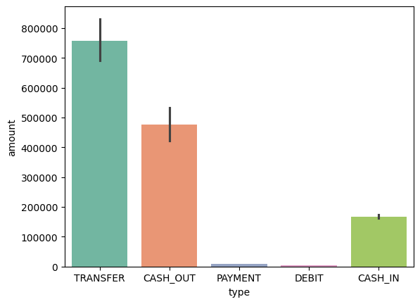
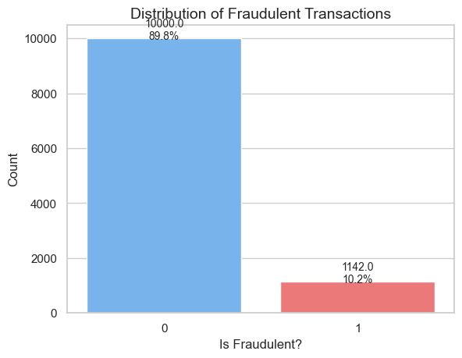
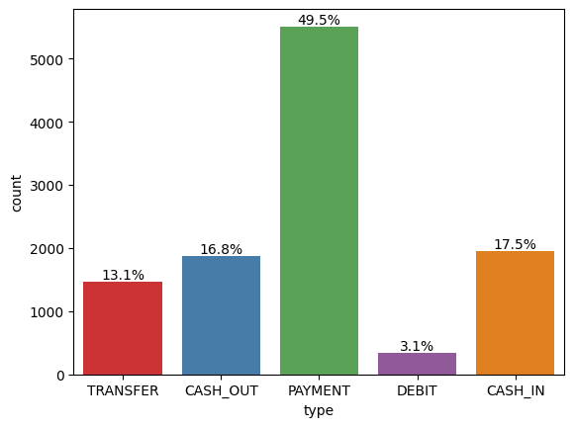
Fraud or Not Fraud Count
Type in percentage
Higher amount in the type

Slide 8
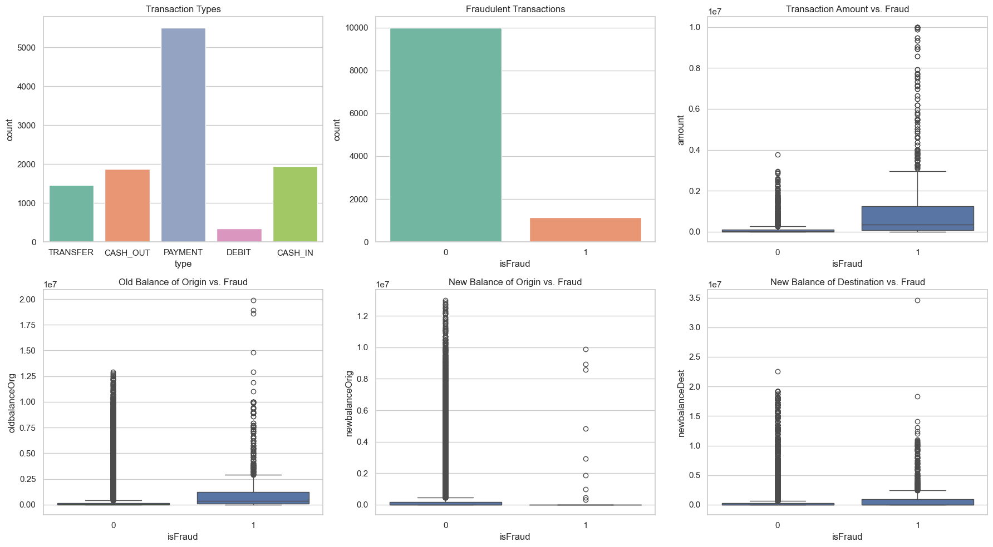
Outlier

Slide 9
PREPROCESSING
Dropping Irrelevant Columns:
Columns Dropped: ‘nameOrig’ and ‘nameDest’
Reason: These columns represent customer IDs for the originator and recipient of transactions, which are non-numeric identifiers. They do not contribute to predicting whether a transaction is fraudulent and could add noise to the model.
Label Encoding of the 'type' Column:
Column Encoded: ‘Type’
The Type Column indicates the type of transaction (CASH_IN, CASH_OUT, DEBIT, PAYMENT, TRANSFER)
Standardization of Numeric Columns:
Columns Standardized: ‘Step’, ’Amount’, ‘Old Balance Org’, ‘New Balance Orig’, ‘ Old Balance Dist’, ‘New Balance Dist’
This scales each feature so that they have a mean of 0 and a standard deviation of 1.

Slide 10
TRAIN TEST SPLIT
Features (X): All columns except 'isFraud', which is the target variable.
Target (y): “isFraud” , indicating whether a transaction is fraudulent (1) or not (0).
Train-Test Split: The dataset is split into training (70%) and testing (30%) sets using train_test_split(), with a random state of 42 for reproducibility.

Slide 11
MODEL SELECTION
Logistic Regression: logistic Regression is commonly used for binary classification problems. it's preferred because it provides a simple an efficient way to model the relationship between the independent variables and the probability of a certain outcome.
Decision Tree: Decision Tree algorithms are used for classification because they are simple, computationally efficient, and effective in handling high-dimensional data.
Works best for categorical independent columns.
Support Vector Machine: SVM is a powerful supervised algorithm that works best on smaller datasets but on complex ones. Support Vector Machine(SVM)can be used for both regression and classification tasks, but generally, they work best in classification problems.
Random Forest Algorithm: Random Forest: Random Forest is a robust supervised algorithm suitable for both regression and classification tasks.

Slide 12
Model Comparison
 | Model | Accuracy | Precision | Recall | F1-Score | AUC-ROC
0 | Logistic Regression | 0.998558 | 1.000000 | 0.875 | 0.933333 | 0.990472
1 | Support Vector Classifier (SVC) | 0.996395 | 0.823529 | 0.875 | 0.848485 | N/A
2 | Random Forest Classifier | 0.997116 | 0.875000 | 0.875 | 0.875000 | 0.998815
3 | Decision Tree Classifier | 0.997116 | 0.875000 | 0.875 | 0.875000 | 0.936771
Precision: The accuracy of the model when it claims to have found something.
Recall: Recall: The ability of a model to find all the relevant cases
F1 Score: A balance between recall and precision, useful when both false positives and false negatives need to be minimized.

Slide 13
Thank You!

