Slide 1

RESEARCH: INTEGRATING SEARCH AND REASONING FOR LLMS USING RL
Based on the Paper by Baichuan Inc., Univ. of Edinburgh, Zhejiang Univ.
PRESENTED BY JAYKUMAR PAL

Slide 2

Introduction
Strong Reasoning by LLMs: Recent models (e.g. OpenAI‑o1, DeepSeek‑R1) can chain complex thoughts internally. ​
Static Knowledge Limitation: Pretrained LLMs cannot fetch up‑to‑date or domain‑specific facts at inference time. ​
RAG Shortcomings: Retrieval‑Augmented Generation concatenates retrieved passages but lacks a strategic, multi‑step search plan for complex questions. ​
Costly Supervision: Supervising each reasoning step (SFT) is labor‑intensive and hard to scale. ​
ReSearch Solution: Introduces an RL‑based framework that learns when and how to interleave external search within the model’s chain‑of‑thought. ​

Slide 3
Term | Definition
LLM | Transformer‑based model pretrained on large text; excels at generation
RAG | Retrieves external docs to augment LLM responses at inference
ReSearch | RL framework integrating <search> and <result> into reasoning
GRPO | Policy gradient comparing group rollouts for normalized advantage
Rollout | Sequence: <think>, <search>, <result>, <answer>
Reward Function | F1‑based answer correctness + format compliance bonus
FlashRAG | FastAPI‑served Wikipedia index for retrieval environment
MuSiQue | Multihop QA dataset built from single‑hop compositions
HotpotQA / 2Wiki… | Standard multi‑hop QA benchmarks
Exact Match (EM) | Strict metric: identical predicted vs ground truth text
LLM-as-a-judge (LJ) | GPT‑4o‑mini semantically judges answer correctness
Key Terms & Definitions

Slide 4
ReSearch Overview
OBJECTIVE: TRAIN LARGE LANGUAGE MODELS (LLMS) TO INTEGRATE EXTERNAL SEARCH WITH MULTI-STEP REASONING USING REINFORCEMENT LEARNING.
KEY INNOVATION: TREAT SEARCH AND RESULT INTERACTIONS AS PRIMARY REASONING TOKENS TO GUIDE WHEN AND HOW THE MODEL QUERIES EXTERNAL KNOWLEDGE.
ALGORITHM: GROUP RELATIVE POLICY OPTIMIZATION (GRPO) USES GROUP ROLLOUTS TO NORMALIZE ADVANTAGES AND INCORPORATES A KL PENALTY TO MAINTAIN ALIGNMENT WITH A REFERENCE MODEL.
MODELS & DATA: QWEN2.5-7B/32B MODELS TRAINED ON THE MUSIQUE DATASET OVER TWO REINFORCEMENT LEARNING EPOCHS.
BENCHMARKS: ACHIEVED 14-22% INCREASE IN EXACT MATCH (EM) SCORES ON HOTPOTQA AND 2WIKIMULTIHOPQA.
EMERGENT BEHAVIORS: MODELS NATURALLY DEVELOP REFLECTION AND SELF-CORRECTION ABILITIES, IMPROVING SEARCH QUERIES AND REASONING DYNAMICALLY.

Slide 5
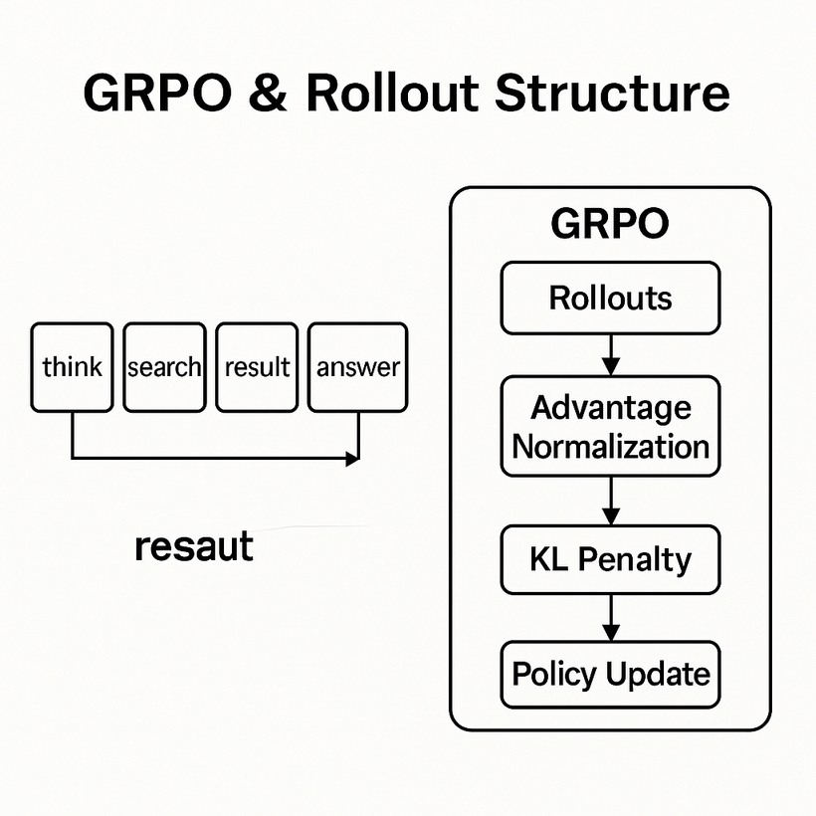
GRPO & Rollout Structure
GRPO (Group-Normalized Policy Optimization): This refers to a framework that compares group-normalized advantages. The approach aims to improve policy optimization by normalizing advantages across groupings, which can lead to more stable and efficient learning. An integral part of this method is the incorporation of a KL (Kullback-Leibler) penalty, which helps in controlling the divergence between the new and old policies, ensuring smoother updates and preventing drastic changes that may destabilize learning.
Rollout Structure: This involves alternating blocks of thinking, searching, resulting, and answering. This structured approach mirrors the cognitive processes involved in decision-making, allowing the model to effectively simulate scenarios, evaluate options, and generate responses. By alternating between these blocks, the model can iteratively improve its understanding and decision-making capabilities.
Mask Retrieval Tokens: In this context, masking retrieval tokens during loss calculation is a technique employed to focus on policy learning. By masking these tokens, the model can concentrate on optimizing the policy directly, rather than being distracted by irrelevant or extraneous elements in the data. This targeted approach enhances the efficiency and effectiveness of the learning process.

Slide 6
Prompt Templates & Reward Design
Understand the distinction between base prompts and instruction-tuned prompts:
Base prompts are simple, with minimal instructions.
Instruction-tuned prompts are detailed, using tags for enhanced guidance.
Recognize the purpose of the reward system:
Reward is calculated by combining the F1 score of the answer with a format compliance bonus.
The F1 score assesses accuracy and precision.
Appreciate the dual reward approach benefits:
Promotes accurate responses.
Ensures adherence to the desired format.
Enhances the model's overall utility and coherence.

Slide 7
Experimental Setup
Training Phase:
Uses the MuSiQue dataset consisting of 19.9K samples.
System is trained over two epochs.
Retrieval Process:
Employs the E5-base-v2 model.
Utilizes a Wikipedia snapshot from December 2018.
Incorporates a method called FlashRAG to enhance retrieval efficiency.
Evaluation:
Assessed on four distinct multi-hop QA benchmarks.
Tests the system's ability to handle complex questions requiring reasoning over multiple information sources.
Objective:
Aims to improve the accuracy and efficiency of multi-hop QA systems.
Leverages advanced retrieval techniques and a robust dataset.

Slide 8
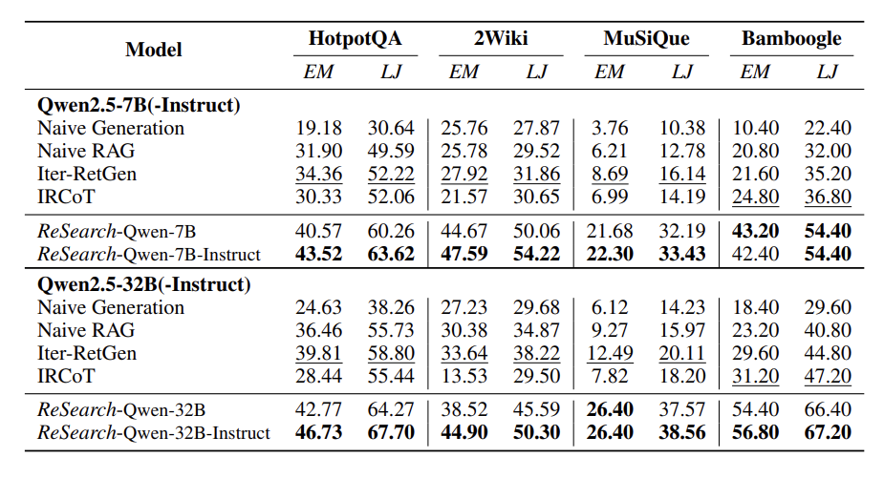
Analysis Results

Slide 9
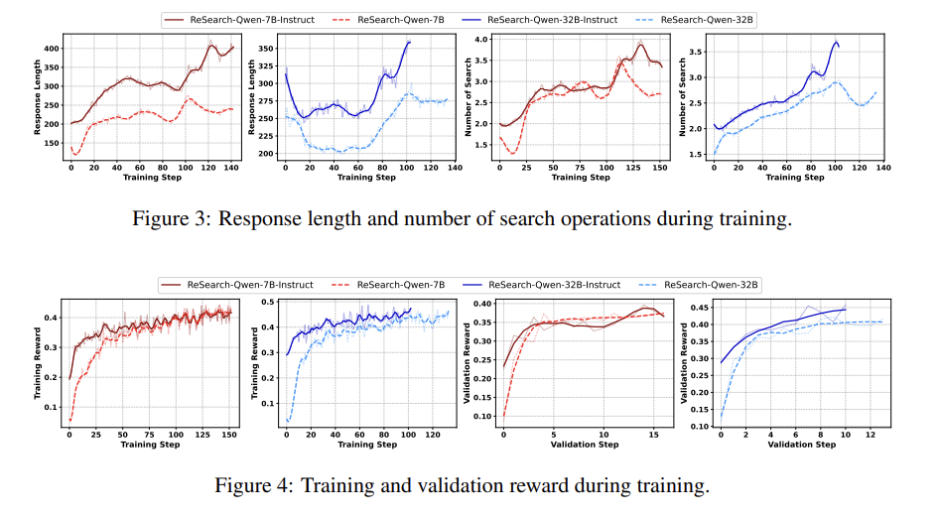
Analysis Results

Slide 10
Main Results
ReSearch significantly outperforms Naive Gen, Naive RAG, Iter-RetGen, and IRCoT.
Achieves a 14-22% increase in Exact Match (EM) scores.
Shows a 15-17% improvement in Likelihood Judgement (LJ) scores.
Demonstrates higher accuracy and reliability in generating expected responses.
Instruction tuning further enhances ReSearch’s performance.
Highlights ReSearch's potential as a superior tool in natural language processing.

Slide 11
Analysis & Emergent Behavior
In machine learning and AI, analysis and emergent behavior are key for understanding model evolution.
As models are trained, their response complexity and length increase, indicating improved information processing.
Search count rises as models navigate large datasets more effectively to produce accurate outputs.
Models engage in reflection, detecting and correcting suboptimal queries to improve response quality over time.
Training and validation reward curves provide quantitative insights, showing steady improvement in performance metrics.
These curves help researchers assess training efficacy, identifying key stages of understanding or needed adjustments.
Analyzing these curves and behaviors reveals insights into AI systems' evolving intelligence.

Slide 12
Case Study
Prompt: "Who won the 2018 election in Mexico?"
Initial Search: Yields info on candidates, not outcome.
Self-Correction: Model reflects and rephrases query.
Refined Search: Fetches correct answer (Andrés Manuel López Obrador).
Reasoning Dynamics:
Interleaved search and thinking steps.
Uses <think> to evaluate result quality.
Revises <search> based on feedback loop.
Outcome: Demonstrates emergent ability to adapt search strategies, a core strength of the ReSearch framework.

Slide 13
Conclusion & Future Work
ReSearch: scalable RL‑based RAG without labels
Outperforms supervised and heuristic baselines
Next: extend to tool use beyond search (e.g., code exec, DB query)
Future: integrate real‑time APIs for dynamic reasoning environments

Slide 14
Thank you very much!
PRESENTED BY JAYKUMAR PAL

