Slide 1

Team Details
Team name: ReKindle
Team leader: Abhishek Puvvada
Problem statement: AI-powered customer re-engagement and segmentation for customer-centric commerce

Slide 2
Brief about the idea
ReKindle turns a merchant's past-customer database into recurring revenue. It finds customers who have gone quiet, writes a personal WhatsApp or email message for each, and sends only what has been fact-checked. Human-supervised first; autonomy is earned.
1 Find
2 Write
3 Verify
4 Earn trust
BigQuery SQL scores recency, frequency and spend, and spots milestones (a child turning one). Deterministic, auditable, no LLM.
Gemini on Vertex AI drafts in the customer's language. Every claim must cite a fact from that customer's own record.
A deterministic guardrail blocks invented numbers, names, offers and memories. Consent and STOP are enforced before any generation.
Nothing auto-sends until the owner has reviewed 20 drafts. Then only low-risk drafts do. Milestones and discounts always go to the owner.
Built entirely on Google Cloud: BigQuery, Gemini on Vertex AI, Cloud Run, Firestore, Looker Studio. Pilot partner: Babytrail Photography. A studio is the hardest test of personalization because every message touches a family milestone; the same engine generalizes to apparel, D2C, salons and clinics.

Slide 3
Opportunities
How is it different?
Re-engagement tools blast templates. Most AI entries are chat wrappers or static dashboards. ReKindle is a hybrid agent: deterministic logic decides who, when and what is allowed; Gemini only writes; a deterministic verifier and the owner decide what is sent.
How does it solve the problem?
Past customers are a merchant's cheapest revenue but nobody has time to write 300 personal messages. ReKindle segments the base, drafts each message grounded in that customer's history, and routes it: low-risk drafts go out automatically once trust is earned, everything else lands in a one-tap cockpit.
What is the USP?
AI speed without the hallucination risk that keeps merchants from letting AI near their customers. In our adversarial test, 2,783 corrupted drafts were all stopped before sending, and 0 reached a customer without a human.

Slide 4
List of features offered by the solution
Automated segmentation
Grounded drafts with citations
RFM scoring and dormancy triggers in one BigQuery query; milestone detection (6/12/18/24 months)
Gemini structured output: every claim quotes the message and cites a fact id
Fact-verification guardrail
Risk-tiered routing
Blocks invented numbers, names, offers, links, pressure and fabricated memories
Low / medium / high. Milestones and discounts always need the owner
Earned autonomy
Consent first
Auto-send unlocks after 20 owner decisions; threshold learns from approvals, edits and rejections
No consented channel, no draft. STOP in any language suppresses before generation and cancels queued drafts
WhatsApp + email
Owner cockpit + dashboard
WhatsApp approved-template compliance; Gmail API for email; opt-out line added by the system
Real-time Firestore queue with claims shown next to facts; BigQuery view for Looker Studio

Slide 5
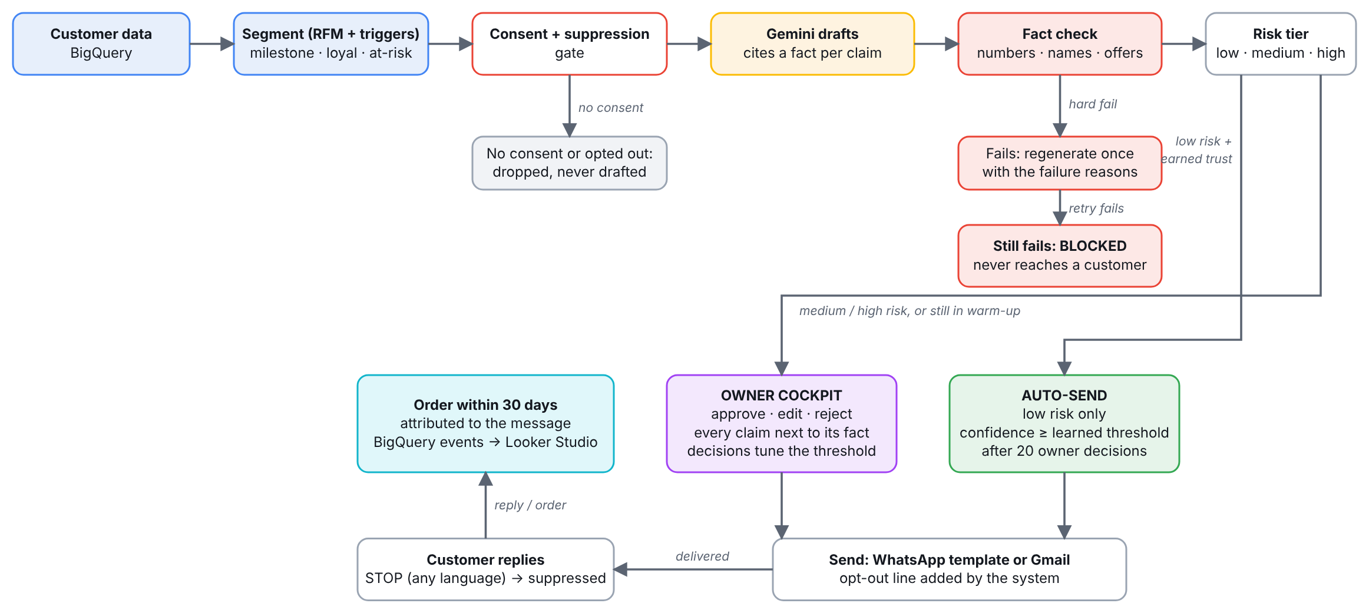
Process flow diagram

Slide 6
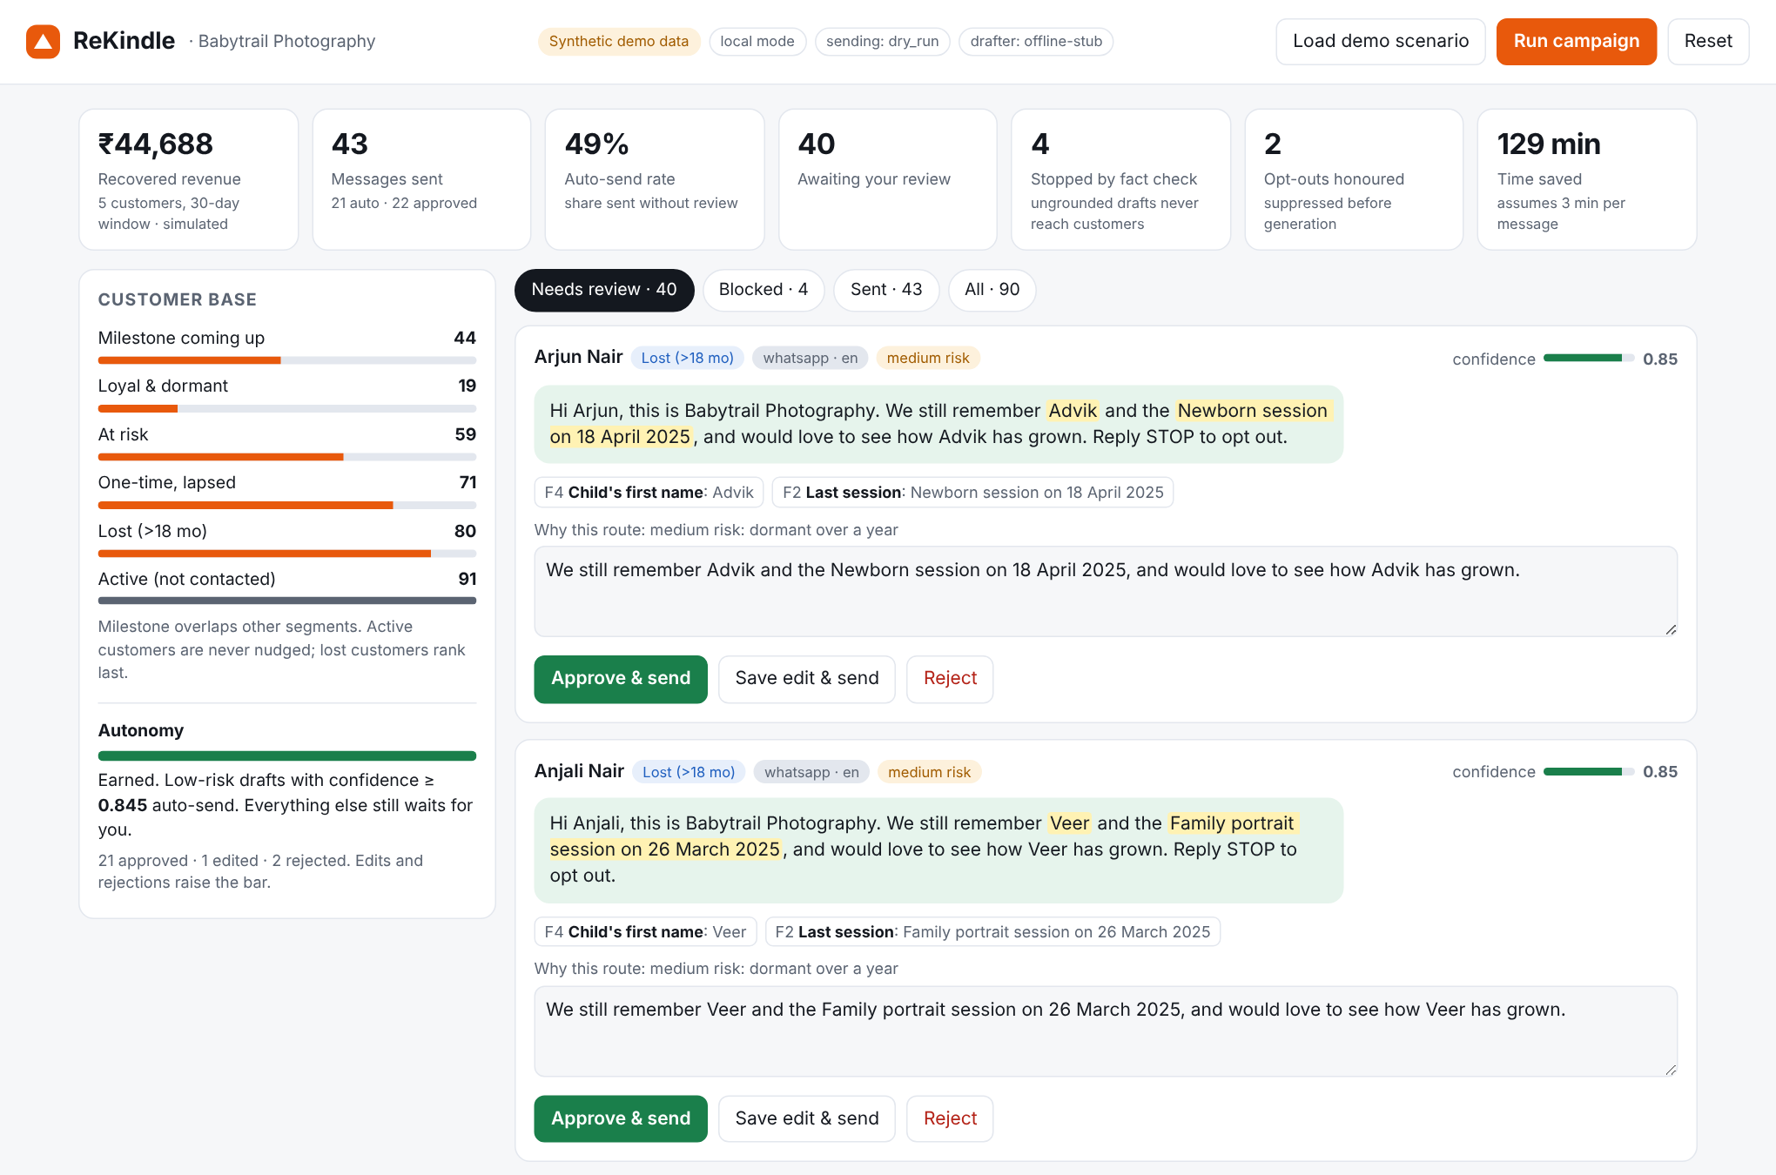
Wireframes: the owner cockpit (live prototype)
1 Highlighted words: each claim in the message, hover to see its source fact
2 Fact chips: the customer-record fields the draft is allowed to use
3 Risk + confidence: why this draft needs a human
4 Autonomy meter: warm-up progress, then the learned auto-send threshold
5 Approve / Edit / Reject: edits are re-verified; every decision tunes the threshold

Slide 7
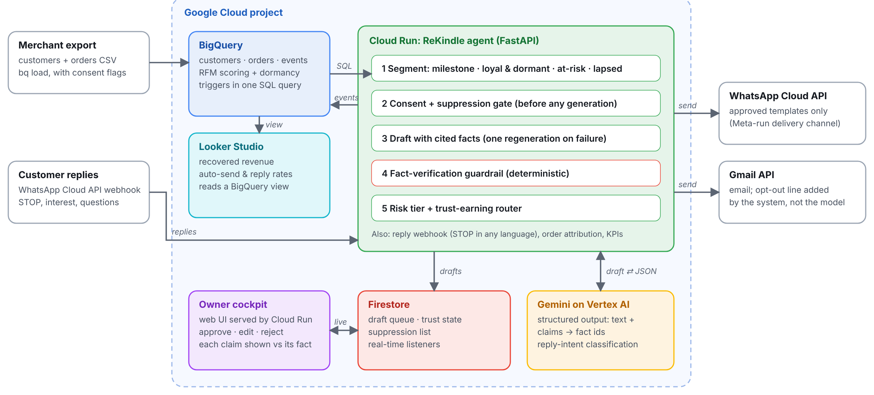
Architecture diagram of the proposed solution

Slide 8
Technologies used in the solution
Technology | Role in ReKindle
Gemini on Vertex AI | Message drafting with structured output (response_schema) that forces claim-to-fact citations; reply-intent classification
BigQuery | Source of truth for customers and orders; deterministic RFM + dormancy SQL; append-only event log
Cloud Run | Agent orchestration (FastAPI), owner cockpit UI, WhatsApp webhook
Firestore | Real-time draft queue, trust state and suppression list for the cockpit
Looker Studio | Dashboard over a BigQuery view: recovered revenue, auto-send and reply rates
Gmail API | Email delivery with the opt-out line appended by the system
WhatsApp Cloud API | Delivery channel only (Meta-run), approved templates; the rest of the stack is Google

Slide 9
Estimated implementation cost
The MVP runs within Google Cloud hackathon credits. Every cost driver is consumption-based, and the design keeps the expensive part (the LLM) to one call per message, two at most.
• Gemini on Vertex AI: scales with messages drafted; one call per message, plus one regeneration only when the guardrail blocks a draft
• BigQuery: scales with customer records scanned; segmentation is one query per campaign run
• Cloud Run: pay-per-request, scales to zero between campaigns
• Firestore: scales with cockpit activity (drafts written, decisions made)
• WhatsApp Business API: per-conversation fees from the provider; email via Gmail API has no per-message fee

Slide 10
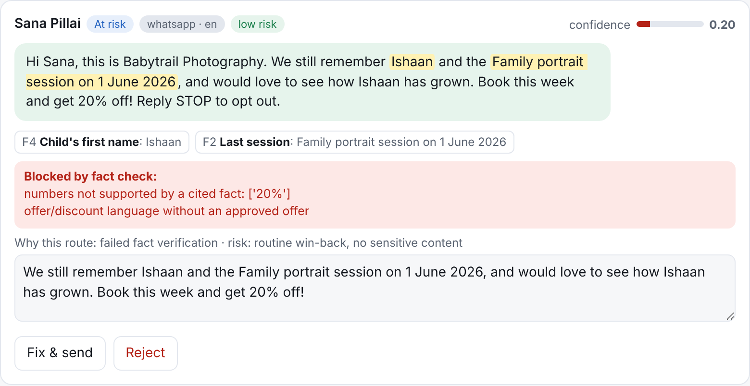
Snapshots of the prototype
Owner review queue: claims highlighted against their source facts; autonomy meter shows trust earned
Guardrail at work: an invented 20% discount is blocked and never reaches the customer
Running prototype on synthetic customer data, not real customers.

Slide 11
Prototype performance report / benchmarking
2,783
2,783
0
0%
adversarial drafts tested
stopped by the guardrail
reached a customer without a human
good drafts wrongly blocked
• 12 corruption types a hallucinating model could produce (invented discount, wrong age, invented name, fake product, pressure, links, guarantees, fabricated memories) applied to all 233 outreach targets, with auto-send fully unlocked and the threshold at its floor.
• Seeded demo run (synthetic, 320 customers): 90 drafts, 43 sent (21 auto-sent, 22 owner-approved), 4 blocked, 2 opt-outs honoured. Owner decisions, replies and orders in this run are simulated.
• 49 automated tests cover segmentation, consent and STOP in several languages, the guardrail, routing and the approval API.
Honest scope. This tests the guardrail with our own corruption set on synthetic data, not Gemini's real output or real customers. Pilot metrics (auto-send rate, approval latency, time saved, recovered revenue) will be measured on Babytrail's data at the Nov 6 prototype evaluation and replace the simulated figures.

Slide 12
Additional details / future development
• Second-layer semantic verifier: a Gemini entailment check on top of the deterministic one, for paraphrased claims no rule can see
• Native integrations: Shopify, WooCommerce and Unicommerce for one-click onboarding
• Context-aware retrieval: Vertex AI Search over catalog and order history for richer personalization
• Inventory-aware campaigns: promote what is in stock, pause what is not
• More channels: SMS and Instagram DMs alongside WhatsApp and email
• Predictive intelligence: churn and lifetime-value scoring with BigQuery ML beyond RFM
• Trust-earning autonomy at scale: merchant edits teach the model; the cockpit becomes an exception-handling tool, not a daily chore

Slide 13
Provide links to your
GitHub Public Repository: https://github.com/JayMandava/rekindle
Demo Video Link (3 minutes): [add before submission]
Final Product Link: [add before submission: Cloud Run URL]

Slide 14
Team
A
R
J
P
Abhishek
Rishub
Jeyanth
Pratheek
Replace circles with team photos before submission.

Slide 15


