Slide 1
Brain MRI Tumor Detection
Group - 10
Parshwa Shah - AU1940263
Yash Doshi - AU1940197
Jay Mehta - AU1940290

Slide 2
Introduction
We have data set from The Cancer Imaging Archive which have FLAIR (Fluid Attenuated Inversion Recovery) MRI Scans with Hand drawn mask for Low Grade Glioma brain tumor.
We want to predict the mask by doing Semantic Segmentation of MRI Scan.

Slide 3
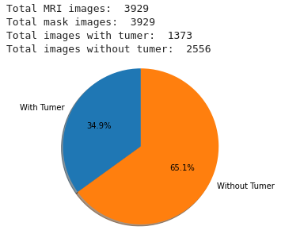
Dataset
Our Dataset have MRI Scans with FLAIR, Pre and Post Contrast.
Here 3 channels are:
Pre Contrast
FLAIR
Post Contrast
Imbalance of dataset

Slide 4
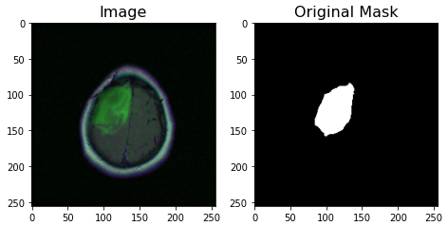
Problem Statement
We have FLAIR Modality MRI Scans from which we want to do semantic segmentation to find LGG brain tumor as a mask over the image.

Slide 5
Existing Body Of Work
There are several approaches tried to get Brain MRI segmentation including: Bayesian Model, UNet Architecture etc.
Out of which UNet Architecture is the best for this type of images as it was developed to treat biomedical images and specifically to deal with problems which includes not only identifying of infection but also identifying the exact area where infection is.
There are multiple research papers who have worked on this problem with various different approaches.

Slide 6
Our Approach
We have finalized on using UNet Architecture for semantic segmentation of Brain MRIs.
We are currently passing 3 channel input with Pre Contrast, FLAIR and Post Contrast channels of input to figure out 1 channel mask for tumor.
We are using dice and tversky loss function to calculate loss of prediction and we are using Adam optimizer for optimizing the model.

Slide 7
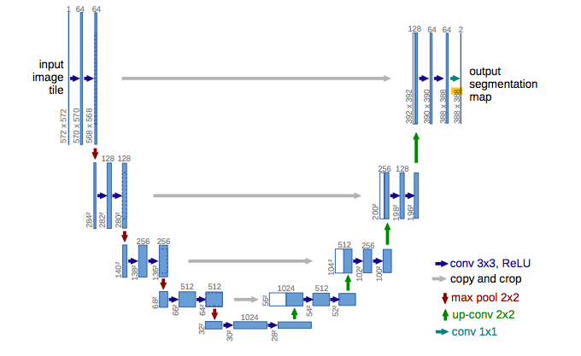
Model Architecture
This is UNet Model which have
Convolution layers,
Max Pooling,
Convolution Transpose and
Copy and crop layers

Slide 8
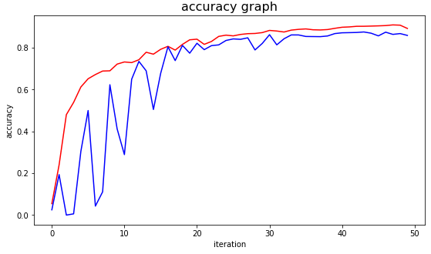
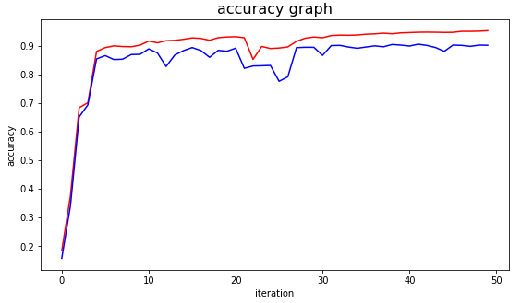
Initial Results
Dice Coefficient - 86.67%
Tversky loss function - 90.59%

Slide 9
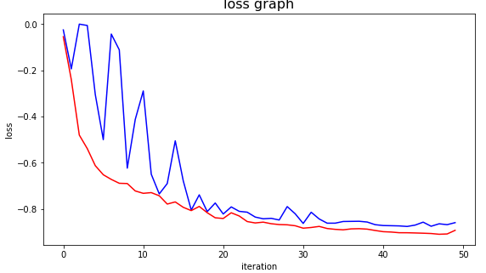
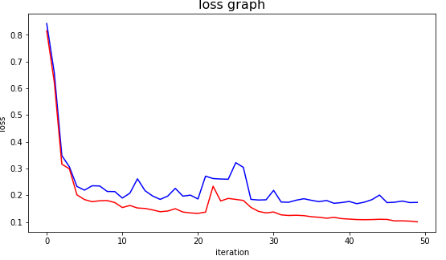
Initial Results
Dice Coefficient
Tversky loss function

Slide 10
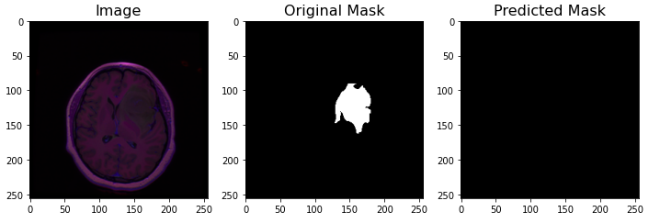
Future Work
Low Accuracy
Failed Predictions
Requirement of pre processing

Slide 11
References
Papers with code - U-net explained. Explained | Papers With Code. (n.d.). Retrieved March 20, 2022, from https://paperswithcode.com/method/u-net
Arora, A., Jayal, A., \& Gupta, M. (2021). Brain Tumor Segmentation of MRI Images Using Processed Image Driven U-Net Architecture.
Vinod, R. (2020, July 3). Dealing with class imbalanced image datasets using the focal tversky loss. Medium. Retrieved April 24, 2022, from https://towardsdatascience.com/dealing-with-class-imbalanced-image-datasets-1cbd17de76b5
Salehi, S. S. M., Erdogmus, D., \& Gholipour, A. (2017, June 18). Tversky loss function for image segmentation using 3D fully convolutional Deep Networks. arXiv.org. Retrieved April 24, 2022, from https://arxiv.org/abs/1706.05721

