Slide 1
Brain MRI Tumor Detection
Group - 10
Parshwa Shah - AU1940263
Yash Doshi - AU1940197
Jay Mehta - AU1940290

Slide 2
Introduction
We are trying to detect brain tumor by looking at MRI Scan of patients brain
It is done using semantic segmentation of the MRI Scan that we ge
We are doing semantic segmentation using UNet Model

Slide 3
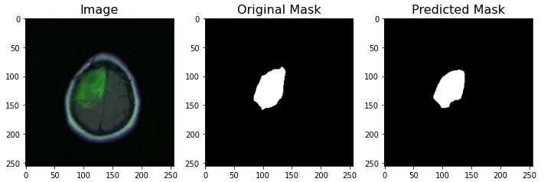
Problem Statement
This image on the left is MRI Scan of a brain scaled down to 256 x 256 pixels and on the right is hand draw mask of tumor inside this brain.
Our problem statement is to figure out a way to predict the tumor mask (on the right) by doing semantic segmentation of MRI scan (on the left).

Slide 4
Existing Body Of Work
There are several approaches tried to get Brain MRI segmentation including: Bayesian Model, UNet Architecture etc.
Out of which UNet Architecture is the best for this type of images as it was developed to treat biomedical images and specifically to deal with problems which includes not only identifying of infection but also identifying the exact area where infection is.
There are multiple research papers who have worked on this problem with various different approaches.

Slide 5
Our Approach
We have finalized on using UNet Architecture for semantic segmentation of Brain MRIs.
We are currently passing 3 channel input with red, green and blue channels of input to figure out 1 channel mask for tumor.
We are using dice loss function to calculate loss of prediction and we are using Adam optimizer for optimizing the model.

Slide 6
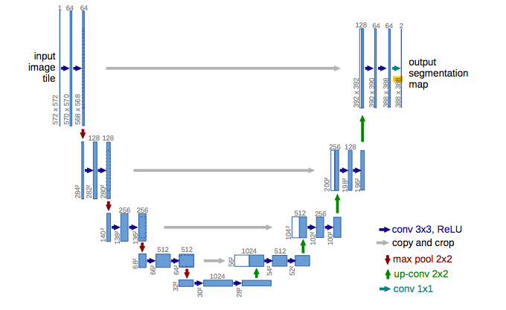
Model Architecture
This is UNet Model which have
Convolution layers,
Max Pooling,
Convolution Transpose and
Copy and crop layers

Slide 7
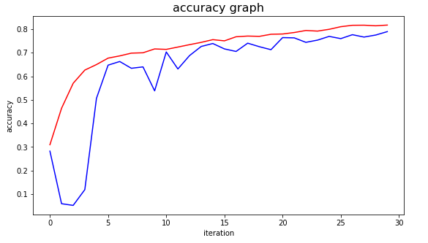
Initial Results
Accuracy of 81.72%
Many Correct Predictions

Slide 8
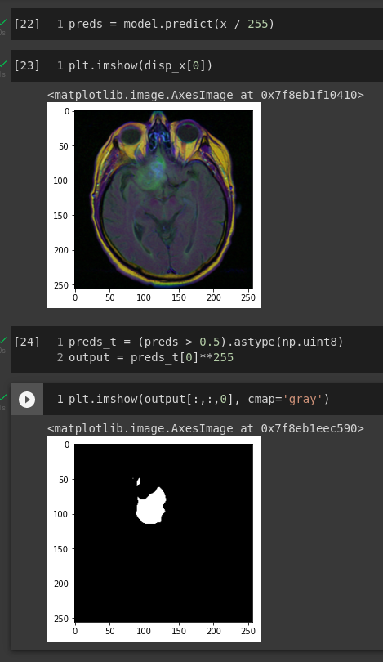
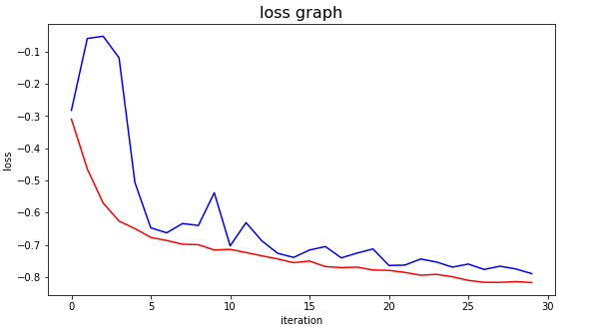
Initial Results
We extracted model and try predicting mask with least
time and processing power.

Slide 9
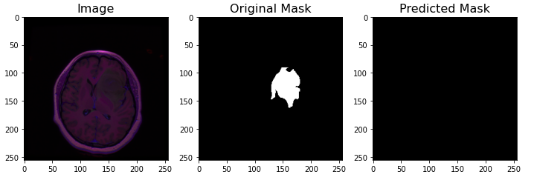
Future Work
Low Accuracy
Failed Predictions
Requirement of pre processing

Slide 10
References
https://paperswithcode.com/method/u-net
https://mdpi-res.com/d_attachment/computers/computers-10-00139/article_deploy/computers-10-00139-v2.pdf
https://arxiv.org/pdf/2003.01995v3.pdf

