Slide 1

LiViD
Bhavik bhundiya-186020307011
Jay nakum-186020307051
Kishan dholakiya-186020307033
Date :

Slide 2
ABSTRACT
LiViD (short for LIVe VIDeo) is a streaming platform that provides live interaction using camera and screen sharing, which will provide connection to large audience for any live events.
In LiViD, public and private live sessions can be scheduled and will provide end to end encryption and good security in private streams to ensure user data privacy. It contains a chat section where users can communicate with streamer. Users can create community posts sharing information about their upcoming sessions. LiViD has an internal currency called LCoins, which can be earned during live sessions and can be spent to get membership; and send gifts to their friends and fans. Becoming a member will give access to unlimited stream time, special chats and advertisements; for their promotion as a creator. Streamers will be ranked according to their statistics such as maximum watch time, maximum viewers and longest stream; based on which their LCoin revenue will increase.
LiViD will allow users to connect, interact and broadcast around the world at any time. With a smooth, fast and better experience Let the world know what you’re doin’!

Slide 3
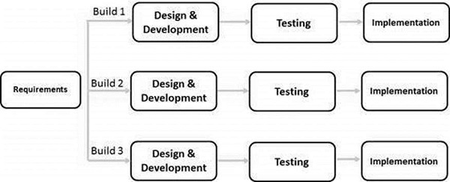
Software Development Model Used (SDLC)
Incremental Model is a process of software development where requirements divided into multiple standalone modules of the software development cycle. In this model, each module goes through the requirements, design, implementation and testing phases. Every subsequent release of the module adds function to the previous release. The process continues until the complete system achieved.
Reason to use:
When the requirements are superior.
A project has a lengthy development schedule.
When Software team are not very well skilled or trained.
When the customer demands a quick release of the product.
You can develop prioritized requirements first.

Slide 4
List or Requirements as per SRS
F1. Registration
Input: Name, Email, Password, Profile photo
Output: “Confirm registration by OTP”
Process: Check constraints of mandatory fields and others and store data in database,
and generate OTP.
F2. Confirm Registration
Input: OTP, Email
Output: Registration status
Process: check whether it is correct or not. Generate a tag, Send to Email.

Slide 5
F3. Login
Input: Email Id/Tag, Password.
Output: Login Status
Process: Check constraints of mandatory fields and others. And match Id and Password.
F4. Change Password/Forgot Password
4.1
Input: User Details
Output: Link will be received in mail
Process: Generate a link to change password and send via email

Slide 6
4.2
Input: New Password, Confirm Password
Output: “Password changed successfully”
Process: Update password in data-base
F5. Explore
Output: Display streamers rank wise
Process: Calculate Rank according to Lscore
5.1 Search
Input: Name/Id
Output: Display streamers
Process: Retrieve from Database

Slide 7
F6. Buy membership
Input: Membership Plans
Output: “Membership purchased”
Process: Deduct Lcoins from account/profile.
F7. Go live
7.1 Details for stream to display
Input: Title of stream*, Thumbnail*, Description, Schedule Session
Output: Preview
7.2 Advanced Options
Input: Enable/Disable special chats.
Output: “Settings saved”
Process: Start the live session according to saved settings

Slide 8
F8 View Stream
Input: Stream id
Output: Play Stream
Process: Retrieve stream data from server
F9 Chat
9.1 Regular Chat
Input: Chat Message
Output: Comment On the stream
Process: Show message in chat section
9.2 Special Chat
Input: Chat Message, Lcoins (minimum 1)
Output: Highlighted Comment in the Stream
Process: Show message in chat section with Highlighted and notify streamer

Slide 9
F10 Statistics
Input: Stream data from profile
Output: Show stats graphs and Charts
Process: Calculate required Data
F11 Redeem LCoins
Output: LCoins Credited
Process: Add LCoin to user’s profile
Received gifts & donations
Special chats
From ranking revenue [LScore / 1000]
F12 Convert LCoins to Money and purchase LCoins
Output: Simulation of Transaction

Slide 10
F13 Contact Us/ Grievance and Report
13.1 User
Input: Ask a Question
Output: Reply from Admin/ Invalid Question
Process: Add Question Box
13.2 Admin
Input: Get Reply Message
Output: Reply to User
Process: Add Answer to Question Box

Slide 11
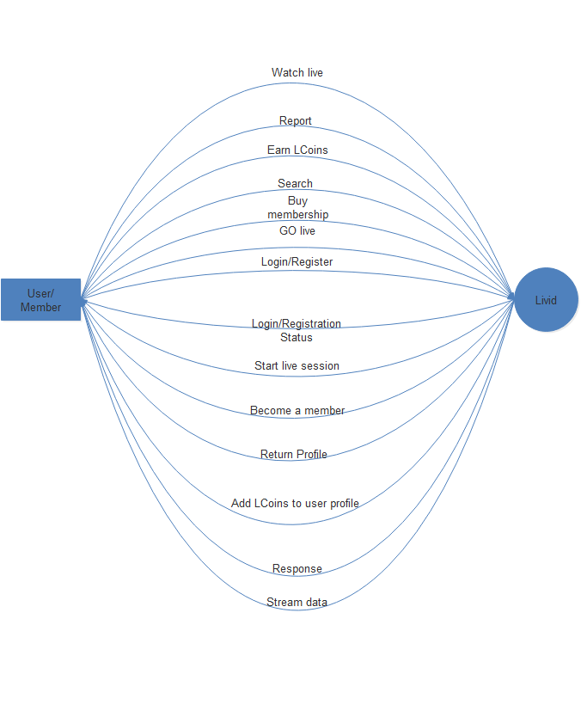
Level-0 Dataflow Diagram

Slide 12
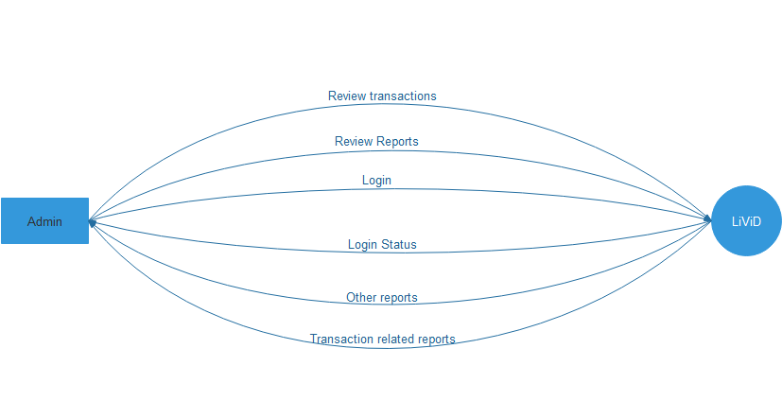
Level-0 Dataflow Diagram

Slide 13
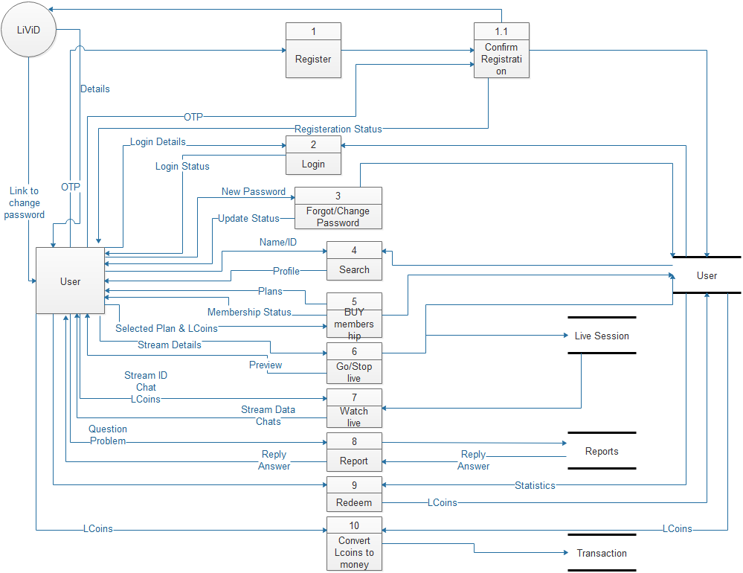
Level-1 Dataflow Diagram

Slide 14
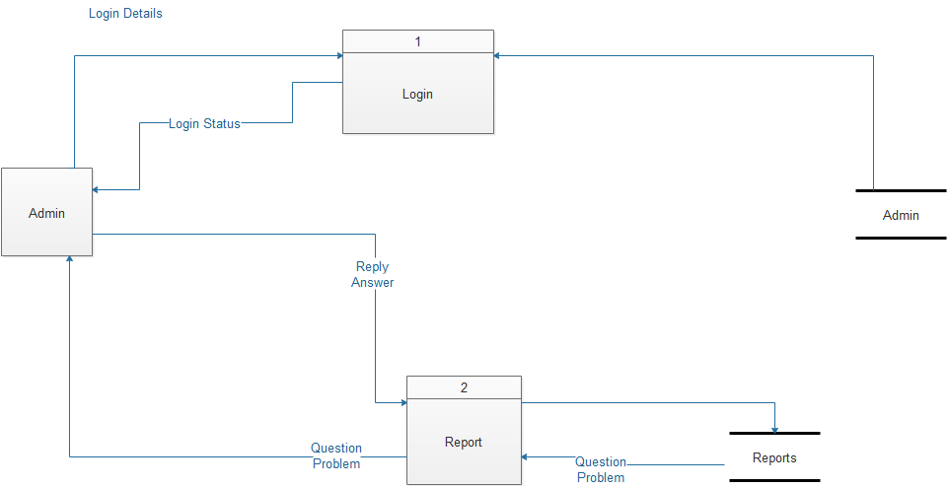
Level-1 Dataflow Diagram

Slide 15
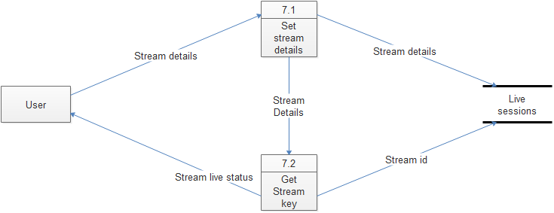
Level-2 Dataflow Diagram

Slide 16
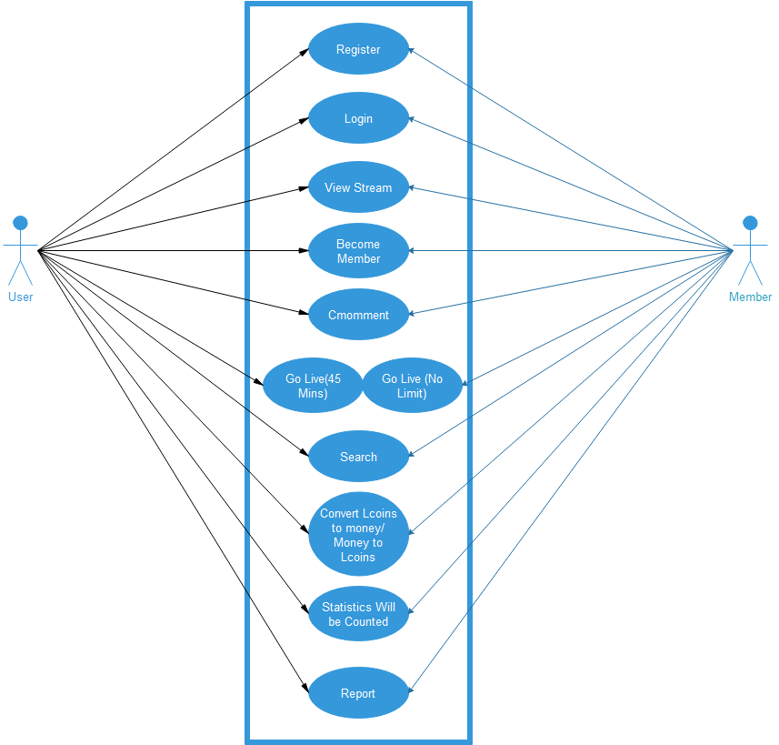
Use case Diagram

Slide 17
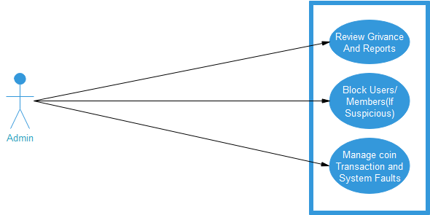
Use case Diagram

Slide 18
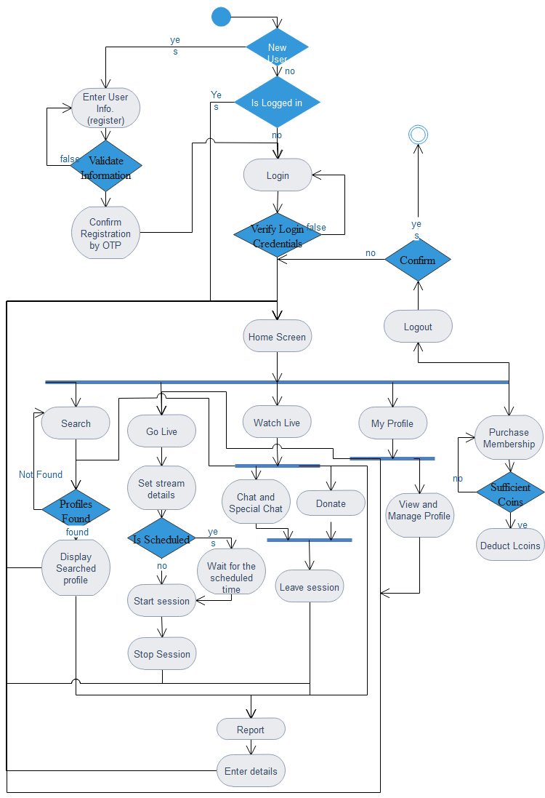
Activity Diagram

Slide 19
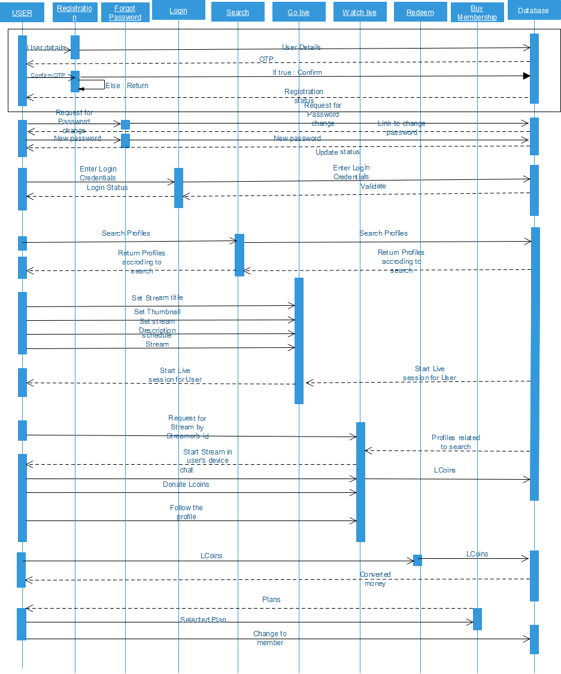
Sequence Diagram

Slide 20
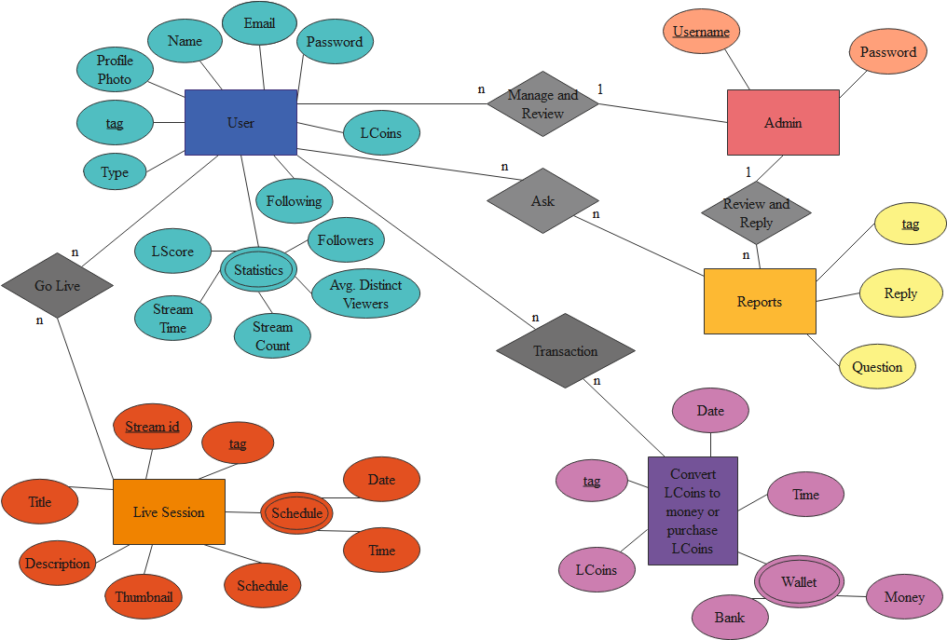
ER Diagram

Slide 21
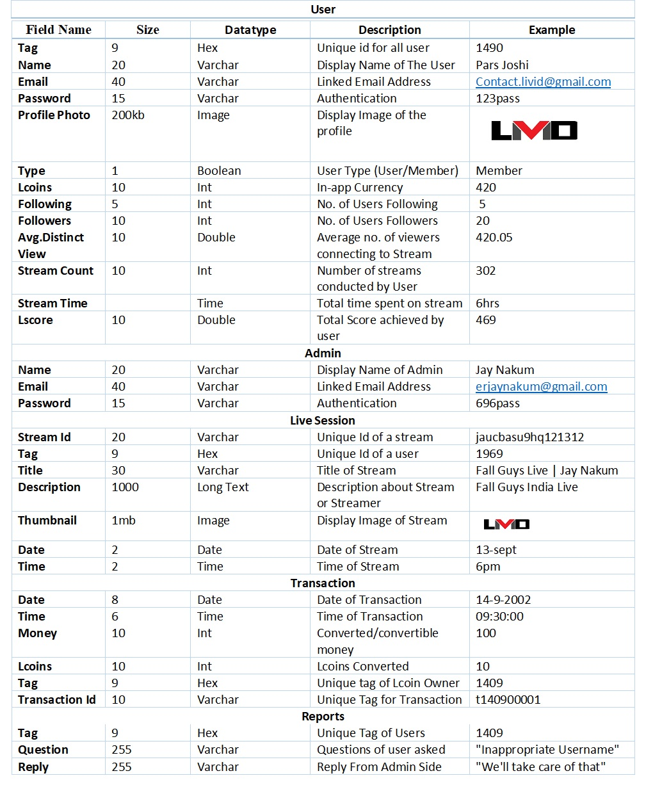
Data Dictionary

Slide 22

Sample UI

Slide 23
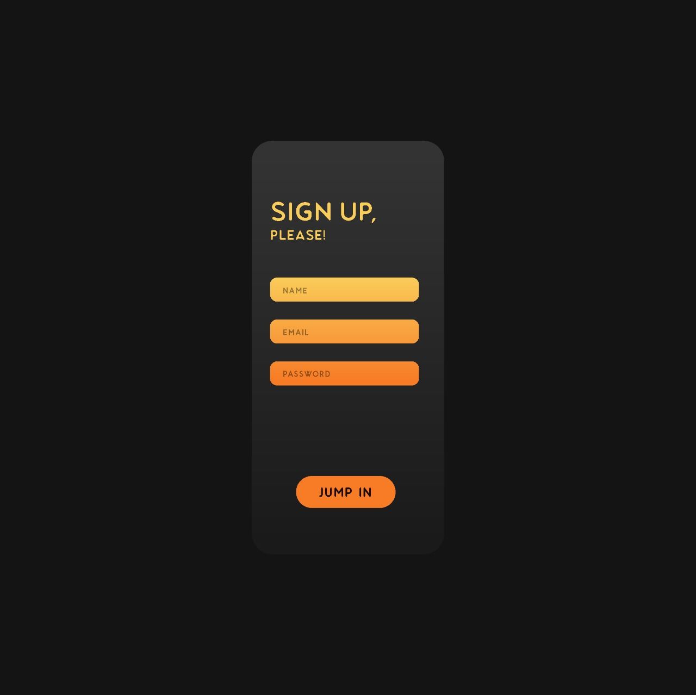
Sample UI

Slide 24
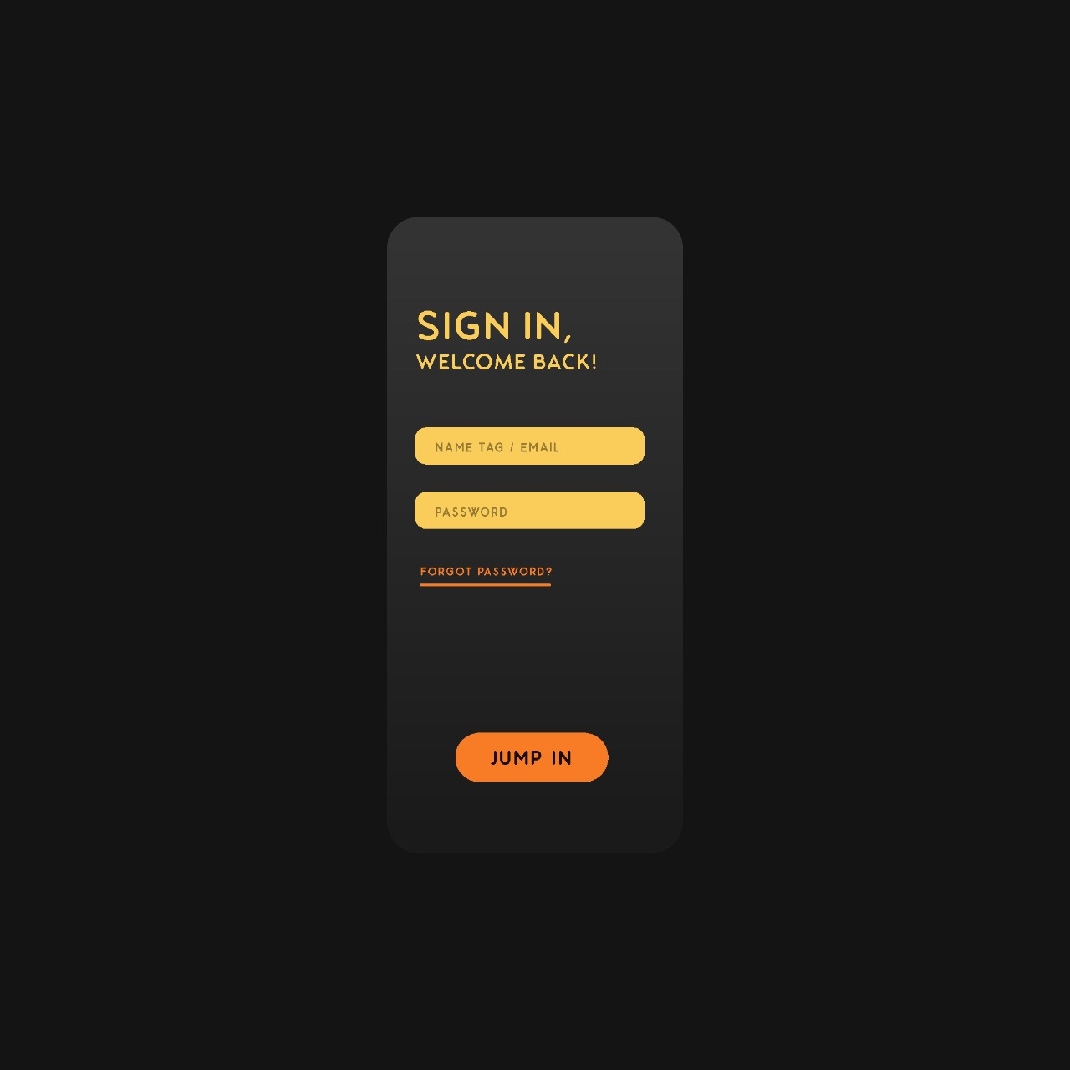
Sample UI

Slide 25
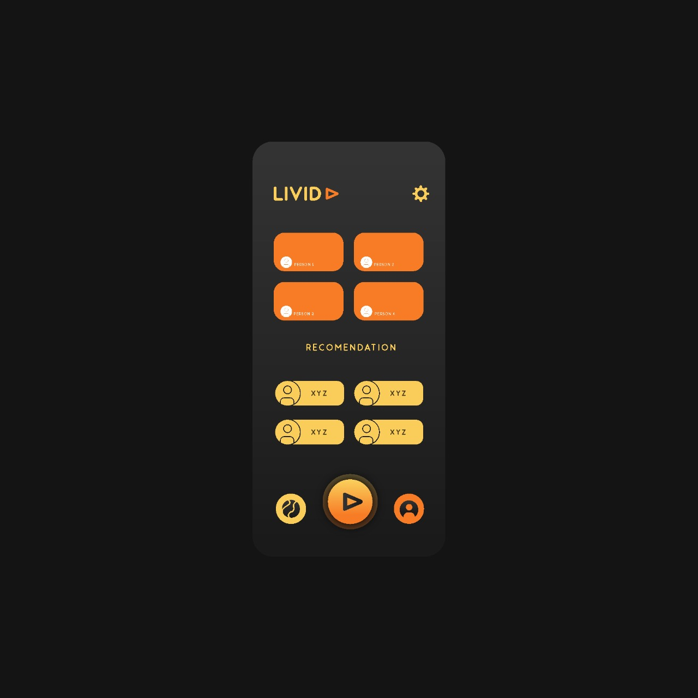
Sample UI

Slide 26

Sample UI

Slide 27

References
https://www.twitch.tv/
https://obsproject.com/
https://meet.google.com/
https://www.javatpoint.com/
https://www.geeksforgeeks.org/
https://www.visual-paradigm.com/guide/data-flow-diagram/what-is-data-flow-diagram/
https://www.lucidchart.com/blog/data-flow-diagram-tutorial
https://medium.com/@warren2lynch/data-flow-diagram-comprehensive-guide-with-examples-d9858387f25e
https://miro.medium.com/max/829/0*W691GG6rn94caqFZ.gif
https://pin.it/2P3MkH9
https://pin.it/7CsN0a8

Slide 28

References
https://pin.it/1E8mBb5
https://pin.it/1UIKXTz
https://pin.it/4z3KorM
https://www.sketch.com/
https://www.behance.net/gallery/88403131/Social-App-for-Live-streaming-Video
https://blog.hootsuite.com/youtube-stats-marketers/#:~:text=1.,1.8%20billion%20in%20May%202018
https://www.tutorialspoint.com/sdlc/images/sdlc_iterative_model.jpg
https://www.javatpoint.com/software-engineering-incremental-model
https://www.qualcomm.com/snapdragon/processors/comparison
https://gadgets.ndtv.com/mobiles/micromax-phones

Slide 29
Thank You
Instagram http://instagram.com/Jay__Nakum
http://instagram.com/_ig_parzival
http://instagram.com/_bhavikbhundiya
Twitter http://twitter.com/Jay__Nakum
http://twitter.com/kishan9217
http://twitter.com/__DicTaToR1__
Email contact.jaynakum@gmail.com
erbhavikbhundiya@gmail.com
kishan9217@gmail.com

Slide 30
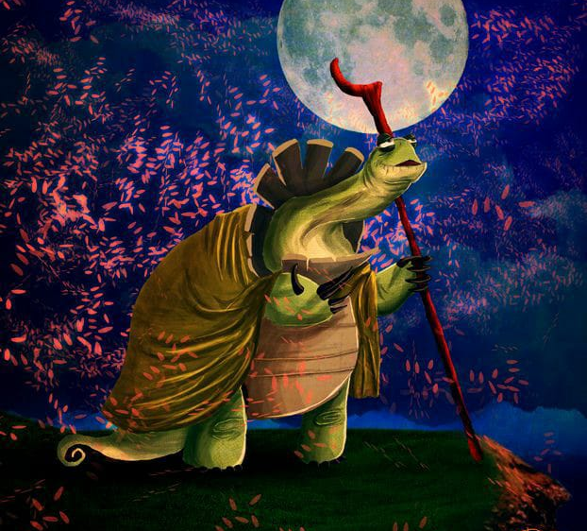
Yesterday is history, tomorrow is a mystery, and today is a gift...that's why they call it present- Master Oogway (Kung-fu Panda)

