Slide 1
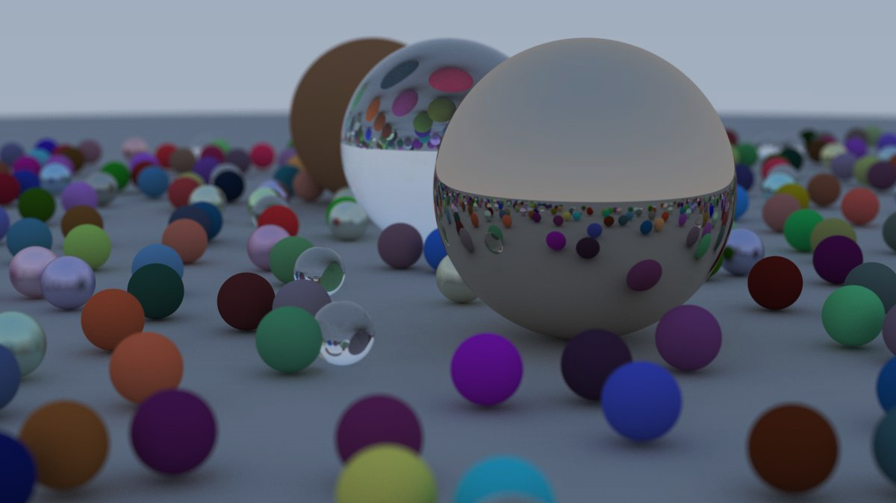
Realtime Ray Tracing & Global Illumination
Project by: Jay Nakum and Ckewyn Chawda
Guided by: Dr. Samir Patel

Slide 2
Introduction
Computing how light will behave in real world.
To achieve more photo realistic renders.
Developing using C++, Premake, Vulkan, CUDA.
Applications
Gaming
Light Simulations
Interior Design etc

Slide 3


Background Review
Rise in gaming industry.
Everyone wants more realistic graphics.
Ray tracing == physically based rendering.
Unreal Engine 5
NVIDIA Omniverse
Games: GTA5, Cyberpunk, Portal, Minecraft

Slide 4
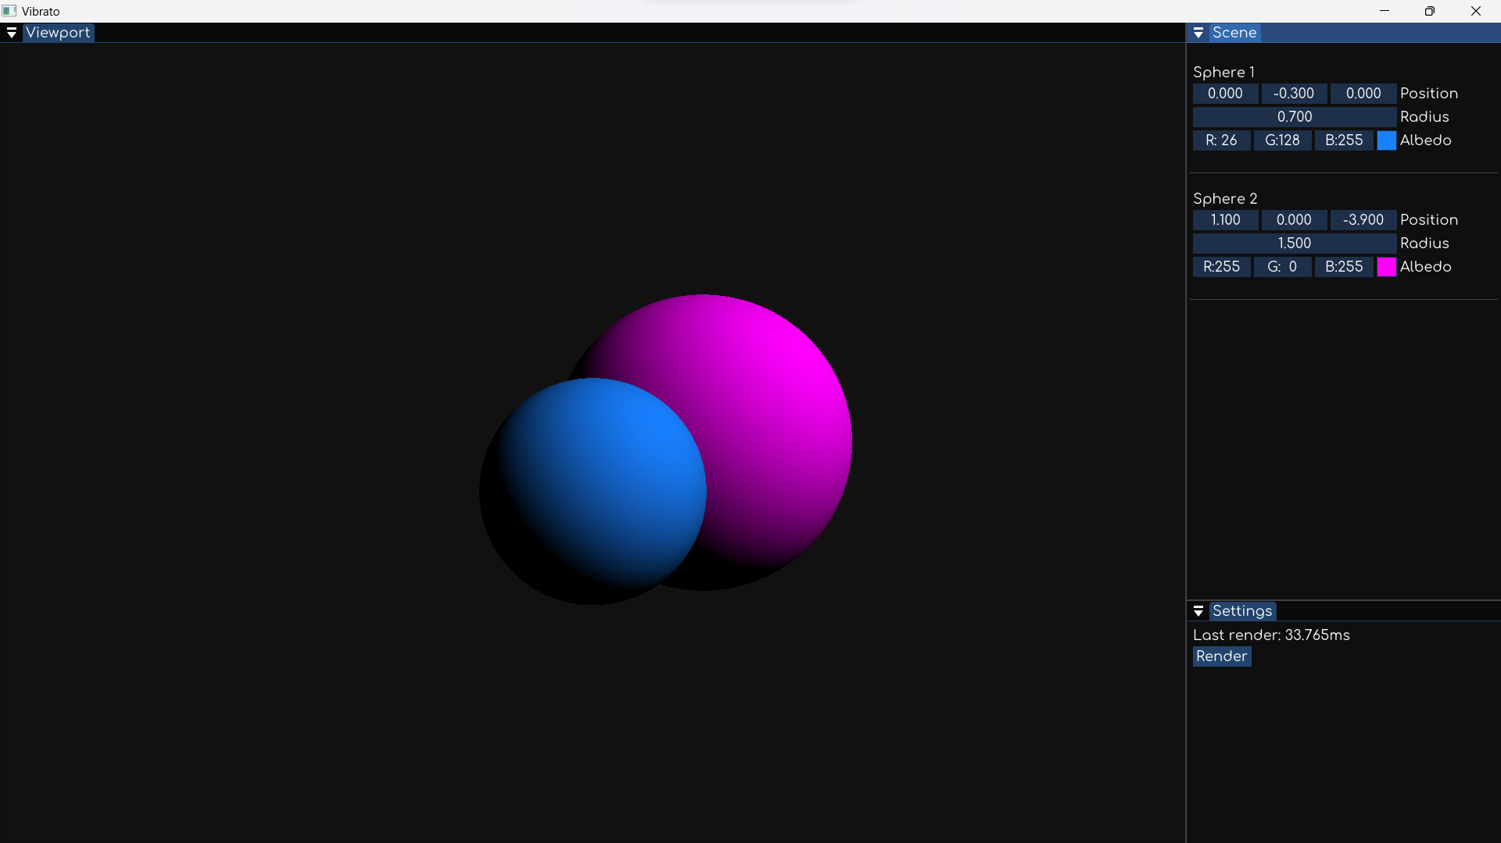
Implementation

Slide 5

Project Architecture
Application Framework • Clef • Vulkan, ImGui
01
Ray tracing Module • Vibrato • Algorithms
02
Renderer Software • Clef App
03

Slide 6

Clef
A simple application framework.
Built with Dear ImGui and designed to be used with Vulkan.
Seemlessly blend real-time Vulkan rendering with a great UI library to build desktop applications.
The plan is to expand Clef to include common utilities to make immediate-mode desktop apps and simple Vulkan applications.

Slide 7

Vibrato
Ray Tracing Methods
Mathematics
Different Approaches
Brute Force Approach (implemented)
Optimizations
GPU Acceleration

Slide 8
Architecture
Our Project
Hardware
GPU
Languages and APIs
CPU
C++
Vulkan
CUDA
Clef
Vibrato

Slide 9
Progress and Findings
Application framework (Week 1)
Ray tracing pipeline (Week 2)
Brute force approach (Week 3)
Polygons, Textures and Materials (In Progress)
Ensuring 60fps output requires powerful computations. Some way of parallel processing is must for realtime renders.

Slide 10
Future Plans and Research
Implement different raytracing methods:
Monte Carlo, bi-directional, metropolis, photon mapping methods
GPU Acceleration using CUDA or Vulkan.
Attempt to devise an improved method:
Faster Calculation or Better Results

Slide 11
References
“Vulkan Tutorial” https://vulkan-tutorial.com/
“Dear ImGUI” https://github.com/ocornut/imgui
“Ray Tracing in One Weekend.” raytracing.github.io/books/RayTracingInOneWeekend.html
“Ray Tracing Series by The Cherno” https://youtube.com/playlist?list=PLlrATfBNZ98edc5GshdBtREv5asFW3yXl

