Slide 1
CNN
Image Processing Workshop Presentation Export
Generated: 2026-03-06 17:25:32

Slide 2
Table of Contents
Workshop 1 - Basic CNN

Slide 3
Workshop 1 - Basic CNN - Summary
Dataset: size=28, samples/class=500, split=0.20, seed=42
Augmentation: rotation=on (18.0), noise=on (std=10.0)
Training: mode=Workshop/full, epochs=10, batch=32, tf_logs=ERROR
Evaluation: accuracy=89.75% | loss=0.2276

Slide 4
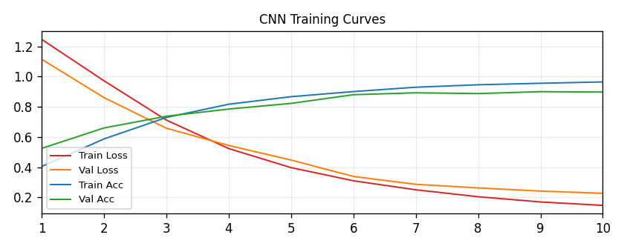
Workshop 1 - Basic CNN
CNN - Training curves

Slide 5
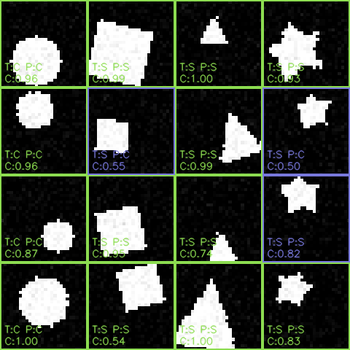
Workshop 1 - Basic CNN
CNN - Prediction montage

