Slide 1
Workshop 5
Image Processing Workshop Presentation Export
Generated: 2026-03-05 17:19:25

Slide 2
Table of Contents
Thresholding
Assignment 1 - Task 2
Assignment 2 - Object Detection

Slide 3
Thresholding - Summary
Adaptive Method: Gaussian
Block Size: 27, C: 15.7
Otsu Blur: 5

Slide 4

Thresholding
Original gray

Slide 5
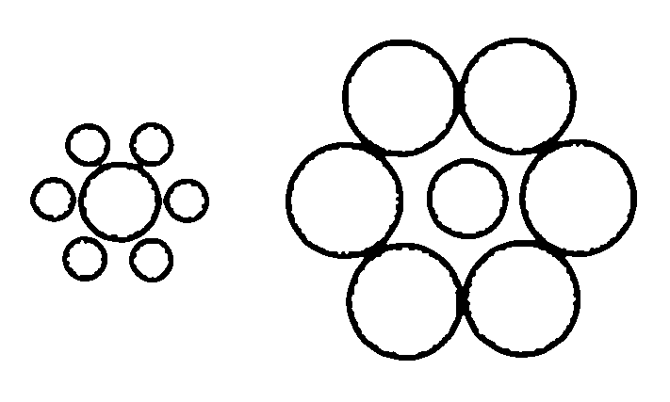
Thresholding
Adaptive

Slide 6

Thresholding
Otsu raw

Slide 7

Thresholding
Otsu blur

Slide 8
Assignment 1 - Task 2 - Segmentation
Method: Otsu
Block: 25, C: 12.5

Slide 9
Assignment 1 - Task 2
Segmentation - Original gray

Slide 10
Assignment 1 - Task 2
Segmentation - Binary

Slide 11

Assignment 1 - Task 2
Segmentation - Labeled

Slide 12
Assignment 1 - Task 2 - Object Detection
Mask Source: Otsu
Min Area: 182.7
Morph Open: 5, Morph Close: 7

Slide 13

Assignment 1 - Task 2
Detection - Binary

Slide 14
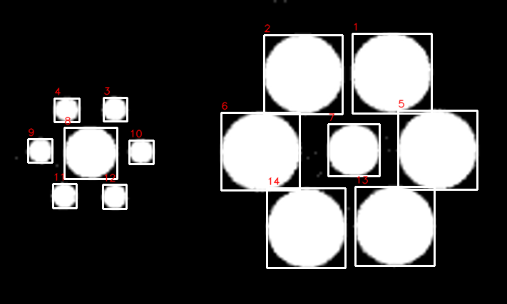
Assignment 1 - Task 2
Detection - Annotated

Slide 15
Assignment 1 - Task 2 - Detection Table
Label | Area | Perimeter | BBox | Centroid
1 | 9728 | 371.12 | (494, 47, 111, 112) | (548.7, 101.9)
2 | 9662 | 365.95 | (370, 49, 110, 111) | (425.0, 103.8)
3 | 883 | 109.25 | (145, 137, 33, 33) | (160.6, 153.2)
4 | 892 | 110.33 | (76, 138, 35, 33) | (93.0, 153.7)
5 | 9659 | 367.95 | (558, 155, 111, 111) | (613.1, 209.9)
6 | 9574 | 365.46 | (310, 158, 110, 109) | (365.1, 212.5)
7 | 4161 | 240.89 | (460, 174, 72, 73) | (495.6, 210.6)
8 | 4166 | 243.48 | (90, 179, 74, 72) | (126.7, 214.1)

Slide 16
Assignment 1 - Task 2 - Detection Table
Label | Area | Perimeter | BBox | Centroid
9 | 912 | 111.25 | (39, 195, 34, 33) | (55.9, 211.3)
10 | 904 | 110.08 | (181, 197, 34, 33) | (197.7, 212.8)
11 | 920 | 110.67 | (74, 258, 33, 34) | (89.8, 274.6)
12 | 896 | 110.08 | (144, 259, 33, 34) | (160.3, 275.6)
13 | 9678 | 369.71 | (498, 262, 111, 111) | (553.4, 316.9)
14 | 9613 | 368.53 | (374, 264, 110, 112) | (429.2, 320.1)

Slide 17
Assignment 2 - Object Detection - Settings
Invert: No, Blur: 5
Min Area: 534.2, Min Circularity: 0.53
Morph Open: 3, Morph Close: 3
Table sort: Area Desc, label >= 1

Slide 18
Assignment 2 - Object Detection
Original gray

Slide 19

Assignment 2 - Object Detection
Binary

Slide 20
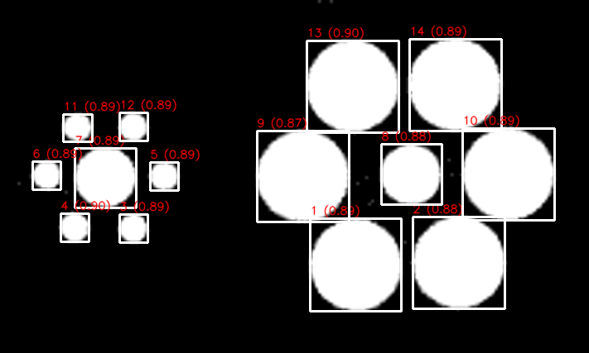
Assignment 2 - Object Detection
Annotated

Slide 21
Assignment 2 - Object Detection Table
Label | Area | Circularity | BBox | Centroid
14 | 9563.0 | 0.890 | (494, 47, 111, 111) | (548.7, 101.8)
2 | 9529.0 | 0.885 | (498, 262, 111, 111) | (553.4, 316.9)
13 | 9522.5 | 0.895 | (370, 49, 111, 111) | (425.0, 103.8)
10 | 9501.5 | 0.888 | (558, 155, 111, 111) | (613.1, 209.9)
1 | 9457.5 | 0.889 | (374, 264, 110, 112) | (429.2, 320.1)
9 | 9431.0 | 0.874 | (310, 158, 111, 110) | (365.2, 212.6)
7 | 4065.5 | 0.892 | (90, 179, 74, 72) | (126.8, 214.1)
8 | 4054.0 | 0.885 | (460, 174, 73, 73) | (495.6, 210.6)

Slide 22
Assignment 2 - Object Detection Table
Label | Area | Circularity | BBox | Centroid
4 | 875.5 | 0.904 | (73, 258, 34, 34) | (89.7, 274.7)
6 | 859.5 | 0.887 | (39, 195, 34, 34) | (55.9, 211.3)
5 | 858.5 | 0.886 | (181, 196, 34, 34) | (197.7, 212.7)
3 | 848.5 | 0.895 | (144, 259, 34, 34) | (160.4, 275.7)
11 | 843.5 | 0.890 | (76, 138, 35, 33) | (93.0, 153.6)
12 | 837.0 | 0.892 | (144, 136, 34, 34) | (160.5, 153.1)

