Slide 1
SnakeGuard
Explainable snake vs. look-alike detection for an ankle-worn early-warning system
Review 2 · Objectives · Dataset Selection & Understanding · Methodology
[Member A name] · [Member B name] | Guide: [Guide name] | October 2026
Notes:
Introduce the project and the three topics of this review: objectives, the dataset and how we selected and understood it, and the complete methodology.

Slide 2
Why SnakeGuard
5 M
138 k
7 of 8
0 of 8
snakebites per year worldwide (WHO)
deaths per year, mostly rural farmers
prior systems train on snake-only data
prior systems explain what the detector looks at
Gap 1 – Data: detectors never see ropes, roots or hoses, so they alarm on a garden hose as readily as on a viper.
Gap 2 – Trust: a bare confidence score cannot reveal a spurious correlation or explain a failure. A warning device nobody trusts is one nobody keeps wearing.
SnakeGuard: ankle camera → detect snake vs. look-alike → classify venom → estimate proximity → glanceless beep, with an explainability layer that validates the detector.
Notes:
Snakebite is a major hazard for farmers. Existing systems are trained on snake-only data and none explains its decisions. Our system adds an explicit look-alike class and a validated explainability layer.

Slide 3
Clear Objectives
1
Aim · specific objectives · research questions · scope

Slide 4
Aim: detect, explain, validate
Build a trustworthy snake-detection pipeline for a wearable device that separates real snakes from look-alikes, explains every detection, and quantitatively validates which explanation method can be trusted before deployment.
1
2
3
Detect
Explain
Validate
Lightweight YOLO11n detector trained on snakes and an explicit look-alike class (ropes, roots, hoses, pipes, belts).
Several independent XAI families explain each detection: activation, gradient (multi-scale) and perturbation methods.
Objective tests decide which explanation to trust: faithfulness vs. random, localisation, sanity, stability, cost.
Notes:
One sentence aim, then three pillars. The key word is validate: we do not trust a heatmap because it looks plausible; we test it quantitatively.

Slide 5
Specific objectives
O1
Dataset
O2
Detector
Two-class dataset with explicit look-alikes; documented, audited
Edge-ready YOLO11n; mAP and error taxonomy on held-out test
O3
Explainers
O4
Objective comparison
Activation, gradient (multi-scale) and perturbation methods, one interface
Faithfulness, localisation, agreement, sanity, stability, cost
O5
Hard cases
O6
Validation signal
Matched snake vs. look-alike pairs: why right, why wrong
Can explanations flag wrong detections better than confidence?
O7
Runtime pipeline
O8
Venom stage (B)
Confirmation, proximity, 0–100 threat score, beep rate
Venom classifier + its XAI on the shared protocol
Notes:
Eight objectives, each with a measurable success criterion (details in the report, Table 2.1). O1–O7 are Member A's detector and pipeline work; O8 is Member B's venom classifier.

Slide 6
Research questions
RQ1
Faithfulness
Which XAI method most faithfully explains a one-stage YOLO detector, judged against a random baseline?
RQ2
Localisation
Do explanations land on the snake itself (box or polygon) or on background cues?
RQ3
Hard cases
In matched snake / look-alike pairs, what drives correct detections and confusions?
RQ4
Design choices
Does multi-scale fusion beat one coarse layer? Is agreement between methods trustworthy?
RQ5
Deployment
Best trade-off between faithfulness, localisation, stability and runtime for the device?
Notes:
These five questions structure the methodology. Every metric we compute answers one of them.

Slide 7
Scope and division of work
In scope
A
Member A: Detection · XAI · evaluation · pipeline
Frozen YOLO11n detector on the two-class dataset
Post-hoc explanation of individual detections
Quantitative comparison of XAI methods
Runtime logic: confirmation, proximity, threat, alert
Venom-classifier interface
Detector wrapper and baseline evaluation
Detector explainers
Shared evaluation harness
Benchmark, hard cases, explanation check
Runtime pipeline
B
Member B: Venom classification · application
Out of scope (this phase)
Retraining / architecture search
Hardware build and field trials
Depth sensing (distance from box size only)
Species-labelled dataset, venom mapping
Venom classifier
Classifier explainers (shared interface)
Classifier XAI benchmark
Demonstration app
Notes:
Be clear about what is not in this phase: no retraining, no hardware build, no field trials. The detector is frozen so the XAI work explains a fixed model.

Slide 8
Dataset Selection & Understanding
2
Requirements · composition · statistics · quality audit

Slide 9
Selection: requirements and why a composite dataset
R1
Explicit hard negatives
Decision: build a composite dataset
A dedicated look-alike class, not unstructured background
Public snake datasets are almost all positive-only
The one prior system with negatives (ropes, sticks, leaves) did not release its data
So: merge public Roboflow Universe and Kaggle sources: snake sets for class 0, one source per look-alike category for class 1
Relabel into two classes, split into train / validation / test
Look-alikes become a first-class part of training, not an afterthought
R2
Natural snake imagery
Many species, postures, backgrounds, night shots
R3
Localisation labels
Boxes for detection; polygons for precise XAI checks
R4
Scale
Tens of thousands of images with held-out splits
R5
Open licences
Public sources, mostly CC BY 4.0
Notes:
No public dataset has natural snakes plus an explicit class of look-alikes at this scale, so we merged public sources. This directly addresses the dataset gap from the literature review.

Slide 10
Classes and composition
0
snake
Any real snake: any species, posture, partly hidden, any light
1
snake_like_object
Elongated, thin, curved or coiled non-snakes: belts, ropes and nooses, roots, hoses, pipes
Notes:
Images were renamed during merging, so we reconstructed the composition from the data: each source shows up as a block of image IDs with one fixed resolution. Exact links are in report/dataset_sources.md.

Slide 11
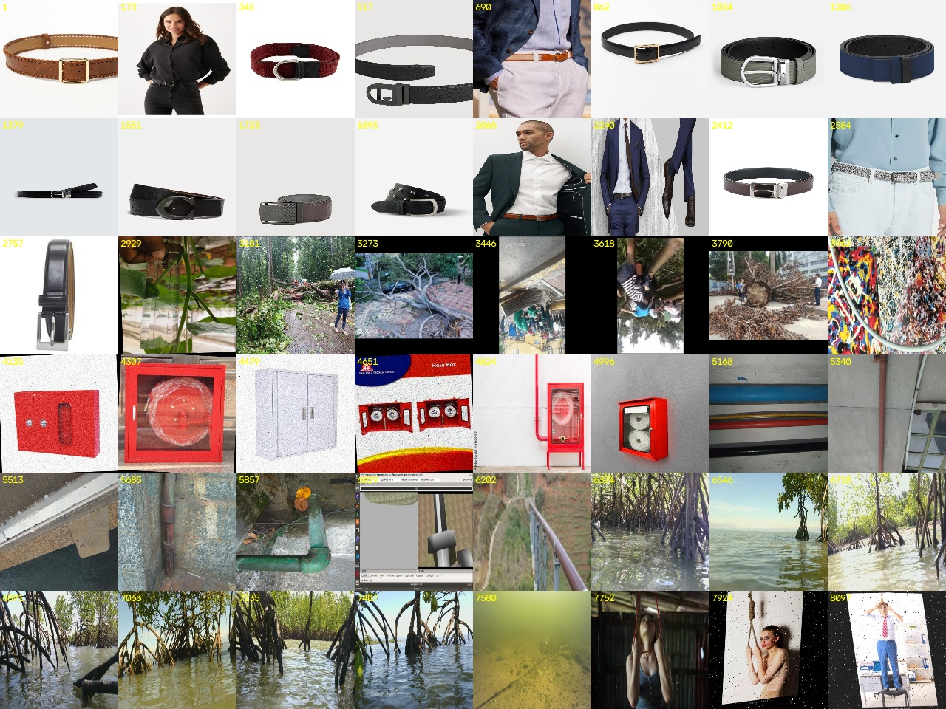
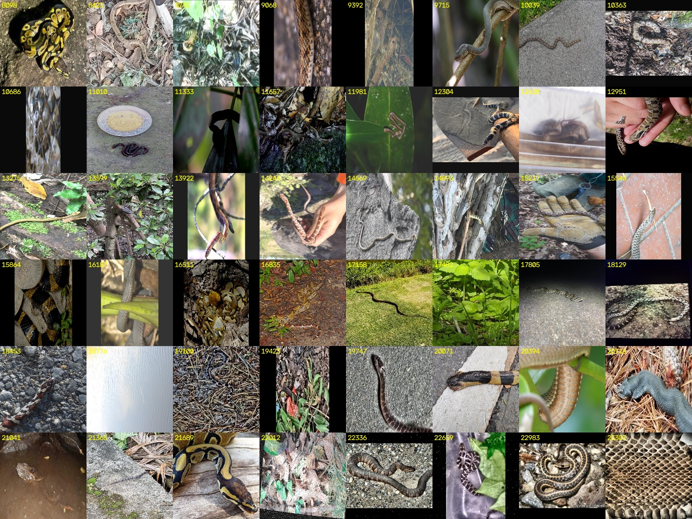
What the classes look like
Look-alike class (48 samples)
Snake class (48 samples)
Notes:
Left: look-alikes sampled across the ID range; the source blocks are visible (belts, fallen trees, hose cabinets, pipes, mangrove roots, ropes). Right: snakes, with many species and backgrounds.

Slide 12
Splits and annotation format
Split | Images | Box / polygon | Background
Train | 20,294 | 16,630 / 4,850 | 1,813
Validation | 2,172 | 2,057 / 451 | 7
Test | 841 | 707 / 242 | 0
YOLO label lines
Box: class, x-centre, y-centre, width, height (≈ 77 %)
Polygon: class, x1 y1 x2 y2 … (≈ 23 %): the exact outline
Empty file = background image (no object)
All coordinates normalised to [0, 1]
Notes:
23,307 images, 24,937 objects. Both classes are present in every split (55 : 45). Labels are YOLO format: mostly boxes, about a quarter polygons, which we later use as precise masks for XAI.

Slide 13
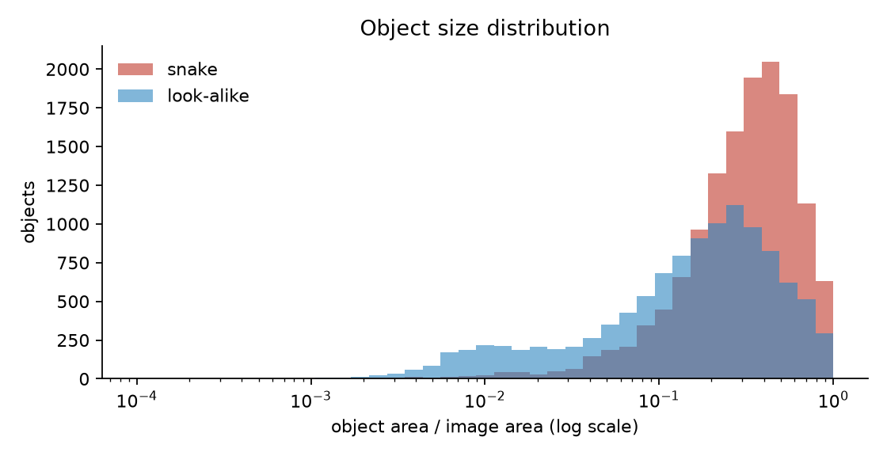
Understanding the data
33 %
median snake size (share of image)
18 %
median look-alike size
83 %
of training images hold exactly one object
994
distinct image resolutions
Object area as a share of image area (log scale). 6.3 % of look-alikes but only 0.5 % of snakes are smaller than 1 % of the image.
Notes:
Snakes tend to fill the frame (median 33 %), look-alikes are smaller (18 %). Most images hold one object. Small, distant objects are the hard case, which is why the pipeline has a small-object filter and a proximity estimate.

Slide 14
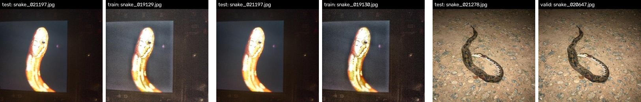
Data quality audit
!
Source shortcut risk
≈
Near-duplicates across splits
99.4 %
of images: the class is predictable from resolution alone, because each class came from different sources.
Hash + pixel check: 646 verified pairs
Only 20 test images (2.4 %) have a near-twin
Validation used only for tuning
Test reported with and without them
Mitigation: all inputs are resized, and the localisation metrics check that explanations point at the object, not at source style.
Notes:
Two risks of merged datasets. Shortcut: resolution alone predicts the class for 99.4 % of images; the network never sees raw resolution, but source style could leak, and our localisation metrics test exactly that. Leakage: only 20 test images have a verified near-twin; results are checked with and without them.

Slide 15
Complete Methodology
3
Detector · target score · XAI methods · evaluation · runtime pipeline

Slide 16
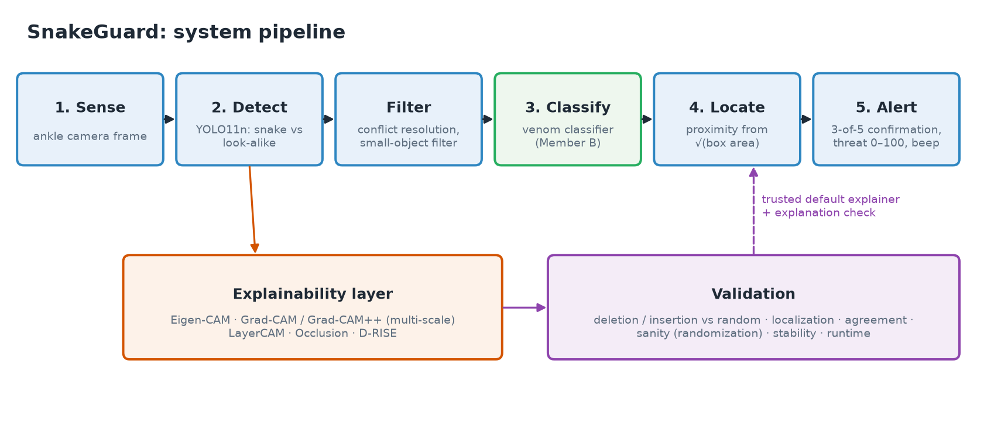
System pipeline
Notes:
Five stages from the proposal, with the explainability and validation layer attached to the safety-critical Detect stage. The validated method feeds back into the device as its default explainer.

Slide 17
Detection model: YOLO11n
Backbone
Neck
Head
Training and evaluation
Layers 0–10
Layers 11–22
Layer 23
Ultralytics pipeline, 30 epochs, batch 16, Colab
Per-class NMS (IoU 0.7), conf ≥ 0.25
mAP@0.5, mAP@0.5:0.95, per-class P / R
Error taxonomy: TP, class confusion, background FP, missed object
Failure gallery of the most confident mistakes
C3k2 blocks, SPPF, C2PSA attention
Feature pyramid → P3 (stride 8), P4 (16), P5 (32)
Box + 2 class scores at every P3/P4/P5 location
2.58 M
6.4
640 px
parameters
GFLOPs
input, rect letterbox
Notes:
Nano model for an embedded wearable: 2.58 M parameters. Three output scales; P3 sees small objects, P5 large ones. The model is frozen for the XAI work.

Slide 18
What is being explained: the target score
s(x) = maxᵢ IoU( bᵢ(x), b ) · pᵢ( c | x )
1
b, c
2
i
box and class of the detection we explain
every raw (pre-NMS) prediction of the image x
3
Same score everywhere
4
Contrastive variant
gradients (CAMs), perturbations (Occlusion, D-RISE), deletion / insertion metric
IoU · (p(c) − p(other class)): why snake rather than look-alike
Notes:
YOLO outputs hundreds of boxes, so confidence has to be defined per detection. We use the D-RISE similarity. It equals the detection's confidence on the original image and keeps following the object under perturbation. The same score is used by every method and every metric.

Slide 19
Explanation methods: three independent families
1
Activation
2
Gradient
3
Perturbation
Eigen-CAM
Grad-CAM · Grad-CAM++ · LayerCAM
Occlusion · D-RISE
First principal component of the feature maps. Fast, no gradients, class-agnostic.
Weight feature maps by gradients of s, fused over P3–P5. LayerCAM weights every location separately.
Hide patches or random masks and measure the drop in s. Model-agnostic, slow.
Proposal: first-pass check
Proposal: why labelled snake
Proposal: ground-truth cross-check
Baselines: random map (the proposal's random-order reference) and box prior (a blob on the detected box): does a method do more than highlight the box?
Notes:
The proposal asks for methods that cross-check each other. Activation methods see what the network responds to; gradient methods see what drives this detection; perturbation methods measure the model's response directly. SHAP and LIME are set aside for the detector because they assume single-label classification.

Slide 20
Multi-scale fusion
P3 · 80 × 80
Fusion
stride 8 · small objects, fine detail
Compute the CAM on layers 16, 19 and 22 (P3, P4, P5)
Upsample each map to the input size
Normalise each map to [0, 1]
Fuse: mean (max and sum also tested)
Map back to original image coordinates
Ablations: P3-only, P4-only, P5-only
P4 · 40 × 40
stride 16 · medium objects
P5 · 20 × 20
stride 32 · large objects, coarse
Notes:
A single coarse layer (P5, 20×20 grid) cannot resolve a thin snake. We hook all three neck outputs, normalise each map and fuse them. Single-scale P3, P4 and P5 variants are kept as ablations to test the proposal's claim.

Slide 21
Evaluation protocol: six axes
1
Faithfulness
2
Localisation
3
Agreement
Deletion ↓ and insertion ↑ AUC, compared with the random baseline on the same detection
Pointing game, energy inside GT, saliency IoU, against box and polygon
Spearman rank and top-20 % IoU between methods
4
Sanity
5
Stability
6
Cost
Cascading weight randomisation: the map must change when the model is destroyed
Similarity of maps under small input noise (σ = 0.02)
Milliseconds per explanation on the target GPU
Notes:
An explanation is judged by tests, not by how plausible it looks. Faithfulness is the main axis; the others check localisation, agreement, sanity, stability and cost. Means come with 95 % bootstrap intervals and paired Wilcoxon tests.

Slide 22
Hard cases and explanation-based check
A
Matched snake / look-alike pairs
B
Explanation-based verification
Embed every detection: RoI-aligned P5 features
Pair each look-alike, confusion or false positive with its most similar real snake (cosine)
Explain both with all methods, side by side
Question: does the model use body / head shape or a snake-like texture?
Features per detection: share of saliency inside the box, peak inside the box, agreement between methods
Logistic regression trained on validation, tested on test
Target: is this detection wrong?
Compared with confidence alone: AUROC and false alarms at 90 % / 95 % recall
Notes:
Matched pairs: pair each look-alike with the snake the detector itself finds most similar, and compare explanations side by side. Verification: test whether explanation features flag wrong detections better than confidence alone.

Slide 23
Runtime pipeline
Conflict resolution
Small-object filter
1
2
Overlapping snake and look-alike: keep snake unless the look-alike is ≥ 0.15 more confident
Drop boxes < 0.1 % of the frame
Venom status
Proximity
3
4
Member B's classifier → P(venomous); unknown counts as venomous
clip((√area − √0.005) / (√0.25 − √0.005), 0, 1)
Confirmation
Threat and alert
5
6
Snake in ≥ 3 of the last 5 frames
T = 100 · conf · (0.6 · proximity + 0.4 · P(venomous)); beep 1,500 → 150 ms
Notes:
The proposal's stages around the detector. Safety bias in conflict resolution; temporal confirmation against one-frame false alarms; proximity from box size because the device has no depth sensor; one 0–100 threat score drives the beep rate.

Slide 24
Work plan
1
2
3
4
5
6
7
Setup and baseline
Explainers
Evaluation harness
Benchmark and analysis
Venom stage
Integration
Reporting
A
A
A (shared)
A
B
A + B
A + B
Shared contract: every explainer returns a [0, 1] map aligned with the original image, and every metric takes a map plus a score function, so detector and classifier explanations are evaluated the same way.
Notes:
Seven phases. A builds the shared harness, so B's classifier XAI is evaluated on exactly the same protocol. Integration and reporting are joint.

Slide 25
Thank you
Questions on objectives, dataset or methodology
Notes:
Prepared answers to likely questions are in Chapter 5 of the Review-2 document.

