Slide 1
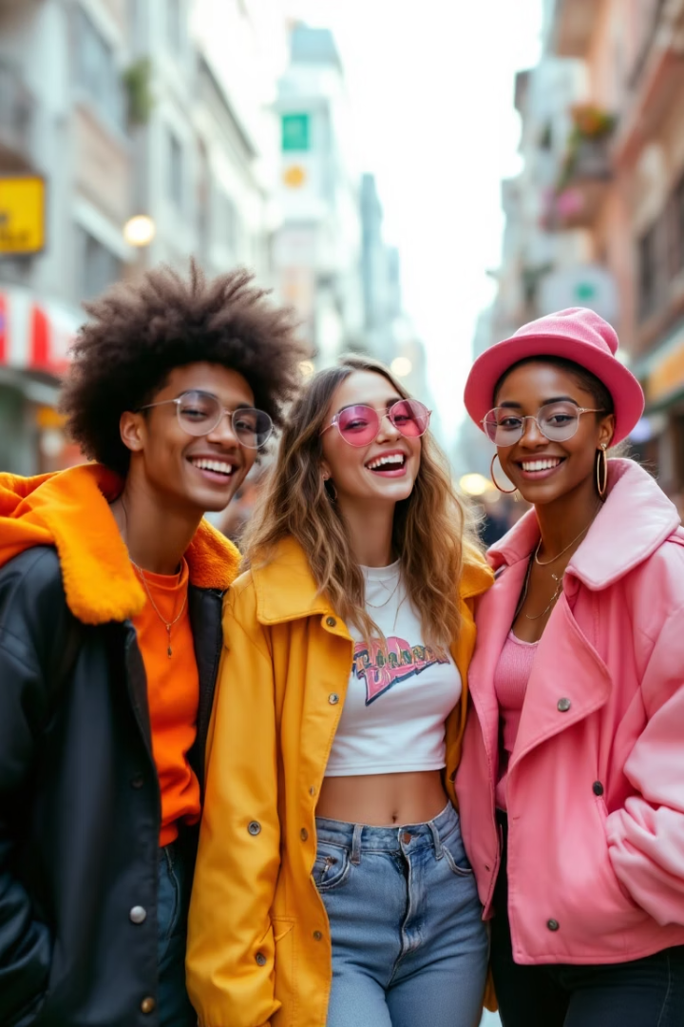

Empowering Individuality with Praso Clothing
Praso Clothing is a Gen Z brand celebrating bold, unique fashion. Our e-commerce platform empowers self-expression with personalized shopping, AI chatbot, and engaging features. Inspired at a grand fashion show, we make fashion a platform for individuality.
by Jay Patel

Slide 2
Lessons That Shaped Us
Technical Growth
User Focus
Mastered HTML, CSS, and JavaScript. Integrated AI chatbots and countdown timers.
Designed intuitive, Gen Z-friendly interfaces. Learned the value of gamified rewards.

Slide 3
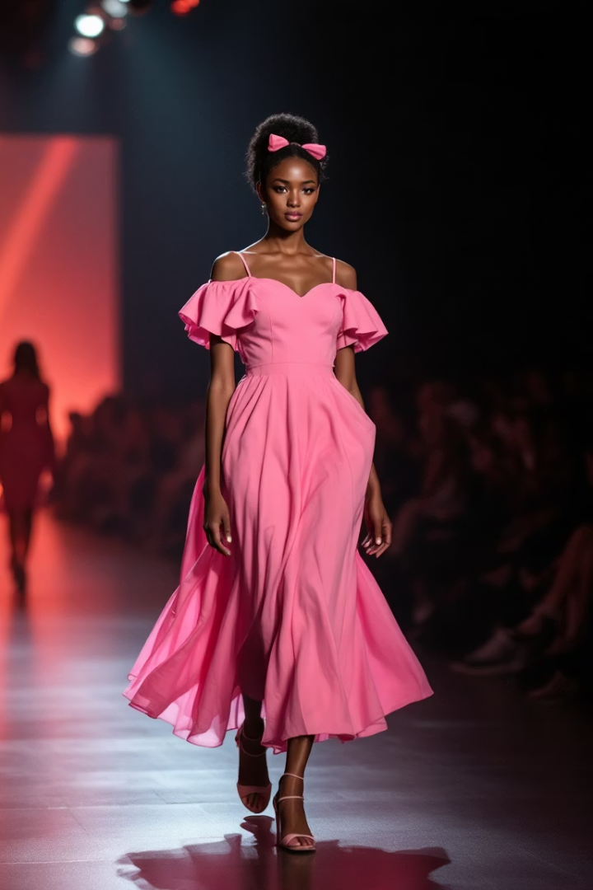
A Spark of Inspiration
Origin Story
Mission
Born at a Clique Entertainment fashion show, inspired by individuality.
Empower users to shine with bold designs and engaging experiences.
Impact
Resonates with Gen Z, celebrating self-expression.

Slide 4

Navigating the Roadblocks
Technical Hurdles
AI chatbot integration and mobile responsiveness were challenging.
Design Balance
Blending vibrant aesthetics with usability required iteration.
Time Pressure
Delivering features like cart and rewards under tight deadlines.
User Engagement
Making rewards exciting but not overwhelming.

Slide 5





Turning Challenges into Triumphs
Technical Solutions
Design Iteration
Agile Process
Used frameworks and testing for smooth integration.
Refined style and function with user feedback.
Adopted sprints for efficient task management.
Engagement
Streamlined rewards with clear visuals.

Slide 6




What Sets Praso Apart
Home Page
Shop
Hero section, countdown, and AI chatbot.
1
2
Curated Men and Women sections for easy browsing.
Rewards & Contact
About Us
4
3
Daily bonuses, discounts, and responsive support.
Founders’ story, reviews, and trust-building content.

Slide 7

Crafting with Code
1
Frontend
HTML, CSS, and JavaScript for structure and style.
2
Dynamic Features
Countdowns, real-time cart, and AI chatbot.
3
Responsiveness
Seamless on desktop, tablet, and mobile.
4
Modular Design
Scalable code for future features.

Slide 8




Conclusion & Future Scope
Reflecting
Praso journey blended creativity, skill, and resilience.
Looking Ahead
Plan to add AR try-on, expand products, and enhance AI chatbot.
Community
Scale rewards and foster user-driven campaigns.

