Slide 1
INDIVIDUAL PROJECT PRESENTATION
Anemia Risk Prediction
Using Machine Learning
NFHS-5 District Factsheet Data | KDD-Based Predictive Analytics
Presented by: Jay Pawar
PRN : 23070521064
01

Slide 2
01 | Problem Statement
Why district-level anemia risk classification?
Problem statement
Project objective
To develop a machine learning model that predicts anemia risk based on demographic, nutritional, and health-related factors.
Classify districts into Low, Medium, or High relative anemia-risk groups using NFHS-5 indicators.
What the model is designed to support
Explore patterns
Prioritise attention
Communicate clearly
Compare health and nutrition indicators across districts.
Flag districts for further public-health review.
Present risk class with a simple district lookup.
ANEMIA RISK PREDICTION • NFHS-5
02

Slide 3
02 | Dataset at a Glance
Source: NFHS-5 India Districts Factsheet dataset
707
106
district records
numeric features before selection
20
80:20
features selected
train/test split
Target variable
The anemia percentage is divided into three risk levels:
  Low (0): Lower anemia percentage
  Medium (1): Moderate anemia percentage
  High (2): Higher anemia percentage
ANEMIA RISK PREDICTION • NFHS-5
03

Slide 4
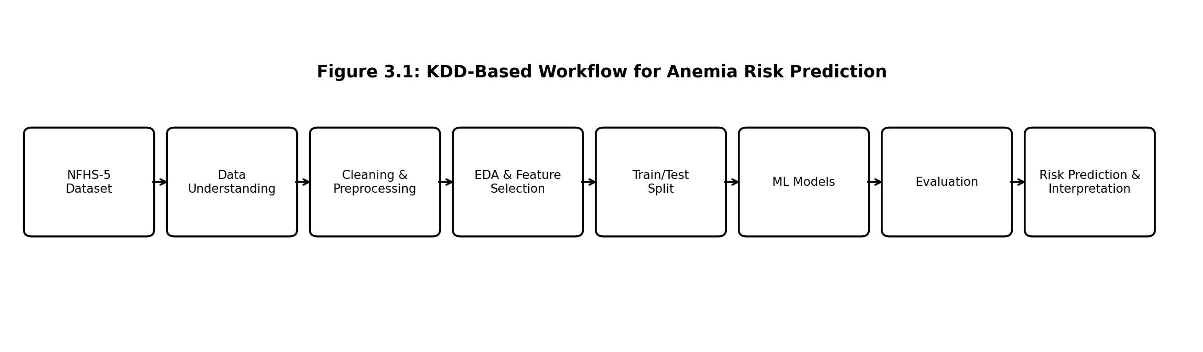
03 | KDD Workflow
From raw factsheet to interpreted district-level prediction
Prepare
Learn
Present
Standardise columns and handle missing values.
Train candidate classifiers on training data.
Report metrics and district prediction.
ANEMIA RISK PREDICTION • NFHS-5
04

Slide 5
05 | EDA & Feature Selection
Keep informative signals and reduce noise
EDA checks
Feature selection
Final feature set
• Missing values
• Numeric summaries
• Class distribution
• Feature correlations
Random Forest importance ranking fitted on training data.
20 top-ranked numeric features retained for modelling.
Before: 106 features
Selected: 20 features
Types of features selected
• nutrition_index
• sanitation_score
• healthcare_access
• BMI overweight/obesity
Feature selection was performed using training data to avoid using test-set information.
ANEMIA RISK PREDICTION • NFHS-5
06

Slide 6
06 | Predictive Modelling Approach
Three candidate models were developed and compared
Random Forest
XGBoost
Stacking Ensemble
Ensemble of decision trees.
Useful for nonlinear patterns and feature-importance ranking.
Gradient-boosted trees.
Learns patterns iteratively and supports sample weighting.
Combines Random Forest and XGBoost outputs using Logistic Regression.
Training setup
80% training
20% testing
565 district records
142 unseen district records
ANEMIA RISK PREDICTION • NFHS-5
07

Slide 7
08 | Dataset & Class Balance
Observed outputs from the notebook run
707
565
142
20
total district records
training records
testing records
selected features
Risk class | Training | Testing
Low (0) | 185 | 47
Medium (1) | 187 | 47
High (2) | 193 | 48
Interpretation
The split keeps the three classes similarly represented in training and testing.
ANEMIA RISK PREDICTION • NFHS-5
09

Slide 8
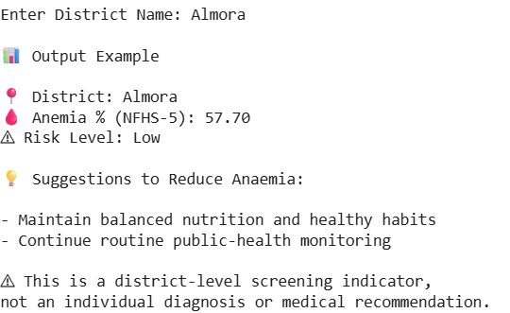
09 | Results: District Prediction Example
Example shown by the notebook for Almora
📍 District
Almora
🩸 NFHS-5 anemia prevalence
57.70%
⚠ Predicted risk class
Low
Important: 57.70% is read from the dataset; the model predicts the risk category, not a new percentage.
ANEMIA RISK PREDICTION • NFHS-5
10

Slide 9
10 | Interpretation & Limitations
What the output means
Key limitations
Risk levels are based on the anemia percentages in our dataset.
Results show anemia risk at the district level.
The model does not diagnose individual people.
• Risk levels are not official medical categories.
• The model needs more testing on other data.
Next improvements
Confirm the target and remove direct/near-direct proxies.
Report measured test metrics and compare with a simple baseline.
Validate on independent data before practical deployment.
ANEMIA RISK PREDICTION • NFHS-5
11

Slide 10
CONCLUSION
An end-to-end KDD workflow was built for district-level anemia risk classification.
01
02
03
Prepare
Model
Interpret
Clean and transform NFHS-5 indicators.
Compare Random Forest, XGBoost and stacking.
Present risk classes with evaluation and limitations.
Thank you
12

