Slide 1
ShopOS
Open-source shop operations for repair, maintenance, fabrication —
and any business that services customer-owned assets.
Automotive-first, deliberately general: customers · assets · work orders · estimates · parts · invoices
github.com/JayQuattro/ShopOS · self-hostable · no crippled community edition
Co-created by a human builder and Z.AI GLM-5.2 & GLM-5.3

Slide 2
WHY THIS EXISTS
Shop management software shouldn't own your shop
THE INDUSTRY DEFAULT
SHOPOS
▸ Closed ecosystems. Your records live in someone else's cloud; export is an afterthought.
▸ Per-seat pricing that climbs as the shop grows.
▸ Roadmaps set by vendors, not by the people turning wrenches.
▸ Open source. One deployable stack, your data in your own PostgreSQL.
▸ Every external dependency sits behind a provider interface — no vendor is required to read your own records.
▸ Ops-first, feedback-driven. The full customer-to-payment workflow ships today.
Product promise: approachable for a small independent shop, structured enough for multi-location — managed SaaS and genuine self-hosting from the same codebase.
ShopOS · open-source launch preview · 2026 · Co-created by a human builder and Z.AI GLM-5.2 & GLM-5.3
2

Slide 3
WHAT'S IN IT TODAY
The full customer-to-payment workflow, implemented
Work orders
Estimating
Authorization
10-state lifecycle enforced server-side, board view, canned jobs, tasks, time, quality checks
Jobs with drag-and-drop lines, good/better/best options, immutable revisions, change orders
Line-level approve/decline via signed expiring links, email, SMS, or staff recording
Inspections
Parts & inventory
Billing & payments
DVI templates with photos and video, flowing into estimates with evidence attached
Suppliers, purpose-tracked orders, OE/aftermarket numbers, interchange, units, cores
Invoice series, AR aging, statements, BYO Stripe/Square/Adyen/Mollie/Mercado Pago/Razorpay
644 integration tests cover it — cross-tenant denial paths, money as integer minor units, immutable documents.
Everything in this deck runs today in the seeded demo (pnpm db:seed).
ShopOS · open-source launch preview · 2026 · Co-created by a human builder and Z.AI GLM-5.2 & GLM-5.3
3

Slide 4
WORK ORDERS
A lifecycle enforced by the server, not by convention
Draft
Estimating
Awaiting auth
Authorized
In progress
Completed
Invoiced
Closed
…with blocked and cancelled branches, and illegal transitions rejected server-side.
▸ Everything on one RO — customer concern, assets, assignments with assisting techs, shop stage, bay, key tag.
▸ Canned jobs apply reusable service templates to an estimate in one click.
▸ Tasks, labor time, quality checks with technician attribution and location time zones.
▸ Refresh-safe — drafts survive a reload; the open RO set lives in the URL.
▸ Activity history on every record, plus an explicit declined-work follow-up queue.
▸ Sublet work tracked alongside parts on the work order.
ShopOS · open-source launch preview · 2026 · Co-created by a human builder and Z.AI GLM-5.2 & GLM-5.3
4

Slide 5
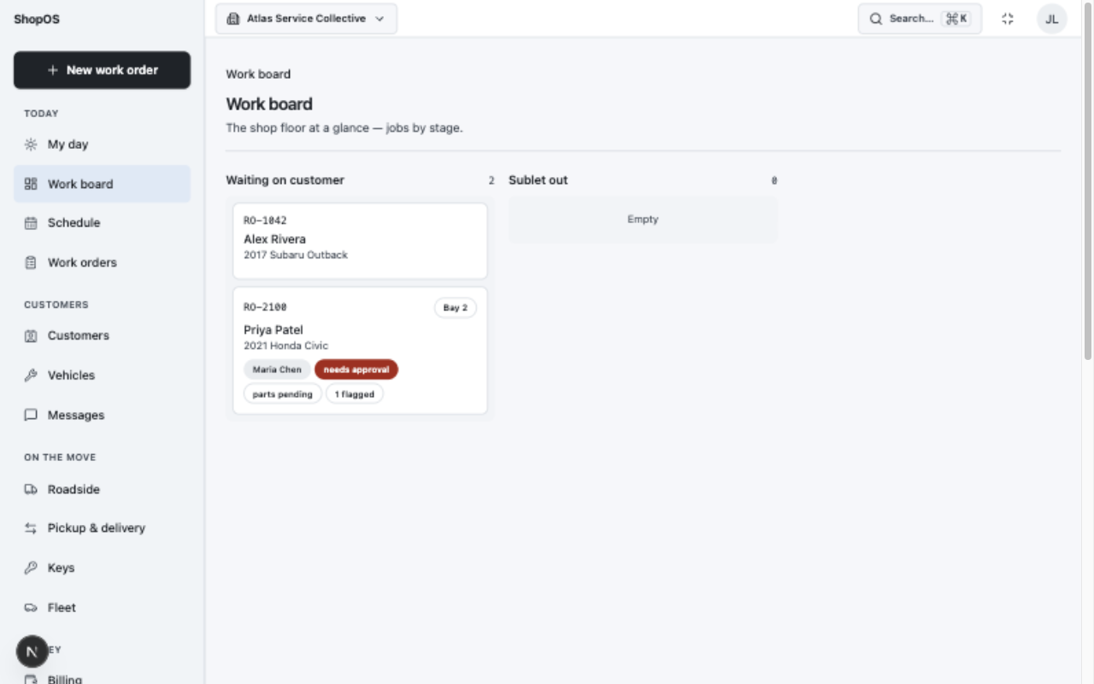
OPERATIONS
The whole shop on one board
Live work across the shop — kanban stages you can extend per organization, drag between columns, plus My day and schedule views.
ShopOS · open-source launch preview · 2026 · Co-created by a human builder and Z.AI GLM-5.2 & GLM-5.3
5

Slide 6
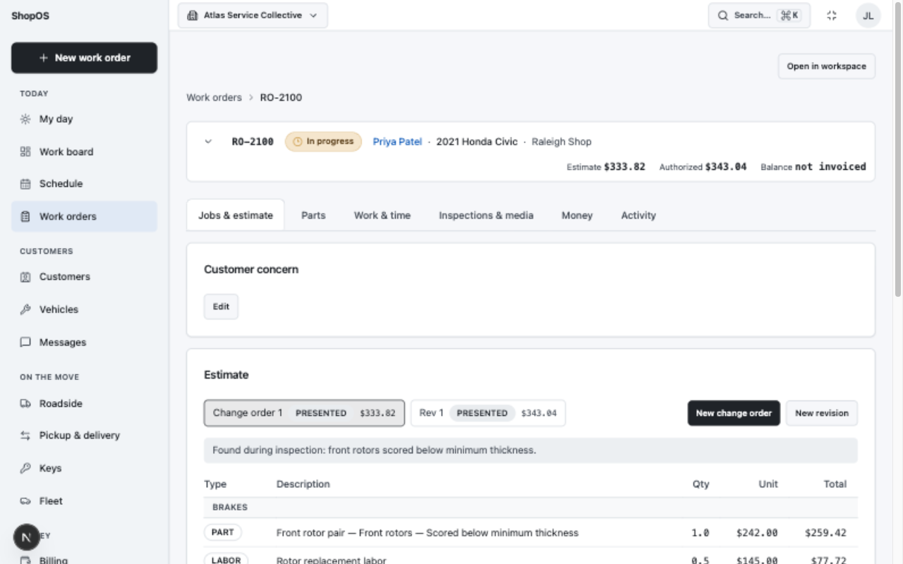
OPERATIONS
Work orders that stay out of the way
▸ Six workflow tabs — jobs & estimate, parts, work & time, inspections, money, activity.
▸ Always-visible context — customer · vehicle · status plus estimate / authorized / balance in the collapsible header.
▸ Multi-RO workspace — several repair orders open as tabs; the set lives in the URL, refresh restores it.
▸ Touch-first — built for a tablet on the counter or a laptop at the bench.
ShopOS · open-source launch preview · 2026 · Co-created by a human builder and Z.AI GLM-5.2 & GLM-5.3
6

Slide 7
ESTIMATING & AUTHORIZATION
Estimates the way shops actually think
JOB ON THE ESTIMATE
OPTION GROUP — CUSTOMER PICKS ONE
Front brakes
Standard oil change
Rotors (2)
$64.99
5W-30 synthetic blend · 5 qt · filter
Ceramic pads
Labor 1.6 hr
Tune-up
✓
Premium oil change
$94.99
Full synthetic · premium filter · 21-pt check
Spark plugs (4)
Labor 0.8 hr
— or “none of these options”, recorded explicitly.
Group lines into jobs — drag and drop lines between jobs, reorder, rename inline. Grouping carries through to the authorization page and print with per-job subtotals.
Good / better / best, enforced — a single choice per group server-side, alternatives auto-declined, only the chosen option reaches the invoice. Estimates are immutable once presented: corrections are revisions or change orders (ADR 0004, 0014), never silent edits.
ShopOS · open-source launch preview · 2026 · Co-created by a human builder and Z.AI GLM-5.2 & GLM-5.3
7

Slide 8
AUTHORIZATION, INSPECTIONS, CUSTOMERS
From “can you approve this?” to signature, without the phone tag
▸ Signed, expiring, revocable links sent by email or SMS — the customer approves line by line on their phone, no account needed.
▸ Staff-recorded decisions for walk-ins, with the same unambiguous record.
▸ Change orders as supplemental authorization — the original approval is never overwritten.
▸ Printable authorization documents for the clipboard world.
▸ Digital vehicle inspections — templates with ok / watch / replace / n/a per item, notes, photos, and video (Mux or local storage).
▸ Recommendations flow into estimates with their evidence attached.
▸ Customer tracker link — watch job progress without an account.
▸ Full customer portal — history, authorizations, invoices, payments.
Choosing an option on the public page records the whole decision unambiguously — approve, decline, and which alternative won.
ShopOS · open-source launch preview · 2026 · Co-created by a human builder and Z.AI GLM-5.2 & GLM-5.3
8

Slide 9
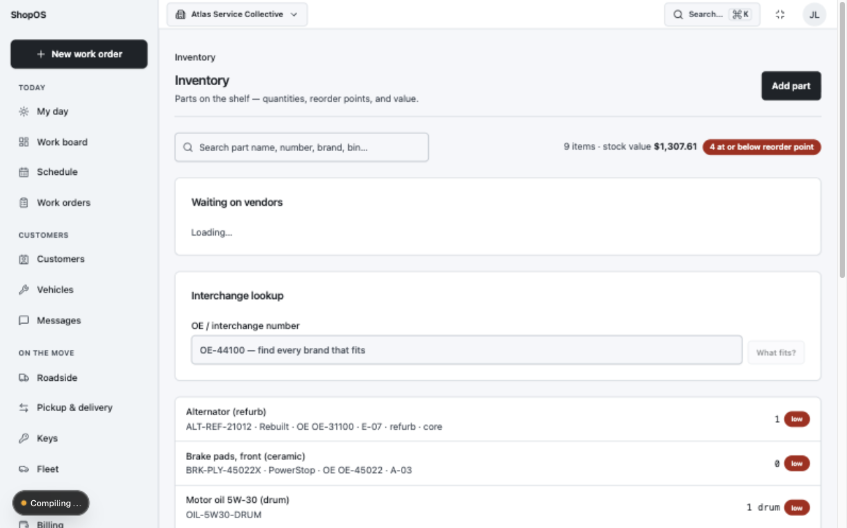
PARTS & INVENTORY
Auto-parts depth without a separate app
▸ OE numbers plus per-manufacturer aftermarket numbers and interchange lookup.
▸ Purpose-tracked orders — job-specific vs stock replenishment vs allocation, with a waiting-on-vendors board.
▸ Real units — quarts/gallons/drums with base-unit totals, cores, bin locations, photos.
▸ Reorder points with low-stock surfacing and reorder suggestions.
ShopOS · open-source launch preview · 2026 · Co-created by a human builder and Z.AI GLM-5.2 & GLM-5.3
9

Slide 10
BILLING & PAYMENTS
Money handled like it matters
▸ Immutable invoice snapshots from completed work — per-establishment series, legal numbering, tax IDs on prints, void/reissue semantics.
▸ Deposits before invoicing, split and mixed tenders, refunds, AR aging with printable statements.
▸ Cash drawer — count-in/count-out sessions with expected-vs-counted reconciliation.
▸ Zero-decimal currencies (JPY, CLP, COP) handled correctly; money is always integer minor units.
BRING YOUR OWN PROCESSOR
Connect your own account — payment links with signed webhooks, in-app charges, refunds:
Stripe
Square
Adyen
Mollie
Mercado Pago
Razorpay
No processor? No problem. Cash, check, and record-only cards always work without any connected provider — and invoices and history never depend on one.
E-invoicing built in: Factur-X/ZUGFeRD, XRechnung, FatturaPA as tamper-evident snapshots; clearance adapters (SDI, KSeF, IRP, VeriFactU) are connector slots.
ShopOS · open-source launch preview · 2026 · Co-created by a human builder and Z.AI GLM-5.2 & GLM-5.3
10

Slide 11
INTERNATIONAL
Built for more than one country from day one
▸ Regional settings per organization with location overrides — currency, locale, phone country, cash rounding, week start.
▸ Tax identity — org and customer tax IDs, VAT-inclusive or exclusive documents, stacked taxes (GST + PST/QST) with per-component rounding.
▸ E-invoicing formats generated as tamper-evident snapshots for Germany, Italy, France, Poland and friends.
▸ Phone and calendar sense — E.164 parsing with country defaults, per-location holiday calendars, country-aware address shapes.
▸ Localization architecture — product messages in checked-in ICU catalogs; user content translation is a separate, tenant-scoped boundary.
▸ Provider-neutral translation — translations are labeled, versioned projections that never authorize access or overwrite the source.
▸ Bidirectional UI — logical layout properties and mixed-direction protections tested with pseudo-locales and RTL suites.
▸ Locale ≠ currency ≠ time zone — all kept separate, UTC instants recorded, IANA zones for people.
ShopOS · open-source launch preview · 2026 · Co-created by a human builder and Z.AI GLM-5.2 & GLM-5.3
11

Slide 12
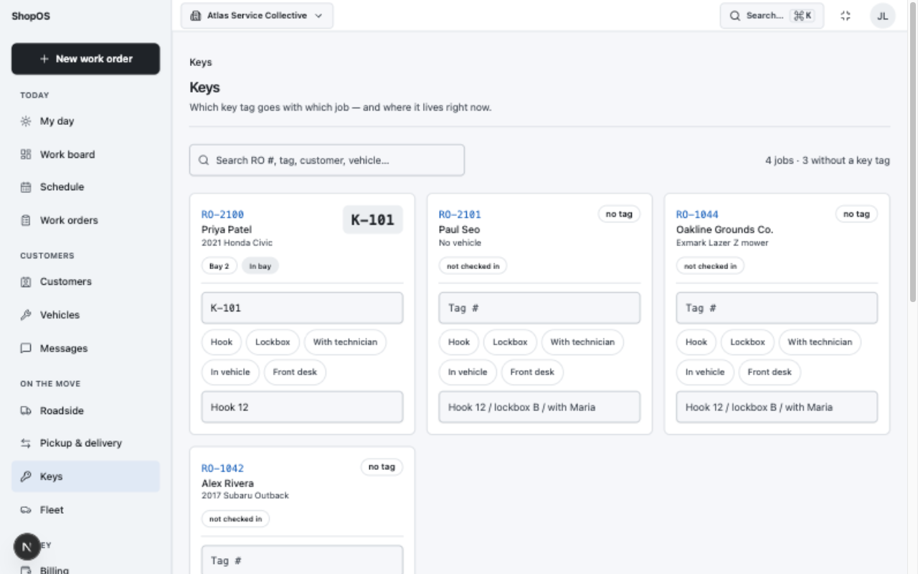
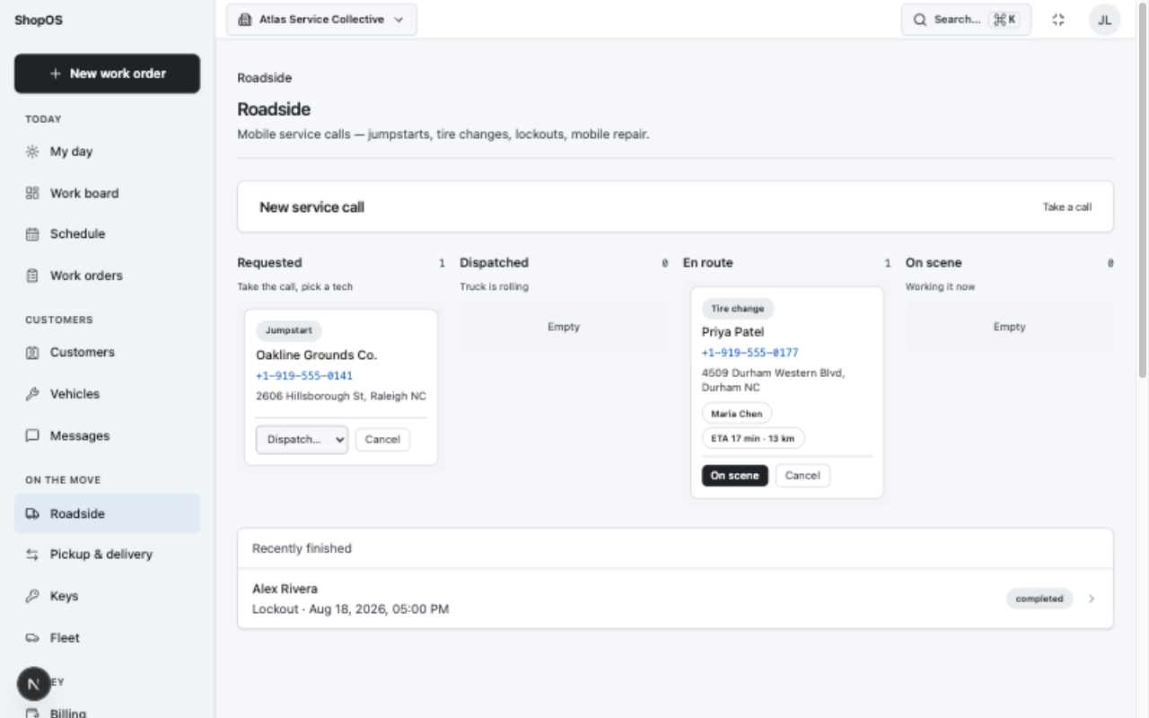
OPERATIONS
Beyond the service bay
Key board
Which tag goes with which job and where it lives right now — card grid with one-tap location chips, built for a wall-mounted tablet.
Roadside dispatch
Mobile service calls — jumpstarts, tire changes, lockouts — status board, tap-to-call, technician assignment, geocoding/routing via the maps connector.
Also: fleet vehicles with loaner checkouts and registration/insurance tracking · declined-work follow-ups · pickup & delivery logistics.
ShopOS · open-source launch preview · 2026 · Co-created by a human builder and Z.AI GLM-5.2 & GLM-5.3
12

Slide 13
PLATFORM & SECURITY
Multi-tenant from the first query
▸ Every business record carries its organization — organization and location are authorization boundaries, not display filters.
▸ Permissions rebuilt server-side on every request from membership and location-access records — nothing from the browser is trusted.
▸ Cross-tenant denial paths are integration-tested, not assumed: wrong-org reads, identifier guessing, nested-resource abuse, unauthorized mutations.
▸ Better Auth throughout — email/password, magic link, email OTP, MFA, passkeys, recovery. No parallel auth tables.
▸ SaaS control plane — a separate MFA-gated security plane (/platform) for plans, entitlements, org lifecycle, and platform audit.
▸ Audit history on both planes; tenant audit records platform actions that affect a tenant.
A federated identity never grants membership by itself. Provider, issuer/tenant, organization binding, verified domain, and provisioning policy are all checked — SSO federation itself is on the roadmap.
ShopOS · open-source launch preview · 2026 · Co-created by a human builder and Z.AI GLM-5.2 & GLM-5.3
13

Slide 14
ARCHITECTURE
A modular monolith, decided in the open
work-orders
estimates
invoices
billing
payments
parts
inventory
service-calls
loaners
customers
assets
appointments
followups
inspections*
portal
identity
memberships
organizations
tenancy
integrations
outbox
taxes
time-tracking
activity
notifications
reports
platform
27 business modules in src/modules — organized by domain, not by technical layer.
▸ Application services for mutations — routes only validate transport input; domain rules live in modules.
▸ Prisma + PostgreSQL with tenant-scoped repositories and hand-reviewed migrations preserving constraints Postgres can express and Prisma can't.
▸ Outbox-based delivery for domain events and jobs — no fire-and-forget side effects.
▸ 18 ADRs record the durable decisions — modular monolith, tenant context, money, estimate revisions, Better Auth, connector model, e-invoicing, native/white-label platform.
▸ Strict TypeScript, no `any`, exact-optional types, React 19, Next.js 16 App Router.
▸ Quality gate — lint, format, types, db validation, 644 tests, and the production build on every change.
ShopOS · open-source launch preview · 2026 · Co-created by a human builder and Z.AI GLM-5.2 & GLM-5.3
14

Slide 15
CONNECTORS — ADR 0008
Bring your own provider — or none
Payments
Stripe · Square · Adyen · Mollie · Mercado Pago · Razorpay
payment links, in-app charges, refunds
Maps
Google Maps · Azure Maps · Mapbox · AWS Location
geocoding + routing for roadside; degrades gracefully without a key
Storage
S3-compatible object storage
photos and documents
Video
Mux or local storage
inspection and evidence video
E-invoicing
Factur-X/ZUGFeRD · XRechnung · FatturaPA
tamper-evident snapshots; clearance slots for regional intermediaries
Email / SMS
console adapter in dev · BYO provider in prod
authorization links and notifications
Credentials are envelope-encrypted. No vendor is ever required to read your own data.
ShopOS · open-source launch preview · 2026 · Co-created by a human builder and Z.AI GLM-5.2 & GLM-5.3
15

Slide 16
THEMES & CUSTOMIZATION
Your shop, your look — tokens, not CSS hacks
Warm
Light
Dark
Dusk
bg · card · primary · accent
bg · card · primary · accent
bg · card · primary · accent
bg · card · primary · accent
counter-friendly cream
clean daylight
night shifts
low-glare purple
Appearance menu in the top bar — System, Light, Dark, Warm, or Dusk, per user, with live preview. Density (comfortable / compact) follows the user. Themes are semantic design tokens with automated contrast checks — no customer CSS, no hard-coded brand colors.
▸ Configurable today: board columns, tax rates, invoice series, canned jobs, inspection templates, regional settings, themes, per-user density.
▸ On the roadmap: organization theme publishing, deeper brand customization within the token system, and white-label branded customer apps from the same codebase (ADR 0013).
ShopOS · open-source launch preview · 2026 · Co-created by a human builder and Z.AI GLM-5.2 & GLM-5.3
16

Slide 17
ROADMAP — NEAR TERM
What's next, kept honest
▸ SSO federation for organizationsMicrosoft, Google, OIDC, SAML — the policy module and issuer/binding checks exist; the sign-in flow ships next.
▸ Production email delivery adaptersSMTP/SES/Mailgun/Resend/SendGrid — console adapter today, BYO provider from day one in prod.
▸ Locale-prefixed UI routing + ICU catalogsthe localization architecture and tests are in; full UI catalog coverage is ongoing.
▸ Org-scoped URLs and onboarding polishorg slugs instead of UUIDs, currency/locale defaults in first-run setup.
▸ Support access, threat-modeledtime-limited, user-visible, independently audited — deliberately not built until its threat model exists.
Roadmap state is explicit in docs/roadmap.md — “complete” means implemented and verified, not modeled.
ShopOS · open-source launch preview · 2026 · Co-created by a human builder and Z.AI GLM-5.2 & GLM-5.3
17

Slide 18
ROADMAP — THE BIG BETS
Where this goes
Integrations platform
Payments & financing
Warranty & history
Native & white-label
Reporting & analytics
▸ Accounting: QuickBooks Online, Xero
▸ VIN decode & plate lookup
▸ Labor-time & repair guides
▸ Parts catalog, fitment, ordering
▸ Google / Outlook / iCal scheduling
▸ Card-present + ACH abstraction
▸ Hosted fields, minimal PCI scope
▸ Saved methods & settlement reporting
▸ Financing-partner boundary
▸ Coverage verification & claims
▸ Third-party + aftermarket workflows
▸ CARFAX service-history reporting
▸ Replaceable provider boundary
▸ Technician-first Staff app (Expo)
▸ Shared Customer app
▸ Branded shop apps, same codebase
▸ PWA-first, desktop later
▸ Work mix, cycle time, margin
▸ Technician productivity
▸ Multi-location rollups
▸ Custom report builder
Every named integration enters discovery first — commercial access, API capability, security, data rights, and real demand are validated before a partner is committed.
ShopOS · open-source launch preview · 2026 · Co-created by a human builder and Z.AI GLM-5.2 & GLM-5.3
18

Slide 19
DEPLOYMENT
Self-hosting is the product, not an afterthought
▸ One deployable stack — Next.js app plus a worker process, your PostgreSQL. No proprietary runtime dependencies.
▸ Same codebase, two modes — genuinely self-hostable application and a managed SaaS from one product.
▸ Reviewed migrations — deterministic seed data, hand-inspected SQL preserving tenant compound keys, checks, and partial indexes.
▸ SaaS control plane — plans, entitlements, lifecycle, audit — separated from tenant data by design.
▸ Infrastructure-as-code boundary — the runtime app never holds cloud-account or IaC credentials.
▸ Degraded-state discipline — connectors fail soft: no maps key, no email provider, no processor… the shop keeps working.
Business model, stated plainly: sustainable revenue may come from hosting, onboarding, migration, support, integrations, and branded apps — never from artificially removing core shop operations.
ShopOS · open-source launch preview · 2026 · Co-created by a human builder and Z.AI GLM-5.2 & GLM-5.3
19

Slide 20
GET RUNNING
Try it in five minutes
1
Clone & install
SEEDED DEMO ACCOUNTS
git clone …/ShopOS && pnpm install
owner@example.test demo-password-123
2
Start PostgreSQL
Shop owner — full operations
docker compose up -d (or any Postgres 16+)
driver@example.test demo-password-123
Customer portal view
3
Migrate & seed
pnpm db:migrate && pnpm db:seed
maria@example.test magic link → console
Magic-link sign-in (prints to terminal in dev)
4
Run it
pnpm dev → http://localhost:3000
5
Sign in
owner@example.test / demo-password-123
The seed is deterministic — automotive, motorcycle, and lawn-equipment examples that exercise every workflow end to end.
ShopOS · open-source launch preview · 2026 · Co-created by a human builder and Z.AI GLM-5.2 & GLM-5.3
20

Slide 21
WHAT WE NEED FROM YOU
This release exists to collect feedback
▸ Does the workflow fit your shop?You know the counter, the bench, and the parts run. Tell us where ShopOS fights the way you actually work.
▸ What's missing before it's daily-drivable?Parts ordering realities, tax shapes, inspection patterns, payment habits — the unglamorous bits.
▸ Where should the API go first?The domain model is deliberate; the public API surface is still young and shaped best by early users.
WHERE TO TALK
GitHub Discussions
for questions, workflows, and show-and-tell
GitHub Issues
for anything reproducible — fixes land with regression tests
github.com/JayQuattro/ShopOS
KEPT HONEST — NOT SHIPPED YET
SSO/SAML federation · production email delivery adapters · native mobile apps (the web UI is tablet-first) · support access / impersonation · locale-prefixed UI routing · license selection (a governance decision we're making with the community, not before it).
ShopOS · open-source launch preview · 2026 · Co-created by a human builder and Z.AI GLM-5.2 & GLM-5.3
21

Slide 22
Run your shop on your terms.
Clone it, seed it, kick the tires — then tell us where it's wrong.
The parts that matter to real shops get built first.
github.com/JayQuattro/ShopOS · Discussions · Issues · docs/features.md
Built in the open.
The application and this presentation were co-created by a human builder working with Z.AI GLM-5.2 & GLM-5.3.

