Slide 1

Department of Computer Engineering
Academic Year 2026-2027 (Odd Semester)
Mini Project
Bank Transaction Analytics and Fraud Detection
Jay Dhake (A – 07)
Samarth Ghanekar (A – 10)
Saahir Joshi (A – 16)
Name of the Guide:- Prof. Mrunali Desai
Notes:
Introduce the project, the team and the guide. One sentence: a big-data system that finds fraud among 6.36 million bank transactions and lets an analyst search, investigate and upload data.

Slide 2
Problem Statement
The Core Problem
Fraud is extremely rare: in the PaySim data only 8,197 of 6,362,604 transactions (0.13%) are fraudulent. Existing approaches rely on fixed rules or single-machine notebooks that cannot search, investigate or score data at scale.
Rules miss most fraud: The dataset's own rule flags only 16 of 8,197 frauds (recall 0.2%).
Accuracy hides the problem: A model that always says "legitimate" is 99.87% accurate yet useless, so precision and recall are needed.
Scale and speed: A Spark scan to look up one account takes 1.4 s; an analyst needs the answer in milliseconds.
Analysis stops at the model: Flagged transactions must be searched, investigated as cases, and new files must be scored; most solutions offer none of this.
Notes:
Fraud is about 1 in 776 transactions. Accuracy is meaningless; we judge with precision and recall. The gap is a complete system: scale, millisecond search, a case workflow and file upload.

Slide 3
Literature Survey
Title/ Year | Methodology | Findings | Limitation | Algorithms Used
Random Forests (Breiman, 2001) | Introduced an ensemble of randomised decision trees trained on bootstrap samples; predictions are averaged. | Accurate and robust to noise; gives variable importance. Basis of the fraud model. | Hard to interpret as a whole; needs care with extreme class imbalance. | Bagging, random feature selection, decision trees
Apache Spark: A Unified Engine for Big Data Processing (Zaharia et al., 2016) | Describes Spark's design: distributed datasets, DataFrames, SQL and libraries on one engine. | Parallel in-memory processing and a query optimiser run batch, SQL and ML workloads on large data. | Built for batch jobs; scanning for each single lookup is too slow for interactive use. | DataFrame API, Spark SQL, Catalyst optimiser
MLlib: Machine Learning in Apache Spark (Meng et al., 2016) | Presents Spark's distributed ML library with pipelines, feature transformers and scalable learners. | Provides Random Forest and Logistic Regression that train on millions of rows within pipelines. | A trained model must be exported to be served outside Spark. | ML pipelines, Random Forest, Logistic Regression
Notes:
Foundations: Random Forests for the model, Spark for the batch pipeline, MLlib for training at scale.

Slide 4
Literature Survey
Title/ Year | Methodology | Findings | Limitation | Algorithms Used
PaySim: A Financial Mobile Money Simulator for Fraud Detection (Lopez-Rojas et al., 2016) | Agent-based simulator calibrated on aggregated logs of a real mobile-money service. | Gives a labelled benchmark of 6.36 million transactions; fraud appears only in transfers and cash-outs. | Simulated data; the fraud pattern is simpler than real fraud. | Agent-based simulation
SMOTE: Synthetic Minority Over-sampling Technique (Chawla et al., 2002) | Creates synthetic minority-class examples by interpolating between neighbouring minority points. | Improves detection of the minority class on imbalanced data compared with plain undersampling. | Changes the data distribution and can create unrealistic samples; not used here. | k-nearest neighbours, oversampling
The Precision-Recall Plot Is More Informative than the ROC Plot (Saito and Rehmsmeier, 2015) | Compared ROC and precision-recall plots on imbalanced binary classification tasks. | Precision-recall plots show the true effect of false positives when positives are rare. | Guidance on evaluation only; no new model. | Precision-recall curve, ROC curve
Notes:
The dataset (PaySim), how others handle imbalance (SMOTE), and why we use precision-recall metrics.

Slide 5
Literature Survey
Title/ Year | Methodology | Findings | Limitation | Algorithms Used
DuckDB: an Embeddable Analytical Database (Raasveldt and Muhleisen, 2019) | Describes an in-process analytical database with columnar, vectorised query execution. | Runs analytical SQL without a server and reads Parquet files directly. Used for the search index. | Single-writer design; not meant for many concurrent writers. | Columnar storage, vectorised execution
The Adaptive Radix Tree: ARTful Indexing for Main-Memory Databases (Leis et al., 2013) | Proposes an adaptive radix tree index whose nodes adapt their size to the keys stored. | Fast exact and prefix lookups with low memory use; behind account search and suggestions. | Designed for main memory; ordering follows the key bytes. | Adaptive radix tree, path compression
Notes:
The two papers behind the search: DuckDB as the analytical engine and the adaptive radix tree as the index.

Slide 6
Objectives
Process Big Data at Scale
Ingest and clean 6.36 million transactions into a partitioned Parquet lake with Spark.
Run Spark SQL analyses of where, when and how fraud occurs.
Detect Rare Fraud Accurately
Train and compare Logistic Regression and Random Forest with Spark MLlib.
Judge them with precision, recall and AUC-PR, not accuracy.
Enable Instant Search
Find every transaction of an account in milliseconds with an index.
Suggest matching account ids while the user types.
Support Investigation and Upload
Manage fraud cases with create, read, update and delete.
Score uploaded files of millions of rows and explore them.
Notes:
Four objectives: process the data at scale, detect the rare fraud accurately, make search instant, and support investigation and upload.

Slide 7
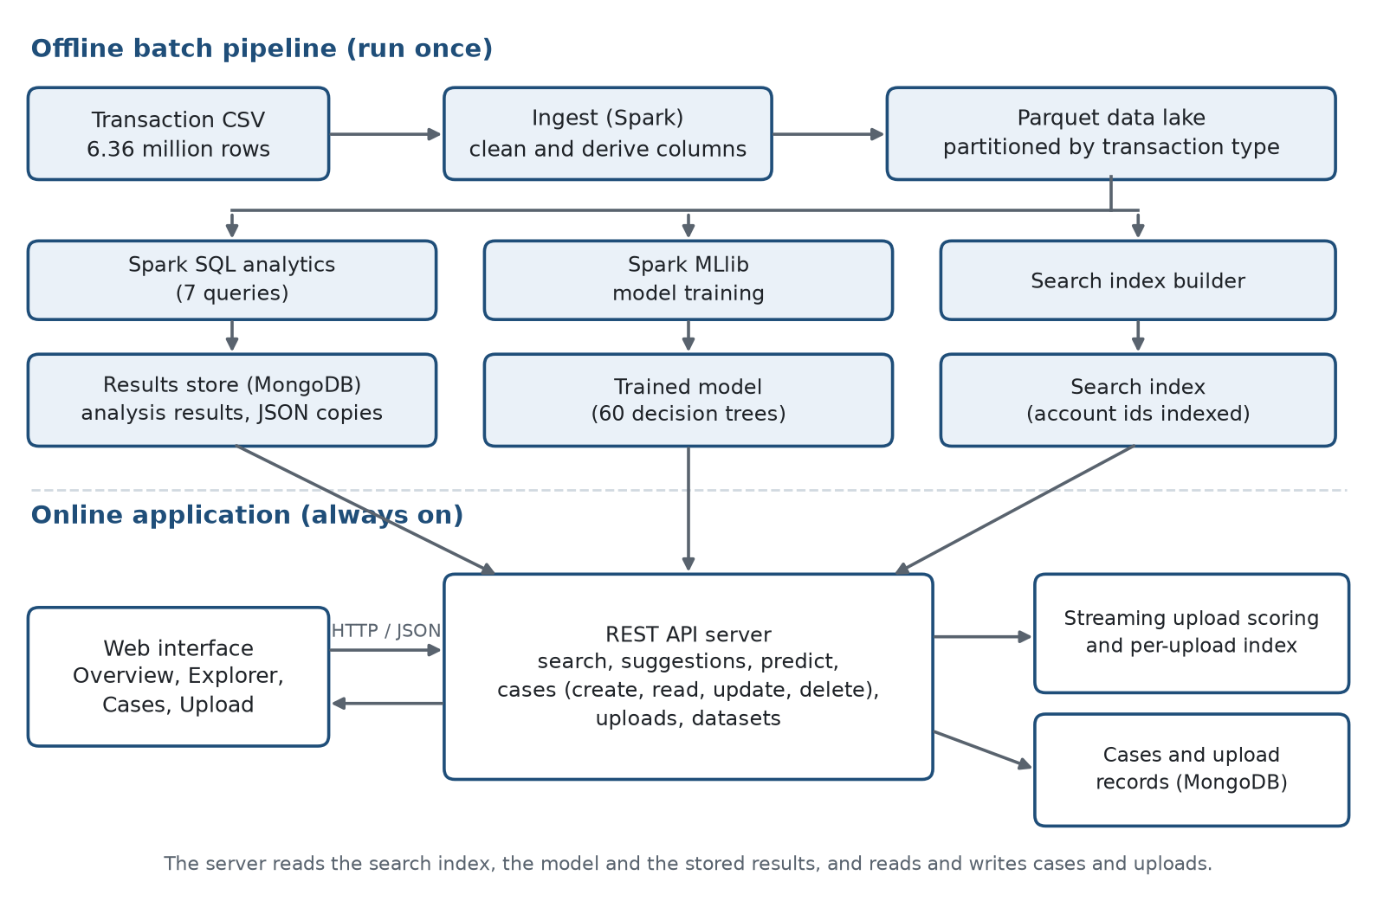
System Architecture
Notes:
Top half is the offline batch pipeline run once with Spark. Bottom half is the always-on application: a REST API that reads the index, the model and the stored results, and reads and writes cases and uploads.

Slide 8
Proposed Solution
Offline Batch Pipeline: Spark ingests 6.36 million transactions into a partitioned Parquet lake, runs 7 SQL analyses and trains the models.
Fraud Model: A 60-tree Random Forest scores transfers and cash-outs from nine features, with 99.3% precision and 99.75% recall on held-out data.
Millisecond Search: An indexed table finds an account's transactions in about 2 to 7 ms, with suggestions while the user types.
Case Management: Create, read, update and delete cases in MongoDB with a status workflow, notes and one open case per transaction.
Upload and Batch Scoring: Files of millions of rows are streamed, validated and scored in about a minute, then indexed so they can be explored.
Notes:
Five parts: the batch pipeline, the fraud model, millisecond search, case management, and upload with batch scoring.

Slide 9
Results
Table 1: Model Comparison on the Held-out Test Set (831,437 transactions, 2,407 frauds)
Model | Precision | Recall | F1 | AUC-PR | Frauds Caught | False Alarms
Logistic Regression (baseline) | 0.043 | 0.909 | 0.083 | 0.549 | 2,189 / 2,407 | 48,466
Random Forest (selected) ★ | 0.993 | 0.998 | 0.995 | 0.998 | 2,401 / 2,407 | 17
Dataset rule (isFlaggedFraud) | 1.000 | 0.002 | 0.003 | – | 4 / 2,407 | 0
Table 2: Time to Find All Transactions of One Account (6.36 million rows)
Method | Median | 95th Percentile | Faster than Spark
Spark SQL scan of the data lake | 1,441 ms | 1,730 ms | 1×
DuckDB on the Parquet files | 276 ms | 329 ms | 5×
DuckDB table, no index | 28 ms | 35 ms | 51×
DuckDB table with index (used) ★ | 2.5 ms | 2.8 ms | 574×
★ Unseen generated files: 8.0M rows scored in about 30 s and indexed in about 42 s, finding 92.1% of frauds at 51.8% precision; the 7.0M-row unlabelled file was scored in about 35 s. 144 automated tests pass.
Notes:
Table 1: the Random Forest finds 2,401 of 2,407 frauds with 17 false alarms; the baseline raises 48,466. Table 2: the indexed lookup is 574 times faster than a Spark scan. On unseen generated files recall stays high but precision drops to 51.8%, an honest result on a different dataset.

Slide 10
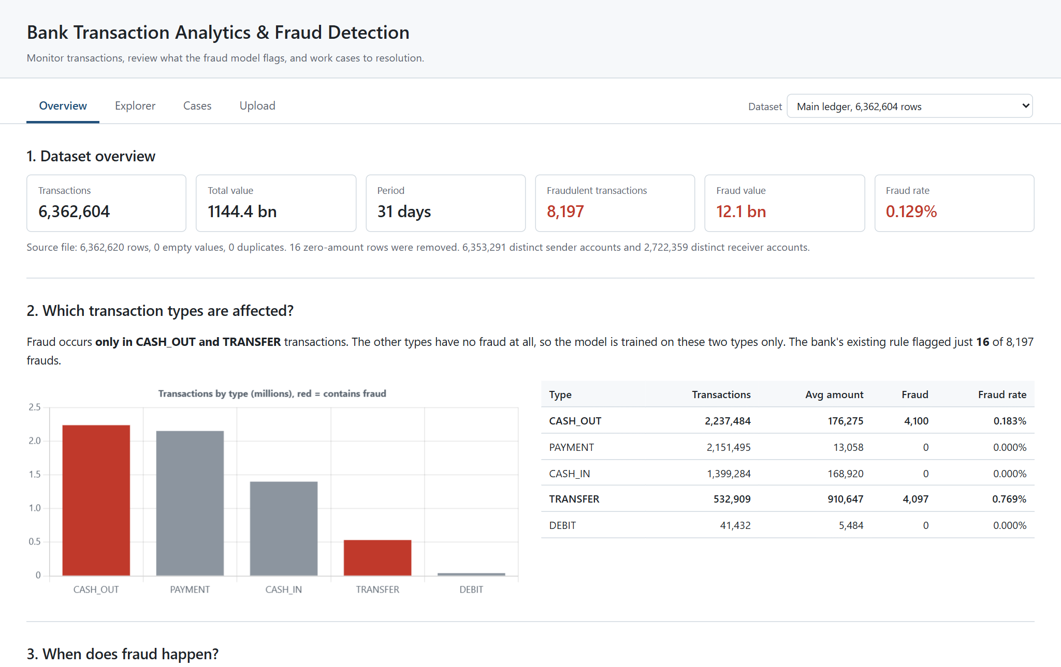
Conclusion
A Spark pipeline and a 60-tree Random Forest find 99.75% of frauds with 99.3% precision on unseen test data, far above the dataset's own rule (0.2% recall).
An index makes account lookup 574 times faster than a Spark scan, so search and suggestions answer in milliseconds.
Cases (CRUD) and streaming upload turn the model into an investigation tool; 8-million-row files are scored and explorable in about a minute.
Limits: simulated data, Spark in local mode, no login. Future work: streaming scoring, a cluster, authentication and per-transaction explanations.
Notes:
Summarise: accurate model, instant search, a full case workflow and upload at scale. Be open about the limits: simulated data, local-mode Spark and no authentication.

Slide 11
References
[1] L. Breiman, “Random Forests,” Machine Learning, vol. 45, no. 1, pp. 5–32, 2001.
[2] M. Zaharia et al., “Apache Spark: A Unified Engine for Big Data Processing,” Commun. ACM, vol. 59, no. 11, 2016.
[3] X. Meng et al., “MLlib: Machine Learning in Apache Spark,” J. Mach. Learn. Res., vol. 17, no. 34, 2016.
[4] E. A. Lopez-Rojas, A. Elmir and S. Axelsson, “PaySim: A financial mobile money simulator for fraud detection,” Proc. EMSS, 2016.
[5] N. V. Chawla et al., “SMOTE: Synthetic Minority Over-sampling Technique,” J. Artif. Intell. Res., vol. 16, 2002.
[6] T. Saito and M. Rehmsmeier, “The Precision-Recall Plot Is More Informative than the ROC Plot…,” PLoS ONE, vol. 10, no. 3, 2015.
[7] M. Raasveldt and H. Muhleisen, “DuckDB: an Embeddable Analytical Database,” Proc. ACM SIGMOD, 2019.
[8] V. Leis, A. Kemper and T. Neumann, “The Adaptive Radix Tree: ARTful Indexing for Main-Memory Databases,” Proc. IEEE ICDE, 2013.
[9] Apache Spark Documentation, Spark SQL and MLlib guides. spark.apache.org/docs/latest
[10] Apache Parquet Documentation. parquet.apache.org/docs
[11] MongoDB Documentation, Indexes (TTL and partial). mongodb.com/docs/manual/indexes
[12] FastAPI Documentation. fastapi.tiangolo.com
[13] DuckDB Documentation. duckdb.org/docs
Notes:
Foundational papers for the model, the engine, the dataset, the evaluation and the index, plus the documentation of the tools used.

