Slide 1
SOEN 6441
ADVANCED PROGRAMMING PRACTICES
Project Warzone Game
Team W18
Instructor :
Dr. Amin Ranj Bar

Slide 2
TEAM MEMBERS
Jay Bhatt
Madhav Anadkat
Bhargav Fofandi
Reema Ann Reny
Mariya Bosy Kondody
Meera Muraleedharan Nair

Slide 3
Agenda
The Goal of the Build-3 is to demonstrate an operational version of the Project Warzone Game.
This includes:
Refined architecture of the system
Use of Design Patterns to implement different functionalities
Adapter Pattern
Strategy Pattern
Refactoring of code to enhance the game
Demo of the project
Test Cases
Javadocs

Slide 4
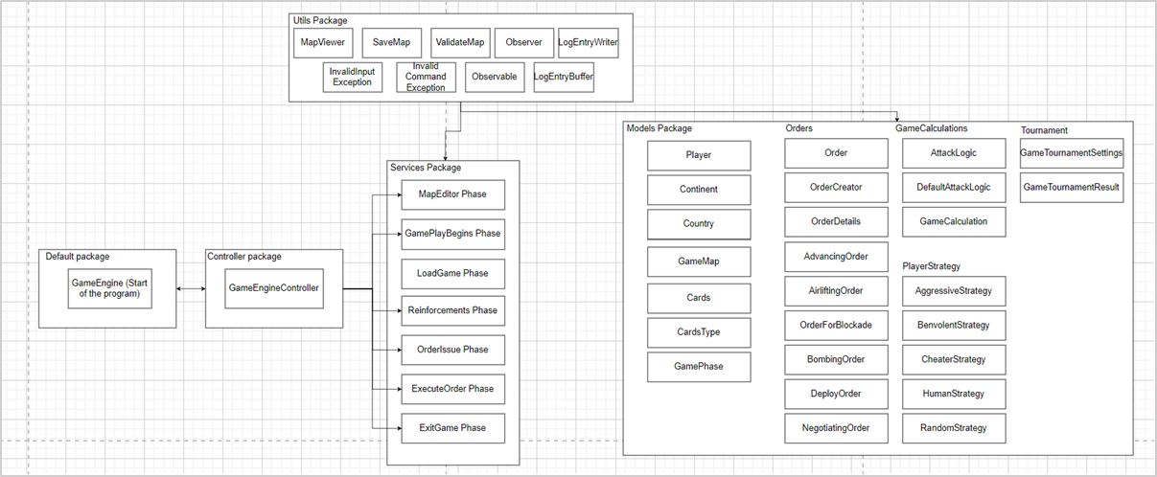
Architecture design of the project

Slide 5
Functional Requirements
Adapter Pattern
Used for flexible reading and writing to and from files.
Seamlessly switch between "conquest" and "domination" map file formats.
Strategy Pattern
Restructured Player's issueOrder() method using the Strategy Pattern
Implements different computer player behaviors using the Strategy pattern
Executes different actions with the issueOrders() method.
Along with these, the State Pattern, Observer Pattern and Command Pattern have been implemented.

Slide 6
Demo of the game

Slide 7
Enhancements added in Build 3
Single Game Mode
- Begins the game by picking a saved map loading it as a connected graph.
- User chooses the number and behavior of players.
- If no human player is chosen, the game runs on its own until one player takes over the whole map
Tournament Game Mode
- Option for Tournament Mode at the game start
- Proceeds without user interaction, displaying the final results at the end.
Tournament gameplay command:
tournament -M listofmapfiles -P listofplayerstrategies -G numberofgames -D maxnumberofturns
Game Save/Load:
- savegame filename
- loadgame filename

Slide 8
Test Cases
A comprehensive suite of 50 test cases has been implemented.
It thoroughly assess critical aspects of the codebase.
Ensures the robustness of the system and include evaluations for all the key scenarios.

Slide 9
Javadocs
Documentation generation tool and a standardized way of documenting Java code
Documented each file with detailed Javadocs for enhanced code readability and understanding.
Implemented Javadocs for every file, ensuring clear and thorough documentation of the codebase.

Slide 10
Thank you

