Slide 1
SOEN 6441
ADVANCED PROGRAMMING PRACTICES
Project Warzone Game
Team - W18
Instructor :
Dr. Amin Ranj Bar

Slide 2
TEAM MEMBERS
Jay Bhatt
Madhav Anadkat
Bhargav Fofandi
Reema Ann Reny
Mariya Bosy Kondody
Meera Muraleedharan Nair

Slide 3
Agenda
The Goal of the Build-2 is to demonstrate an operational version of the Project Warzone Game.
This includes:
Refined architecture of the system
Use of Design Patterns to implement different functionalities
State Pattern
Observer Pattern
Command Pattern
Refactoring of code to enhance the game
Demo of the project
Test Cases

Slide 4
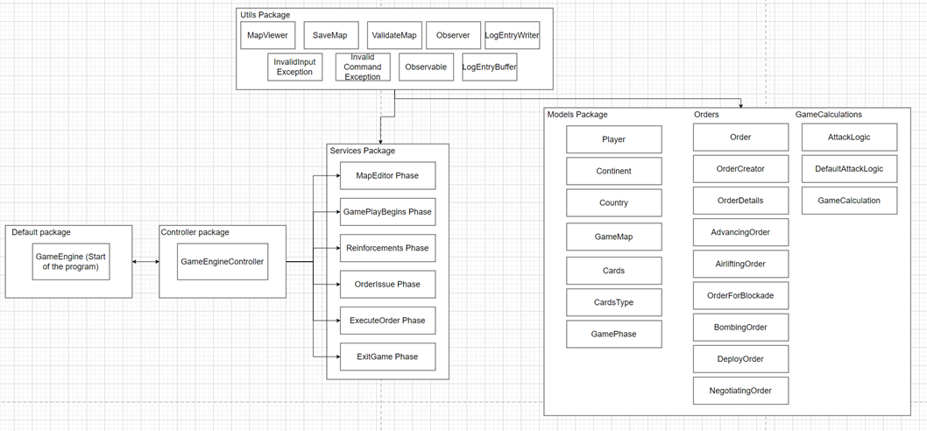
Architecture design of the project

Slide 5
Functional Requirements
State Pattern
Implemented in the GamePhase enum
Represents different states of a game and the possibleStates() method defines a set of allowed next states for each state.
Observer Pattern
Enables different components to subscribe to particular events.
Receive log files when changes occurs.
The observable subject is the LogEntryBuffer and the Observer interface is the LogEntryWriter class.
Command Pattern
Used to implement the Orders
Command class is Order class, Invoker Class is Player, and Client class is the GameEngine.

Slide 6
Demo of the game

Slide 7
Enhancements added in Build 2
Advance
advance countrynamefrom countynameto numarmies
Airlift
airlift sourcecountryID targetcountryID numarmies
Bombing
bomb countryID
Blockade
blockade countryID
Negotiating
negotiate playerID

Slide 8
Test Cases
A comprehensive suite of 30 test cases has been implemented.
It thoroughly assess critical aspects of the codebase.
Ensures the robustness of the system and include evaluations for all the key scenarios.

Slide 9
Thank you

