Slide 1
FitQuest
Gamified Fitness Challenge Platform
Web Application React.js | Spring Boot | REST APIs | MySQL
Presented by
Jayraj Gajul
Sagar Sonkamble
Tanmay Kaldate
Hemanshu Kulkarni

Slide 2
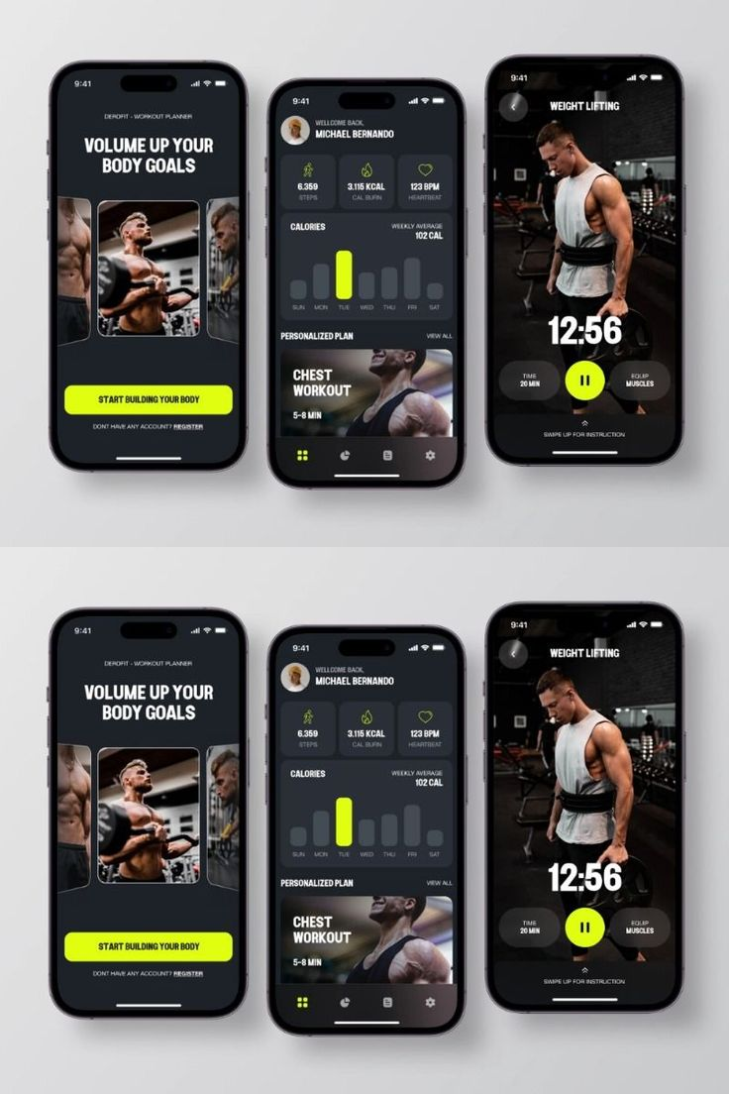
PROBLEM STATEMENT
Most fitness applications only track workouts
Users lose motivation and consistency over time
No social competition or group engagement
Lack of gamification such as streaks and rewards

Slide 3
SOLUTION: FITQUEST
Gamified fitness challenge platform
Personal and group-based challenges
Daily activity check-ins
Streak tracking and reward system
Leaderboards for social competition

Slide 4

OBJECTIVES OF THE PROJECT
Promote healthy and consistent fitness habits
Increase user motivation using gamification
Enable social interaction and group challenges
Track progress through streaks and leaderboards
Build a scalable and secure full-stack system

Slide 5

TECH STACK USED
Frontend
React.js
HTML, CSS, JavaScript
Backend
Spring Boot
REST APIs
Hibernate (JPA)
Database
MySQL
Security
JWT Authentication

Slide 6

SYSTEM ARCHITECTURE
React frontend (Client-side UI)
Spring Boot backend (REST APIs)
Layered backend architecture
Hibernate ORM for database interaction
MySQL relational database

Slide 7
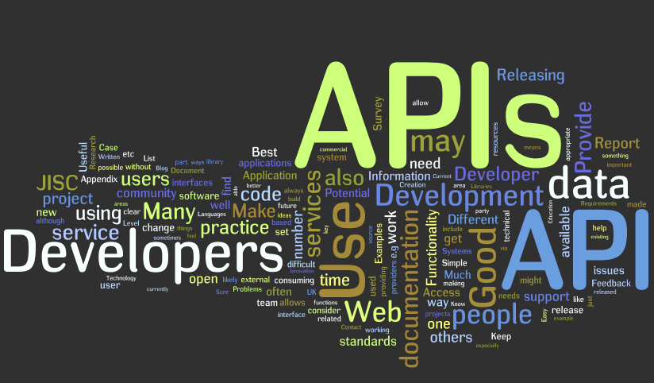
Backend Architecture Layers
Controller Layer
Service Layer
Repository Layer
Model (Entity) Layer

Slide 8
CORE FEATURES
User registration and login
Create and join fitness challenges
Daily activity check-ins
Streak tracking system
Leaderboard ranking
Achievement badges
Challenge-level group chat

Slide 9

DATABASE DESIGN
Users
Challenges
Challenge Participation
Activities
Badges
User Badges
Chat Messages

Slide 10
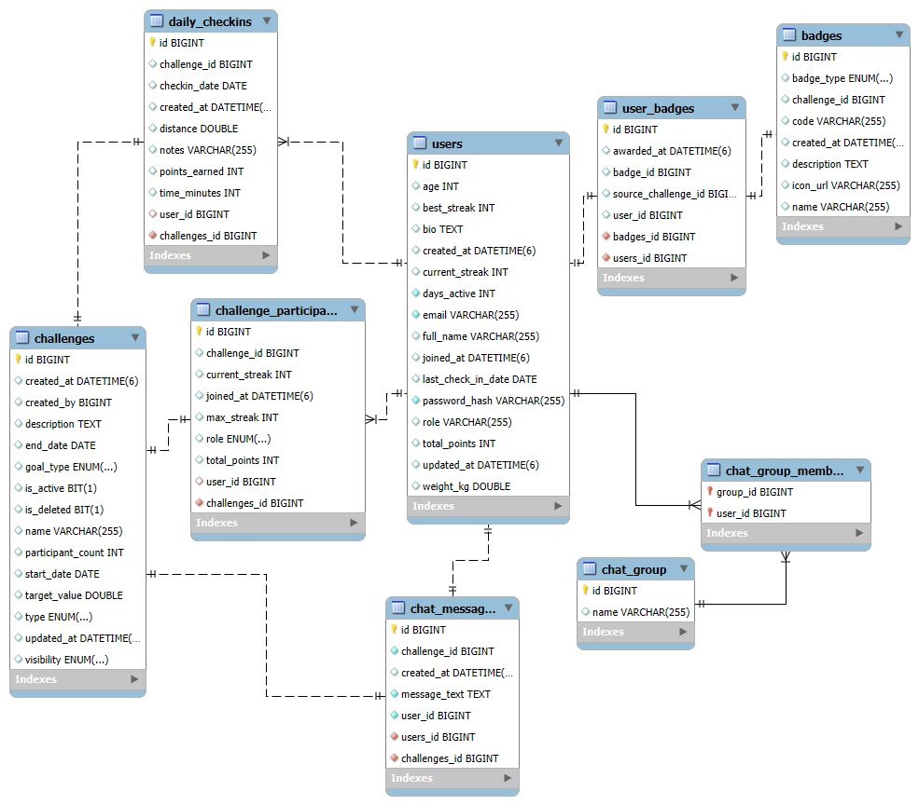

Slide 11

BUSINESS LOGIC ENGINE
Streak Calculation Tracks user consistency by increasing streaks on consecutive daily activity completion and resetting streaks when a day is missed.
Score Computation Points are calculated using rule-based logic combining streak length and total activities to reward consistency.
Leaderboard Ranking Users are ranked dynamically based on computed scores to encourage healthy competition.
Automated Challenge Completion Challenges are automatically marked as completed when users meet goals or when the challenge duration ends

Slide 12
SECURITY IMPLEMENTATION
RESTful API architecture
Clear and meaningful endpoints
JSON-based request and response
Uses HTTP methods (GET, POST)
Examples:​
/auth/login​
/challenges​
/activities/checkin​
/leaderboard​
/chat​​

Slide 13
LOGIN & AUTHENTICATION
Secure login interface for registered users
User credentials validated using backend APIs
JWT token generated after successful login
Token used for accessing protected features
Ensures authenticated and safe user access

Slide 14
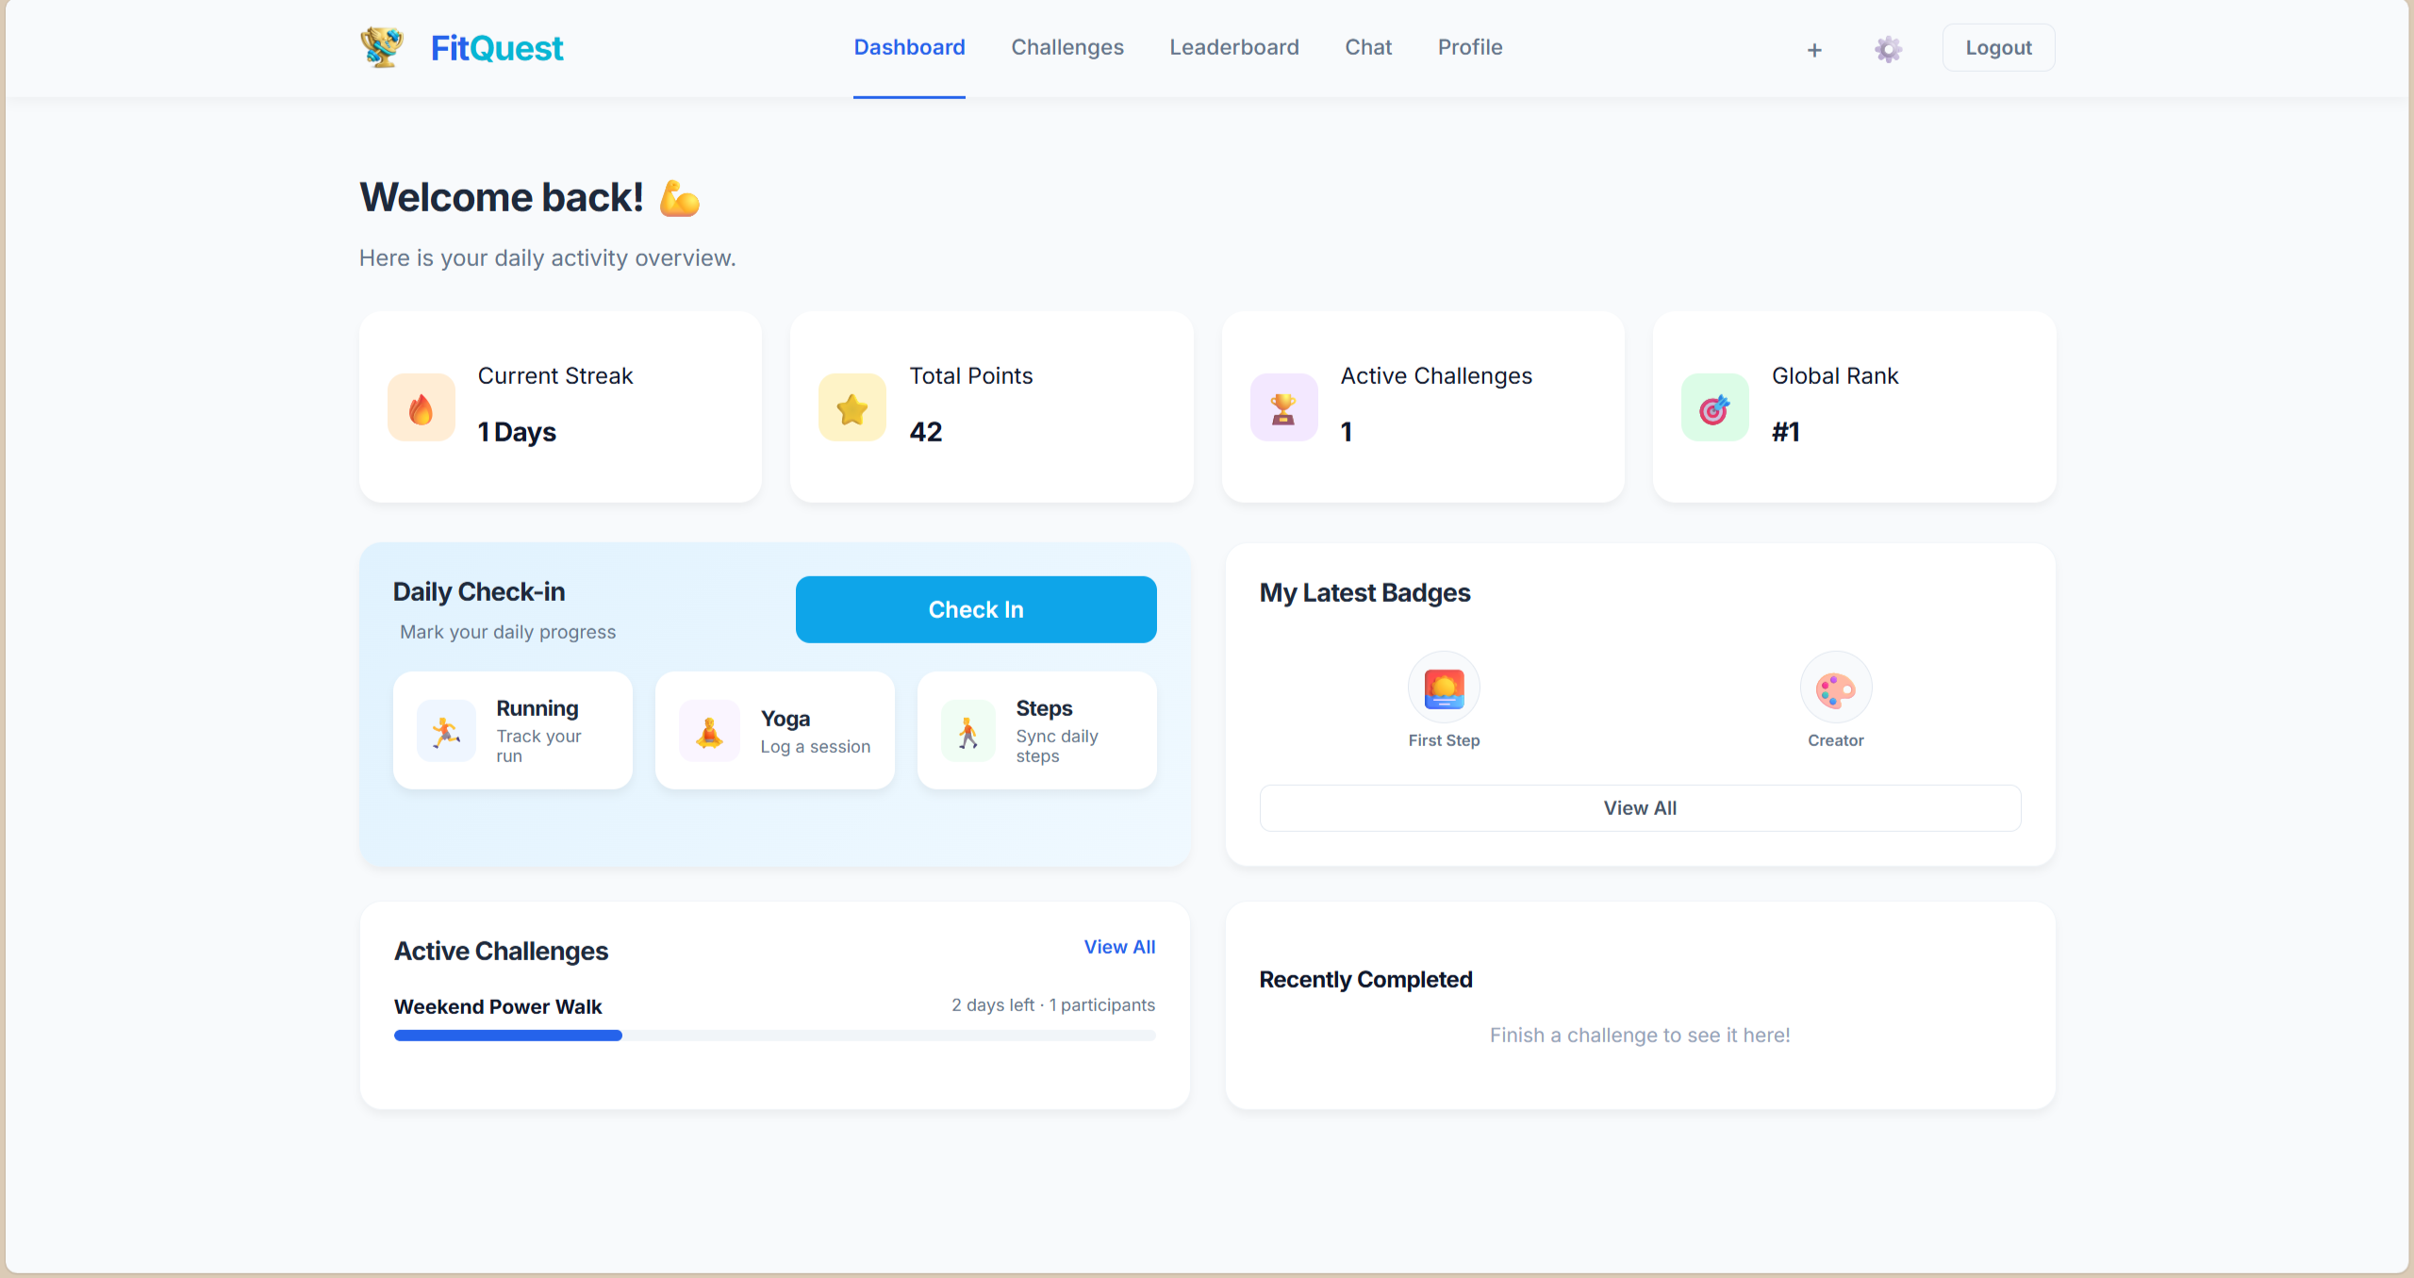
DASHBOARD
Centralized user dashboard
Displays active challenges and progress
Shows current streak and consistency
Quick access to daily check-ins
Real-time data fetched from backend APIs

Slide 15
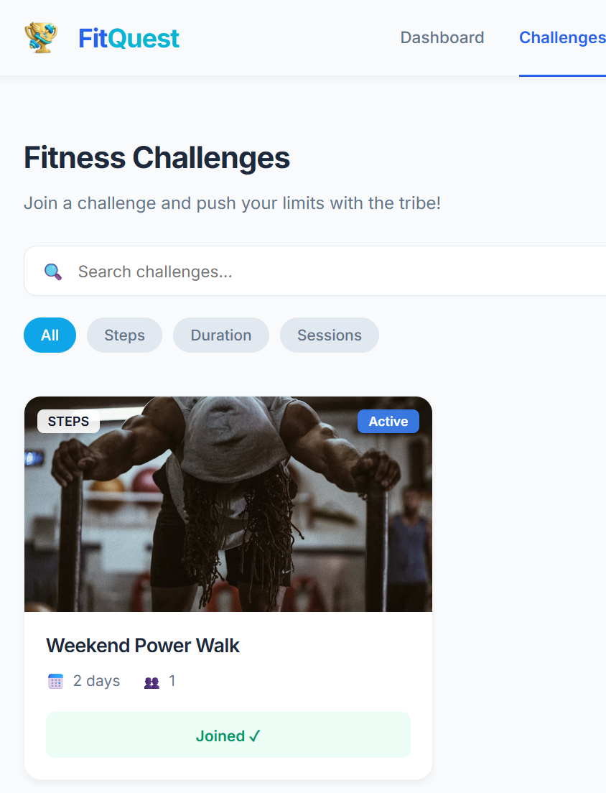
CHALLENGES
Create and join fitness challenges
Support for personal and group challenges
Displays challenge goals and duration
Tracks individual participation progress
Encourages competition and engagement

Slide 16
DAILY CHECK-IN & LEADERBOARD
Users log daily fitness activities through check-ins
Daily check-ins help maintain streak consistency
Prevents multiple check-ins on the same day
Leaderboard ranks users based on score and streak
Encourages healthy competition and motivation
Rankings update dynamically after each activity

Slide 17
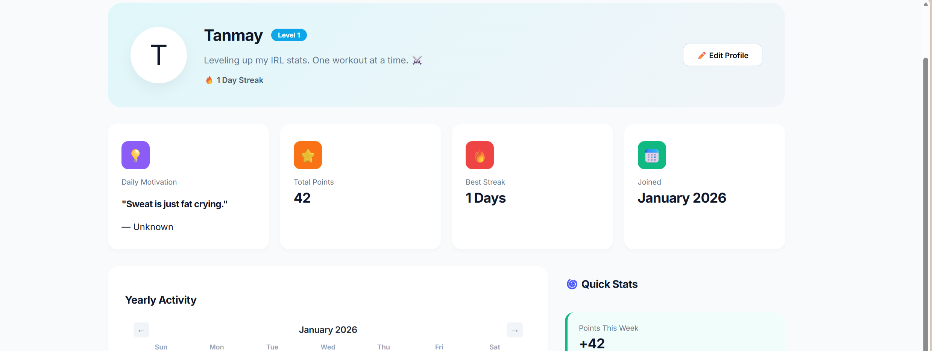
PROFILE & SETTINGS
User profile management
View personal fitness progress
Update account and security settings
Manage preferences and user details
Ensures personalized user experience

Slide 18

FUTURE ENHANCEMENTS
Mobile application for Android and iOS
Wearable device integration for automatic tracking
AI-based personalized fitness recommendations
Cloud deployment for scalability
Advanced analytics and progress insights

Slide 19

CONCLUSION
Gamified approach improves fitness consistency
Combines challenges, streaks, and competition
Built using modern full-stack technologies
Secure, scalable, and modular architecture
Can be extended into a production-ready platform

Slide 20


