Slide 1


Unit – 2
Cut-Sets & Connectivity
B.Tech., B.Sc.(H) CS $→5$^{th} Semester
Graph theory (2301CS595)
CO2:
At the end of this unit, students will be able to
Demonstrate the use of cut-sets, connectivity, and Separability..
Prof. Punit Vadher
Department of Humanities & Science
punit.vadher@darshan.ac.in
9662443859

Slide 2

Topics of Unit 2
  Brief Introduction of Unit
  Introduction to cut and cut - set
  Fundamental cut–sets with respect to a spanning tree
  Relationship between fundamental cut-sets and fundamental Circuits
  Connectivity and Separability
Looping

Slide 3
Brief Introduction

Slide 4
Unit Overview
Key Question: What are the critical components of a graph whose removal disconnects it?
Understanding:
  Cut-vertices (Articulation points), Cut-edges (Bridges), Cut-sets
Exploring:
  Connectivity of graphs (Vertex connectivity & Edge connectivity)
Advanced Insight:
  Relationship between spanning trees and fundamental cut-sets
Key idea:
  A spanning tree connects, while a cut-set disconnects

Slide 5
Method – 1
Introduction and Properties

Slide 6

Cut-sets
In a connected graph G, a cut-set is a set of edges whose removal from G makes the graph disconnected, and no smaller subset of these edges can disconnect the graph.
Also called minimal cut-set. We will simply use the term cut-set.
a
k
b
c
g
h
e
d
f
The set of edges$\{a, c, d, f\}$is a cut-set.

Slide 7



Cut-sets
There are many other cutsets, such as
a
k
a
k
k
a
b
b
b
c
c
c
g
h
g
h
g
h
e
e
e
d
d
d
f
f
f
$$\{a, b, g\}$$
$$\{a, b, e, f\}$$
$$\{d, h, f\}$$

Slide 8

Observation
?
Edge$\{k\}$ alone is also a cut-set.
The set of edges$\{a, c, h, d\}$, is not a cut-set.
As its proper subset of edges$\{a, c, h\}$is a cut-set .
a
k
b
c
g
h
e
d
f

Slide 9
Properties
No proper subset of a cut-set is a cut-set.
Every edge of a tree is a cut-edge (cut-set of size 1)
A cut-set always divides a graph into two components.
Every cut-set contains at least one branch of every spanning tree.

Slide 10
Why
No proper subset of a cut-set is a cut-set.
  A cut-set is minimal — remove fewer edges → graph stays connected
a
k
b
c
g
h
e
d
f
The set of edges$\{a, c, d, f\}$is a cut-set.

Slide 11
Why
Every edge of a tree is a cut-edge (cut-set of size 1)
  Tree is minimally connected
A cut-set always divides a graph into two components
  Removing it “cuts” the graph into two parts

Slide 12
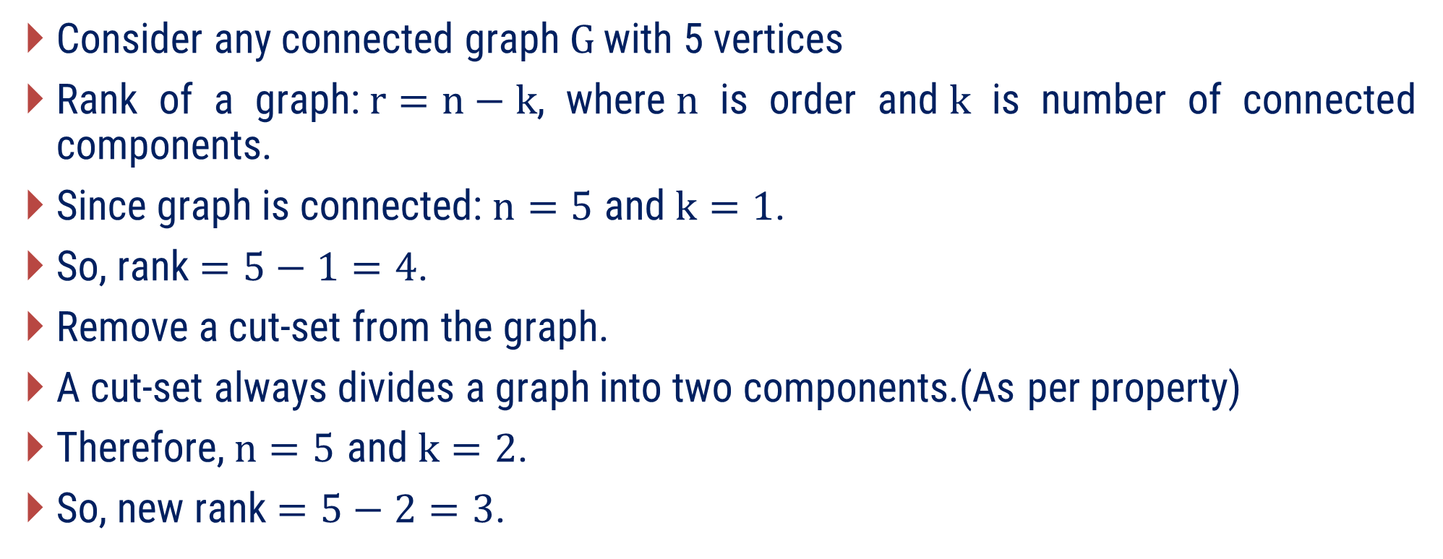
Verification: Cut-set reduces rank by 1
Consider any connected graph$G$ with 5 vertices
Rank of a graph:$r=n−k$, where$n$ is order and$k$ is number of connected components.
Since graph is connected:$n=5$ and$k=1$.
So, rank $=5−1=4$.
Remove a cut-set from the graph.
A cut-set always divides a graph into two components.(As per property)
Therefore,$n=5$ and$k=2$.
So, new rank $=5−2=3$.

Slide 13
Examples of Method-1

Slide 14
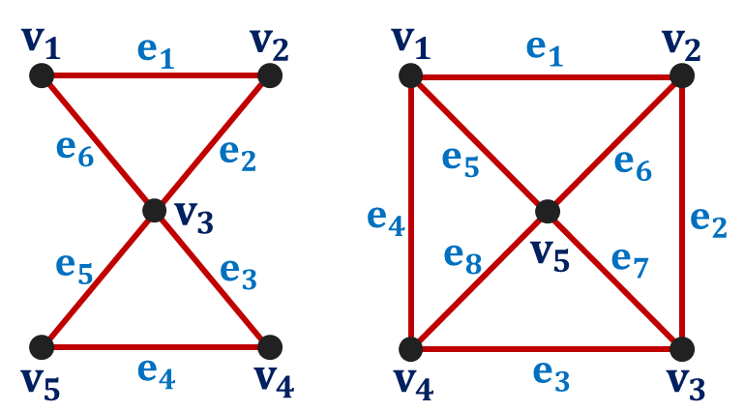


Method 1 ⇝ Example 1
Find cut-set of the following graphs
Solution
$$G_{1}$$
$$G_{2}$$

Slide 15




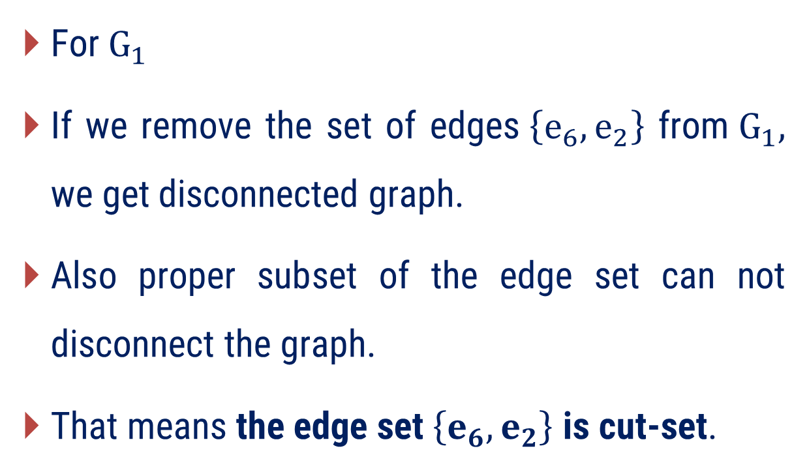








Method 1 ⇝ Example 1(Cont.)
Find cut-set of the following graphs
Solution
For$G_{1}$
If we remove the set of edges$\left\{e_{6},e_{2}\right\}$ from$G_{1},$ we get disconnected graph.
Also proper subset of the edge set can not disconnect the graph.
That means the edge set$\left\{e_{6},e_{2}\right\}$ is cut-set.
$$v_{1}$$
$$e_{1}$$
$$v_{2}$$
$$e_{6}$$
$$e_{2}$$
$$v_{3}$$
$$e_{5}$$
$$e_{3}$$
$$v_{5}$$
$$e_{4}$$
$$v_{4}$$
$$G_{1}$$

Slide 16





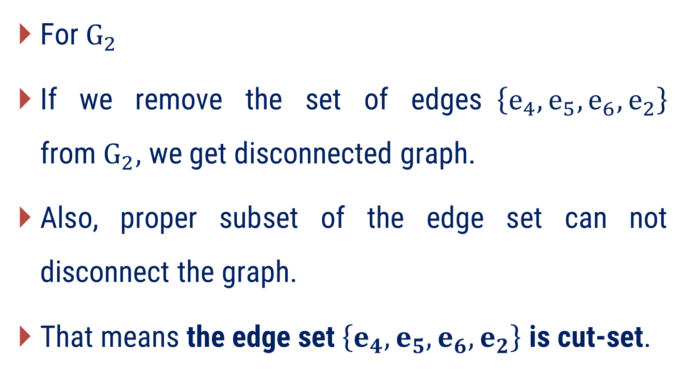









Method 1 ⇝ Example 1(Cont.)
Find cut-set of the following graphs
Solution
For$G_{2}$
If we remove the set of edges$\left\{{e_{4}, e_{5}, e}_{6},e_{2}\right\}$ from$G_{2},$ we get disconnected graph.
Also, proper subset of the edge set can not disconnect the graph.
That means the edge set$\left\{{e_{4}, e_{5}, e}_{6},e_{2}\right\}$ is cut-set.
$$v_{1}$$
$$e_{1}$$
$$v_{2}$$
$$e_{5}$$
$$e_{6}$$
$$e_{4}$$
$$e_{2}$$
$$e_{8}$$
$$v_{5}$$
$$e_{7}$$
$$v_{4}$$
$$e_{3}$$
$$v_{3}$$
$$G_{2}$$

Slide 17





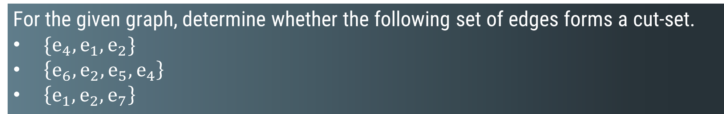



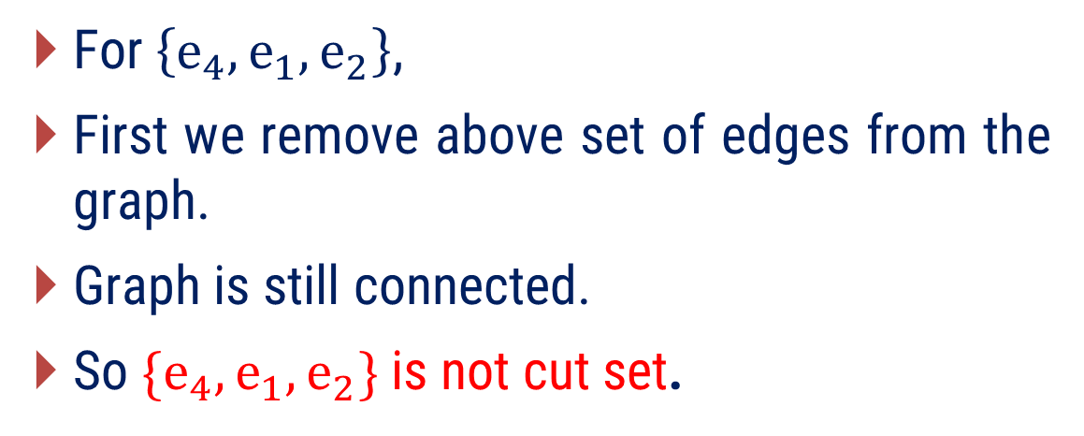




Method 1 ⇝ Example 2
For the given graph, determine whether the following set of edges forms a cut-set.
$\{e_{4}, e_{1},e_{2}\}$
$\left\{e_{6}, e_{2}, e_{5},e_{4}\right\}$
$\left\{e_{1},e_{2}, e_{7}\right\}$
Solution
$$v_{1}$$
$$e_{1}$$
$$v_{2}$$
For$\left\{e_{4}, e_{1},e_{2}\right\}$,
First we remove above set of edges from the graph.
Graph is still connected.
So $\{e_{4}, e_{1},e_{2}\}$ is not cut set.
$$e_{4}$$
$$e_{5}$$
$$e_{2}$$
$$e_{6}$$
$$v_{4}$$
$$e_{3}$$
$$v_{3}$$
$$e_{7}$$
$$v_{5}$$

Slide 18
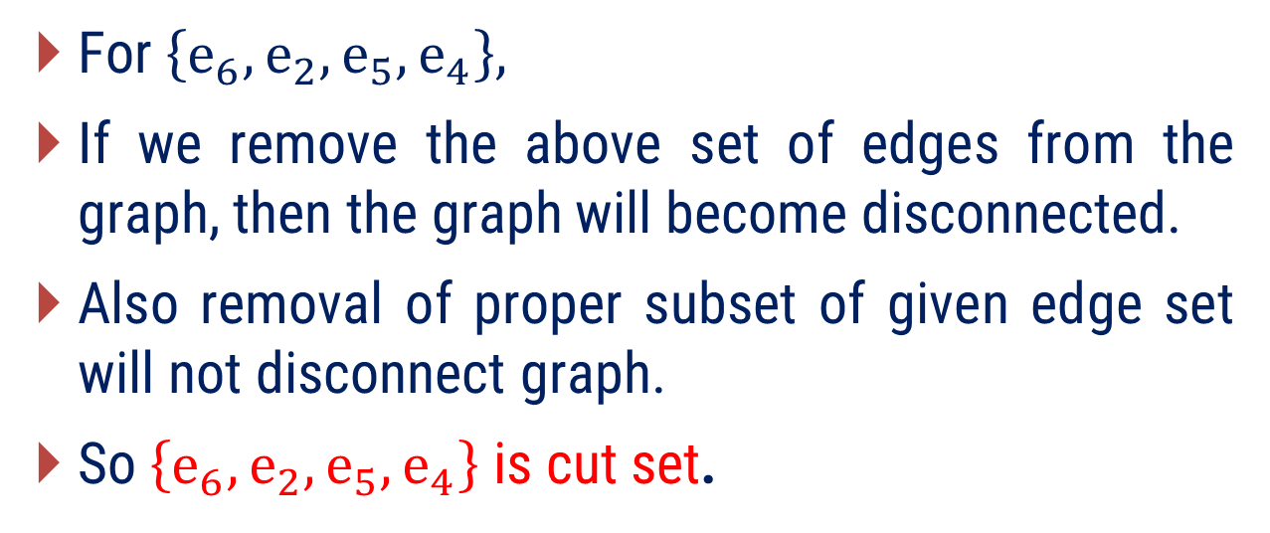
Method 1 ⇝ Example 2(Cont.)
For the given graph, determine whether the following set of edges forms a cut-set.
$\{e_{4}, e_{1},e_{2}\}$
$\left\{e_{6}, e_{2}, e_{5},e_{4}\right\}$
$\left\{e_{1},e_{2}, e_{7}\right\}$
Solution
$$v_{1}$$
$$e_{1}$$
$$v_{2}$$
For $\left\{e_{6}, e_{2}, e_{5},e_{4}\right\},$
If we remove the above set of edges from the graph, then the graph will become disconnected.
Also removal of proper subset of given edge set will not disconnect graph.
So$\left\{e_{6}, e_{2}, e_{5},e_{4}\right\}$ is cut set.
$$e_{4}$$
$$e_{5}$$
$$e_{2}$$
$$e_{6}$$
$$v_{4}$$
$$e_{3}$$
$$v_{3}$$
$$e_{7}$$
$$v_{5}$$

Slide 19
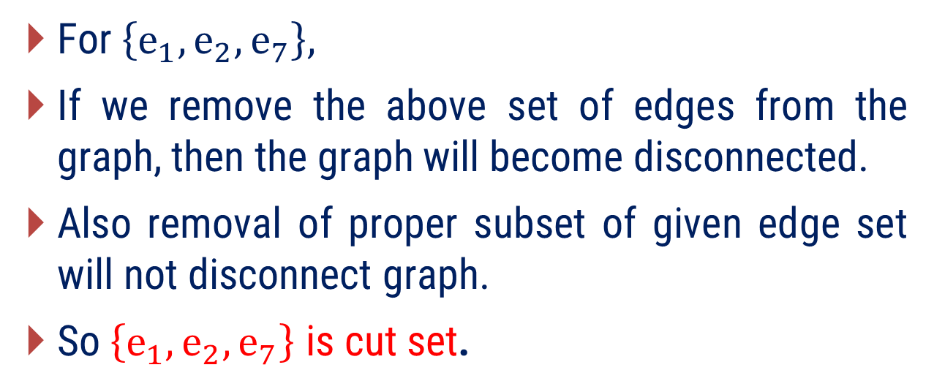
Method 1 ⇝ Example 2(Cont.)
For the given graph, determine whether the following set of edges forms a cut-set.
$\{e_{4}, e_{1},e_{2}\}$
$\left\{e_{6}, e_{2}, e_{5},e_{4}\right\}$
$\left\{e_{1},e_{2}, e_{7}\right\}$
Solution
$$v_{1}$$
$$e_{1}$$
$$v_{2}$$
For $\left\{e_{1},e_{2}, e_{7}\right\},$
If we remove the above set of edges from the graph, then the graph will become disconnected.
Also removal of proper subset of given edge set will not disconnect graph.
So$\left\{e_{1}, e_{2}, e_{7}\right\}$ is cut set.
$$e_{4}$$
$$e_{5}$$
$$e_{2}$$
$$e_{6}$$
$$v_{4}$$
$$e_{3}$$
$$v_{3}$$
$$e_{7}$$
$$v_{5}$$

Slide 20

Method 1 ⇝ Example 3
How many cut-sets does a tree with 10 vertices have?
Solution
Since, Every edge of a tree is a cut-edge (cut-set of size 1)
Recall: Tree with$n$ vertices have$n−1$ edges
Therefore, tree with 10 vertices have 9 edges.
Hence, a tree with 10 vertices have 9 cut-set

Slide 21
Method 1 ⇝ Example 4
Prove that : Every cut set in a connected graph G must contain at least one branch of every
spanning tree of G.
Solution
Let T is a spanning tree of G and S is arbitrary subset in G that is not to have any edge in common with T.
Then removal S from G would not disconnect the graph.
So, S is not a cut set in G.

Slide 22
Method 1 ⇝ Example 5
Prove that: In a connected graph G, any minimal set of edges containing at least one
branch of every spanning tree of G is a cut-set.
Solution
In a given connected graph G, let Q be a minimal set of edges containing at least one branch of every spanning tree of G.
Consider G − Q, the subgraph that remains after removing the edges in Q from G.
Since the subgraph G − Q contains no spanning tree of G, G − Q is disconnected.
Therefore, Q is a minimal set of edges whose removal from G disconnects G.
By definition, Q is a cut-set.

Slide 23
Method – 2
Fundamental Cut-Sets with respect to a spanning tree

Slide 24
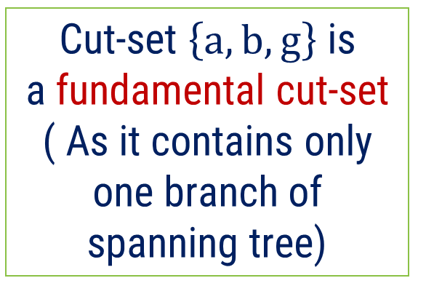

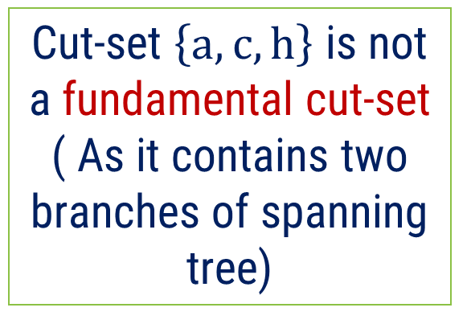
Fundamental cut-set
Definition: A fundamental cut-set (with respect to a spanning tree$T$) is a cut-set that contains exactly one branch of$T$.
Cut-set $\left\{a, b, g\right\}$ is
a fundamental cut-set ( As it contains only one branch of spanning tree)
a
k
Cut-set $\left\{a, c, h\right\}$ is not a fundamental cut-set
( As it contains two branches of spanning tree)
b
c
g
h
e
d
f
Consider a graph with a spanning tree (green edges)

Slide 25


Fundamental cut-set
As Spanning tree have 5 branches we get 5 fundamental cut set .
a
k
k
a
b
b
c
c
g
h
g
h
e
e
d
d
f
f
$\left\{a, b, g\right\}$
$\left\{a, b, e, f\right\}$

Slide 26


Fundamental cut-set
As Spanning tree have 5 branches we get 5 fundamental cut set .
a
k
k
a
b
b
c
c
g
h
g
h
e
e
d
d
f
f
$\left\{c, b, e, d\right\}$
$\left\{k\right\}$

Slide 27

Fundamental cut-set
As Spanning tree have 5 branches we get 5 fundamental cut set .
a
k
b
c
g
h
e
d
f
$\left\{a, b, e, d,h\right\}$

Slide 28
What Happened if we change spanning tree
If we change spanning tree for the same graph, list of fundamental cut set may be change but total number remains same. As we have 5 branches we again get 5 fundamental cut set.
a
k
b
c
g
h
e
d
f

Slide 29
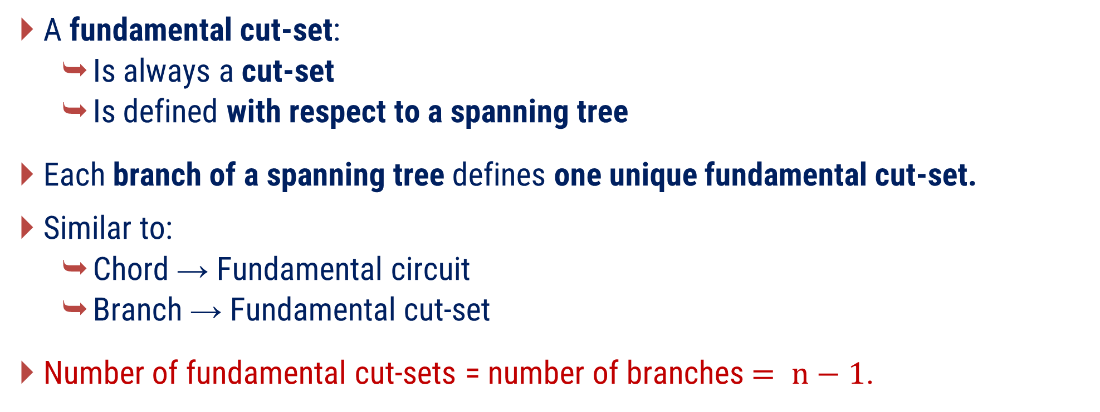
Remarks
A fundamental cut-set:
  Is always a cut-set
  Is defined with respect to a spanning tree
Each branch of a spanning tree defines one unique fundamental cut-set.
Similar to:
  Chord → Fundamental circuit
  Branch → Fundamental cut-set
Number of fundamental cut-sets = number of branches$= n−1$.

Slide 30
Examples of Method-2

Slide 31
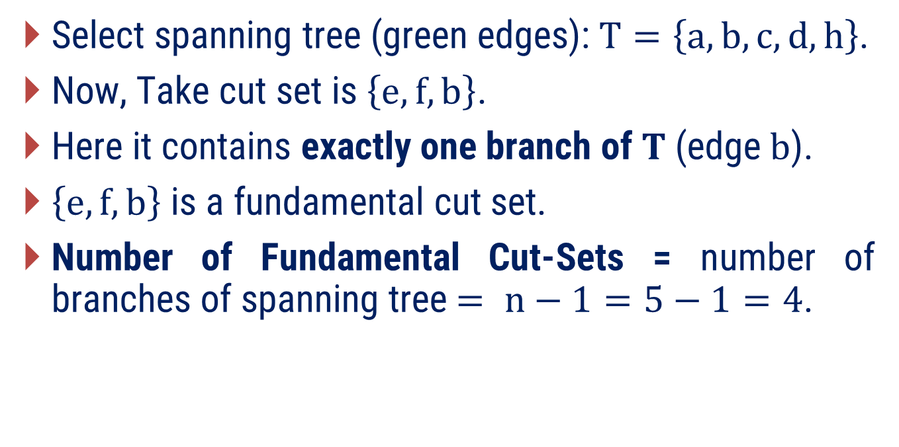
Method 2 ⇝ Example 1
For a given graph find a fundamental cut-set with respect to a spanning tree of your choice. Also determine how many such cut-sets exist.
Solution
h
Select spanning tree (green edges): $T=\left\{a,b,c,d,h\right\}$.
Now, Take cut set is $\left\{e,f,b\right\}$.
Here it contains exactly one branch of$T$ (edge$b$).
$\left\{e,f,b\right\}$ is a fundamental cut set.
Number of Fundamental Cut-Sets = number of branches of spanning tree$= n−1=5−1=4$.
a
e
g
b
d
f
c

Slide 32
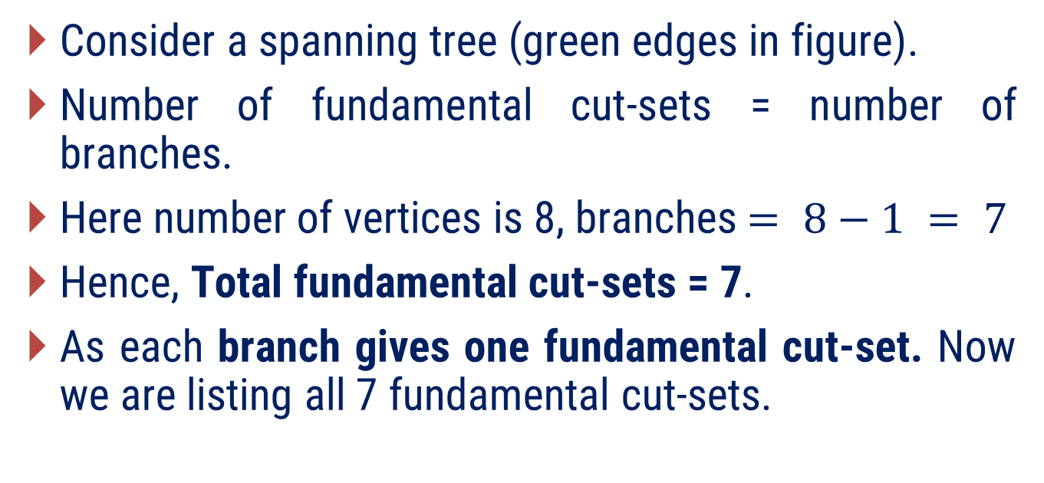
Method 2 ⇝ Example 2(Cont.)
Pick an arbitrary spanning tree in the given graph. List all fundamental cutsets with respect to this tree.
Solution
e
g
Consider a spanning tree (green edges in figure).
Number of fundamental cut-sets = number of branches.
Here number of vertices is 8, branches $= 8−1 = 7$
Hence, Total fundamental cut-sets = 7.
As each branch gives one fundamental cut-set. Now we are listing all 7 fundamental cut-sets.
f
a
h
d
b
l
c
i
k
j

Slide 33



Method 2 ⇝ Example 2(Cont.)
Pick an arbitrary spanning tree in the given graph. List all fundamental cutsets with respect to this tree.
Solution
e
g
e
g
e
g
f
a
h
f
a
h
f
a
h
d
b
d
b
d
b
l
c
i
l
c
i
l
c
i
k
j
k
j
k
j
$\left\{ k,j \right\}$
$\left\{ l,d, c, j \right\}$
$\left\{ f,d, c, j \right\}$

Slide 34



Method 2 ⇝ Example 2(Cont.)
Pick an arbitrary spanning tree in the given graph. List all fundamental cutsets with respect to this tree.
Solution
e
g
e
g
e
g
f
a
h
f
a
h
f
a
h
d
b
d
b
d
b
l
c
i
l
c
i
l
c
i
k
j
k
j
k
j
$\left\{ g,a, c,j \right\}$
$\left\{ h,b,j \right\}$
$\left\{ e,a, c,j \right\}$

Slide 35

Method 2 ⇝ Example 2(Cont.)
Pick an arbitrary spanning tree in the given graph. List all fundamental cutsets with respect to this tree.
Solution
e
g
f
a
h
d
b
l
c
i
k
j
$\left\{ h,i \right\}$

Slide 36
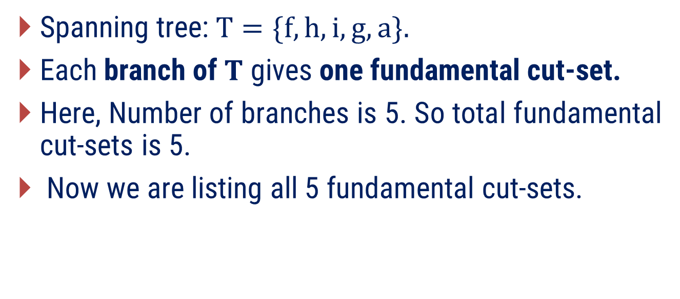
Method 2 ⇝ Example 3
Find all fundamental cut-sets with respect to spanning tree$\{f,h,i,g,a\}$ for for following graph.
Solution
Spanning tree:$T=\{f,h,i,g,a\}.$
Each branch of$T$ gives one fundamental cut-set.
Here, Number of branches is 5. So total fundamental cut-sets is 5.
Now we are listing all 5 fundamental cut-sets.
e
f
h
i
c
d
g
a
b

Slide 37





Method 2 ⇝ Example 3(Cont.)
Find all fundamental cut-sets with respect to spanning tree$\{f,h,i,g,a\}$ for following graph.
Solution
e
f
e
f
e
f
e
f
e
f
h
h
h
h
h
i
i
i
i
i
c
d
c
d
c
d
d
c
d
c
g
g
g
g
g
a
b
a
b
a
b
a
b
a
b
$\left\{ e, f \right\}$
$\left\{ e, h, d \right\}$
$\left\{ c, i, d \right\}$
$\left\{ c, g, b \right\}$
$\left\{ a, b \right\}$

Slide 38
Method – 3
Relationship between Fundamental Cut-Set and Fundamental Circuit

Slide 39
Relationship: Fundamental Circuits vs Cut-Sets
As we know, fundamental circuits and fundamental cut-sets are key concepts derived from a spanning tree of a connected graph.
The relationship between them provides insight into how connectivity and cycles interact in a graph.
Concept | Based on | Result
Fundamental Circuit | Add a chord to tree | Creates a cycle
Fundamental Cut-Set | Remove a branch from tree | Creates a cut (disconnect)

Slide 40
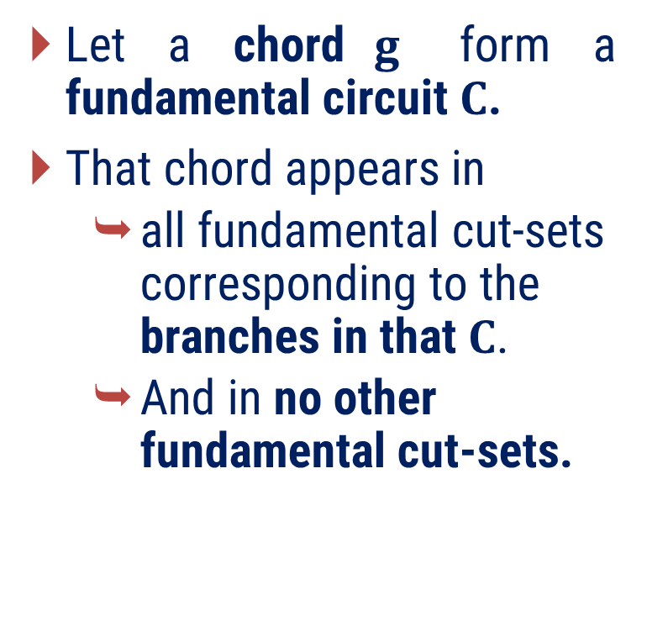

Relationship: Chord & Fundamental Cut-Sets
A chord that forms a fundamental circuit$C$, appears in all fundamental cut-sets corresponding to the branches of$C$, and in no other fundamental cut-sets.
Let a chord$g$ form a fundamental circuit$C$.
That chord appears in
  all fundamental cut-sets corresponding to the branches in that$C$.
  And in no other fundamental cut-sets.
d
a
h
e
c
g
$$C$$
b
k
f
A chord belongs only to cut-sets of branches in its circuit

Slide 41

Relationship: Chord & Fundamental Cut-Sets
Consider another chord, $d$ forming a fundamental circuit$C$.
That chord$d$ appears in all fundamental cut-sets corresponding to the branches in that$C$. And in no other fundamental cut-sets.
d
a
h
e
c
g
b
k
f

Slide 42
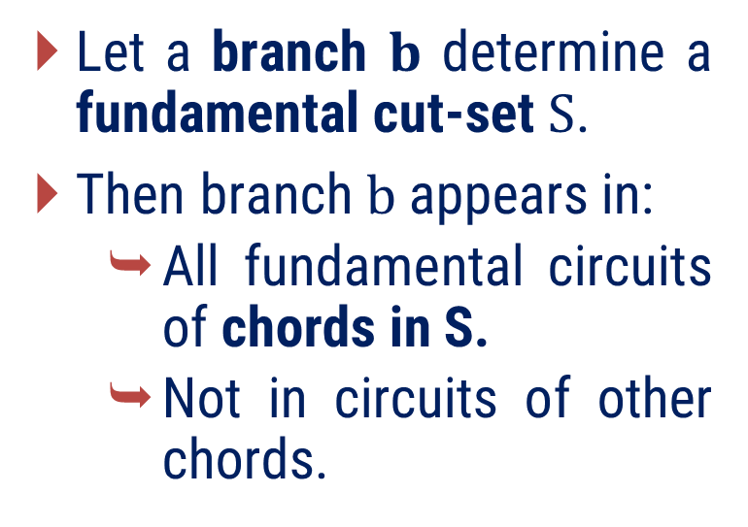


Relationship: Branch & Fundamental Circuits
A branch that determines a fundamental cut-set$S$ appears in all fundamental circuits corresponding to the chords of$S$, and in no other fundamental circuits.
Let a branch $b$ determine a fundamental cut-set$S$.
Then branch$b$ appears in:
  All fundamental circuits of chords in S.
  Not in circuits of other chords.
d
a
h
e
c
g
b
k
$$S$$
f
A branch belongs only to circuits of chords in its cut-set

Slide 43


Relationship: Branch & Fundamental Circuits
Consider another branch,$h$ forming a fundamental cut-set $S$.
That branch$h$ appears in all fundamental circuits corresponding to the chords in that$S$, and in no other fundamental circuits.
d
a
h
$$S$$
e
c
g
b
k
f

Slide 44

Relationship: Branch & Fundamental Circuits
Consider another branch,$h$ forming a fundamental cut-set $S$.
That branch$h$ appears in all fundamental circuits corresponding to the chords in that$S$, and in no other fundamental circuits.
d
a
h
$$S$$
e
c
g
b
k
f

Slide 45



For you ?
Explain property 1 for the spanning tree is$\left\{b, c, e, h, k\right\}$ and the fundamental circuit made by chord$f$.
d
Determined by branch$e:\left\{d, e, f\right\}$.
a
h
e
c
g
    Determined by branch $h: \{f, g, h\}$.
b
k
Determined by branch$k: \{f, g, k\}$.
f

Slide 46


For you ?
Explain property 2 for the spanning tree is$\left\{b, c, e, h, k\right\}$ and the fundamental cut-set made by branch$e$ is$\{d,e,f\}$.
d
Determined by chords $d:\left(d, e, c\right)$.
a
h
e
c
1
g
2
    Determined by chords $f:\left(f, k, h,e\right)$.
b
k
f

Slide 47
Examples of Method-3

Slide 48
Method 3 ⇝ Example 1
Explain property with example:
A chord that determines a fundamental circuit C occurs in every fundamental cut-set associated with the branches in C and in no other.
Solution
h
a
Consider the graph, where the green lines represent the edges of a spanning tree.
The blue dotted lines indicate the corresponding fundamental cut-sets with respect to that spanning tree.
e
g
b
d
f
c

Slide 49

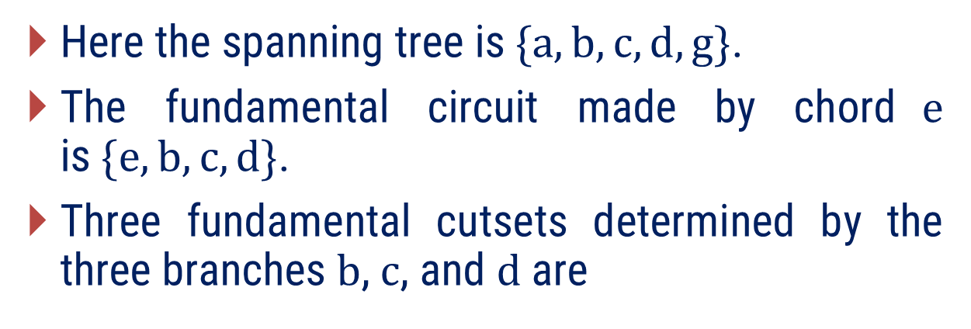



Method 3 ⇝ Example 1
Solution
h
a
Here the spanning tree is$\{a, b, c, d, g\}$.
The fundamental circuit made by chord$e$ is$\{e, b, c, d\}$.
  Three fundamental cutsets determined by the three branches $b$, $c$, and $d$ are
e
g
b
d
f
c
Determined by branch$b:\left\{b, f, e\right\}$.
    Determined by branch $c: \{c,f, e\}$.
Determined by branch$d: \{e, d\}$.
  Chord$e$ that determines a fundamental circuit occurs in each of these three fundamental cutsets, and there is no other fundamental cut-set that contains e.

Slide 50
Method 3 ⇝ Example 2
Explain property with example:
A branch that determines a fundamental cut-set S is contained in every fundamental circuit associated with the chords in S, and in no others.
Solution
h
a
Consider the graph below, where the green lines represent the edges of a spanning tree.
e
g
b
d
f
c

Slide 51

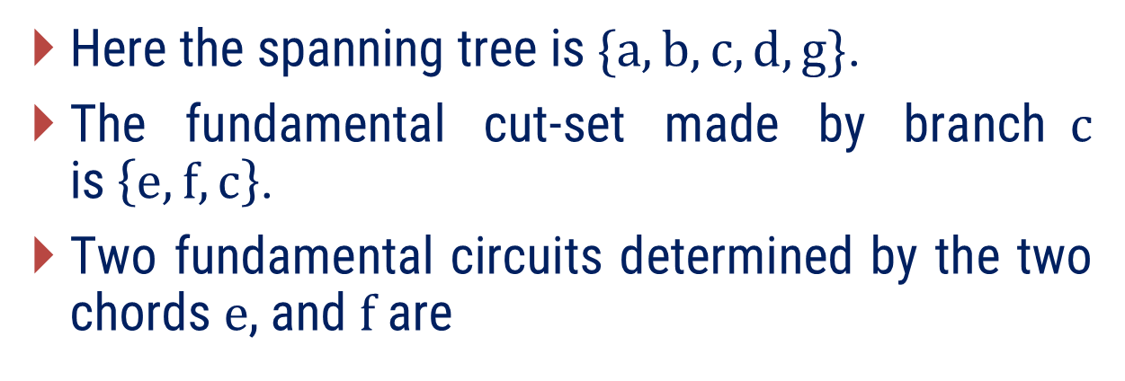
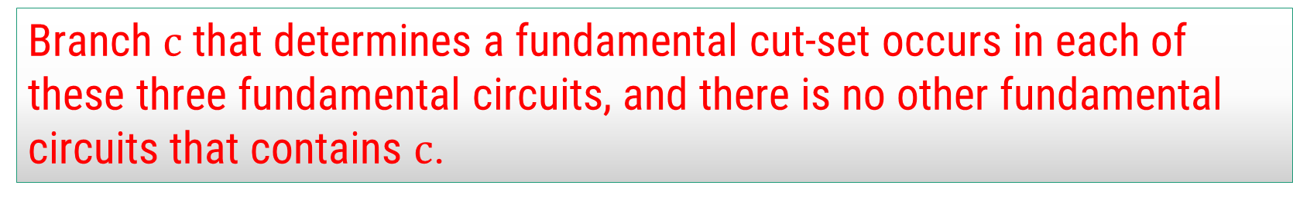

Method 3 ⇝ Example 1
Solution
h
a
Here the spanning tree is$\{a, b, c, d, g\}$.
The fundamental cut-set made by branch$c$ is$\left\{e, f, c\right\}$.
  Two fundamental circuits determined by the two chords $e$, and $f$ are
e
g
b
d
f
c
Determined by chords $e:\left\{e,b, c, d\right\}$.
    Determined by chords $f: \{b,c,f\}$.
  Branch$c$ that determines a fundamental cut-set occurs in each of these three fundamental circuits, and there is no other fundamental circuits that contains $c$.

Slide 52
Method – 4
Connectivity and Separability

Slide 53
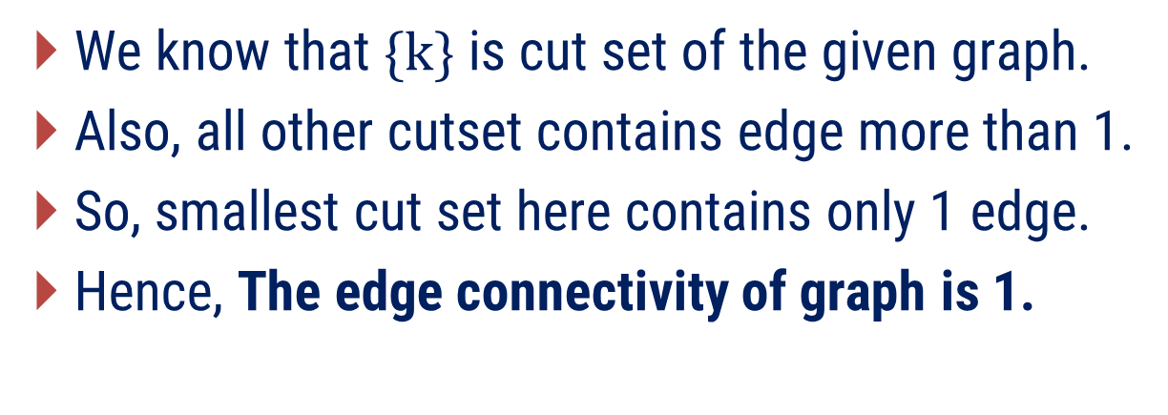
Connectivity
The edge connectivity of a connected graph can be defined as the number of edges in the smallest cut-set (i.e., cutset with fewest number of edges).
Equivalently, is defined as the minimum number of edges whose removal (i.e., deletion) reduces the rank of the graph by one.
a
k
We know that $\{k\}$ is cut set of the given graph.
Also, all other cutset contains edge more than 1.
So, smallest cut set here contains only 1 edge.
Hence, The edge connectivity of graph is 1.
b
c
g
h
e
d
f

Slide 54
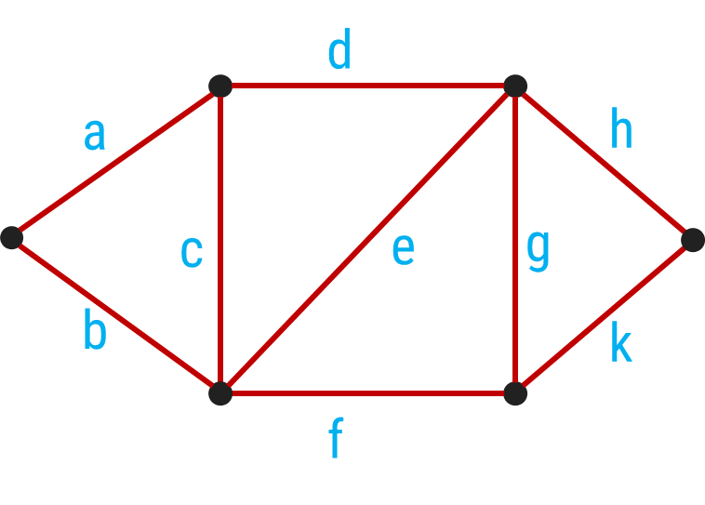
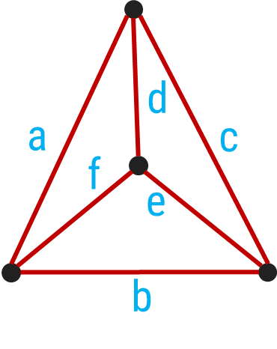


Find The edge connectivity of following graph.
$$G_{1}$$
$$G_{2}$$

Slide 55

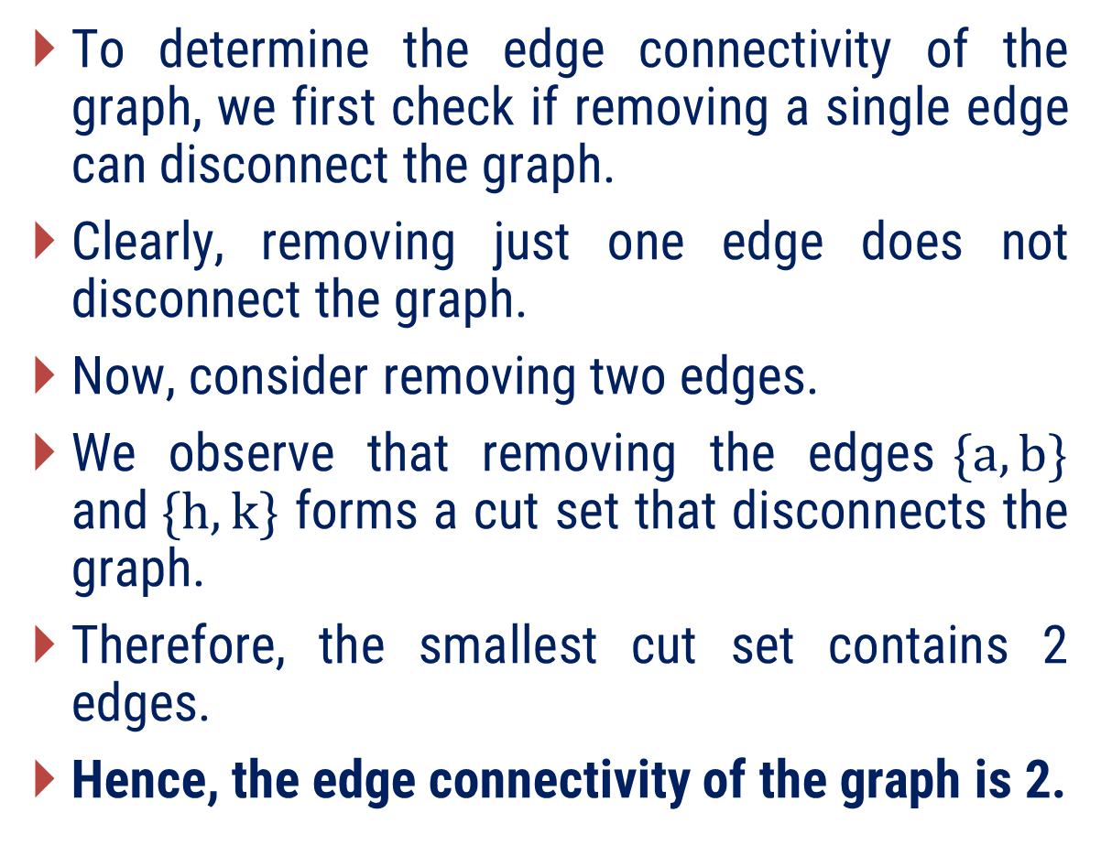
Solution
To determine the edge connectivity of the graph, we first check if removing a single edge can disconnect the graph.
Clearly, removing just one edge does not disconnect the graph.
Now, consider removing two edges.
We observe that removing the edges$\{a, b\}$ and$\{h, k\}$ forms a cut set that disconnects the graph.
Therefore, the smallest cut set contains 2 edges.
Hence, the edge connectivity of the graph is 2.
d
a
h
e
c
g
b
k
$$G_{1}$$

Slide 56

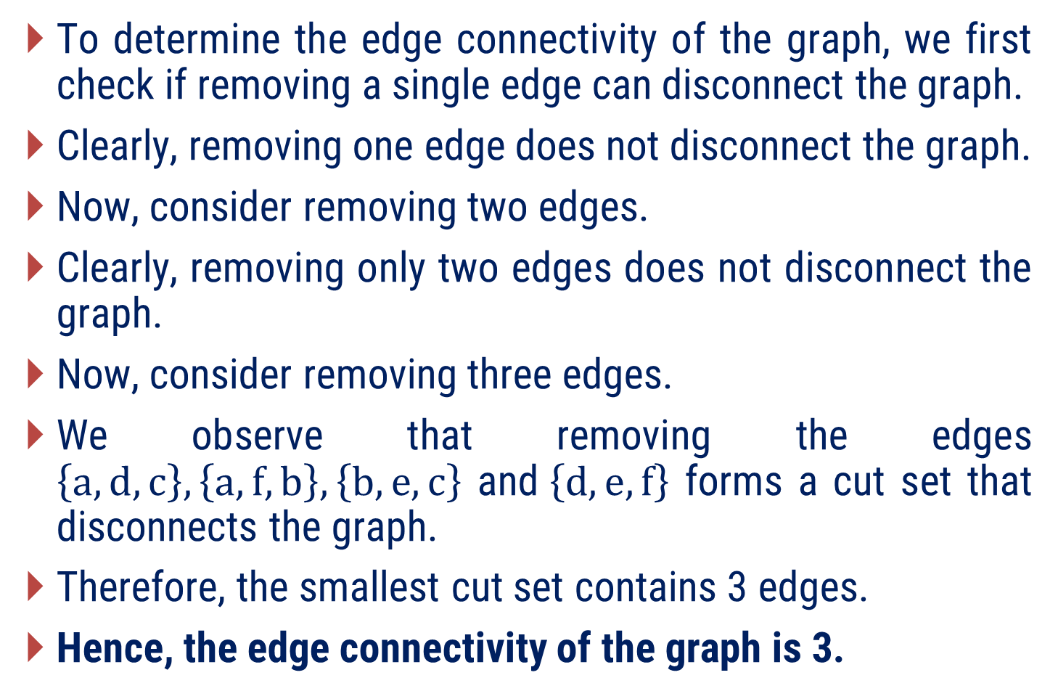
Solution
To determine the edge connectivity of the graph, we first check if removing a single edge can disconnect the graph.
Clearly, removing one edge does not disconnect the graph.
Now, consider removing two edges.
Clearly, removing only two edges does not disconnect the graph.
Now, consider removing three edges.
We observe that removing the edges $\left\{a, d,c\right\},\left\{a, f,b\right\},\left\{b,e,c\right\}$ and$\left\{d,e,f\right\}$ forms a cut set that disconnects the graph.
Therefore, the smallest cut set contains 3 edges.
Hence, the edge connectivity of the graph is 3.
d
a
c
f
e
b
$$G_{2}$$

Slide 57
The edge connectivity of a tree, is one.
In a tree, there is exactly one unique path between every pair of vertices.
This means that if we remove even a single edge, the path between some pair of vertices will be broken, and the graph will become disconnected.
Therefore, removing just one edge is enough to disconnect a tree.
This implies that the smallest edge cutset in a tree contains only one edge.
Hence, the edge connectivity of any tree is 1.

Slide 58
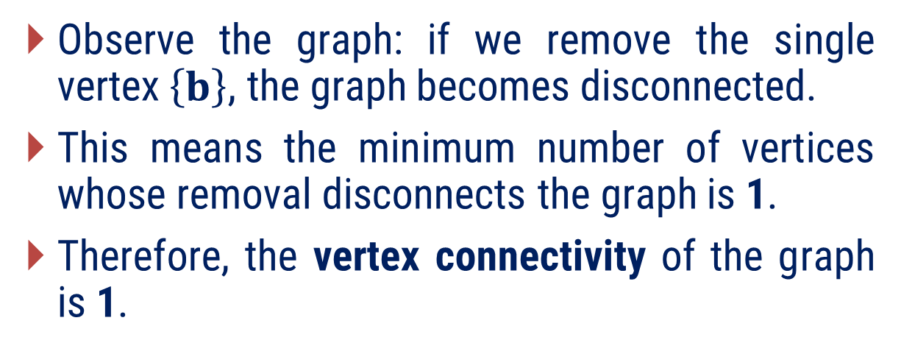
Vertex Connectivity
The vertex connectivity (or simply connectivity) of a connected graph G is defined as the minimum number of vertices whose removal from G leaves the remaining graph disconnected.
Observe the graph: if we remove the single vertex$\left\{b\right\}$, the graph becomes disconnected.
This means the minimum number of vertices whose removal disconnects the graph is 1.
Therefore, the vertex connectivity of the graph is 1.
e
a
b
f
Note that:
From the way we have defined it vertex connectivity is meaningful only for graphs that have three or more vertices and are not complete.
d
c

Slide 59


Find the vertex connectivity of following graph
e
d
e
d
g
h
b
a
f
c
c
f
a
b
$$G_{1}$$
$$G_{2}$$

Slide 60

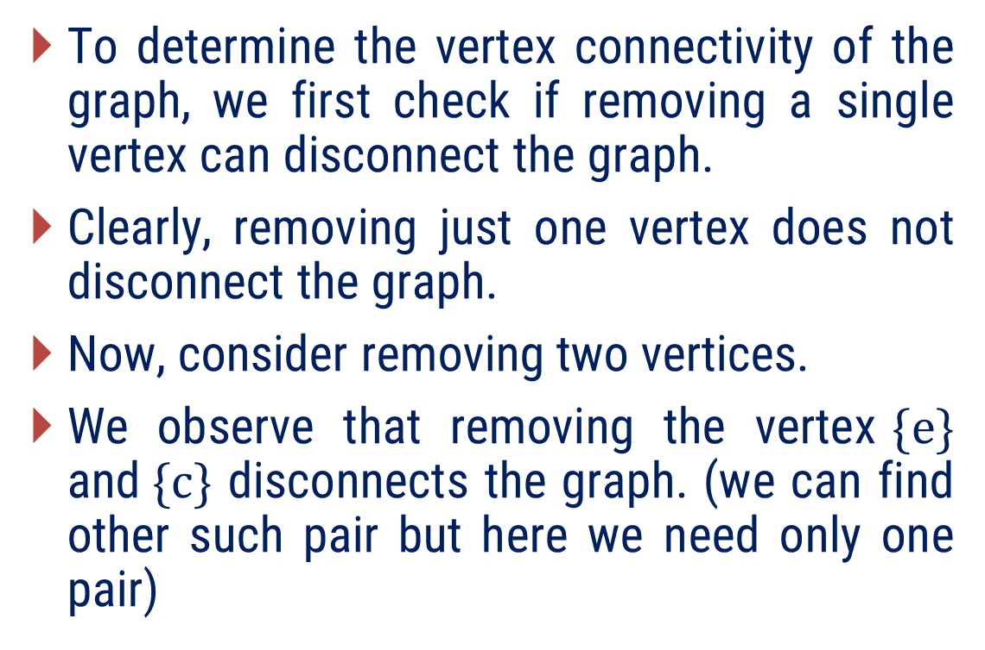
Find the vertex connectivity of following graph
To determine the vertex connectivity of the graph, we first check if removing a single vertex can disconnect the graph.
Clearly, removing just one vertex does not disconnect the graph.
Now, consider removing two vertices.
We observe that removing the vertex$\{e\}$ and$\{c\}$ disconnects the graph. (we can find other such pair but here we need only one pair)
d
e
b
a
c
$$G_{1}$$
f
So, the minimum number of vertices whose removal disconnects the graph is 2.
Hence, the vertex connectivity of the graph is 2.

Slide 61

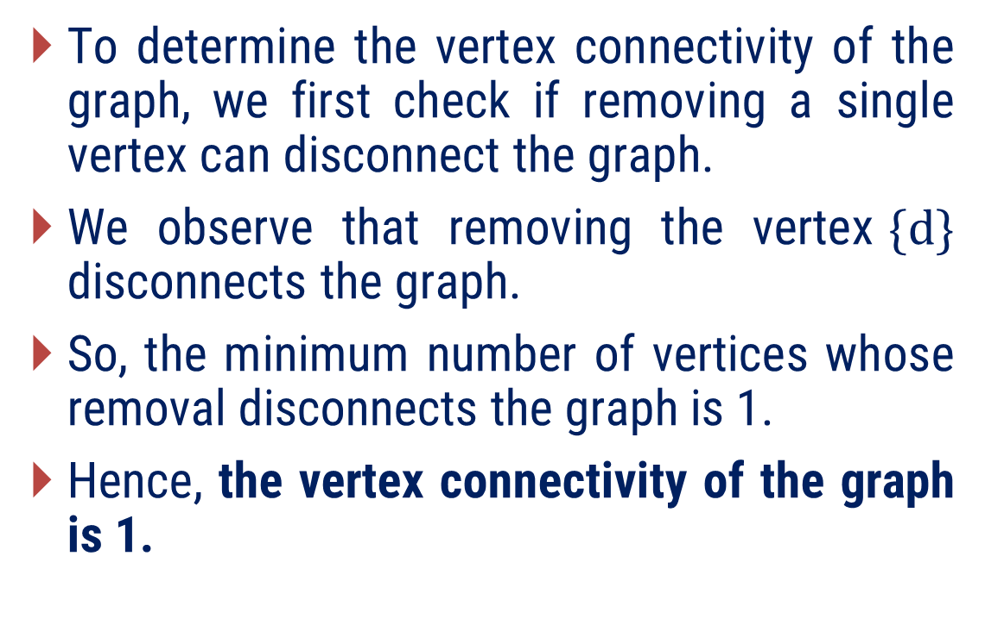
Find the vertex connectivity of following graph
To determine the vertex connectivity of the graph, we first check if removing a single vertex can disconnect the graph.
We observe that removing the vertex$\{d\}$ disconnects the graph.
So, the minimum number of vertices whose removal disconnects the graph is 1.
Hence, the vertex connectivity of the graph is 1.
e
d
g
h
f
c
a
b
$$G_{2}$$

Slide 62
Separable
A connected graph is said to be separable if its vertex connectivity is one.
Following graphs are separable.
In a separable graph a vertex whose removal disconnects the graph is called a cut-vertex, a cut-node, or an articulation point.
Cut vertex
Vertex connectivity is 1

Slide 63
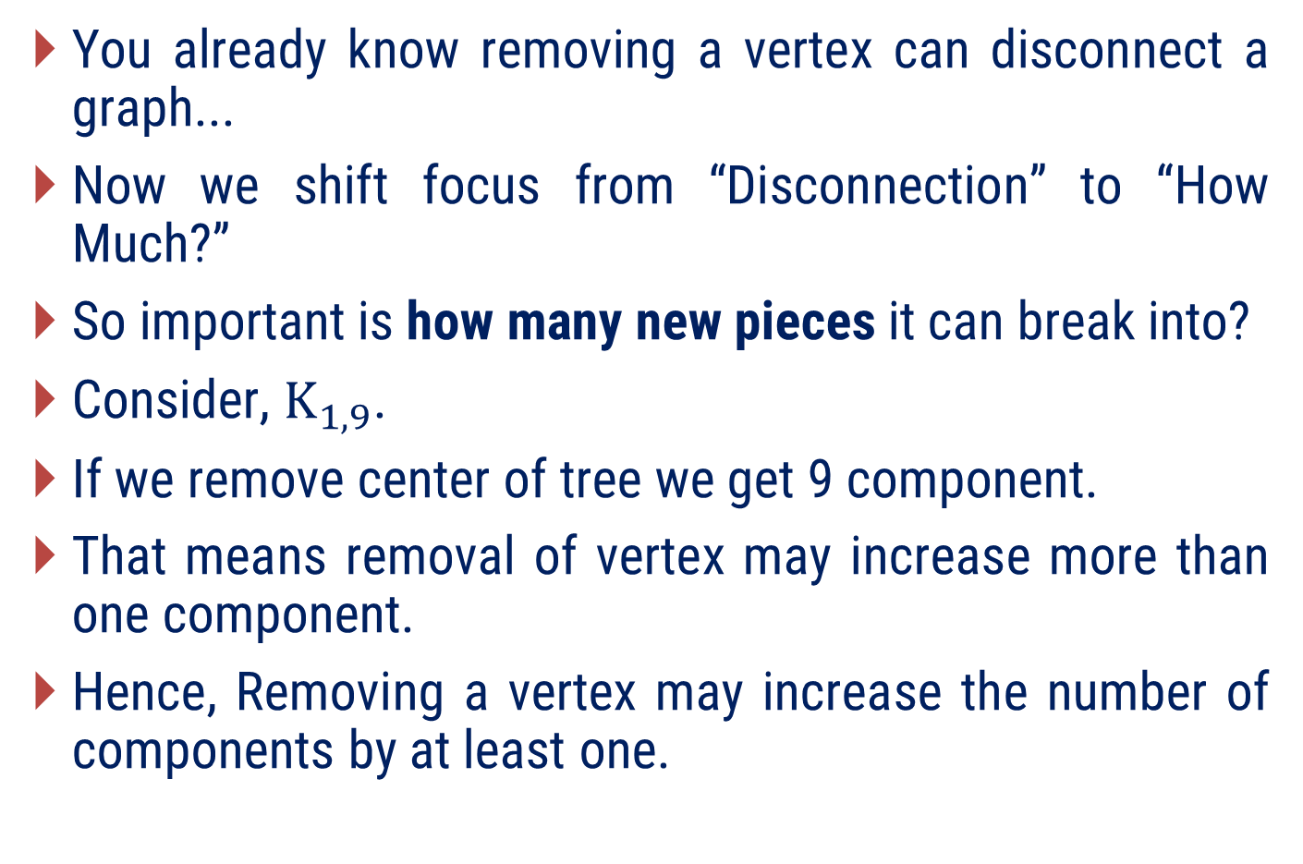
What do you think will happen if I remove a vertex from a graph?
You already know removing a vertex can disconnect a graph...
Now we shift focus from “Disconnection” to “How Much?”
So important is how many new pieces it can break into?
Consider, $K_{1,9}$.
If we remove center of tree we get 9 component.
That means removal of vertex may increase more than one component.
Hence, Removing a vertex may increase the number of components by at least one.

Slide 64
What happen if I remove a edge from a graph?
You already know removing a edge can disconnect a graph...
Removing one edge:
  Either keeps the number of components the same Or increases it by exactly one.
  Since, one edge connects only two vertices.
  At most, it can split one component into two.
  Hence, Removing an edge may increase the number of components by at most one.

Slide 65
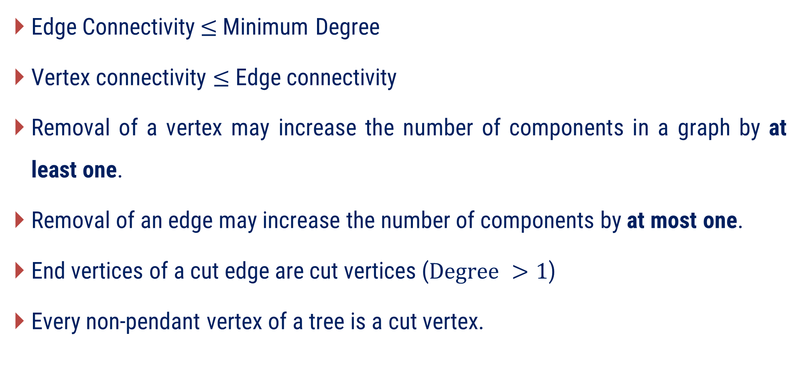
Remarks:
Edge Connectivity$≤$Minimum Degree
Vertex connectivity $≤$Edge connectivity
Removal of a vertex may increase the number of components in a graph by at least one.
Removal of an edge may increase the number of components by at most one.
End vertices of a cut edge are cut vertices ($Degree >1$)
Every non-pendant vertex of a tree is a cut vertex.

Slide 66
Examples of Method-4

Slide 67
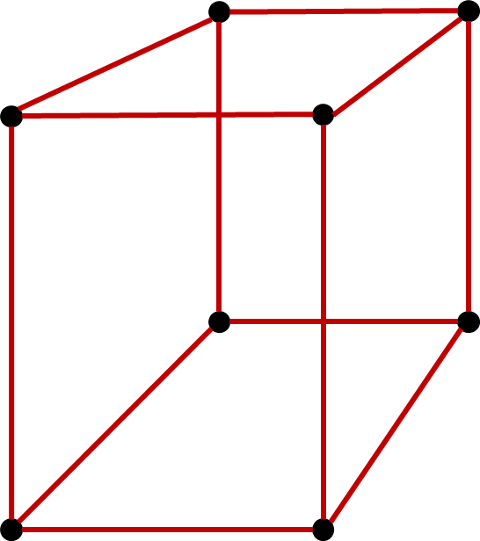
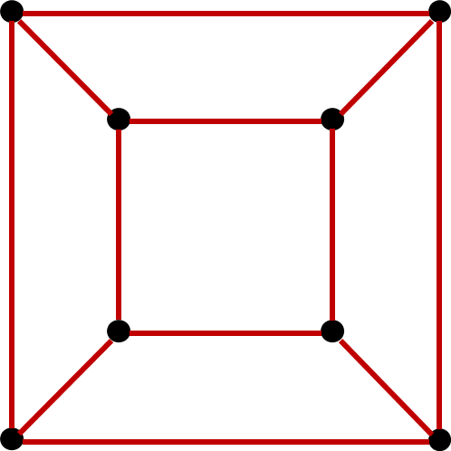
Method 4 ⇝ Example 1
Show that the edge connectivity and vertex connectivity of the below graphs are equal and three.

Slide 68
Method 4 ⇝ Example 1(Cont.)
Solution
To determine the edge connectivity of the graph, we first check if removing a single edge can disconnect the graph. Clearly, removing just one edge does not disconnect the graph.
Also, removing two edges can not disconnect the graph.
We know that the edge connectivity of a graph G cannot exceed the degree of the vertex with the smallest degree in G.
Here degree of each vertex is 3 so, edge connectivity can not be greater than 3.
Hence, the edge connectivity of the graph is 3.

Slide 69
Method 4 ⇝ Example 1(Cont.)
Solution
To determine the edge connectivity of the graph, we first check if removing a single edge can disconnect the graph. Clearly, removing just one edge does not disconnect the graph.
Also, removing two edges can not disconnect the graph.
We know that the edge connectivity of a graph G cannot exceed the degree of the vertex with the smallest degree in G.
Here degree of each vertex is 3 so, edge connectivity can not be greater than 3.
Hence, the edge connectivity of the graph is 3.

Slide 70
Method 4 ⇝ Example 1(Cont.)
Solution
To determine the vertex connectivity of the graph, we first check if removing a single vertex can disconnect the graph. Clearly, removing just one vertex does not disconnect the graph.
We know that the vertex connectivity of any graph G can never exceed the edge connectivity of G.
Here, the edge connectivity of the graph is 3.
So, vertex connectivity is either 2 or 3.
But 2 vertex does not disconnect the graph.
Hence the vertex connectivity of the graph is 3.

Slide 71
Method 4 ⇝ Example 1(Cont.)
Solution
To determine the vertex connectivity of the graph, we first check if removing a single vertex can disconnect the graph. Clearly, removing just one vertex does not disconnect the graph.
We know that the vertex connectivity of any graph G can never exceed the edge connectivity of G.
Here, the edge connectivity of the graph is 3.
So, vertex connectivity is either 2 or 3.
But 2 vertex does not disconnect the graph.
Hence the vertex connectivity of the graph is 3.

Slide 72


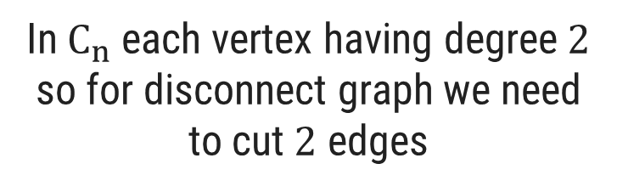
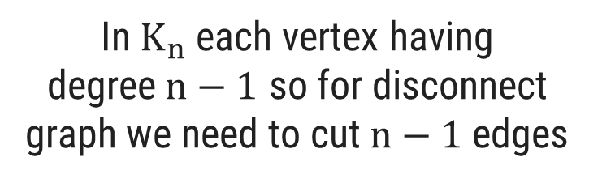

Method 4 ⇝ Example 2
What is the edge connectivity of the complete graph and cycle graph of n vertices?
Solution
Graph Type
Edge Connectivity
Justification
In$K_{n}$ each vertex having degree$n−1$ so for disconnect graph we need to cut$n−1$edges
$K_{n}$
$n−1$
$$C_{n}$$
2
In$C_{n}$ each vertex having degree$2$ so for disconnect graph we need to cut$2$ edges

Slide 73

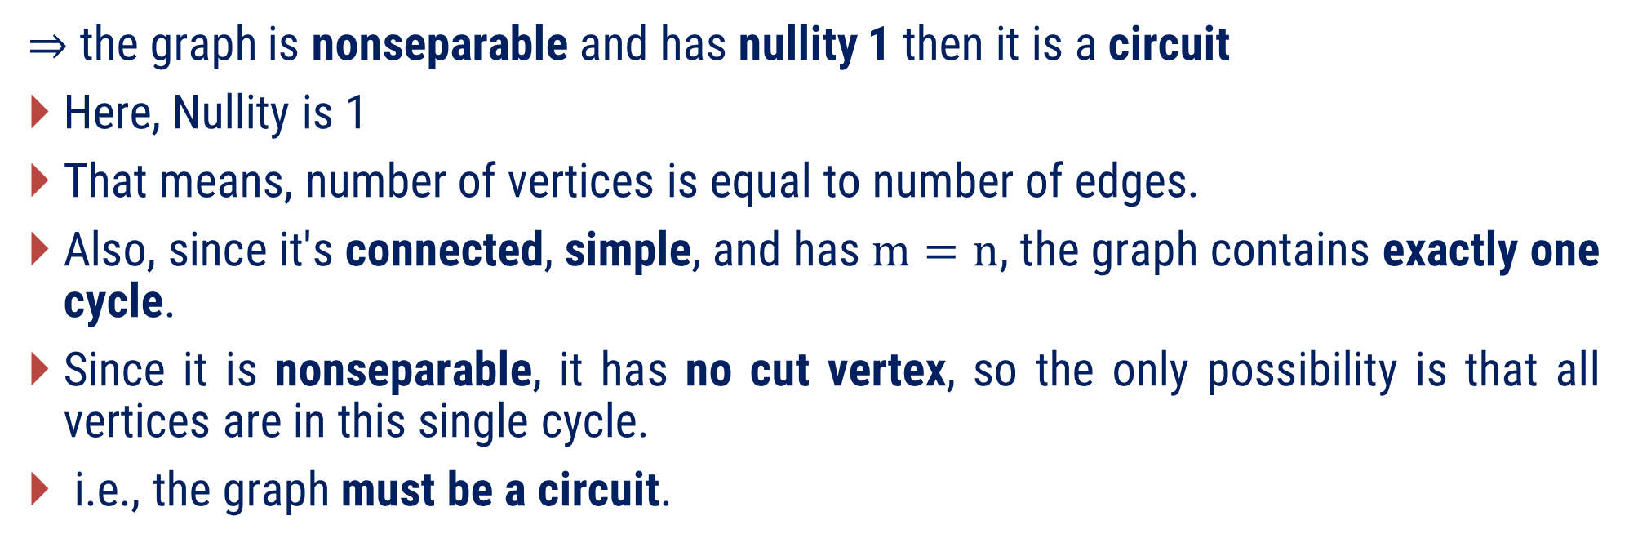

Method 4 ⇝ Example 3
Prove that a nonseparable simple graph has a nullity 1 if and only if the graph is a circuit.
Solution
$⇒$ the graph is nonseparable and has nullity 1 then it is a circuit
Here, Nullity is 1
That means, number of vertices is equal to number of edges.
Also, since it's connected, simple, and has$m=n$, the graph contains exactly one cycle.
Since it is nonseparable, it has no cut vertex, so the only possibility is that all vertices are in this single cycle.
i.e., the graph must be a circuit.
$$⇒m−n+1=1$$
$$⇒n=m$$

Slide 74
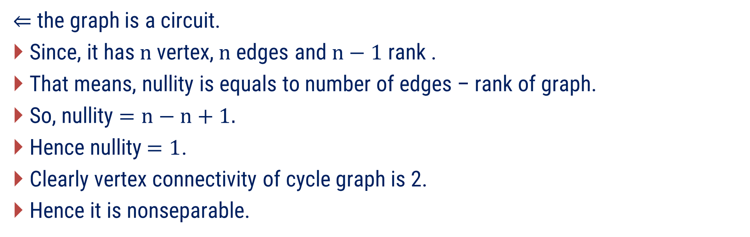
Method 4 ⇝ Example 3(Cont.)
Prove that a nonseparable simple graph has a nullity 1 if and only if the graph is a circuit.
Solution
$⇐$ the graph is a circuit.
Since, it has $n$vertex,$n$edges and $n−1$ rank .
That means, nullity is equals to number of edges – rank of graph.
So, nullity $=n−n+1.$
Hence nullity$=1$.
Clearly vertex connectivity of cycle graph is 2.
Hence it is nonseparable.

Slide 75

Method 4 ⇝ Example 4
Is every regular graph of degree$(d ≥ 3)$ nonseparable? If not, give a simple regular graph of degree three that is separable.
Solution
No, not every regular graph of degree $d≥3$ is nonseparable.
Consider, example of a simple 3 regular graph of degree three that is separable.

Slide 76
?
In a connected graph G the complement of a cut-set in G does not contain a spanning tree and the complement of a spanning tree does not contain a cut-set. (True/False)
For _________________graph the set of edges incident on each vertex of G is a cut-set. (separable/non separable)
Prove that in a tree every vertex of degree greater than one is a cut vertex.
Construct a graph G with the following properties: Edge connectivity of G = 4, vertex connectivity of G = 4, and degree of every vertex of G ≥ 4.
Euler graph cannot have a cut-set with an odd number of edges. (True/False)

Slide 77
Solution
? In a connected graph G the complement of a cut-set in G does not contain a spanning tree and the complement of a spanning tree does not contain a cut-set.
Part 1: A cut-set is defined as a minimal set of edges whose removal disconnects the graph. Because removing the cut-set disconnects the graph, the remaining edges (the complement of the cut-set) cannot possibly connect all the vertices. Part 2: A spanning tree T is minimally connected. Its complement consists of the remaining edges in the graph (often called chords). If you remove all of these chords (which is the complement of the spanning tree), the graph that remains is exactly the spanning tree T.

Slide 78
Solution
? For _________________graph the set of edges incident on each vertex of G is a cut-set. (separable/non separable)
Is this set a cut-set?
No
So, Graph is non separable.
Why?
As, there are no cut-vertices. Removing the incidence set of any vertex isolates it and disconnects the graph, and no proper subset of those edges will do the same. Thus, the incidence set is minimal.

Slide 79
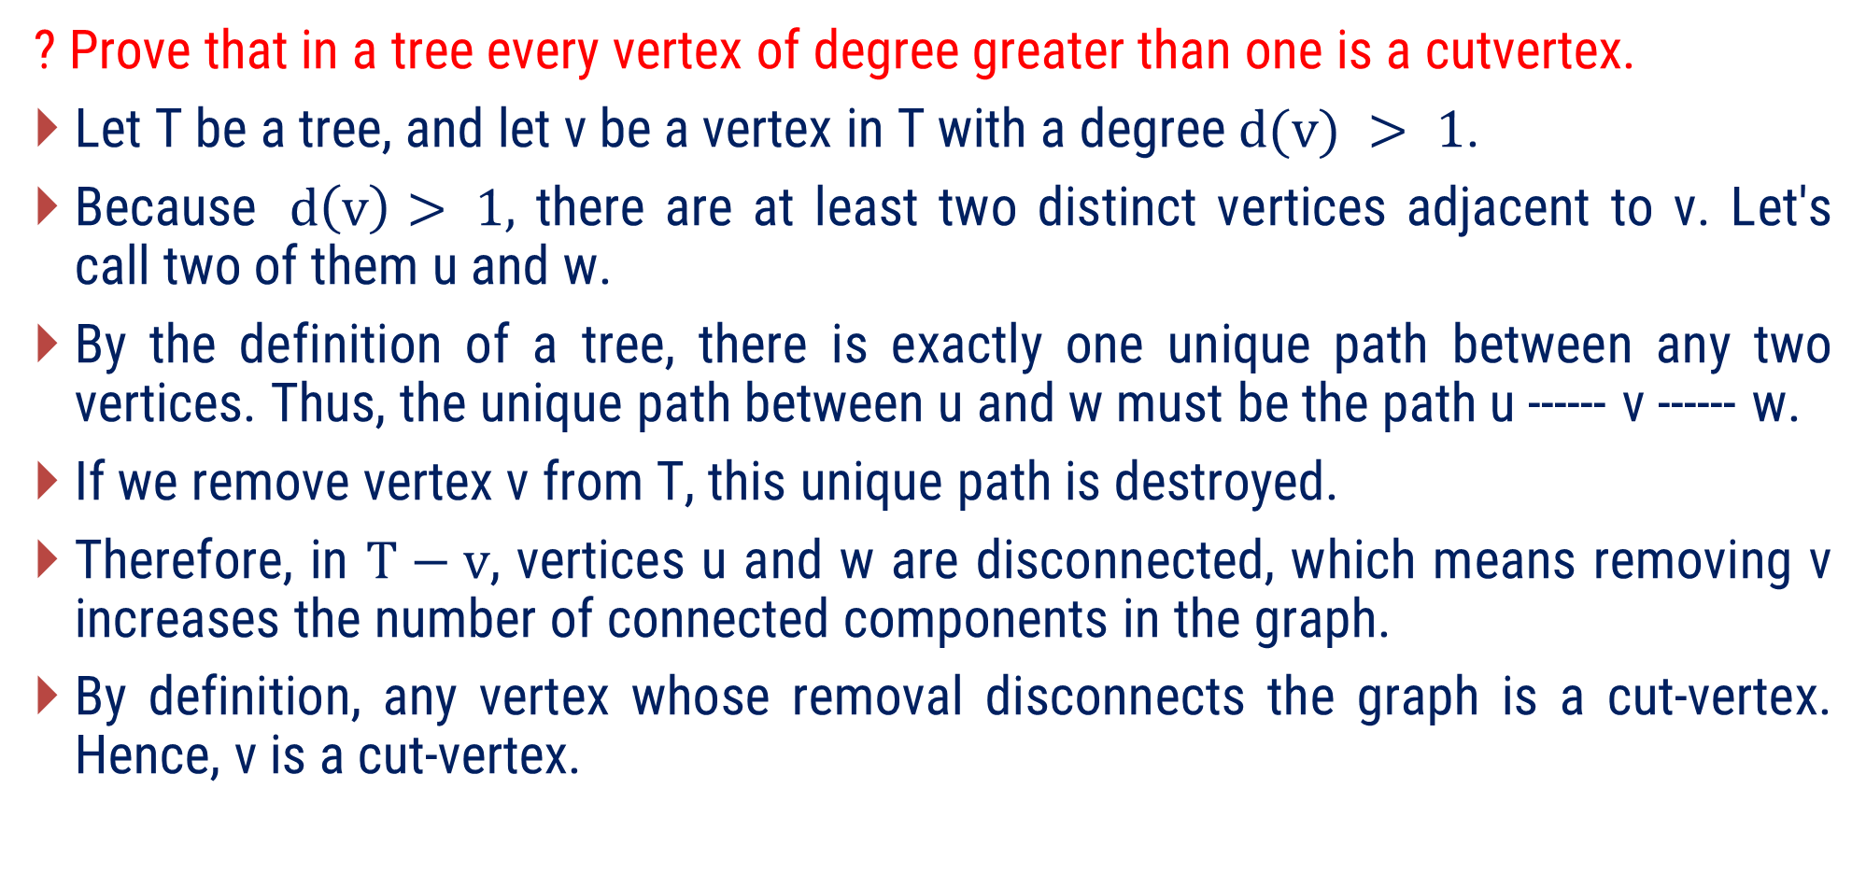
Solution
? Prove that in a tree every vertex of degree greater than one is a cutvertex.
Let T be a tree, and let v be a vertex in T with a degree$d(v) > 1$.
Because $d\left(v\right)> 1,$ there are at least two distinct vertices adjacent to v. Let's call two of them u and w.
By the definition of a tree, there is exactly one unique path between any two vertices. Thus, the unique path between u and w must be the path u ------ v ------ w.
If we remove vertex v from T, this unique path is destroyed.
Therefore, in $T−v$, vertices u and w are disconnected, which means removing v increases the number of connected components in the graph.
By definition, any vertex whose removal disconnects the graph is a cut-vertex. Hence, v is a cut-vertex.

Slide 80
Solution
? Prove that in a tree every vertex of degree greater than one is a cut vertex.
Another Proof :
  Every edges of tree is bridge and we know that end vertices of bridge is cut vertex if its degree greater then 1.
  So, every non pendent vertices are cut vertex.

Slide 81
Solution
? Construct a graph G with the following properties: Edge connectivity of G = 4, vertex connectivity of G = 4, and degree of every vertex of G ≥ 4.

Slide 82
?
If the minimum degree of a connected graph is 4, then the edge connectivity is
  A. Always 4
  B. At least 4
  C. At most 4
  D. Cannot be determined
Can a cut vertex exist without being incident to any bridge? (Yes/No)
If a vertex lies on cycle then it is not a cut vertex. (True/False)
If a vertex does not lies on any cycle then it is cut vertex. (True/False)
A tree of order 3 or more has more cut vertices than end vertices. (True/False)
A tree of order 3 or more has more cut vertices than bridges. (True/False)
Give an example of graph that contains more bridges than cut vertices.

Slide 83
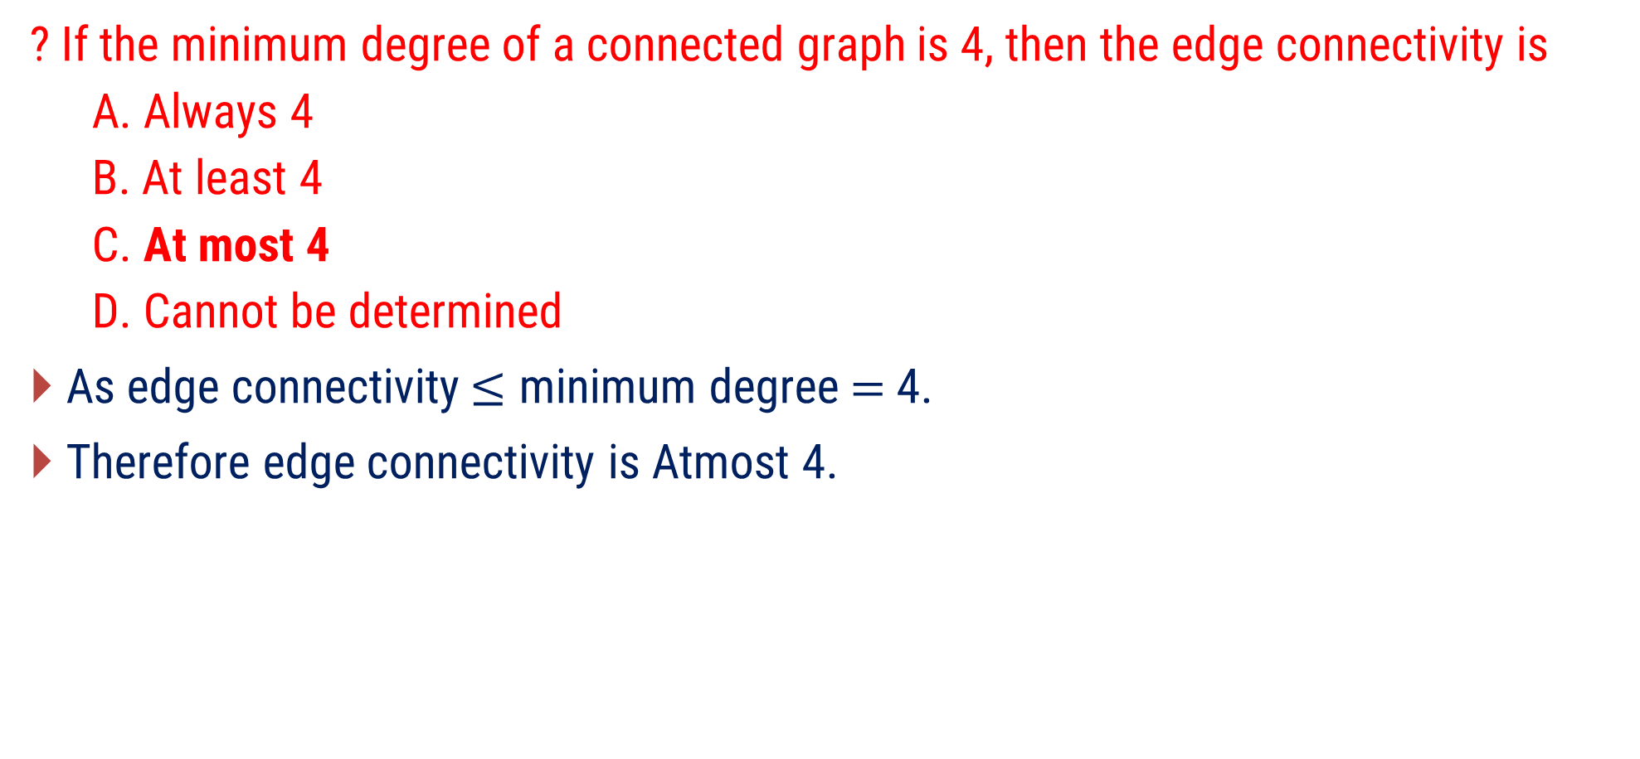
Solution
? If the minimum degree of a connected graph is 4, then the edge connectivity is
  A. Always 4
  B. At least 4
  C. At most 4
  D. Cannot be determined
As edge connectivity$≤$ minimum degree$=$ 4.
Therefore edge connectivity is Atmost 4.

Slide 84
?
? Can a cut vertex exist without being incident to any bridge?
Yes
? If a vertex lies on cycle then it is not a cut vertex. (True/False)
False
A cut vertex exist without being incident to any bridge
A vertex lies on cycle still it is a cut vertex

Slide 85
?
? If a vertex does not lies on any cycle then it is cut vertex. (True/False)
False
A vertex does not lies on cycle and still it is not cut vertex.

Slide 86
?
? A tree of order 3 or more has more cut vertices than end vertices.
False
? A tree of order 3 or more has more cut vertices than bridges.
False
? Give an example of graph that contains more bridges than cut vertices.
Tree has 1 cut vertex and 2 end vertices as well as 2 bridges

Slide 87
?
Give an example of graph that contains more cut vertices than bridges.
Every tree of order n has _________bridges and at most __________cut vertices.
Give counter example of the following
  If G is a connected graph of order 13 and v is a cut-vertex of G, then there exists a component of G−v containing at least 7 vertices.
  If G is a connected graph containing only even vertices, then G contains no cut-vertices.
  If G is a connected graph with a cut-vertex, then G contains a bridge.
  If G is a connected graph with a bridge, then G contains a cut-vertex.

Slide 88
?
? Give an example of graph that contains more cut vertices than bridges.
Graph has 0 bridge but 1 cut vertex

Slide 89

?
? Every tree of order n has _________bridges and at most __________cut vertices.
A tree with $n$ vertices has$n−1$ edges and each edges is bridge so every tree of order$n$ has$n−1$ bridges.
Also we know that each non leaf vertices is cut vertex in tree. So, maximum non leaf vertices are in path tree of order$n$. and minimum non leaf vertex is in star tree of order$n$. That means every tree has at most$n−2$ cut vertices

Slide 90
?
? Give counter example of the following
  If G is a connected graph of order 13 and v is a cut-vertex of G, then there exists a component of G−v containing at least 7 vertices.
    For a star graph of order 13, when we remove the center, no component of the graph contains at least 7 vertices.
  If G is a connected graph containing only even vertices, then G contains no cut-vertices.
G is a connected graph containing only even vertices, but it has cut vertex.

Slide 91
?
? Give counter example of the following
  If G is a connected graph with a cut-vertex, then G contains a bridge.
  If G is a connected graph with a bridge, then G contains a cut-vertex.
  G is a connected graph with a cut-vertex, but G not contains a bridge.
  G is a connected graph with a bridge, but G not contains a cut vertex.

Slide 92
?
For the Given graph determine the cut-vertices, bridges
Give an example of graph for which vertex connectivity is 2, edge connectivity is 3 and minimum degree of graph is 4.
d
h
c
a
b
g
i
j
e
f

Slide 93
?
? For the Given graph determine the cut-vertices, bridges
cut-vertices: b, c, and g.
Bridges: ab, cg.
d
h
c
a
b
g
i
j
e
f

Slide 94
?
? Give an example of graph for which vertex connectivity is 2, edge connectivity is 3 and minimum degree of graph is 4.
Edge connectivity is 3
Vertex connectivity is 2
Minimum degree of graph is 4

Slide 95

B.Tech. $→5$^{th} Semester
Graph Theory (2301CS595)
THANK YOU
Prof. Punit Vadher
Department of Humanities & Science
punit.vadher@darshan.ac.in
9662443859

