Slide 1


Unit – 3
Domination & Matching in Graphs
B.Tech., B.Sc.(H) CS $→5$^{th} Semester
Graph theory (2301CS595)
CO3:
At the end of this unit, students will be able to
use domination and matching techniques. .
Prof. Punit Vadher
Department of Humanities & Science
punit.vadher@darshan.ac.in
9662443859

Slide 2

Topics of Unit 3
  Introduction to Domination in Graphs
    Closed neighborhood
    Dominating Set
  Domination Number and Total Domination
  Matching in Graphs
    Maximal Matching
    Maximum Matching
  Perfect Matching and Hall’s Theorem (without proof)
Looping

Slide 3
Brief Introduction

Slide 4
Brief Introduction of Unit
This Unit Focuses On
Domination in Graphs:
  Selecting important vertices to control a network,
  Dominating set and domination number.
Matching in Graphs:
  Pairing vertices without overlap,
  Maximal, maximum, and perfect matching.
Real-Life Applications:
  Network monitoring,
  Resource placement,
  Job assignment Scheduling and pairing problems.

Slide 5
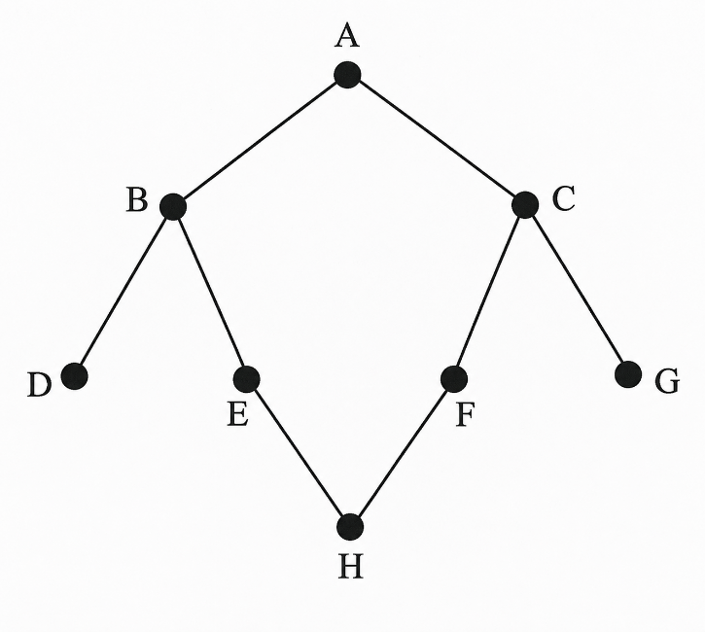
Real-Life Problem : Wi-Fi Router Placement
A university campus has several classrooms connected through corridors. The campus map is represented as a graph, where:
  Vertices represent classrooms
  Edges represent direct corridor connections
  The administration wants to install the minimum number of Wi-Fi routers such that every classroom:
  Has a router OR
  Is directly connected to a classroom having a router.
  Question Which classrooms should contain Wi-Fi routers?

Slide 6
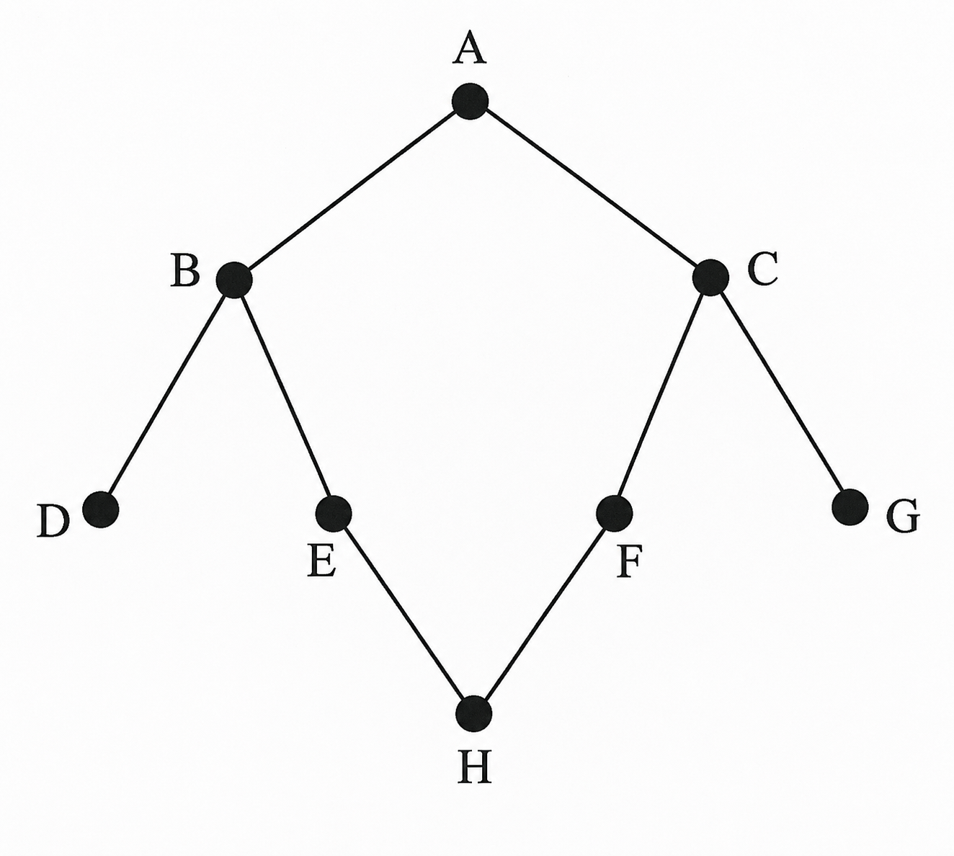
Real-Life Problem : Wi-Fi Router Placement

Slide 7
Real-Life Problem : Intern–Task Assignment
Situation:
  There are 6 interns and 6 tasks
  Each intern can perform only certain tasks
  Possible assignments are represented using a graph
Objective:
  Assign tasks such that:
    Each intern gets exactly one task
    No task is assigned to more than one intern
    Maximum possible assignments are made
Question:
  How can we assign interns efficiently?

Slide 8
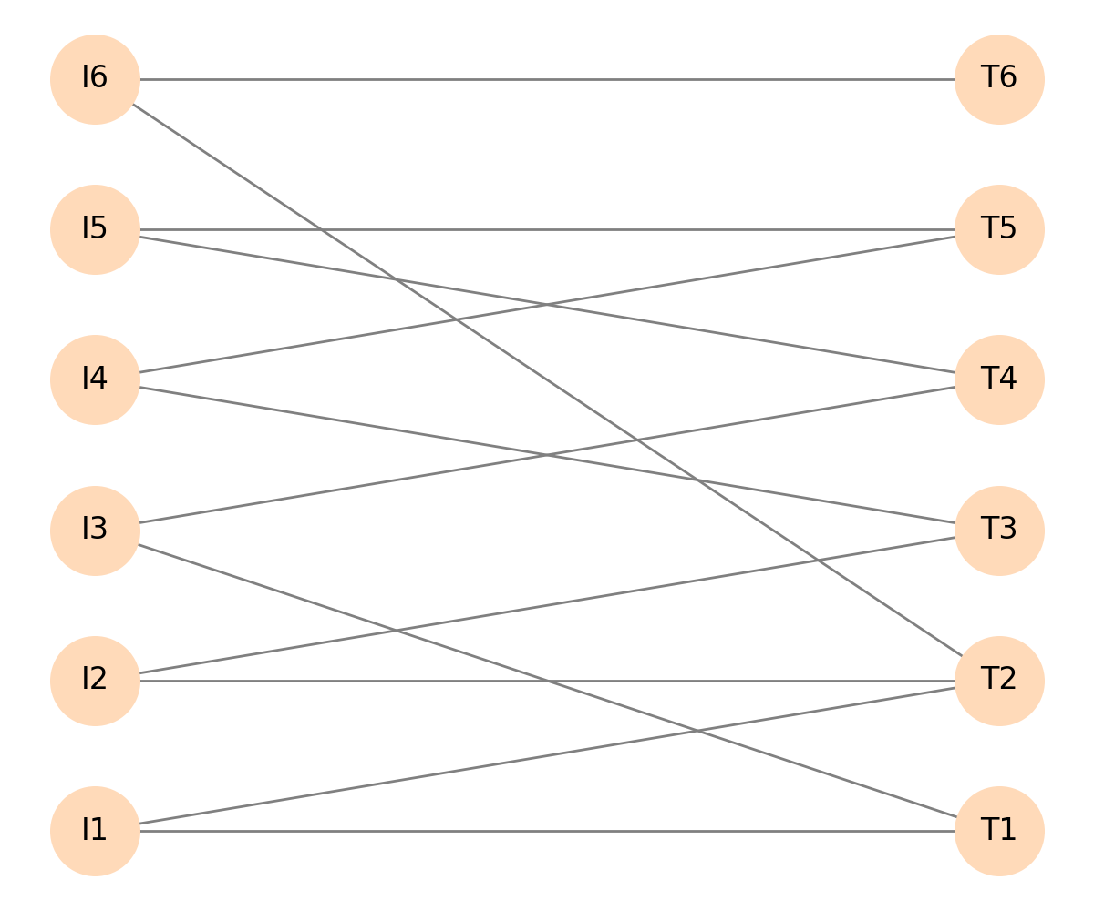
Real-Life Problem : Intern–Task Assignment

Slide 9
Method – 1
Introduction to Domination

Slide 10


Important Terms
For a vertex v of a graph G, a neighbor of$v$ is a vertex adjacent to$v$ in$G$. Also, the neighborhood (or open neighborhood)$N\left(v\right)$ of$v$ is the set of neighbors of$v$.
v
e
d
a
c
b
$$N\left(v\right)=\left\{a,b,c\right\}$$

Slide 11




Important Terms
The closed neighborhood$N\left[v\right]$ is defined as$N\left[v\right]= N\left(v\right)∪\{v\}$.
v
e
d
a
c
b
$$N\left(v\right)=\left\{a,b,c\right\}$$
$∪\{v\}$.
$$N\left[v\right]=\left\{a,b,c,v\right\}$$

Slide 12

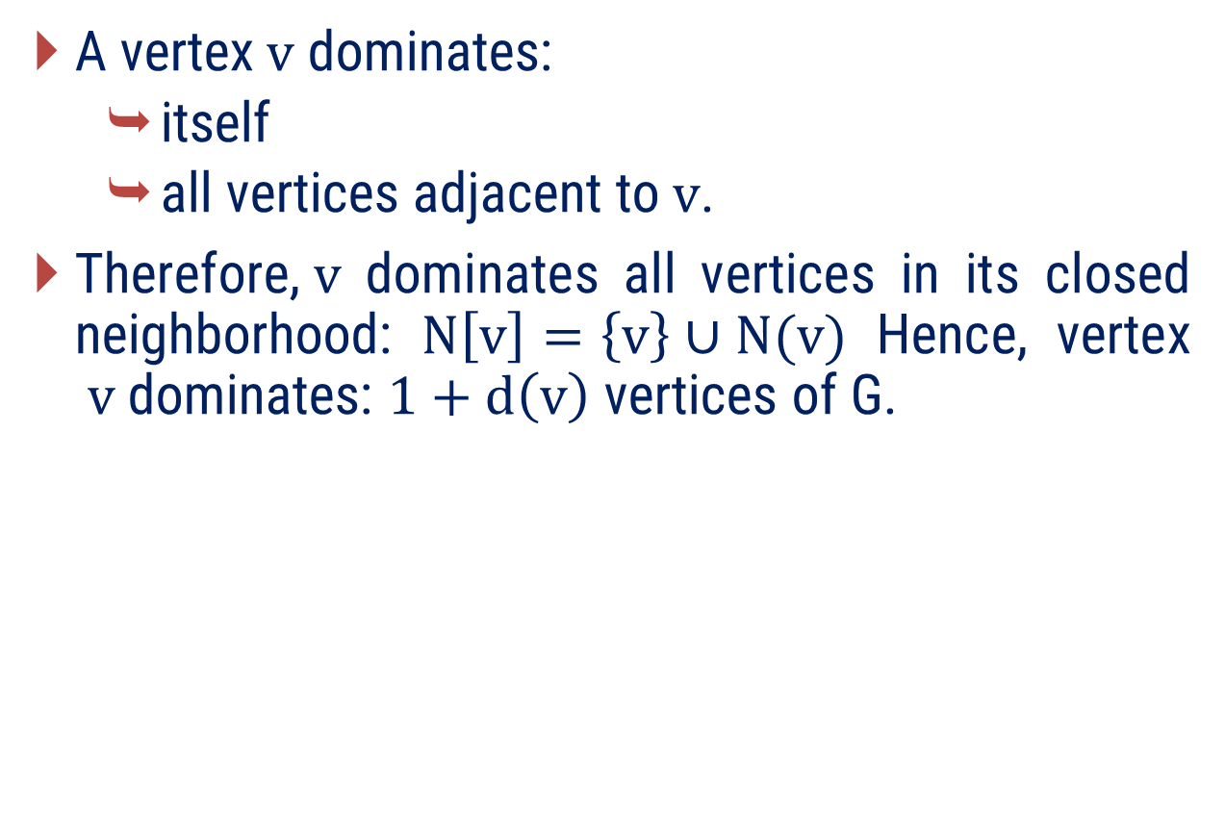
Important Terms
A vertex$v$ dominates:
  itself
  all vertices adjacent to$v$.
Therefore,$v$ dominates all vertices in its closed neighborhood: $N\left[v\right]=\left\{v\right\}∪N(v)$ Hence, vertex $v$ dominates: $1+d\left(v\right)$ vertices of G.
$$v$$

Slide 13
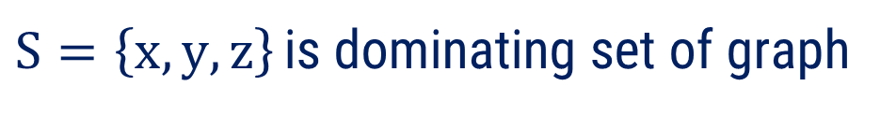
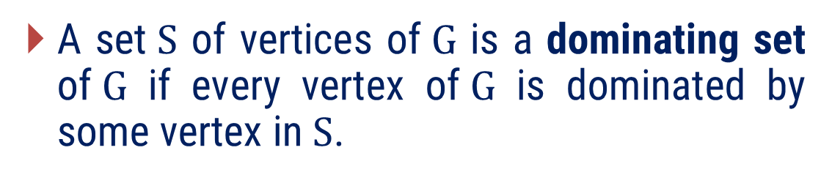
Dominating Set
A set$S$ of vertices of$G$ is a dominating set of$G$ if every vertex of$G$ is dominated by some vertex in$S$.
x
g
h
$S=\left\{x,y,z\right\}$ is dominating set of graph
e
f
y
c
d
z
a
b

Slide 14
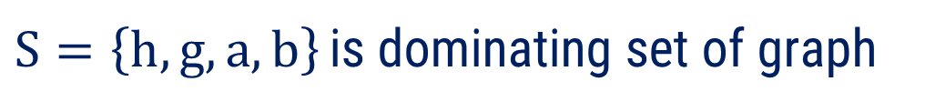
Dominating Set
A set$S$ of vertices of$G$ is a dominating set of$G$ if every vertex of$G$ is dominated by some vertex in$S$.
x
h
g
$S=\left\{h,g,a,b\right\}$ is dominating set of graph
e
f
y
c
d
z
a
b

Slide 15
Examples of Method-1

Slide 16

Method 1 ⇝ Example 1
Can a 6×6 chessboard be dominated using 3 queens?
Solution
Idea:
  Each queen attacks: its row, its column, diagonals.
A square is considered dominated if:
  it contains a queen or is attacked by a queen.

Slide 17
Method 1 ⇝ Example 1
Solution
Yes, the following placement of three queens dominates the entire board.

Slide 18
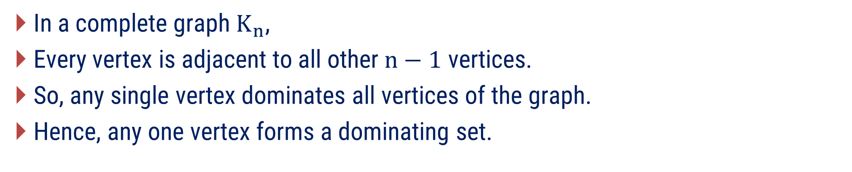

Method 1 ⇝ Example 2
What is dominating set of complete graph$K_{n}$? justify
Solution
In a complete graph$K_{n}$,
Every vertex is adjacent to all other$n−1$ vertices.
So, any single vertex dominates all vertices of the graph.
Hence, any one vertex forms a dominating set.
Think About It:
How many minimum dominating sets exist in$K_{n}$​?

Slide 19
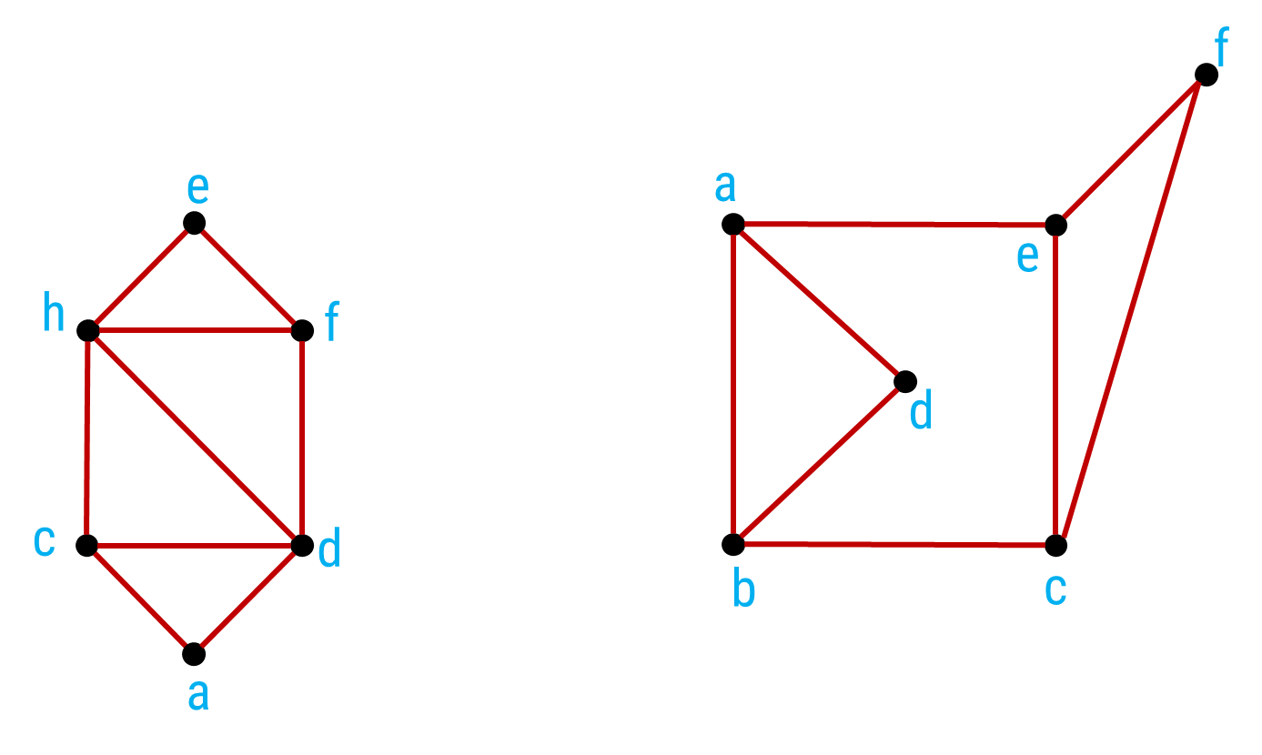
Method 1 ⇝ Example 3
Find any dominating set for the following graphs.
Solution

Slide 20


Method 1 ⇝ Example 3
Find any dominating set for the following graphs.
Solution
e
e
f
a
h
f
d
c
d
b
c
a
Dominating set $=\left\{e,a\right\}$
Dominating set $=\left\{e,b\right\}$.

Slide 21
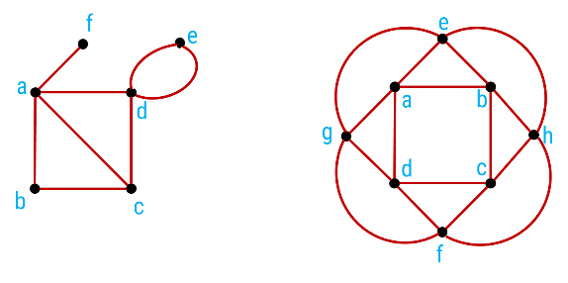
Method 1 ⇝ Example 4
Give at least 2 dominating set for each of the following graphs
Solution

Slide 22
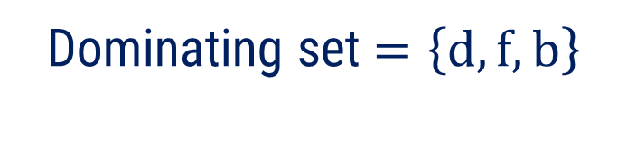
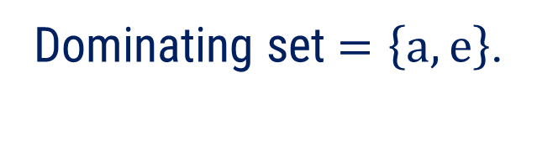
Method 1 ⇝ Example 4(Cont.)
Give at least 2 dominating set for each of the following graphs
Solution
f
f
e
e
a
a
d
d
b
c
b
c
Dominating set $=\left\{a,e\right\}$.
Dominating set $=\left\{d,f,b\right\}$

Slide 23


Method 1 ⇝ Example 4(Cont.)
Give at least 2 dominating set for each of the following graphs
Solution
e
e
a
b
a
b
g
h
g
h
d
c
d
c
f
f
Dominating set $=\left\{e,f\right\}$.
Dominating set $=\left\{a,c\right\}$.

Slide 24
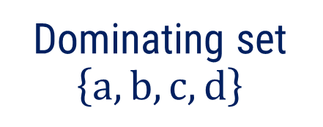
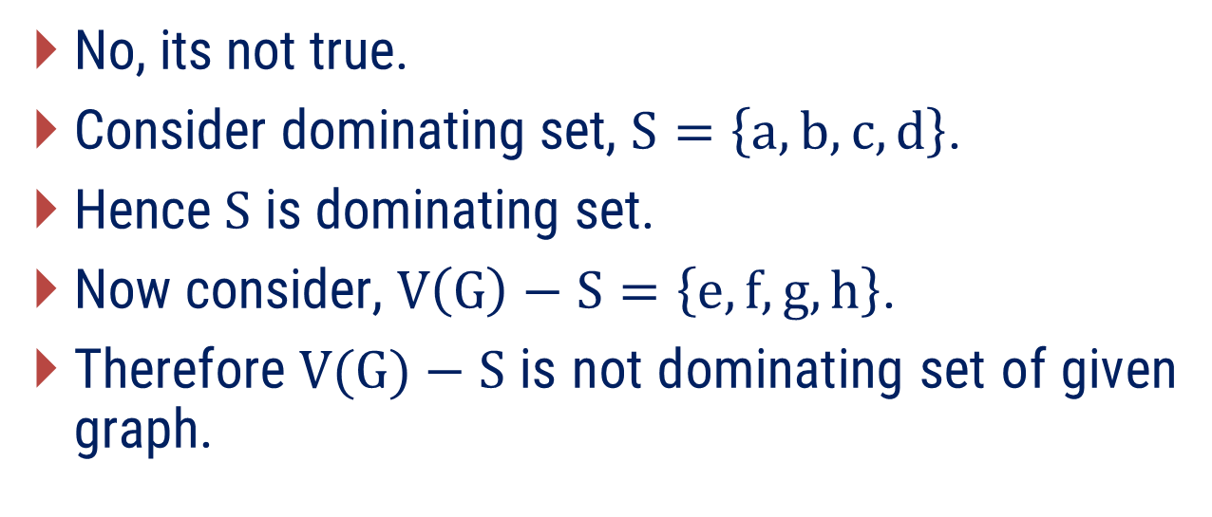
Method 1 ⇝ Example 5
Justify following statement:
Let G be a graph without isolated vertices. If S is a dominating set of G, then
V(G) − S is a dominating set of G.
Solution
f
e
No, its not true.
Consider dominating set, $S=\left\{a,b, c,d\right\}$.
Hence$S$ is dominating set.
Now consider, $V\left(G\right)−S=\left\{e,f,g,h\right\}$.
Therefore$V(G)−S$ is not dominating set of given graph.
a
b
c
d
g
h
Dominating set $\left\{a,b, c,d\right\}$

Slide 25
Method – 2
Domination Number and Total Domination

Slide 26
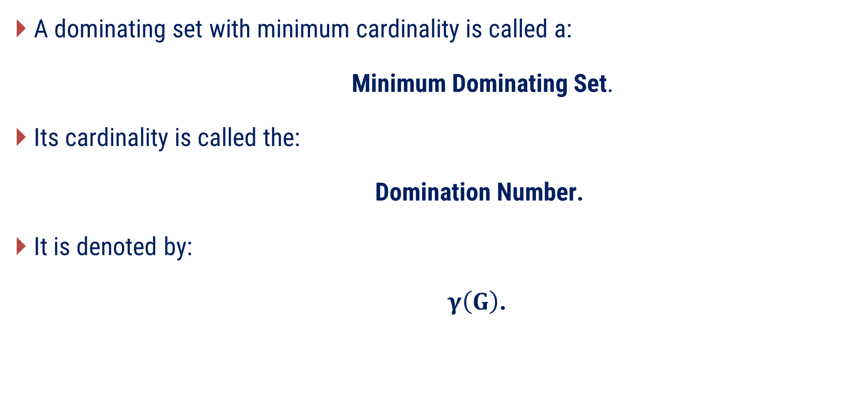
Domination number
A dominating set with minimum cardinality is called a:
Minimum Dominating Set.
Its cardinality is called the:
Domination Number.
It is denoted by:
$γ\left(G\right)$.

Slide 27
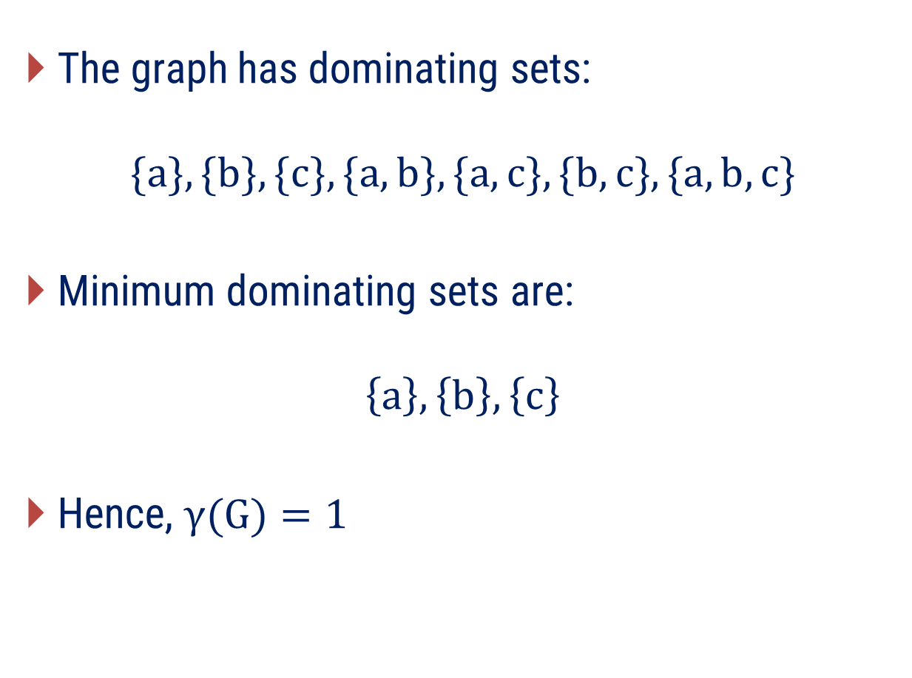
Example: Domination number
The graph has dominating sets:
$$\{a\}, \{b\}, \{c\}, \{a,b\}, \{a,c\}, \{b,c\}, \{a,b,c\}$$
Minimum dominating sets are:
$$\left\{a\right\}, \left\{b\right\}, \left\{c\right\}$$
Hence, $γ(G)=1$​
a
c
b

Slide 28
Find the domination number of below graph
x
h
g
y
e
f
z
c
d
a
b

Slide 29

Finding a Dominating Set
Observation:
The set $S=\left\{x, y, z\right\}$ is a dominating set of$G$.
Therefore, $γ\left(G\right)≤3$.
x
h
g
e
y
f
c
d
z
a
b

Slide 30
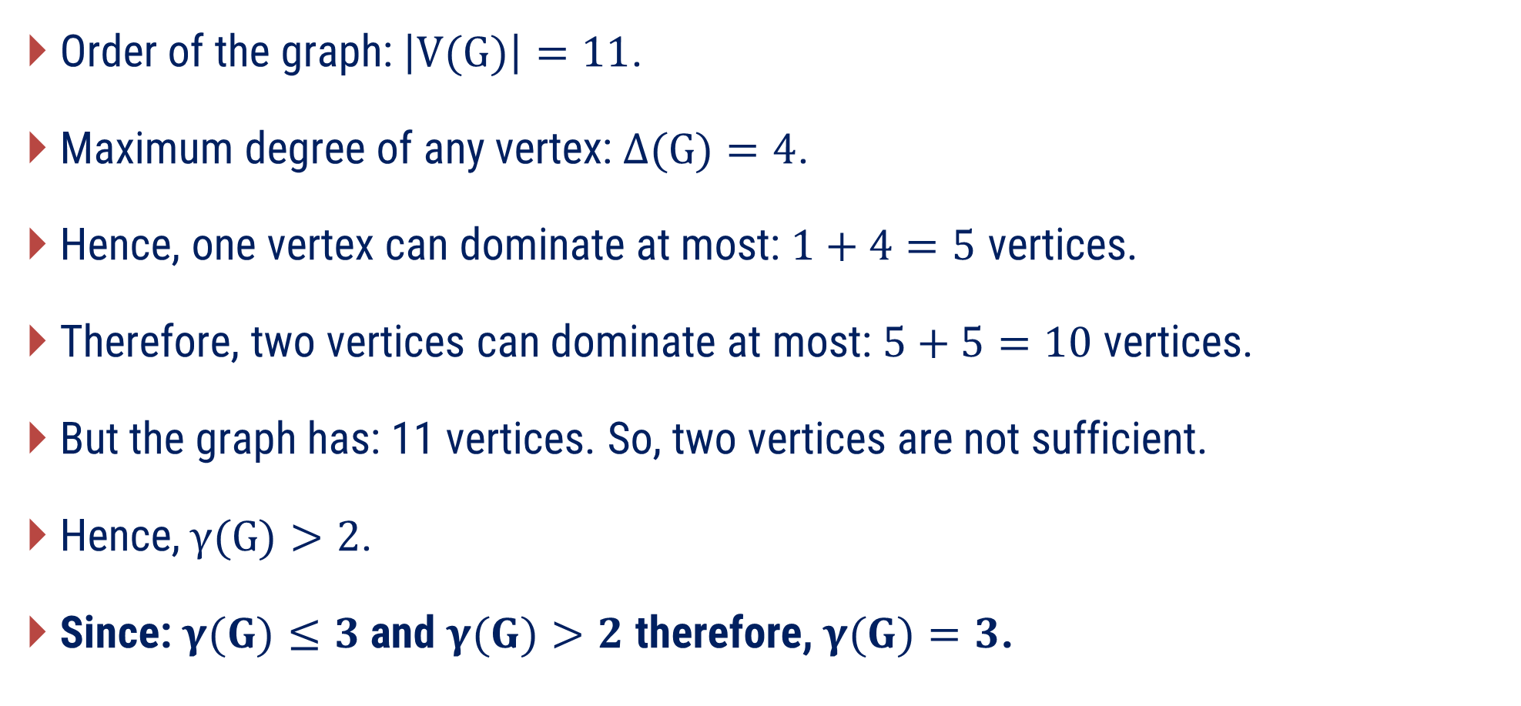
Can Two Vertices Dominate the Graph?
Order of the graph: $\left|V(G)\right|=11$.
Maximum degree of any vertex:$Δ(G)=4$.
Hence, one vertex can dominate at most:$1+4=5$ vertices.
Therefore, two vertices can dominate at most:$5+5=10$ vertices.
But the graph has: 11 vertices. So, two vertices are not sufficient.
Hence,$γ(G)>2$.
Since: $γ(G)≤3$ and $γ(G)>2$ therefore, $γ(G)=3$​.

Slide 31
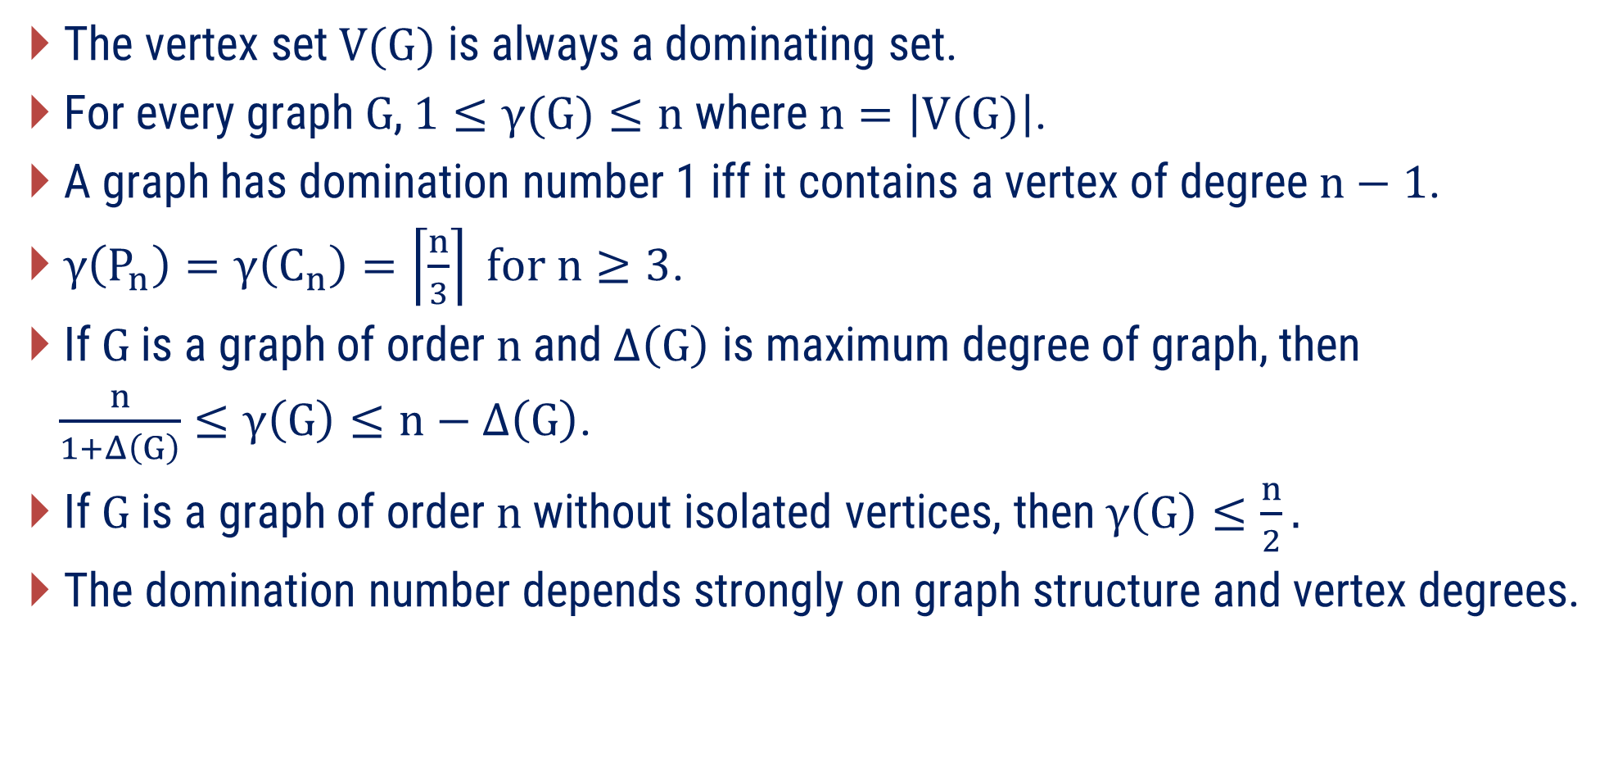
Remarks
The vertex set$V(G)$ is always a dominating set.
For every graph$G$, $1≤γ(G)≤n$ where$n=\left|V(G)\right|$.
A graph has domination number 1 iff it contains a vertex of degree$n−1$.
$γ\left(P_{n}\right)=γ\left(C_{n}\right)=\left\lceil \frac{n}{3}\right\rceil for n≥3$.
If$G$ is a graph of order$n$ and $Δ\left(G\right)$ is maximum degree of graph, then
$\frac{n}{1+Δ\left(G\right)}≤γ\left(G\right)≤n−Δ\left(G\right)$.
If$G$ is a graph of order$n$ without isolated vertices, then$γ\left(G\right)≤\frac{n}{2}.$
The domination number depends strongly on graph structure and vertex degrees.

Slide 32
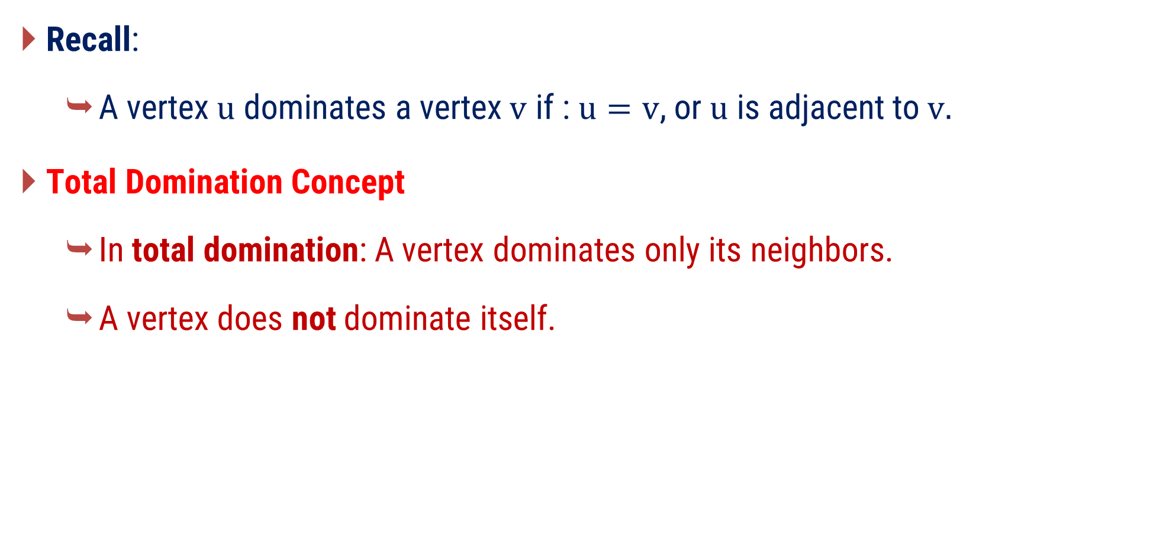
Total Domination
Recall:
  A vertex$u$ dominates a vertex$v$ if : $u=v$, or$u$ is adjacent to$v.$
Total Domination Concept
  In total domination: A vertex dominates only its neighbors.
  A vertex does not dominate itself.

Slide 33
Domination vs. Total Domination
?
?
2 vertices will dominate graph
2 vertices will not totally dominate graph

Slide 34
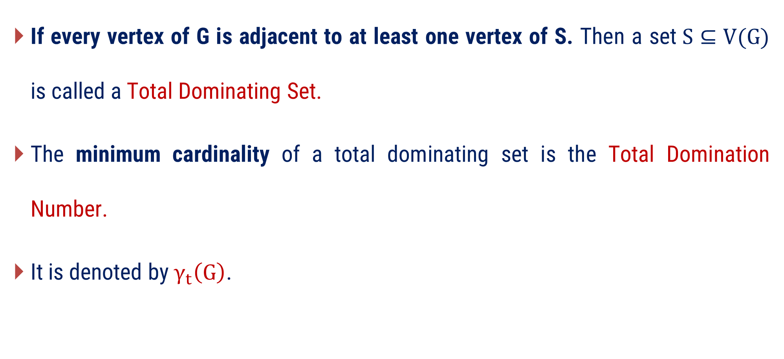
Total Domination Number
If every vertex of G is adjacent to at least one vertex of S. Then a set$S⊆V(G)$ is called a Total Dominating Set.
The minimum cardinality of a total dominating set is the Total Domination Number.
It is denoted by $γ_{t}\left(G\right)$.

Slide 35
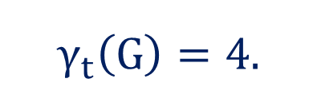
Find the Total Domination Number
$$γ_{t}\left(G\right)=4.$$

Slide 36

Find the Total Domination Number
?
x
h
g
?
y
e
f
?
z
c
d
a
b
$$γ_{t}\left(G\right)=4$$

Slide 37
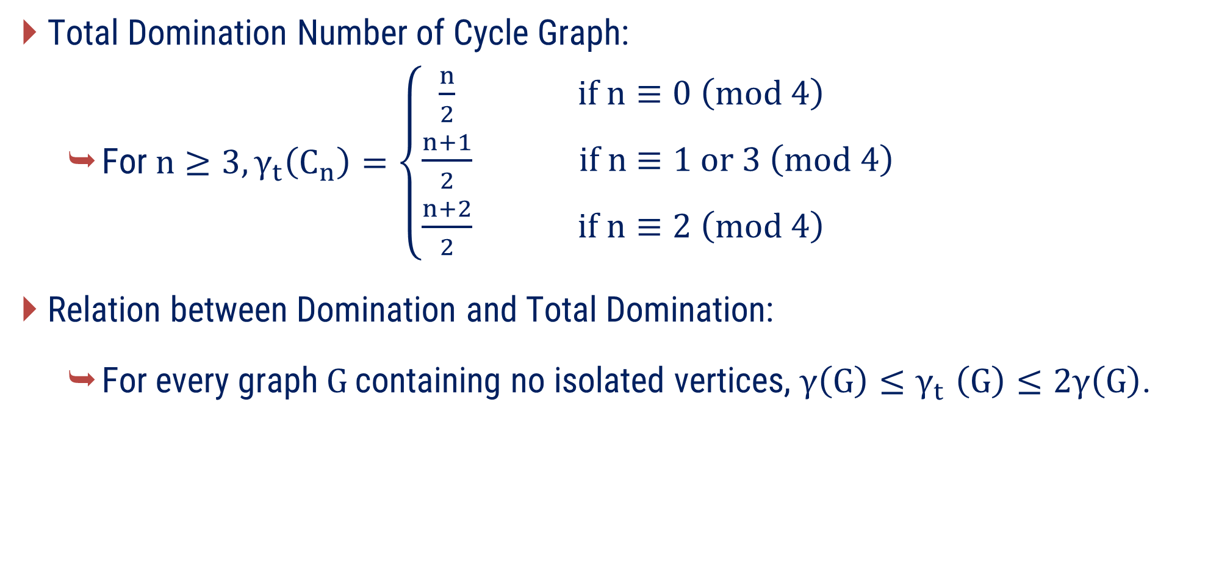
Remarks
Total Domination Number of Cycle Graph:
  For$n≥3,γ_{t}\left(C_{n}\right)=\left\{\begin{matrix}\frac{n}{2} & if n≡0 \left(mod 4\right) \\ \frac{n+1}{2} & if n≡1 or 3 \left(mod 4\right) \\ \frac{n+2}{2} & if n≡2 \left(mod 4\right)\end{matrix}\right.$
Relation between Domination and Total Domination:
  For every graph$G$ containing no isolated vertices, $γ\left(G\right){≤γ}_{t}\left(G\right)≤2γ\left(G\right)$.

Slide 38
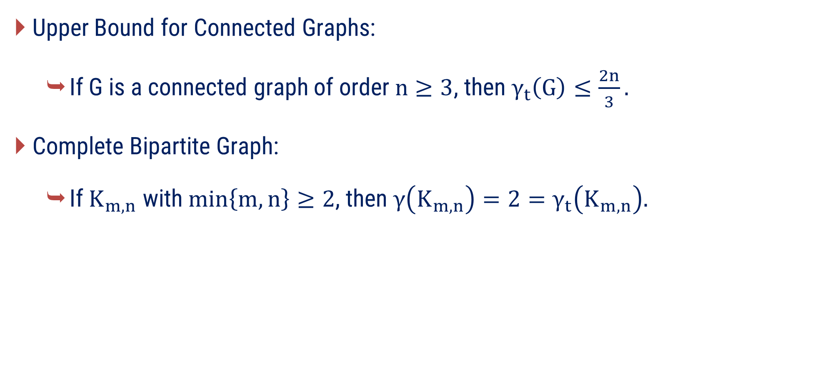
Remarks
Upper Bound for Connected Graphs:
  If G is a connected graph of order$n≥3$, then $γ_{t}\left(G\right)≤\frac{2n}{3}.$
Complete Bipartite Graph:
  If $K_{m,n}$ with$\min\left\{m,n\right\}≥2$, then $γ\left(K_{m,n}\right)=2=γ_{t}\left(K_{m,n}\right).$

Slide 39
Examples of Method-2

Slide 40

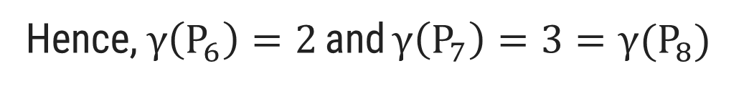


Method 2 ⇝ Example 1
Find the domination number for $P_{n} and C_{n}, 6≤n≤8.$
Solution
$$P_{6}$$
$$P_{7}$$
$$P_{8}$$
Hence,$γ\left(P_{6}\right)=2$ and $γ\left(P_{7}\right)=3={γ(P}_{8})$

Slide 41

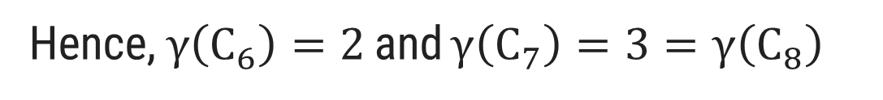


Method 2 ⇝ Example 1(Cont.)
Find the domination number for $P_{n} and C_{n}, 6≤n≤8.$
Solution
$$C_{6}$$
$$C_{7}$$
$$C_{8}$$
Hence,$γ\left(C_{6}\right)=2$ and $γ\left(C_{7}\right)=3=γ\left(C_{8}\right)$

Slide 42
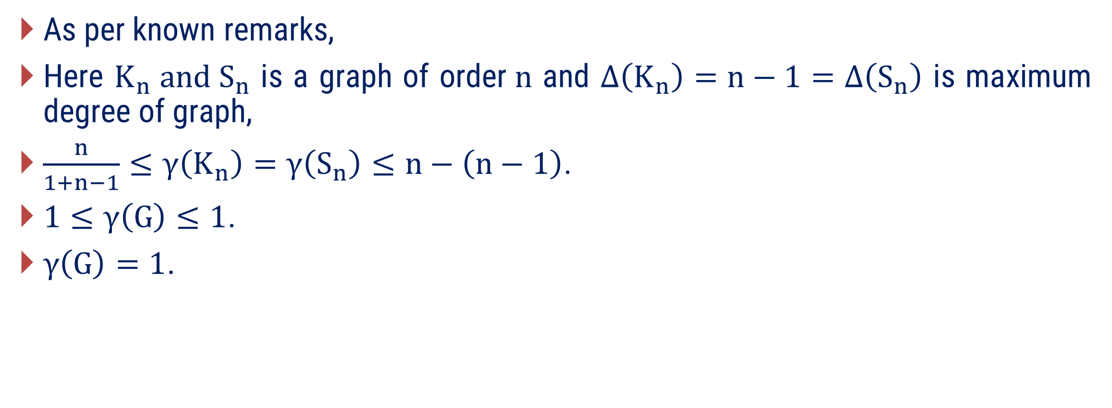
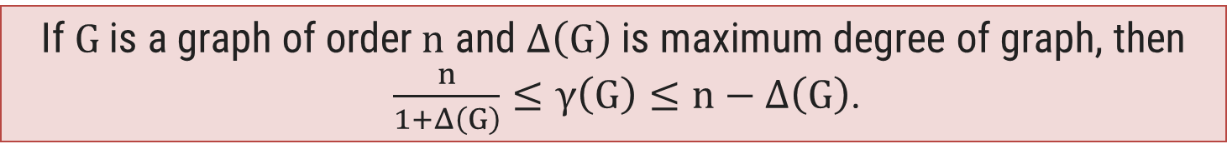
Method 2 ⇝ Example 2
Prove mathematically that the domination number for$K_{n}$ and$S_{n}$ are 1.
Solution
As per known remarks,
Here $K_{n} and S_{n}$ is a graph of order$n$ and $Δ\left(K_{n}\right)=n−1=Δ\left(S_{n}\right)$ is maximum degree of graph,
$\frac{n}{1+n−1}≤γ\left(K_{n}\right)=γ\left(S_{n}\right)≤n−\left(n−1\right)$.
$1≤γ\left(G\right)≤1$.
$γ\left(G\right)=1$.
If$G$ is a graph of order$n$ and $Δ\left(G\right)$ is maximum degree of graph, then
$\frac{n}{1+Δ\left(G\right)}≤γ\left(G\right)≤n−Δ\left(G\right)$.

Slide 43
Method 2 ⇝ Example 3
Determine the domination number and total domination number for the given graphs.

Slide 44
Method 2 ⇝ Example 3
Determine the domination number and total domination number for the given graphs.
Solution
Domination Number
Total Domination Number
Domination Number = 2
Total Domination Number = 4

Slide 45
Method 2 ⇝ Example 4
Find the domination number and total domination number of$K_{2,3}$.
Solution
Domination Number
Total Domination Number
Domination Number = 2
Total Domination Number = 2

Slide 46

Method 2 ⇝ Example 5
Give an example of a connected graph$G$ such that$γ_{t}\left(G\right)=1.5γ\left(G\right)$.
Solution
$$∴γ\left(G\right)=2$$

Slide 47

Method 2 ⇝ Example 5
Give an example of a connected graph$G$ such that$γ_{t}\left(G\right)=1.5γ\left(G\right)$.
Solution
${∴γ}_{t}\left(G\right)=3$
  $${∴γ}_{t}\left(G\right)=3=1.5\left(2\right)=1.5γ\left(G\right)$$

Slide 48
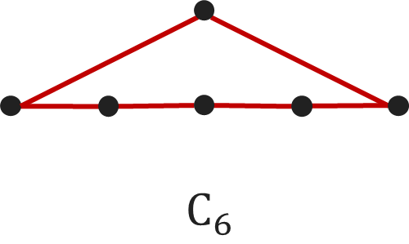
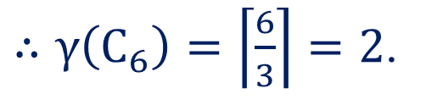
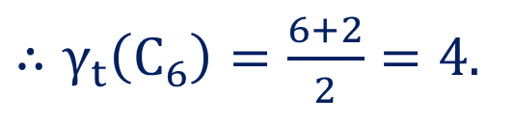
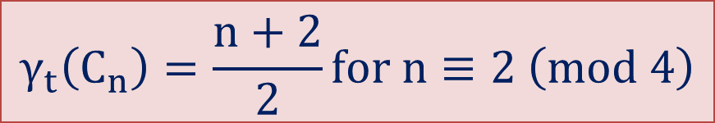
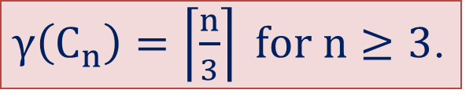
Method 2 ⇝ Example 6
Give an example of a connected graph$G$ such that $γ\left(G\right)=2$ and $γ_{t}\left(G\right)=4$
Solution
$γ\left(C_{n}\right)=\left\lceil \frac{n}{3}\right\rceil for n≥3$.
$∴γ\left(C_{6}\right)=\left\lceil \frac{6}{3}\right\rceil =2$.
$$γ_{t}\left(C_{n}\right)=\frac{n+2}{2}for n≡2 \left(mod 4\right)$$
$∴γ_{t}\left(C_{6}\right)=\frac{6+2}{2}=4$.

Slide 49
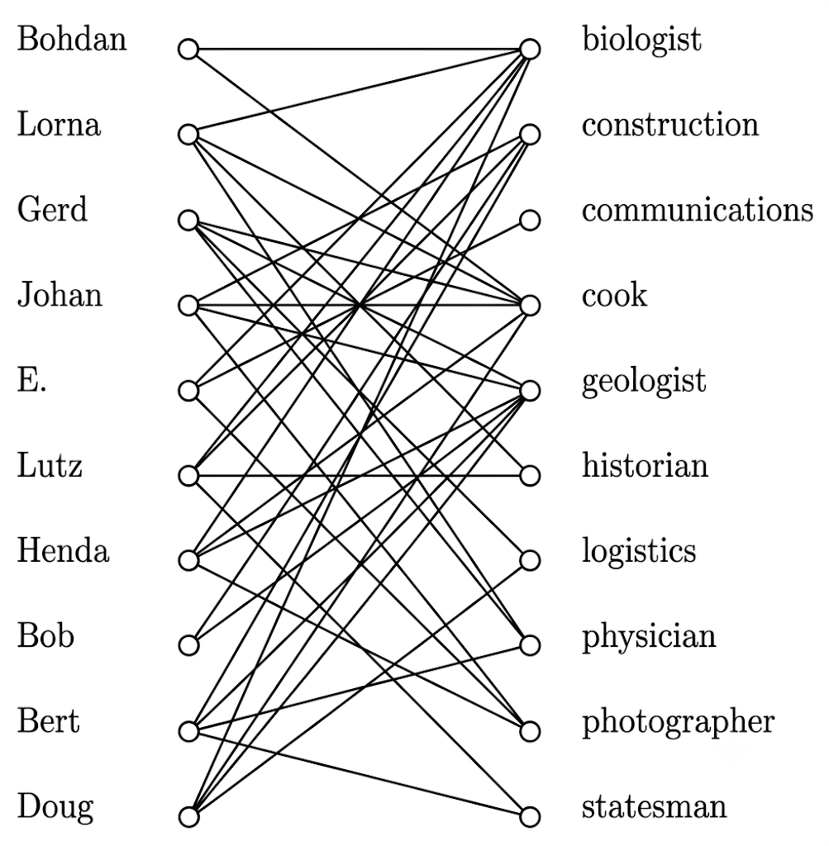

Some Application
let the vertices of a. graph be of two kinds: those representing the members of an exploration society, and those representing types of skills. In this graph, an edge between a person and a skill means that person has expertise in that skill area. We wish to send an expedition to set up a camp and explore some remote part of the world. In order to save costs, we want to send as few people as possible, but we must be sure that every skill is possessed by at least one member of the expedition.
So, We send Gerd, E. and Lutz

Slide 50

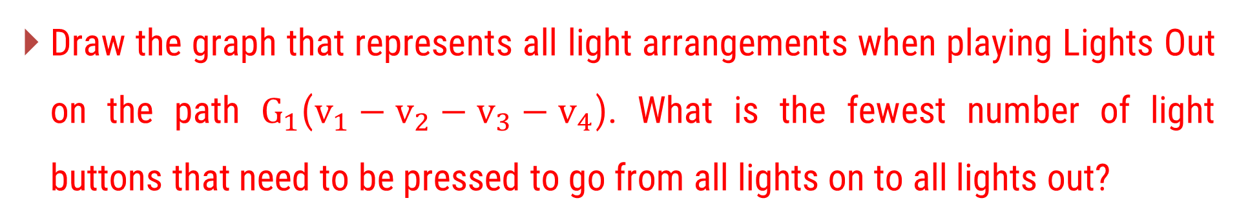



Light Out on Graph
Draw the graph that represents all light arrangements when playing Lights Out on the path $G_{1}$($v_{1}−v_{2}−v_{3}−v_{4}$). What is the fewest number of light buttons that need to be pressed to go from all lights on to all lights out?
When we select $v_{1}$that implies light out of$v_{1}$ and$v_{2}$.
$$v_{1}$$
$$v_{2}$$
$$v_{3}$$
$$v_{4}$$
When we select $v_{4}$that implies light out of$v_{3}$ and$v_{4}$.

Slide 51
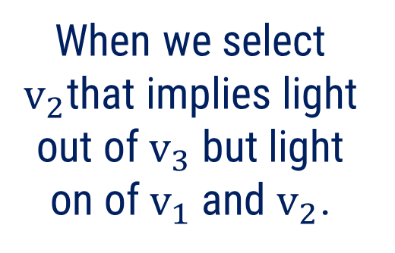
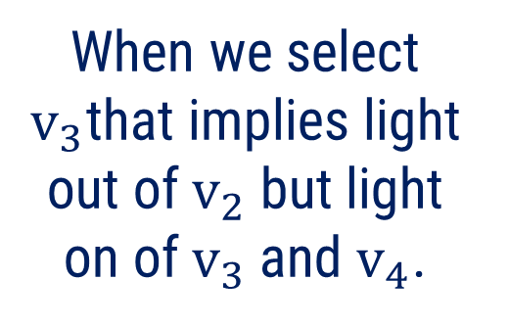
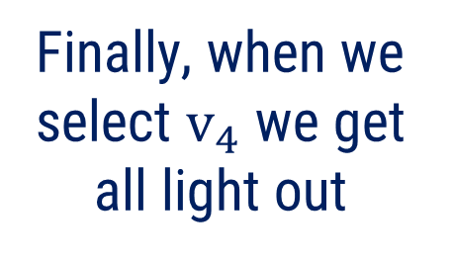


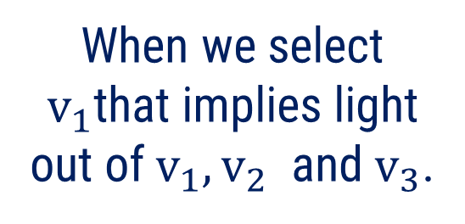


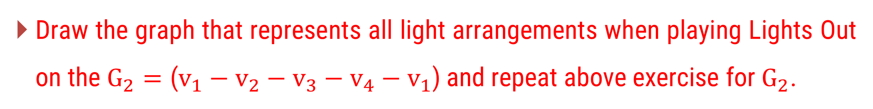












Light Out on Graph
Draw the graph that represents all light arrangements when playing Lights Out on the $G_{2}=\text{(}v_{1}−v_{2}−v_{3}−v_{4}−v_{1}\text{)}$ and repeat above exercise for$G_{2}$.
$$v_{1}$$
$$v_{2}$$
$$v_{1}$$
$$v_{2}$$
$$v_{1}$$
$$v_{2}$$
$$v_{1}$$
$$v_{2}$$
$$v_{4}$$
$$v_{3}$$
$$v_{4}$$
$$v_{3}$$
$$v_{4}$$
$$v_{3}$$
$$v_{4}$$
$$v_{3}$$
When we select $v_{1}$that implies light out of$v_{1},v_{2}$ and$v_{3}$.
When we select $v_{2}$that implies light out of$v_{3}$ but light on of$v_{1}$and $v_{2}$.
When we select $v_{3}$that implies light out of$v_{2}$ but light on of$v_{3}$and $v_{4}$.
Finally, when we select $v_{4}$ we get all light out

Slide 52


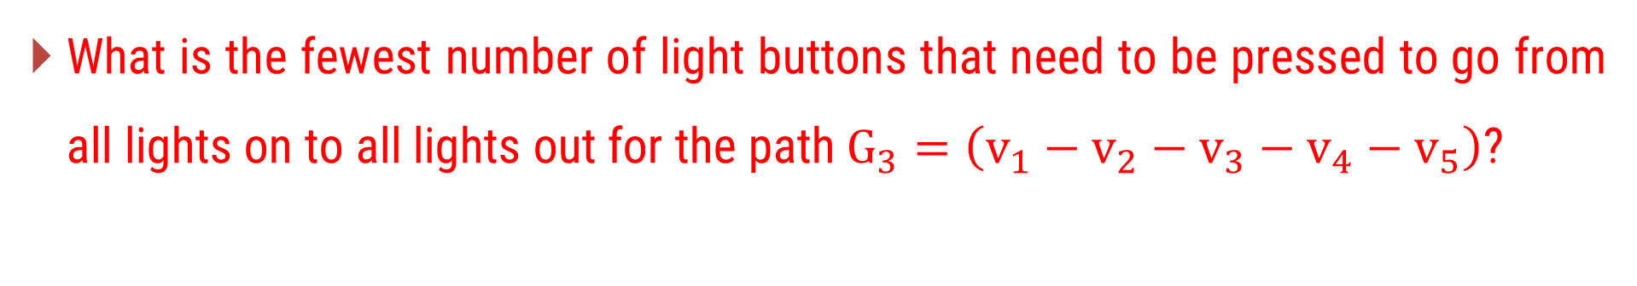

Light Out on Graph
What is the fewest number of light buttons that need to be pressed to go from all lights on to all lights out for the path $G_{3}=\left(v_{1}−v_{2}−v_{3}−v_{4}−v_{5}\right)$?
When we select $v_{2}$that implies light out of$v_{1},v_{2}$ and$v_{3}$.
$$v_{1}$$
$$v_{2}$$
$$v_{3}$$
$$v_{4}$$
$$v_{5}$$
When we select $v_{5}$that implies light out of$v_{5}$ and$v_{4}$.

Slide 53
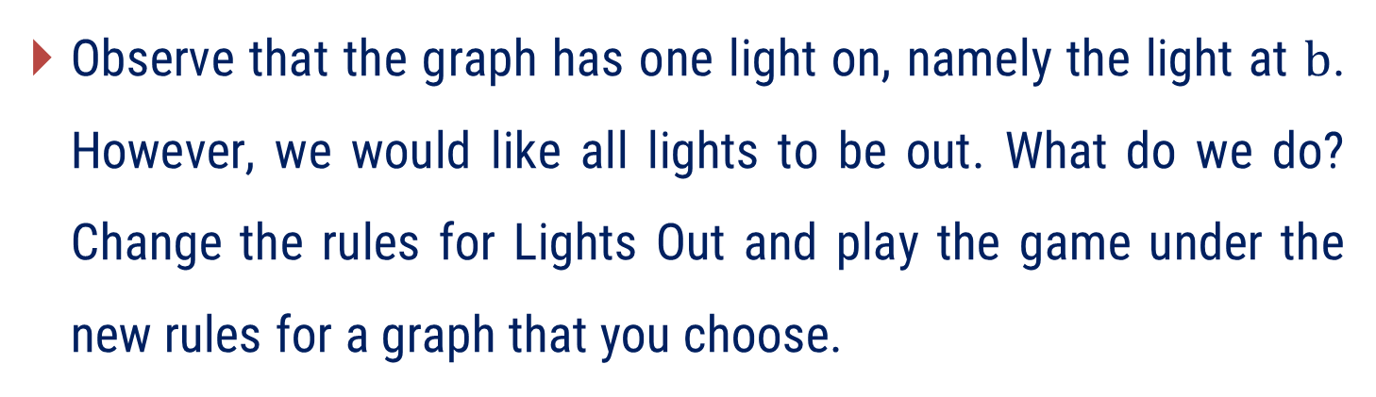
? Light out on Graph
Observe that the graph has one light on, namely the light at $b$. However, we would like all lights to be out. What do we do? Change the rules for Lights Out and play the game under the new rules for a graph that you choose.
b
a
c
d
  There is no sequence of button presses that turns off all the lights.
  Rule 1: Pressing a button toggles only the pressed vertex (not its neighbours).
  Rule 2: Pressing a button toggles only its neighbours, not itself.
  Rule 3: Pressing a button toggles the pressed vertex and only its leaf neighbors.
  Rule 4: _________________________________

Slide 54
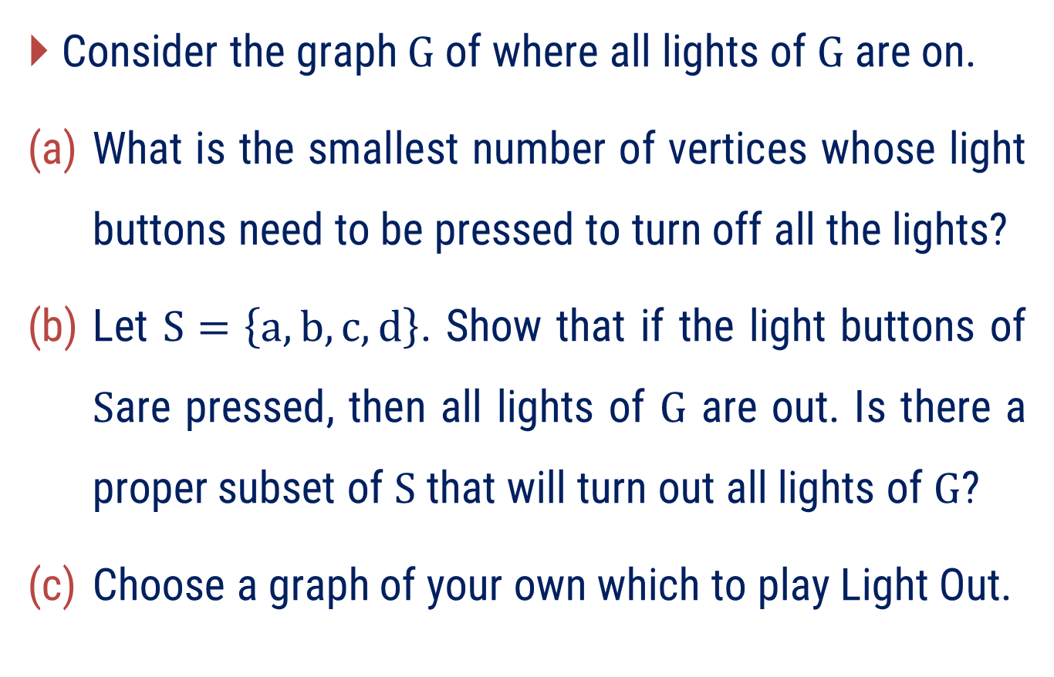
? Light out on Graph
Consider the graph $G$ of where all lights of $G$ are on.
What is the smallest number of vertices whose light buttons need to be pressed to turn off all the lights?
Let $S=\left\{a,b,c,d\right\}$. Show that if the light buttons of $S$are pressed, then all lights of $G$ are out. Is there a proper subset of $S$ that will turn out all lights of $G$?
Choose a graph of your own which to play Light Out.
a
b
c
d
e

Slide 55
Method – 3
Matching, Maximal Matching and Maximum Matching

Slide 56



Matching
A matching in a graph is a subset of edges in which no two edges are adjacent.
a
a
a
a
c
b
c
b
c
b
c
b
G
$$M_{1}$$
$$M_{2}$$
$$M_{3}$$
A single edge in a graph is a matching.

Slide 57




Matching
A matching in a graph is a subset of edges in which no two edges are adjacent.
G
$$M_{1}$$
$$M_{2}$$
$$M_{3}$$
$$M_{4}$$

Slide 58

Maximal Matching
A matching M in a graph G such that no additional edge of G can be added to M without violating the matching property.
a
a
a
a
c
b
c
b
c
b
c
b
G
$$M_{1}$$
$$M_{2}$$
$$M_{3}$$
Here all three are maximal matching.
In a$K_{3}$ any single edge is a maximal matching.

Slide 59


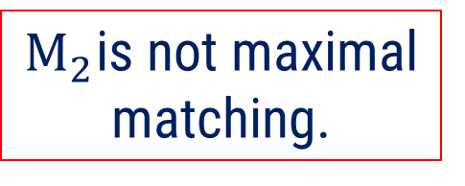
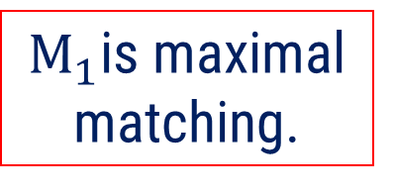
Maximal Matching
A matching M in a graph G such that no additional edge of G can be added to M without violating the matching property.
G
$$M_{1}$$
$$M_{2}$$
$M_{1}$is maximal matching.
$M_{2}$is not maximal matching.

Slide 60




Maximal Matching
A matching M in a graph G such that no additional edge of G can be added to M without violating the matching property.
G
$$M_{1}$$
$$M_{2}$$
$M_{1}$is maximal matching.
$M_{2}$is not maximal matching.

Slide 61
Remarks
A graph may have many different maximal matchings, and of different sizes.
The maximal matchings with the largest number of edges are called the maximum matchings.
The number of edges in a maximum matching is called the matching number of the graph.
Every maximum matching is maximal, but every maximal matching is not necessarily maximum.

Slide 62
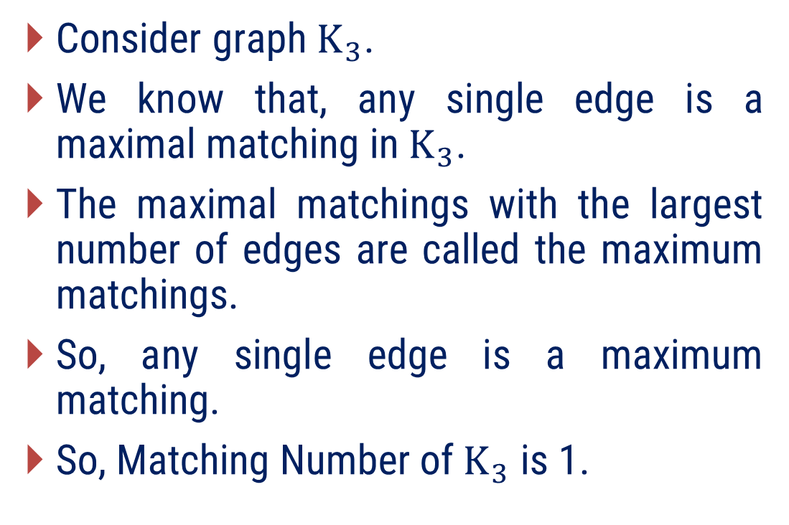
Find the matching number of$K_{3}$?
Consider graph$K_{3}$.
We know that, any single edge is a maximal matching in$K_{3}$.
The maximal matchings with the largest number of edges are called the maximum matchings.
So, any single edge is a maximum matching.
So, Matching Number of$K_{3}$ is 1.
a
c
b
G

Slide 63



Find Matching Number of following graph.
Lets consider some matching of G.
G
$$M_{1}$$
$$M_{2}$$
$$M_{3}$$

Slide 64




Find Matching Number of following graph.
Consider maximal matching of the following graph $G$.
$$M_{1}$$
$$M_{2}$$
$$M_{3}$$
G
Maximal matching.
Maximal matching.
Maximal matching.

Slide 65

Find Matching Number of following graph.
So${M_{1},M}_{2}$, and$M_{3}$ are maximal matching of graph G.
Clearly, we can not find maximal matching with 3 edges.
So maximum matching is$M_{2}$and$M_{3}.$
Hence the matching number of G is 2.
G
Maximum matching.
Maximum matching.

Slide 66
Examples of Method-3

Slide 67



Method 3 ⇝ Example 1
Find any three matching of the following graphs.
Solution
$$G_{1}$$
$$G_{2}$$
$$G_{3}$$

Slide 68




Method 3 ⇝ Example 1(Cont.)
Find any three matching of the following graphs.
Solution
$$G_{1}$$
$$M_{1}$$
$$M_{2}$$
$$M_{3}$$

Slide 69




Method 3 ⇝ Example 1(Cont.)
Find any three matching of the following graphs.
Solution
$$G_{2}$$
$$M_{1}$$
$$M_{2}$$
$$M_{3}$$

Slide 70




Method 3 ⇝ Example 1(Cont.)
Find any three matching of the following graphs.
Solution
$$M_{1}$$
$$M_{2}$$
$$M_{3}$$
$$G_{3}$$

Slide 71


Method 3 ⇝ Example 2
Find a matching of the following graphs.
Solution
h
h
i
g
f
e
d
e
f
g
c
a
c
d
b
b
a
$$G_{1}$$
$$G_{2}$$

Slide 72


Method 3 ⇝ Example 2(Cont.)
Find a matching of the following graphs.
Solution
h
i
h
i
g
g
d
d
e
f
e
f
c
c
b
a
b
a
$$M_{1}=\left\{d,b,i\right\}$$
$$G_{1}$$

Slide 73

Method 3 ⇝ Example 2(Cont.)
Find a matching of the following graphs.
Solution
h
h
f
f
e
e
g
c
g
c
a
a
d
d
b
b
$$M_{1}=\left\{f,b\right\}$$
$$G_{2}$$

Slide 74

Method 3 ⇝ Example 3
Find any two maximal matching of the following graphs.
Solution
h
i
g
d
e
f
c
b
a
$$G$$

Slide 75



Method 3 ⇝ Example 3
Find any two maximal matching of the following graphs.
Solution
h
i
h
i
h
i
g
g
g
d
d
d
e
f
e
f
e
f
c
c
c
b
b
b
a
a
a
$$G$$
Maximal matching $M_{1}$
Maximal matching $M_{2}$

Slide 76
Method 3 ⇝ Example 4
Find matching number of the following graphs.
Solution
h
i
g
d
e
f
c
b
a
$$G$$

Slide 77




Method 3 ⇝ Example 4(Cont.)
Find matching number of the following graphs.
Solution
Consider graph with two maximal matching $M_{1}$ and$M_{2}$ of it.
Here$M_{1}$ and $M_{2}$ both are maximal but $M_{1}$ is largest in size so,${ M}_{1}$is maximum matching.
Size of $M_{1}$ is 3.
Hence, Matching number of graph is 3.
i
h
i
g
d
d
e
f
e
f
c
b
b
a
$$M_{1}$$
$$M_{2}$$
$$G$$
Maximum matching
Not Maximum matching

Slide 78




Method 3 ⇝ Example 5
Find matching number of the following graphs.
Solution
Consider graph with two maximal matchings$M_{1}$and $M_{2}$.
Here, $M_{1}$ is maximum but $M_{2}$ is not maximum.
Hence matching number is 3.
f
e
h
e
f
h
a
g
d
c
b
b
b
$$M_{2}$$
$$M_{1}$$
$$G$$

Slide 79
Method-4
Perfect Matching and Hall’s Theorem (without proof)

Slide 80



Perfect Matching
A matching of a graph in which every vertex is matched is called perfect matching.
OR
A matching for which degree of each vertex is 1 is called perfect matching.
a
a
a
a
c
b
c
b
c
b
c
b
G
$$M_{1}$$
$$M_{2}$$
$$M_{3}$$
So, for$K_{3}$, $M_{1}, M_{2},$and $M_{3}$are not perfect matching

Slide 81





Perfect Matching
A matching for which degree of each vertex is 1 is called perfect matching.
G
$$M_{1}$$
$$M_{2}$$
$$M_{3}$$
$$M_{4}$$
So, for$G, M_{2}, and M_{3}$are perfect matching but,
$M_{1},$and $M_{4}$are not perfect matching.

Slide 82

Is Perfect matching possible for graph with odd order?
From definition, In a perfect matching, every vertex is incident with exactly one matched edge.
If a graph has n vertices, then a perfect matching contains: $\frac{n}{2}$ edges, because each edge matches exactly two vertices.
Therefore, perfect matchings are only possible in graphs with an even number of vertices.
Hence, perfect matching is not possible for graph with odd order.

Slide 83



Is Perfect matching possible for all graph with even order?
No perfect matching is not possible for all graph with even order.
Consider following graph with all of its possible matching,
$$M_{1}$$
$$M_{2}$$
$$M_{3}$$
Hence perfect matching is not possible for all graph with even order

Slide 84

Remarks
When n is even,${ C}_{n}$ has exactly 2 distinct perfect matchings.
When n is even, the path has a unique perfect matching.
A star graph $K_{1,n}$ has a perfect matching if and only if n = 1.
A Perfect matching in $K_{n,n}$ is$n!$.
A Perfect matching in $K_{n}$ is$\frac{\left(2n\right)!}{\left(2^{n}n!\right)}$.
Every tree has at most one perfect matching.
Every r-regular bipartite graph$\left(r≥1\right)$has a perfect matching.

Slide 85
Real-Life Situation
A department has:
  12 mathematics books
  10 successful students
Each student should receive:
  exactly one book
However:
  some students already own certain books.
  some books are not useful for certain students.
Thus, not every student is interested in every book.

Slide 86
Real-Life Situation
Can the books be distributed so that:
  Every student receives exactly one book.
  Each student gets a desired book.
  No book is assigned to more than one student.
Even though there are more books than students:
  some books may not be wanted by anyone
  several students may want the same set of books
  Hence, a complete assignment may still be impossible.

Slide 87
This situation can be modeled by a graph
Students and books are represented as vertices, say S1, S2, …, S10 and the books, say B1, B2, …, B12.
Let U = {S1, S2, …, S10} be the set of students and W = {B1, B2, …, B12} be the set of books.
Thus, the graph G is a Bipartite Graph shown in Figure.
S1
S2
S3
S4
S5
S6
S7
S8
S9
S10
B1
B2
B3
B4
B5
B6
B7
B8
B9
B10
B11
B12

Slide 88
Model and Solve problem using graph theory
As a result of doing well on an exam, six students A, B, C, D, E, and F have earned the right to receive a complimentary textbook in either a, c, d, g, h, p, t.
Where, a: Algebra, c: Calculus, d: Differential Equations, g: Geometry, h: History of Mathematics, p: Programming, t: Topology.
There is only one book on each of these subjects.

Slide 89

Model Student Preferences using graph theory
A
B
C
D
E
F
a
c
d
g
h
p
t

Slide 90

Model and Solve following real life problem using graph theory
Solution of problem using matching
A
B
C
D
E
F
a
c
d
g
h
p
t
Yes, each of the students receive a book he or she likes

Slide 91

Conclusion
Given Situation
Solution
Yes, each of the students receive a book he or she likes

Slide 92
Model and Solve problem using graph theory
Seven seniors: B, D, F, J, K, L, M, are applying for the jobs: a, c, e, p, r, s, t.
where:
  a: Accountant
  c: Consultant
  e: Editor
  p: Programmer
  r: Reporter
  s: Secretary
  t: Teacher
Only one position is available for each job.

Slide 93

Model Student Preferences using graph theory
Modeling of problem using graph
B
D
F
J
K
L
M
a
c
e
p
r
s
t

Slide 94

Model and Solve following real life problem using graph theory
Solution of problem using graph
B
D
F
J
K
L
M
a
c
e
p
r
s
t

Slide 95
Conclusion
Solution of problem using graph
B
D
F
J
K
L
M
As J and L both wants Job e,
We can not find Perfect Matching
a
c
e
p
r
s
t
No, it is not possible for each student to be hired for a job for which he or she has applied

Slide 96



Hall’s Theorem (without proof)
Hall’s Marriage Theorem:
Let$G$ be a bipartite graph with$V=X∪Y$. Then$G$ contains a matching that saturates every vertex of$X$ if and only if:$\left|N\left(S\right)\right|≥\left|S\right|$ for every subset$S⊆X$.
” $G$ contains a matching that saturates every vertex of$X$ ”
Meaning: every vertex in the set$X$ is matched with exactly one vertex in the other partite set.
$\left|N\left(S\right)\right|≥\left|S\right|$ for every subset$S⊆X$. is Known as Hall’s condition.

Slide 97


Illustration: Hall’s condition
If we take$S=\left\{B,F,J,L\right\}$.
So, $\left|S\right|=4.$
But,$N\left(S\right)=\left\{c,e,r\right\}.$
So,$\left|N\left(S\right)\right|=3.$
$i.e. \left|N\left(S\right)\right|<\left|S\right|$.
Hence graph is not satisfy Hall’s condition.
B
D
F
J
K
L
M
a
c
e
p
r
s
t
$\left|N\left(S\right)\right|≥\left|S\right|$ for every subset$S⊆X$. is Known as Hall’s condition.

Slide 98

Hall’s Theorem Application.
In this diagram, a bipartite graph, the students are at the top and the companies are at the bottom. A student and a company is connected if the company wants to hire the student. For example, d will hire any student, so d is connected to A, B, C, and D. Can every student gets a job?
A
B
C
D
For answer to this question we apply Hall’s theorem.
Here if we take$S=\left\{A,B,D\right\}$ then$N\left(S\right)=\left\{b,d\right\}$.
So,$\left|S\right|>\left|N\left(S\right)\right|$.
So Hall's condition is violated.
No matching saturating all students exists.
Therefore, not every student can get a job.
a
b
c
d

Slide 99
Hall’s Theorem Application.
Using Hall's Theorem, determine whether it is possible to schedule 7 distinct matches (1 from each team in Group A to 1 distinct team in Group B).
Is it possible that India plays against Pakistan in such a matching?

Slide 100
Hall’s Theorem Application.
Two groups of 7 cricket teams are set to play one-on-one matches — each team from Group A must play against exactly one distinct team from Group B. Matches are allowed only if both teams agree to play (i.e., there's an edge between them).
Group A (Home Teams):
India (IND)
Sri Lanka (SL)
New Zealand (NZ)
South Africa (SA)
Australia (AUS)
England (ENG)
Bangladesh (BAN)
Edges (Match Preferences):
(A1) India → Pakistan (B1), West Indies (B2), Afghanistan (B3)
(A2) Sri Lanka → West Indies (B2), Afghanistan (B3), Ireland (B4)
(A3) New Zealand → Ireland (B4), Namibia (B5)
(A4) South Africa → Namibia (B5), Netherlands (B6)
(A5) Australia → Netherlands (B6), Scotland (B7)
(A6) England → Afghanistan (B3), Scotland (B7)
(A7) Bangladesh → Pakistan (B1), Netherlands (B6)
Group B (Away Teams):
Pakistan (PAK)
West Indies (WI)
Afghanistan (AFG)
Ireland (IRE)
Namibia (NAM)
Netherlands (NED)
Scotland (SCO)

Slide 101
Hall’s Theorem Application.
First we model problem into graph.
Edges (Match Preferences):
(A1) India → Pakistan (B1), West Indies (B2), Afghanistan (B3)
(A2) Sri Lanka → West Indies (B2), Afghanistan (B3), Ireland (B4)
(A3) New Zealand → Ireland (B4), Namibia (B5)
(A4) South Africa → Namibia (B5), Netherlands (B6)
(A5) Australia → Netherlands (B6), Scotland (B7)
(A6) England → Afghanistan (B3), Scotland (B7)
(A7) Bangladesh → Pakistan (B1), Netherlands (B6)
A1
A2
A3
A4
A5
A6
A7
B1
B2
B3
B4
B5
B6
B7

Slide 102

Hall’s Theorem Application.
After observation, every subset of teams in Group A, the number of available opponents in Group B is at least as large as the subset size. So, graph must satisfy Hall’s condition.
Hence, it is clear from Hall’s theorem graph have A matching of size 7 exists.
i.e. it is possible to schedule 7 distinct matches.

Slide 103
Hall’s Theorem Application.
Now we find such perfect matching.
A1
A2
A3
A4
A5
A6
A7
B1
B2
B3
B4
B5
B6
B7

Slide 104
Hall’s Theorem Application.
Is India playing Pakistan?
Yes. In the matching above: India↔Pakistan.
However, Hall's theorem only guarantees the existence of a complete matching.
There may be multiple perfect matchings, some with India–Pakistan and some without India–Pakistan.
So the correct conclusion for class is:
A complete schedule of 7 distinct matches exists. One such schedule includes India vs Pakistan, but Hall's theorem itself does not force India to play Pakistan.

Slide 105
Examples of Method-4

Slide 106
Method 4 ⇝ Example 2
Give an example of a graph that has a perfect matching, but its matching number is 1.
Give an example of a graph whose matching number is 1, but it does not have a perfect matching.
Solution
For (a)
Clearly graph have perfect matching as in matching of graph degree of each vertex is 1 also size of maximum matching is 1 so, matching number is 1.

Slide 107
Method 4 ⇝ Example 2(Cont.)
Give an example of a graph that has a perfect matching, but its matching number is 1.
Give an example of a graph whose matching number is 1, but it does not have a perfect matching.
Solution
For (b)
Clearly graph does not have perfect matching as in matching of graph degree of each vertex is not 1 but matching number is 1 as maximum matching size is 1.

Slide 108

Method 4 ⇝ Example 3
Give nine perfect matchings of the following graph.
Solution
$$G$$

Slide 109



Method 4 ⇝ Example 3(Cont.)
Give nine perfect matchings of the following graph.
Solution
$M_{1}$
$$M_{2}$$
$$M_{3}$$

Slide 110
Method 4 ⇝ Example 3(Cont.)
Give nine perfect matchings of the following graph.
Solution
$M_{1}$
$$M_{2}$$
$$M_{3}$$

Slide 111
Method 4 ⇝ Example 3(Cont.)
Give nine perfect matchings of the following graph.
Solution
$M_{1}$
$$M_{2}$$
$$M_{3}$$

Slide 112

Method 4 ⇝ Example 3(Cont.)
Give nine perfect matchings of the following graph.
Solution

Slide 113

Method 4 ⇝ Example 4
Prove that if a graph have perfect matching, then order of graph is even.
Solution
Suppose a graph of order $n$ has a perfect matching.
This means the graph has a matching in which the degree of each vertex is exactly 1.
By applying the Degree Sum Formula to this matching,
The total sum of degrees of all vertices involved in the matching is$n.$
As we know total sum of degrees of all vertices is always even.
That means,$n$ is even.
Hence, a graph have perfect .matching then order of graph is even.

Slide 114



?
A Latin rectangle is an$r×n$ matrix with$r≤n$. Each entry of the matrix has numbers from an alphabet$\{a_{1}, a_{2}, . . . , a_{n}\}$.
  Think of these as colors – more vibrant that way! The constraint is that any row and any column has no repeating entry. So, if we go up a column or left-to-right a row, no color is repeated. The following are examples of Latin rectangles; One is a$2×5$ and the other is a$3×5$.
  An$n×n$ Latin rectangle is called a Latin square. A completion of an r × n Latin rectangle is an $n×n$ Latin square whose first$r$ rows is the Latin rectangle. The question is: Can every Latin rectangle be completed?

Slide 115













Solution
Consider$3×5$
As we know every $r−$regular bipartite graph have $r−$ perfect matching.
So, we can find 2 perfect matching of given graph.
$$C_{1}$$
$$C_{2}$$
$$C_{3}$$
$$C_{4}$$
$$C_{5}$$
$$C_{1} C_{2} C_{3} { C}_{4} { C}_{5}$$
$$\begin{matrix}R_{1} \\ R_{2} \\ R_{3}\end{matrix}$$
$$a_{1}$$
$$a_{2}$$
$$a_{3}$$
$$a_{4}$$
$$a_{5}$$

Slide 116


































Solution
$$C_{1}$$
$$C_{2}$$
$$C_{3}$$
$$C_{4}$$
$$C_{5}$$
$$C_{1}$$
$$C_{2}$$
$$C_{3}$$
$$C_{4}$$
$$C_{5}$$
$$a_{1}$$
$$a_{2}$$
$$a_{3}$$
$$a_{4}$$
$$a_{5}$$
$$C_{1} C_{2} C_{3} { C}_{4} { C}_{5}$$
$$\begin{matrix}R_{1} \\ R_{2} \\ R_{3}\end{matrix}$$
$$a_{1}$$
$$a_{2}$$
$$a_{3}$$
$$a_{4}$$
$$a_{5}$$
$$R_{4}$$
$$a_{4}$$
$$a_{3}$$
$$a_{5}$$
$$a_{2}$$
$$a_{1}$$
$$R_{5}$$
$$a_{5}$$
$$a_{4}$$
$$a_{2}$$
$$a_{1}$$
$$a_{3}$$

Slide 117



?
Find domination number and total domination number of the following graph.
Web Graph
Cocktail Party Graph
Wheel Graph

Slide 118
?
Find matching number of the following graph.
Web Graph
Cocktail Party Graph
Wheel Graph

Slide 119
?
Is a perfect matching possible?
Web Graph
Cocktail Party Graph
Wheel Graph

Slide 120
Solution
Full Name of Graph | Number of Vertices | Matching Number | Perfect Matching | Domination Number | Total Domination Number
Web Graph | 12 | 6 | Yes ✓ | 4 | 4
Cocktail Party Graph | 6 | 3 | Yes ✓ | 2 | 2
Wheel Graph | 11 | 5 | No ✗ | 1 | 2

Slide 121

?
The following simple undirected graph is referred to as the Peterson graph.
  Find Domination and Total Domination number.
  Find any maximal and maximum matching.
  Find 6 perfect matching.

Slide 122
?
The following simple undirected graph is referred to as the Peterson graph.
  Find Domination and Total Domination number.
  Find any maximal and maximum matching.
  Find 6 perfect matching.

Slide 123


?
Let $G$ be an undirected graph, which is a path on $8$ vertices. The number of matchings in $G$ is $____$. (answer in integer)
Is the following graph a bipartite graph? If yes then find its perfect matching.
Suppose you deal 52 regular playing cards into 13 piles of 4 cards each. Prove that you can always select one card from each pile to get one of each of the 13 card values Ace, 2, 3, …, 10, Jack, Queen, and King.

Slide 124

Solution
For a path graph${ P}_{n}$with$n$ vertices, we can find the number of matchings $M(n)$ using a recurrence relation :
  $M\left(n\right)=M\left(n−1\right)+M(n−2)$ where $M\left(1\right)=1=M\left(0\right)$.
Calculating for$(n = 8)$ Vertices:
  $M\left(2\right)= 2$
  $M\left(3\right)= 1 + 2 = 3$
  $M\left(4\right)= 2 + 3 = 5$
  $M\left(5\right)= 3 + 5 = 8$
  $M\left(6\right)= 5 + 8 = 13$
  $M\left(7\right)= 8 + 13 = 21$
  $M\left(8\right)= 13 + 21 =34$

Slide 125



Solution
Yes given graph is a bipartite graph. Give any perfect matching of your choice.
Construct a graph with 13 vertices in the set$A$ , each representing one of the 13 card values, and 13 vertices in the set $B$, each representing one of the 13 piles. Draw an edge between a vertex$a∈A$ to a vertex$b∈B$ if a card with value is in the pile .

Slide 126

Solution of 3 (Cont.)
Notice that we are just looking for a matching of $A$ ; each value needs to be found in the piles exactly once.
We will have a matching if the matching condition holds. Given any set of card values (a set $S⊆A$ ) we must show that $\left|N\left(S\right)\right|≥\left|S\right|$.
S = chosen values and N(S) = piles containing those values
If you choose k different card values, they must be found in at least k different piles.
But what if it wasn’t? Say $\left|S\right|=k$. If, $\left|N\left(S\right)\right|<k$.
Fewer than$k$ piles can hold at most$4(k−1)$ cards. But we have$4k$ cards.
which is impossible. Therefore, the chosen k values must appear in at least k piles.
Thus the matching condition holds, so there is a matching, as required.

Slide 127
?
The Setup: Imagine a university department has 13 professors and 13 core course subjects. Every professor is qualified to teach exactly 4 distinct subjects. Every subject has exactly 4 qualified professors who can teach it. The department head needs to schedule final exams over a 4-day exam period (Monday, Tuesday, Wednesday, and Thursday).
The Rule: Each day, the department must schedule exactly 13 individual exam slots such that: Every professor proctors exactly one exam. Every subject has exactly one exam held.
The Question:
Can the department head necessarily build a complete 4-day schedule where every single professor proctors every subject they are qualified or exactly once, with zero scheduling conflicts?

Slide 128
?
Problem: Suppose you have 6 gifts (labeled 1, 2, 3, 4, 5, 6) to distribute among 5 friends. Their gift preferences are listed below:
  Aarav wants: 1, 5; Divya wants: 2, 3, 6; Ishaan wants: 1, 4, 5; Kavya wants: 4, 5; Rahul wants: 1.
  Determine if it is possible to give everyone a gift they want. If it is impossible, give reason.
Using the same 5 friends and 6 gifts, consider this new set of preferences:
  Aarav wants: 1, 2; Divya wants: 2, 3; Ishaan wants: 3, 4; Kavya wants: 4, 5; Rahul wants: 5, 6
  Show that everyone gets a gift they want. Which gift is left over?

Slide 129

Solution
No,
Proof: To find out why it fails, we look for a subset of friends whose total number of desired gifts is smaller than the number of friends in that group.
  Let's look at the group of friends:$S=\left\{Aarav, Ishaan, Kavya, Rahul\right\}.$
  Now let's list all the unique gifts this group collectively wants:
  The set of all unique gifts they want is$N(S) = \{1, 4, 5\}$.
  Number of friends in subset is 4.
  Number of unique gifts they like is 3.
Conclusion:
Since, Hall's Condition fails. it is impossible to distribute the gifts satisfactorily.

Slide 130
Solution
Yes, it is possible. Gift 6 is left over.
The Valid Distribution:
  Aarav gets Gift 1
  Divya gets Gift 2
  Ishaan gets Gift 3
  Kavya gets Gift 4
  Rahul gets Gift 5
Gift 6 remains unassigned.

Slide 131

B.Tech. $→5$^{th} Semester
Graph Theory (2301HS301)
THANK YOU
Prof. Punit Vadher
Department of Humanities & Science
punit.vadher@darshan.ac.in
9662443859

