Slide 1

Crime Hotspot Detection
Presented By :- Jay Riziya .

Slide 2
AGENDA
Introduction
Data Collection
Data Cleaning
Data Pre-processing
Exploratory Data Analysis (EDA)
Feature Engineering
Model Selection
Model Training
Model Deployment

Slide 3
Introduction
The project focuses on detecting crime hotspots using machine learning techniques. By analyzing historical crime data and other relevant information, we aim to identify areas with high crime rates and predict potential future hotspots. This approach leverages the power of data and advanced algorithms to enhance crime prevention strategies.
Predictive policing represents a significant advancement over traditional crime prevention methods. It allows law enforcement agencies to allocate resources more efficiently, proactively address potential crime areas, and ultimately improve public safety.

Slide 4
Data Collection
The data collection process for crime hotspot detection involves gathering various types of data from multiple sources. Key data types include crime incident reports, geographic data, demographic information, and socio-economic indicators. Crime incident reports provide detailed records of past crimes, including the type, date, time, and location of each incident. Geographic data includes latitude and longitude coordinates, maps, and other spatial information necessary for pinpointing crime locations.

Slide 5
Data Cleaning & Preprocesing
FUNCTION | OPERATIONS
df=pd.read_csv(“”) | Importing our dataset into Data frame and storing in df (i.evariable) (pd refers to pandas)
df.head(), df.tail() | To Display the first 5 Rows and last 5 Rows
df.shape() | array dimensions that tells the number of rows and columns of a given Data Frame.
df.info() | Display columns ,datatypes, non-null count and memory usage
df.describe() | Provides summary statistics of data like mean, median, minimum, maximum and more
df.isnull().sum() | Check the Total missing /null values
df.duplicated().sum() | Check the duplicate values

Slide 6
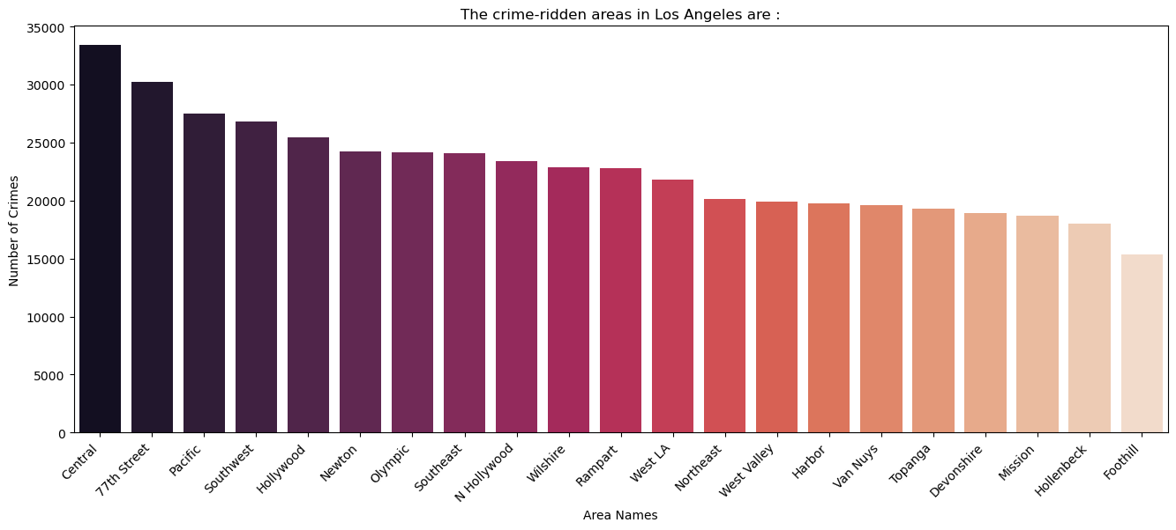
Exploratory Data Analysis
Count Plot of Crimes by Area

Slide 7
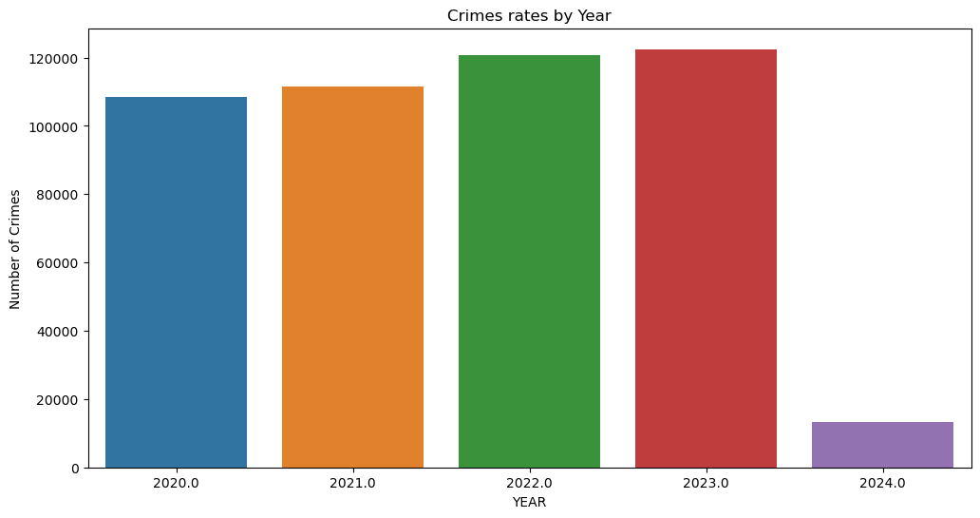
Data Visualization
Yearly Crime Counts

Slide 8
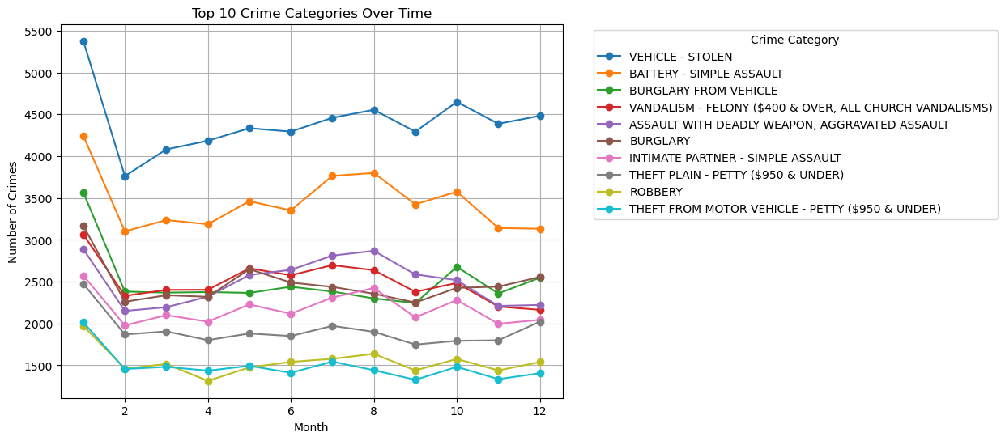
Data Visualization
Monthly Top 10 Crime Categories

Slide 9
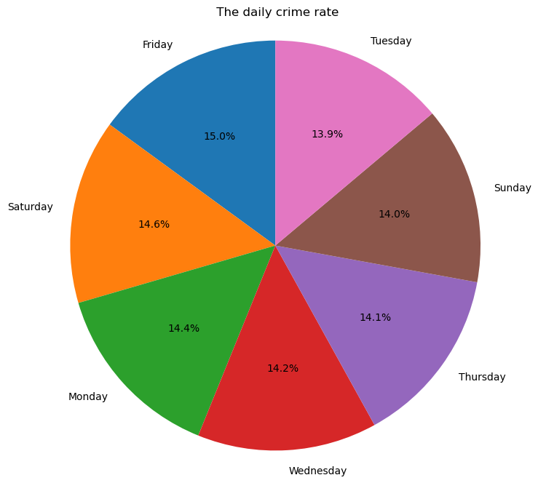
Data Visualization
Daily Crime Rate Distribution

Slide 10
Machine Learning
Encoding Categorical Features
Preparing Data for Modeling
encoder = LabelEncoder()
for column in columns_to_encode:
df[column] = encoder.fit_transform(df[column])
features = df.drop(columns=['Crm Cd Desc'])
target = df['Crm Cd Desc']

Slide 11
Splitting Data and Scaling Features
from sklearn.model_selection import train_test_split
from sklearn.preprocessing import StandardScaler, LabelEncoder
X_train, X_test, y_train, y_test = train_test_split(features, target, test_size=0.2, random_state=42)
scaler = StandardScaler()
X_train_scaled = scaler.fit_transform(X_train)
X_test_scaled = scaler.transform(X_test)

Slide 12
Model Selection .1
Random Forest Regressor
Random Forest Regressor Results:
R^2 Score: 1.00
Mean Absolute Error: 0.00
Accuracy within Tolerance: 99.74%

Slide 13
Model Selection .2
Gradient Boosting Regressor
Gradient Boosting Regressor Results:
R^2 Score: 0.98
Mean Absolute Error: 3.92
Accuracy: 97.82%

Slide 14
Model Selection .3
Decision Tree Regressor
Decision Tree Regressor Results:
R^2 Score: 1.00
Mean Absolute Error: 0.00
Accuracy: 100.00%

Slide 15
Model Selection .4
Ada Boost Regressor
Ada Boost Regressor Results:
R^2 Score: 0.75
Mean Absolute Error: 19.30
Accuracy: 74.96%

Slide 16
Results and Conclusion
MODEL | ACCURACY | MODEL FIT
Random Forest Regressor | 99.74 % | Overfit
Gradient Boosting Regressor | 97.82 % | Good fit
Decision Tree Regressor | 100.00 % | Overfit
Ada Boost Regressor | 74.96 % | Partially overfit

Slide 17
Thank You !
Jay Riziya

