Slide 1
Facespace v2
Achmad Baskara
Justin Little
Jeremy Sao

Slide 2
Work division
Achmad
Logged in Status, On/Offline Icons, Testing
Justin
Selection Preview Window, Wall Posts, Testing
Jeremy
Password Recovery, Walls, Database, Testing
All
Minor v1 upgrades
Page Stylings

Slide 3
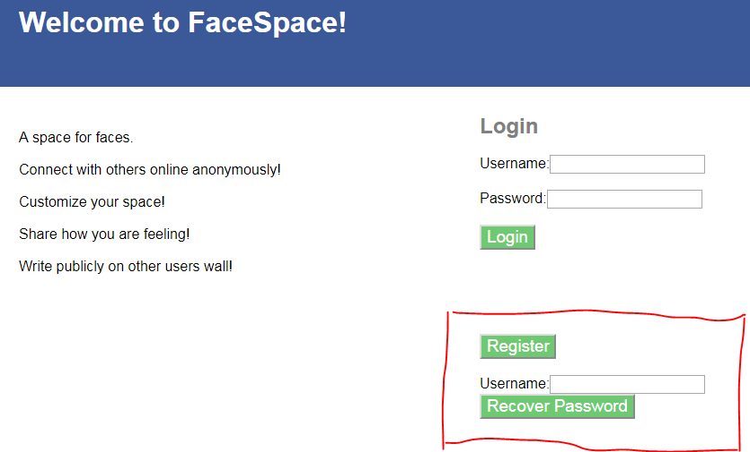
Overview
A Social Media Website using HTML, CSS, PHP, and MySQL

Slide 4
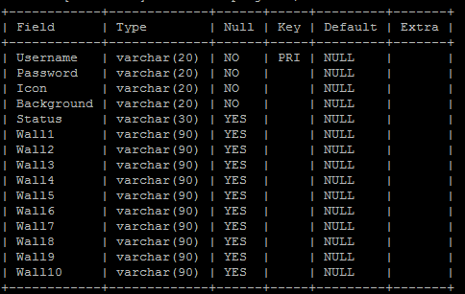
Mysql
Login Information
Displayed Information

Slide 5
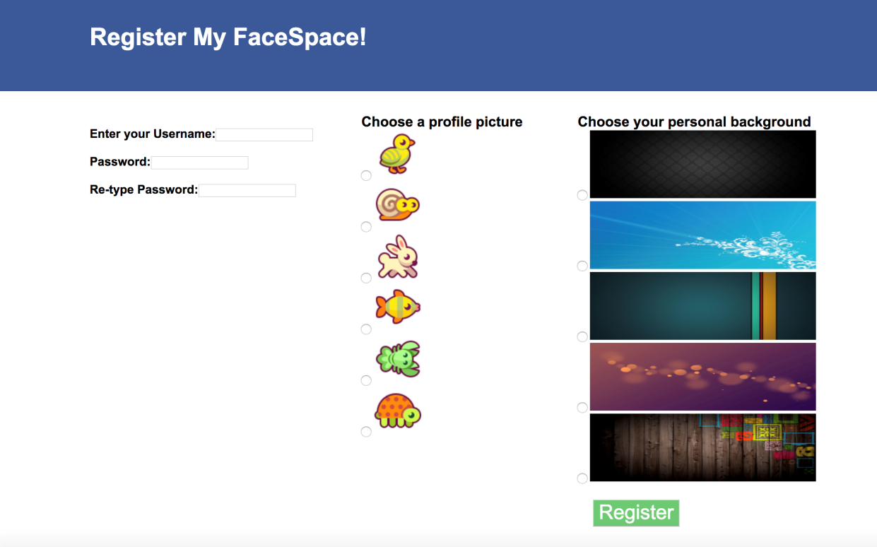
Register
Username
Primary Key
Password
Re-enter
Icon
Choice of 6
Background
Choice of 5

Slide 6
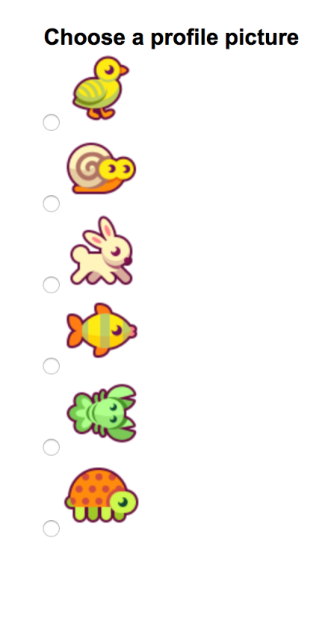
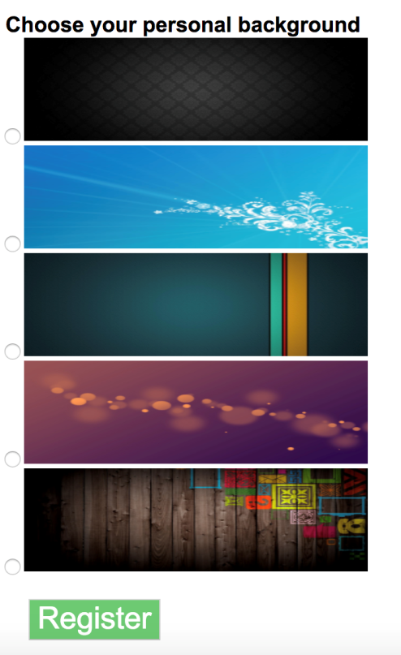
Register
Icon
Background
Now With Preview

Slide 7
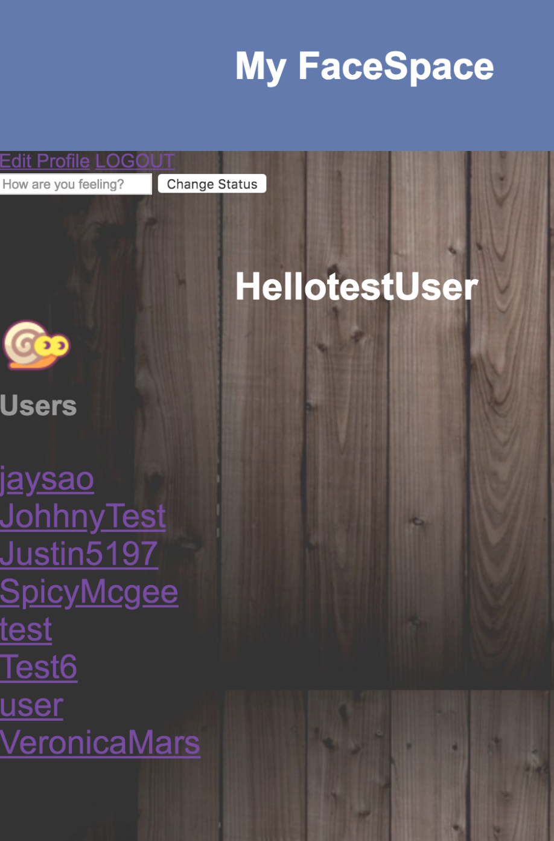
User_home
Username
Icon
Background image
Friend list (auto populated from all users)
Displays status edit

Slide 8
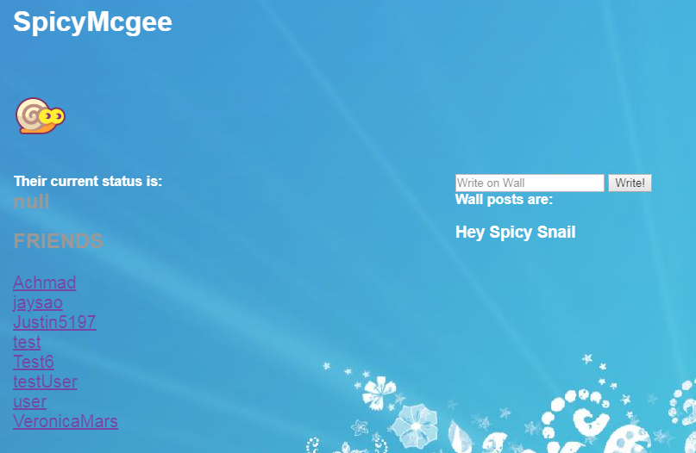
Friend_home

Slide 9
Friend_home
All friend links go to same friend_home.php
Display based on following
<a href='friend_home.php?fname=$friends'>
Doesn’t display status edit
Displays wall post
$sql2 = "UPDATE project3 SET Wall1='$wall' WHERE Username='$fname'";

Slide 10
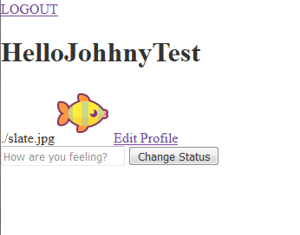
Testing
Edit profile
Required login to update
Background IMG
wasn’t displaying background
Inline php
style= "background-image: url(‘ <?php echo $background;?>’)

Slide 11
testing
User_home
Updating Status
Showing the current users status
Different $_SESSION based on logged in user or friend
Friend_home
Able to write on wall
Showing wall posts that belong to that user
Iterate through “null” values to write to the next wall space

Slide 12
http://codd.cs.gsu.edu/~abaskara1/Project3/home.html

