Slide 1
Facespace
Achmad Baskara
Justin Little
Jeremy Sao

Slide 2
Work division
Achmad
Register, Dynamic Icons, Backgrounds, Friend Homepage, Testing
Stylings
Justin
Login, Register, Database, User and Friend Homepage, Friend Displays, Testing
Stylings
Jeremy
Login, Register, Edit Profile, Walls, Status, User and Friend Homepage, Testing
Stylings

Slide 3
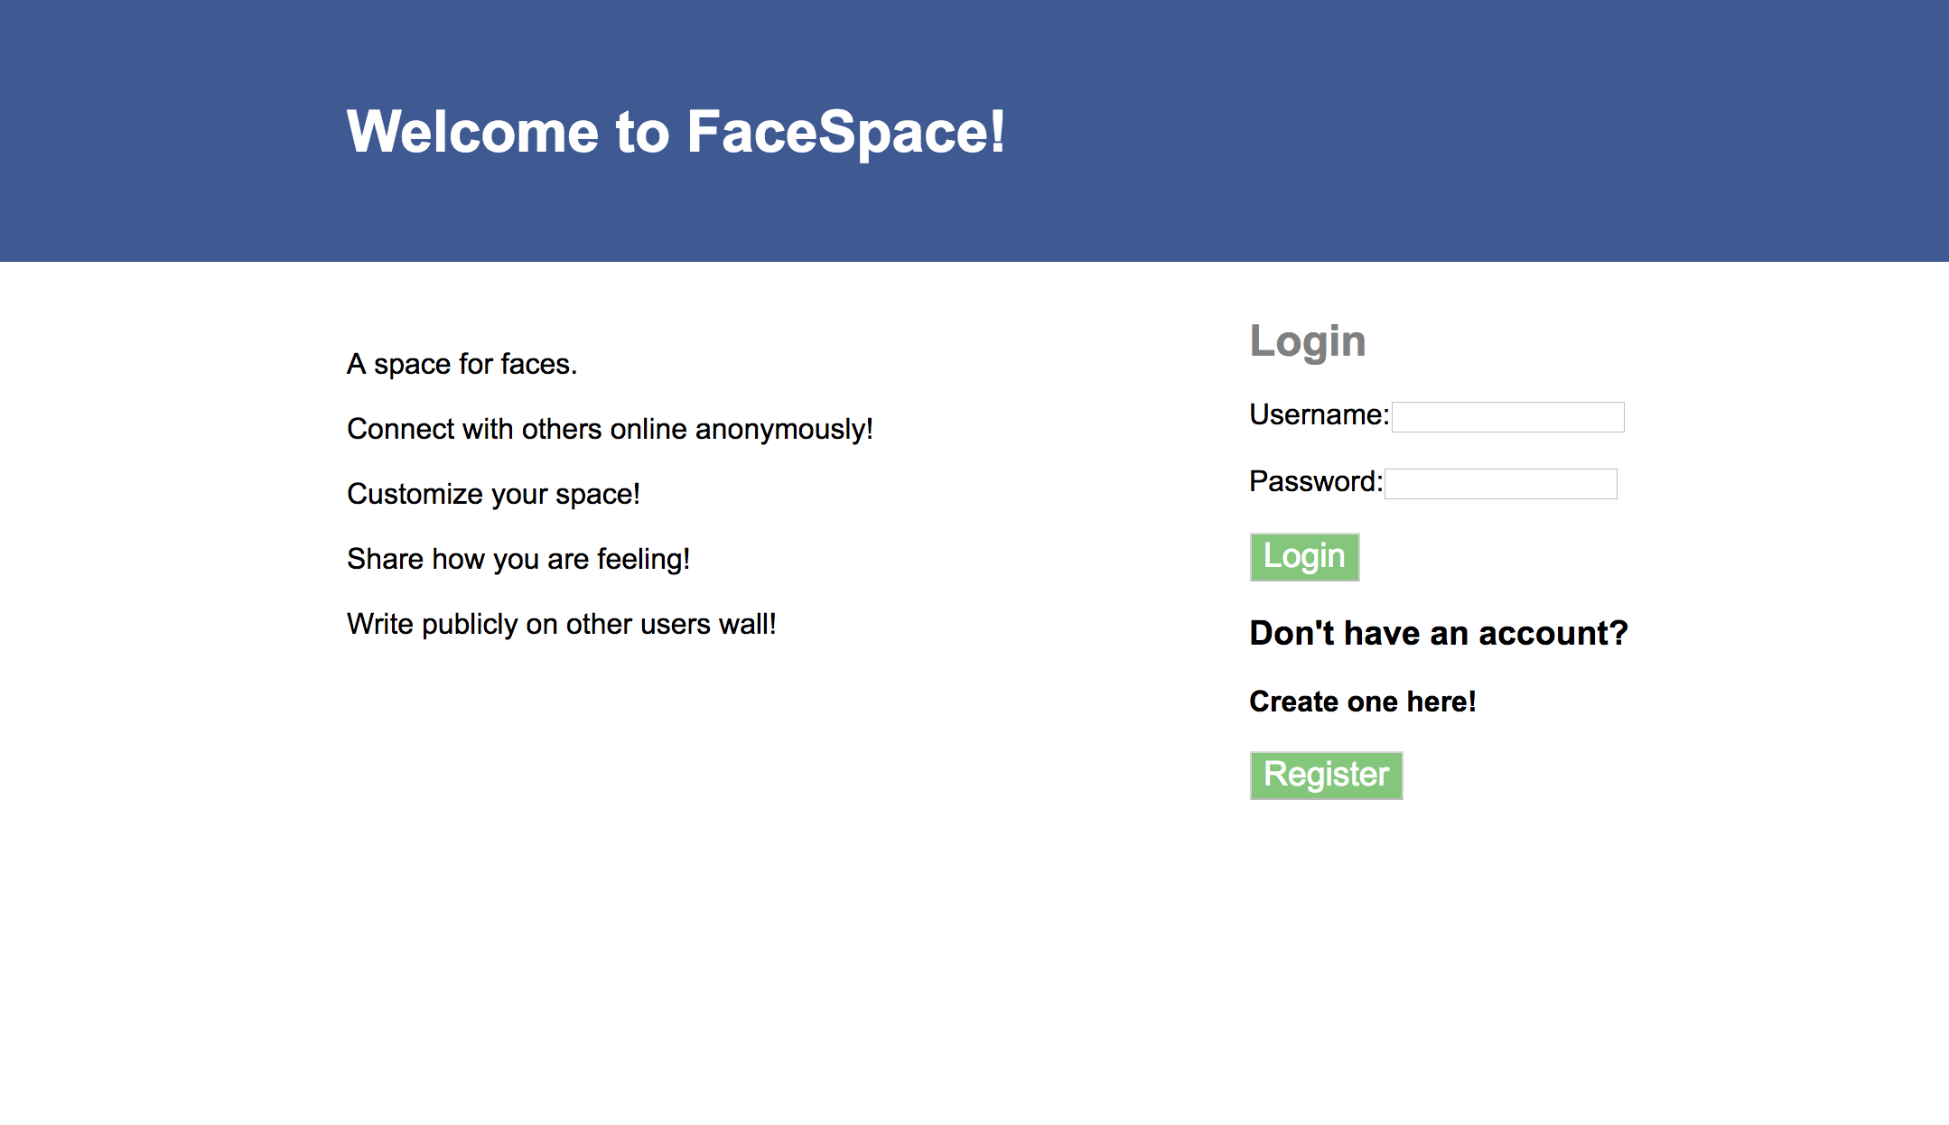
Overview
A Social Media Website using HTML, CSS, PHP, and MySQL

Slide 4
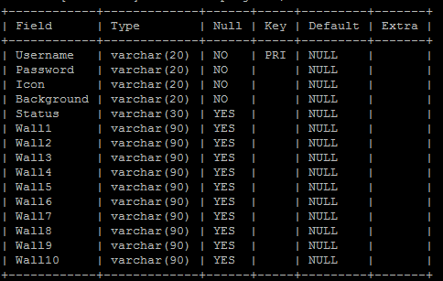
Mysql
Login Information
Displayed Information

Slide 5
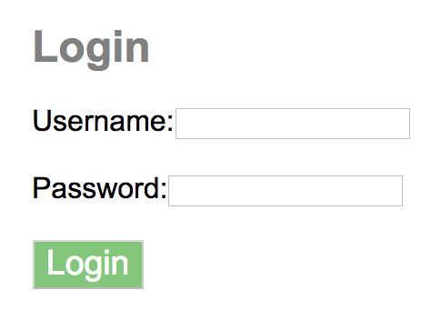
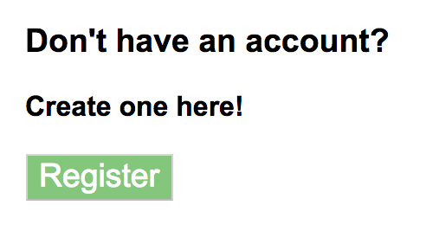
Home
Login
Username
Password
Register
Username
Password
Icon
Background

Slide 6
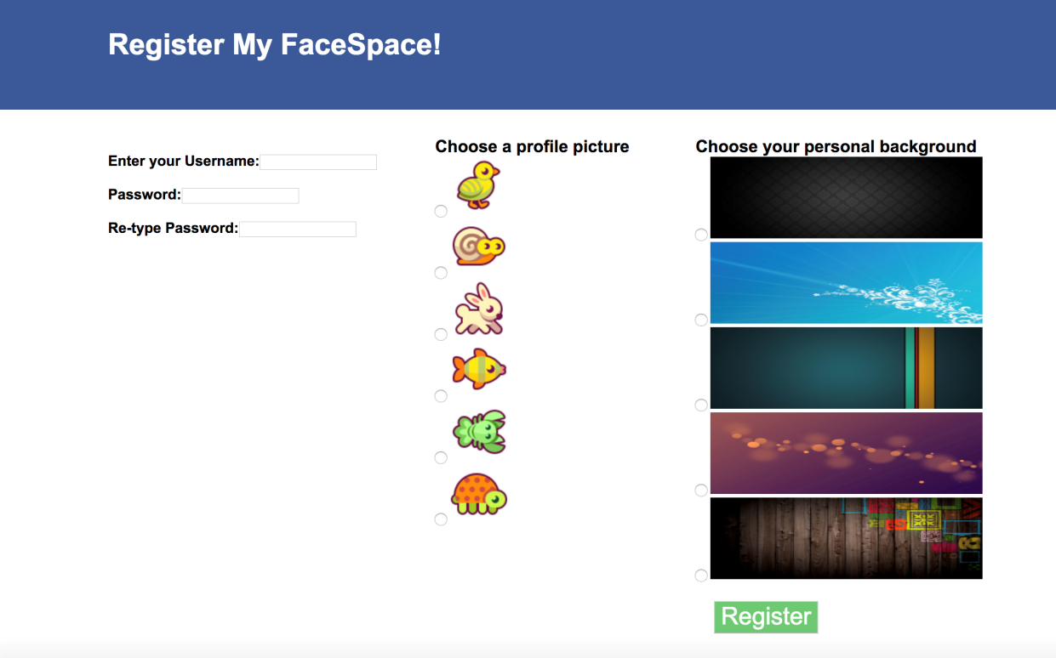
Register
Username
Primary Key
Password
Re-enter
Icon
Choice of 6
Background
Choice of 5

Slide 7
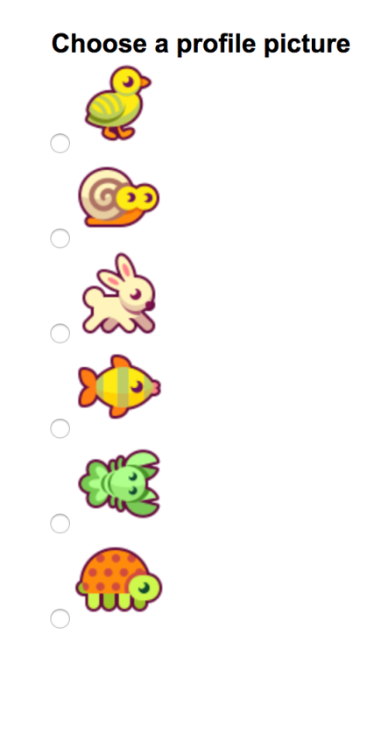
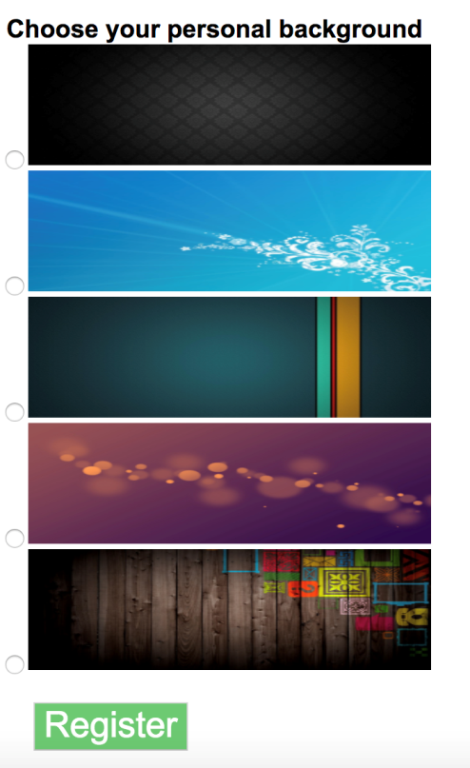
Register
Icon
Background
Form
Radio buttons
Images as options
Value = file name
“./fish.png”

Slide 8
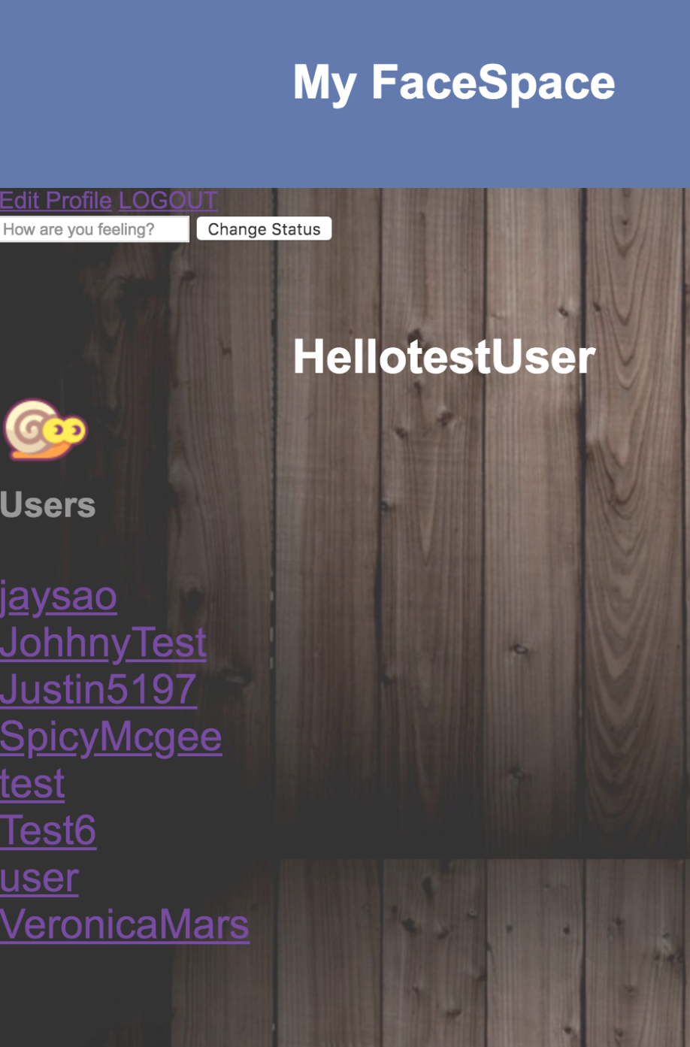
User_home
Username
Icon
Background image
Friend list (auto populated from all users)
Displays status edit

Slide 9
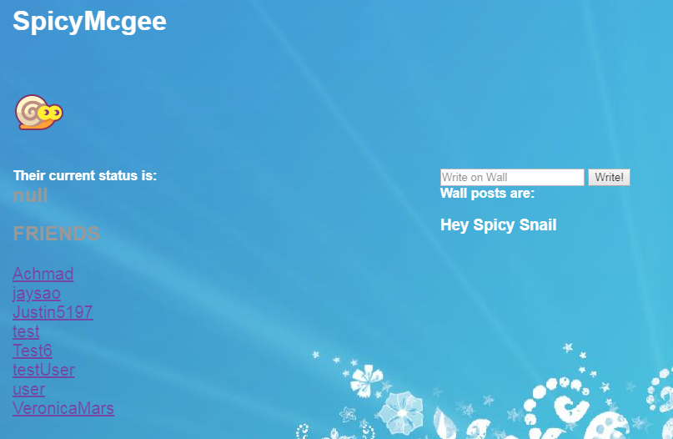
Friend_home

Slide 10
Friend_home
All friend links go to same friend_home.php
Display based on following
<a href='friend_home.php?fname=$friends'>
Doesn’t display status edit
Displays wall post
$sql2 = "UPDATE project3 SET Wall1='$wall' WHERE Username='$fname'";

Slide 11
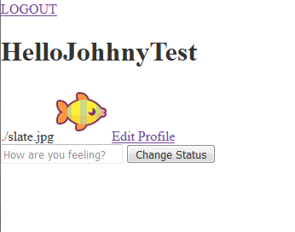
Testing
Edit profile
Required login to update
Background IMG
wasn’t displaying background
Inline php
style= "background-image: url(‘ <?php echo $background;?>’)

Slide 12
testing
User_home
Updating Status
Showing the current users status
Different $_SESSION based on logged in user or friend
Friend_home
Able to write on wall
Showing wall posts that belong to that user
Iterate through “null” values to write to the next wall space

Slide 13
http://codd.cs.gsu.edu/~abaskara1/Project3/home.html

