Slide 1
Facespace v2
Achmad Baskara
Justin Little
Jeremy Sao

Slide 2
Work division
Achmad
Logged in Status, On/Offline Icons, Testing
Justin
Selection Preview Window, Wall Posts, Testing
Jeremy
Password Recovery, Walls, Database, Testing
All
Minor v1 upgrades
Page Stylings

Slide 3
Minor v1 upgrades
Adding scrollbar
Previously: could not see entire friends list
overflow-y:scroll;
Hidden Passwords
Previously: password field was shown as text
<input type="password" name="password">
Wall Post Location
Previously: after post Location:home
Location: friend_home.php?fname=$fname

Slide 4
Things we couldn’t do
Log out on browser close
On page “Friend Search”
Edit profile updating immediately
User_home loads from session variables

Slide 5
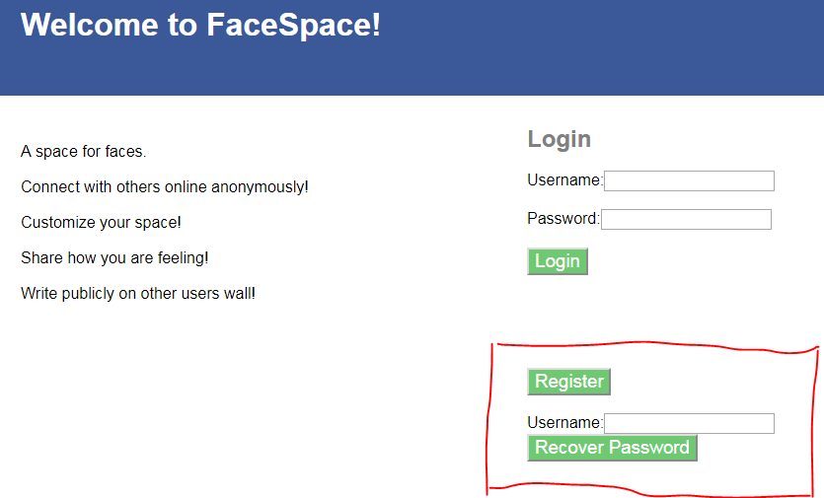
Overview and new features
A Social Media Website using HTML, CSS,JS, PHP, and MySQL

Slide 6
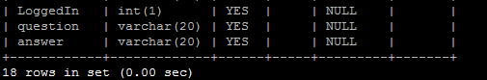
Mysql
LoggedIn
Security Q&A

Slide 7
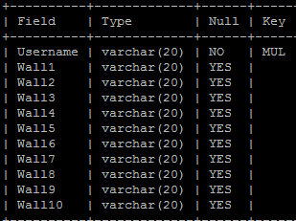
Mysql
CREATE TABLE wallposts ( Username VARCHAR(20) NOT NULL, Wall1 VARCHAR(20), Wall2 VARCHAR(20), Wall3 VARCHAR(20), Wall4 VARCHAR(20), Wall5 VARCHAR(20), Wall6 VARCHAR(20), Wall7 VARCHAR(20), Wall8 VARCHAR(20), Wall9 VARCHAR(20), Wall10 VARCHAR(20), FOREIGN KEY (Username) REFERENCES project3 (Username) );

Slide 8
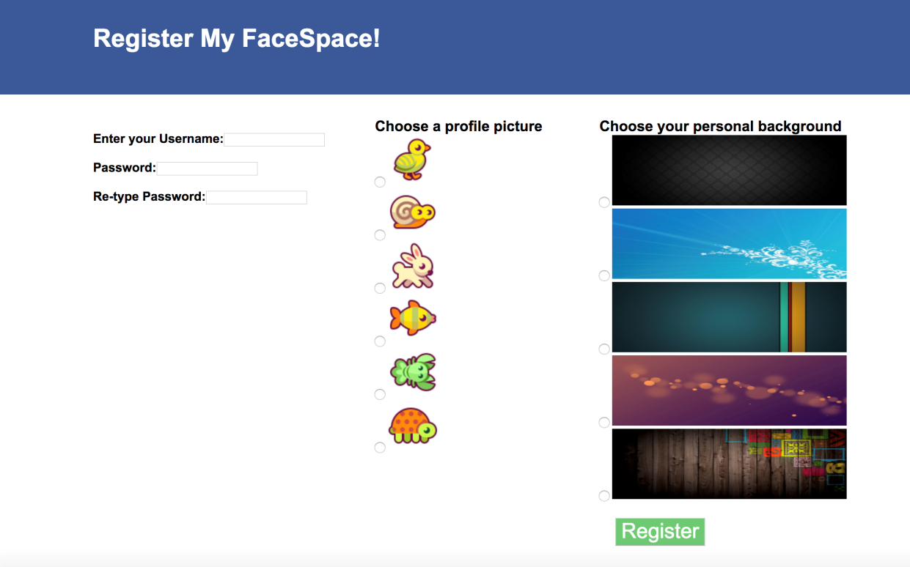
Register
Username
Primary Key
Password
Re-enter
Icon
Choice of 6
Background
Choice of 5

Slide 9

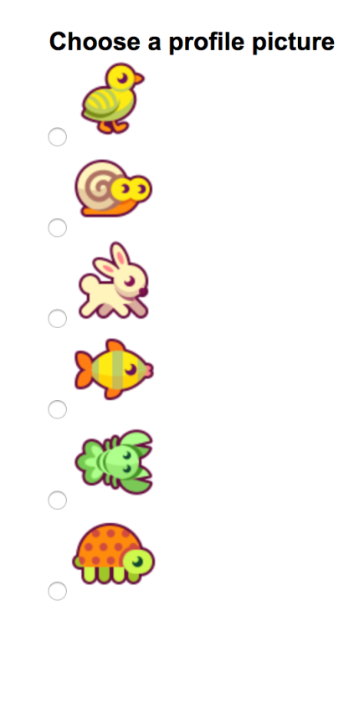

Register
Icon
Background
Now With Preview
Position:absolute

Slide 10
Preview details
HTML
type="radio“
onclick='check_logo(n)
onclick='check_back(n)
JS
function check_logo(n)
switch (n) {
case 1:
doc.getEleById(“p1").innerHTML = "<img src='./bird.png'>";

Slide 11
Login/logout
UPDATE project3
SET LoggedIn='1'
WHERE …;
UPDATE project3
SET LoggedIn='0'
WHERE …;
session_destroy();
header(home);

Slide 12
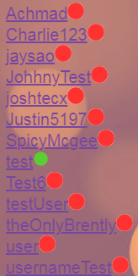
Online/offline
if($Logged==0)
Print(“<img>red”)
Else
Print(“<img>green”)

Slide 13
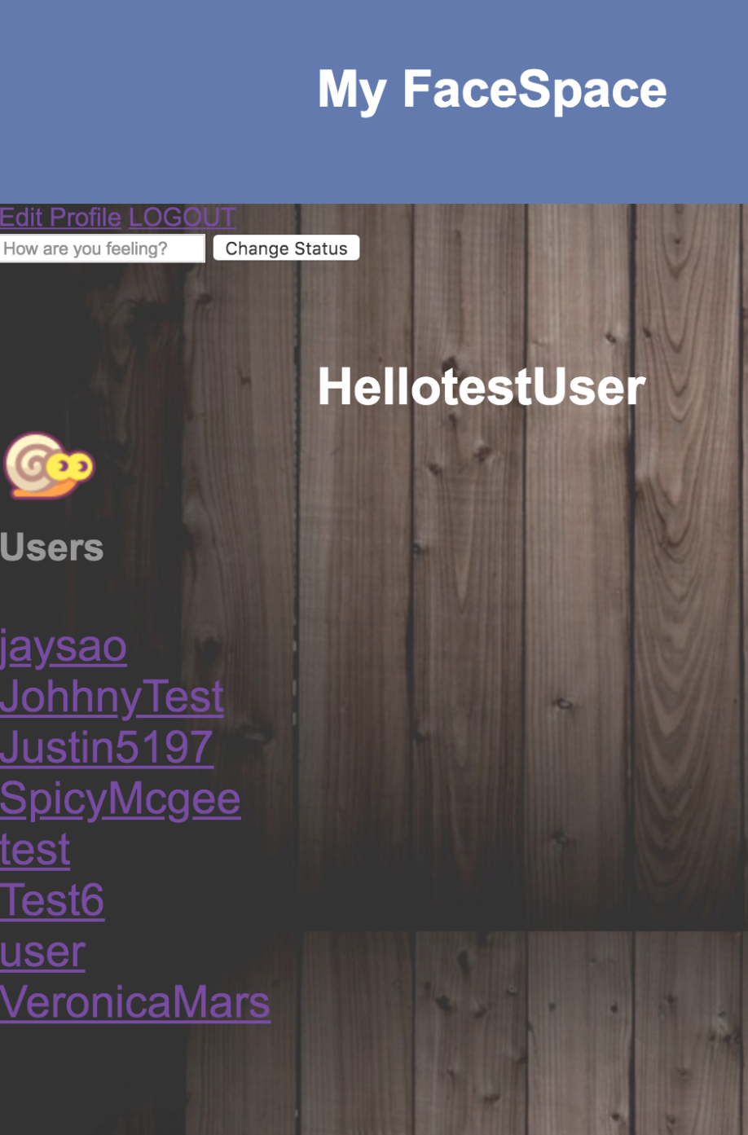
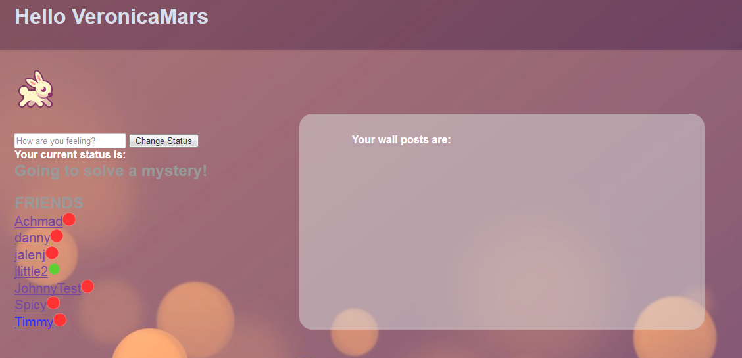
User_home

Slide 14
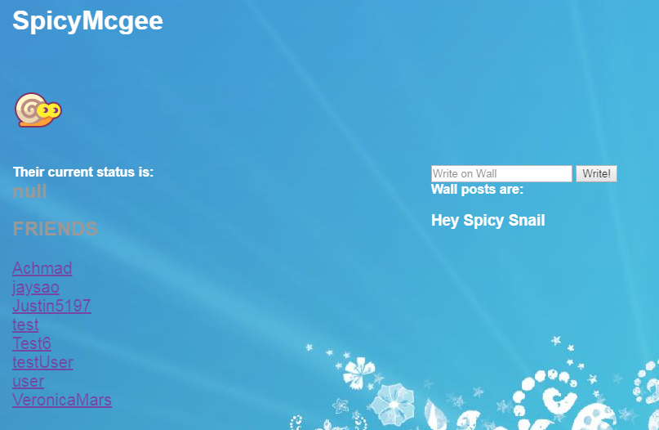
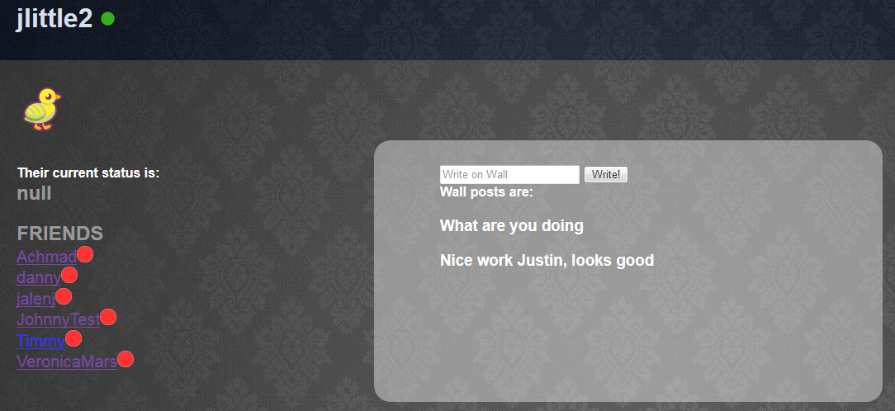
Friend_home

Slide 15
Friend_home
All friend links go to same friend_home.php
Display based on following
<a href='friend_home.php?fname=$friends'>
Doesn’t display status edit
Displays wall post
$sql2 = "UPDATE wallposts SET Wall1='$wall' WHERE Username='$fname'";

Slide 16
Testing
Logging in and out
Ensure database updates
Comparing printed value and database value
Checking other users values

Slide 17
testing
User_home
Updating Status
Showing the current users status
Different $_SESSION based on logged in user or friend
Friend_home
Able to write on wall
Showing wall posts that belong to that user
Iterate through “null” values to write to the next wall space

Slide 18
Linked db
PROBLEM
Error when posting on wall
Old users were not linked
Removed all users
Added Log value
Added Sec Q
Added Linked DB
SOLUTION
Delete from … where username = ‘’

Slide 19
Linked db
PROBLEM
Accidentally made linked wall posts VARCHAR(20)
Previously VARCHAR(90)
SOLUTION
ALTER TABLE wallposts modify column … VARCHAR(90)

Slide 20
http://codd.cs.gsu.edu/~abaskara1/Project3/home.html

