Slide 1

1.1 Introduction to Java

Slide 2
You will learn:
Why Java?
Java compilation and bytecode
Install Java Development Kit

Slide 3
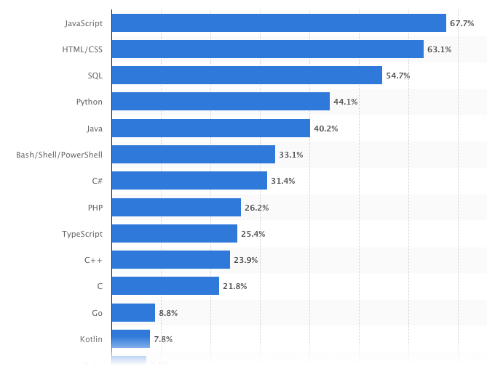
CSC 122
CSC 276
CSC 175/275
https://www.statista.com/statistics/793628/worldwide-developer-survey-most-used-languages/

Slide 4
Java
Object-Oriented Programming Language
General purpose
Class based
Write once, run anywhere (wora)

Slide 5
Principles of Software Engineering
Portability: effort to transfer a program from one hardware configuration and/or software system environment to another
Interoperability: effort to link one system to another
Reusability: effort to reuse code
Maintainability: effort to correct errors in code
Extendability: effort to incorporate new or extend facilities into a software system

Slide 6
What about Java?
Addresses above issues
Natural way of structuring the world
Objects
Attributes
Behavior
Messages
Means to achieve high quality by
Information hiding
Abstraction
Modularization
Reuse

Slide 7
Sample Java Code
import java.util.Scanner; // Scanner class for reading in inputs
public class UtilityBill
{
public static void main (String[] args)
{
Scanner input = new Scanner (System.in); // for keyboard input
System.out.print (”Enter an integer and a decimal value: "); //display
int num1 = input.nextInt(); // reading in an integer
double num2 = input.nextDouble(); // reading in a double value
System.out.println ("num1 = " + num1 + " and num2 = " + num2 ); // display and go to next line
} // end main
} // end class UtilityBill

Slide 8
Steps to run your program
Save as UtilityBill.java (same name as the class and in plain text file)
To complile: javac UtilityBill.java
To run: java UtilityBill
Make sure the text editor is set to be plain text (not rich text) in Options (Windows) or Preferences (Mac) before typing your code.
Also take note of where you saved the .java file (source code).

Slide 9
Java APIs
aka Java APIs (Application Programming Interfaces).
Rich collections of existing classes and methods
Everything goes in a class
Use Java API classes and methods instead of writing your own versions
Example:
import java.util.Scanner;
https://docs.oracle.com/javase/8/docs/api/
Notes:
Show Java API online

Slide 10
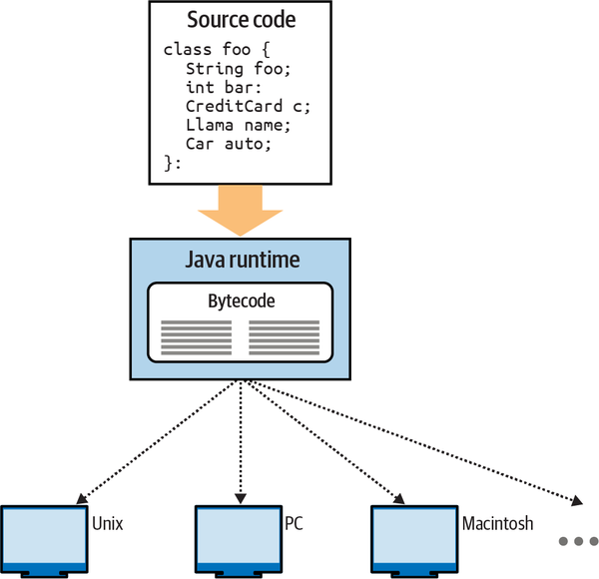
Portable executables
javac – compiles java code to bytecode
bytecode – virtual machine instructions (machine independent 🡪 portable)
write-once-run-anywhere
Image: Learning Java, 6th Edition Marc Loy, Patrick Niemeyer, Daniel Leuck

Slide 11
Java Virtual Machine (JVM)
JVM
byte code to machine code translation
java command invokes JVM
run on class that contains main method

Slide 12
Creating, Compiling And Running Java Programs
Source
Type a Source Code file in a text editor (e.g., Notepad, emacs), name it as
Filename.java
Compiler
To Compile :
javac Filename.java
Output bytecode
Filename must be the same as class name.
Compiled file:
Filename.class
JVM
Just In Time (JIT) Compiler
To Run :
java Filename
Note:
Different from C++
C++ files are compiled directly to machine language
To :
Machine language
Notes:
Introduction to CPSC 233
12

Slide 13
Some features
Code in main method will be executed.
A class can have at most one main method.
An application must have at least one main method (not one main method per class)
An application can have many classes, but usually only one main method.
Method signature: public static void main (String[] args)

Slide 14
About Java Bytecode
Bytecodes are executed by the Java Virtual Machine (JVM)—a part of the JDK and the Java platform.
Virtual machine (VM)—a software application that simulates a computer
Hides the underlying operating system and hardware from the programs that interact with it.
Provides portability
Same VM is implemented on many computer platforms; therefore a bytecode can be executed on all those platforms (bytecodes are platform independent)
Provides security
Bytecode runs only within the JVM
JVM enforces strong security to make sure bytecodes arriving over the network do not damage your files or your system (as computer viruses and worms might).

Slide 15
Hello World Java Program
HelloWorld.java
public class HelloWorld
{
public static void main (String[] args)
{
System.out.println(“Hello World!”);
}
}
To compile:
javac HelloWorld.java
Output file:
HelloWorld.class
To run:
java HelloWorld

Slide 16
Download Java Development Kit (JDK)
Follow instructions to install Java JDK
on windows 10: https://www.youtube.com/watch?v=IJ-PJbvJBGs
on Mac: https://www.youtube.com/watch?v=mE7WyUrD_nY
Write the Hello World program using an editor of your choice:
Windows editors: Notepad, Notepad++, EditPlus, jEdit, …
Linux editors: vi, emacs, pico
Mac: TextEdit
Make sure you save the program with .java extension (Java source code file).

Slide 17
1.2 Introduction to OOP

Slide 18
You will learn:
Demo coding Hello world in a plain text editor

Slide 19
1.3 Introduction to OOP

Slide 20
You will learn:
Coding in a plain text editor
IDEs
Install Eclipse

Slide 21
Plain Text Editor
Use an editor of your choice (make sure it is plain text):
Windows editors: Notepad, Notepad++, EditPlus, jEdit, …
Linux editors: vi, emacs, pico
Mac: TextEdit
Save the program with .java extension (Java source code file).

Slide 22
First Java Program
Use a plain text editor to type in the following
public class HelloWorld
{
public static void main (String[] args)
{
System.out.println (“Hello world!”);
}
}
Save as HelloWorld.java (must be plain text, not rtf so you may need to go to options/preferences in your editor to select plain text)
Run command prompt (Windows) / terminal (Mac)
Go to the folder where HelloWorld.java is saved
To compile, type javac HelloWorld.java
To run, type java HelloWorld

Slide 23
Basic command line commands
ls or dir – find the content in current directory/folder
cd .. – go back up a level
cd <folder name> - go to a subfolder
cd <path name> - go to a specific folder
pwd – find the current path

Slide 24
Let’s add some stuff…
Use a plain text editor to type in the following
import java.util.Scanner;
public class Adder
{
public static void main (String[] args)
{
Scanner input = new Scanner (System.in);
int num1, num2;
System.out.println (“Enter an integer: ”);
num1 = input.nextInt();
System.out.println (“Enter another integer: ”);
num2 = input.nextInt();
System.out.println(“Sum is ” + (num1 + num2));
}
}
Save as Adder.java
To compile on Command Prompt/Terminal, type javac Adder.java
To run, type java Adder

Slide 25
Exercise: Programming
Write a program to ask user to enter their height in inches, then display the height in feet and inches.

Slide 26
A Java source code file must end with the ________ file extension.
The _________ command from the JDK executes a Java application.
The _________ command from the JDK compiles a Java program.
When a Java program is compiled, the file produced by the compiler ends with the __________ file extension.
The file produced by the Java compiler contains __________ that are executed by the Java Virtual Machine.
The ability of a language to let a programmer develop a program on computer system that can be run on other systems is called ________________.
Name the five good criteria for good software.
Quick Check
Notes:
Java
Java
Javac
Class
Bytecode
Portability
Portability, Interoperability, Maintainability, Extendability, Reuse

Slide 27
A Java source code file must end with the .java file extension.
The java command from the JDK executes a Java application.
The javac command from the JDK compiles a Java program.
When a Java program is compiled, the file produced by the compiler ends with the .class file extension.
The file produced by the Java compiler contains bytecode that are executed by the Java Virtual Machine.
The ability of a language to let a programmer develop a program on computer system that can be run on other systems is called portability.
Name the five good criteria for good software. (portability, interoperability, maintainability, extendability, reuse)
Quick Check
Notes:
Java
Java
Javac
Class
Bytecode
Portability
Portability, Interoperability, Maintainability, Extendability, Reuse

Slide 28
Java IDEs
IDEs provide tools that support the software development process
Includes tools for editing, compiling, running and debugging (locate logic errors).
Popular IDEs
Eclipse (www.eclipse.org) – I will be using this.
NetBeans (www.netbeans.org)
IntelliJ (https://www.jetbrains.com/idea)
jGRASP™ IDE (www.jgrasp.org)
Geany (www.geany.org)
DrJava IDE (www.drjava.org/)
BlueJ IDE (www.bluej.org/)

Slide 29
Install Eclipse
Install Eclipse IDE on Windows 10:
https://www.youtube.com/watch?v=N-wXTRpR03U
Install Eclipse IDE on Mac:
https://www.youtube.com/watch?v=vOF35qsWn8M
Follow the instructions, write and run a Hello World program on Eclipse.

Slide 30
1.4 Introduction to OOP

Slide 31
You will learn:
Object Oriented Programming
Classes vs. Objects
UML – Unified Modeling Language
Information hiding
Code Reuse
Inheritance

Slide 32
OOP based on observation that the world consists of objects: people, courses, trees, automobiles, … they are all objects!
An object has
Attributes: e.g., name, color, size, …
Behaviors or Actions (called methods): these are procedures applicable to the object. e.g., accelerate a car, student enrolls in a course, …
When an object performs an action, it affects itself and/or other objects
OOP: a program is a collection of objects that interact with each other via actions
Notes:
Important: A car object can accelerate. A student cannot accelerate. A car cannot enroll in a course. Such separation is possible with OOP – accelerate is a method of car and not of student. Therefore, a student cannot perform the action “accelerate”. Similarly enroll in a course is not an action for car – so a car cannot enroll in a course.
In procedural programming – there is a procedure defined for accelerate, and a procedure for enrolling in a course. These procedures are global, and will take parameters – we should ensure that we pass car as parameter to accelerate, and student to enroll in a course. It would be good if accelerate procedure is not global – and is defined only within car (similarly enroll in a course) – this is exactly achieved by OOP.

Slide 33
Object = data + behavior
Tight coupling
Software = Collection of objects that send each other messages
m1
m2
m5
m4
m3

Slide 34
Non-Object-Oriented Approach
Object-Oriented Approach
Type
Lion = record
:
end;
: :
procedure run ();
begin
:
end;
public class Lion
{
private int height;
private int weight;
public void run ()
{
:
}
}

Slide 35
Procedural approach (CSC 175)
Design and build software in terms of actions (verbs)
Object-Oriented approach (CSC 275/276)
Design and build software in terms of things (nouns)

Slide 36
Break down the program by what it does (described with actions/verbs)
Word Processor
File
Edit
…
Help
Creating new document
Opening a document
Saving a document
…
Exiting program

Slide 37
Break down the program into ‘physical’ components (nouns)
Zoo
Animals
Amphibians | Fish
Bird | Insects
Mammals | Reptiles
Staff
Trainer | Janitor
Feeder | Gatekeeper

Slide 38
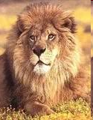


Mammals
Lion
Monkey
Polar Bear
…

Slide 39
What information can be used to describe the lion? (Attributes)
What can the lion do? (Behaviors)

Slide 40

Represents information (characteristics) about a lion:
Species
Size
Prey
Name
Age
…

Slide 41
Represents what the lion can do/behave (the verb/action part):
Howl
Attack
Run
…

Slide 42
Java Class – Simplified UML
Unified Modeling Language
Lion
size species age name prey
howl attack run eatPrey
Class name
Instance variables / fields (attributes)
Methods (behaviors)

Slide 43
Class is modeled in a class diagram as a rectangle with 3 compartments
Top = name of class
Middle = class’s attributes/instance variables
Bottom = class’s operations/methods
Operations are modeled by method name preceded by an access modifier
Access modifiers
+ indicates public
# indicates protected
- indicates private
Notes:
If you want to generate UML diagrams from Java code with Eclipse, you can try http://objectaid.com/
See that it is available as a plugin, install as specified at http://objectaid.com/installation
The UML diagrams generated by ObjectAid will look slightly different from what is shown in the textbook – ObjectAid will show the default constructor, also explicitly say that a method returns void.

Slide 44
<Name of Class>
<attribute name>:<data type>
<method name>()
Lion
size:double species:String age:int name:String prey:String[]
howl () attack () run () eatPrey ()

Slide 45
<Name of Class>
<access modifier><attribute name>:<data type>
<access modifier><method name> (p1: p1type; p2 : p2 type..): <return type>
Lion
-size : double -species : String -age : int -name : String -prey : String[]
+howl () : void +attack () : void +run (speed : double; distance : double) : double +eatPrey () : boolean
Notes:
For the first assignment, students are required to draw class diagrams like this.

Slide 46
For each of the following system, first decide on classes to include, then create class diagrams using UML.
Hospital
Car dealership
Home entertainment system
Bank
Supermarket

Slide 47

OOP Principles: Object vs. Class
Class = set of programming statements that define a blueprint for objects of the same type with attribute names and types, and methods
Objects of the same type belong to the same class.
Objects of a class have a common set of methods and the same kinds of data (attributes)
Each object can have its own data values.
An object is an instantiation of a class (cookie vs. cookie recipe)
An object is also called an instance of a class
We can have many instantiations of a class (hence many objects of a class)
Image: https://www.annclark.com/products/gingerbread-man-cookie-cutter-3-in
Notes:
Using a house blueprint as example: it has rooms, doors, windows, wires, pipes, switches, and it has actions that can be acted upon them like turning on a switch, open a door/window, flush toilet (then water level sinks followed by increasing water level).

Slide 48
OOP Principles: Object vs. Class
Each object has
Values for attributes
Student: Adam object has name = Adam, ID = 1, major = CIS, …
Student: Eve object has name = Eve, ID = 2, major = CSC, …
Methods
Student: Adam and Student: Eve both can enroll in courses
An object does not know the values for attributes of other objects
Student: Adam does not know the ID of Student: Eve
A method call is a message that tells an object to perform a task (E.g., when Student: Adam enrolls in a course, a message is sent to Student: Adam object to perform the task).

Slide 49
Example: Class and Objects
The Student class defines the attributes (name, id, major, …) and methods (enroll, drop, …) that will exist in all objects that are instances of the Student class.
Object: Adam
Adam object is an instance of the Student class.
class
Student
-name:String
-id: int
-major:String
:
:
Eve object is an instance
of the Student class.
+enroll (courseNo:int):void
+drop (courseNo:int):void
:
:
Object: Eve

Slide 50
OOP principles: Encapsulation /Information Hiding/Data Hiding
The data and methods associated with any particular class are encapsulated (“put together in a capsule”)
only part of the contents is made accessible.
protects attributes from accidental corruption by outside objects.
E.g., student ID may not be modifiable
hides the details of how an object works, so the programmer can concentrate on using it.
E.g., details about enrolling in course can be hidden
maintainer of the object can modify the internal functioning of the object without “breaking” someone else’s code.

Slide 51
OOP Principles: Code Reuse
Once a class is defined, we can create many instances (i.e., objects) of the class
These instances have the same attributes (with different values)
These instances have the same methods
Reuse saves time and effort
Reuse helps build more reliable and effective systems, because existing classes and components often have gone through extensive testing, debugging and performance tuning.

Slide 52
OOP Principles: Inheritance
Inheritance is the ability of a child class to extend the capabilities of a parent class
Child class absorbs the features of parent class
Child class can add unique characteristics of its own

Slide 53
Example: Inheritance
Student
name
id
major
enroll ()
Student represents all of the generic attributes (name, id, major) and methods (enroll in a course) of a student.
Student is the parent class. UndergradStudent and GradStudent are child classes of Student class.
is-a
UndergradStudent has additional unique attribute highSchool and method joinClub
UndergradStudent
highSchool
joinClub ()
GradStudent
undergradCollege
joinResearchGroup ()
GradStudent has additional attribute undergradCollege and method joinResearchGroup

Slide 54
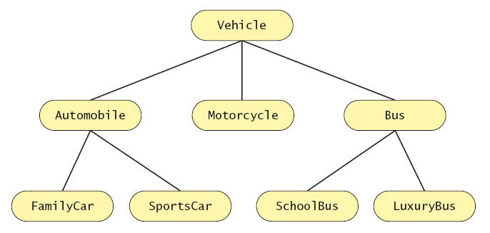
Inheritance: Another Example (src: Savitch)

Slide 55

Details about how a Student class implements enrolling in a course is hidden from Course objects. What is this principle called?
Reusability
Inheritance
Encapsulation
Unbreakable code
Messaging
Quick Check
Notes:
C

Slide 56
How does Java provide security even while running third party programs obtained over the Internet?
Encapsulation provides the security needed.
Transmitting Java bytecode ensures that we cannot see the original source code.
JVM ensures .class files cannot do bad things.
Information hiding provides the security needed.
None of the above.
Quick Check
Notes:
C

