Slide 1
10.1 GUI
javax.swing.JOptionPane class
showMessageDialog() & showInputDialog() - Static methods
PLAIN_MESSAGEWARNING_MESSAGE, INFORMATION_MESSAGE, ERROR_MESSAGE, QUESTION_MESSAGE - Static Fields (int)
Notes:
Code Samples Available at http://media.pearsoncmg.com/ph/esm/deitel/java_htp9e/code_examples/code_examples.html

Slide 2
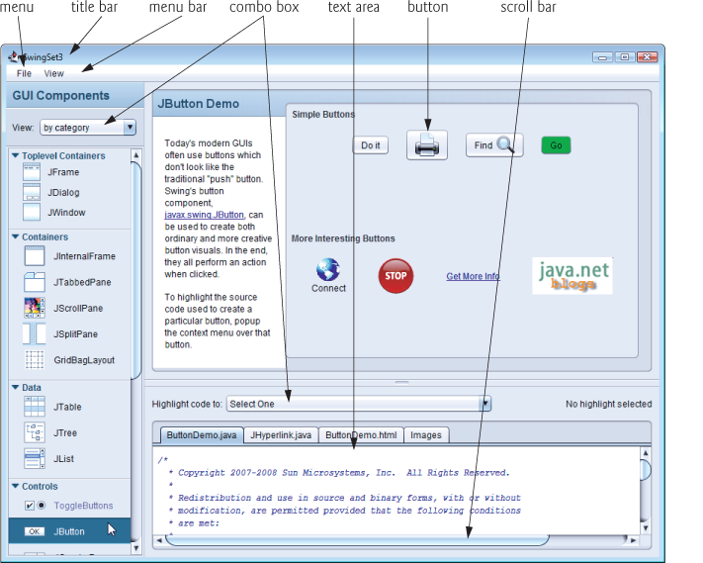
GUI Packages
javax.swing.*
java.awt.*
java.awt.event.*

Slide 3
Java Swing
Java swing (package: javax.swing) contains many classes that help create GUIs.
GUI components facilitate data entry and presentation of outputs to user

Slide 4
Dialog Box – GUI-based input/output
JOptionPane static method showMessageDialog displays a dialog box containing a message
Takes 2 arguments:
first argument is the “component” where the dialog box should appear. We use null, then box displayed at center of screen
Second is the string to display in the box
All these dialogs are modal (i.e., each showXxxDialog method blocks the caller until the user interaction is complete)

Slide 5
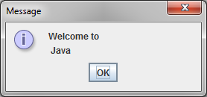
import javax.swing.JOptionPane;
public class Dialog1 {
public static void main(String[] args) {
JOptionPane.showMessageDialog(null, "Welcome to \n Java");
}
}
Typically, dialog boxes are windows in which programs display important messages to users.
Class JOptionPane provides prebuilt dialog boxes that enable programs to display windows containing messages—such windows are called message dialogs.
http://docs.oracle.com/javase/tutorial/uiswing/components/dialog.html

Slide 6
JOptionPane.showInputDialog
import javax.swing.JOptionPane;
public class Dialog1 {
public static void main(String[] args) {
String name = JOptionPane.showInputDialog("What is your name?");
String message = String.format ("Welcome, %s, to Java", name);
JOptionPane.showMessageDialog(null, message, "Welcome", JOptionPane.PLAIN_MESSAGE);
}
}
JOptionPane.showInputDialog returns a reference to String typed in by the user
If we press the dialog’s cancel button or the Esc key, the method returns null
String.format()is similar to System.printf(); except a reference to the formatted String is returned
We could have used: String message = "Welcome, " + name + ", to Java";
Additional arguments to showMessageDialog: the third argument is the title of the dialog box; the fourth argument specifies icon to be shown in the dialog box (JOptionPane.PLAIN_MESSAGE means no icon is shown in the dialog box). Try also WARNING_MESSAGE, QUESTION_MESSAGE (see next slide)
Notes:
More constants:
WARNING_MESSAGE
QUESTION_MESSAGE

Slide 7
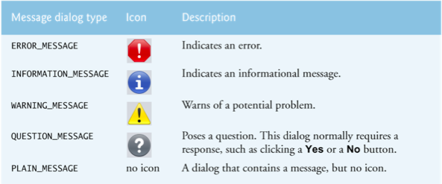
Message dialog constants
Notes:
0 - ERROR_MESSAGE
1 – PLAIN_MESSAGE
2 – WARNING_MESSAGE
3 – PLAIN_MESSAGE?
4 – invalid constant

Slide 8
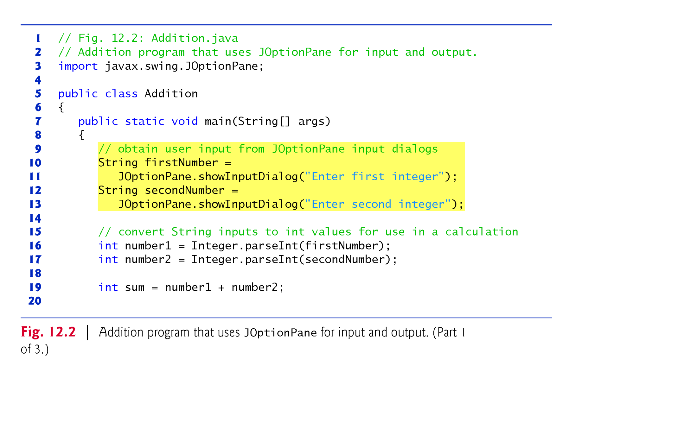
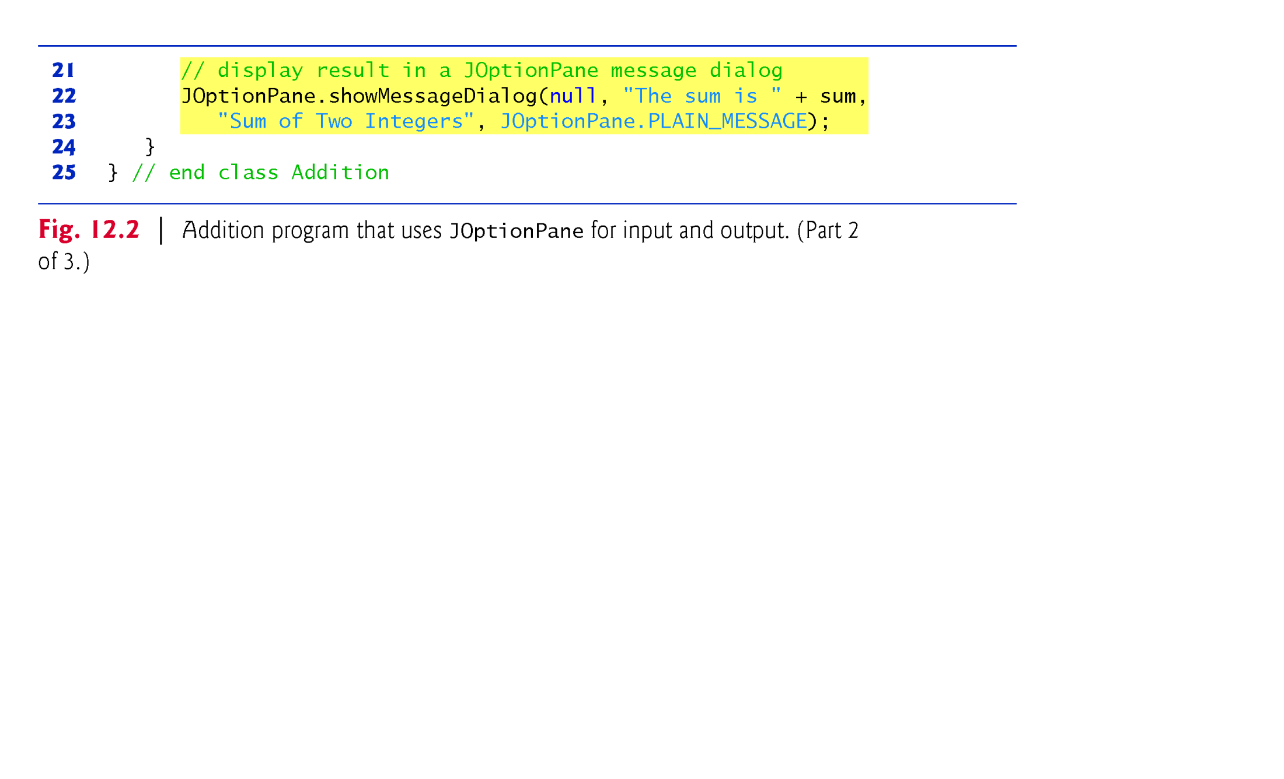

Slide 9
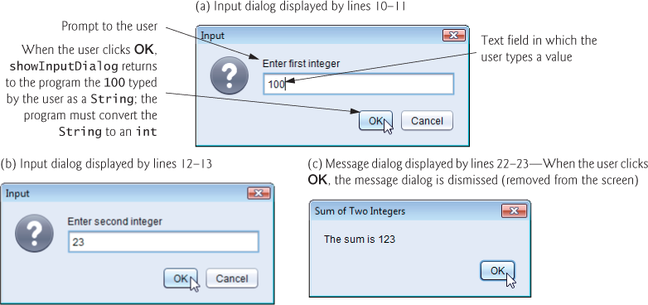

Slide 10
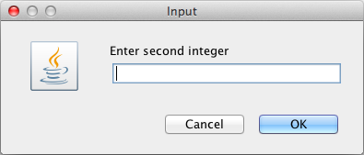
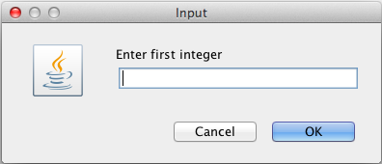
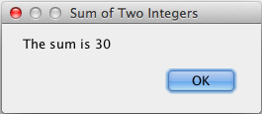

Slide 11
10.2 GUI
Basic Swing components & Layout Managers
JFrame (default: BorderLayout)
Jpanel (default: FlowLayout)
JButton, JLabel, JTextField
Layout Managers: BorderLayout, FlowLayout, BoxLayout, GridLayout, GradBagLayout
Notes:
Code Samples Available at http://media.pearsoncmg.com/ph/esm/deitel/java_htp9e/code_examples/code_examples.html

Slide 12
Swing Components
Swing GUI components located in package javax.swing.
Swing GUI components look-and-feel across platforms.
Abstract Window Toolkit (AWT) in package java.awt
AWT GUI components display differently on different platforms.

Slide 13
GUI: Colors and Filled Shapes
Colors displayed on the screen have red, green, blue (RGB) values – each value is an integer between 0 and 255.
The higher the value of a component, the richer that shade will be in the color.
java.awt.Color class has 13 predefined colors (p. 224)
BLACK, BLUE, CYAN, GRAY, DARK_GRAY, LIGHT_GRAY, GREEN, MAGENTA, RED, ORANGE, PINK, YELLOW & WHITE
Also Color constructor allows multiple ways of constructing a Color object
Graphics methods: fillRect, fillOval, setColor

Slide 14
import java.awt.Color;
import java.awt.Graphics;
import javax.swing.JPanel;
public class DrawSmiley extends JPanel {
public void paintComponent(Graphics g) {
super.paintComponent(g);
// draw the face
g.setColor(Color.YELLOW);
g.fillOval(10, 10, 200, 200);
// draw the eyes
g.setColor(Color.BLACK);
g.fillOval(55, 65, 30, 30);
g.fillOval(135, 65, 30, 30);
// draw the mouth
g.fillOval(50, 110, 120, 60);
Example on p. 224 (Deitel)
// turn it into a smile
g.setColor(Color.YELLOW);
g.fillRect(50, 110, 120, 30);
// touch up the mouth
g.fillOval(50,120,120,40);
} // end method paintComponent
} // end class DrawSmiley

Slide 15
import javax.swing.JFrame;
public class DrawSmileyTest {
public static void main(String[] args) {
DrawSmiley panel = new DrawSmiley();
JFrame frame = new JFrame();
frame.setDefaultCloseOperation(JFrame.EXIT_ON_CLOSE);
frame.setSize(230,250);
frame.add(panel);
frame.setVisible(true);
} // end method main
} // end class DrawSmileyTest

Slide 16
GUI and Graphics
Graphics.fillArc(…) similar to Graphics.fillOval(…), but takes in 2 more parameters that specifies how much of the oval to fill (measured in degrees)
Specify start angle, and angle to be covered
For instance specifying these 2 parameters as 0, 180 draws a semi-circle starting at 0 degrees
Remember, the first 4 parameters specify the rectangle (just as in fillOval)
setBackground(Color) used to specify the background color of any GUI Component

Slide 17
import java.awt.Color;
import java.awt.Graphics;
import javax.swing.JPanel;
import javax.swing.JFrame;
public class DrawRainbow extends JPanel {
private final static Color VIOLET = new Color(128, 0, 128);
private final static Color INDIGO = new Color(75, 0, 130);
private Color[] colors = { Color.WHITE, Color.WHITE, VIOLET, INDIGO,
Color.BLUE, Color.GREEN, Color.YELLOW, Color.ORANGE, Color.RED
};
public DrawRainbow() {
setBackground(Color.WHITE);
} // end constructor

Slide 18
public void paintComponent(Graphics g) {
super.paintComponent(g);
int radius = 20;
// draw rainbow near bottom center
int centerX = getWidth()/2;
int centerY = getHeight() – 10;
// draw filled arcs from the outermost
for (int i = colors.length; i > 0; i--) {
g.setColor(colors[i- 1]);
g.fillArc(centerX - i * radius, centerY - i * radius, i * radius * 2, i * radius * 2, 0, 180);
}
} // end method paintComponent
public static void main(String[] args) {
JFrame frame = new JFrame();
DrawRainbow panel = new DrawRainbow();
frame.setDefaultCloseOperation(JFrame.EXIT_ON_CLOSE);
frame.add(panel);
frame.setSize(400, 250);
frame.setVisible(true);
} // end method main
} // end class DrawRainbow

Slide 19
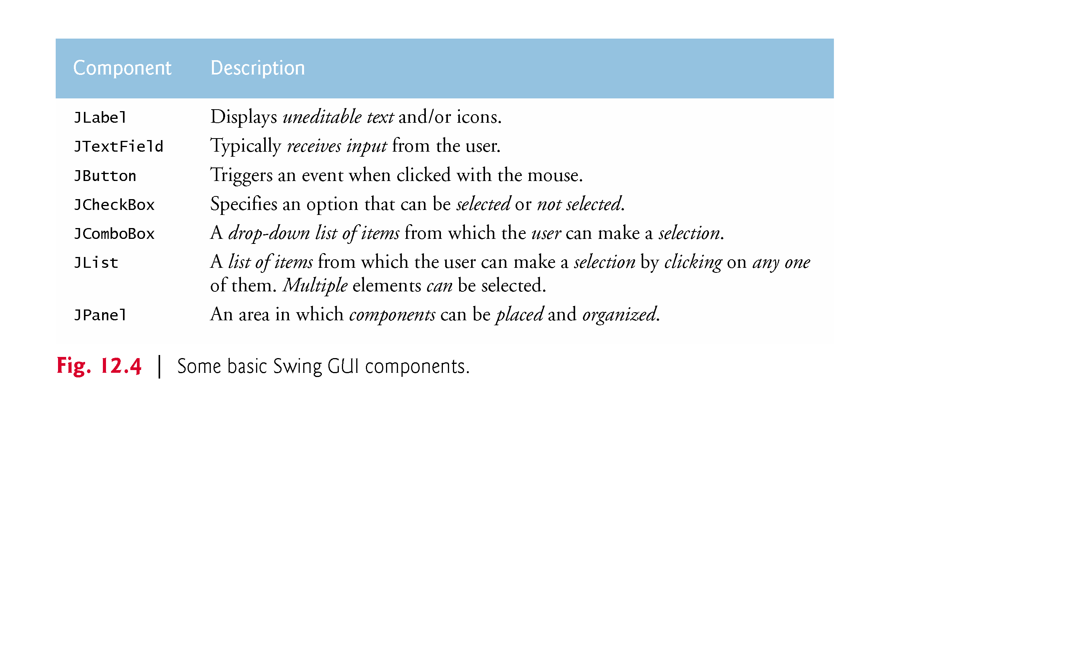
Basic Swing GUI components

Slide 20
Swing GUI Components
JPanel – an area other components can be placed
JButton – trigger an event when clicked with a mouse
JLabel – uneditable text or graphics to provide info
JTextfield – receives keyboard input & editable
JList – a list of items for selection; multiple items may be selected
JCheckBox– specify an option: select/unselect
JComboBox – dropdown list for users to select

Slide 21
GUI Components
Frame – window (title bar, menu bar, max/min/close buttons)
Panel – can hold other components
Button – clickable with text/graphics
Label – text or graphics to provide info
Text field/area – display keyboard input & editable
Drop-down List – group of related items for selection
Checkbox & Radio Button – selected/unselected

Slide 22
JFrame and JPanel
Window that can contain Swing GUI components
JFrame f = new JFrame(); // no-argument constructor
JFrame f = new JFrame(“Java if fun”); // title of frame
JPanel
JPanel p = new JPanel();
f.getContentPane().add(p);

Slide 23
JButton
Generates an ActionEvent when clicked
JButton b1 = new JButton(); // without label
JButton b2 = new JButton (“Save”); // labeled Save
p.add(b1); // p references a JPanel
p.add(b2);

Slide 24
JFrame
Window that can contain Swing GUI components
JFrame f = new JFrame ();
JFrame f = new JFrame (“Java if fun”); // title of frame

Slide 25
Layout Managers
Several layout managers provided by Java
BorderLayout, BoxLayout, GroupLayout, …
BorderLayout is default for a frame’s container pane.
In this example, we add several JLabel components to a Jframe
We used method JFrame.add(Component comp, Object constraints) – JFrame inherited this method from its superclass java.awt.Container
Constraints depend on the LayoutManager used – BorderLayout defines 5 constraints (which are Strings):
BorderLayout.CENTER, BorderLayout.NORTH, BorderLayout.SOUTH, BorderLayout.EAST, BorderLayout.WEST

Slide 26
Layout Managers
BorderLayout
FlowLayout
BoxLayout
GridLayout
GridBagLayout

Slide 27
BorderLayout
Default layout for JFrame
One component per region
North
West
Center
East
South
Notes:
JPanel top = new JPanel(new GridLayout(1,2))
JPanel left = new JPanel();
JPanel right = new JPanel();
top.add(left);
top.add(right);
JFrame frame = new JFrame();
frame.add(top);
frame.setSize(400,400);
frame.setVisible(true);

Slide 28
BorderLayout
JFrame f = new JFrame (“GUI Frame”);
JPanel p = new JPanel ();
f.getContentPane().add(BorderLayout.WEST, p);
p.add(new JButton (“New Button”));

Slide 29
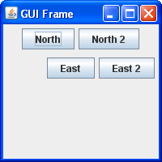
BorderLayout
import javax.swing.*;
import java.awt.*;
public class GUI {
JFrame f= new JFrame ("GUI Frame");
JPanel pEast = new JPanel ();
JPanel pNorth = new JPanel ();
public void go(){
f.getContentPane().add(BorderLayout.EAST, pEast);
f.getContentPane().add(BorderLayout.NORTH, pNorth);
f.setSize(200, 200);
f.setVisible(true);
JButton b2 = new JButton("North");
pNorth.add(b2);
pNorth.add (new JButton("North 2"));
pEast.add (new JButton("East"));
pEast.add (new JButton("East 2"));
}
public static void main(String[] args) {
GUI gui = new GUI();
gui.go();
}
}

Slide 30
FlowLayout
Default for JPanel
Left to right in order they were added
Each component can have own size
Word-wrap

Slide 31
FlowLayout
FlowLayout fl = new FlowLayout(FlowLayout.LEFT, 2, 3);
JPanel p = new JPanel()
p.setLayout (fl);
Alignment: CENTER, LEFT, RIGHT, LEADING, or TRAILING
Horizontal gap and Vertical gap in # of pixel

Slide 32
BoxLayout
Component has own size
Placed in order they were added
Stack vertically or horizontally, e.g.
BoxLayout vBoxLayout = new BoxLayout (centerPanel, BoxLayout.Y_AXIS);
Notes:
BoxLayout vBoxLayout = new BoxLayout (centerPanel, BoxLayout.Y_AXIS);

Slide 33
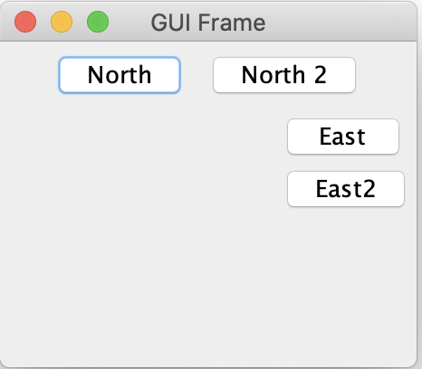
BoxLayout
import javax.swing.*;
import java.awt.*;
public class GUI {
private JFrame f= new JFrame ("GUI Frame");
private JPanel pEast = new JPanel ();
private JPanel pNorth = new JPanel ();
public void go(){
f.getContentPane().add(BorderLayout.EAST, pEast);
f.getContentPane().add(BorderLayout.NORTH, pNorth);
pEast.setLayout(new BoxLayout(pEast, BoxLayout.Y_AXIS));
pEast.add(new JButton("East"));
pEast.add (new JButton("East 2"));
f.setSize(200, 200);
f.setVisible(true);
JButton b2 = new JButton("North");
pNorth.add(b2);
pNorth.add (new JButton("North 2"));
}
public static void main(String[] args) {
GUI gui = new GUI();
gui.go();
}
}

Slide 34
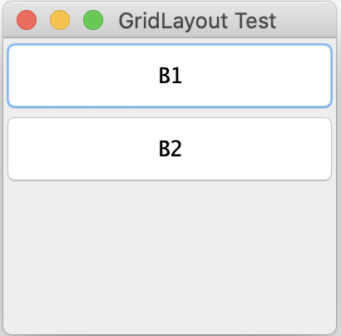
GridLayout
import java.awt.BorderLayout;
import java.awt.GridLayout;
import javax.swing.*;
public class GridLayoutTest {
public static void main(String[] args) {
JFrame f = new JFrame("GridLayout Test");
// GridLayout gr = new GridLayout(4, 6);
GridLayout gr = new GridLayout(4, 6, 2, 3);
JPanel p = new JPanel();
p.setLayout(gr);
JButton b1 = new JButton("B1");
JButton b2 = new JButton("B2");
p.add(b1);
p.add(b2);
f.getContentPane().add(p, BorderLayout.CENTER);
f.setSize(200, 200);
f.setVisible(true);
}
}
# of rows
# of columns
Horizontal gap and Vertical gap in # of pixels
Notes:
B1 and b2 will be placed in the first row in order.
The placement will fulfil the rows first (i.e. it will fixate on the no of rows.
If there are enough components to fill the first column, the components will be placed horizontally then fill the rows.
If there are more components that the row and columns specified, it will be placed horizontally and keep expanding to the right.
For example, if the specified dimension is 2 and 3:
The placement will be:
B1
B2 (when there are only 2 components)
Or
B1 B2
B3 (when there are 3 components)
Or
B1 B2 B3
B4 B5 B6 (when there are 2x3=6 components)
Or
B1 B2 B3 B4 B5
B6 B7 B8 B9 (when there are 9 components)

Slide 35
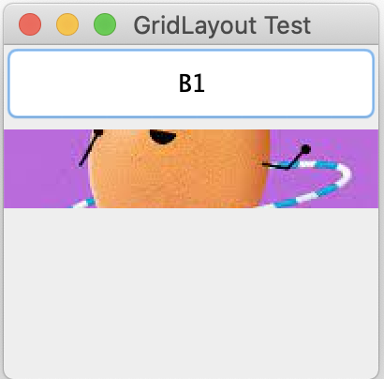
ImageIcon
import java.awt.BorderLayout;
import java.awt.GridLayout;
import javax.swing.*;
public class GridLayoutTest {
public static void main(String[] args) {
JFrame f = new JFrame("GridLayout Test");
GridLayout gr = new GridLayout(4, 6, 2, 3);
JPanel p = new JPanel();
p.setLayout(gr);
ImageIcon image = new ImageIcon("Hoola.jpg");
JButton b1 = new JButton("B1");
JButton b2 = new JButton(image);
//b2.setSize(180,100);
p.add(b1);
p.add(b2);
f.getContentPane().add(p, BorderLayout.CENTER);
f.setSize(200, 200);
f.setVisible(true);
}
}
Put the images inside the Java project folder, not inside src.
Notes:
The image file should be placed inside the java project folder (not inside src).

Slide 36
GridBagLayout
Two dimensional grid layout
Allow programmers to place components in individual cells within a two-dimensional grid
Each cell of this grid is indexed using one number for the column, x, and another number for the row, y.
The top-left cell is at location (x=0, y=0), and column numbers increase going right, while row numbers increase going down.
The programmer can add padding (i.e., empty space) between Swing GUI components.
Notes:
B1 and b2 will be placed in the first row in order.
The placement will fulfil the rows first (i.e. it will fixate on the no of rows.
If there are enough components to fill the first column, the components will be placed horizontally then fill the rows.
If there are more components that the row and columns specified, it will be placed horizontally and keep expanding to the right.
For example, if the specified dimension is 2 and 3:
The placement will be:
B1
B2 (when there are only 2 components)
Or
B1 B2
B3 (when there are 3 components)
Or
B1 B2 B3
B4 B5 B6 (when there are 2x3=6 components)
Or
B1 B2 B3 B4 B5
B6 B7 B8 B9 (when there are 9 components)

Slide 37
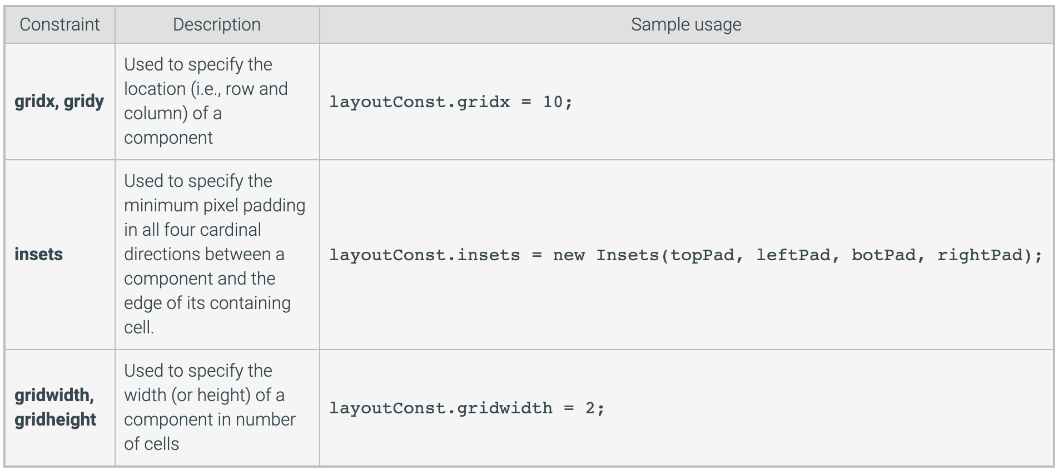
GridBagConstraints
Common layout constraints
Source: zyBook
Notes:
B1 and b2 will be placed in the first row in order.
The placement will fulfil the rows first (i.e. it will fixate on the no of rows.
If there are enough components to fill the first column, the components will be placed horizontally then fill the rows.
If there are more components that the row and columns specified, it will be placed horizontally and keep expanding to the right.
For example, if the specified dimension is 2 and 3:
The placement will be:
B1
B2 (when there are only 2 components)
Or
B1 B2
B3 (when there are 3 components)
Or
B1 B2 B3
B4 B5 B6 (when there are 2x3=6 components)
Or
B1 B2 B3 B4 B5
B6 B7 B8 B9 (when there are 9 components)

Slide 38
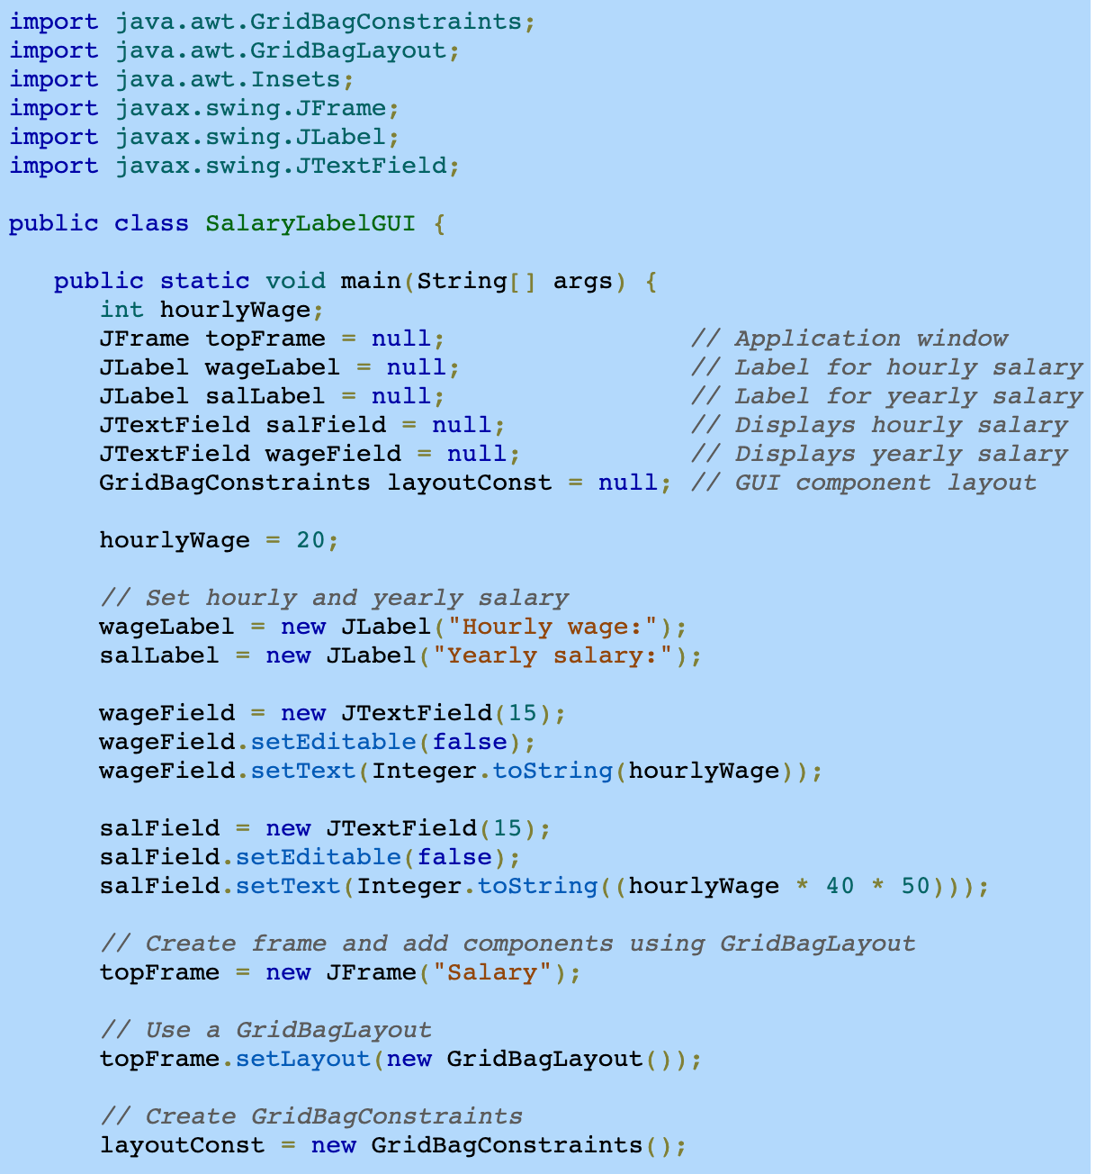
Source: zybook

Slide 39
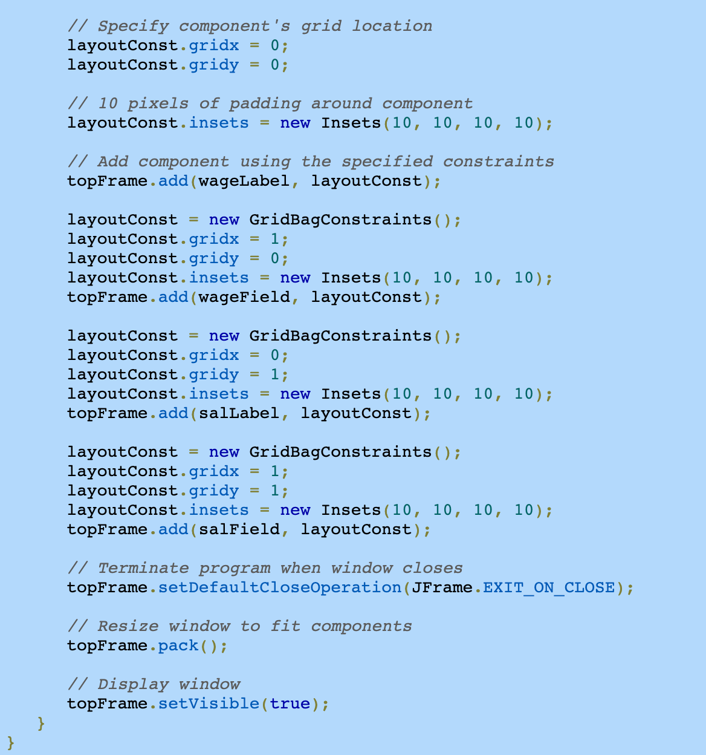

Slide 40
JLabel
Constructors
JLabel (String) –specified text
JLabel (String, int) – specified text and text alignment
JLabel (String, Icon, int)
// int can be SwingConstants.LEFT, CENTER, or RIGHT

Slide 41
Adding Jlabels to JFrame
import java.awt.BorderLayout;
import javax.swing.ImageIcon;
import javax.swing.JLabel;
import javax.swing.JFrame;
public class LabelDemo {
public static void main(String[] args) {
JLabel northLabel = new JLabel("North");
JLabel southLabel = new JLabel("South");
ImageIcon icon = new ImageIcon("GUItip.gif");
JLabel centerLabel = new JLabel(icon);
JFrame frame = new JFrame();
frame.setDefaultCloseOperation(JFrame.EXIT_ON_CLOSE);
frame.add(northLabel, BorderLayout.NORTH);
frame.add(southLabel, BorderLayout.SOUTH);
frame.add(centerLabel, BorderLayout.CENTER);
frame.setSize(300, 300);
frame.setVisible(true);
}
} // end class LabelDemo

Slide 42
JLabel, Icon and ImageIcon
Look up javax.swing.JLabel
Can be used to display text and images
We used constructors
JLabel(String text)
JLabel(Icon image)
Icon is an interface, and ImageIcon is a class that implements this interface
We used constructor ImageIcon(String fileName)
Notes:
This requires the image file available from the last Deitel Example for Chapter 9

Slide 43
JTextField
Constructors
JTextField() – empty text field
JTextField(int) – specified width
JTextField(String, int) – specified text and width
Methods
setEditable(boolean)
isEditable()
setText(String)
getText()
getSelectedText()

Slide 44
10.3 GUI
Demo: GridBagLayout
Notes:
Code Samples Available at http://media.pearsoncmg.com/ph/esm/deitel/java_htp9e/code_examples/code_examples.html

Slide 45
10.4 GUI
Jtextfield & ActionListener & inner class
import java.awt.event.ActionListener;
import java.awt.event.ActionEvent;
actionPerformed(ActionEvent)
getSource()
Inner class to implement ActionListener
Notes:
Code Samples Available at http://media.pearsoncmg.com/ph/esm/deitel/java_htp9e/code_examples/code_examples.html

Slide 46
TextFields and ActionEvents
// Fig. 14.9: TextFieldFrame.java
// Demonstrating the JTextField class.
import java.awt.FlowLayout;
import java.awt.event.ActionListener;
import java.awt.event.ActionEvent;
import javax.swing.JFrame;
import javax.swing.JTextField;
import javax.swing.JPasswordField;
import javax.swing.JOptionPane;
public class TextFieldFrame extends JFrame {
private JTextField textField1; // text field with set size
private JTextField textField2; // text field constructed with text
private JTextField textField3; // text field with text and size
private JPasswordField passwordField; // password field with text

Slide 47
// TextFieldFrame constructor adds JTextFields to JFrame
public TextFieldFrame() {
super( "Testing JTextField and JPasswordField" );
setLayout(new FlowLayout()); // set frame layout
// construct textfield with 10 columns
textField1 = new JTextField(10);
add(textField1); // add textField1 to JFrame
// construct textfield with default text
textField2 = new JTextField("Enter text here");
add(textField2); // add textField2 to JFrame
// construct textfield with default text and 21 columns
textField3 = new JTextField("Uneditable text field", 21);
textField3.setEditable(false); // disable editing
add(textField3); // add textField3 to JFrame
// construct passwordfield with default text
passwordField = new JPasswordField("Hidden text");
add(passwordField); // add passwordField to JFrame
// register event handlers
TextFieldHandler handler = new TextFieldHandler();
textField1.addActionListener(handler);
textField2.addActionListener(handler);
textField3.addActionListener(handler);
passwordField.addActionListener(handler);
} // end TextFieldFrame constructor

Slide 48
// private inner class for event handling (i.e. This class is inside TextFieldFrame class)
private class TextFieldHandler implements ActionListener {
// process textfield events
public void actionPerformed( ActionEvent event ) {
String msg = ""; // declare string to display
// user pressed Enter in a JTextField
if ( event.getSource() == textField1 )
msg = String.format( "textField1: %s”, event.getActionCommand() );
else if ( event.getSource() == textField2 )
msg = String.format( "textField2: %s”, event.getActionCommand() );
else if ( event.getSource() == textField3 )
msg = String.format( "textField3: %s", event.getActionCommand() );
else if ( event.getSource() == passwordField )
msg = String.format( "passwordField: %s”, event.getActionCommand() );
JOptionPane.showMessageDialog( null, msg); // display JTextField content=
} // end method actionPerformed
} // end private inner class TextFieldHandler
public static void main( String[] args )
{
TextFieldFrame textFieldFrame = new TextFieldFrame();
textFieldFrame.setDefaultCloseOperation( JFrame.EXIT_ON_CLOSE );
textFieldFrame.setSize( 350, 100 ); // set frame size
textFieldFrame.setVisible( true ); // display frame
} // end main
} // end class TextFieldFrame

Slide 49
public static void main( String[] args )
{
TextFieldFrame textFieldFrame = new TextFieldFrame();
textFieldFrame.setDefaultCloseOperation( JFrame.EXIT_ON_CLOSE );
textFieldFrame.setSize( 350, 100 ); // set frame size
textFieldFrame.setVisible( true ); // display frame
} // end main
} // end class TextFieldFrame

Slide 50
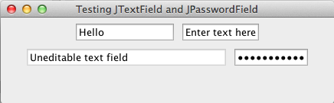
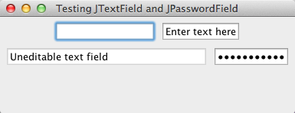
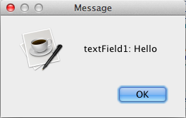
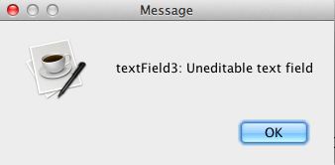

Slide 51
10.4 GUI
Create interactive program:
Event Source
Event Handling
Event Listener Interfaces
Notes:
Code Samples Available at http://media.pearsoncmg.com/ph/esm/deitel/java_htp9e/code_examples/code_examples.html

Slide 52
Create Interactive Program
Listener Interface
Listener implements the interface
Event Source notifies the Listener when an event is fired through the interface, e.g., actionPerformed (theEvent ev)
The Listener
Event Source
Register with the event source to be a specific Listener, e.g., button.addActionListener (this);
Usually the class defining the GUI
e.g., button, text field, checkbox

Slide 53
Event Source
Creates an event object when the user does something to an event source, e.g., click a button
Every event type has a matching listener interface,
e.g., MouseEvents → MouseListener
WindowEvents → WindowListener

Slide 54
Event Handling
java.awt.event package
contains event listeners and the objects that represent specific events, e.g., ActionListener interface and ActionEvent object

Slide 55
Event Listener Interfaces
ActionListener – Action events e.g., click a button
AdjustmentListener – Adjustment events e.g., scrollbar is moved
FocusListener – Keyboard focus events, e.g., text field gains/loses focus
ItemListener – Item events, e.g., checkbox is changed
KeyListener – Keyboard events, e.g., enter text on keyboard
MouseListener – Mouse events, e.g., mouse clicks, mouse entering/leaving a component’s area
MouseMotionListener – Mouse movement events, e.g., track movement over component
WindowListener – Window events, e.g., window maximized, minimized, moved, closed

Slide 56
Example Events
If you implement MouseListener, the mousePressed()method is called when the mouse is pressed.
If you implement ActionListener, the actionPerformed()method is called when e.g., a button is clicked.

Slide 57
Event Handling
Implement the ActionListener interface
Register with the event source
Define the event-handling method (i.e. implement the actionPerformed()method from the ActionListener interface)

Slide 58
method1
Listener Interface
(ActionListener)
method2
:
:
(1) implements ActionListener
(3) implements all the methods
Listener
Event Source (button)
(2) add (as a) Listener
- button.addActionListener (this)

Slide 59
import javax.swing.*;
import java.awt.*;
public class GUI {
JFrame f= new JFrame ("GUI Frame");
JPanel pNorth = new JPanel ();
JButton b2 = new JButton("Save");
public void go(){
f.getContentPane().add(BorderLayout.NORTH, pNorth);
f.setSize(200, 200);
f.setVisible(true);
pNorth.add(b2);
}
public static void main(String[] args) {
GUI gui = new GUI();
gui.go();
}
}

Slide 60
import javax.swing.*;
import java.awt.*;
import java.awt.event.*;
public class GUI implements ActionListener{
JFrame f= new JFrame ("GUI Frame");
JPanel pNorth = new JPanel ();
JButton b2 = new JButton("Save");
public void go(){
f.getContentPane().add(BorderLayout.NORTH, pNorth);
f.setSize(200, 200);
f.setVisible(true);
pNorth.add(b2);
b2.addActionListener(this);
}
public void actionPerformed (ActionEvent event) {
b2.setText ("Save button is clicked");
}
public static void main(String[] args) {
GUI gui = new GUI();
gui.go();
}
}

Slide 61
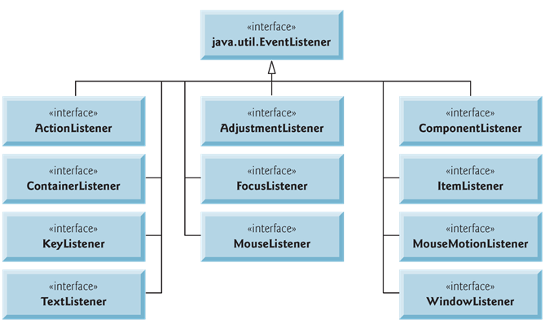
Event-listener interfaces of package java.awt.event

Slide 62
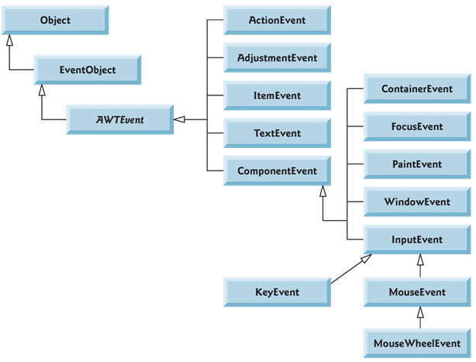
Some Event classes in package java.awt.event

Slide 63
10.5 GUI
Create interactive program:
Event Source
Event Handling
Event Listener Interfaces
Notes:
Code Samples Available at http://media.pearsoncmg.com/ph/esm/deitel/java_htp9e/code_examples/code_examples.html

Slide 64
Event Handling in Java
Every JComponent has an instance variable listenerList, that maintains references to the set of registered listeners
When a listener is registered, a new entry is placed in the component’s listenerList
Every entry also includes the listener’s type

Slide 65
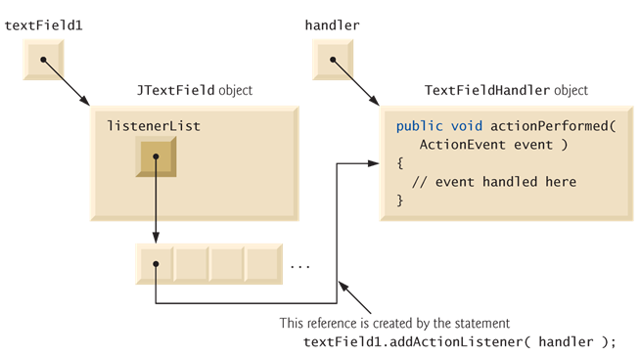
Event registration for JTextField textField1

Slide 66
Event Handling in Java
When an event happens
Event is “dispatched” to the event listeners of the appropriate type
ActionEvents are handled by ActionListeners
MouseEvents are handled by MouseListeners and MouseMotionListeners
Here the GUI component calls an event handling method on each of its listeners that are registered for the event type.
an ActionEvent is dispatched to every registered ActionListener’s actionPerformed method

Slide 67
JPasswordField
JPasswordField pswd = new JPasswordField(15);
pswd.setEchoChar (‘*’);

Slide 68
JTextArea
Constructors
JTextArea(int, int) – specified #rows and #columns
JTextArea(String, int, int) – specified text, rows and columns
Methods
getText()
getSelectedText()
setText(String)
append(String)
insert(String, int)
setLineWrap(boolean)

Slide 69
JScrollPane
To provide horizontal or vertical scrollbars
JScrollPane(Component)– specified component to have scroll bars
JScrollPane(Component, int, int)– plus vertical, horizontal scrollbar configurations
ScrollPaneConstants.VERTICAL_SCROLLBAR_ALWAYS / AS_NEEDED / NEVER
ScrollPaneConstants.HORIZONTAL_SCROLLBAR_ALWAYS / AS_NEEDED / NEVER

Slide 70
JScrollPane
JPanel p = new JPanel();
JTextArea letter = new JTextArea(5, 20);
JScrollPane scroll = new JScrollPane (letter, ScrollPaneConstants.VERTICAL_SCROLLBAR_ALWAYS, ScrollPaneConstants.HORIZONTAL_SCROLLBAR_NEVER);

Slide 71
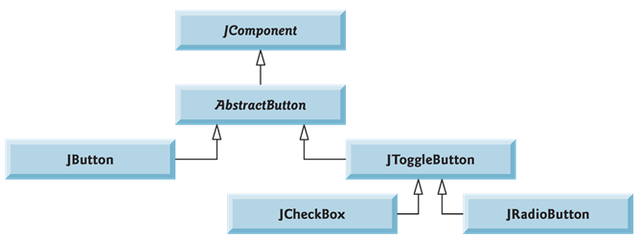
Buttons in Java
Command buttons (Jbutton)
Check boxes (JCheckBox)
Radio buttons (JRadioButton)

Slide 72
JButton
Command buttons
Generates an ActionEvent when user clicks it
Text on the face of a JButton is called the button label
JButtons can display text labels or image icon labels

Slide 73
import java.awt.FlowLayout;
import java.awt.event.ActionEvent;
import java.awt.event.ActionListener;
import javax.swing.JFrame;
import javax.swing.JButton;
import javax.swing.JOptionPane;
public class ButtonFrame extends JFrame {
private JButton button1;
private JButton button2;
public ButtonFrame() {
super("Testing Buttons");
setLayout(new FlowLayout());
button1 = new JButton("Button1");
add(button1);
button2 = new JButton("Button2");
add(button2);
ButtonHandler handler = new ButtonHandler();
button1.addActionListener(handler);
button2.addActionListener(handler);
}
private class ButtonHandler implements ActionListener {
@Override
public void actionPerformed (ActionEvent event) {
JOptionPane.showMessageDialog(ButtonFrame.this,
"You pressed " + event.getActionCommand());
}
}
public static void main (String [] argv) {
ButtonFrame frame = new ButtonFrame();
frame.setDefaultCloseOperation(JFrame.EXIT_ON_CLOSE);
frame.setSize(300, 100);
frame.setVisible(true);
}
} // end class ButtonFrame
Note:
In an inner class, this refers to the current inner class object.
An inner class can use an outer class object’s this by specifying OuterClassName.this
Notes:
PRINT THIS

Slide 74
Buttons that maintain state
JToggleButton - on/off or true/false values
JCheckBox
String passed to JCheckBox constructor is the label that appears to the right of the JCheckBox by default
isSelected() method returns true if JCheckBox is selected
When user clicks on a JCheckBox, an ItemEvent occurs
Handled by an ItemListener object
ItemListener object must implement method itemStateChanged()
JRadioButton
grouped together and mutually exclusive (only one in group can be selected at any time)

Slide 75
JCheckBox
private class CheckBoxHandler implements ItemListener {
@Override
public void itemStateChanged(ItemEvent e) {
Font f = null;
if (boldCheckBox.isSelected() && italicCheckBox.isSelected())
f = new Font(Font.SERIF, Font.BOLD + Font.ITALIC, 14);
else if (boldCheckBox.isSelected())
f = new Font(Font.SERIF, Font.BOLD, 14);
else if (italicCheckBox.isSelected())
f = new Font(Font.SERIF, Font.ITALIC, 14);
else
f = new Font(Font.SERIF, Font.PLAIN, 14);
text.setFont(f);
}
} // end class CheckBoxHandler
public static void main(String[] argv) {
CheckBoxFrame frame = new CheckBoxFrame();
frame.setDefaultCloseOperation(JFrame.EXIT_ON_CLOSE);
frame.setSize(300, 100);
frame.setVisible(true);
}
}
import java.awt.FlowLayout;
import java.awt.Font;
import java.awt.event.ItemListener;
import java.awt.event.ItemEvent;
import javax.swing.JFrame;
import javax.swing.JTextField;
import javax.swing.JCheckBox;
public class CheckBoxFrame extends JFrame {
private JTextField text;
private JCheckBox boldCheckBox;
private JCheckBox italicCheckBox;
public CheckBoxFrame() {
super("Testing JCheckBox");
setLayout(new FlowLayout());
text = new JTextField
("Watch the font style change", 25);
text.setFont(new Font(Font.SERIF, Font.PLAIN, 14));
add(text);
boldCheckBox = new JCheckBox("Bold");
italicCheckBox = new JCheckBox("Italic");
add(boldCheckBox);
add(italicCheckBox);
CheckBoxHandler handler = new CheckBoxHandler();
boldCheckBox.addItemListener(handler);
italicCheckBox.addItemListener(handler);
}

Slide 76
JCheckBox (JRadioButton)
Constructors
JCheckBox(String) – specified label
JCheckBox(String, boolean) – specified label and selected if true
JCheckBox(Icon) – specified icon
JCheckBox(Icon, boolean) – icon and selected if true
JCheckBox(String, Icon) – specified label and icon
JCheckBox(String, Icon, boolean) – label, icon and selected if true
Methods
setSelected(boolean)
isSelected()

Slide 77
JRadioButton
JRadioButton (like JCheckBox) have 2 states –selected and not selected
One constructor is JRadioButton(String label, boolean selected) – default for selected = false
Radio Buttons appear as a group, only one button in a group is selected at a time
Group maintained by adding buttons to a javax.swing.ButtonGroup object – ButtonGroup object not displayed
JRadioButtons (like JCheckBoxes) generate ItemEvents when they are clicked

Slide 78
ButtonGroup
ButtonGroup bg = new ButtonGroup();
JRadioButton rb1 = new JRadioButton(“One”, false);
bg.add(rb1);
bg.add(new JRadioButton(“Two”, true);

Slide 79
JRadioButton
plainButton = new JRadioButton("Plain", true);
boldButton = new JRadioButton("Bold", false);
italicButton = new JRadioButton("Italic");
boldItalicButton = new JRadioButton("Bold/Italic");
add(plainButton);
add(boldButton);
add(italicButton);
add(boldItalicButton);
radioGroup = new ButtonGroup();
radioGroup.add(plainButton);
radioGroup.add(boldButton);
radioGroup.add(italicButton);
radioGroup.add(boldItalicButton);
plainFont = new Font(Font.SERIF, Font.PLAIN, 14);
boldFont = new Font(Font.SERIF, Font.BOLD, 14);
italicFont = new Font(Font.SERIF, Font.ITALIC, 14);
boldItalicFont = new Font(Font.SERIF, Font.BOLD + Font.ITALIC, 14);
plainButton.addItemListener(new Handler(plainFont));
boldButton.addItemListener(new Handler(boldFont));
italicButton.addItemListener(new Handler(italicFont));
boldItalicButton.addItemListener(new Handler(boldItalicFont));
}
import java.awt.FlowLayout;
import java.awt.Font;
import java.awt.event.ItemListener;
import java.awt.event.ItemEvent;
import javax.swing.JFrame;
import javax.swing.JRadioButton;
import javax.swing.JTextField;
import javax.swing.ButtonGroup;
public class RadioButtonFrame extends JFrame {
private JTextField text;
private JRadioButton plainButton;
private JRadioButton boldButton;
private JRadioButton italicButton;
private JRadioButton boldItalicButton;
private ButtonGroup radioGroup;
private Font plainFont;
private Font boldFont;
private Font italicFont;
private Font boldItalicFont;
public RadioButtonFrame() {
super("Testing Radio Button");
setLayout(new FlowLayout());
text = new JTextField
("Watch font style change", 25);
add(text);

Slide 80
private class Handler implements ItemListener {
Font font;
public Handler(Font f) {
font = f;
}
@Override
public void itemStateChanged(ItemEvent e) {
text.setFont(font);
}
} // end class Handler
public static void main(String[] argv) {
RadioButtonFrame frame = new RadioButtonFrame();
frame.setDefaultCloseOperation(JFrame.EXIT_ON_CLOSE);
frame.setSize(300, 100);
frame.setVisible(true);
}
}

Slide 81
JComboBox
JComboBox() – create an empty combobox
getItemAt(int) – return text of indexed item
getItemCount()
getSelectedIndex()
getSelectedItem()
setSelectedIndex(int)
setSelectedIndex(Object)

Slide 82
JComboBox
JComboBox (or a drop-down list) enables user to select one item from a list
The first item added to a JComboBox appears as the currently selected item
JComboBox generates ItemEvents
JComboBox method getSelectedIndex() returns the index of the selected item
For each item selected, another item is deselected – so two ItemEvents occur when an item is selected
ItemEvent.getStateChange() returns type of state change

Slide 83
JCheckBox
private class CheckBoxHandler implements ItemListener {
@Override
public void itemStateChanged(ItemEvent e) {
Font f = null;
if (boldCheckBox.isSelected() && italicCheckBox.isSelected())
f = new Font(Font.SERIF, Font.BOLD + Font.ITALIC, 14);
else if (boldCheckBox.isSelected())
f = new Font(Font.SERIF, Font.BOLD, 14);
else if (italicCheckBox.isSelected())
f = new Font(Font.SERIF, Font.ITALIC, 14);
else
f = new Font(Font.SERIF, Font.PLAIN, 14);
text.setFont(f);
}
} // end class CheckBoxHandler
public static void main(String[] argv) {
CheckBoxFrame frame = new CheckBoxFrame();
frame.setDefaultCloseOperation(JFrame.EXIT_ON_CLOSE);
frame.setSize(300, 100);
frame.setVisible(true);
}
}
import java.awt.FlowLayout;
import java.awt.Font;
import java.awt.event.ItemListener;
import java.awt.event.ItemEvent;
import javax.swing.JFrame;
import javax.swing.JTextField;
import javax.swing.JCheckBox;
public class CheckBoxFrame extends JFrame {
private JTextField text;
private JCheckBox boldCheckBox;
private JCheckBox italicCheckBox;
public CheckBoxFrame() {
super("Testing JCheckBox");
setLayout(new FlowLayout());
text = new JTextField
("Watch the font style change", 25);
text.setFont(new Font(Font.SERIF, Font.PLAIN, 14));
add(text);
boldCheckBox = new JCheckBox("Bold");
italicCheckBox = new JCheckBox("Italic");
add(boldCheckBox);
add(italicCheckBox);
CheckBoxHandler handler = new CheckBoxHandler();
boldCheckBox.addItemListener(handler);
italicCheckBox.addItemListener(handler);
}

Slide 84
JComboBox
import java.awt.FlowLayout;
import java.awt.event.ItemEvent;
import java.awt.event.ItemListener;
import javax.swing.JFrame;
import javax.swing.JComboBox;
import javax.swing.JLabel;
public class ComboBoxFrame extends JFrame {
private JComboBox comboBox;
private JLabel label;
private String [] names = {"Item 1", "Item 2", "Item 3"};
private String [] msgs = {"Msg 1", "Msg 2", "Msg 3"};
public ComboBoxFrame() {
super("Testing ComboBox");
setLayout(new FlowLayout());
comboBox = new JComboBox(names);
add(comboBox);
label = new JLabel(msgs[0]);
add(label);
comboBox.addItemListener(new ItemListener() {
@Override
public void itemStateChanged(ItemEvent e) {
if (e.getStateChange() == ItemEvent.SELECTED)
label.setText(msgs[comboBox.getSelectedIndex()]);
}
});
}
public static void main(String[] argv) {
ComboBoxFrame frame = new ComboBoxFrame();
frame.setDefaultCloseOperation(JFrame.EXIT_ON_CLOSE);
frame.setSize(300, 100);
frame.setVisible(true);
}
}
Anonymous inner class is an inner class that is declared without a name. Typically appears inside a method declaration.
Usually the inner class implements some interface or extend a superclass.
When implementing an interface
new InterfaceType() {
inner class methods and data
}
Anonymous inner classes cannot have explicit constructors.
One object of the anonymous inner class is created where the class is declared.
Just like any inner class, anonymous inner class can access its top-level class’s members (e.g., can access label).

Slide 85
JList, JScrollPane
JList supports single-selection lists as well as multiple selection list
Specified using ListSelectionModel
JList does not provide scrollbar if there are more items than the number of visible rows
JScrollPane object provides scrolling capability
JLists generate ListSelectionEvents in single selection lists (no events generated for multiple selection lists)
Note ListSelectionEvent is in package javax.swing.event

Slide 86
JList
colorList.addListSelectionListener(new ListSelectionListener(){
@Override
public void valueChanged(ListSelectionEvent e) {
getContentPane().setBackground
(colors[colorList.getSelectedIndex()]);
}
});
}
public static void main(String[] argv) {
ListFrame frame = new ListFrame();
frame.setDefaultCloseOperation(JFrame.EXIT_ON_CLOSE);
frame.setSize(300, 100);
frame.setVisible(true);
}
} // end class ListFrame
import java.awt.FlowLayout;
import java.awt.Color;
import javax.swing.JFrame;
import javax.swing.JList;
import javax.swing.JScrollPane;
import javax.swing.event.ListSelectionEvent;
import javax.swing.event.ListSelectionListener;
import javax.swing.ListSelectionModel;
public class ListFrame extends JFrame {
private JList<String> colorList;
private String[] options =
{"Black", "Blue", "Green", "Red"};
private Color[] colors = {Color.BLACK,
Color.BLUE, Color.GREEN, Color.RED};
public ListFrame() {
super("Testing JList");
setLayout(new FlowLayout());
colorList = new JList<String>(options);
colorList.setVisibleRowCount(3);
colorList.setSelectionMode (ListSelectionModel.SINGLE_SELECTION);
add(new JScrollPane(colorList));
Each JFrame consists of 3 layers: background, content pane and glass pane.
Content pane appears in front of the background, and is where the GUI components are displayed.
Glass pane displays tool tips and other items that should appear in front of the GUI components.
To change background color, change the background color of the content pane.

Slide 87
Multiple Selection List
A multiple selection list allows user to select many items from a JList
A SINGLE_INTERVAL_SELECTION list allows selecting a contiguous range of items
A MULTIPLE_INTERVAL_SELECTION list (which is the default) allows multiple ranges of items to be selected
As no events are generated to indicate user has made multiple selections in a multiple selection list, we use another GUI component (here, a JButton)

Slide 88
button = new JButton("Copy >>>");
add(button);
copyList = new JList<String>();
copyList.setVisibleRowCount(5);
copyList.setFixedCellWidth(100);
copyList.setFixedCellHeight(15);
add (new JScrollPane(copyList));
button.addActionListener(new ActionListener() {
@Override
public void actionPerformed(ActionEvent e) {
String [] a = {};
copyList.setListData
(colorList.getSelectedValuesList().toArray(a));
}
});
}
public static void main(String [] argv) {
MultSelectionFrame frame = new MultSelectionFrame();
frame.setDefaultCloseOperation(JFrame.EXIT_ON_CLOSE);
frame.setSize(350, 150);
frame.setVisible(true);
}
}
import java.awt.FlowLayout;
import java.awt.event.ActionListener;
import java.awt.event.ActionEvent;
import javax.swing.JFrame;
import javax.swing.JList;
import javax.swing.JButton;
import javax.swing.JScrollPane;
import javax.swing.ListSelectionModel;
public class MultSelectionFrame extends JFrame {
private JList<String> colorList;
private JList<String> copyList;
private JButton button;
private String[] names = {"Black", "Blue", "Cyan", "Dark Gray", "Gray", "Green",
"Light Gray", "Magenta", "Orange",
"Pink", "Red", "White", "Yellow"};
public MultSelectionFrame() {
super("Testing Multiple Selection Frame");
setLayout(new FlowLayout());
colorList = new JList(names);
colorList.setVisibleRowCount(5);
colorList.setSelectionMode
(ListSelectionModel.MULTIPLE_INTERVAL_SELECTION);
add(new JScrollPane(colorList));

Slide 89
Exercise
Create a GUI with a textbox and a button.
Implementing event-handling such that when the button is clicked, a dialog box will display the text entered in the textbox.

Slide 90
Let us find out the installed look and feels
import javax.swing.UIManager;
import javax.swing.UIManager.LookAndFeelInfo;
public class TestClass {
public static void main(String[] args) {
for (LookAndFeelInfo info : UIManager.getInstalledLookAndFeels()) {
System.out.println(info.getName());
}
} // end method main
} // end class TestClass
To use Nimbus look and feel, set the following VM argument (Run/Debug Settings):
-Dswing.defaultlaf=com.sun.java.swing.plaf.nimbus.NimbusLookAndFeel

