Slide 1
2.1 Java Programming Basics
Demo: Use an IDE, e.g. Eclipse, to create a Java program
Name the class IntegerComparison
Display the larger integer meaningfully
Notes:
Chapter 2:
Use in-class programming exercise to review basic programming constructs and to learn basic new Java constructs
Open up a text editor, provide the basic structure: class declaration and the main().

Slide 2
2.2 Java Programming Basics
Notes:
Chapter 2:
Use in-class programming exercise to review basic programming constructs and to learn basic new Java constructs
Open up a text editor, provide the basic structure: class declaration and the main().

Slide 3
You will learn:
Identifiers
Keywords
Variables and constants
Semicolon and curly braces

Slide 4
Data Types
What data types do you know/remember?
Declare some variables.

Slide 5
Java Trivia
Name the primitive data types in Java
What are their sizes?
What characters can be used for identifiers? Any rules?
Java keywords?
Declare variables using the primitive data types.
What’s the naming convention for variables?

Slide 6
Eight Built-In Primitive Data Types
Type | Description
byte | 8 bit signed integer
short | 16 bit signed integer
int | 32 bit signed integer
long | 64 bit signed integer
float | 32 bit signed real number
double | 64 bit signed real number
char | 16 bit Unicode character
boolean | 1 bit true or false value (but “size” not precisely defined)
http://docs.oracle.com/javase/tutorial/java/nutsandbolts/datatypes.html
Notes:
url checked 2021-01-12

Slide 7
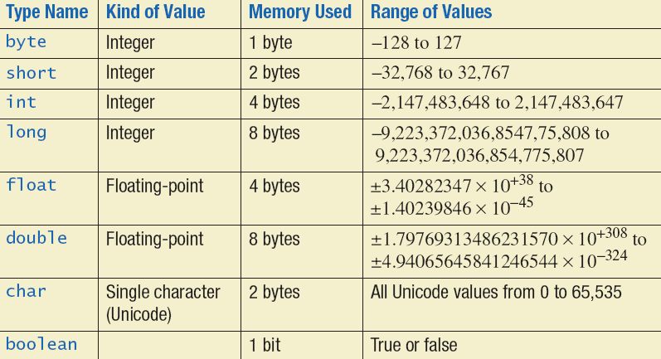
Java numeric data types (some different from C++)
Undefined
Differences: http://aelinik.online.fr/javaguide/APPB.HTM#PrimitiveDataTypes
Notes:
2 to power 16 = 65535.

Slide 8
Java Identifiers
letters, digits, underscores (_) and dollar signs ($) that does not begin with a digit and does not contain spaces. (Recall: C++ identifiers cannot have $)
Java keywords and reserved words cannot be used as identifiers
Java is case sensitive -- so abc and Abc are different identifiers.

Slide 9
Java Keywords (App C in Deitel)
abstract | boolean | break | byte | case | catch | char
class | const | continue | default | do | double | else
extends | final | finally | float | for | goto | if
implements | import | instanceof | int | interface | long | native
new | package | private | protected | public | return | short
static | super | switch | synchronized | this | throw | throws
transient | try | void | volatile | while
Notes:
To be replaced by Appendix C.

Slide 10
Declaring Variables
Format:
DataType <variableName>;
DataType <variableName> = <initialValue>;
Example:
int num1;
double num2 = 2.33;
Notes:
Will learn about access modifier later: public, protected, and private

Slide 11
Variable Naming
Compiler requirements
Cannot be a keyword or special constants “true”, “false” or “null”
Can be any combination of letters, numbers, underscore or dollar sign (first character must be a letter or underscore)
Common stylistic conventions
The name should describe the purpose of the variable
Avoid using the dollar sign
With single word variable names, all characters are lower case
e.g., double grades;
Multiple words are separated by capitalizing the first letter of each word except for the first word (camel case notation)
e.g., String firstName = “Peter”;

Slide 12
Variable Naming Convention
Choose meaningful, descriptive variable names;
this helps a program to be self-documenting
we can understand the program by reading the code even without reviewing comments.
Variable name identifiers begin with a lower-case letter, and every word in the name after the first word begins with an upper-case letter (camel case notation).
Examples:
firstName, noOfStudents, bankAccountNum, countOfAnimals

Slide 13
Local Variables
public class <ClassName>
{
public static void main (String[] args)
{
// Local variables declared here
<< statements >>
: :
}
}

Slide 14
Local variables
Do not have default values
Must be initialized before use; Otherwise, compiler error
Notes:
Long needs a suffix L

Slide 15
Local variables
iVar is not initialized before use: compiler error
int iVar;
System.out.println ("iVar = " + iVar);
The followings will work:
int iVar;
iVar = 10;
System.out.println ("iVar = " + iVar);
OR
int iVar = 10;
System.out.println ("iVar = " + iVar);

Slide 16
Java Trivia
Local variables? default values?
Constants – naming convention, declare some constants
Why use constants?
Can values of constants be changed?

Slide 17
Named Constants in Java
Format:
final <data type> <CONSTANT_NAME> = <value>;
Example:
final int SIZE = 100;
final double PI = 3.14;
final double INTEREST_RATE = 0.02;
final double MICHIGAN_SALES_TAX = 0.06;
Constant identifiers are typically in all upper case, and words are separated by underscore.

Slide 18
Named Constants
Use named constants when a program has data that are not changed during execution
Named constants provides a single point for changing values when needed
final double PI = 3.14159; // declare constant
double area = PI * r * r; // use the declared constant
Notes:
Think about the varying daily interest rates for bank accounts

Slide 19


More about named constants
No need to initialize named constants at declaration. But must be initialized before first use (otherwise compiler error)
Reassigning values to final variables will give compiler error
final double PI;
double r = 10;
double area = PI * r * r;
final double PI;
PI = 3.14159; double r = 10;
double area = PI * r * r;
final double PI;
PI = 3.14159; PI = 3.1416; double r = 10;
double area = PI * r * r;

Slide 20
Location Of Constant Declarations
public class <name of class>
{
public static void main (String[] args)
{
// Local CONSTANTS declared here
// Local variable declarations
< statements >>
: :
}
}

Slide 21
Semicolon In Java (as in C++)
Follows each statement
public class BadExample {
public static void main (String [] args){
System.out.println("one");
System.out.println("two")
}
}
Missing ;

Slide 22
Curly Braces (as in C++)
Used to enclose a block of code
public class Smallest{
public static void main (String[] args){
}
}

Slide 23
Constant Naming
Compiler requirements
Cannot be a keyword or special constants “true”, “false” or “null”
Can be any combination of letters, numbers, underscore or dollar sign (first character must be a letter or underscore)
Common stylistic conventions
The name should describe the purpose of the constant
Avoid using the dollar sign
All characters are capitalized
e.g., float SIZE = 100.0f;
Multiple words are separated with an underscore between each word.
e ,g, float CORPORATE_TAX_RATE = 0.46;

Slide 24
2.3 Java Programming Basics
Notes:
Chapter 2:
Use in-class programming exercise to review basic programming constructs and to learn basic new Java constructs
Open up a text editor, provide the basic structure: class declaration and the main().

Slide 25
You will learn:
Primitive data types
Arithmetic operators
Type conversion
Automatic promotion
Casting

Slide 26
Primitive data types
Undefined
Differences: http://aelinik.online.fr/javaguide/APPB.HTM#PrimitiveDataTypes

Slide 27
float vs. double in Java
A floating-point literal is of type float if it ends with the letter F or f (32-bit)
e.g., float num = 123.4f
Otherwise its type is double -- 64-bit double literal; this is the default and by convention is omitted; can optionally end with the letter D or d
e.g., double d1 = 123.4;
The floating point types (float and double) can also be expressed using E or e (for scientific notation)
e.g., double d2 = 1.234e2; // same value as d1, but in scientific notation
Notes:
In Java any value declared with decimal point is by default of type double.
Suppose we have to assign float value then we must use f or F literal to specify that current value is float.

Slide 28
float and double
Java is strongly typed
C++ has automatic type conversion; type rules in C++ are looser than Java
When we have literals such as 1.5 it is considered as a double (not as a float)
Consider the statement:
float fVar = 1.5;
This will give an error because 1.5 is double. We cannot assign a double value to float variable (unlike C++).
The following will work (1.5F is a float value)
float fVar = 1.5F;

Slide 29
More about Java’s strong typing
byte bVar = 10; // works fine
byte bVar = 300; // compiler error
short sVar = 300; // works fine
short sVar = 40000; // compiler error
int iVar = 40_000; // works fine
int iVar = 4_000_000_000; // compiler error
long lVar = 4_000_000_000; // compiler error
long lVar = 4_000_000_000L; // works fine
From Java 7 onwards, we can have underscore in numeric literals (with some restrictions)
http://docs.oracle.com/javase/tutorial/java/nutsandbolts/datatypes.html

Slide 30
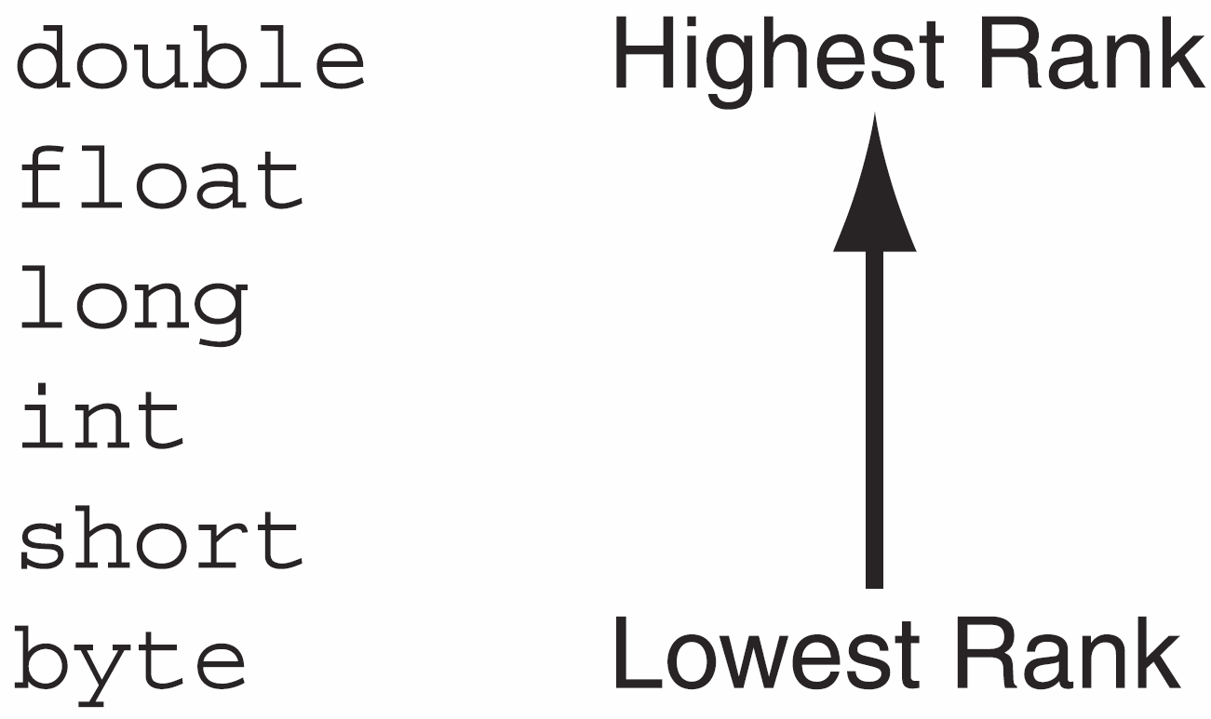
Ranking of Java Primitive Types
Example:
double dVar;
int iVar = 10;
dVar = iVar;
Java allows automatic promotion (i.e., ok to assign value of a lower ranked type to variable of a higher ranked type)

Slide 31
Automatic Promotions
Type | Valid promotions
double | None
float | double
long | float or double
int | long, float or double
char | int, long, float or double
short | int, long, float or double (but not char)
byte | short, int, long, float or double (but not char)
boolean | None (boolean values are not considered to be numbers in Java)
p. 208 Java: How to program

Slide 32
No automatic demotion
Java does not allow automatic demotion
- value of a higher ranked type assigned to a lower ranked type is not automatic.
double dVar = 10;
int iVar;
iVar = dVar;
Not allowed
Need casting

Slide 33
Type Demotion Using Cast Operators
We can use cast operators to perform demotion conversions. The following will print 10
Such casting is also allowed in C++
C++ also has static_cast and other explicit casts
double dVar = 10.5;
int iVar;
iVar = (int) dVar; // works fine (truncated and not rounded)
System.out.println ("iVar = " + iVar);
Important: the value of dVar doesn’t change, only the casted value assigned to iVar.
Cast Operator
Notes:
Up to here 9/11/2-14

Slide 34
char and int
We can also assign character values to variables of type int as shown
char cVar = 'A';
int iVar;
iVar = cVar;
What’s the value of iVar?
Notes:
iVar = 65
Ascii of 0 = 48 (zero)
Ascii of A = 65
Ascii of a = 97

Slide 35
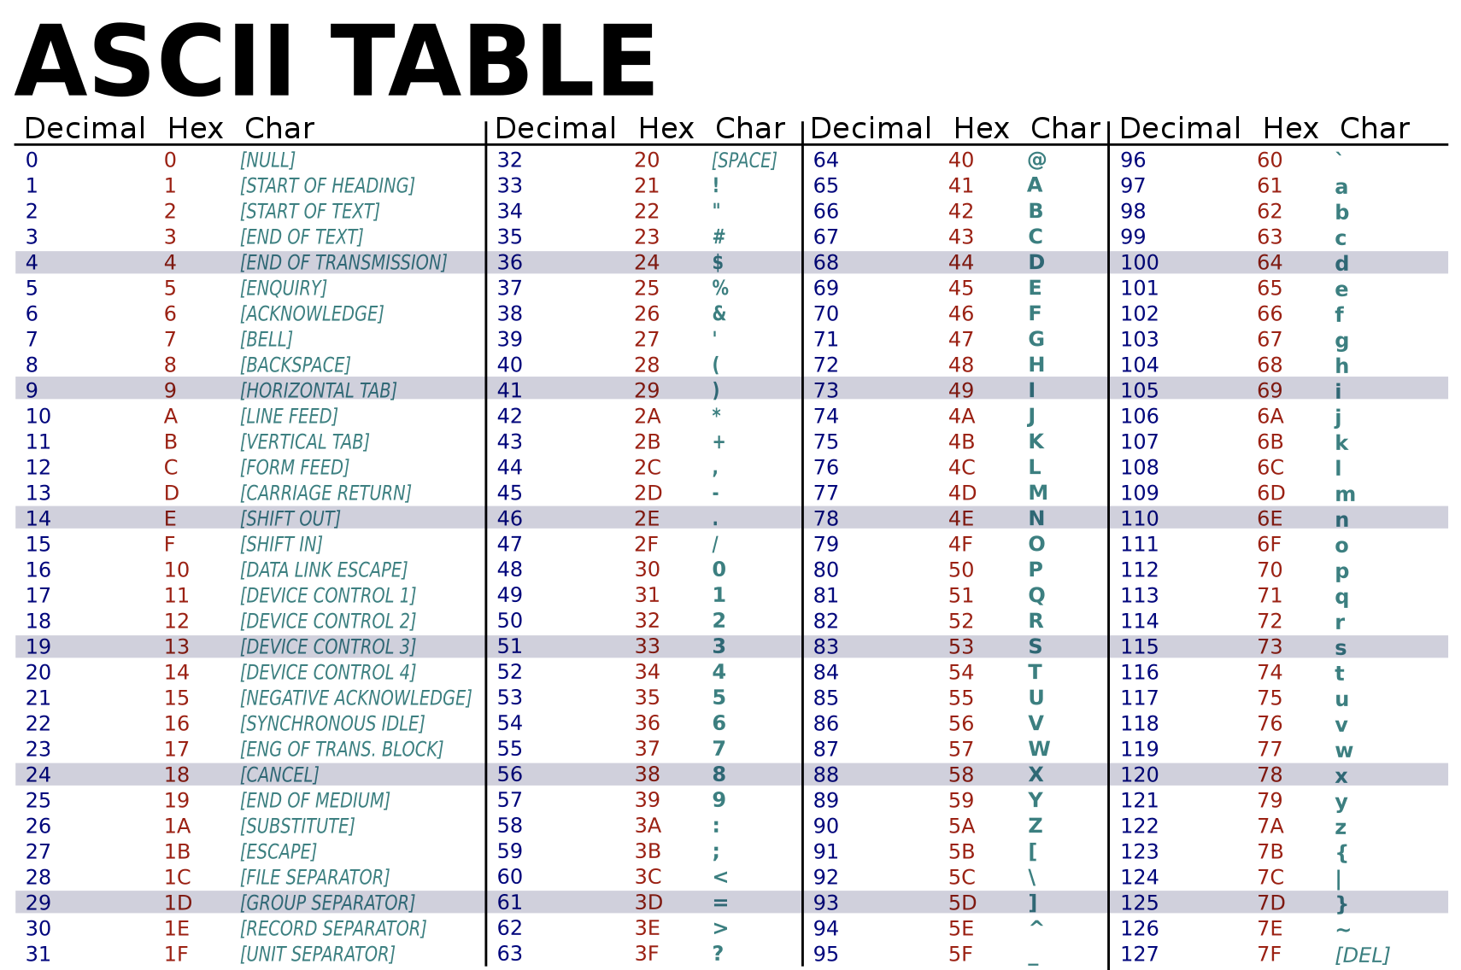

Slide 36
Arithmetic Operators (as in C++)
Operator | Meaning | Type | Example
+ | Addition | Binary | total = cost + tax;
- | Subtraction | Binary | cost = total – tax;
* | Multiplication | Binary | tax = cost * rate;
/ | Division | Binary | salePrice = original / 2;
% | Modulus | Binary | remainder = value % 5;
All these are binary operators: that is, they have two operands.
Also remember: integer division produces integers
(i.e. Suppose we do: double result = 1/2 , result will be assigned 0

Slide 37
Arithmetic Operations
When we perform arithmetic operations with byte and short, they are converted to int.
Therefore, the following gives compiler error
short s1 = 10, s2 = 20, s3;
s3 = s1 + s2;
System.out.println ("s3 = " + s3);
So either declare s3 as int or cast the result to short:
s3 = (short)(s1 + s2);

Slide 38
Arithmetic Operations
How about this?
short s1 = 10, s2 = 20, s3;
s3 = (short) s1 + s2; // cast s1 as short
System.out.println ("s3 = " + s3);
And this?
short s1 = 10, s2 = 20, s3;
s3 = (short) (s1 + s2); // cast (s1 + s2) as short
System.out.println ("s3 = " + s3);
Compiler error
This will work fine

Slide 39
Mixed Mathematical Expressions
If an operation has mixed operand types, the lower ranked type is automatically converted to the higher ranked type
E.g., double x = 1.5 + 2 * 3 will be evaluated as:
2 * 3 will give integer 6
1.5 + 6 will give double 7.5 (6 is converted to double)
x is assigned 7.5

Slide 40
Quick Check
2.1 What is the value assigned to variable x when the following expression is evaluated?
double x = 1.5 + 3 / 2;
(Remember / has higher precedence than +)
3
2
2.5
0
We will get a compiler error
Notes:
C
Will only get the quotient of the division for integer divisions.

Slide 41
Quick Check
2.2 What is the value assigned to variable x when the following expression is evaluated?
double x = 1.5 * 3 / 2;
1.5
2.25
2.5
0
We will get a compiler error
Notes:
B

Slide 42
Quick Check
2.3 You get a compiler error with the following code fragment. How can we fix it? (Multiple answers may be correct)
byte b1 = 10, b2 = 10, b3;
b3 = b1 + b2;
Declare b3 as int (instead of as byte)
Second statement becomes: b3 = (byte) b1 + b2;
Second statement becomes: b3 = (byte) (b1 + b2);
Declare b3 as float
None of the above
Notes:
A, C

Slide 43
2.4 Java Programming Basics
Notes:
Chapter 2:
Use in-class programming exercise to review basic programming constructs and to learn basic new Java constructs
Open up a text editor, provide the basic structure: class declaration and the main().

Slide 44
You will learn:
Java class
main ()
Documentation

Slide 45
Java class
public class Welcome { // main method begins program execution
public static void main(String [] args){
System.out.println("Programming is great fun!"); } // end method main
} // end class Welcome

Slide 46
Class Naming
Convention: begin with a capital letter and capitalize the first letter of each word they include (e.g., SampleClassName).
A class name is an identifier – so follow the variable naming rules (except the first letter)

Slide 47
Public Class Declaration
A public class must be placed in a file that has the same name as the name of the class (case-sensitive) with the .java extension
E.g. public class Welcome must be in a file called Welcome.java
Otherwise, we will get compiler error.
The naming is automatically done when we use Eclipse (and most Java IDEs).
A .java file may have any number of classes, but may have only one public class

Slide 48
The main() method
public static void main(String[] args)
Main() is the starting point of execution
main is a method/function just like main in C++
Recall: when a method (or function) finishes execution, it returns information to the calling function. (for main method in Java, it returns to the JVM).

Slide 49


The main() method
public static void main(String[] args)
It must be declared exactly as shown (except the parameter name args which can be renamed)
A public method – more later
A static method – more later
A void method – exactly like void functions in C++ (functions that does not return anything).
String [] args refers to an array of Strings as input parameter

Slide 50
Class declaration
All import statements must appear before the first class declared in a file.
If we do not import a necessary class, then we will get an error.
For example, if we do not import Scanner class:
Scanner cannot be resolved to a type …
java.lang.* is imported by default

Slide 51
Documentation
As in C++
Multi-line documentation
/* Start of documentation
End of documentation */
Single-line documentation
// Everything until the end of the line is a comment

Slide 52
Documentation
Unique to Java: Javadoc
Used to generate HTML documentation automatically using a utility tool called javadoc
Delimited by /** … */
More later, also you can read about Appendix G of the Deitel book
Notes:
Show an example of html documentation

Slide 53
Good practice
For less obvious variable declaration, comment what the variable will be used for.
Scanner input = new Scanner (System.in); // scanner object to read user input
Scanner input = declaring a variable called input of type Scanner.
The above statement also assigns a Scanner object to the variable input (an input device)

Slide 54
2.5 Java Programming Basics
Notes:
Chapter 2:
Use in-class programming exercise to review basic programming constructs and to learn basic new Java constructs
Open up a text editor, provide the basic structure: class declaration and the main().

Slide 55
You will learn:
Getting input from keyboard
Scanner
Displaying output to console
System.out.print ()
System.out.println ()
System.out.prinf ()
Format modifiers
%d, %f, %s, %c, %b

Slide 56
Reading input from keyboard
We will use Scanner class defined in the Java API in this program
import java.util.Scanner;
public class Addition {
public static void main(String[] args) {
Scanner input = new Scanner (System.in);
int n1, n2, sum;
System.out.print("Enter the first integer: ");
n1 = input.nextInt();
System.out.print("Enter the second integer: ");
n2 = input.nextInt();
input.close();
sum = n1 + n2;
System.out.println(n1 + " + " + n2 + " = " + sum);
}
}
Create Scanner object, that is assigned to variable called input
What kind of variables? Do they have default values?
Reads an integer, and assigns to variable n1
Close Scanner object
Notes:
import declaration: used to specify predefined classes and objects that will be used by the class. We can import predefined classes and objects provided as part of the Java API, other third party APIs, or we can even create our own APIs and import them as well.
We can have any number of import declarations in a class, all of them MUST appear before the class declaration
java.util.Scanner is a class defined in the Java API. java.util is the name of the package, and Scanner is the class within java.util package.
java.lang.* is imported by default
We use a constructor defined within a class to create an object of the class – in our code, we create an object of Scanner class.

Slide 57
Scanner Class
From API documentation
public final class Scanner
extends Object
implements Iterator<String>, Closeable
A simple text scanner which can parse primitive types and strings using regular expressions.
The Scanner methods we used
new Scanner (java.io.InputStream)
Note: System.in is an object of java.io.InputStream
import java.util.Scanner; // placed before the class
Scanner scnr = new Scanner (System.in); // likely in main
scnr.nextInt();
scnr.close();
Notes:
Show the Scanner class on Eclipse: Java.util package

Slide 58






Variable declarations and memory allocations
int num = 5;
Address: 5675
5
Declare variable num, memory (4 bytes for int) allocated for the variable with the initial value.
Program keeps track of the memory location for each variable
int n1, n2, sum;
Address: 5678
Declare variables n1, n2, sum
4 bytes allocated for each variable
Address: 5682
Address: 5686
n1 = input.nextInt();
n2 = input.nextInt();
sum = n1 + n2;
If user input = 10
If user input = 20
Address: 5678
10
Address: 5678
10
Address: 5678
10
Address: 5682
Address: 5682
20
Address: 5682
20
Address: 5686
Address: 5686
Address: 5686
30

Slide 59

Standard Output
Java | C++
System.out.print (“…”); | cout << …;
System.out.println (“…” + “…” + var); | cout << … << … << endl;
System.out.printf (“…”, …);

Slide 60

Standard Output
Format:
System.out.println (<string or variable name one> + <string or variable name two>…);
Assuming variable num has been declared and initialized:
1. Display “Good night Mary!”
System.out.println ("Good-night Mary!");
2. Display the value stored in num
System.out.print (num);
3. Display “num = <value of num>”
System.out.println ("num = " + num);

Slide 61
Quick Check
2.4 What will be the output of the following program?
(A) Welcome to Java Programming
(B) Welcome to
Java Programming
(C) Welcome to
Java Programming
// File: Welcome2.java
// Text printing program
public class Welcome2
{
public static void main(String [] args){
System.out.print ("Welcome to ");
System.out.println ("Java Programming");
} // end main
} // end class Welcome2
(D) Welcome to
Java Programming
(E) None of the above
Notes:
A

Slide 62
Formatting Output
Escape sequence | Description
\t | Horizontal tab
\n | New line
\" | Double quote
\\ | Backslash
What will be the output?
System.out.print ("One\t\"Two\"\tThree\n ");
System.out.println ("Four\t\\Five\\\tSix");
http://docs.oracle.com/javase/specs/jls/se7/html/jls-3.html#jls-3.10.6

Slide 63




Format output: printf
public class Welcome {
public static void main (String[] args) {
System.out.printf ("Welcome to %s %s!!\n", "Java", "Programming");
}
}
SAME AS:
System.out.println ("Welcome to Java Programming!!");
System.out.print ("Welcome to Java Programming!!\n");
System.out.print ("Welcome to Java Programming!!" + "\n");
System.out.println ("Welcome to " + "Java " + "Programming!!");
Notes:
%s – format specifier

Slide 64



Quick Check
2.5 Rewrite the following output statement using printf.
System.out.printf ("Welcome to %s”, "Java Programming");
System.out.printf ("Welcome to %s %s”, "Java”, “Programming");
public class Welcome2 { public static void main(String [] args) {
System.out.print ("Welcome to ");
System.out.println ("Java Programming");
} // end method main
} // end class Welcome2
Notes:
A

Slide 65
printf: Format Specifiers
Format Specifier | Type of Data
%s | string
%d | integer
%f | float/double
%b | boolean
%c | character
%n | new line
int courseNum = 276;
double gpa = 3.75;
System.out.printf ("Welcome to CSC%d class!”, courseNum);
System.out.printf (”My gpa is %f overall.”, gpa);

Slide 66
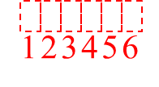
printf: Specify Field Width, Precision
We can specify width as part of format specifier using printf
int number = 9;
System.out.printf("The value is %6d\n", number);
The format specifier %6d indicates that the argument number should be printed in a field that is (at least) 6 places wide. If the value in number is shorter than 6 places, it will be right justified. Here is the output of the code.
The value is 9
If the value of the argument is wider than the specified field width, the field width will be expanded to accommodate the value.

Slide 67
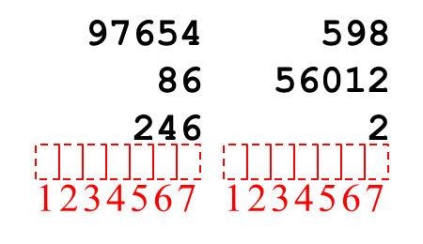
Using field widths to print columns
Field widths can help when you need to print values aligned in columns. For example, look at the following code:
int num1 = 97654, num2 = 598; int num3 = 86, num4 = 56012; int num5 = 246, num6 = 2; System.out.printf("%7d %7d\n", num1, num2); System.out.printf("%7d %7d\n", num3, num4); System.out.printf("%7d %7d\n", num5, num6);
This code displays the values of the variables in a table with three rows and two columns. Each column has a width of seven spaces. Here is the output for the code:

Slide 68
Format floating point values
When printing floating point values using printf, typically 6 digits after the decimal are printed (rounded to 6 digits).
double d1 = 2.7249123;
System.out.printf ("%9f\n", d1);
We can specify the number of digits after the decimal to be printed as follows
double d1 = 2.7249123;
System.out.printf ("%9.2f\n", d1);
Fancy Formatting…
double d1 = 2000.7249123;
System.out.printf ("%,9.2f\n", d1);
double x = 1_237_898.456789;
System.out.printf("%,.4f", x);
2.724912
1
2
3
4
5
6
7
8
9
1
2
3
4
5
6
2.72
1
2
3
4
5
6
7
8
9
1
2
2,000.72
1
2
3
4
5
6
7
8
9
1
2
Display: 1,237,898.4568
Notes:
The following is ok:
double x = 1_237_898.456789;
System.out.printf("%,.4f", x);

Slide 69
Format String output
Strings can be formatted similarly
System.out.printf ("%-9s %9s\n", "Name", "Marks");
Name
Marks
1
2
3
4
5
6
7
8
9
1
2
3
4
5
6
7
8
9

Slide 70
2.5 Suppose n1, n2, sum are declared as integers.
Which of the following is an equivalent statement to
System.out.print (n1 + " + " + n2 + " = " + sum);
System.out.printf("%d + %d = %d", n1, n2, sum);
System.out.printf("n1 + n2 = %d", n1, n2, sum);
System.out.printf("n1 + n2 = %d", sum);
System.out.printf("n1 + n2 = sum");
System.out.printf(n1 + n2 = sum);
Quick Check
Notes:
A

Slide 71
Quick Check
2.6 What will be the value printed by the first printf statement?
double d1 = 2.745;
System.out.printf ("%.2f\n", d1);
System.out.printf ("%.1f\n", d1);
3
2.7
2.8
2.74
2.75
Notes:
(Note that first statement will print 2.75)
E

Slide 72
Quick Check
2.6 What will be the value printed by the second printf statement?
double d1 = 2.745;
System.out.printf ("%.2f\n", d1);
System.out.printf ("%.1f\n", d1);
3
2.7
2.8
2.74
2.75
Notes:
B

