Slide 1
6.1 Array and ArrayList
Array declaration and creation
Reference variable
Memory allocation

Slide 2
Declaring Arrays (different from C++)
Arrays in Java involve a reference to the array so creating an array requires two steps:
Declaring a reference to the array
Allocating memory for the array

Slide 3
Declaring and Creating Array (1)
Format:
<dataType> [] <arrayName>;
<arrayName> = new <dataType> [<no. of elements>];
Example:
int [] arr1;
int [][] arr2;
int SIZE = 10;
arr1 = new int[SIZE];
arr2 = new int[SIZE][SIZE];

Slide 4
Declaring and Creating Array (2)
Format:
<dataType> [] <arrayName> = new <dataType> [<no. of elements>];
Example:
int SIZE = 10;
int [] arr1 = new int[SIZE];
int [][] arr2 = new int[SIZE][SIZE];
Note: int [12] arr; and int arr[12]; will give compiler errors

Slide 5
Declaring and creating arrays
Specify the data type of elements and the name of the array: int[] arr;
No size needs to be specified (unlike C++)
int arr[]; is allowed, but not recommended
Create an array as: arr = new int[12];
Often we combine as: int[] arr = new int[12];
When an array is created, each element of the array will get the default value (same default values for instance variables)
Note: int [12] arr; and int arr[12]; will give compiler errors
http://docs.oracle.com/javase/tutorial/java/nutsandbolts/datatypes.html
Notes:
Use Eclipse to declare arrays and manipulate array elements.

Slide 6
Exercise: Declaring arrays
An array of 100 scores
An array for storing the number of students in 100 classrooms
An array of 50 students’ letter grade
An array of 200 names
An array of 10 Calculator
An array of 80 Student
An array of 100 Ship
An array of 20 Shape
Notes:
Double [] scores = new double [100];
Int [] students = new int [100];
char[] grades = new char[50];
String [] names = new String [200];
Calculator [] calculatorArr = new Calculator [10];

Slide 7
Sample Code: Declaring arrays
double [] scores = new double [100];
int [] students = new int [100];
char[] grades = new char[50];
String [] names = new String [200];
Calculator [] calculatorArr = new Calculator [10];
Student [] studentList = new Student [80];
Ship [] shipDock = new Ship [100];
Shape [] shapeCollection = new Shape [20];
Notes:
Double [] scores = new double [100];
Int [] students = new int [100];
char[] grades = new char[50];
String [] names = new String [200];
Calculator [] calculatorArr = new Calculator [10];

Slide 8
Array: An Example
import java.util.Scanner;
public class Driver {
public static void main(String[] args) {
int i, len;
int [] myArray;
Scanner input = new Scanner (System.in);
System.out.print ("Enter the number of array elements: ");
len = input.nextInt();
input.close();
myArray = new int [len];
System.out.println ("myArray has " + myArray.length + " elements.");
for (i = 0; i < myArray.length; i++){
myArray [i] = i;
System.out.println("Element[" + i + "] = " + myArray [i]);
}
}
}
Notes:
Arrays are special objects in Java. They have a simple attribute length which is final.

Slide 9
Array In Java (same as C++)
An array of n elements will have an index of zero for the first element up to (n-1) for the last element
The array index must be an integer
Array elements accessed by arrayName [index]
Array elements are of the same type (an array can hold values of the same primitive type or references to objects of the same class)

Slide 10
Array In Java (Different from C++)
Array reference and explicit memory allocation are required
Each array element has a default value when an array is created
Zero for numeric primitive-type elements, false for Boolean, and null for references (like those for instance variables).
length is a final variable and its value cannot be changed
Several error checking mechanisms are available
Using a null array reference
Array bounds checking
Useful link: http://docs.oracle.com/javase/tutorial/java/nutsandbolts/arrays.html

Slide 11
6.2 Array and ArrayList
Array manipulation and exercises
Array indexing
ArrayIndexOutOfBounds Exception

Slide 12
1) What is the output of the following code?
int[] c = new int[12];
System.out.println (c.length);
(A) 12
(B) 11
(C) 13
(D) Compiler error because we need to use c.length() to determine the length
(E) None of the above
Notes:
A

Slide 13
2) What is the output of the following code?
int[] c = new int[12];
System.out.println (c[5]);
(A) 0
(B) 5
(C) 4
(D) Compiler error because array is not yet initialized
(E) None of the above
Notes:
A

Slide 14
More about arrays
Arrays can be initialized during declaration as:
int [] c = {1, 2, 3, 4, 5, 6, 7, 8, 9, 10, 11, 12};
c is an integer array of length 12.
We can use any expression as an index.
e.g. c[x + y] = …;
If we specify an out of range index, we get ArrayIndexOutOfBoundsException at runtime and program exits
Notes:
int [] arr = new int [10];
arr [10] = 100;
Cannot assign a set of values to an array after the declaration/initialization.
ArrayIndexOutOfBoundsException

Slide 15
More about arrays
If we have multiple declarations in one line as:
int [] a, b, c;
then a, b and c are integer array variables.
If we have int a[], b, c;
then b and c are integer variables, and a is an integer array variable.
Both are not recommended.
Declaring variables in separate lines is preferred.

Slide 16
3) What is the output of the following code?
int[] c = {1, 2, 3, 4, 5, 6, 7, 8, 9, 10, 11, 12};
int x = 2, y = 3;
System.out.println(c[x + y]);
(A) 4
(B) 5
(C) 6
(D) 7
(E) ArrayIndexOutOfBounds Exception is thrown
Notes:
C

Slide 17
4) What is the output of the following code?
int[] c = {1, 2, 3, 4, 5, 6, 7, 8, 9, 10, 11, 12};
int x = 2, y = 3;
System.out.println(c[x - y]);
(A) -1
(B) 0
(C) 1
(D) 2
(E) ArrayIndexOutOfBoundsException is thrown
Notes:
E

Slide 18
5) What is the output of the following code?
int[] c = {1, 2, 3, 4, 5, 6, 7, 8, 9, 10, 11, 12};
System.out.println(c[12]);
(A) 10
(B) 11
(C) 12
(D) 13
(E) ArrayIndexOutOfBoundsException is thrown
Notes:
E
Thrown at compile time.

Slide 19
Keys to Questions
A
A
C
E
E

Slide 20
Looping through array elements
int[] c = {1, 2, 3, 4, 5};
System.out.printf("%10s%10s\n","counter","value");
for (int i = 0; i < c.length; i++) {
System.out.printf("%10d%10d\n", i, c[i]);
}
counter value
0 1
1 2
2 3
3 4
4 5
Notes:
https://www.baeldung.com/java-printstream-printf
Printf – formatting output using conversion-characters %:
%[flags][width][.precision]conversion-character
s – formats strings (S for upper cases)
d – formats decimal integers
f – formats the floating-point numbers
t– formats date/time values
To break the string into separate lines, we have a %n specifier:
System.out.printf("baeldung%nline%nterminator");The code snippet above will produce the following output:
baeldung line terminator

Slide 21
Exercise – Array manipulation
Declare an array studentID to store 10 student IDs in integer.
Initialize the student IDs with values from 11 to 20 (use a for loop).
Declare an array score to store 10 student scores in double.
Initialize the score array to 100 each (for loop).
Change the score of the 4th student to 85.7 and that of the 10th student to 65.
Change the score of the other students to be 5 times their student ID (using for loop).
Display all the scores in the array.
Display the scores of the students with odd student ID and their student IDs, followed by the even student IDs.
Find the average score.
Find the student with the highest mark, return the score and the ID of the student.i

Slide 22
Sample Code – Array manipulation
int [] studentID = new int [10];
2. for (int x = 0; x < studentID.length; x++) {
studentID[x] = x + 11;}
3. double [] scores = new double [10];
4. for (int x=0; x < scores.length; x++) {
scores[x] = 100;
}
5. scores[3] = 85.7;
scores[9] = 65;
6. for (int x=0; x < studentID.length; x++) {
if (x != 3 and x != 9) {
scores[x] = 5 * x;
}
}

Slide 23
Sample Code – Array manipulation
7. for (int x=0; x < scores.length; x++) {
System.out.println (scores[x]);
}
8. for (int x=0; x < studentID.length; x++) {
if (studentID[x} % 2 == 1) {
System.out.println (studentID[x] + “\t” + scores[x]);
}
}
for (int x=0; x< studentID.length; x++) {
if (studentID[x} % 2 == 0) {
System.out.println (studentID[x] + “\t” + scores[x]);
}
}

Slide 24
Sample Code – Array manipulation
9. int x=0, total=0;
while (x < scores.length) {
total += scores[x];
x++;
}
double avg = (double)total/scores.length;
10. double highest = scores[0];
int id = studentID[0];
for (int x = 1; x < studentID.length; x++) {
if (scores[x] > highest) {
highest = scores[x];
id = studentID[x];
}
}
System.out.print(“Student of ID " + id + “has highest score ” + highest);

Slide 25
Exercise – Methods with arrays
Create a class NumberArray and create a driver class NumberArrayTest to try the following:
Declare an array, numArr to store 5 integers and declare a constant literal for the array size.
Write a method to fill in numArr by asking the user to enter 5 integers.
Write a method to display numArr.
Write a method to find the highest number in numArr.
Write a method to find the lowest number in numArr.
Write a method to find the average of numbers in numArr.
Write a method to sort numArr in ascending order.
Notes:
Write a method to search for a number (ask user to provide the number to search in the calling method).

Slide 26
Sample Code – Methods with arrays
Create a class NumberArray and create a driver class NumberArrayTest to try the following:
Declare an array, numArr to store 5 integers and declare a constant literal for the array size.
Write a method to fill in numArr by asking the user to enter 5 integers.
Write a method to display numArr.
Write a method to find the highest number in numArr.
Write a method to find the lowest number in numArr.
Write a method to find the average of numbers in numArr.
Write a method to sort numArr in ascending order.
Notes:
Write a method to search for a number (ask user to provide the number to search in the calling method).

Slide 27
6.3 Array and ArrayList
Enhanced for statement

Slide 28
Enhanced for statement
Iterate through array elements without using a counter
Syntax:
for (parameterType variableName: arrayName){
statements
}
Parameter type must be consistent with the array’s element type

Slide 29
Enhanced for statement
1
2
3
4
5
int[] c = {1, 2, 3, 4, 5};
for (int i=0; i<c.length; i++){
System.out.println(c[i]);
}
int[] c = {1, 2, 3, 4, 5};
for (int num: c) {
System.out.println(num);
}
The enhanced for-loop iterates over the elements of the array c in each iteration, the corresponding element of c is stored in variable num
Enhanced for loop cannot be used to modify elements
In other words, num = 10; inside the loop will not modify the array element’s values.
http://docs.oracle.com/javase/tutorial/java/nutsandbolts/for.html
Notes:
Will not affect compilation

Slide 30
What does this code do?
int[] ratings = {3, 4, 5, 4, 5};
int[] cum = new int[6];
for (int i = 0; i < ratings.length; i++) {
cum[ratings[i]]++;
}
System.out.println("cumulative ratings");
System.out.printf("%10s%10s\n","rating","number");
for (int i = 0; i < cum.length; i++) {
System.out.printf("%10d%10d\n",i, cum[i]);
}
cumulative ratings
rating number
0 0
1 0
2 0
3 1
4 2
5 2
How will you rewrite the first for loop as an enhanced for statement?
Notes:
for (int i:ratings)
cum [i] ++;
Check: what happens if we specify the format string as: “%010d%10d\n” ?? Check Fig. 7.6 in Deitel

Slide 31
Enhanced first for loop
for (int i:ratings)
cum[i]++;

Slide 32
toString() method for a class
Every object has a toString()method defined.
Check toString() in class java.lang.Object
When we print an object, the object’s toString()method is invoked to convert the object into a String and this string is returned.
Notes:
Check Fig. 7.9 (Section 7.5) in Deitel

Slide 33
Printing object and toString()
public class PlayingCard {
private String face;
private String suit;
private double value;
public PlayingCard (String cardFace, String cardSuit) {
face = cardFace;
suit = cardSuit;
value = 0;
} // end constructor
public static void main(String[] args) {
PlayingCard c = new PlayingCard("5", "Diamonds");
System.out.println(c);
System.out.println(c.toString());
} // end method main
} // end class PlayingCard
What method is this?
Is this good?
new PlayingCard();

Slide 34
Printing object and toString()
public class PlayingCard {
private String face;
private String suit;
private double value;
public PlayingCard (String cardFace, String cardSuit) {
face = cardFace;
suit = cardSuit;
value = 0;
} // end constructor
public static void main(String[] args) {
PlayingCard c = new PlayingCard("5", "Diamonds");
System.out.println(c);
System.out.println(c.toString());
} // end method main
} // end class PlayingCard
Output:
PlayingCard@1bc4459
PlayingCard@1bc4459

Slide 35
Overriding toString()
We can override the default toString() method:
public String toString() {
return (face + " of " + suit);
} // end method toString()
toString() method must return a String
Output:
5 of Diamonds
5 of Diamonds
Notes:
Check Fig. 7.9 (Section 7.5) in Deitel

Slide 36
A larger example – Shuffling cards
public class Card {
private String face;
private String suit;
public Card (String cardFace, String cardSuit) {
face = cardFace;
suit = cardSuit;
} // end constructor
public String toString() {
return (face + " of " + suit);
} // end method toString()
} // end class Card
Overriding toString() in Card class
Notes:
Section 7.5 in Deitel
Use Eclipse to show this code example.

Slide 37
import java.util.Random;
public class DeckOfCards {
private Card[] deck;
private static final int NUMBER_OF_CARDS = 52;
private int currentCard; // used to deal cards
public DeckOfCards() {
String[] faces = { "Ace", "Deuce", "Three", "Four", "Five", "Six", "Seven",
"Eight", "Nine", "Ten", "Jack", "Queen", "King" };
String[] suits = { "Clubs", "Diamonds", "Hearts", "Spades"};
deck = new Card[NUMBER_OF_CARDS];
// set deck to have cards in order
for (int i = 0; i < NUMBER_OF_CARDS; i++) {
deck[i] = new Card(faces[i%13], suits[i/13]);
}
shuffle(); // shuffle the cards
currentCard = 0; // next card to deal = card at index 0
} // end constructor
Reference variable for an array of Card

Slide 38
public void shuffle() {
// for each card, pick a random card and swap them
Random r = new Random();
int j;
for (int i = 0; i < deck.length; i++) {
j = r.nextInt(NUMBER_OF_CARDS);
// swap cards at indexes i and j
Card temp = deck[i];
deck[i] = deck[j];
deck[j] = temp;
} // end for loop
} // end method shuffle
Swapping Cards

Slide 39
Return Card
// method that deals the next card
public Card dealCard() {
if (currentCard < deck.length) return deck[currentCard++];
else return null;
}
public static void main(String[] args) {
DeckOfCards myDeck = new DeckOfCards();
for (int i = 0; i < DeckOfCards.NUMBER_OF_CARDS; i++) {
System.out.printf("%19s", myDeck.dealCard());
if (i % 4 == 3) System.out.println();
} // end for loop
} // end method main
} // end class DeckOfCards
Invoke toString() of Card class

Slide 40
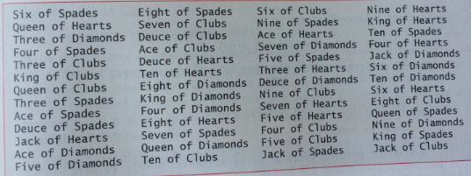
Output

Slide 41
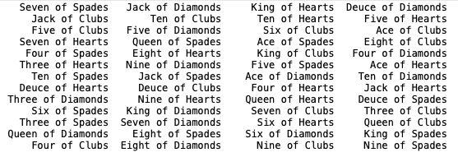
Output

Slide 42
Passing Arguments to Methods
Pass-by-value (also called call-by-value)
A copy of the argument’s value is passed to the called method.
The called method works exclusively with the copy.
Changes to the called method’s copy do not affect the original variable’s value in the caller.
Pass-by-reference (also called call-by-reference)
The called method can access the argument’s value in the caller directly and modify that data, if necessary.
Improves performance by eliminating the need to copy possibly large amounts of data.
Notes:
This has been covered in Methods topic.

Slide 43
Passing Arguments to Methods
All arguments in Java are passed by value.
A method call can pass two types of values to a method
Copies of primitive values
Copies of references to objects
Objects (not references to objects) cannot be passed to methods.

Slide 44
Passing Arguments to Methods
If a method modifies a reference-type parameter so that it refers to another object, only the parameter refers to the new object
The reference stored in the caller’s variable still refers to the original object.
Although an object’s reference is passed by value, a method can still interact with the referenced object by calling its public methods using the copy of the object’s reference.
The parameter in the called method and the argument in the calling method refer to the same object in memory.

Slide 45
Passing Arguments in Java
public class TestClass
{
public void fn1 (int x)
{
x = 10;
} // end method fn1
public static void main(String args[]) {
TestClass t = new TestClass();
int y = 5;
t.fn1 (y);
System.out.println(y);
} // end method main
} // end class TestClass
6a) What is the output of the following code?
5
10
Compiler error
Values of primitive types are passed by value (i.e., a copy of the value is passed to the called method).
Notes:
A

Slide 46
Passing object references
public class TestClass {
public int iV;
public void fn1 (TestClass t1) {
t1.iV = 10;
} // end method fn1
public static void main(String args[]) {
TestClass t = new TestClass();
t.iV = 5;
t.fn1(t);
System.out.println(t.iV);
} // end method main
} // end class TestClass
6b) What is the output of the following code?
5
10
Compiler error
Object references are passed by value (i.e., the method stores a new reference to the passed object in its local variable, similar to pass by reference in C++).
Notes:
B

Slide 47
public class TestClass {
public int iV;
public void fn1 (TestClass t1) {
t1 = new TestClass();
t1.iV = 10;
} // end method fn1
public static void main(String args[]) {
TestClass t = new TestClass();
t.iV = 5;
t.fn1(t);
System.out.println(t.iV);
} // end method main
} // end class TestClass
7) What is the output of the following code?
5
10
Compiler error
In fn1, t1 initially has a reference to the same object that t1 references.
After the first statement in fn1, t1 references a new object.
Notes:
A

Slide 48
6.4 Array and ArrayList
Passing array reference to methods
toString()

Slide 49
Passing array references in Java
To pass an array, just specify the array name without any brackets (same as in C++)
E.g., int [] myArray;
we pass this array to method fn1 as fn1(myArray);
Array length need not be passed in Java. The length of the array can be found by the array final instance variable length (myArray.length)
myArray is a reference to the array. So fn1 receives a copy of this reference (as in C++)
Notes:
Start from here on Feb 17, 2014

Slide 50
8)What is the output of the following code?
0
10
Compiler error
public class TestClass {
public void fn1 (int[] arr) {
arr[0] = 10;
} // end method fn1
public static void main(String args[]) {
int[] arr1 = new int[2];
TestClass t = new TestClass();
t.fn1(arr1);
System.out.println(arr1[0]);
} // end method main
} // end class TestClass
A reference to arr1 is passed to fn1.
Remember: array elements get initialized to default values (unlike local variables)
Notes:
B

Slide 51
9) What is the output of the following code?
0
10
Compiler error
public class TestClass {
public void fn1(int[] arr) {
arr = new int[2];
arr[0] = 10;
} // end method fn1
public static void main(String args[]) {
int[] arr1 = new int[2];
TestClass t = new TestClass();
t.fn1(arr1);
System.out.println(arr1[0]);
} // end method main
} // end class TestClass
After the first statement in fn1, arr references a different array than arr1.
Notes:
A
The default value of array elements is zero

Slide 52
10) What is the output of the following code?
0
10
Compiler error
public class TestClass {
public void fn1(int x) {
x = 10;
} // end method fn1
public static void main(String args[]) {
int[] arr1 = new int[2];
TestClass t = new TestClass();
t.fn1 (arr1[0]);
System.out.println(arr1[0]);
} // end method main
} // end class TestClass
If an array element is of a primitive type, then when this array element is passed, a copy of the value is passed (NOT the reference to the array).
Notes:
A

Slide 53
toString() method for a class
Every object has a toString()method defined.
Check toString() in class java.lang.Object
When we print an object, the object’s toString()method is invoked to convert the object into a String and this string is returned.
Notes:
Check Fig. 7.9 (Section 7.5) in Deitel

Slide 54
0
10
Compiler error
11) What is the output?
public class TestClass {
public int iV;
public void fn1(TestClass[] arr) {
arr[0].iV = 10;
} // end method fn1
public String toString() {
return (String.format("%d",iV));
} // end method toString
public static void main(String args[]) {
TestClass t = new TestClass();
TestClass[] arr1 = new TestClass[2];
arr1[0] = new TestClass();
arr1[1] = new TestClass();
t.fn1(arr1);
System.out.println(arr1[0]);
} // end method main
} // end class TestClass
Notes:
B
Review again.

Slide 55
0
10
Compiler error
12) What is the output?
public class TestClass {
public int iV;
public void fn1 (TestClass obj) {
obj.iV = 10;
} // end method fn1
public String toString() {
return (String.format("%d",iV));
} // end method toString
public static void main(String args[]) {
TestClass t = new TestClass();
TestClass[] arr1 = new TestClass[2];
arr1[0] = new TestClass();
arr1[1] = new TestClass();
t.fn1 (arr1[0]);
System.out.println(arr1[0]);
} // end method main
} // end class TestClass
Notes:
B

Slide 56
Summary: Passing Arrays to Methods
A method can pass two types of values to a method
Copies of primitive values
Copies of references to objects
Objects cannot be passed to methods
When an object’s reference is passed to a method, the parameter in the called method and the argument in the calling method both refer to the same object in memory
If the called method modifies an object’s reference to refer to another object, only the parameter in the called method refers to the new object
The reference stored in the calling method’s variable still refers to the original object
Notes:
Look at Fig. 7.15 in Deitel. See whether you can code it yourself.

Slide 57
6.5 Array and ArrayList
GradeBook Example using array

Slide 58
Exercise 1: redo GradeBook class
Two instance variables: courseName and an array of grades in integer
A constructor with two parameters for initializing course and the array of grades
Setter and getter for courseName
displayMessage() that displays “Welcome to the Grade Book for [whatever course specified in courseName]

Slide 59
Sample Code: redo GradeBook
public class GradeBook {
private String courseName;
private int[] grades; // store the grades of students
public GradeBook(String name, int[] gradesArray) {
courseName = name;
grades = gradesArray;
} // end constructor
public void setCourseName(String name) {
courseName = name;
} // end method setCourseName
public String getCourseName() {
return courseName;
} // end method getCourseName
}

Slide 60
Exercise 2: modify GradeBook class
Add the following methods to the GradeBook class:
outputGrades() to display the grades
getAverage() to return the average of the grades
getMaximum() to return the highest grade
getMinimum() to return the lowest grade
processGrades() to first display the grades (by calling outputGrades(), then display the average grade, the maximum grade and the minimum grade.

Slide 61
Sample Code: modify GradeBook
public class GradeBook {
private String courseName;
private int[] grades; // store the grades of students
public GradeBook(String name, int[] gradesArray) {
courseName = name;
grades = gradesArray;
} // end constructor
public void setCourseName(String name) {
courseName = name;
} // end method setCourseName
public String getCourseName() {
return courseName;
} // end method getCourseName

Slide 62
public void displayMessage() {
System.out.println ("Welcome to the Grade Book for " +
getCourseName() + "!");
} // end method displayMessage
private double getAverage() {
int total = 0;
for (int grade : grades)
total += grade;
return ((double) total/grades.length);
} // end function getAverage
private int getMinimum() {
int currMin = grades[0];
for (int grade : grades)
currMin = (grade < currMin ? grade : currMin);
return currMin;
} // end function getMinimum

Slide 63
private int getMaximum() {
int currMax = grades[0];
for (int grade : grades)
currMax = (grade > currMax ? grade : currMax);
return currMax;
} // end function getMaximum
public void outputGrades() {
System.out.println("The grades are: ");
for (int i = 0; i < grades.length; i++) {
System.out.printf("Student %2d: %3d\n", i + 1, grades[i]);
} // end method outputGrades
public void processGrades() {
outputGrades();
System.out.printf("Class Average = %.2f\n", getAverage());
System.out.println("Lowest grade = " + getMinimum());
System.out.println("Highest grade = " + getMaximum());
} // end method processGrades
} // end class GradeBook

Slide 64
GradeBook Test Application
public class GradeBookTest {
public static void main(String[] args) {
int[] gradesArray = {87, 75, 94, 100, 83, 78, 85, 91, 87, 93};
GradeBook gb = new GradeBook("Java", gradesArray);
gb.displayMessage();
gb.processGrades();
} // end function main
} // end class GradeBookTest
Test data can come from any of the following sources:
Placed directly into an array – this is what we did above.
Can come from the user at the keyboard
Can come from a file in the file system
Can come from a network

Slide 65
6.6 Array and ArrayList
Multi-dimensional arrays
Two-dimensional GradeBook

Slide 66
Multi-dimensional arrays in Java
2-dimensional arrays can be used to represent tables of values
Multi-dimensional arrays can have more than 2 dimensions
Java does not support multi-dimensional arrays directly.
But Java supports multi-dimensional arrays by specifying arrays whose elements are arrays
Therefore, unlike C++, we can have 2 rows in a 2-D array with different number of columns.

Slide 67
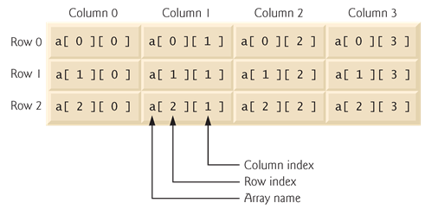
2-D array

Slide 68
Multi-dimensional arrays
A 2-D array could be declared and initialized with nested array initializers as:
int[][] b = { {1, 2}, {3, 4} };
The row b[0] is an int array with elements {1, 2}
The row b[1] is an int array with elements {3, 4}
Rows can have different length
int[][] b = { {1, 2}, {3, 4, 5} };
Notes:
To create 2d ArrayList: ArrayList<ArrayList<String>> array = new ArrayList<ArrayList<String>>();
That is, ArrayList of ArrayList

Slide 69
Multi-dimensional arrays
A 2-D array with the same number of columns in every row can be created as:
int[][] b = new int[3][4]; // 3 rows, 4 columns
Remember: array elements get default values
A 2-D array with different number of columns can be created as:
int[][] b = new int[2][];
b[0] = new int[5]; // this row has 5 elements
b[1] = new int[3]; // this row has 3 elements
Notes:
It has to be int[][] b = new int[2][]; and not int[][] b = new int[][2];

Slide 70
13) What will be the output of the following code fragment?
0
1
3
Compiler error
Runtime exception
int[][] a = { {1, 2}, {3}, {4, 5, 6} };
System.out.println(a[1][0]);
Notes:
C

Slide 71
14) What will be the output of the following code fragment?
0
3
4
Compiler error
Runtime exception
int[][] a = { {1, 2}, {3}, {4, 5, 6} };
System.out.println(a[1][1]);
Exercise:
Write code to display the array:
2
3
4 5 6
Notes:
E – IndexOutOfBoundsException (run time error)
For (int [] m: a)
{
for (int n: m)
System.out.print (n + “ ”);
System.out.println ();
}

Slide 72
Key
8) B
9) A
10) A
13) C
14) E

Slide 73
Sample code for #14 Exercise
for (int [] m: a) {
for (int n: m) {
System.out.print (n + “ ”);
{
System.out.println ();
}

Slide 74
Case study: Gradebook using 2-D array
public class GradeBook {
private String courseName;
private int[][] grades; // store the grades of students
public GradeBook(String name, int[][] gradesArray) {
courseName = name;
grades = gradesArray;
} // end constructor
public void setCourseName(String name) {
courseName = name;
} // end function setCourseName
public String getCourseName() {
return courseName;
} // end function getCourseName
Notes:
The 2 dimensional array is for storing a list of students with a no of test results. Then the display will show the average for all the tests for each student.

Slide 75
public void displayMessage() {
System.out.println ("Welcome to the Grade Book for " +
getCourseName() + "!");
} // end function displayMessage
public void processGrades() {
outputGrades();
System.out.printf("Class Average = %.2f\n", getAverage());
System.out.println("Lowest grade = " + getMinimum());
System.out.println("Highest grade = " + getMaximum());
} // end function processGrades
Notes:
Class average is the average of all the tests of all students, i.e. sum of all scores/no of scores

Slide 76
public void outputGrades() {
System.out.println("The grades are: ");
System.out.printf("%10s", "");
for (int i = 0; i < grades[0].length; i++)
System.out.printf("%8s", ("Test " + (i + 1)));
System.out.printf("%10s\n", "Average");
for (int i = 0; i < grades.length; i++) {
System.out.printf("Student %2d", i + 1);
for (int j = 0; j < grades[i].length; j++) {
System.out.printf("%8d", grades[i][j]);
}
System.out.printf("%10.2f\n", getStudentAverage(grades[i]));
}
} // end function outputGrades

Slide 77
// this function gets average grade over all grades
private double getAverage() {
int total = 0;
int numGrades = 0;
for (int[] studentGrades : grades)
for (int grade : studentGrades) {
total += grade;
numGrades++;
}
return ((double) total/numGrades);
}
// this function gets average grade for 1 student
private double getStudentAverage(int[] studentGrades) {
int total = 0;
for (int grade : studentGrades)
total += grade;
return (double) total/studentGrades.length;
}

Slide 78
private int getMinimum() {
int currMin = grades[0][0];
for (int[] studentGrades : grades)
for (int grade : studentGrades)
currMin = Math.min(grade, currMin);
return currMin;
} // end function getMinimum
private int getMaximum() {
int currMax = grades[0][0];
for (int[] studentGrades : grades)
for (int grade : studentGrades)
currMax = Math.max(grade, currMax);
return currMax;
} // end function getMaximum
} // end class GradeBook

Slide 79
public class GradeBookTest {
public static void main(String[] args) {
int[][] gradesArray =
{ {87, 95, 89},
{78, 92, 80},
{92, 100, 91},
{89, 97, 93},
{89, 100, 100},
{75, 85, 95},
{76, 99, 95},
{81, 84, 89},
{79, 94, 97},
{86, 87, 95}
};
GradeBook gb = new GradeBook("Java", gradesArray);
gb.displayMessage();
gb.processGrades();
} // end function main
} // end class GradeBookTest

Slide 80
6.7 Array and ArrayList
Variable length argument list

Slide 81
Variable length argument lists
Parameter variable is an array
public class TestClass {
public double average(double... numbers) {
double total = 0;
for (double d: numbers)
total += d;
return total/numbers.length;
}
public static void main(String[] args) {
TestClass t = new TestClass();
double d1 = 10, d2 = 20, d3 = 30, d4 = 40;
System.out.println("d1 = " + d1);
System.out.println("d2 = " + d2);
System.out.println("d3 = " + d3);
System.out.println("d4 = " + d4);
System.out.println("average of d1, d2 = " + t.average(d1, d2));
System.out.println("average of d1, d2, d3 = " + t.average(d1, d2, d3));
System.out.println("average of d1, d2, d3, d4 = " + t.average(d1, d2, d3, d4));
} // end method main
} // end class TestClass
Enhanced for-loop
Length
Variable length argument lists

Slide 82
Variable length argument lists
Used to create method that receive unspecified number of arguments
Parameter type followed by ellipsis (…) indicates method receives variable number of arguments of that type
The parameter variable is an array. Can access elements using index, can access length variable etc.
The ellipsis can occur only at the end of a parameter list
Otherwise, it is a compile time error

Slide 83
Command Line Arguments
public class TestClass {
public static void main(String[] args) {
if (args.length != 3) {
System.out.println("Invoke as java TestClass arraySize initValue increment");
System.exit(0);
}
else {
System.out.printf("%5s%8s\n", "Index", "Value");
int length = Integer.parseInt(args[0]);
int init = Integer.parseInt(args[1]);
int incr = Integer.parseInt(args[2]);
for (int i = 0; i < length; i++) {
int val = init + incr * i;
System.out.printf("%5d%8d\n", i, val);
} // end for loop
} // end else
} // end method main
} // end class TestClass
Checking the number of command line arguments
Use a wrapper class to parse a string into an int

Slide 84
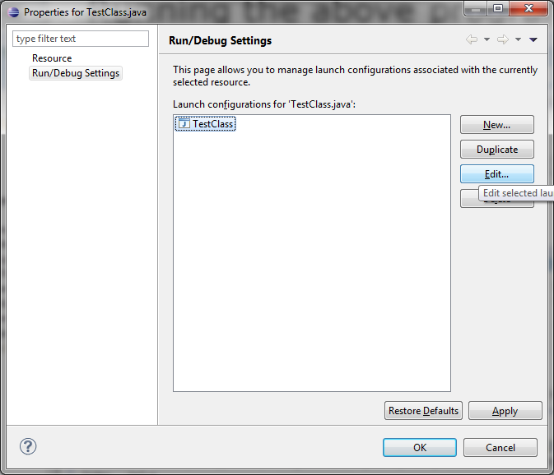
Running the above program from Eclipse
Properties > Run/Debug Settings > Name of the class (TestClass) > Edit

Slide 85
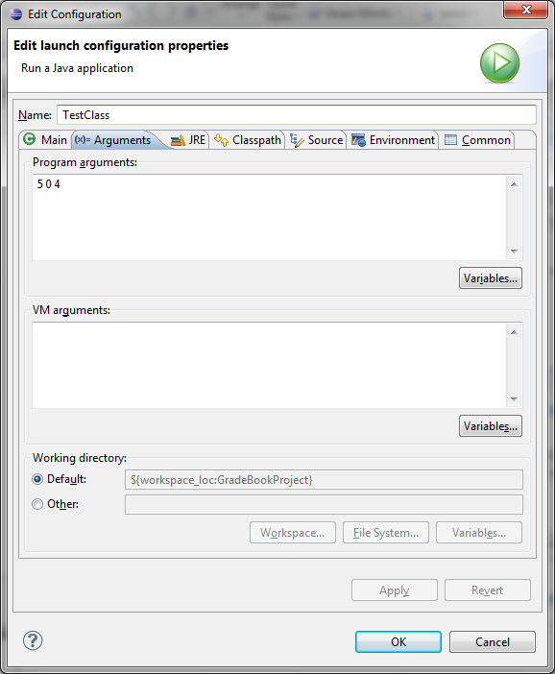
Select Arguments
Now specify the arguments as a space-separated list
If using command line, just type java TestClass 5 0 4

Slide 86
6.8 Array and ArrayList
java.util.Arrays
static methods for common array manipulations

Slide 87
Class: java.util.Arrays
Provides static methods for common array manipulations
Can be used with arrays of primitive types as well as arrays of objects
Methods include: sort, binarySearch, equals, fill, toString
Note: binarySearch requires sorted array, otherwise the value returned is undefined
Static method: System.arraycopy
Copies contents from one array to another
For array of objects, object references are copied
https://docs.oracle.com/en/java/javase/11/docs/api/java.base/java/util/Arrays.html

Slide 88
import java.util.Arrays;
class TempClass { // package class
public int v1;
public TempClass(int v) {
v1 = v;
}
public String toString() {
return ("" + v1); // to return a String
}
} // end class TempClass
public class TestClass {
public static void main(String[] args) {
double[] dArr = { 8.4, 9.3, 0.2, 7.9, 3.4 };
System.out.println("original dArr = " + Arrays.toString(dArr));
Arrays.sort(dArr);
System.out.println("dArr after sort = " + Arrays.toString(dArr));
Notes:
Java provides a default specifier which is used when no access modifier is present. Any class, field, method or constructor that has no declared access modifier is accessible only by classes in the same package.
The default modifier is not used for fields and methods within an interface.

Slide 89
int[] iArr1 = new int[10];
Arrays.fill(iArr1, 7);
System.out.println("iArr1 filled = " + Arrays.toString(iArr1));
int[] iArr2 = {1, 2, 3, 4, 5, 6};
int[] iArrCopy = new int[iArr2.length];
System.arraycopy(iArr2, 0, iArrCopy, 0, iArr2.length);
System.out.println("iArr2 = " + Arrays.toString(iArr2));
System.out.println("iArrCopy = " + Arrays.toString(iArrCopy));
if (Arrays.equals(iArr2, iArrCopy))
System.out.println("iArr2 == iArrCopy");
else System.out.println("iArr2 != iArrCopy");
TempClass[] tArr1 = new TempClass[2];
tArr1[0] = new TempClass(0);
tArr1[1] = new TempClass(1);
TempClass[] tArr2 = new TempClass[2];

Slide 90
// when objects are copied, references are copied
System.arraycopy(tArr1, 0, tArr2, 0, tArr1.length);
tArr2[1].v1 = 2;
System.out.println("tArr1 = " + Arrays.toString(tArr1));
System.out.println("tArr2 = " + Arrays.toString(tArr2));
if (Arrays.equals(tArr1, tArr2))
System.out.println("tArr1 == tArr2");
else System.out.println("tArr1 != tArr2");
// binary search returns < 0 means key not present in array
// otherwise binary search returns location where key is present
int loc = Arrays.binarySearch(iArr2, 5);
System.out.println("binary search returned " + loc);
loc = Arrays.binarySearch(iArr2, 10);
System.out.println("binary search returned " + loc);
} // end method main
} // end class TestClass

Slide 91
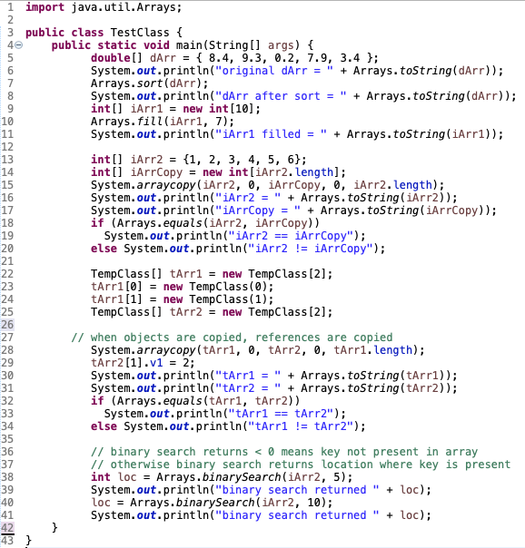

Slide 92
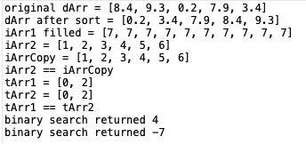
Output

Slide 93
6.9 Array and ArrayList
java.util.ArrayList
implements resizable arrays
ArrayList declaration
ArrayList methods
Wrapper Classes

Slide 94
Introduction to Collections
Java API provides several predefined data structures, called Collections to store groups of related objects
They provide methods to organize, store and retrieve data without requiring knowledge of how data is stored
Reduces application development time
Examples: ArrayList, Stack, LinkedList, HashSet, HashMap, …

Slide 95
ArrayList (Dietel 10th Ed: p. 287)
ArrayList<T> is a generic class that dynamically changes size to accommodate more elements
T is placeholder for type of elements in Collection
T is class name, and cannot be primitive type. Therefore ArrayList is a collection of objects (not of primitive types)
Classes with such placeholders are called generic classes

Slide 96
ArrayList Declaration
ArrayList<String> items = new ArrayList<String> ();
ArrayList<String> items = new ArrayList<> ();
Java SE 7 introduced Diamond <> notation for creating an object of a generic class
When the compiler encounters <> in the class instance creation expression, it uses the declaration of variable items to determine the ArrayList’s element type (String in this case)
– inferring the element type

Slide 97
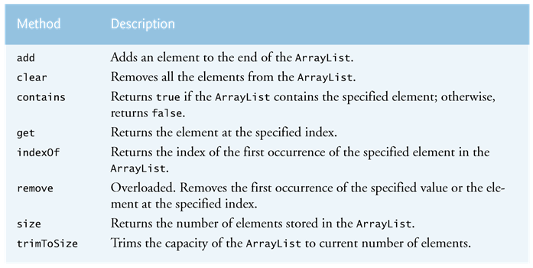
Some methods of ArrayList
import java.util.ArrayList;
add Overloaded. Adds an element to specified index of the ArrayList.
isEmpty Returns true if the ArrayList is empty, otherwise false.

Slide 98
Examples: ArrayList
ArrayList<Dog> dogList = new ArrayList<Dog> ();
OR
ArrayList<Dog> dogList = new ArrayList<> ();
Dog d1 = new Dog ();
Dog d2 = new Dog ();
dogList.add (d1);
dogList.add (0, d2); // overloaded add()
Notes:
Inferring the element type: when the compiler encounters the <> in the class instance creation expression, it uses the declaration of variable dogList to determine the ArrayList’s element type (Dog).

Slide 99
ArrayList methods
int size = dogList.size();
boolean isIn = dogList.contains(d1);
int i = dogList.indexOf (d2);
boolean isEmp = dogList.isEmpty();
dogList.remove (d1);
Dog d3 = dogList.get(0);

Slide 100
ArrayList for Primitive Types
Need the wrapper class to wrap the primitive as an object reference
Automatic wrapping/unwrapping (auto-boxing) for JDK 5.0 or greater

Slide 101
Wrapper Classes (in java.lang)
Boolean
Character
Byte
Short
Integer
Long
Float
Double

Slide 102
ArrayList of Primitives
ArrayList <Integer> intList = new ArrayList <Integer> ();
intList.add(3);
intList.add(4);
intList.add(5);
int value = intList.get(1);
int index = intList.indexOf(3);
Notes:
Integer value = intList.get(1): also works

Slide 103
import java.util.ArrayList;
public class ArrayListCollection {
public static void display (ArrayList<String> arrList) {
System.out.print ("display using enchanced for loop : ");
for (String item : arrList) {
System.out.print(item + " ");
}
System.out.println();
System.out.print ("Display using counter controlled loop : ");
for (int i = 0; i < arrList.size(); i++) {
System.out.print(arrList.get(i) + " ");
}
System.out.println();
} // end method display
Enhanced for loop
Using size() in for loop
Access object by index

Slide 104
public static void main(String[] args) {
ArrayList<String> items = new ArrayList<String>();
items.add("red"); // note that this function call returns true
display(items);
items.add(0, "yellow"); //this overloaded function has no return value
display(items);
items.add("green");
display(items);
items.add("yellow");
display(items);
// this method removes the first element with value yellow
// uses "yellow".equals(element) to check if the element has the value
// this method returns true if the array had an element with the
// specified value
items.remove("yellow");
display(items);
boolean add(element)
Overloaded.
void add(int, element)

Slide 105
// this method returns the removed element at specified index and returns the element
String s = items.remove(1);
System.out.println("removed item = " + s);
display(items);
System.out.printf("red is %sin the list\n", items.contains("red”)?””:"not ");
System.out.println("size = " + items.size());
} // end method main
} // end class ArrayCollection
What does this expression do?
Returns the size of the ArrayList

Slide 106
6.10 Array and ArrayList
Intro to Exceptions
try{} catch () {}

Slide 107
Java Exceptions: An introduction
An exception indicates a problem that occurs while a program executes
Exception handling allows us to create programs that can resolve (or handle) exceptions
When the JVM detects a problem, such as an invalid array index, it throws an exception
If we do not do any exception handling in the code, the program exits.
Check Java HTML API documentation for Class: java.lang.ArrayIndexOutOfBoundsException
Notes:
https://docs.oracle.com/javase/8/docs/api/java/lang/ArrayIndexOutOfBoundsException.html

Slide 108
Handling Exceptions: try… catch block
try {
Place codes that might throw an exception here
} catch(specificException identifier) {
Codes for handling the exception when it occurs
}
Can have many catch blocks to handle different types of exceptions that might be thrown in the try block
When an exception is thrown in a statement inside a try block, the rest of the try block is not executed, and the catch block for that exception will be executed.

Slide 109
Handling Exceptions: try… catch block
To handle an exception, place any code that might throw an exception in a try block
The catch block contains code that handles exception if one occurs.
We can have many catch blocks to handle different types of exceptions that might be thrown in the corresponding try block
When an exception is thrown in a statement inside a try block, the rest of the try block is not executed, and the catch block for that exception will be executed.

Slide 110
No try… catch block
int[] ratings = {3, 4, 5, 10, 4, 5};
int[] cum = new int[6];
for (int r: ratings) {
cum[r]++;
}
System.out.println("cumulative ratings");
System.out.printf("%10s%10s\n","rating","number");
for (int i = 0; i < cum.length; i++) {
System.out.printf("%10d%10d\n",i,cum[i]);
}
When r = 10, cum[r] in the first for loop throws an exception. If there is no try… catch block, then no more statement in the body of the method is executed and the program stops. We get a message indicating the exception.

Slide 111
With try… catch block
java.lang.ArrayIndexOutOfBoundsException: 10
Cumulative Ratings
rating number
0 0
1 0
2 0
3 1
4 1
5 1
int[] ratings = {3, 4, 5, 10, 4, 5};
int[] cum = new int[6];
try {
for (int r: ratings) {
cum[r]++;
}
} catch(ArrayIndexOutOfBoundsException e){
System.out.println(e);
}
System.out.println(“Cumulative Ratings");
System.out.printf("%10s%10s\n","rating","number");
for (int i = 0; i < cum.length; i++) {
System.out.printf("%10d%10d\n",i,cum[i]);
}
When r = 10, cum[r] throws an exception, which is handled by the catch block. The program then resumes after the catch block.
Also check: Throwable.toString() method
Notes:
https://docs.oracle.com/javase/7/docs/api/java/lang/Throwable.html

Slide 112
How to use try… catch block depends on your requirements…
java.lang.ArrayIndexOutOfBoundsException: 10
Cumulative Ratings
rating number
0 0
1 0
2 0
3 1
4 2
5 2
int[] ratings = {3, 4, 5, 10, 4, 5};
int[] cum = new int[6];
for (int rating: ratings) {
try {
cum[rating]++;
} catch(ArrayIndexOutOfBoundsException e){
System.out.println(e);
}
}
System.out.println(“Cumulative Ratings");
System.out.printf("%10s%10s\n","rating","number");
for (int i = 0; i < cum.length; i++) {
System.out.printf("%10d%10d\n",i,cum[i]);
}

Slide 113
GUI and Graphics
Graphics.fillArc(…) similar to Graphics.fillOval(…), but takes in 2 more parameters that specifies how much of the oval to fill (measured in degrees)
Specify start angle, and angle to be covered
For instance specifying these 2 parameters as 0, 180 draws a semi-circle starting at 0 degrees
Remember, the first 4 parameters specify the rectangle (just as in fillOval)
setBackground(Color) used to specify the background color of any GUI Component

Slide 114
import java.awt.Color;
import java.awt.Graphics;
import javax.swing.JPanel;
import javax.swing.JFrame;
public class DrawRainbow extends JPanel {
private final static Color VIOLET = new Color(128, 0, 128);
private final static Color INDIGO = new Color(75, 0, 130);
private Color[] colors = { Color.WHITE, Color.WHITE, VIOLET, INDIGO,
Color.BLUE, Color.GREEN, Color.YELLOW, Color.ORANGE, Color.RED
};
public DrawRainbow() {
setBackground(Color.WHITE);
} // end constructor

Slide 115
public void paintComponent(Graphics g) {
super.paintComponent(g);
int radius = 20;
// draw rainbow near bottom center
int centerX = getWidth()/2;
int centerY = getHeight() – 10;
// draw filled arcs from the outermost
for (int i = colors.length; i > 0; i--) {
g.setColor(colors[i- 1]);
g.fillArc(centerX - i * radius, centerY - i * radius, i * radius * 2, i * radius * 2, 0, 180);
}
} // end method paintComponent
public static void main(String[] args) {
JFrame frame = new JFrame();
DrawRainbow panel = new DrawRainbow();
frame.setDefaultCloseOperation(JFrame.EXIT_ON_CLOSE);
frame.add(panel);
frame.setSize(400, 250);
frame.setVisible(true);
} // end method main
} // end class DrawRainbow

Slide 116
Readings
Chapter 7 (Deitel)

Slide 117
Arrays Of References To Objects: An Example
Manager
Book
Driver
+MAX_ELEMENTS: int
bookList [0..9] : Book
lastElement: int
+Manager ()
+display ()
+add ()
+remove ()
-name : String
+Book (newName : String)
+getName()
+setName (newName : String)
Menu
aManager : Manager
menuSelection : char
+Manager ()
+getSelection ()
+processSelection ()

Slide 118
The Driver Class
public class Driver
{
public static void main (String [] args)
{
Menu aMenu = new Menu ();
aMenu.processSelection();
}
}

Slide 119
The Menu Class
public class Menu
{
private Manager aManager;
private char menuSelection;
public Menu () { aManager = new Manager (); }
public void display ()
{
System.out.println("\n\nLIST MANAGEMENT PROGRAM: OPTIONS");
System.out.println("\t(d)isplay list");
System.out.println("\t(a)dd new element to end of list");
System.out.println("\t(r)emove last element from the list");
System.out.println("\t(q)uit program");
System.out.print("Selection: ");
}

Slide 120
The Menu Class (2)
public void getSelection ()
{
menuSelection = br.readLine().charAt(0);
}
public void processSelection ()
{
do
{
display();
getSelection();

Slide 121
The Menu Class (3)
switch (menuSelection)
{
case 'D':
case 'd':
aManager.display();
break;
case 'A':
case 'a':
aManager.add();
break;
case 'R':
case 'r':
aManager.remove();
break;

Slide 122
The Menu Class (4)
case 'Q':
case 'q':
System.out.println("Quitting program.");
break;
default:
System.out.println("Please enter one of 'd','a','r' or 'q'");
}
} while ((menuSelection != 'Q') && (menuSelection != 'q'));
}
}

Slide 123
The Manager Class
public class Manager
{
public final int MAX_ELEMENTS = 10;
private Book [] bookList;
private int lastElement;
public Manager ()
{
bookList = new Book[MAX_ELEMENTS];
int i;
for (i = 0; i < MAX_ELEMENTS; i++)
{
bookList[i] = null;
}
lastElement = -1;
}

Slide 124
The Manager Class (2)
public void display()
{
int i;
System.out.println("Displaying list");
if (lastElement == -1)
System.out.println("\tList is empty");
for (i = 0; i <= lastElement; i++)
{
System.out.println("\tTitle No. " + (i+1) + ": "+ bookList[i].getName());
}
}

Slide 125
The Manager Class (3)
public void add ()
{
String newName;
System.out.print("Enter a title for the book: ");
newName = Console.in.readLine();
if ((lastElement+1) < MAX_ELEMENTS)
{
lastElement++;
bookList[lastElement] = new Book(newName);
System.out.println("Book " + newName + " added");
}

Slide 126
The Manager Class (4)
else
{
System.out.print("Cannot add new element: ");
System.out.println("List already has " + MAX_ELEMENTS + "
elements.");
}
}

Slide 127
The Manager Class (5)
public void remove ()
{
if (lastElement != -1)
{
bookList[lastElement] = null;
lastElement--;
System.out.println("Last element removed from list.");
}
else
{
System.out.println("List is already empty: Nothing to remove");
}
}
}

Slide 128
The Book Class
public class Book
{
private String name;
public Book (String newName) { name = newName; }
public void setName (String newName) { name = newName; }
public String getName () { return name; }
}

Slide 129
Creating Objects With The Constructor
A method that is used to initialize the attributes of an object as the objects are instantiated (created).
The constructor is automatically invoked whenever an instance of the class is created.
Object
Object
x
y
z
x = 1
y = 2
z = 3
Constructor

Slide 130
Creating Objects With The Constructor (2)
If no constructor is specified then the default constructor is called
e.g., Sheep jim = new Sheep();

Slide 131
Writing Your Own Constructor
Format (Note: Constructors have no return type):
public <class name> (<parameters>)
{
// Statements to initialize the fields of the class
}
Example:
public Sheep ()
{
System.out.println("Creating \"No name\" sheep");
name = "No name";
}

Slide 132
Overloading The Constructor
Creating different versions of the constructor
Each version is distinguished by the number, type and order of the parameters
public Sheep ()
public Sheep (String n)
When overloading constructors
Avoid distinguishing constructors solely by the order of the parameters
Avoid overloading constructors but having identical implementation for each body

Slide 133
Constructors: An Example
Driver
Sheep
-name: String
+Sheep()
+Sheep(newName: String)
+getName()
+changeName(newName: String)

Slide 134
The Driver Class
public class Driver
{
public static void main (String [] args)
{
Sheep nellie;
Sheep jim;
System.out.println("Creating flock...");
nellie = new Sheep ("Nellie");
jim = new Sheep();
jim.setName("Jim");
System.out.println("Displaying updated flock");
System.out.println(“ "+ nellie.getName());
System.out.println(“ "+ jim.getName());
}
}

Slide 135
Class Sheep
public class Sheep
{
private String name;
public Sheep ()
{
System.out.println("Creating \"No name\" sheep");
name = "No name";
}
public Sheep (String newName)
{
System.out.println("Creating the sheep called " + newName);
name = newName;
}
public String getName () { return name; }
public void setName (String newName) { name = newName; }
}

Slide 136
Shadowing
When a variable local to the method of a class has the same name as an attribute of that class.
Be careful of accidentally doing this.
public class Sheep
{
private String name;
public Sheep (String newName)
{
String name;
System.out.println("Creating the sheep called " + newName);
name = newName;
}

Slide 137
Shadowing
Scope Rules:
Look for a local identifier
Look for an attribute
public class Foo
{
// Attributes
public void method ()
{
// Local variables
num = 1;
}
}
Second: Look for an attribute by that name
First: Look for a local identifier by that name
A reference to an identifier

Slide 138
Information Hiding
An important part of Object-Oriented programming
Protects the inner-workings (data) of a class
Only allow access to the core of an object in a controlled fashion (use public parts to access the private sections)

Slide 139
Encapsulation
Grouping data and methods together within a class definition to allow the private attributes to be accessible only through the public methods (this allows for information to be hidden and protected because access to the data occurs only through a controlled scenario).

Slide 140
Public And Private Parts Of A Class
The public methods can be used to do things such as access or change the instance fields of the class
get data
set data
publicmethod
publicmethod
publicmethod
private data

Slide 141
Public And Private Parts Of A Class
Types of methods that utilize the instance fields:
Accessor methods - ‘getter’
Used to get the current value of a field
Example:
public int getNum ()
{
return num;
}
Mutator methods - ‘setter’
Used to set a field to a new value
Example:
public void setNum (int newValue)
{
num = newValue;
}

