Slide 1
9.1 Polymorphism
Concept of Polymorphism in OOP
Polymorphic array & ArrayList
Polymorphic method
Polymorphic argument

Slide 2
So far…
Friend myFriend = new Friend ();
Same Reference type and Object type

Slide 3
Polymorphism
HospitalWorker
Physician
Nurse
Radiologist

Slide 4
Polymorphism
HospitalWorker hw = new Physician ();
Reference to a HospitalWorker
Created object is a Physician
** The reference type can be a superclass of the actual object type

Slide 5
Polymorphism
HospitalWorker
helpPatient()
Physician
helpPatient()
Nurse
helpPatient()
Radiologist
helpPatient()

Slide 6
(1) Polymorphic Array
HospitalWorker[] hWorkers = new HospitalWorker [3];
hWorkers[0] = new Physician();
hWrokers[1] = new Nurse();
hWorkers[2] = new Radiologist();

Slide 7
(2) Polymorphic ArrayList
ArrayList<HospitalWorker> hwList = new ArrayList<> ();
Physician aPhysician = new Physician();
Nurse aNurse = new Nurse();
Radiologist aRadiologist = new Radiologist();
hwList.add(aPhysician);
hwList.add(aNurse);
hwList.add(aRadiologist);

Slide 8
Exercise 1
Vehicle: Car, Suv, Truck, Bus, Train
SportsEquipment: HockeyStick, TennisRacquet, BaseballBat, GolfClub, SoccerBall
Shoe: Sneaker, Loafer, Wedge, Boot, Flat
School: Kindergarten, Elementary, HighSchool, College, University
Furniture: Table, Chair, Sofa, Recliner, Bench
1) Create an array containing 2, 1, 1, 2, 1 of the subclass objects.
2) Do the same using an ArrayList.
Notes:
Vehicle[] v = new Vehicle[7];
V[0] = new Car();
V[1] = new Car();
V[2] = new Suv();
V[3] = new Truck();
V[4] = new Bus();
V[5] = new Bus();
V[6] = new Train();
ArrayList<Vehicle> v = new ArrayList<>();
v.add (new Car());
v.add (new Car());

Slide 9
Exercise 1A – Sample Code
// Using an array (fixed size once declared so no more items)
Vehicle[] v = new Vehicle[7];
V[0] = new Car();
V[1] = new Car();
V[2] = new Suv();
V[3] = new Truck();
V[4] = new Bus();
V[5] = new Bus();
V[6] = new Train();
// Using an ArrayList (more items can be added)
ArrayList<Vehicle> v = new ArrayList<>();
v.add (new Car());
v.add (new Car());
v.add (new Suv());
v.add (new Truck());
v.add (new Bus());
v.add (new Bus());
v.add (new Train());
Notes:
Vehicle[] v = new Vehicle[7];
V[0] = new Car();
V[1] = new Car();
V[2] = new Suv();
V[3] = new Truck();
V[4] = new Bus();
V[5] = new Bus();
V[6] = new Train();
ArrayList<Vehicle> v = new ArrayList<>();
v.add (new Car());
v.add (new Car());

Slide 10
(3) Polymorphic methods
for (int i=0; i<hWorkers.length; i++){
hWorkers[i].helpPatient();
}

Slide 11
(4) Polymorphic arguments
public class Patient {
public void needService (HospitalWorker hw){
hw.helpPatient();
}
}
public class HospitalSystem {
public void static main (String[] args){
Patient aPatient = new Patient();
Physician aPhysician = new Physician();
Nurse aNurse = new Nurse();
aPatient.needService(aPhysician);
aPatient.needService(aNurse);
}
}
Declare method parameter as a superclass type
Pass in any subclass object at runtime

Slide 12
public class TestBoats {
public static void main(String[] args){
Boat b1 = new Boat();
Sailboat b2 = new Sailboat();
Rowboat b3 = new Rowboat();
b2.setLength(32);
b1.move();
b3.move();
b2.move();
}
} // end class SubSubClass
// No polymorphic, only inheritance
public class Boat {
private int length;
public void setLength (int len) {
length = len;
}
public int getLength() {
return length;
}
public void move() {
System.out.println (”Drift");
}
} // end class Boat
1) What is the output?
public class Rowboat extends Boat {
public void rowTheBoat() {
System.out.println (”Row a boat");
}
} // end class Rowboat
public class Sailboat extends Boat {
public void move() {
System.out.println (”Set sail");
}
} // end class Sailboat
Notes:
drift
drift
set sail

Slide 13
public class Ship {
private int length;
public void setLength (int len) {
length = len;
}
public int getLength() {
return length;
}
public void move() {
System.out.print (”Launch. ");
}
} // end class Boat
public class Sailboat extends Ship {
public void move() {
System.out.print (”Set sail. ");
}
} // end class Sailboat
public class Shipdock {
public static void main(String[] args){
Ship s1 = new Ship();
Sailboat s2 = new Sailboat();
Rowboat s3 = new Rowboat();
s2.setLength(32);
s1.move();
s3.move();
s2.move();
}
} // end class SubSubClass
public class Rowboat extends Ship {
public void rowTheBoat() {
System.out.print (”Row a boat. ");
}
} // end class Rowboat
Notes:
Launch
Launch
Set sail

Slide 14
9.2 Polymorphism
Reference vs. Object
Early binding
Dynamic binding
Casting Object References
upcasting
downcasting

Slide 15
Reference vs. object
Assigning a superclass reference to a superclass object is straightforward
SuperClass obj1 = new SuperClass();
Same for subclass reference to a subclass object
SubClass obj2 = new SubClass();
Notes:
Start from here March 24, 2014

Slide 16
Reference vs. object
Assigning a superclass reference to a subclass object is safe
SuperClass s1 = new SubClass();
Assigning a subclass reference to a superclass object results in compiler error
SubClass s2 = new SuperClass();
Notes:
Object and variable seem to be used interchangeably.

Slide 17
Early vs. late (dynamic) binding
At compile time, when the compiler encounters a method call through a reference, it checks that the method is defined for that type
E.g., compiler checks setArea(int) is defined for Shape
At execution time, the type of the object to which the reference refers determines the method to use – dynamic binding

Slide 18
Why not use Object Class?
Every class in Java extends class Object
Can we do this?
Object obj = new Ferrari();
obj.goRocketFast();
Notes:
No, at compilation, it will look for goRocketFast() in the Object class.

Slide 19
Casting Object References between Classes in Inheritance Hierarchy
SubClass obj1 = new SubClass();
SuperClass obj2 = (SuperClass) obj1;
SuperClass obj3 = obj1;
obj2.fn1();
obj3.fn1();
UpCasting: Casting an object of a subclass into an object of a superclass. Always works.
A
DownCasting: Casting an object of a superclass into an object of a subclass. No compiler error. We may get run-time error (in some cases).
SuperClass obj1 = new SuperClass();
SubClass obj2 = (SubClass) obj1;
obj2.fn1();
SubClass obj1 = new SubClass();
SuperClass obj2 = obj1;
SubClass obj3 = (SubClass) obj2;
obj3.fn1();
B
C
Run-time Error: ClassCastException
No Run-time Error
Notes:
C: Java compiler allows the assignment of a superclass reference to a subclass variable if we explicitly cast the superclass reference to the subclass type.

Slide 20
9.3 Polymorphism
Example Program using Polymorphism
Shape
Square
Circle
ShapeTest
Polymorphic Features

Slide 21
public class Shape {
protected double perimeter;
protected double area;
public double getPerimeter() {
return perimeter;
}
public void setPerimeter(double perimeter) {
this.perimeter= perimeter;
}
public double getArea() {
return area;
}
public void setArea(double area) {
this.area = area;
}
@override
public String toString() {
String s = "";
s = String.format(”perimeter= %.2f;", perimeter);
s = String.format("%s area = %.2f", s, area);
return s;
}
} // end class Shape

Slide 22
import java.lang.Math;
public class Square extends Shape {
protected double side;
public double getSide() {
return side;
}
public void setSide(double s) {
side = s;
super.setPerimeter(side * 4);
super.setArea(side * side);
}
@override
public void setPerimeter(double p) {
side = p/4;
super.setPerimeter(p);
super.setArea(side * side);
}
@override
public void setArea(double a) {
side = Math.sqrt(a);
super.setPerimeter(side * 4);
super.setArea(a);
}
public Square(int s) {
side = s;
super.setPerimeter(side * 4);
super.setArea(side * side);
}
} // end Class Square
Notes:
public Square(int s) {
side = s;
super.setCircumference(side * 4);
super.setArea(a);
}
I think a should be replaced by side * side.

Slide 23
import java.lang.Math;
public class Circle extends Shape {
protected double radius;
public double getRadius() {
return radius;
}
public void setRadius(double r) {
radius = r;
super.setPerimeter(2 * Math.PI * radius);
super.setArea(Math.PI * radius * radius);
}
@override
public void setPerimeter(double c) {
radius = c/(2 * Math.PI);
super.setPerimeter(c);
super.setArea(Math.PI * radius * radius);
}
@override
public void setArea(double a) {
radius = Math.sqrt(a/Math.PI);
super.setPerimeter(2 * Math.PI * radius);
super.setArea(a);
}
public Circle(double r) {
radius = r;
super.setPerimeter(2 * Math.PI * radius);
super.setArea(Math.PI * radius * radius);
}
} // end Class Circle

Slide 24
public class ShapeTest {
public static void main(String[] args) {
Shape[] arr = new Shape[3];
arr[0] = new Shape();
arr[1] = new Square(5);
arr[2] = new Circle(5);
arr[0].setArea(100);
arr[1].setArea(100);
arr[2].setArea(100);
for (int i = 0; i < arr.length; i++) {
System.out.println(arr[i].toString());
}
}
} // end Class ShapeTest

Slide 25
Dynamic binding
arr[1] is of type Shape, and it can reference a Square/Circle object because a Square (or Circle) object is also a Shape object.
arr[1] = new Square(5);
When we call Shape.setArea(int), the appropriate setArea method is invoked at runtime – called dynamic binding
For instance, arr[1].setArea(100) calls setArea(100) in Square class.

Slide 26
Polymorphism
At run-time, different objects know how to “do the right thing” in response to the same method call
Invoking a method on a subclass object via a superclass reference invokes subclass functionality
The same message sent to a variety of objects has many forms of results – hence polymorphism

Slide 27
Polymorphism
Enables us to “program in the general” rather than “program in the specific” – simplifies programming
We can write programs that process objects that share a superclass as if they are all objects of the superclass
In Shape example:
we process Shape, Square and Circle objects as if they are all Shape objects
Notes:
Think about later on you may want to include more subclasses. Programming in the general makes it more flexible.

Slide 28
Polymorphism features
Polymorphism helps us design and implement systems that are extensible
New classes can be added with little or no modification to the general portions of the program
The only parts of the program that need modification are those that deal with the new types

Slide 29
Polymorphism features
At compile time, when the compiler encounters a method call through a reference, it checks that the method is defined for the referenced type.
E.g., compiler checks setArea(int) is defined for Shape
At execution time, the type of the object to which the reference refers determines the method to use – dynamic binding

Slide 30
public class SuperClass {
public void fn1() {
System.out.println("superClass fn1");
}
public static void main(String[] args) {
SuperClass obj1 = new SubSubClass();
obj1.fn1();
}
} // end class SuperClass
1) What is the output?
superClass fn1
subClass fn1
subSubClass fn1
Compiler error
Run-time error
public class SubClass extends SuperClass {
@Override
public void fn1() {
System.out.println("subClass fn1");
}
} // end class SubClass
public class SubSubClass extends SubClass {
@Override
public void fn1() {
System.out.println("subSubClass fn1");
}
} // end class SubSubClass
Notes:
C

Slide 31
public class SuperClass {
public static void main(String[] args) {
SuperClass obj1 = new SubSubClass();
obj1.fn1();
}
} // end class SuperClass
2) What is the output ?
superClass fn1
subClass fn1
subSubClass fn1
Compiler error
Run-time error
public class SubClass extends SuperClass {
public void fn1() {
System.out.println("subClass fn1");
}
} // end class SubClass
public class SubSubClass extends SubClass {
public void fn1() {
System.out.println("subSubClass fn1");
}
} // end class SubSubClass
Notes:
D – fn1() is undefined for SuperClass → compilation error (early binding was not successful)

Slide 32
public class SuperClass {
public void fn1() {
System.out.println("superClass fn1");
}
public static void main(String[] args) {
SuperClass obj1 = new SubSubClass();
obj1.fn1();
}
} // end class SuperClass
3) What is the output?
superClass fn1
subClass fn1
subSubClass fn1
Compiler error
Run-time error
public class SubClass extends SuperClass {
} // end class SubClass
public class SubSubClass extends SubClass {
public void fn1() {
System.out.println("subSubClass fn1");
}
} // end class SubSubClass
Notes:
C

Slide 33
public class SuperClass {
public void fn1() {
System.out.println("superClass fn1");
}
public static void main(String[] args) {
SuperClass obj1 = new SubSubClass();
obj1.fn1();
}
} // end class SuperClass
4) What is the output?
superClass fn1
subClass fn1
subSubClass fn1
Compiler error
Run-time error
public class SubClass extends SuperClass {
public void fn1() {
System.out.println(”subClass fn1");
}
} // end class SubClass
public class SubSubClass extends SubClass {
} // end class SubSubClass
Notes:
B

Slide 34
Try the following code…
{
Object o = "a string";
String s = (String) o;
// System.out.println(o.length());
System.out.println(s.length());
}
Why does the above work??
What is the inheritance hierarchy between Object and String?
Use debugger, and evaluate the expression o.getClass(). What do you see?? Can you now explain why the above code works?
What will happen if we uncomment the line commented out? Is it a compile-time error? Why do we get this error?

Slide 35
9.4 Polymorphism
Java operator: instanceof
getClass()
getName()

Slide 36
Java operator: instanceof
instanceof operator compares an object to a type.
Use it especially before downcasting
If object reference is null, it is not an instanceof anything.
Notes:
Output:
SubClass@6d4b473
null
Left:
class SubClass
class SubClass
class SubClass
class SuperClass
Print obj5.getclass() gives java.lang.NullPointerException (run time error)

Slide 37
Java operator: instanceof
public class SuperClass {
} // end class SuperClass
public class SubClass extends SuperClass{
public static void main(String[] args) {
SubClass obj1 = new SubClass();
SuperClass obj2 = (SuperClass) obj1;
SubClass obj3 = null;
if (obj2 instanceof SubClass)
obj3 = (SubClass) obj2;
System.out.println(obj3);
SuperClass obj4 = new SuperClass();
SubClass obj5 = null;
if (obj4 instanceof SubClass)
obj5 = (SubClass) obj5;
System.out.println(obj5);
}
} // end class SubClass
Output:
SubClass@6d4b473
Null
Notes:
Output:
SubClass@6d4b473
null
Right:
class SubClass
class SubClass
class SubClass
class SuperClass
Print obj5.getclass() gives java.lang.NullPointerException (run time error)

Slide 38
Java operator: instanceof
public class SuperClass {
} // end class SuperClass
(4b) Also, try the following code. Look up getClass() method in java.lang.Object
public class SubClass extends SuperClass{
public static void main(String[] args) {
SubClass obj1 = new SubClass();
SuperClass obj2 = (SuperClass) obj1;
SubClass obj3 = null;
if (obj2 instanceof SubClass)
obj3 = (SubClass) obj2;
System.out.println(obj3);
SuperClass obj4 = new SuperClass();
SubClass obj5 = null;
if (obj4 instanceof SubClass)
obj5 = (SubClass) obj5;
System.out.println(obj5);
}
} // end class SubClass
System.out.println(obj1.getClass());
System.out.println(obj2.getClass());
System.out.println(obj3.getClass());
System.out.println(obj4.getClass());
System.out.println(obj5.getClass());
Output:
class SubClass
class SubClass
class SubClass
class SuperClass
Output:
SubClass@6d4b473
Null
NullPointerException is thrown when trying to print obj5.getClass()
Notes:
Output:
SubClass@6d4b473
null
Right:
class SubClass
class SubClass
class SubClass
class SuperClass
Print obj5.getclass() gives java.lang.NullPointerException (run time error)

Slide 39
getClass() & getName()
To determine the Class of an object at runTime
Use method getClass() defined in java.lang.Object.
Also check getClass().getName() defined in java.lang.Class
public class SuperClass {
public void fn1() {
System.out.println("superClass fn1");
}
public static void main(String[] args) {
SuperClass obj1 = new SubClass();
obj1.fn1();
System.out.println(obj1.getClass());
System.out.println(this.getClass().getName());
}
}
public class SubClass extends SuperClass{
public void fn1() {
System.out.println("subClass fn1");
}
}
subClass fn1
class SubClass
SuperClass

Slide 40
5) Assume SubClass extends SuperClass. What will the following code print?
{
SubClass obj = new SubClass();
System.out.println(obj instanceof SuperClass);
}
Notes:
True because all subclass objects are also superclass objects

Slide 41
9.5 Polymorphism
Abstract Classes and Methods
Notes:
Work on the following hierarchy. You can also show an ArrayList<Animal> example here
Animal - Pet – Cat Dog
- Horse

Slide 42
Revisit Polymorphism
HospitalWorker
helpPatient()
Physician
helpPatient()
Nurse
helpPatient()
Radiologist
helpPatient()

Slide 43


Physician
Physician aPhysician = new Physician();
HospitalWorker hw1 = new Physician();

Slide 44


Nurse
Nurse aNurse = new Nurse();
HospitalWorker hw2 = new Nurse();

Slide 45

Radiologist
Radiologist aRadiologist = new Radiologist();
HospitalWorker hw3 = new Radiologist();

Slide 46
HospitalWorker
HospitalWorker hWorker = new HospitalWorker();
What is a HospitalWorker object?
What does a HospitalWorker look like?
What are the instance variable values?
Do we really want to instantiate a HospitalWorker object?

Slide 47
Abstract Classes
Some classes just should NOT be instantiated!
Used only as super classes in inheritance hierarchies
Serves as a superclass from which other classes can inherit and share a common design

Slide 48
Abstract Class
public abstract class HospitalWorker {
public void method1() {…}
public abstract void method2();
}
Concrete method: - method defined
- with curly braces
Abstract method:
no definition
no curly braces
only prototype
How are these two methods different?

Slide 49
Abstract Class
Abstract classes are “incomplete”
define some methods → concrete methods
declare other methods only (not define) → abstract methods

Slide 50
Abstract Class
Cannot be instantiated
Must be extended
Can have both abstract methods and concrete methods
Can be used as a reference type
How?
Polymorphism
- Polymorphic arrays
- Polymorphic arguments
- Return types

Slide 51
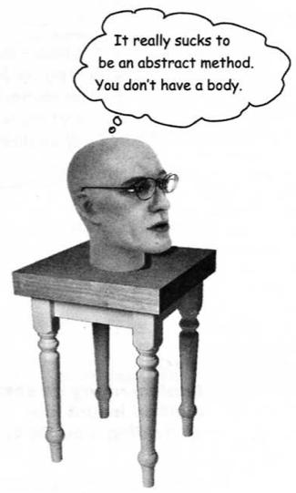
Abstract Method
Has no body (no curly braces, just semi-colon)
E.g., public abstract void play();
Cannot be inside a non-abstract class
Must be implemented in a subclass
must be implemented no later than the first concrete class in the inheritance hierarchy

Slide 52
Abstract Class and Subclass
Subclasses define the missing pieces to become “concrete classes”, from which we can instantiate objects
If subclasses do not define all the missing pieces of an abstract superclass, then that subclass is also abstract

Slide 53
Abstract Class and Method
concrete methods
abstract
HospitalWorker
abstract methods
concrete methods (can override abstract methods in HospitalWorker class)
abstract
Clinician
abstract methods
concrete methods (must implement all remaining abstract methods in Clinician and HospitalWorker classes)
concrete
Physician
MUST NOT contain abstract methods
Notes:
A good resource for explaining why an abstract class can inherit a concrete class.
http://www.coderanch.com/t/245074/java-programmer-SCJP/certification/Abstract-Classes-extending-concrete-classes
Sometimes you don't always start from the abstract and work toward concrete. Sometimes, you start with something concrete, but some subset of those can have something "abstracted out" to a middle layer.
public class Employee
{
private String fname;
private String lname;
private String ssn;
private long emplID;
public String getFName() {return fname;}
public String getLName() {return lname;}
public String getSSN() {return ssn;}
public String getEmplID() {return emplID;}
}
public abstract class BaseballPlayer extends Employee
{
private int playerNumber;
private String team;
public int getPlayerNumber() {return playerNumber;}
public String getTeam() {return team;}
}
public class Pitcher extends BaseballPlayer
{
public Pitcher throwFastball() {...}
public Pitcher throwSpitball() throws UmpireException {...}
}
public class Batter extends BaseballPlayer
{
public void swingBat() {...}
public void stealBase() {...}
}

Slide 54
Class exercise
Classes: Vehicle, UtilityVehicle, PublicTransport, Car, Suv, Truck, Bus, Train
1) Create a class diagram.
2) Specify the classes: abstract or concrete
3) Declare some key methods
Notes:
Vehicle[] v = new Vehicle[7];
V[0] = new Car();
V[1] = new Car();
V[2] = new Suv();
V[3] = new Truck();
V[4] = new Bus();
V[5] = new Bus();
V[6] = new Train();
ArrayList<Vehicle> v = new ArrayList<>();
v.Add (new Car());
v.Add (new Car());

Slide 55
Abstract Classes
Classes used to instantiate objects are called concrete classes
Concrete classes provide implementation for every method they declare (some of the implementations may be inherited)
Abstract superclasses too general to create real objects – they specify what is common (attributes and behavior) among subclasses
Concrete classes provide the specifics that make them reasonable to create objects
Not all hierarchies contain abstract classes
Some hierarchies may have several levels of abstract classes

Slide 56
9.6 Polymorphism
Declaring Abstract Classes and Methods
Constructors in Abstract Classes

Slide 57
Exercise
Create a class diagram for the following.
Specify abstract or concrete classes.
Musical instruments
Animals in a zoo
Employees in a restaurant
Players in a sports team (e.g., baseball, basketball, hockey…)
Notes:
Abstract class MusicInstrument
------
String type;
------
Abstract Play(): void

Slide 58
Abstract Classes
Programmers often write code that uses abstract superclasses so that it works with a wide range of subclasses (remember: polymorphism).
Consider a method declared with a parameter of type abstract superclass
This method can be invoked with an object of any concrete class that directly or indirectly extends the superclass
Notes:
Example: look up abstract class javax.swing.JComponent

Slide 59
Declaring abstract classes and abstract methods
Abstract class declared using keyword abstract
A method that is declared (but not defined) in the abstract class is an abstract method
using keyword abstract
A class that contains abstract methods must be an abstract class
Constructors and static methods in an abstract class cannot be declared abstract.
Instance variables and “concrete” methods in an abstract class are subject to the normal rules of inheritance
Notes:
To read more about if static methods can be overridden: http://www.geeksforgeeks.org/can-we-overload-or-override-static-methods-in-java/
You would define a constructor in an abstract class if you are in one of these situations
- you want to perform some initialization (to fields of the abstract class) before the instantiation of a subclass actually takes place
- you have defined final fields in the abstract class but you did not initialize them in the declaration itself; in this case, you MUST have a constructor to initialize these fields
Note that:
you may define more than one constructor (with different arguments)
you can (should?) define all your constructors protected (making them public is pointless anyway)
your subclass constructor(s) can call one constructor of the abstract class; it may even have to call it (if there is no no-arg constructor in the abstract class)
======
Why abstract class has constructors?
Its there to be able to initialize the abstract class internal state.
Lets say you would like to assign two variables, you would have to do this for every implementation, but with constructors in the abstract class you only need it once:
public abstract class javaRanch{
int x, y, z;
public javaRanch(int x, int y, int z){
this.x = x;
this.y=y;
this.z = z;
}
}
and now every class inheriting only needs to call the abstract superclass constructor in the subclass constructor, instead of assigning the values themself every time :)
You cannot use the normal way of new AbstractClass() because you cannot instantiate objects of an abstract class.

Slide 60
Why constructors in an Abstract Class?
Define a constructor in an abstract class if you are in one of these situations
you want to perform some initialization (to fields of the abstract class) before the instantiation of a subclass takes place
remember that a subclass constructor will either explicitly or implicitly call a superclass constructor before the subclass constructor statements are executed
you have defined final fields in the abstract class but you did not initialize them in the declaration itself; in this case, you MUST have a constructor to initialize these fields
Constructors in an abstract class should be declared as protected
Do not use the normal way of new AbstractClass() because you cannot instantiate objects of an abstract class.
Notes:
Example: look up abstract class javax.swing.JComponent

Slide 61
Abstract classes
Trying to instantiate an object of an abstract class is a compilation error
However, we can declare references of abstract class type .
A concrete subclass (that is, one not declared abstract) that does not implement an abstract superclass method is a compilation error
Note: it is fine for an abstract subclass to not implement an abstract superclass method
Can use abstract superclass name to invoke static methods declared in the abstract superclass

Slide 62
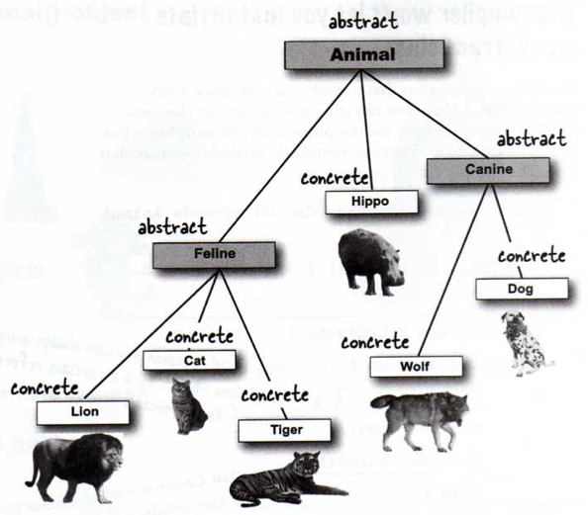
Abstract vs. Concrete

Slide 63
Abstract vs. Concrete

Slide 64
9.7 Polymorphism
Abstract Shape Class Example

Slide 65
public class Shape {
protected double perimeter;
protected double area;
public double getPerimeter() {
return perimeter;
}
public void setPerimeter(double c) {
perimeter = c;
}
public double getArea() {
return area;
}
public void setArea(double a) {
area = a;
}
public String toString() {
String s = "";
s = String.format("perimeter = %.2f;", perimeter);
s = String.format("%s area = %.2f", s, area);
return s;
}
} // end class Shape
Concrete Shape Class

Slide 66
public class Square extends Shape {
protected double side;
public double getSide() {
return side;
}
public void setSide(double s) {
side = s;
super.setPerimeter(side * 4);
super.setArea(side * side);
}
public void setPerimeter(double c) {
side = c/4;
super.setPerimeter(c);
super.setArea(side * side);
}
public void setArea(double a) {
side = Math.sqrt(a);
super.setPerimeter(side * 4);
super.setArea(a);
}
public Square(int s) {
side = s;
super.setPerimeter(side * 4);
super.setArea(side * side);
}
} // end Class Square
Notes:
public Square(int s) {
side = s;
super.setCircumference(side * 4);
super.setArea(a);
}
I think a should be replaced by side * side.

Slide 67
public class Circle extends Shape {
protected double radius;
public double getRadius() {
return radius;
}
public void setRadius(double r) {
radius = r;
super.setPerimeter(2 * Math.PI * radius);
super.setArea(Math.PI * radius * radius);
}
public void setPerimeter(double c) {
radius = c/(2 * Math.PI);
super.setPerimeter(c);
super.setArea(Math.PI * radius * radius);
}
public void setArea(double a) {
radius = Math.sqrt(a/Math.PI);
super.setPerimeter(2 * Math.PI * radius);
super.setArea(a);
}
public Circle(double r) {
radius = r;
super.setPerimeter(2 * Math.PI * radius);
super.setArea(Math.PI * radius * radius);
}
} // end Class Circle

Slide 68
public class ShapeTest
{
public static void main(String[] args)
{
Shape[] arr = new Shape[3];
arr[0] = new Shape();
arr[1] = new Square(5);
arr[2] = new Circle(5);
arr[0].setArea(100);
arr[1].setArea(100);
arr[2].setArea(100);
for (int i = 0; i < arr.length; i++) {
System.out.println(arr[i].toString());
}
}
} // end Class ShapeTest

Slide 69
Modify Shape
Make Shape an abstract class that defines getArea() and getPerimeter methods
Shape declares (but does not define) setArea() and setPerimeter() methods. But requires any concrete subclass to define these methods
Shape declares attributes area and perimeter

Slide 70
public abstract class Shape {
protected double perimeter;
protected double area;
public double getPerimeter() {
return perimeter;
}
public abstract void setPerimeter(double c);
public double getArea() {
return area;
}
public abstract void setArea(double a);
public String toString() {
String s = "";
s = String.format(”perimeter = %.2f;", perimeter);
s = String.format("%s area = %.2f", s, area);
return s;
}
} // end class Shape
Abstract Shape
Notes:
Start from here 2014-11-13

Slide 71
public class Square extends Shape {
protected double side;
public double getSide() {
return side;
}
public void setSide(double s) {
side = s;
super.setPerimeter(side * 4);
super.setArea(side * side);
}
public void setPerimeter(double c) {
side = c/4;
super.setPerimeter(c);
super.setArea(side * side);
}
public abstract class Shape {
protected double perimeter;
protected double area;
public double getPerimeter() {
return perimeter;
}
public abstract void setPerimeter(double c);
public double getArea() {
return area;
}
public abstract void setArea(double a);
public String toString() {
String s = "";
s = String.format(”perimeter = %.2f;", perimeter);
s = String.format("%s area = %.2f", s, area);
return s;
}
} // end class Shape
public void setArea(double a) {
side = Math.sqrt(a);
super.setPerimeter(side * 4);
super.setArea(a);
}
public Square(int s) {
side = s;
super.setPerimeter(side * 4);
super.setArea(side * side);
}
} // end Class Square
What do you think about this Square class?
What type of class?
Are all abstract methods defined?
What happens when using super?
Notes:
A subclass cannot call an abstract method in the super class (i.e. super.setPerimeter is illegal)

Slide 72
Modify Square and Circle
Square and Circle are subclasses of Shape, they will define setArea() and setPerimeter() methods
Actually any concrete subclass of Shape will be required to define setArea() and setPerimeter() methods

Slide 73
public class Square extends Shape {
protected double side;
public double getSide() {
return side;
}
public void setSide(double s) {
side = s;
perimeter = side * 4;
area = side * side;
}
public void setPerimeter(double c) {
side = c/4;
perimeter = side * 4;
area = side * side;
}
Extends abstract Shape
public void setArea(double a) {
side = Math.sqrt(a);
perimeter = side * 4;
area = side * side;
}
public Square(int s) {
setSide(s);
}
} // end Class Square

Slide 74
import java.lang.Math;
public class Square extends Shape {
protected double side;
public double getSide() {
return side;
}
public void setSide(double s) {
side = s;
perimeter = side * 4;
area = side * side;
}
public void setPerimeter(double c)
{
side = c/4;
perimeter = side * 4;
area = side * side;
}
public abstract class Shape {
protected double perimeter;
protected double area;
public double getPerimeter() {
return perimeter;
}
public abstract void setPerimeter (double c);
public double getArea() {
return area;
}
public abstract void setArea(double a);
public String toString() {
String s = "";
s = String.format(”perimeter = %.2f;",perimeter);
s = String.format("%s area = %.2f", s, area);
return s;
}
} // end class Shape
public void setArea(double a) {
side = Math.sqrt(a);
perimeter = side * 4;
area = side * side;
}
public Square(int s) {
setSide(s);
}
} // end Class Square
Any abstract methods in the abstract Shape class are not defined in Square class?
Notes:
Print this.

Slide 75
public class Square extends Shape {
protected double side;
public double getSide() {
return side;
}
public void setSide(double s) {
side = s;
super.setPerimeter(side * 4);
super.setArea(side * side);
}
public void setPerimeter(double c) {
side = c/4;
super.setPerimeter(c);
super.setArea(side * side);
}
public class Square extends Shape {
protected double side;
public double getSide() {
return side;
}
public void setSide(double s) {
side = s;
perimeter = side * 4;
area = side * side;
}
public void setPerimeter(double c) {
side = c/4;
perimeter = side * 4;
area = side * side;
}
concreteShape
abstract Shape
public void setArea(double a) {
side = Math.sqrt(a);
super.setPerimeter(side * 4);
super.setArea(a);
}
public Square(int s) {
side = s;
super.setPerimeter(side * 4);
super.setArea(side * side);
}
} // concrete Shape class
public void setArea(double a) {
side = Math.sqrt(a);
perimeter = side * 4;
area = side * side;
}
public Square(int s) {
setSide(s);
}
} // abstract Shape class
Notes:
Why super.setPerimeter() is not used in the class with abstract Shape class?
Because setPerimeter() is not defined in the Shape class, It’s an abstract method.

Slide 76
public class Circle extends Shape {
protected double radius;
public double getRadius() {
return radius;
}
public void setRadius(double r) {
radius = r;
perimeter = 2 * Math.PI * radius;
area = Math.PI * radius * radius;
}
public void setPerimeter(double c) {
radius = c/(2 * Math.PI);
perimeter = 2 * Math.PI * radius;
area = Math.PI * radius * radius;
}
public void setArea(double a) {
radius = Math.sqrt(a/Math.PI);
perimeter = 2 * Math.PI * radius;
area = Math.PI * radius * radius;
}
Extends abstract Shape
public Circle(double r) {
setRadius(r);
}
} // end Class Circle
Notes:
Print this.

Slide 77
Abstract Shape Class
public class ShapeTest {
public static void main(String[] args) {
Shape[] arr = new Shape[3];
arr[0] = new Square(10);
arr[1] = new Square(5);
arr[2] = new Circle(5);
arr[0].setArea(100);
arr[1].setArea(100);
arr[2].setArea(100);
for (int i = 0; i < arr.length; i++) {
System.out.println(arr[i].toString());
}
}
} // end Class ShapeTest
Ok because it’s an array of references to Shape
Are these ok?
arr[0] = new Shape();
Not ok because you cannot instantiate Shape object
Notes:
Shape[] arr = new Shape[3]; is legal even though Shape is an abstract class, as long as you do not try to instantiate Shape objects.

Slide 78
Abstract Shape Class
public class ShapeTest {
public static void main(String[] args) {
Shape[] arr = new Shape[3];
arr[0] = new Square(10);
arr[1] = new Square(5);
arr[2] = new Circle(5);
arr[0].setArea(100);
arr[1].setArea(100);
arr[2].setArea(100);
for (int i = 0; i < arr.length; i++) {
System.out.println(arr[i].toString());
}
}
} // end Class ShapeTest
What about now?
Notes:
Shat[] arr = new Shape[3]; is legal even though Shape is an abstract class, as long as you do not try to instantiate Shape objects.

Slide 79
public class ShapeTest {
public static void main(String[] args) {
Shape[] arr = new Shape[3];
arr[0] = new Square(10);
arr[1] = new Square(5);
arr[2] = new Circle(5);
arr[0].setArea(100);
arr[1].setArea(100);
arr[2].setArea(100);
for (int i = 0; i < arr.length; i++) {
System.out.println(arr[i].toString());
}
}
} // end Class ShapeTest
public class Circle extends Shape {
protected double radius;
public double getRadius() {
return radius;
}
public void setRadius(double r) {
radius = r;
circumference = 2 * Math.PI * radius;
area = Math.PI * radius * radius;
}
public void setCircumference(double c) {
radius = c/(2 * Math.PI);
circumference = 2 * Math.PI * radius;
area = Math.PI * radius * radius;
}
public void setArea(double a) {
radius = Math.sqrt(a/Math.PI);
circumference = 2 * Math.PI * radius;
area = Math.PI * radius * radius;
}
Output:
perimeter = 40.00; area = 100.00
perimeter = 40.00; area = 100.00
perimeter = 35.45; area = 100.00
public Circle(double r) {
setRadius(r);
}
} // end Class Circle

Slide 80
When to use abstract classes?
When we want to provide common functionality across several classes
E.g., device driver may be an abstract class, and each individual device driver could be a concrete subclass that implements the various device driver methods.
This enables new devices to be ready with their device drivers.

Slide 81
Constructors in abstract class?
Yes
when a class extends abstract class, constructor of subclass will invoke constructor of superclass either implicitly or explicitly
to initialize the abstract class internal state
every child only needs to call the constructor instead of assigning the values themselves

Slide 82
Constructor in abstract class
public abstract class Animal {
int x, y, z;
public Animal (int x, int y, int z){
this.x = x;
this.y=y;
this.z = z;
}
}

Slide 83
/**
* Simple Java program to prove that abstract class can have constructor in Java.
* @author http://java67.blogspot.com
*/
public class AbstractConstructorTest {
public static void main(String args[]) {
Server server = new Tomcat("Apache Tomcat");
server.start();
}
}
abstract class Server{
protected final String name;
public Server(String name){
this.name = name;
}
public abstract boolean start();
}
class Tomcat extends Server{
public Tomcat(String name){
super(name);
}
@Override
public boolean start() {
System.out.println( this.name + " started successfully");
return true;
}
}
Output:
Apache Tomcat started successfully

Slide 84
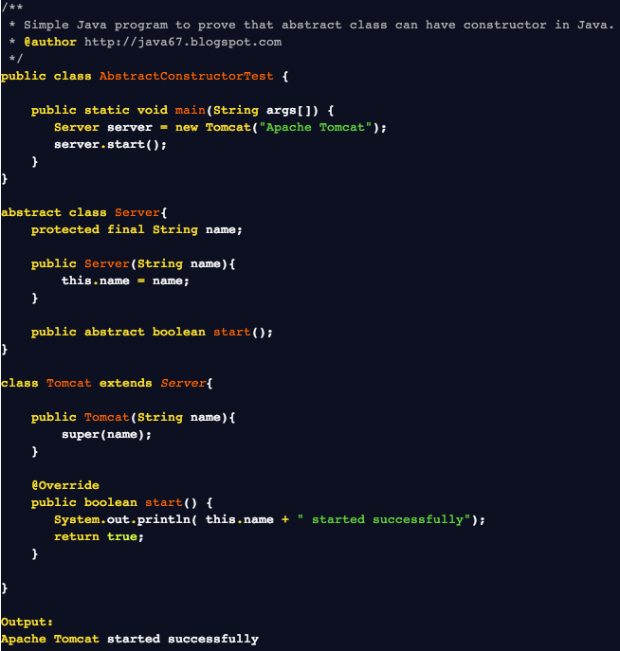


Slide 85
7) Which of the following has/have compiler error? (Multiple answers may be correct)
(A)
public abstract class SuperClass {
public abstract void fn1() {
System.out.println("superClass fn1");
}
} // end class SuperClass
public class SubClass extends SuperClass {
public void fn1() {
System.out.println("subClass fn1");
}
} // end class SubClass
public abstract class SuperClass {
public abstract void fn1();
} // end class SuperClass
public class SubClass extends SuperClass {
public void fn1() {
System.out.println("subClass fn1");
}
} // end class SubClass
(B)
public abstract class SuperClass {
public abstract void fn1();
} // end class SuperClass
public class SubClass extends SuperClass {
public void fn1(int x) {
System.out.println("subClass fn1");
}
} // end class SubClass
(C)
(D)
public abstract class SuperClass {
public void fn1();
} // end class SuperClass
public class SubClass extends SuperClass {
public void fn1() {
System.out.println("subClass fn1");
}
} // end class SubClass
Notes:
A, C, D
A: it must not have method definition
C: it must not have arguments
D: fn1() in superclass is not abstract so method definition is needed.

Slide 86
Keys
1) Drift
Drift
Set sail
2) C
3) D
4) C
5) B
6) True
7) A, C, D
Notes:
Start from here March 24, 2014

Slide 87
9.8 Polymorphism
final Methods and Classes
Why Interface?

Slide 88
final Methods and final Classes
A final method cannot be overridden in a subclass
Otherwise, compiler error.
A final class cannot be “extended” (that is, it cannot be a superclass for any class)
Otherwise, compiler error.

Slide 89
Why use final?
Remember: final fields to indicate constants
final “interferes” with typical Object Orientation
final classes and methods used primarily for 2 reasons
Security reasons: we do not want anyone to modify the code provided by extending in a subclass
Example: java.lang.String is “immutable”. We do not want someone to extend it and make it mutable
Performance reasons: early vs. late binding
compiler might know which method to use at compile-time. So it can do “internal” computation at compile time (rather than dynamic binding)

Slide 90
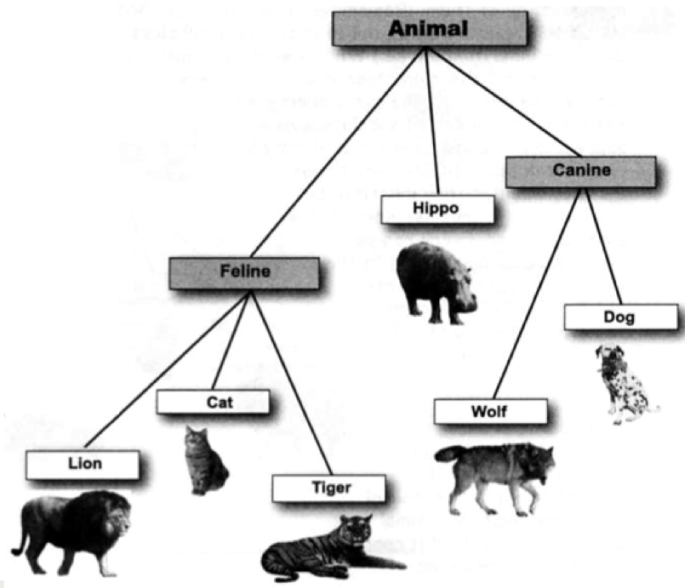
Abstract vs. Concrete
Abstract
Abstract
Concrete
Abstract
Concrete
Concrete
Concrete
Concrete
Concrete

Slide 91
Design options for a Petshop

Slide 92
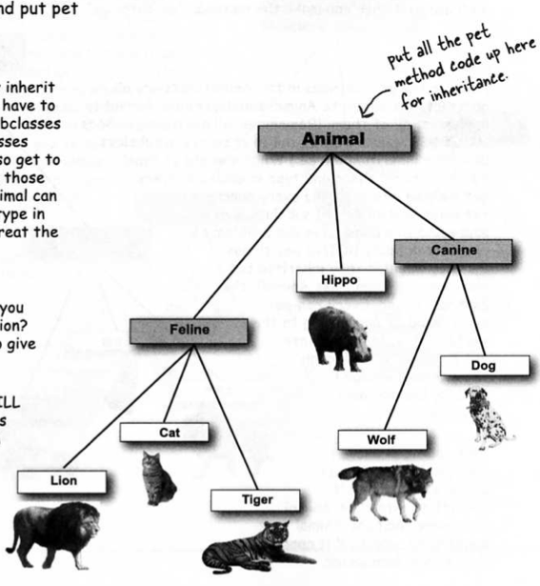
Concrete Animal
Pros:
Animal can be used as polymorphic type
All animals inherit pet behaviors
Cons:
Hippo as a pet?
Lion?
Wolf?
Tiger?

Slide 93
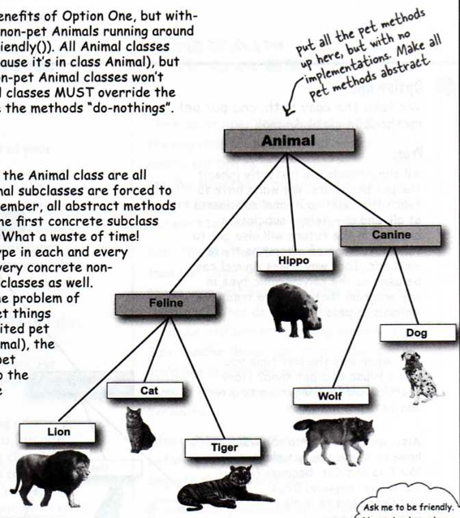
Abstract pet methods in Animal
Pros:
Non-pet subclasses make pet-behaviors to do nothing
Cons:
All concrete subclasses must implement the pet-behaviors so wasting time

Slide 94
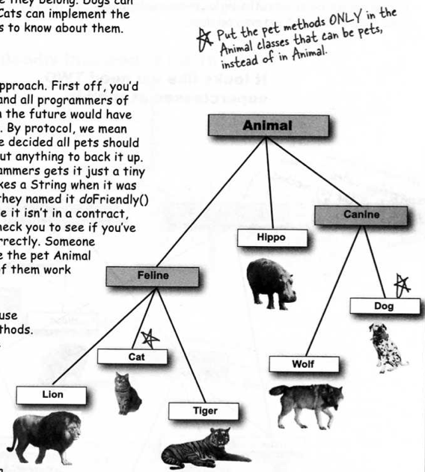
Pet methods in pet classes only
Pros:
Hippos, Lions, Tigers, and Wolves can no longer have pet bahaviors
Cons:
- Need to know exact prototypes for individual pet methods, e.g. doFriendly() vs. beFriendly() or different parameters
- Cannot use polymorphism for pet methods

Slide 95
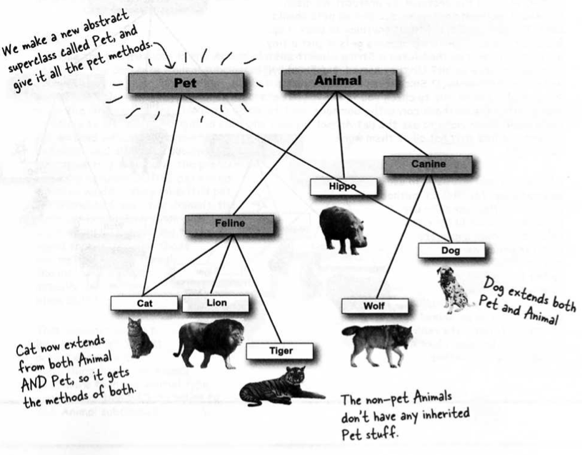
Pet superclass
Java supports single inheritance only

Slide 96
Deadly Diamond of Death
DigitalRecorder
int i
burn ()
CDBurner and DVDBurner both inherit from DigitalRecorder, both override burn() and both inherit i
Imagine i is used by both CDBurner and DVDBurner with different values.
CDBurner
burn ()
DVDBurner
burn ()
ComboDrive
What happens if ComboDrive needs to use both values of i?
And which burn() runs when burn() is called on ComboDrive?

Slide 97
Java: interface
In Java, we use interface to specify a set of functionality that must be implemented in classes that implement the interface
Used typically to specify common functionality across classes that are not related
Abstract classes specify functionality across related classes
Abstract classes can implement some methods (it is a partial class)
Interface cannot implement any method
A class can extend only one abstract class
A class can implement any number of interfaces
http://docs.oracle.com/javase/tutorial/java/IandI/createinterface.html
-- excellent tutorial, highly recommended

Slide 98
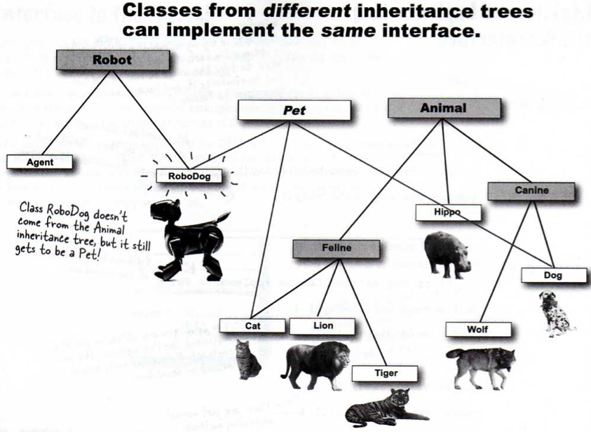

Slide 101
9.9 Polymorphism
Define Interface
implements Interface
Design Considerations
Use case:
-Please create an abstract Person class, and a Student which is subclass.
-I want to create a CBBPlayer class, but how???

Slide 102
Java Interface
Provides a design guide rather than implementation details (i.e. all methods are abstract)
Specifies what methods should be implemented but not how
Cannot be instantiated
<< interface >>
Interface name
Method declaration
Implements
Class name
Method definition

Slide 103
Interface
Defining an interface
public interface <name of interface>
{
constants
methods declaration only -- to be implemented by the class that implements this interface
}
Implementing the interface
public class <name of class> implements <interface>
{
attributes
methods actually implemented by this class
}
implicitly public, static and final
implicitly public and abstract

Slide 104
Declaring interface in Java
An interface declaration begins with keyword interface and contains only constants and abstract methods
All methods declared in an interface are implicitly public and abstract
All fields are implicitly public, static and final
Therefore, these modifiers may be omitted
Important: Interfaces cannot specify any method implementation details
A public interface, called MyInterface must be declared in a file: MyInterface.java

Slide 105
Using an Interface
To use an interface, a class specifies that it implements the interface
public class MyClass implements MyInterface
public class MyClass extends SuperClass implements MyInterface1, MyInterface2
A class that does not define all the methods of an interface it implements is an abstract class
If any method is not defined in an implementing concrete class, it will be a compiler error.
The objects of unrelated classes that implement an interface can be used polymorphically (they respond to same method calls)

Slide 106
Implement Multiple Interfaces
Format:
public class <class name> implements <interface1>, <interface2>, <interface3>…
{
}

Slide 107
Some common interfaces in Java API
java.lang.Comparable
java.lang.Cloneable
java.lang.CharSequence
java.util.Collection
java.util.List (note: this interface extends java.util.Collection)
java.util.Set (extends java.util.Collection)
javax.swing.SwingConstants
…
https://docs.oracle.com/javase/8/docs/api/index.html

Slide 108
Implementing Interfaces
Subclass must implement the methods
JVM will not be confused about which of the two inherited versions to call
A java interface is like a 100% pure abstract class
A class can implement multiple interfaces

Slide 109
Polymorphic arguments
public class Patient
{
public void needService (HospitalWorker hw)
{
hw.helpPatient();
}
}
public class HospitalSystem
{
public void static main (String[] args)
{
Patient aPatient = new Patient();
Physician aPhysician = new Physician();
Nurse aNurse = new Nurse();
aPatient.needService(aPhysician);
aPatient.needService(aNurse);
}
}
Declare method parameter as a superclass type
Pass in any subclass object at runtime

Slide 110
Why use Interfaces?
If you use Interfaces as arguments and return types, you can pass anything that implements that interface
Classes from different inheritance trees can implement the same Interface
A class can implement multiple Interfaces
Polymorphism !!!

Slide 111
Example
Declare an Interface called ComparableObjects that declares a method: int compareTo(Object o)
This method returns 1, 0, or -1 depending on whether the object on which compareTo is invoked is greater than, equal to, or less than Object o
We will make Square implement ComparableObjects interface
Now, we can compare 2 squares.
We will still have Shape as an abstract class, and Circle and Square extends Shape

Slide 112
public interface ComparableObjects {
int compareTo(Object o);
}
public abstract class Shape {
protected double perimeter;
protected double area;
public double getPerimeter() {
return circumference;
}
public abstract void setPerimeter(double c);
public double getArea() {
return area;
}
public abstract void setArea(double a);
public String toString() {
String s = "";
s = String.format(”perimeter = %.2f;", perimeter);
s = String.format("%s area = %.2f", s, area);
return s;
}
} // end class Shape

Slide 113
@Override
public int compareTo(Object o) {
Square s = (Square) o;
double side1 = getSide();
double side2 = s.getSide();
if (side1 > side2)
return 1;
else if (side1 == side2)
return 0;
else return -1;
}
} // end Class Square
public class Square extends Shape implements ComparableObjects {
protected double side;
public double getSide() {
return side;
}
public void setSide(double s) {
side = s;
perimeter = side * 4;
area = side * side;
}
@Override
public void setPerimeter(double c) {
side = c/4;
perimeter = side * 4;
area = side * side;
}
@Override
public void setArea(double a) {
side = Math.sqrt(a);
perimeter = side * 4;
area = side * side;
}
public Square(int s) {
setSide(s);
}
public class ShapeTest {
public static void main(String[] args) {
Square s1 = new Square(5);
Square s2 = new Square(10);
int compareResult = s1.compareTo(s2);
if (compareResult > 0)
System.out.println(s1 + " > " + s2);
if (compareResult == 0)
System.out.println(s1 + " == " + s2);
if (compareResult < 0)
System.out.println(s1 + " < " + s2);
}
} // end Class ShapeTest

Slide 114
Example 2
Make Square implement java.lang.Comparable<Square> interface
Look up the Java API documentation for java.lang.Comparable<T> interface
Let it no longer implement ComparableObjects interface that we defined
public class Square extends Shape implements Comparable<Square> { … }

Slide 115
Design considerations
Make a class not to extend anything when your new class does not pass the IS-A test for any other type
Make a subclass only when you need to make a more specific version of a class and need to override or add new behaviors

Slide 116
Design considerations
Use an abstract class when you want to define a template for a group of subclasses and you have at least some implementation code that all subclasses could use.
Make the class abstract when you want to guarantee that nobody can make objects of that type
Use an interface when you want to define a role that other classes can play, regardless of where those classes are in the inheritance tree

Slide 117
Example 2
Make Square implement java.lang.Comparable<Square> interface
Look up the Java API documentation for java.lang.Comparable<T> interface
Let it no longer implement ComparableObjects interface that we defined
public class Square extends Shape implements Comparable<Square> { … }
Now, we can use Arrays.sort method on an array of Squares that will sort the elements based on the compareTo function defined.

Slide 118
Try the following ShapeTest class after Shapes implements java.lang.Comparable
import java.util.Arrays;
public class ShapeTest {
public static void main(String[] args) {
Square[] squares = new Square[5];
squares[0] = new Square(1);
squares[1] = new Square(5);
squares[2] = new Square(2);
squares[3] = new Square(4);
squares[4] = new Square(3);
System.out.println("Array before sorting:");
System.out.println(Arrays.toString(squares));
Arrays.sort(squares);
System.out.println("Array after sorting:");
System.out.println(Arrays.toString(squares));
}
} // end Class ShapeTest

Slide 119
9.10 Polymorphism
Trivia

Slide 120
Java OOP Trivia 1
Which keyword is for specifying inheritance?
What kind of relation is an inheritance relationship?
How many superclasses can a class has?
Which class is at the top of a inheritance hierarchy?
What does a subclass inherits from its superclass?
Will constructors be inherited?
Which access modifier allows superclass members to be accessed directly by a subclass?

Slide 121
Java OOP Trivia 2
When a method is called by a subclass object, how does the method call works?
How to explicitly call a method in the superclass?
How to explicitly call a superclass constructor?
Will a superclass constructor be called implicitly if no superclass constructor is explicitly called?
If so, which one will always be implicitly called?
Can we declare references of an abstract class?

Slide 122
Java OOP Trivia 3
Can a superclass reference be used to refer to a subclass object?
If so, how? e.g., Animal and Rabbit
What do we call this property?
How can polymorphism take place?
What is early binding?
What is late binding?
What kind of classes would be appropriate for Furniture, Plant, Devices…

Slide 123
Java OOP Trivia 4
What is an abstract class?
Can we create objects of abstract classes?
What do we usually use abstract classes for?
What is the characteristic of an abstract method?
What do we do about abstract methods?
What is an interface?
What members can an interface have?
Which keyword is for using an interface?

Slide 124
Java OOP Trivia 5
How many interfaces can a class implement?
Can we declare references of interface type?
How to execute polymorphism using interfaces?
What is instancef operator for?
What result can obj.instanceof (MyClass) be?
Given obj.instanceof (MyClass), what objects can obj be in order for this to be true?
Upcasting is always ok. What is upcasting?
Can we cast between “unrelated” class references?

Slide 125
Summary: Inheritance and Polymorphism
Java keyword: extends to specify inheritance
A class can extend only one superclass – single inheritance
java.lang.Object is the root of inheritance hierarchy
A subclass inherits all methods of superclass
When we invoke a method on an object, execute the method defined for the object’s class, if defined
Otherwise, execute the method defined in its superclass (do it recursively)
A direct superclass method fn1 can be explicitly invoked from subclass method definition as super.fn1(…)
Constructors are not inherited by subclass
A subclass constructor can explicitly call superclass constructor using super (…)
If no explicit call to superclass constructor, then super() is automatically called

Slide 126
Summary: Polymorphism
A subclass object can be referred to using a reference variable of its superclass (direct or indirect) type
When we invoke a method on an object as obj.fn1(..), where obj is a reference to Class MyClass
Compiler checks that class MyClass has a method defined called fn1(..); otherwise it is a compiler error – early binding
Run-time checks the actual class of obj, which can be MyClass or a subclass of MyClass, say MySub
Run-time invokes the fn1(…) method defined for the exact class of obj, which can be MySub – dynamic binding

Slide 127
Summary: Abstract Class
A class that does not define all methods is an abstract class.
The methods that have only declaration and no definition is declared abstract
Other classes (abstract and concrete) can extend abstract classes (using the typical rules of Java inheritance)
We cannot instantiate objects of abstract class
We can declare reference variables of type abstract class.
A subclass object can be assigned to a reference of type abstract class (using the typical rules of polymorphism).

Slide 128
Summary: Interface
An interface specifies a set of implicitly public abstract methods (i.e. declarations only, no definition) and implicitly public static final constants
Many unrelated classes can implement the interface and define the interface methods
Example: java.lang.Comparable
A class can implement any number of interfaces
We can declare reference variables of interface type
Objects of a class that implements the interface can be assigned to reference variables of the interface type (polymorphism)

Slide 129
Summary: instanceof & casting
Java operator: obj instanceof MyClass used to check whether the object referenced by obj is an instance of class MyClass or one of MyClass’s subclasses
A reference to a subclass object can be cast into its superclass type (using explicit cast or implicit cast) - upcasting
Casting between “unrelated” classes is a compiler error
Casting a superclass object reference to a subclass type (using explicit cast) gives no compiler error if the superclass object reference does hold a reference to subclass type, otherwise, an Exception is raised.

Slide 130
Readings
Chapter 10 (Deitel)
Read Chapter 10.5: Payroll System case study
Read Chapter 10.7: Interface case study
http://docs.oracle.com/javase/tutorial/java/IandI/createinterface.html

