Slide 1
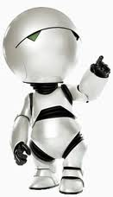
Domain Events Creating compassable applications…
Jay Smith
Lead Programmer Analyst
Tyson Foods, Inc.

Slide 2

?
Notes:
Who am I

Slide 3
Domain Model
A domain model in problem solving and software engineering is a conceptual model of all the topics related to a specific problem. It describes the various entities, their attributes, roles, and relationships, plus the constraints that govern the problem domain.

Slide 4
Database Model
A database model is the theoretical foundation of a database and fundamentally determines in which manner data can be stored, organized, and manipulated in a database system. It thereby defines the infrastructure offered by a particular database system. The most popular example of a database model is the relational model.

Slide 5
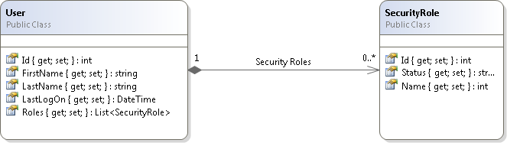
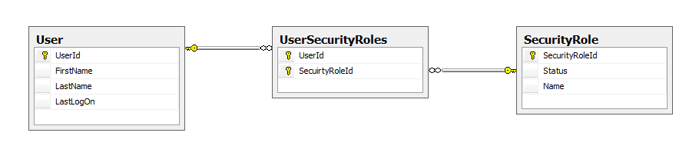
Domain
Database

Slide 6
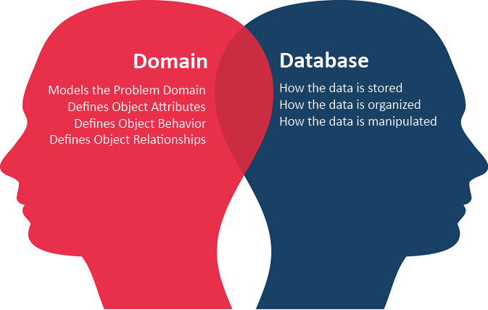
Where do you want your logic?

Slide 7
What are Domain Events
A domain event is an action initiated by a change of state in a Domain Object.
Other parts of the systems register for events and are notified when the registered event occurs.
This allows loosely coupled modules in a system to coordinate efforts to accomplish the goals of the system.
Notes:
an event is an action that is usually initiated outside the scope of a program and that is handled by a piece of code inside the program. Typically events are handled synchronous with the program flow, that is, the program has one or more dedicated places where events are handled. Typical sources of events include the user (who presses a key on the keyboard, in other words, through a keystroke). Another source is a hardware device such as a timer. A computer program that changes its behavior in response to events is said to be event-driven, often with the goal of being interactive.
A domain event is an action initiated by a change of state in a Domain Object. Other parts of the systems register for events and are notified when the registered event occurs. This allows loosely coupled modules in a system to coordinate efforts to accomplish the goals of the system.

Slide 8
DEMO

Slide 9
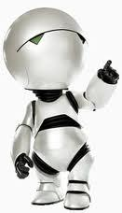
Resources
My Email – jay@jaysmith.us
My Blog – http://jaysmith.us
Other Links - http://delicious.com/jay.smith/domainevents
Udi Dahan’s Blog - http://www.udidahan.com

