Slide 1
DIGITAL SELF-AWARENESS
MERCY ACADEMY
INTRODUCTION TO TECHNOLOGY FALL 2018

Slide 2
SCHEDULE
INTRODUCTION
CYBER-BULLYING
ONLINE STRANGER CONTACT
ACCOUNT AND PASSWORD SECURITY
SOCIAL MEDIA/ONLINE SHARING HYGIENE
WRAP-UP/Q&A

Slide 3
WHOAMI

Slide 4
JASON SMITH
US ARMY VETERAN
CERTIFIED FRONT END WEB DEVELOPER
CERTIFIED CYBERCRIME INVESTIGATOR
CERTIFIED PENETRATION TESTER ('WHITE HAT HACKER')
CONFERENCE TRAINER IN MALWARE ANALYSIS AND DIGITAL MEMORY FORENSICS
MARRIED TO A MERCY ACADEMY ALUMNI

Slide 5
CYBER-BULLYING

Slide 6






WHAT IS CYBER-BULLYING?
Harassment that occurs on any digital medium.
Online gaming
Cellphone/Texting/Pictures
Social Media
Fake Profiles/Images
Private picture exposure

Slide 7

HOW DOES IT DIFFER FROM TRADITIONAL BULLYING?
BULLYING OCCURRED PRIMARILY IN PERSON
CYBERBULLYING CAN BE ANONYMOUS
OCCURS DAY AND NIGHT
FOLLOWS VICTIM WHEREVER THEY ARE
CAN BE HARDER TO DISCOVER BY PARENTS AND TEACHERS
DAMAGE CAN PERSIST ONLINE FOR YEARS AFTER ACTIVITY STOPS
CAN GAIN A MUCH LARGER ‘AUDIENCE’

Slide 8
HOW TO DEAL WITH CYBER-BULLYING
EVERY SITUATION IS UNIQUE, HOWEVER THESE STEPS ARE GENERALLY BEST TO FOLLOW:
DON'T 'ENGAGE' - RESPONDING TO CHAT COMMENTS, E.G.
SCREENSHOT & SAVE ALL INSTANCES OF ABUSE
REPORT TO PARENTS & TEACHERS, DO NOT TRY AND HANDLE THIS YOURSELF
REPORT TO PLATFORM, ALMOST ALL HAVE POLICIES REGARDING ABUSIVE CONTENT
REPORT TO LAW ENFORCEMENT IF MITIGATION STEPS DON'T RESOLVE
ENGAGE LEGAL OR INVESTIGATIVE HELP IF LITIGATION BECOMES NECESSARY
AGAIN, DO NOT TRY TO HANDLE THIS ON YOUR OWN!

Slide 9
IF SOMEBODY YOU KNOW IS INVOLVED IN CYBER-BULLYING ACTIVITY
ENCOURAGE THEM TO STOP, THERE IS NO HIDING YOUR ONLINE ACTIVITY, REGARDLESS OF WHAT PLATFORM IS BEING USED
IF THE SITUATION ESCALATES TO A POINT WHERE LAW ENFORCEMENT GETS INVOLVED, THEIR FUTURE CAN BE IMPACTED SIGNIFICANTLY
COLLEGE AND CAREER PLANS CAN BE DERAILED
PASSIVE PARTICIPANTS CAN ALSO BE CAUGHT UP IN LEGAL TROUBLE
NOBODY DESERVES TO BE HARRASSED

Slide 10
ONLINE CONTACT

Slide 11
ABDUCTION & HUMAN TRAFFICKING MYTHS
OCCURS PRIMARILY IN VIOLENT GRABBINGS 'OFF THE STREET' LIKE IN THE MOVIES - MYTH
IT HAPPENS MAINLY TO POOR OR LESS-EDUCATED PEOPLE – MYTH
VICTIMS DON'T KNOW ABDUCTORS BEFOREHAND – MYTH
IT ONLY HAPPENS TO YOUNG WOMEN – MYTH
PREDATORS AND HUMAN TRAFFICKERS ARE THE SAME - MYTH

Slide 12
ASPECTS OF ONLINE PREDATORS
PREDATORS OPERATE ONLINE MORE THAN TRAFFICKERS, WATCHING FOR AN OPPORTUNITY TO INGRATIATE THEMSELVES WITH SOMEBODY IN A VULNERABLE STATE
PEOPLE OF ALL SOCIAL & ECONOMIC BACKGROUNDS ARE SUSCEPTIBLE TO SOCIAL ENGINEERING (SEE CORINNA SLUSSER CASE)
PEOPLE ABDUCTED FOR HUMAN TRAFFICKING ARE OFTEN TAKEN VIA PEOPLE THEY 'KNOW' BEFOREHAND
GAMES NOT SPECIFICALLY DESIGNED FOR KIDS HAVE FEWER CONTROLS AGAINST INAPPROPRIATE CONTACT (THINK ROBLOX VS. WoW)
'GROOMING' IS WHAT TO BE AWARE OF!
MOST VICTIMS AREN'T FORCED INTO A BAD SITUATION, RATHER OVER TIME ARE CONVINCED IT'S THEIR IDEA AND AFRAID TO BACK OUT BEFORE IT'S TOO LATE

Slide 13
BEST PRACTICES TO REMAIN SAFE
DON'T COURT FOLLOWERS, ONLY ALLOW FOLLOWERS ON SOCIAL MEDIA THAT YOU KNOW. CHECK YOUR FOLLOWERS OUT...ALL OF THEM
YOUNG PEOPLE ARE CURIOUS, BE WARY WHEN EXPLORING THE INTERNET, OTHERS ARE WATCHING WHO POSTS ON CHAT BOARDS
DON'T POST PROVACATIVE PICTURES OR POSTS ONLINE, IT MAY AS WELL BE ON A BILLBOARD
IF A FRIEND IS SECRETIVE AROUND THEIR PHONE OR LAPTOP THAT CAN BE AN INDICATOR OF SOMETHING GOING ON...ASK!
ANYBODY WHO MAKES A REQUEST OF YOU TO DO OR POST SOMETHING YOU WOULDN'T NORMALLY DO...RED FLAG!

Slide 14
ACCOUNT AND PASSWORD SECURITY

Slide 15











WHAT DO THESE COMPANIES HAVE IN COMMON?

Slide 16
EVERY ONE OF THEM SUFFERED A BREACH OF CUSTOMER DATA IN THE LAST 12 MONTHS!
WHAT HAPPENS TO THIS DATA?
SOLD IN 'CARDER' MARKETS, THEN USERNAME/PASSWORDS ARE ALSO SOLD OR POSTED ONLINE IN 'DUMPS'
LUCKILY, CREDIT CARD COMPANIES AND BANKS HAVE GOTTEN BETTER IN THE LAST FEW YEARS IN RECOGNIZING WHEN YOUR MONEY IS COMPROMISED, BUT STILL FAR FROM PERFECT
BUT DUE TO RAMPANT PASSWORD AND SIGN-IN REUSE, BAD ACTORS CAN USE THE DATA TO COMPROMISE AND TAKE OVER OTHER ACCOUNTS THAT HAVE FINANCIAL DATA (AMAZON, PAYPAL, ETC)

Slide 17
ONLINE CREDENTIAL BEST PRACTICES
DON'T REUSE PASSWORDS! BEST TO USE A PASSWORD MANAGER (LASTPASS, 1PASSWORD, DASHLANE)
USE TWO-FACTOR AUTHENTICATION (2FA) WHENEVER POSSIBLE
USE LONG, COMPLEX PASSWORDS, INCLUDE SPECIAL CHARACTERS, NUMBERS AND CASE CHANGES
CHECK WWW.HAVEIBEENPWNED.COM FOR YOUR CREDENTIALS AND SIGN UP FOR ALERTS (FREE)
TAKE ADVANTAGE OF FREE CREDIT REPORTS AND ENSURE THAT EVERYTHING BEING REPORTED ABOUT YOU IS ACCURATE AND NO ACCOUNTS HAVE BEEN OPENED IN YOUR NAME
DON'T ALLOW YOUR BROWSER TO SAVE CREDENTIALS OR KNOW YOUR LOCATION
DON'T SHARE CREDENTIALS WITH ANYBODY

Slide 18

PHISHING
EMAILS MADE TO LOOK LIKE THEY'RE FROM LEGITIMATE VENDORS TO CON USERS INTO CLICKING MALICIOUS LINKS
LINKS USUALLY TAKE UNSUSPECTING USERS TO EITHER A FAKE LOGIN PAGE (PAYPAL) OR A MALICIOUS PAGE THAT 'DRIVE-BY' DOWNLOADS MALWARE TO YOUR COMPUTER
IF YOU GET AN EMAIL THAT CONCERNS YOU ABOUT YOUR CREDENTIALS, OPEN A NEW BROWSER AND GO DIRECTLY
HOVER OVER THE SENDER TO SEE IF THE ACTUAL EMAIL ADDRESS LOOKS SUSPICIOUS

Slide 19
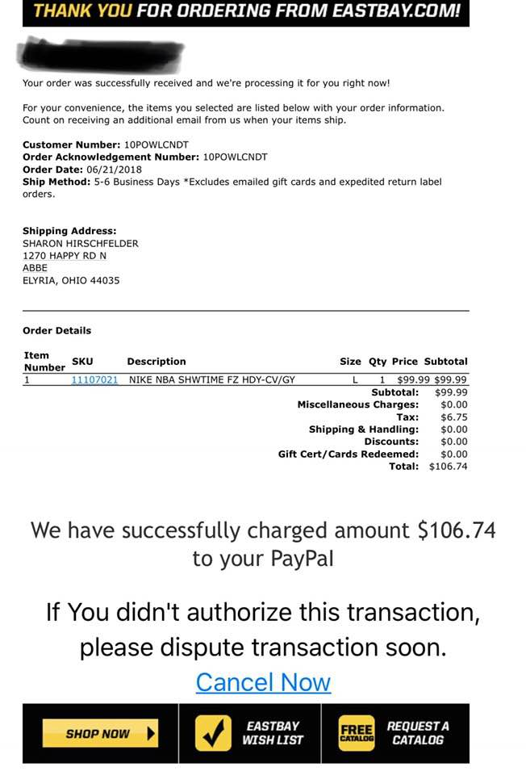
EXAMPLE PHISHING EMAIL
Designed to cause fear and quick action, your Paypal account was used to buy something! CLICK NOW!
IN THIS CASE THE BEST THING TO DO IS LOGIN TO PAYPAL IN ANOTHER BROWSER AND CHECK YOUR ACCOUNT ACTIVITY, IF THIS IS TRUE IT'LL BE THERE.

Slide 20
SOCIAL MEDIA & SHARING

Slide 21
APP & GAME TERMS OF SERVICE
IT'S A GOOD IDEA TO START GETTING IN THE HABIT OF READING THE ToS FOR ANY APP YOU'RE GOING TO INSTALL.
SOME OF THEM MAY MAKE YOU THINK TWICE ABOUT WHETHER THE APP IS WORTH WHAT YOU'RE ALLOWING.
REMEMBER HOW POORLY COMPANIES PROTECT YOUR DATA AND ASK YOURSELF IF WHAT YOU'RE ALLOWING ACCESS TO IS OKAY TO BE OUT IN THE WORLD.

Slide 22
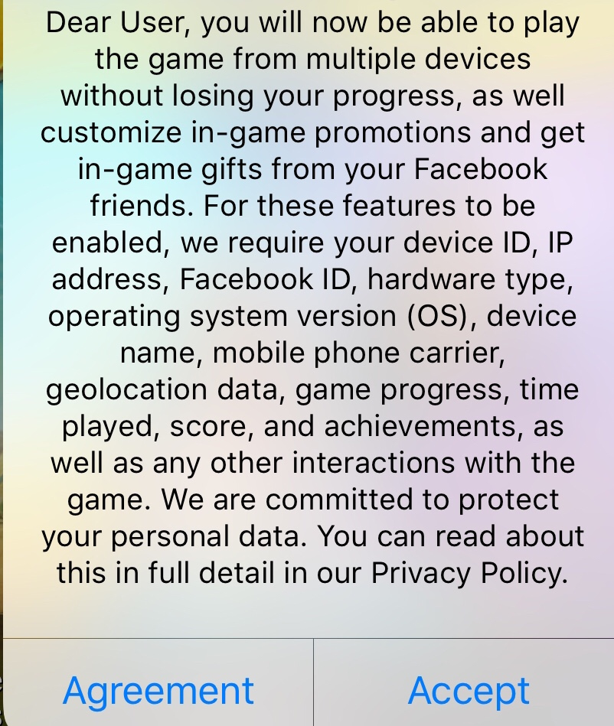
TERMS OF SERVICE
Every app you download, whether free or paid, will likely have a Terms of Service that few people ever read.

Slide 23


Slide 24
FOOD FOR THOUGHT (DON'T ANSWER OUT LOUD)
DID YOUR PARENTS DATE EACH OTHER IN HIGH SCHOOL?
ARE YOUR PARENTS STILL BEST FRIENDS WITH HIGH SCHOOL BEST FRIENDS?
ARE YOU STILL BEST FRIENDS WITH THE SAME PEOPLE EVERY YEAR?

Slide 25
SAFE ASSUMPTION
NO MATTER HOW MUCH YOU TRUST, LIKE OR LOVE SOMEBODY, CHANCES ARE THEY'RE NOT GOING TO DELETE WHAT YOU SHARE WITH THEM BEFORE SHOWING IT TO SOMEBODY ELSE THEY 'TRUST'.
ONCE IT'S IN THE WILD, THERE'S NO TAKING IT BACK.
THINK 3x BEFORE HITTING SEND...WOULD YOU WANT THIS IMAGE/POST/COMMENT ON A BILLBOARD OUTSIDE OF EVERY SCHOOL IN TOWN? IN FRONT OF A PROSPECTIVE EMPLOYER OR SCHOOL ADMISSIONS OFFICER?

Slide 26
SO SHOULD WE JUST PITCH IT AND STAY OFFLINE? OF COURSE NOT!
THE DIGITAL WORLD PROVIDES US ACCESS TO EVERY WRITTEN WORD, EVERY MEDICAL ARTICLE, EVERY PIECE OF ART AND MOST PERSPECTIVES IN THE WORLD IN AN INSTANT.
THE KEY IS TO RECOGNIZE THE IMPORTANCE OF YOUR PERSONAL INFORMATION AND WHAT YOU PUT INTO THE DIGITAL REALM AND WHAT CAN HAPPEN TO OR WITH THAT INFORMATION.
BE STEWARDS OF YOUR OWN PRIVACY, AND HELP OTHERS DO SO AS WELL.

Slide 27

ONE LAST THING...
THE CYBERSECURITY CAREER FIELD NEEDS YOU!
THERE ARE CURRENTLY 3 MILLION UNFILLED ROLES IN INFORMATION SECURITY.
WOMEN CURRENTLY ONLY MAKE UP ABOUT 20% OF THE FIELD!
MALICIOUS ACTORS COME FROM ALL WALKS OF LIFE, ALL COUNTRIES, AND ALL MANNER OF SOCIO-POLITICAL ORIGINS.
DIVERSITY IS CRUCIAL IN PROTECTING OUR DIGITAL ASSETS, NATIONAL SECURITY AND THOSE WE CARE ABOUT.
YOU ABSOLUTELY DO NOT HAVE TO BE A COMPUTER NINJA TO GET INTO INFORMATION SECURITY! THE FIELD IS AS WIDE AS IT IS DEEP.

Slide 28
DNA OF A 'WHITE HAT HACKER'?
CREATIVITY AND CURIOSITY
EMPATHY & SOCIAL AWARENESS
RESILIENCE (STICK TO-IT-IVENESS)
DESIRE TO KNOW HOW THINGS WORK
COMPUTER SKILLS ARE ACTUALLY IMPORTANT ;) BUT CAN BE LEARNED, THE ASPECTS ABOVE HAVE SHOWN TO BE A GOOD BASIS FOR AN EFFECTIVE INFORMATION SECURITY PROFESSIONAL!

Slide 29
ADDITIONAL RESOURCES
http://www.uscyberpatriot.org/
http://charleyproject.org/case/corinna-paige-slusser
https://www.consumer.ftc.gov/features/kids-online
https://www.safeandsecureonline.org/
https://www.state.gov/j/tip/training/index.htm
https://www.forbes.com/sites/laurencebradford/2018/10/18/cybersecurity-needs-women-heres-why/#3a25f8e247e8
IF YOU NEED HELP GETTING POINTED IN THE RIGHT DIRECTION FOR ANYTHING DISCUSSED TODAY YOUR TEACHERS ARE A GREAT RESOURCE!

Slide 30
THANK YOU!
MERCY ACADEMY
INTRODUCTION TO TECHNOLOGY FALL 2018

