Slide 1

MAD – 4360/6370

Slide 2
Setting up a development environment for Flutter

Slide 3

Flutter set-up
Setting up a development environment for Flutter involves installing Flutter itself, along with either Android Studio or Xcode for mobile app development, and configuring emulators for testing your apps.
Download and install the Windows version of the following packages:
Git for Windows 2.4 or later to manage source code.
Android Studio 2023.1.1 to debug and compile Java or Kotlin code for Android. Flutter requires the full version of Android Studio.

Slide 4
Here's a detailed guide to help you through the process:
Pre-installation Requirements
Windows 10 operating system installed (Flutter will work on Windows 7 SP1 and later versions).
At least 1.65 GB of free disk space (Additional free storage is needed for other tools and IDEs, if not already installed).
Windows Powershell 5.0 or newer.
Git for Windows version 2.0 or newer (Optional).
Android Studio installed.
Visual Studio 2022 with C++ (Optional).

Slide 5

1. Install flutter using SDK
Flutter is the open-source UI software development kit created by Google. It allows you to build natively compiled applications for mobile, web, and desktop from a single codebase. Here's how to install Flutter:
Download Flutter:
• Go to the official Flutter website: https://flutter.dev/
• Click on the "Get Started" button.
• Choose your operating system (Windows, macOS, Linux) and download the
It is worth noting that Flutter works great for Android and iOS mobile apps and apps for web and desktop. Today, Flutter’s support for MacOS and Linux is still in beta.

Slide 6

1. Install flutter continue
b. Extract and Add to Path:
• Extract the downloaded archive to a location on your computer.
• Add the Flutter bin directory path to your system's PATH variable.
• This step allows you to run Flutter commands from any terminal window.

Slide 7
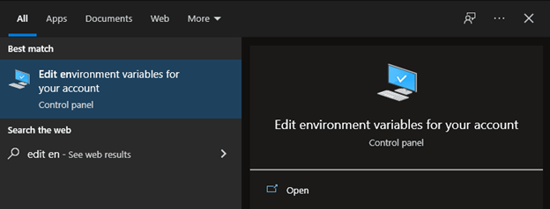
Option B - Update Path Variable for Windows PowerShell
You will need to update your Path environment variable to run Flutter commands in Windows consoles PowerShell and Command Prompt (CMD).
First, click the Start button and type to search for and then click on Edit environment variables for your account.

Slide 8
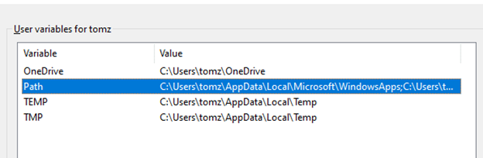

Step 2: Under User variables, click on and highlight Path. Click Edit.

Slide 9
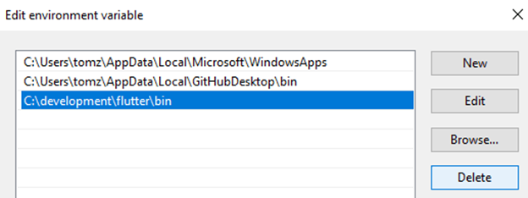
Step 3:
On the next screen, click New and add the full path to your flutter\bin directory. For this guide, it is shown below. Click OK on both windows to enable running Flutter commands in Windows consoles.

Slide 10
1. Use VS Code to install Flutter
Start Flutter install
Open VS Code.
To open the Command Palette, press Control + Shift + P.
In the Command Palette, type flutter.
Select Flutter: New Project.
VS Code prompts you to locate the Flutter SDK on your computer.
If you have the Flutter SDK installed, click Locate SDK.
If you do not have the Flutter SDK installed, click Download SDK
This option sends you the Flutter install page if you have not installed Git for Windows as directed in the development tools prerequisites.
When prompted Which Flutter template?, ignore it. Press Esc. You can create a test project after checking your development setup.

Slide 11
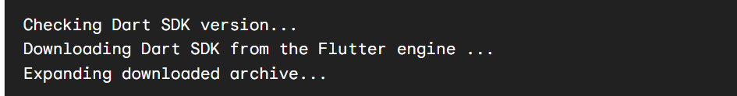
Download the Flutter SDK
When the Select Folder for Flutter SDK dialog displays, choose where you want to install Flutter.
    VS Code places you in your user profile to start. Choose a different location. If want to change
    Consider %USERPROFILE% or C:\dev.
Click Clone Flutter.
While downloading Flutter, VS Code displays this pop-up notification:
Once it finishes downloading Flutter, the Output panel displays.

Slide 12
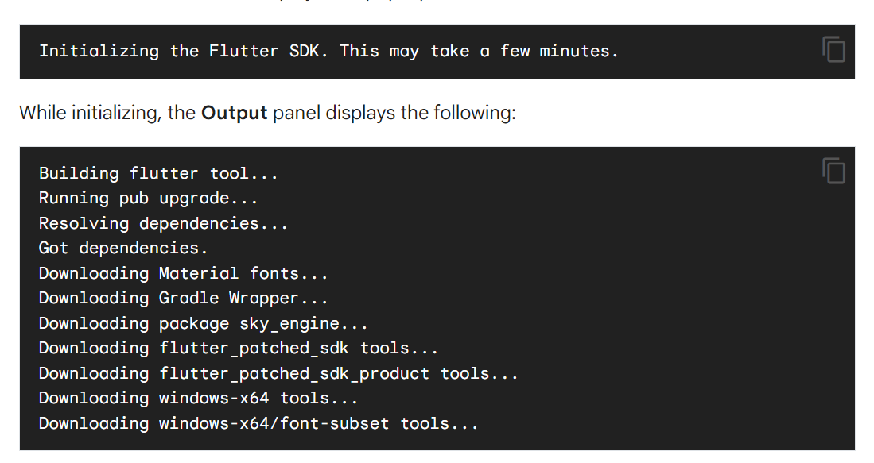
When successful, VS Code displays this pop-up notification:
This process also runs flutter doctor -v. At this point in the procedure, ignore this output. Flutter Doctor might show errors that don’t apply to this quick start.

Slide 13
When the Flutter install succeeds, VS Code displays this pop-up notification:
Click Add SDK to PATH.
When successful, a notification displays:

Slide 14

Run Flutter Doctor:
• Open a terminal window and run flutter doctor.
• This command checks your system for any missing dependencies needed for Flutter development.
• Install any missing dependencies according to the recommendations.

Slide 15
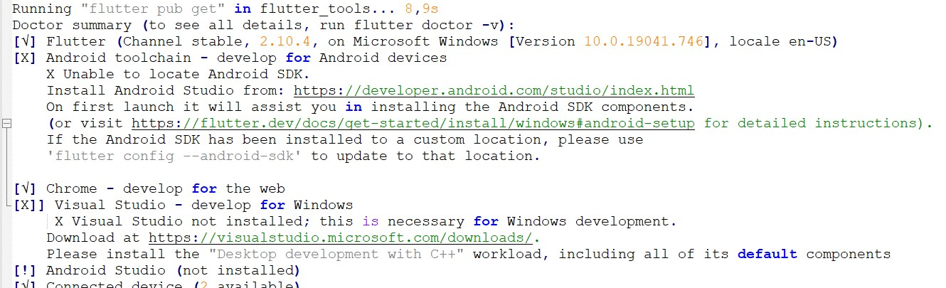
Step 4: Confirm Installed Tools for Running Flutter
In CMD, run the flutter doctor command to confirm the installed tools along with brief descriptions.
As visible, several components still need to be installed to complete the installation.

Slide 16

Step 5: Download and Install Android Studio (Main) then after Xcode
You'll need an integrated development environment (IDE) to write and manage your Flutter code. Android Studio is for Android app development, while Xcode is for iOS app development. You can choose either one based on your target platform(s):
Android Studio (for Android development):
Continue by downloading Android Studio. In the setup, unless you have specific requirements, you can click Next on all screens leaving the default settings. Ensure that the
Android Virtual Device option is selected on the Choose Components screen so that you can have an Android emulator running for Android app development.
• Download Android Studio from: https://developer.android.com/studio
• Install Android Studio by following the installation wizard.
• During installation, make sure to select the "Android" and "Flutter" plugins to install.

Slide 17

Step 6: Set Up Emulators:
Emulators allow you to test your apps without using physical devices. Flutter comes with a command-line tool called "flutter emulators" that helps you manage and launch emulators.
a. Android Emulator (from Android Studio):
• Open Android Studio.
• Click on "Configure" in the welcome screen, then choose "AVD Manager."
• Create a new Android Virtual Device (AVD) by clicking on the "+ Create Virtual Device" button.
• Choose a device definition, select a system image (preferably with Google Play), and configure other settings.
• Start the emulator from the AVD Manager.

Slide 18
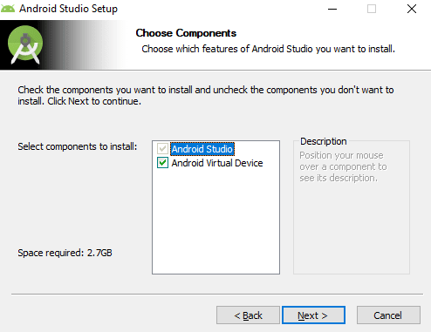
What you will see

Slide 19
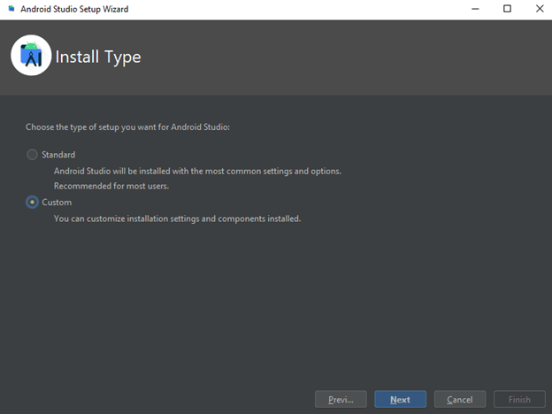
Step 7
On the Install Type screen, select Custom and click Next.

Slide 20
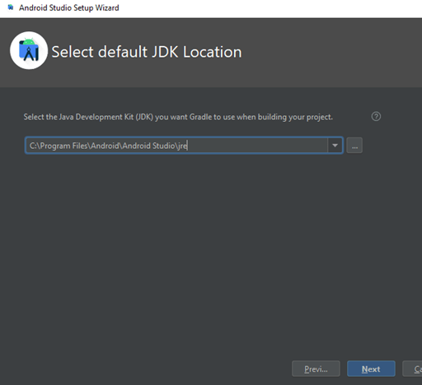
Step 8:
Select the installation location or leave the default path and click Next.

Slide 21
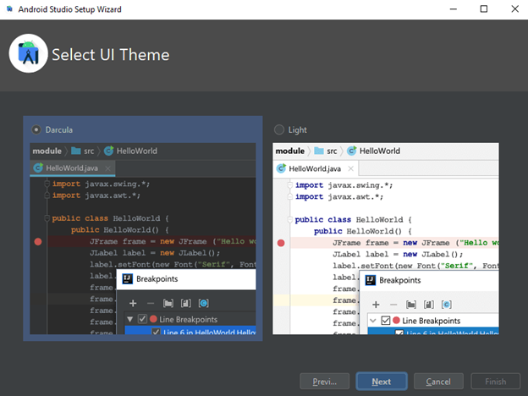
Step 8
Select your UI theme and click Next.

Slide 22
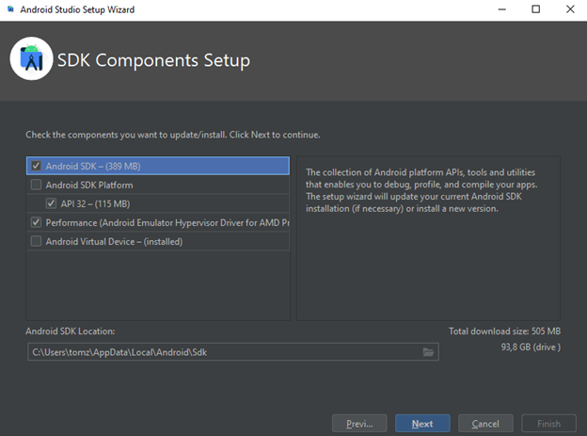
Step 9:
Verify the selections and click Next.

Slide 23
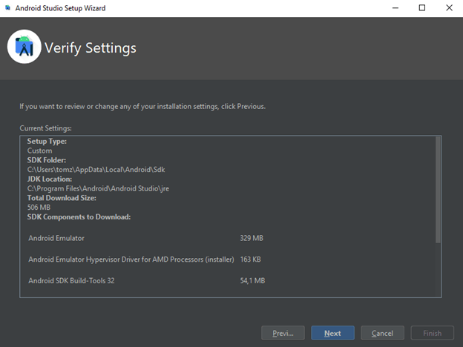
Step 10:
On the next screen, accept the License Agreement and click Finish.

Slide 24
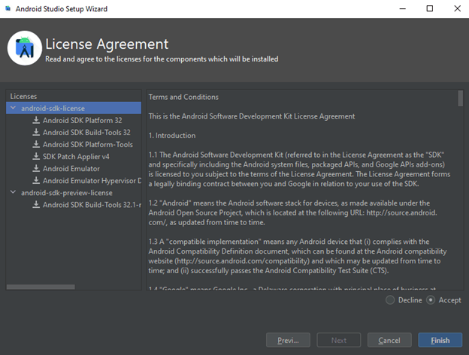
Step 11:
The download of the components will start and Android Studio install. Once completed, click Finish.
After the installation, start Android Studio. On the left side, click Plugins. Search for Flutter and click Install to install the Flutter plugin.

Slide 25
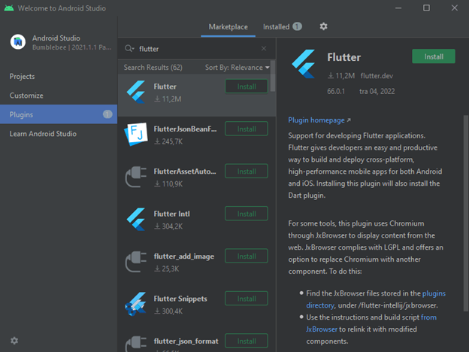
Step 12:
It will also prompt you to install Dart, a programming language used to create Flutter apps. Click Install at the prompt.

Slide 26
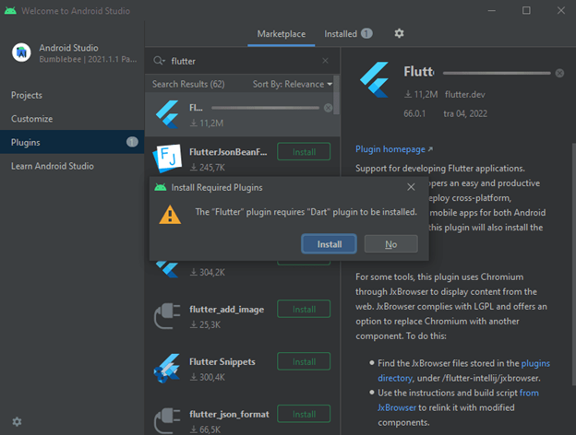
Step 13
Finally, click Restart IDE so that the plugin changes are applied. Click Restart at the prompt to confirm this action.

Slide 27
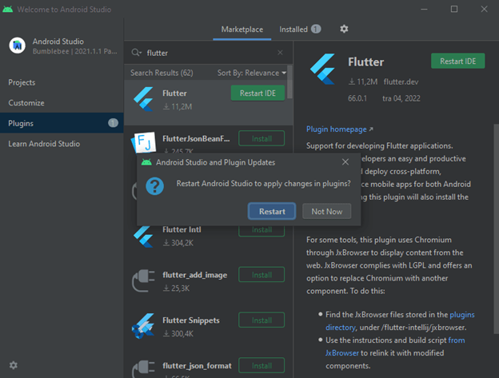
Step 14:
Afterward, run the flutter doctor command in CMD to confirm the Android Studio installation.

Slide 28
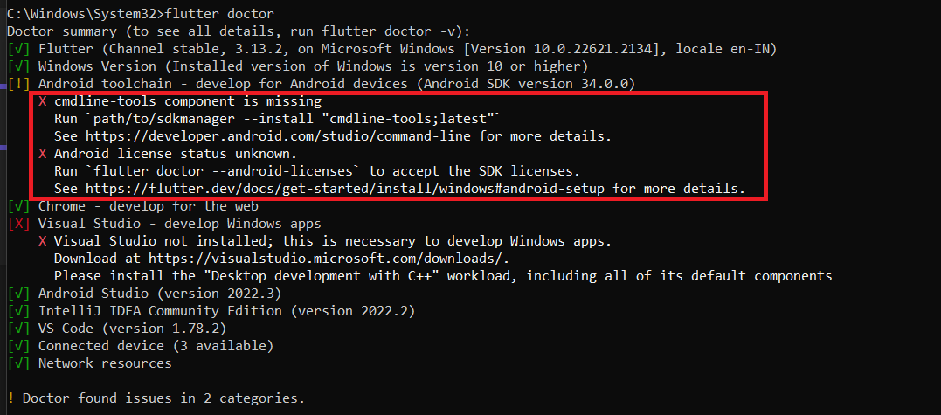
How the CMD line tool error

Slide 29
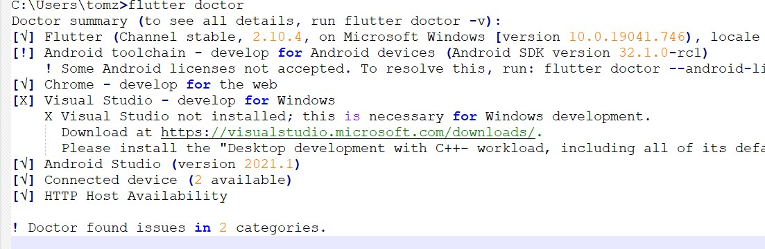
Results from the doctor

Slide 30

After a successful install
Android Studio was successfully installed; however, it finds an issue with Android licenses. This issue is pretty common and is mitigated by running the following command in CMD.
flutter doctor --android-licenses
When asked, input y to all prompts, to accept licenses.
C:\Users\tomz>flutter doctor --android-licenses
5 of 7 SDK package licenses not accepted. 100% Computing updates...
Review licenses that have not been accepted (y/N)? y

Slide 31
Calling the doctor
Running the flutter doctor command again shows the issue resolved.
C:\Users\tomz>flutter doctor
Doctor summary (to see all details, run flutter doctor -v):
[√] Flutter (Channel stable, 2.10.4, on Microsoft Windows [Version 10.0.19041.746], locale en-US)
[√] Android toolchain - develop for Android devices (Android SDK version 32.1.0-rc1)
[√] Chrome - develop for the web
[X] Visual Studio - develop for Windows
X Visual Studio not installed; this is necessary for Windows development.
Download at https://visualstudio.microsoft.com/downloads/.
Please install the "Desktop development with C++" workload, including all of its default components
[√] Android Studio (version 2021.1)
[√] Connected device (2 available)
[√] HTTP Host Availability
! Doctor found issues in 1 category.

Slide 32

Step 15: Verification of the Flutter Installation
a. Run a Sample App:
• Create a new Flutter app by running flutter create myapp in the terminal.
• Navigate to the app's directory using cd myapp.
• Launch the app on an emulator using flutter run.
b. Verify IDE Integration:
• Open your chosen IDE (Android Studio or Xcode) and open your Flutter project folder.
• Make sure you can access Flutter-specific features from within the IDE.
Congratulations! You've successfully set up your Flutter development environment, installed Android Studio or Xcode, and configured emulators to test your apps. You're now ready to start building cross-platform mobile applications using Flutter. Remember to consult the official Flutter documentation for more in-depth information and troubleshooting tips.

Slide 33
Xcode (for iOS development):
• Install Xcode from the Mac App Store if you're on macOS.
• Xcode includes the necessary tools and simulators for iOS development.
b. iOS Simulator (from Xcode):
• Open Xcode.
• Go to "Xcode" in the menu bar, then select "Open Developer Tool" and choose "Simulator."
• In the Simulator app, you can select different iOS devices and versions to simulate.
Verify Flutter Installation:
a. Run a Sample App:
• Create a new Flutter app by running flutter create myapp in the terminal.
• Navigate to the app's directory using cd myapp.
• Launch the app on an emulator using flutter run.

Slide 34
Verify IDE Integration:
Open your chosen IDE (Android Studio or Xcode) and open your Flutter project folder.
Make sure you can access Flutter-specific features from within the IDE.
Congratulations! You've successfully set up your Flutter development environment, installed Android Studio or Xcode, and configured emulators to test your apps. You're now ready to start building cross-platform mobile applications using Flutter. Remember to consult the official Flutter documentation for more in-depth information and troubleshooting tips.

Slide 35

Install Visual Studio (Optional)
The above output also shows that Visual Studio is not installed. Visual Studio is not needed unless you want to use Flutter for Windows desktop development.
If you need to use it, you can download Microsoft’s Visual Studio 2022 with C++. Once the VisualStudioSetup.exe file is downloaded, open it and proceed with the installation by agreeing to all default installation options. This installation requires at least 20 GB of free disk space. After the installation completes, run the flutter doctor command in CMD to confirm the Visual Studio installation.

Slide 36
What you will see
C:\Users\tomz>flutter doctor
Doctor summary (to see all details, run flutter doctor -v):
[√] Flutter (Channel stable, 2.10.4, on Microsoft Windows [Version 10.0.19041.746], locale en-US)
[√] Android toolchain - develop for Android devices (Android SDK version 32.1.0-rc1)
[√] Chrome - develop for the web
[√] Visual Studio - develop for Windows (Visual Studio Community 2022 17.1.3)
[√] Android Studio (version 2021.1)
[√] Connected device (2 available)
[√] HTTP Host Availability
• No issues found!

Slide 37
How To Run Flutter App in VSCode Android Emulator on Windows 10 or 11 (2023)
https://www.youtube.com/watch?v=EhGW4UYpKSE

Slide 38

Conclusion
At this point, all the tools for Flutter projects are ready to be used for the development of Flutter apps. Depending on your needs, you can start your projects in Android Studio or Visual Studio.

