Slide 1
Ground Station Progress
March 5th, 2025

Slide 2
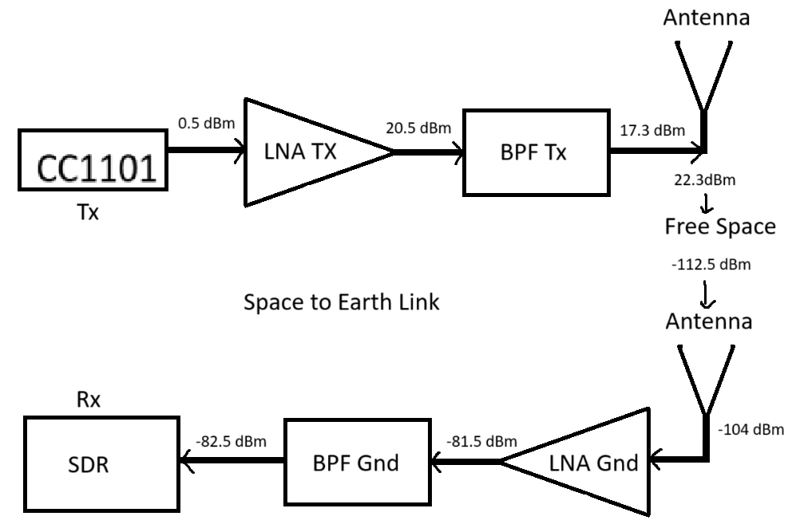
Signal Chain (Space to Earth)
At the output of every block is a signal power measurement in dBm
Main bottleneck of this link is the Tx LNA, because of its low OP1dB

Slide 3
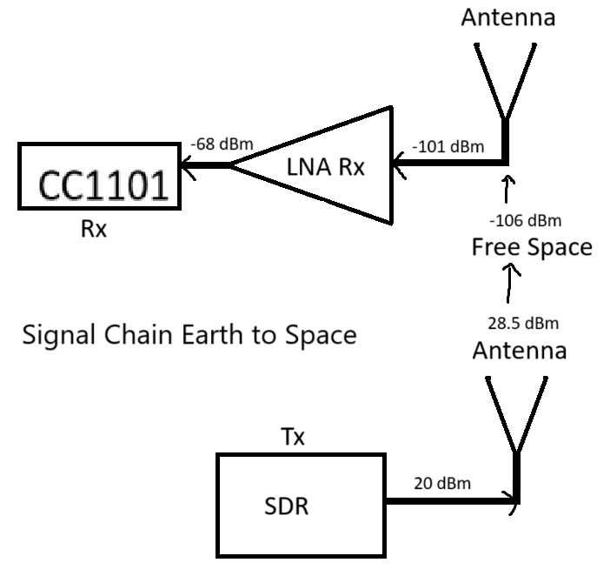
Signal Chain (Earth to Space)
At the output of every block is a signal power measurement in dBm.
Main bottleneck of this link is the SDR, because of its low max Tx power.
May need to look at the harmonic content of the SDR to meet FCC requirements.
Could require an extra BPF on the ground

Slide 4
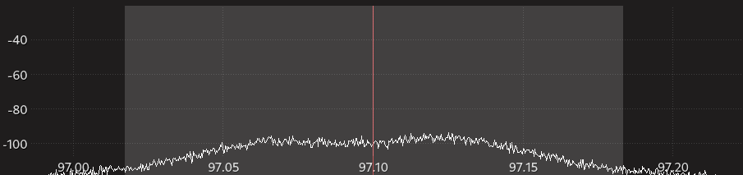
Other Considerations
Friis’ Radio Link formula was used for the free-space propagation calculations, which in practice should be used as an upper bound for received signal strength.
Atmospheric attenuation can be significant, and an extra 10 dB of loss will push our SDR to its limits.
Thermal noise floor of space and Earth need to be considered. If the signal falls below the noise floor at any point, it becomes unrecoverable. (Unless some complicated processing techniques are used)

Slide 5
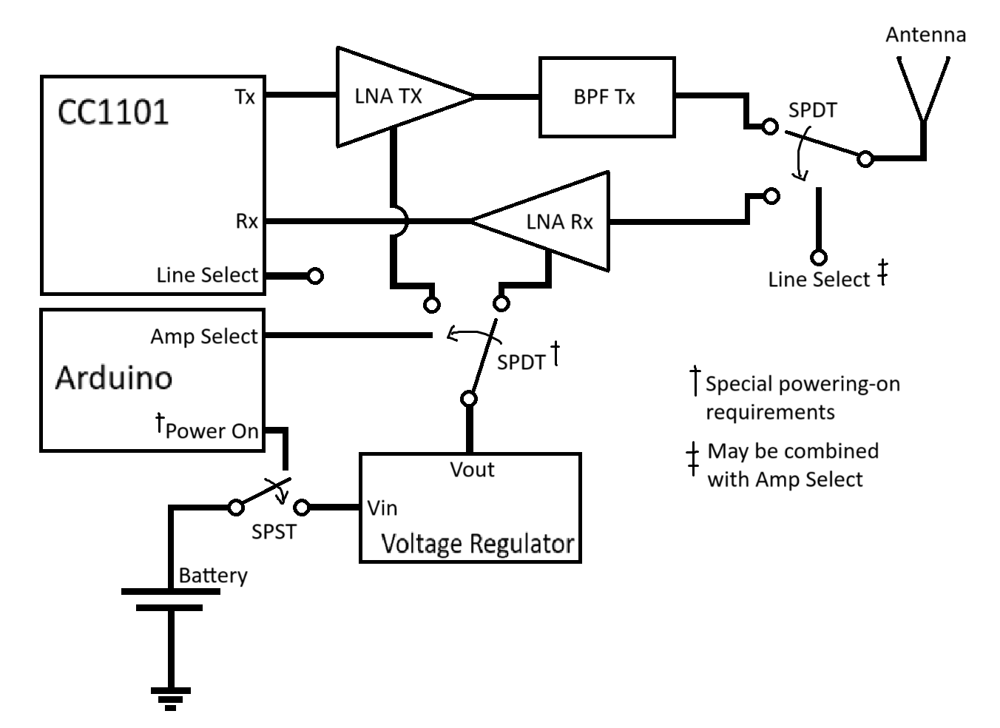
High-Level PCB Block Diagram
The special power on procedure refers to the LNA Tx, due to its various modes.
While letting the voltage regulator stabilize, set the amp select to Rx
CC1101 Datasheet is necessary to determine if the “line select” exists.
Also important to determine how we wire up the switches.

Slide 6
Chosen PCB RF Chips
LNA (Tx): TSY-83LN+
BPF (Tx): SXBP-425+
LNA (Rx): PMA-545G1+
Volt. Reg.: MAX8880
SPDT Antenna: HSWA2-30DR+
SPST Power: TBD, RF switch is overkill
SPDT Power: TBD, RF switch is overkill
Might be worth experimenting with single FET switches.

Slide 7
Notes About Switches
The Antenna switch must be absorptive, so that an accidental delivery of power is not reflected into a sensitive device.
The power switch must be reflective, because an absorptive switch will drain power even though the voltage regulator is off.
RF switches carry their own insertion loss, typically around 1dB. This shouldn’t be an issue for us, but its something to keep in mind.
RF switches also have a finite isolation, which can be more of a concern for us in a narrow band simplex/half duplex link.
Their non-linearity introduces P1dB and IP3 as well.

Slide 8
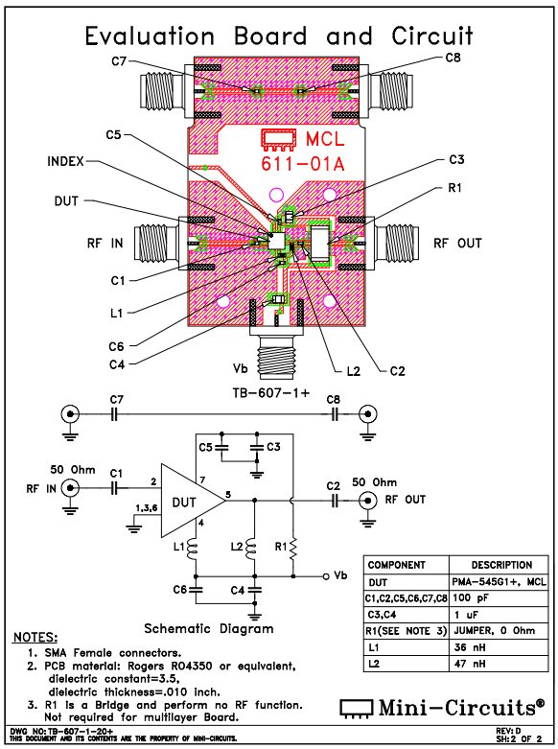
Future PCB Design:
All of the minicircuits components come with suggested PCB layouts as well as the PCB layout they used to test the circuit.
These will be closely followed when drawing schematics.
The components also have S-parameters available for download, which can be useful for importing into a software like ADS to run tests with transmission lines and impedance matching.

Slide 9
What I Want By April:
Terrace opens by April, so there are several things I would like to be done by then:
Vertically mounted antenna (Oscar)
Wooden board for ground station hardware
Ground station LNA power supply
Fully understand safety manual for Jackery portable power supply (this thing scares me, and I do not trust it)
Cmake bug fixed (Emma, maybe Arav)

