Slide 1
VIP Final Presentation:
Communications

Slide 2
What has been done so far?
Arduino to SDR communication link
SDR to Arduino communication link
Antenna Analysis
Approximate Power Requirements

Slide 3
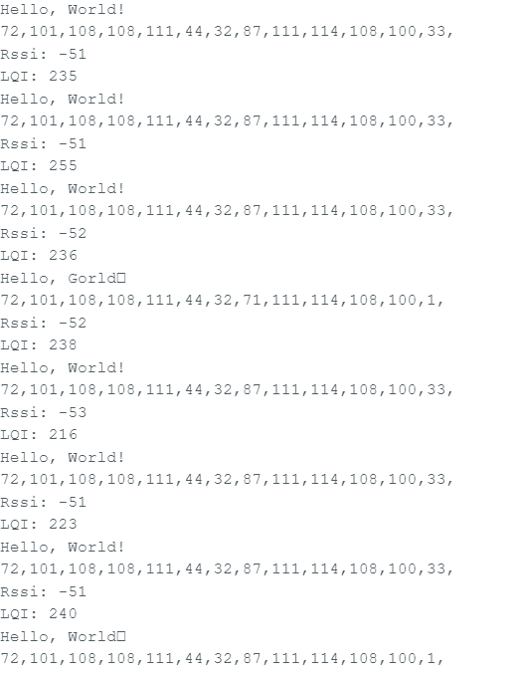
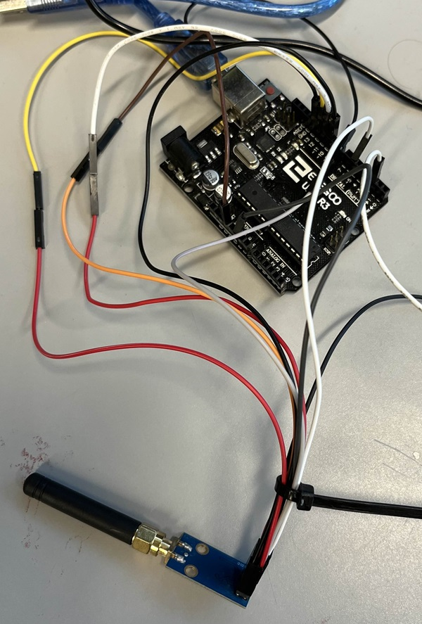
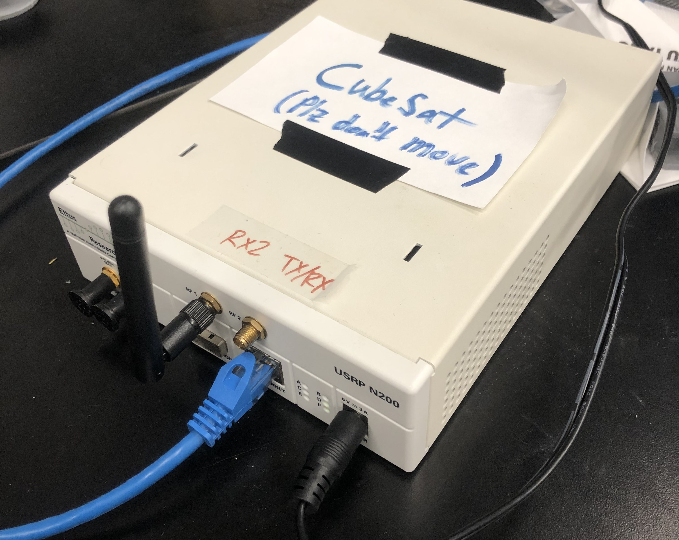
Arduino to SDR Link
Successfully mimicked the signal the Arduino expects, allowing the “forwards” direction of communication

Slide 4
Problems with feeding data into GnuRadio:
Because of bad timing and inefficient power use, we need a new method of feeding data.
I have started work on a custom module to accomplish this
It is functionally the same as a “file sink” block, except that it will come with a sleep timer.
A lot of headache, CMake is frustrating to work with. I will likely have to learn how to do this from the ground up.
This will also take care of the Tx/Rx synchronization, because our radio automatically turns off Rx when we send a Tx instruction.

Slide 5
Mini Lesson Time!

Slide 6
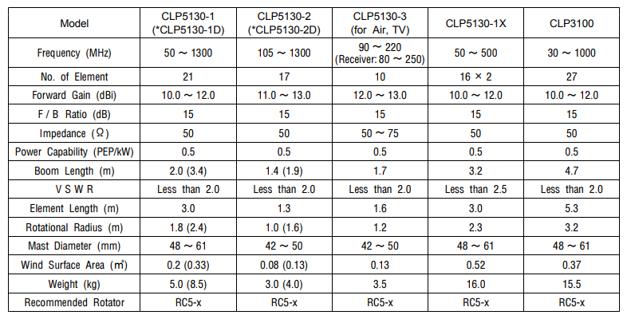
The Antenna: CLP5130-2N
Specifications of interest are:
Power Capability
Forward Gain
We will measure frequency and VSWR ourselves

Slide 7
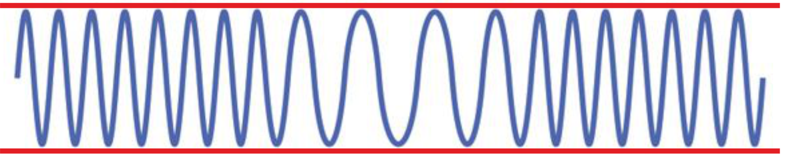
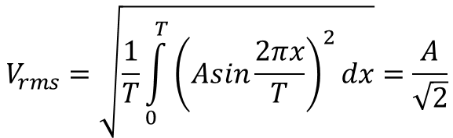
Power Capability
Power capability is given in PEP/kW
PEP stands for peak envelope power, which is heavily dependent on how the signal is modulated.
Our antenna has PEP/kW=0.5
Example of FSK (Our scheme). The red line is the envelope, and is constant, so our PEP is just going to the RMS power of a sinewave, which is independent of frequency.
Disregarding other spectral content, a brief calculation yields, for a 50-Ohm load, a maximum amplitude of 158 Volts.
$$V_{rms}=\sqrt{\frac{1}{T}\int_{0}^{T}{{\left(Asin\frac{2πx}{T}\right)}^{2}dx}}=\frac{A}{\sqrt{2}}$$
$P= \frac{V_{rms}^{2}}{Z}⇒ V_{rms}^{ }=\sqrt{ZP}=158V$ for P = 500 W, or 57 dBm

Slide 8
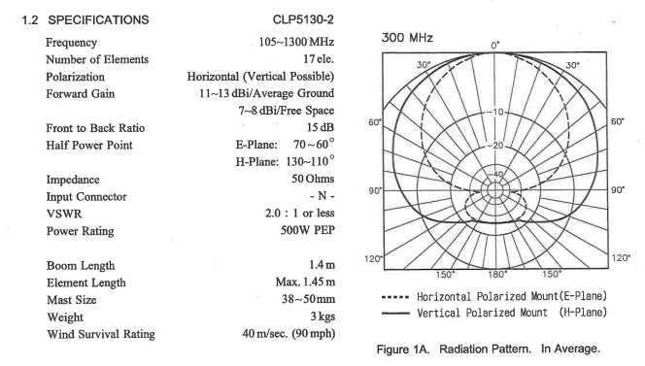
Forward Gain
Forward gain, is given in dBi. This unit describes how much power is delivered in a certain direction, with reference to a perfectly spherically radiating antenna.
The cutoff is marked by the 3dB or half-power point, at orthogonal angles in the E and H-plane.
If our max power is 57dBm, and Forward Gain is 13 dB, we can get up to 70dBm of power in the forward direction

Slide 9
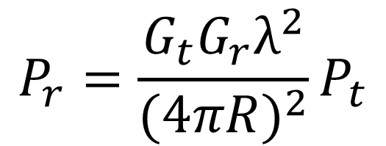
Friis radio link formula
The maximum possible received power is given by the Friis radio link formula
R is the radial distance, Pr and Pt are the Rx and Tx powers, and Gr and Gt are the Rx and Tx gains.
$$P_{r}=\frac{G_{t}G_{r}λ^{2}}{{(4πR)}^{2}}P_{t}$$

Slide 10
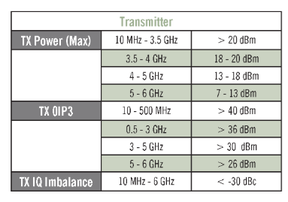
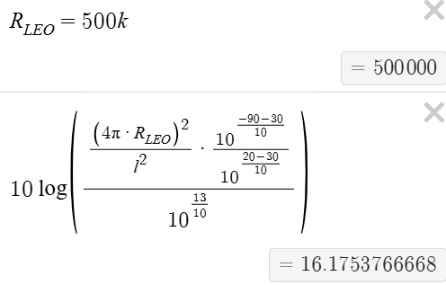
Quick gain estimation
We can use 40km as the height of a weather balloon, and 500km as the altitude of a cubesat and say our minimum received power at the satellite is -90dBm
Our SDR can transmit a max of 20dBm
And factoring out 13dBi antenna gain for now…
We need a system gain of 16.18 dB!
That means for the SDR transmitting 20dBm = 0.1 W, we need to amplify this to 20dBm + 16.18dB = 36.18dBm = 4.15 W

Slide 11
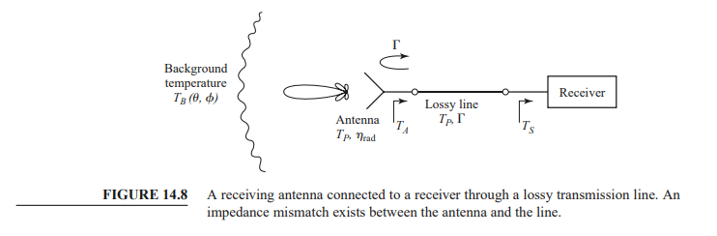

Antenna Reflections
Antennas are 1-port devices, meaning their voltages in and voltages out are governed by a single parameter, S11.
This was empirically determined using a VNA at our transmit and receive frequency, but I would like to re-do it now that I understand experimental flaws better.
S11 is a complex ratio of the reflected voltage to the incident voltage and is always less than 1 in magnitude. Ideally it should be 0.
$$V_{1}^{−}=s_{11}V_{1}^{+}$$
Thus, we can get a power loss due to the antenna.
Note that this power is reflected, and can damage previous components

Slide 12
Getting S11 (again)
I will be the TA for the EMT course (electromagnetics and transmission lines), which means I will be assisting students in their VNA experiments.
I will be getting more training with it over winter break, and I will take advantage of that to test some of our components, including the antenna.
Hopefully after this I could have somewhat free access to the VNA, streamlining testing.

Slide 13
What’s Next:
Now that both directions of communication are working, we need to find a way to automatically alternate between them.
This means we want a “half-duplex” or “simplex” system, meaning we can not simultaneously transmit and receive.
This will need programming outside of what the GnuRadio blocks will allow.
The most convenient option is to create custom GnuRadio blocks, also known as OOT (Out-of-tree) blocks.
GnuRadio provides guides on how to do this

Slide 14
More of what’s next:
Noise budget analysis.
Pozar textbook will help with this (chapter 14), some experimental stuff must be done on the ground as well as research on background noise in LEO orbit.
This is necessary for a better estimate of minimum received power
Transmission protocol
How will we identify ourselves?
Should we switch to CW to save bandwidth? (means a new power budget analysis)
Power amplification and Filtering
Cleanly getting a signal to high power is no easy task, and also introduces spurious signals that will upset spectral neighbors (also illegal)

