Slide 1

EMOTIVATION
Jay Thakare: 23106052
Sneha Utekar: 23106116
Saanj Shetty:23106070
Divya Patil:23106124
Project Guide – RANJITA ASATI
ACADEMIC YEAR 2024-25

Slide 2
Outline
Introduction
Literature Survey of the Existing Systems
Limitations of the Existing Systems
Problem Statement
Technologies and Methodologies
System Design
Implementation Screenshots
Conclusion
References

Slide 3
Introduction
The growing prevalence of mental health challenges has become a significant concern globally, with millions of people struggling to maintain their mental well-being in the face of stress, anxiety, depression, and other psychological issues.
Despite the increasing awareness of mental health, many individuals face barriers to accessing timely and effective support, whether due to the stigma associated with seeking help, the high cost of therapy, or the limited availability of mental health professionals
In response to these challenges, digital health solutions have emerged as a promising avenue for expanding access to mental health care.
Among these innovations is the concept of a mental health companion — a digital tool designed to provide continuous, personalized support for individuals seeking to manage their mental well-being.

Slide 4
Literature Survey of the
Existing System
Title | Authors | Description
Conversational Agents in Mental Health: A Review of Recent Developments and Future Directions | Aditya Nrusimha Vaidyam Hannah Wisniewski John David Halamka | The paper discusses the use of chatbots and other conversational agents in mental health
Evidence on Digital Mental Health Interventions for Adolescents and Young People: Systematic Overview | Susanna Lehtimaki Katherine T Foster | This paper reviews the effectiveness of digital mental health interventions for young people, including apps and online tools.
Artificial Intelligence for Mental Health and Mental Illnesses | Sarah Graham Camille Nebeker | The study explores how AI technologies are applied in mental health care, assessing their potential and current limitations.

Slide 5
Title | Authors | Description
Artificial Intelligence for Mental Healthcare: Clinical Applications, Barriers, Facilitators, and Artificial Wisdom | Ellen E. Lee Munmun De Choudhury Dilip V. Jeste | Artificial Intelligence for Mental Healthcare explores AI's potential in clinical settings, addressing its applications, barriers, facilitators, and evolving ethical considerations like artificial wisdom.

Slide 6
Limitations of Existing Systems
Privacy Concerns :
Users may worry about the security of their sensitive mental health data, as some platforms don’t clearly explain how data is stored or protected.
Lack of Integration with Professional Support:
AI systems typically don’t provide seamless integration with professional therapists or counselors, limiting the pathway to further help if needed.
No Real-Time Assistance:
Many existing platforms cannot offer real-time emotional support during a crisis, limiting their usefulness in urgent situations.
Technology Dependence: Some platforms may be overly dependent on AI technology without
considering user preferences for more personal or interactive human
elements.

Slide 7
Problem statement
In today's fast-paced world, mental health challenges such as stress, anxiety, and emotional fatigue are becoming increasingly prevalent. Many individuals, especially students and young professionals, struggle to find accessible and affordable mental health support. The key problems addressed in this project include: Lack of immediate support, Affordability and accessibility, Stigma around mental health discussions, Need for consistent emotional tracking.

Slide 8
Technologies
Technologies
Html
Javascript.
Api Integration.
React Js.
CSS
Fig1:- Technologies

Slide 9
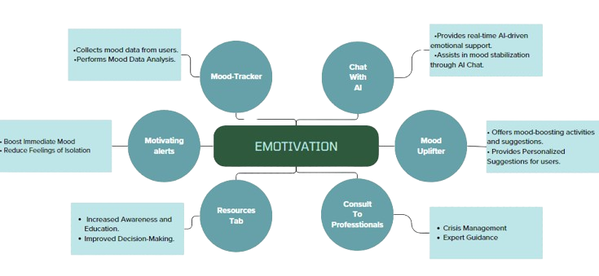
Methodologies
Fig2:-System Design

Slide 10
System Design
Mood-Tracker
Collects mood data from users.
Performs Mood Data Analysis.
Chat With AI
Provides real-time AI-driven emotional support.
Assists in mood stabilization through AI Chat.
Mood Uplifter
Offers mood-boosting activities and suggestions.
Provides personalized suggestions for users.
Consult To Professionals
Crisis management.
Expert guidance.
Resources Tab
Increased awareness and education.
Improved decision-making.
Motivating Alerts
Boosts immediate mood.
Reduces feelings of isolation.

Slide 11
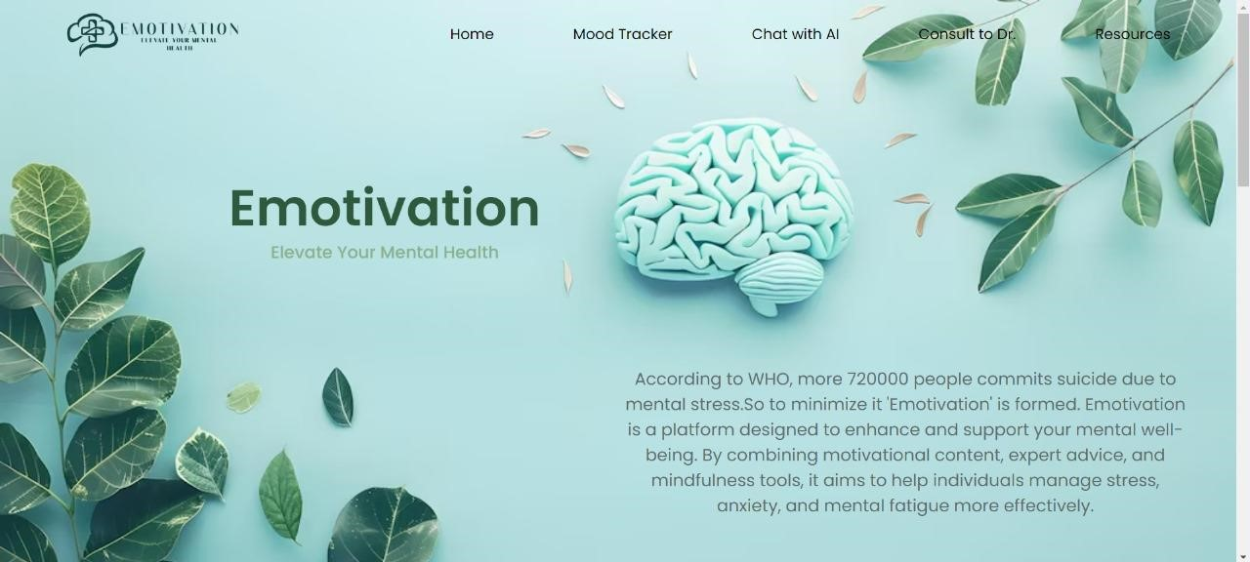
Implementation
Fig1 :- Home Page

Slide 12
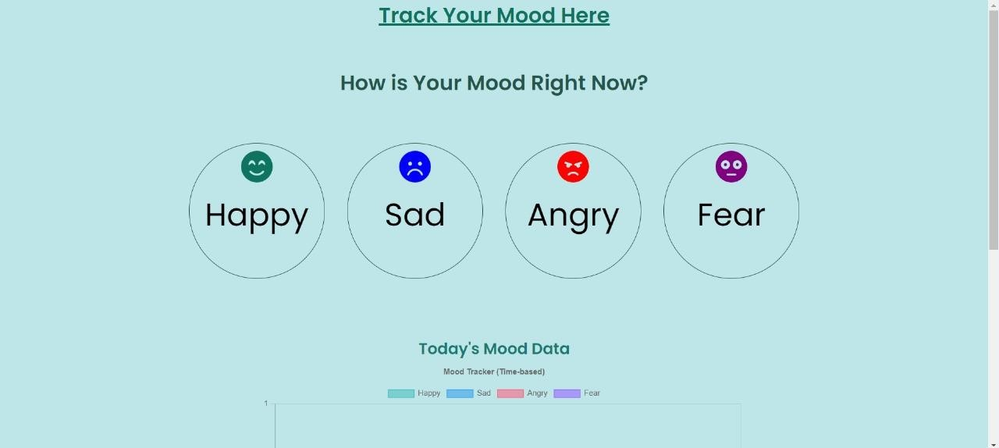
Fig4 :- Mood-Tracker

Slide 13
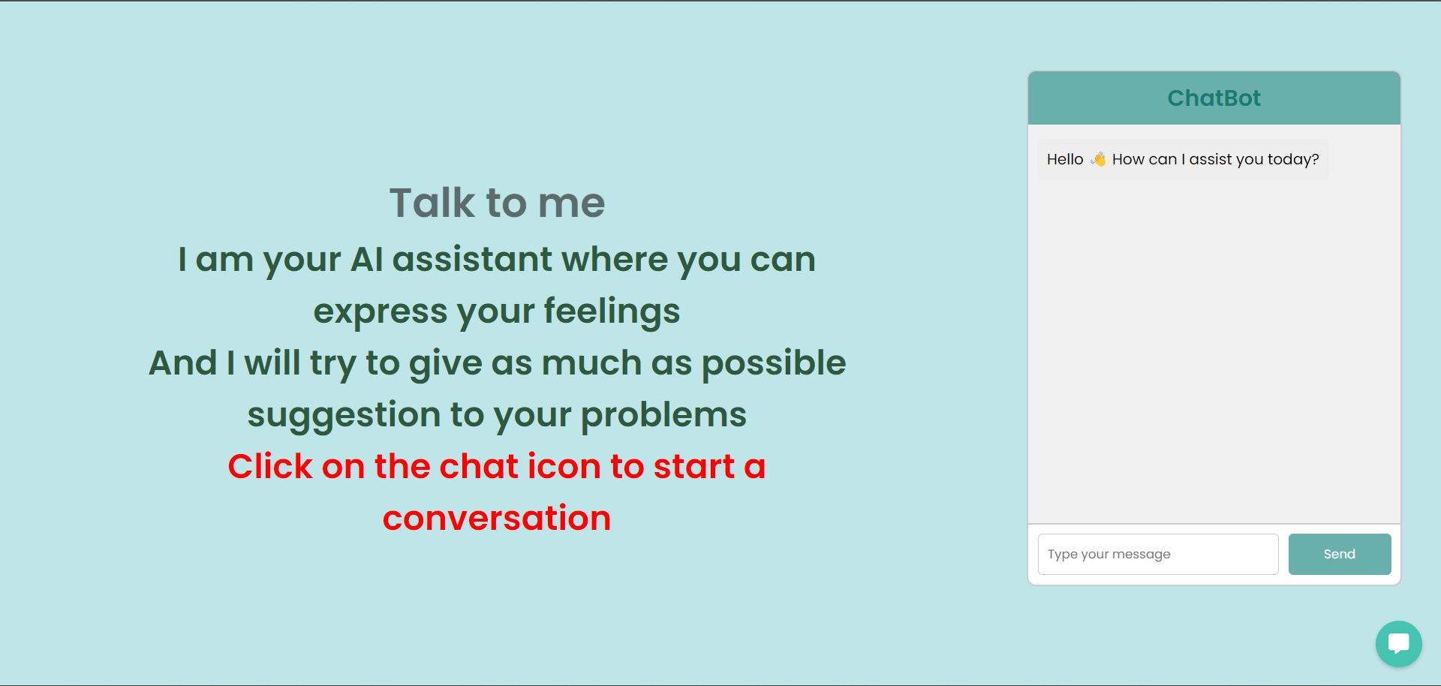
Fig5:-Chatbot

Slide 14
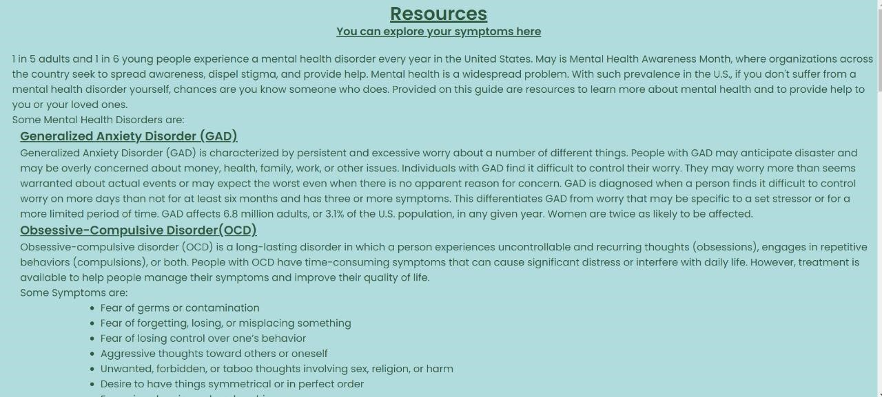
Fig6 :- Resources Page

Slide 15
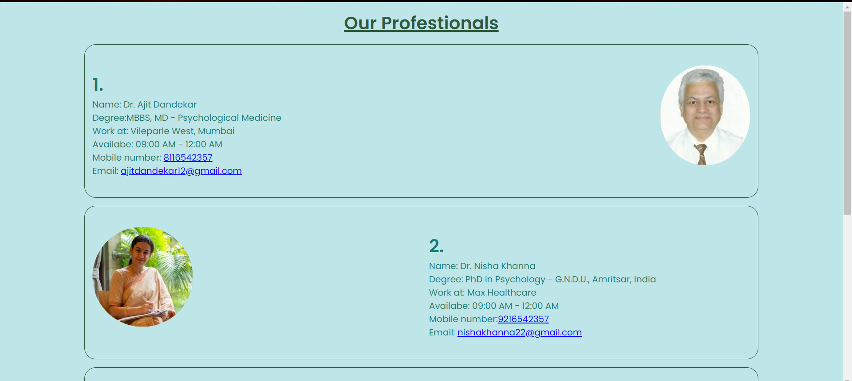
Fig7 :- Consult to Dr. page

Slide 16
Conclusion
Emotivation is a comprehensive platform designed to prioritize and enhance mental well-being through its innovative features like the Mood Tracker, AI Chat, and Mood Refresher. By offering personalized and accessible mental health support, it empowers users to take charge of their emotional health in a convenient and stigma-free environment.

Slide 17
References
[1] “Conversational Agents in Mental Health: A Review of Recent Developments and Future Directions” by Aditya Nrusimha Vaidyam, Hannah Wisniewski, and John David Halamka ,JMIR Mental Health journal, June 2019.
[2] “Evidence on Digital Mental Health Interventions for Adolescents and Young People: Systematic Overview” by Susanna Lehtimaki and Katherine T. Foster ,The Lancet Digital Health , April 2021.
[3] “Artificial Intelligence for Mental Health and Mental Illnesses” by Sarah Graham and Camille Nebeker ,JMIR Mental Health ,November 2019.
[4] “Artificial Intelligence for Mental Healthcare: Clinical Applications, Barriers, Facilitators, and Artificial Wisdom” by Ellen E. Lee, Munmun De Choudhury, and Dilip V. Jeste ,Psychiatric Clinics of North America, September 2022.

Slide 18
Thank You...!!

