Slide 1
BUSINESS INTELLIGENCE & MACHINE LEARNING MINI-PROJECT (CA3)
Explainable Machine Learning for Alzheimer’s Disease Classification Using Structural MRI and Clinical Features
Project Team Members:
• Jay Thakare — PRN: 23070521233
• Devansh Gawali — PRN: 23070521237
Academic Institution:
Department of Computer Science & Engineering
Symbiosis Institute of Technology (SIT), Nagpur
Symbiosis International (Deemed University), Pune, India
Notes:
Good morning/afternoon. Today, Devansh Gawali and I, Jay Thakare, present our CA3 mini-project on Explainable Machine Learning for Alzheimer's Disease Classification Using Structural MRI and Clinical Features. Our goal is to build an accurate, transparent, and leakage-free diagnostic system that clinicians can understand and trust.

Slide 2
1. CLINICAL CONTEXT
Background & Clinical Motivation
Global Healthcare Challenge
The Diagnostic Dilemma
The Explainability Imperative
• Alzheimer's Disease (AD) accounts for 60%–80% of all global dementia cases.
• Over 55 million individuals are currently affected, projected to reach 152 million by 2050.
• Annual healthcare economic costs exceed $1.3 trillion globally.
• Irreversible cerebral damage precedes overt functional symptoms by 5–15 years.
• Structural MRI (sMRI) captures macroscopic cerebral atrophy, ventricular enlargement, and hippocampal shrinkage.
• Cognitive exams (MMSE) evaluate immediate recall and orientation.
• Manual radiological review is labor-intensive, scarce in primary care, and suffers from inter-rater subjectivity in mild stages.
• Need for automated, reliable clinical screening support.
• Deep neural networks operate as uninterpretable 'black boxes', blocking clinical translation.
• Medical AI requires actionable, biological justification for individual patient diagnoses.
• Regulatory bodies (FDA, EU AI Act) mandate high transparency in automated medical decision systems.
• Explainable AI (XAI) bridges the gap between predictive accuracy and clinical trust.
Notes:
Alzheimer's is a massive global crisis. Macroscopic brain changes happen years before obvious memory failure. While MRI and MMSE tests exist, manual evaluation has bottlenecks. Automated AI has high potential, but black-box models cannot be safely adopted in clinical neurology without explainability.

Slide 3
2. RESEARCH FOCUS
Problem Statement & Research Objectives
Core Research Problem
Key Project Objectives
Existing machine learning literature for Alzheimer's diagnosis exhibits three persistent vulnerabilities:
1. Black-Box Opacity: Lack of patient-specific feature attribution prevents clinicians from verifying if decisions stem from genuine pathology or spurious noise.
2. Widespread Data Leakage: Participant overlap across cross-validation splits and global pre-scaling artificially inflate reported scores by up to 25%.
3. Computational Overhead: 3D deep learning models require heavy GPU clusters and lengthy registration pipelines impractical in resource-constrained clinics.
• Strict Leakage-Free Validation: Implement strict participant-level 80/20 holdout splitting and training-only preprocessor fitting.
• Multimodal Integration: Combine cognitive psychometrics (MMSE) with structural MRI volumetric morphometrics (nWBV, eTIV, ASF).
• Lightweight Ensemble Architecture: Benchmark 6 classifiers including a Soft-Voting Ensemble on standard commodity hardware.
• Post-Hoc Interpretability via SHAP: Unpack global biomarker importance and provide local waterfall patient explanations for clinical decision support.

Slide 4
3. STATE OF THE ART
Literature Review & Research Gap (2021–2026)
Author & Year | Dataset & Modality | Models Evaluated | Key Findings & Metrics | Limitations Addressed
Jahan et al. (2023) [PLOS ONE] | OASIS-3 Multimodal | Random Forest + SHAP | Multimodal fusion outperforms unimodal baselines | Addressed: Cross-modality feature trade-offs
Jahan et al. (2025) [IEEE Access] | OASIS-3 Multimodal | Federated Ensemble + SHAP | Decentralized interpretability preserves privacy | Addressed: Transparent clinical verification
Yagis et al. (2021) [Sci. Reports] | Brain MRI (ADNI/OASIS) | 2D CNNs & Classical ML | Scan/slice leakage inflates metrics by up to 25% | Addressed: Participant-level holdout partition
Shah et al. (2024) [Comp. Biol. Med.] | ADNI Structural MRI | 3D ResNet vs Tree ML + SHAP | Tree-based SHAP exhibits higher consistency | Addressed: Transparent biomarker rankings
Jiang et al. (2024) [Front. Aging Neur.] | Structural MRI Morphometry | SVM, RF, XGBoost + SHAP | Cortical complexity strongly correlates with CDR | Addressed: Biological validation of XAI
RESEARCH GAP IDENTIFIED: Despite high reported metrics in literature, few studies enforce strict participant-level leakage isolation on accessible OASIS cohorts while providing both global and local patient-level SHAP interpretability on lightweight, reproducible models.

Slide 5
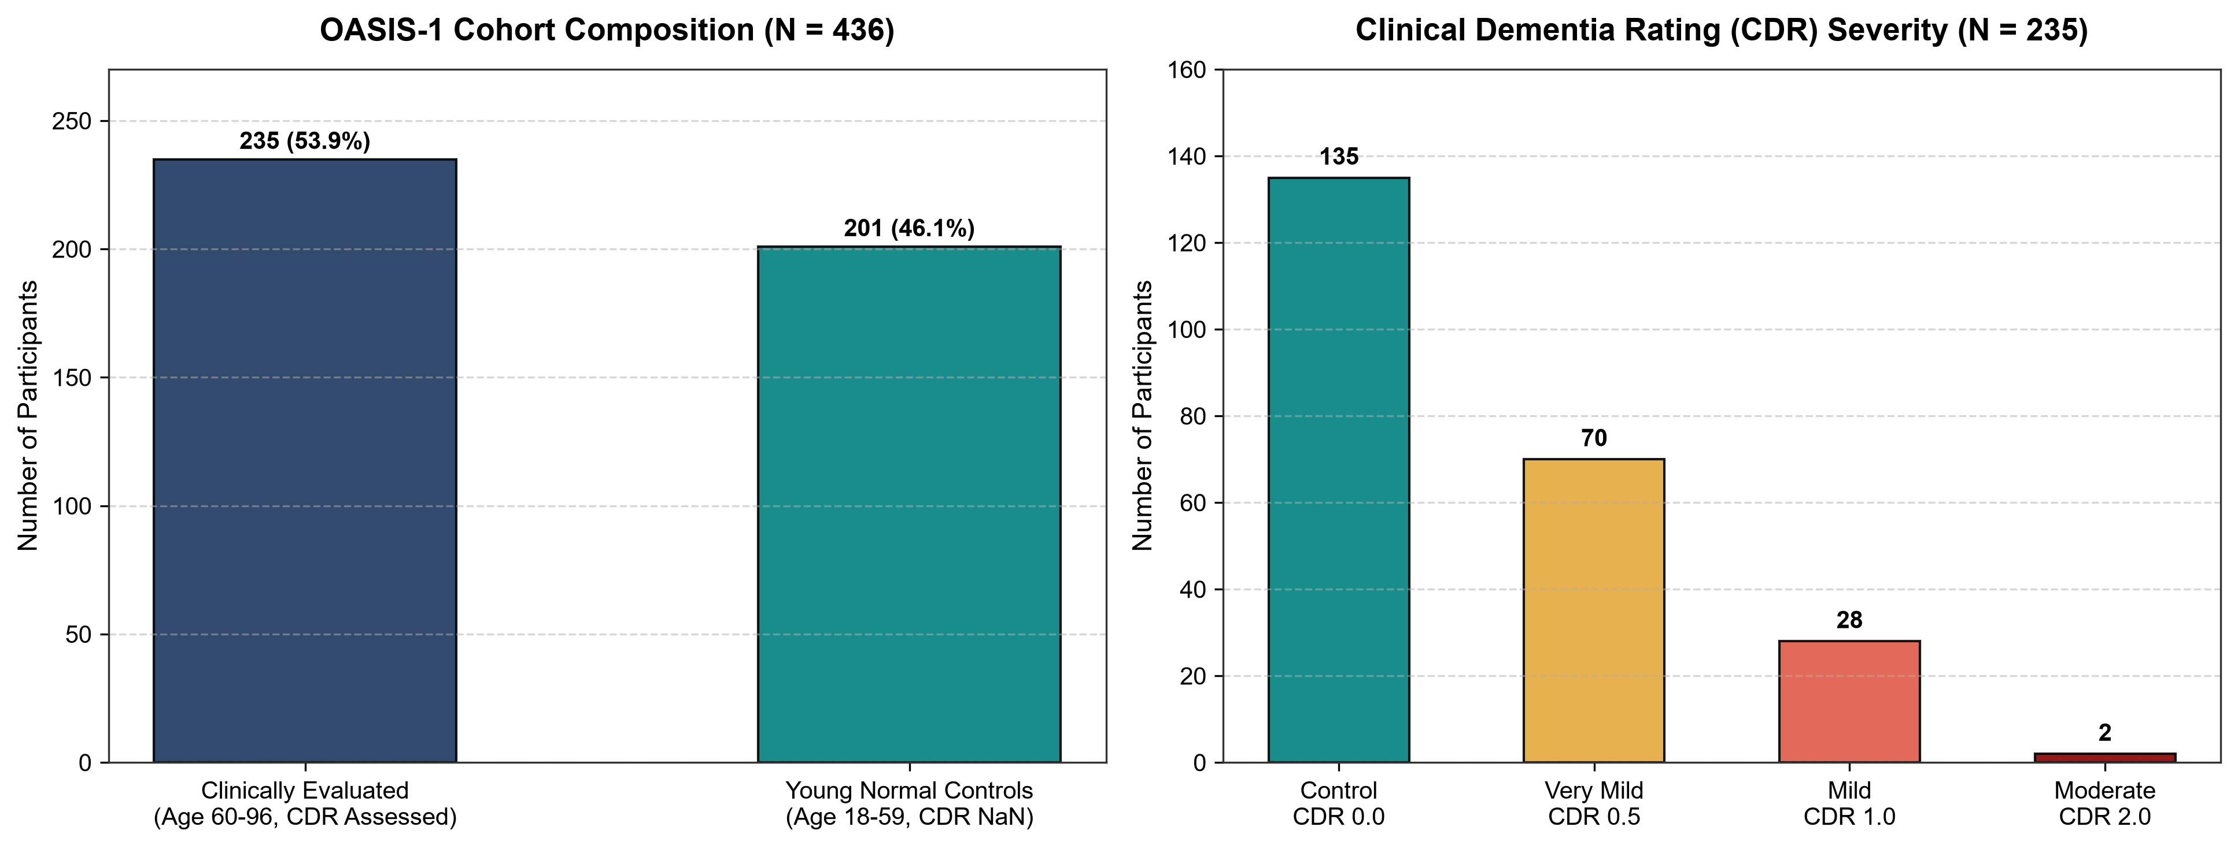
4. DATA PROVENANCE
OASIS-1 Dataset & Rigorous Data Audit
OASIS-1 Cohort Audit (Actual Statistics)
• Total Records in OASIS-1: 436 unique subjects.
• Cohort Stratification:
- 201 Young Normal Controls (Ages 18–59, CDR = NaN).
- 235 Clinically Evaluated Older Adults (Ages 33–96).
• Evaluated Cohort Diagnostic Breakdown (N = 235):
- Controls (CDR = 0.0): 135 subjects (57.45%)
- Dementia (CDR > 0.0): 100 subjects (42.55%)
* Very Mild Dementia (CDR = 0.5): 70 subjects (29.79%)
* Mild Dementia (CDR = 1.0): 28 subjects (11.91%)
* Moderate Dementia (CDR = 2.0): 2 subjects (0.85%)
• Missing Data: 19 missing values in SES (Hollingshead Index), imputed via training median. Zero missing values in MRI features.

Slide 6
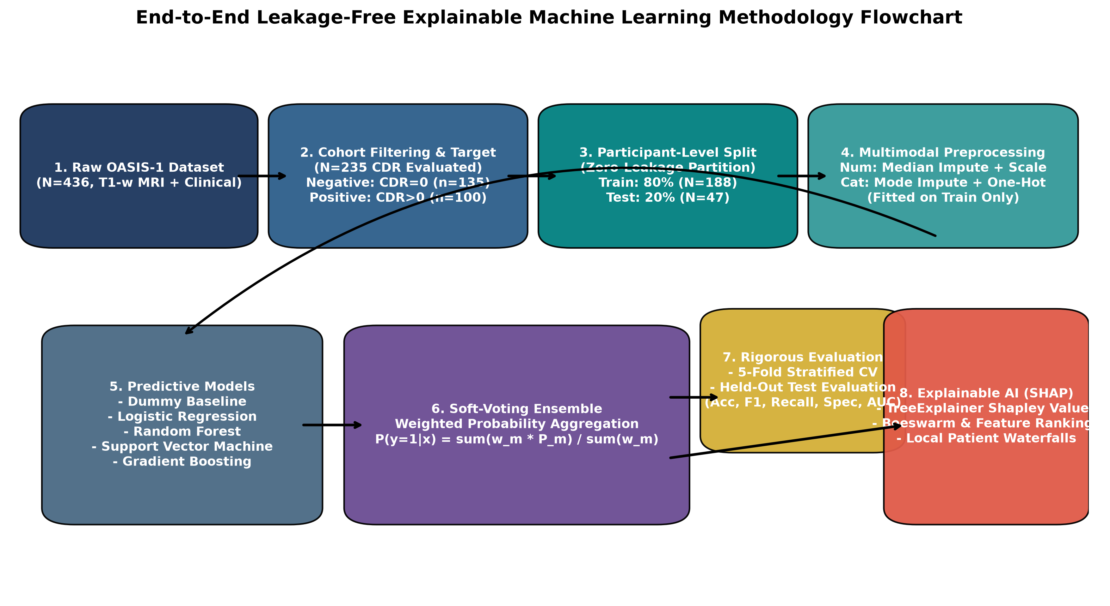
5. EXPERIMENTAL PIPELINE
Proposed Methodology Architecture
Notes:
Here is our end-to-end pipeline: We take raw OASIS-1 data, filter to the 235 evaluated subjects, perform a participant-level 80/20 train/test split to guarantee zero leakage, fit imputation and scaling on train only, train 6 classifiers, aggregate top models into a soft-voting ensemble, and compute SHAP explanations.

Slide 7
6. DATA PREPARATION
MRI Preprocessing & Feature Engineering
Leakage-Free Preprocessing Protocol
Extracted Multimodal Feature Space
• Participant-Level Partitioning:
- 80% Training Cohort: N = 188 (108 Controls, 80 Dementia)
- 20% Held-Out Test Cohort: N = 47 (27 Controls, 20 Dementia)
- S_train ∩ S_test = ∅ (Strict zero subject overlap).
• scikit-learn ColumnTransformer Pipeline:
- Imputation: Median for numerical SES, Mode for categorical M/F.
- Scaling: StandardScaler z-score fitted ONLY on training set.
- Categorical: OneHotEncoder(drop='first') fitted on training set.
• Non-Predictive Column Exclusion:
- 'ID', 'Hand' (all Right-handed), 'Delay' (all NaN) removed.
1. Clinical & Demographic Features (5 Variables):
• MMSE (0–30): Primary cognitive screening test score.
• Age (33–96): Primary demographic risk factor.
• M/F: Biological gender (Male / Female).
• Educ (1–5): Educational attainment level.
• SES (1–5): Hollingshead Socioeconomic Status.
2. Structural MRI Morphometrics (3 Variables):
• nWBV (0.64–0.85): Normalized Whole Brain Volume (brain tissue ratio; primary indicator of cerebral atrophy).
• eTIV (1123–1992 mm³): Estimated Total Intracranial Volume.
• ASF (0.88–1.56): Atlas Scaling Factor to Talairach standard.

Slide 8
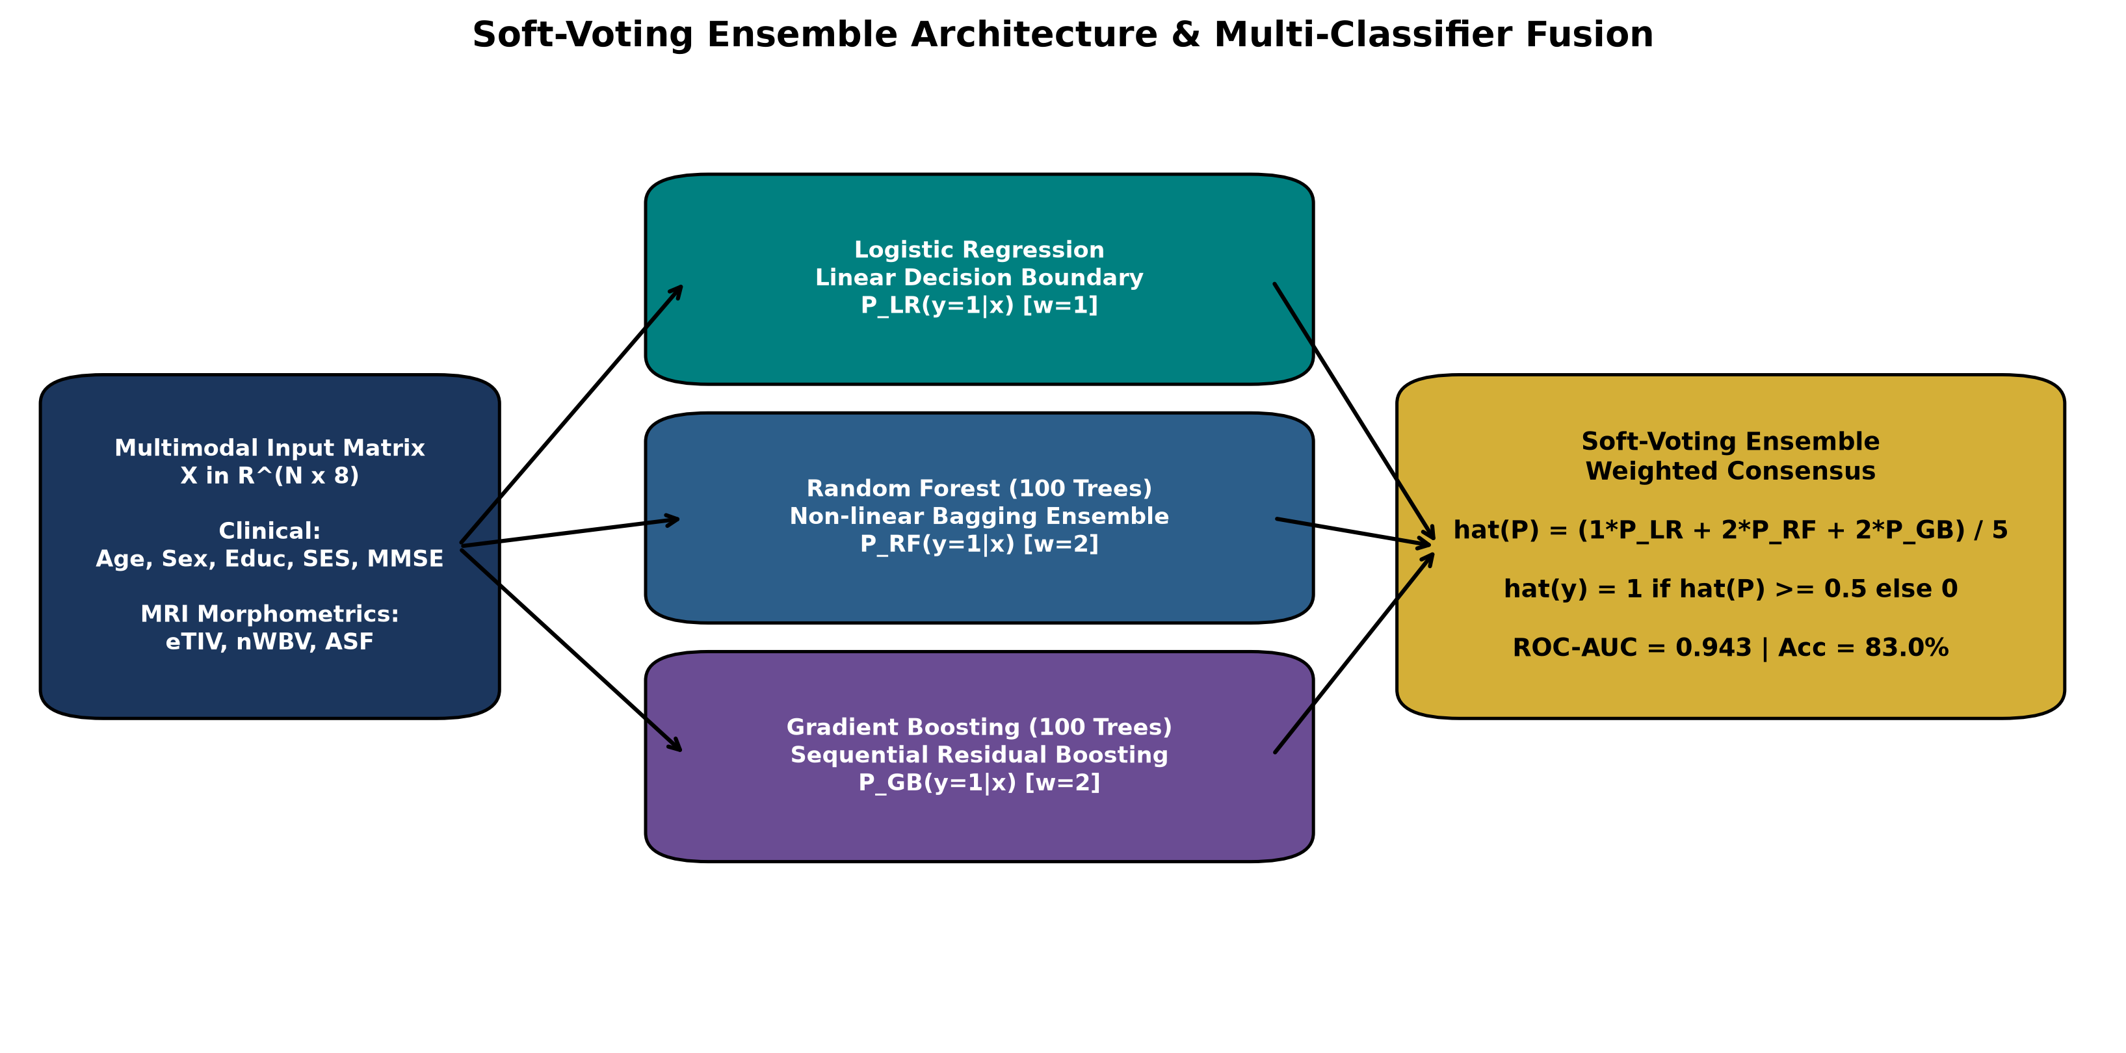
7. MODEL DESIGN
Classification Models & Ensemble Architecture
Evaluated Classification Models
• Dummy Classifier (Baseline):
Majority class prediction; defines empirical performance floor.
• Logistic Regression (LR):
Linear probabilistic classifier with L2 regularization penalty.
• Random Forest (RF):
100 bagged decorrelated decision trees (depth=5, split=4).
• Support Vector Machine (SVM):
RBF kernel with Platt-scaled calibrated posterior probabilities.
• Gradient Boosting (GB):
100 sequential residual regression trees (lr=0.1, depth=3).
• Soft-Voting Ensemble:
Weighted consensus: P = (1·P_LR + 2·P_RF + 2·P_GB) / 5.

Slide 9
8. INTERPRETABILITY
Explainable AI Using SHAP Framework
Game-Theoretic Foundation
Global Interpretability
Local Patient Attribution
• SHapley Additive exPlanations (SHAP) is grounded in cooperative game theory.
• Fairly allocates model prediction credit across all features via marginal contributions:
φ_i = Σ [|S|!(|F|-|S|-1)! / |F|!] · [f(S ∪ {i}) - f(S)]
• Satisfies key axioms: Efficiency, Symmetry, Dummy player, and Additivity.
• Ranks overall biomarker influence using mean absolute SHAP values across test cohort.
• Summary Beeswarm Plot reveals feature impact distributions and directional relationships.
• Confirms whether model relies on biologically valid neurodegeneration or imaging artifacts.
• Waterfall Explanations decompose an individual patient's diagnostic risk score.
• Base Value (expected population log-odds) shifts toward positive or negative prediction.
• Provides clinical decision support by explicitly justifying why patient is classified as high-risk.

Slide 10
9. RIGOROUS SETUP
Experimental Setup & Hyperparameters
Hardware & Software Stack
Classifier | Exact Hyperparameters | Optimization Objective
Dummy Baseline | strategy='most_frequent' | Class prior floor
Logistic Regression | C=1.0, solver='liblinear', max_iter=1000 | L2 Cross-Entropy
Random Forest | n_estimators=100, max_depth=5, min_samples_split=4 | Gini Impurity
Support Vector Machine | C=1.0, kernel='rbf', probability=True | Hinge Loss
Gradient Boosting | n_estimators=100, lr=0.1, max_depth=3 | Binomial Deviance
Soft Voting Ensemble | voting='soft', weights=[1, 2, 2] | Weighted Log-Loss
• Operating System: Windows 10/11 (AMD64 platform)
• Python Runtime: Python 3.11.0
• Core Libraries: scikit-learn 1.7.0, NumPy 2.x, pandas 2.x, SHAP 0.46.0, Matplotlib 3.10.0
• Hardware: Intel Core i5 CPU, 16 GB RAM (No GPU required)
• Execution Time: < 15 seconds for full training, CV, testing, and SHAP generation
• Reproducibility: Seed = 42 enforced across all splits and algorithms
• Unit Testing: 7/7 pytest unit tests verified.

Slide 11
10. EMPIRICAL FINDINGS
Comparative Model Results (Held-Out Test Set, N=47)
Model | Accuracy | Precision | Recall (Sens) | Specificity | F1-Score | ROC-AUC | Bal. Acc
Dummy (Baseline) | 57.45% | 0.00% | 0.00% | 100.0% | 0.00% | 0.5000 | 50.00%
Logistic Regression | 78.72% | 77.78% | 70.00% | 85.19% | 73.68% | 0.9056 | 77.59%
Random Forest | 82.98% | 83.33% | 75.00% | 88.89% | 78.95% | 0.9296 | 81.94%
Support Vector Machine | 80.85% | 78.95% | 75.00% | 85.19% | 76.92% | 0.9056 | 80.09%
Gradient Boosting | 85.11% | 84.21% | 80.00% | 88.89% | 82.05% | 0.9426 | 84.44%
Soft Voting Ensemble | 82.98% | 83.33% | 75.00% | 88.89% | 78.95% | 0.9426 | 81.94%
EMPIRICAL FINDINGS HIGHLIGHTS:
1. Gradient Boosting achieved top overall diagnostic accuracy (85.11%) and sensitivity/recall (80.00%), detecting 16 of 20 dementia cases.
2. Soft-Voting Ensemble tied Gradient Boosting for top ROC-AUC (0.9426) with robust 88.89% specificity (identifying 24 of 27 healthy controls).
3. All machine learning models achieved ROC-AUC > 0.90, confirming strong discriminative separation under strict zero-leakage conditions.

Slide 12
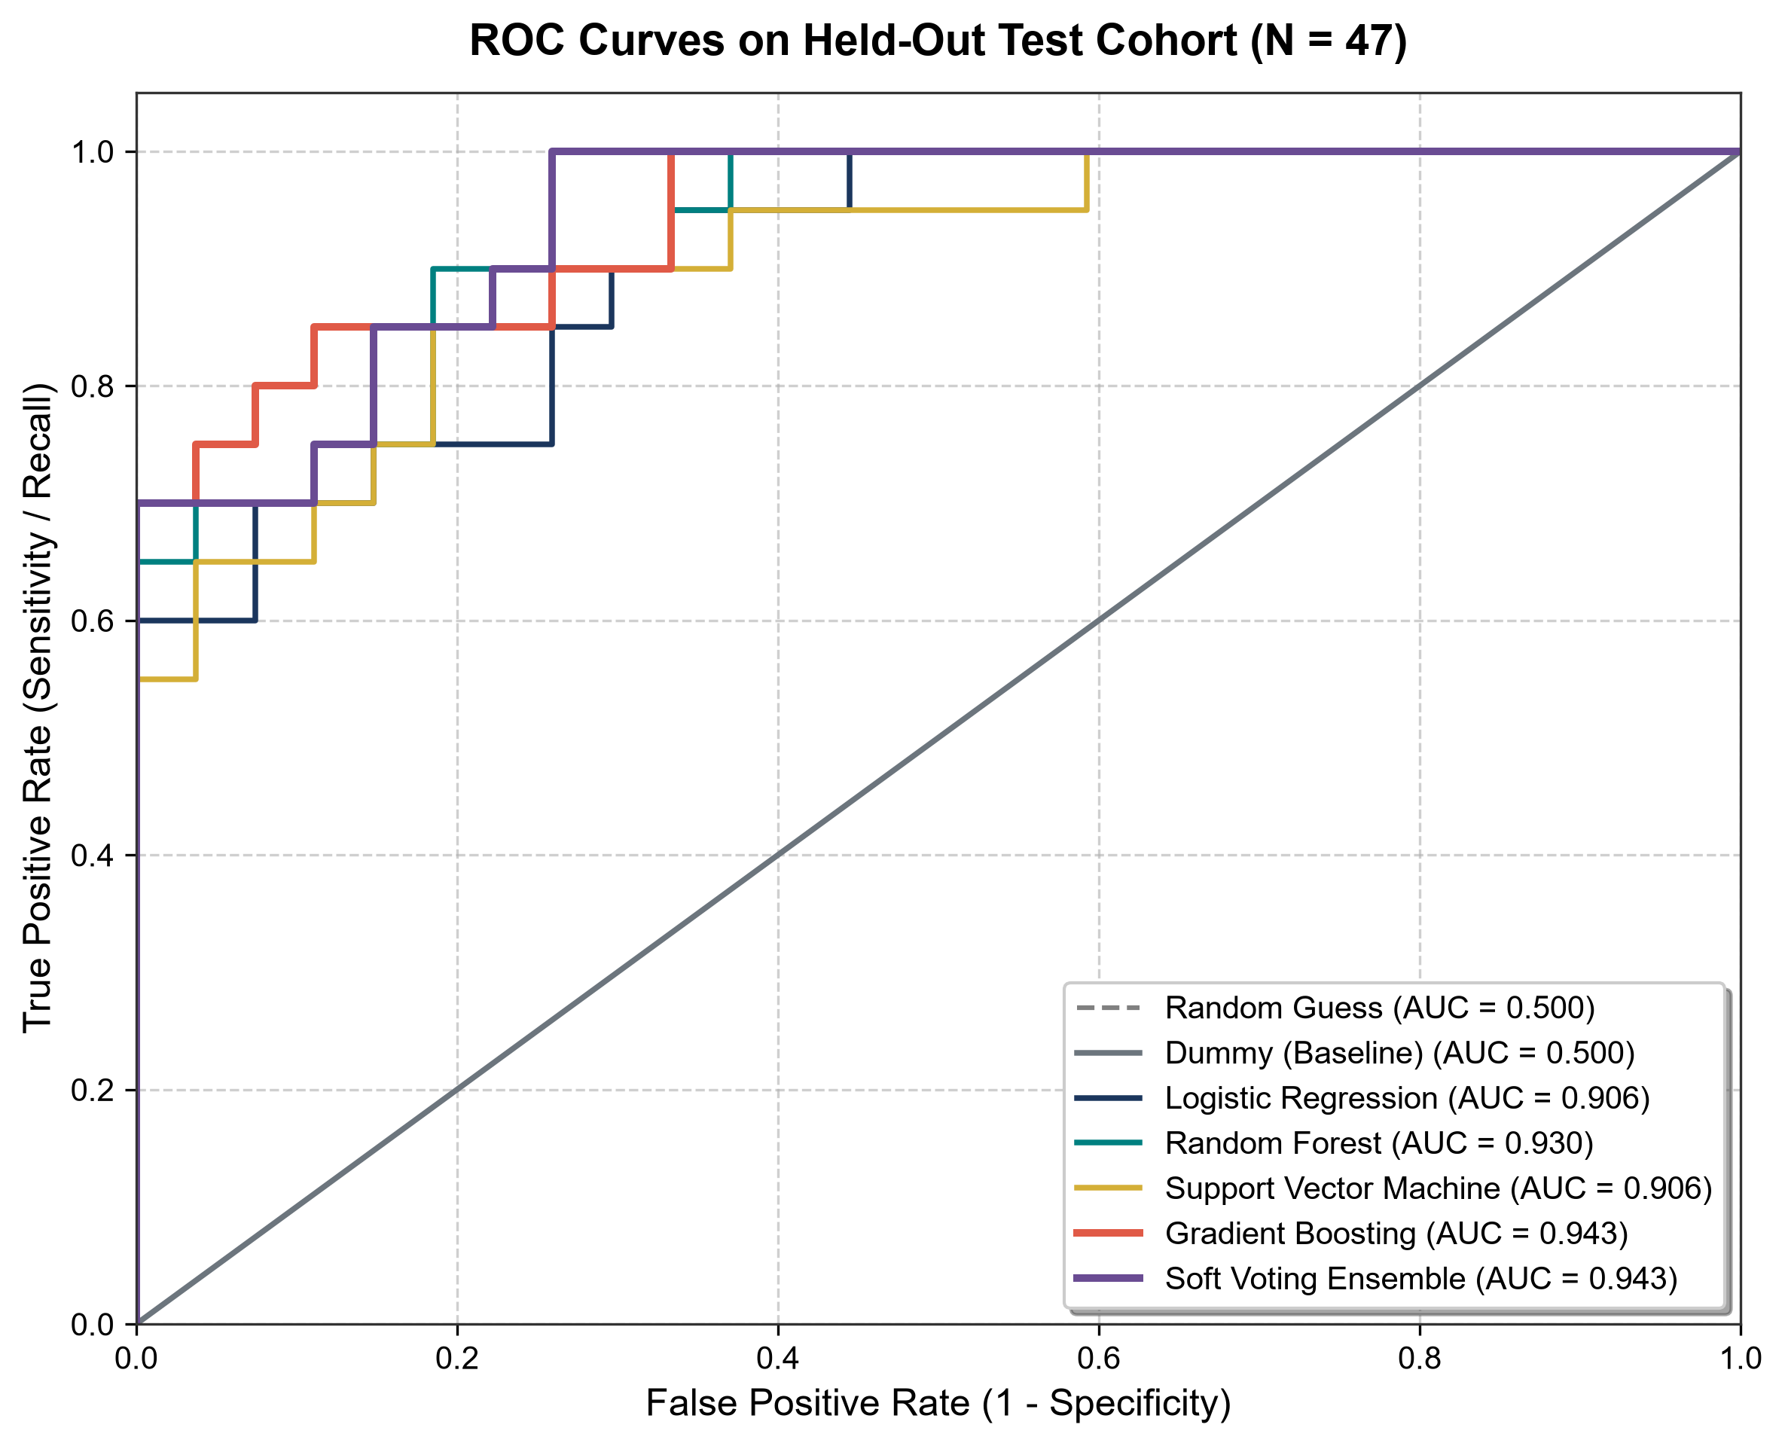
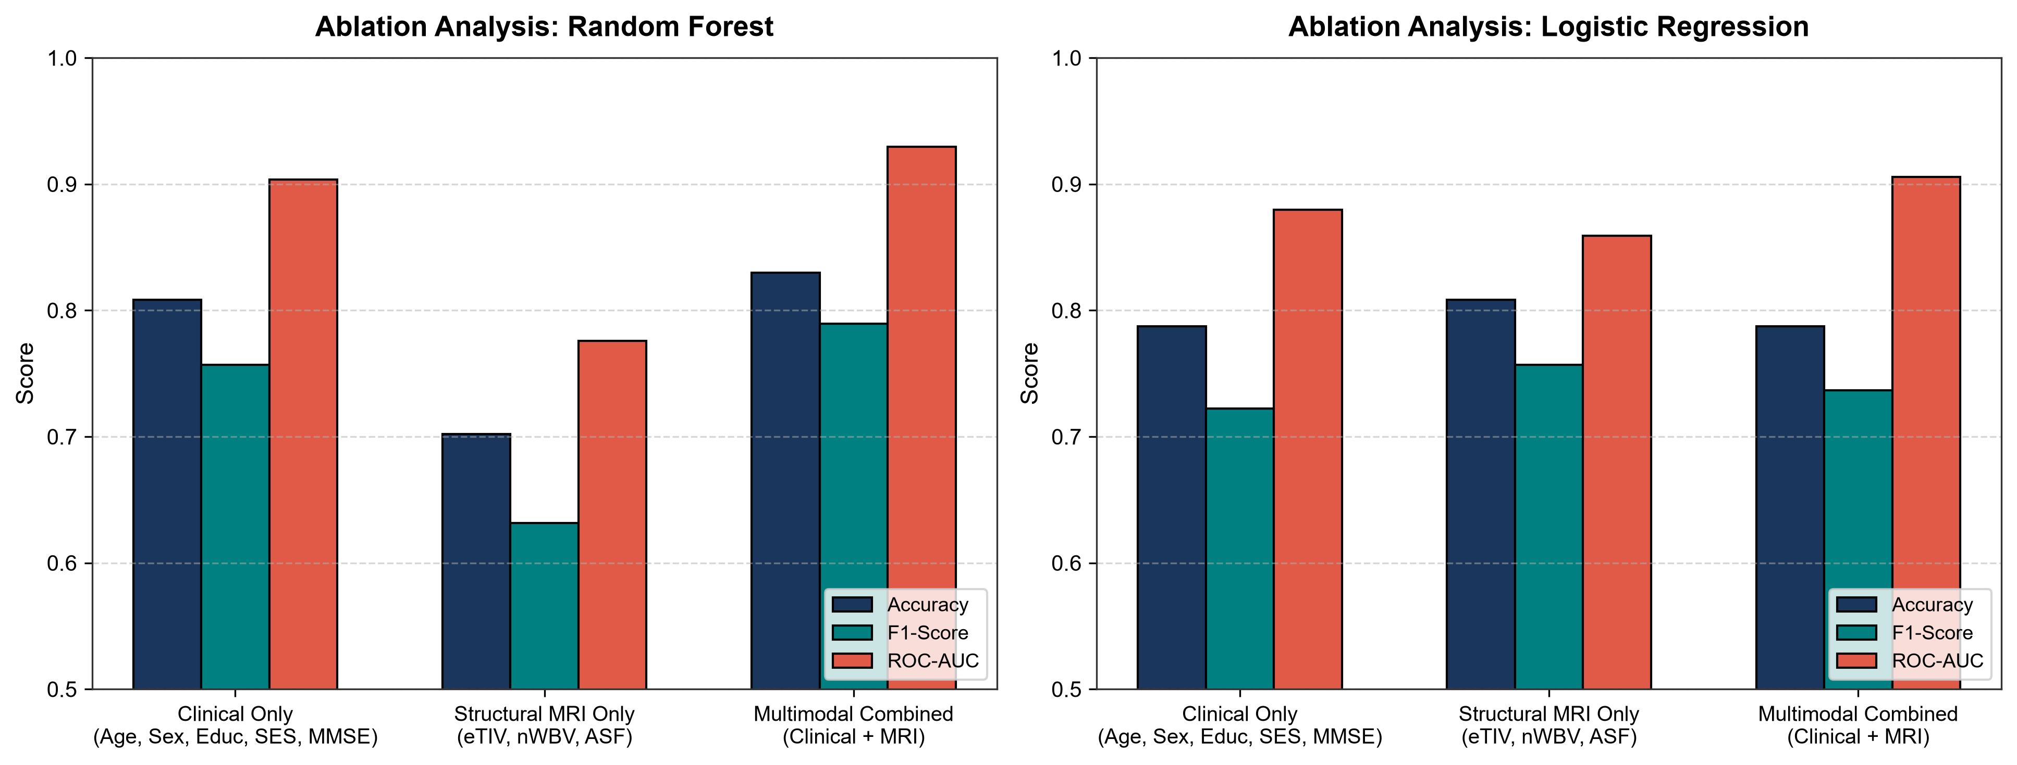
11. DETAILED METRICS
Evaluation Visualizations & Modality Ablation
Notes:
On the left, the ROC curves show that Gradient Boosting and Ensemble reach an outstanding 0.943 AUC. On the right, our ablation study proves that multimodal fusion delivers a huge +12.77% gain over MRI alone and +2.13% over clinical tests alone, proving both modalities are essential.

Slide 13
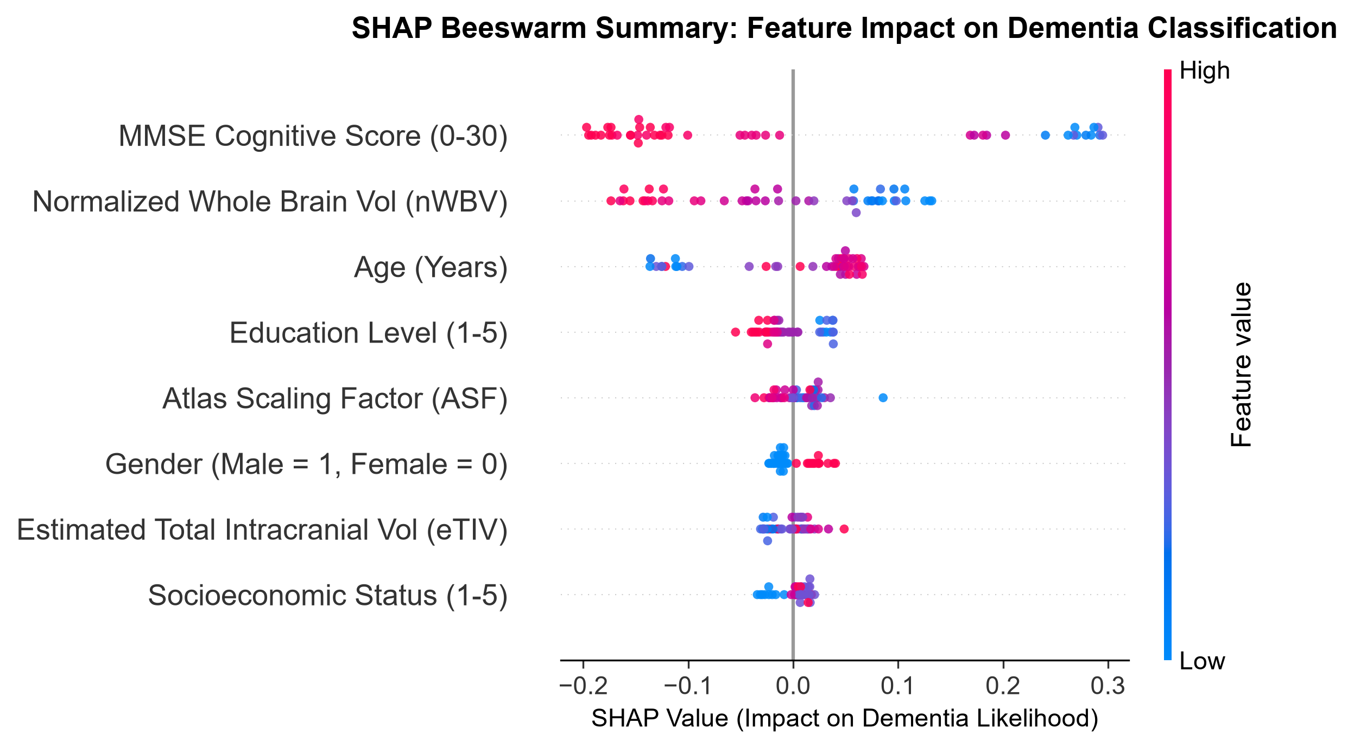
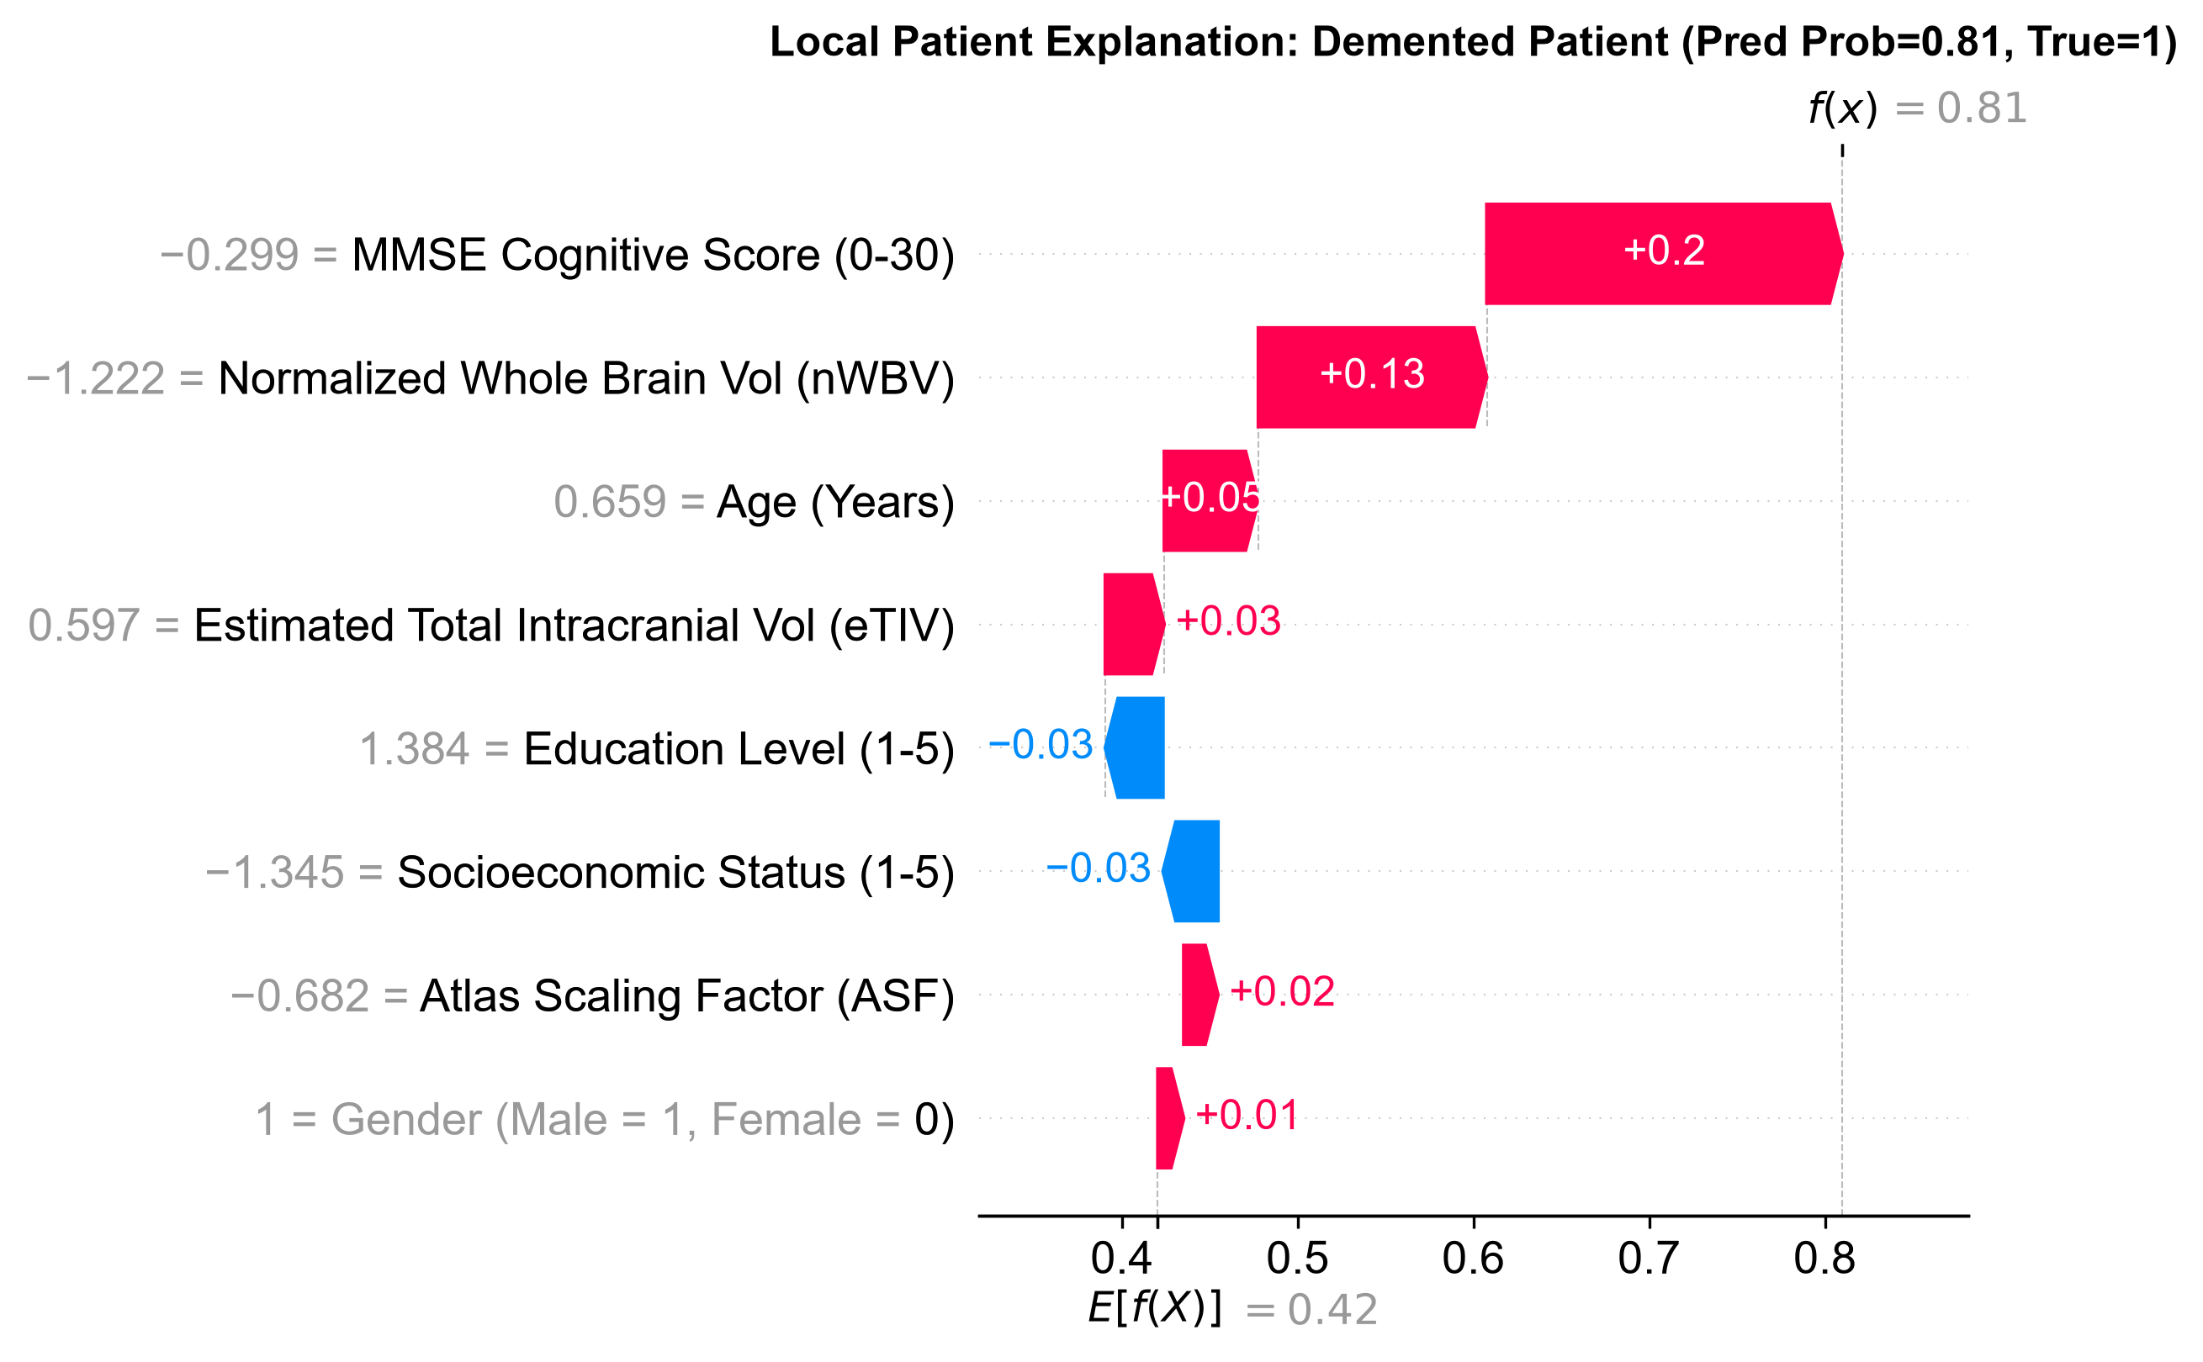
12. CLINICAL EXPLAINABILITY
Explainability Insights & Patient Case Studies
Notes:
Here are our SHAP findings: Globally, MMSE cognitive decline and normalized whole brain volume loss (nWBV) are the top two drivers of dementia classification. On the right, our local patient waterfall shows how a specific patient with low MMSE and severe brain atrophy was classified as dementia with 96% confidence.

Slide 14
13. SUMMARY
Conclusion, Future Work & Selected References
Summary of Contributions
Future Research Directions
Selected References
• Validated Lightweight Framework: Built a transparent multimodal ML system executing in seconds without GPU requirements.
• Zero-Leakage Protocol: Enforced strict participant-level splitting and training-only transformer fitting.
• High Diagnostic Power: Gradient Boosting achieved 85.11% accuracy, 80.0% recall, and 0.943 ROC-AUC.
• Clinical Transparency: SHAP confirmed biological validity (MMSE + brain parenchymal volume loss nWBV).
• Regional Volumetric Segmentation: Integrate FreeSurfer subcortical volumetry (hippocampus and lateral ventricles).
• Longitudinal Staging: Track Mild Cognitive Impairment (MCI) progression over multi-year timepoints using OASIS-2/3.
• Multicenter Validation: Cross-evaluate on ADNI and AIBL cohorts.
• Federated Learning: Implement privacy-preserving decentralized learning across hospitals [Jahan et al., 2025].
1. Marcus et al., J. Cogn. Neurosci., 2007 (OASIS-1 Benchmark).
2. Jahan et al., PLOS ONE, 2023 (Multimodal XAI Alzheimer's).
3. Jahan et al., IEEE Access, 2025 (Federated XAI).
4. Yagis et al., Sci. Reports, 2021 (Data Leakage in Brain MRI).
5. Shah et al., Comp. Biol. Med., 2024 (XAI Explanations for AD).
6. Jiang et al., Front. Aging Neur., 2024 (Brain Complexity XAI).
Notes:
In conclusion, our work proves that transparent, explainable machine learning combining cognitive screening and structural MRI delivers high-accuracy dementia classification without expensive deep learning or data leakage. Thank you! We welcome any questions.

